Slide 1
Meeting 4/27/15

Slide 2
Misc. items
PandaR bioconductor package released with BioC 3.1
Bioinformatics note paper. New updates based on Kimbie's comments.
Oral exam coming up next month.

Slide 3

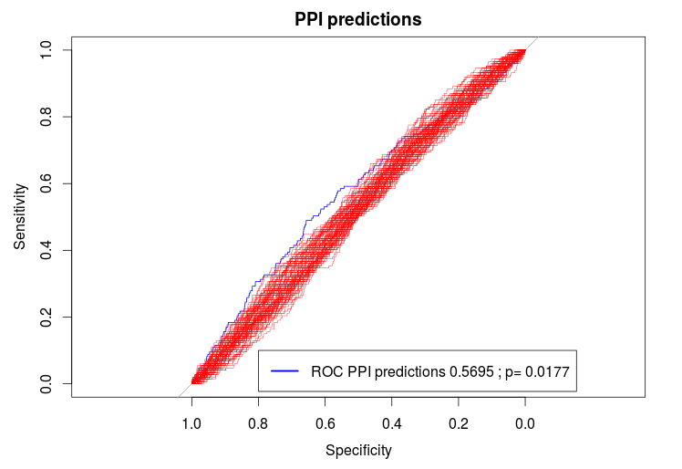

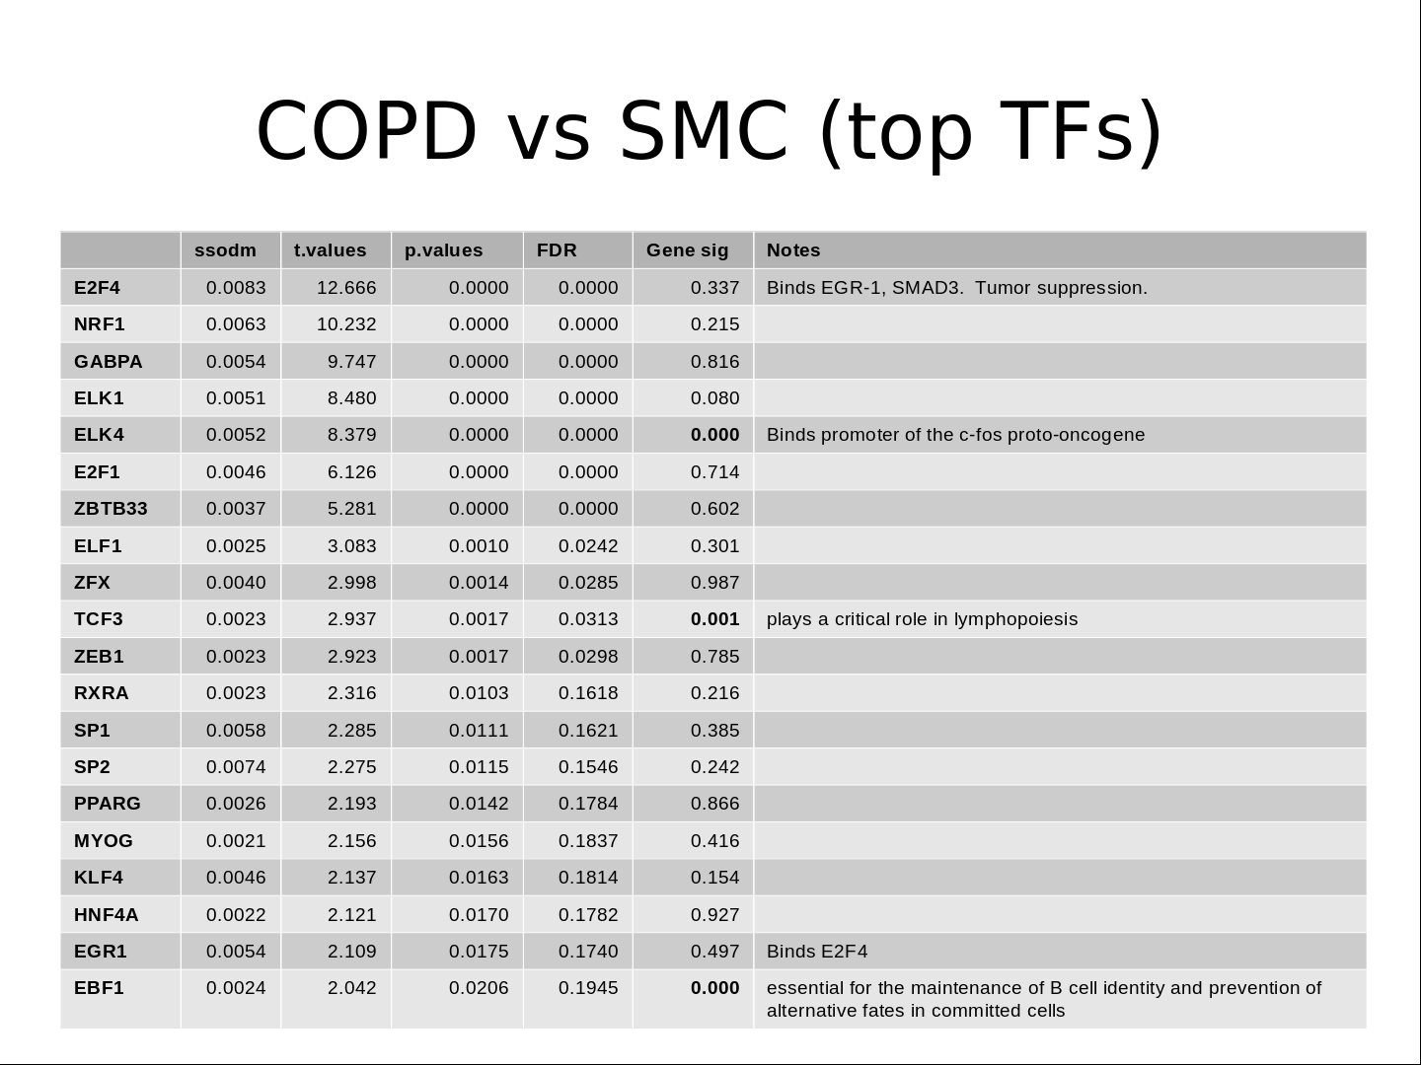
Eclipse Data Motif Data
Observed Partition
COPD vs SMC
Random Partitions
Null x 100
PANDA / BERE
}
Observed
COPD
Network
Observed
SMC
Network
Null
NetworkA
Null
NetworkB
X 100
Transition Matrix calculation (Iterative OLS)
}
X 100
Transition Matrix analysis

Slide 4
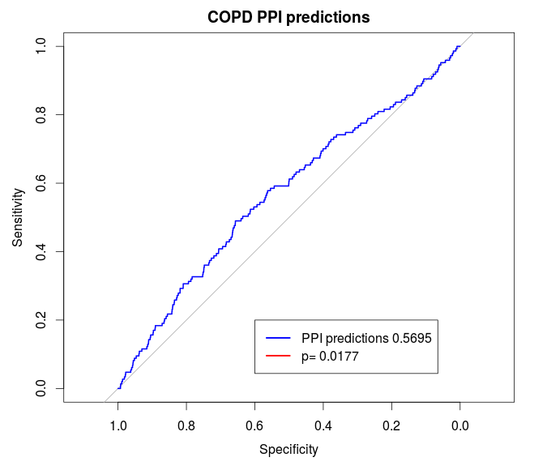
Eclipse Data: predicting PPI
COPD vs Smoker Control networks compared to randomly generated partition
FWIW, high ODM pairs do seem to be more likely to have a known PPI.
This is based on only 223 PPI (out of 189*189=35,000 possible interactions)

Slide 5
Eclipse Data: predicting PPI
Also used human data from BioGRID (updated 3/25/15), which contained 410 interactions. Of which 111 overlap with other PPI set.
BioGrid ROCAUC = .5355, p<.001
Not particularly impressive effect sizes, but strong evidence that this approach is measuring a biologically meaningful interaction.
Conclusion: The transition from COPD network to SMC network yields statistically significant predictions of PPI compared to null networks.
But, this does not have very much clinical/biological value (as far as I can tell), it merely shows that what we're measuring via TM has been independently observed elsewhere.

Slide 6
COPD vs SMC

Slide 7
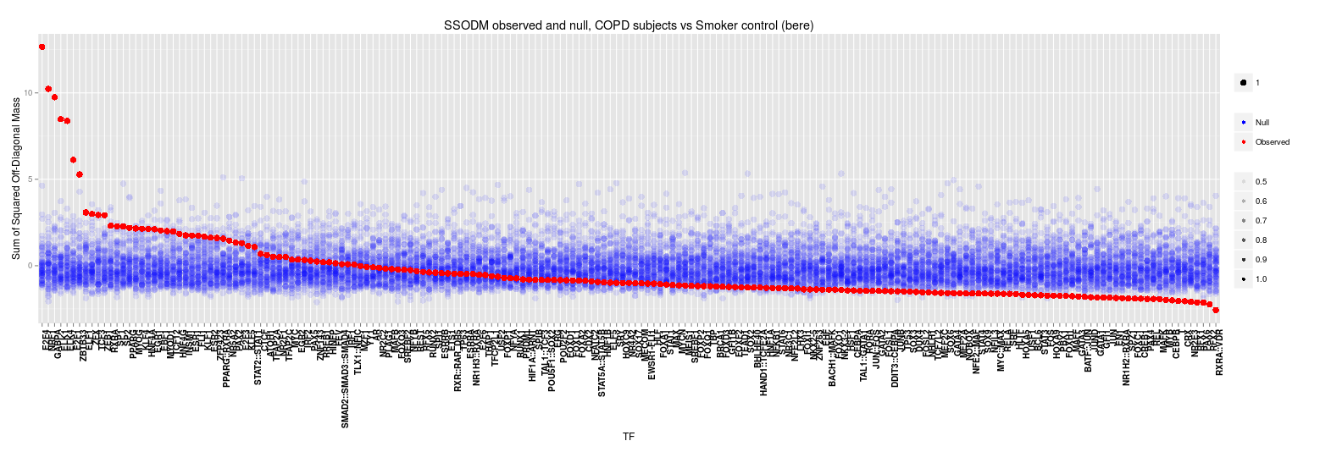
COPD vs SMC

Slide 8
COPD vs SMC (top TFs)
 | ssodm | t.values | p.values | FDR | Gene sig | Notes
E2F4 | 0.0083 | 12.666 | 0.0000 | 0.0000 | 0.337 | Binds EGR-1, SMAD3. Tumor suppression.
NRF1 | 0.0063 | 10.232 | 0.0000 | 0.0000 | 0.215 | acts on nuclear genes encoding respiratory subunits and components of the mitochondrial transcription and replication machinery.
GABPA | 0.0054 | 9.747 | 0.0000 | 0.0000 | 0.816 | Related to NRF1, involved in activation of cytochrome oxidase expression and nuclear control of mitochondrial function
ELK1 | 0.0051 | 8.480 | 0.0000 | 0.0000 | 0.080
ELK4 | 0.0052 | 8.379 | 0.0000 | 0.0000 | 0.000 | Binds promoter of the c-fos proto-oncogene
E2F1 | 0.0046 | 6.126 | 0.0000 | 0.0000 | 0.714 | E2F family...
ZBTB33 | 0.0037 | 5.281 | 0.0000 | 0.0000 | 0.602 | shown to interact with HDAC3, Nuclear receptor co-repressor 1
ELF1 | 0.0025 | 3.083 | 0.0010 | 0.0242 | 0.301 | primarily expressed in lymphoid cells
ZFX | 0.0040 | 2.998 | 0.0014 | 0.0285 | 0.987
TCF3 | 0.0023 | 2.937 | 0.0017 | 0.0313 | 0.001 | plays a critical role in lymphopoiesis
ZEB1 | 0.0023 | 2.923 | 0.0017 | 0.0298 | 0.785
RXRA | 0.0023 | 2.316 | 0.0103 | 0.1618 | 0.216
SP1 | 0.0058 | 2.285 | 0.0111 | 0.1621 | 0.385
SP2 | 0.0074 | 2.275 | 0.0115 | 0.1546 | 0.242
PPARG | 0.0026 | 2.193 | 0.0142 | 0.1784 | 0.866
MYOG | 0.0021 | 2.156 | 0.0156 | 0.1837 | 0.416
KLF4 | 0.0046 | 2.137 | 0.0163 | 0.1814 | 0.154
HNF4A | 0.0022 | 2.121 | 0.0170 | 0.1782 | 0.927
EGR1 | 0.0054 | 2.109 | 0.0175 | 0.1740 | 0.497 | Binds E2F4
EBF1 | 0.0024 | 2.042 | 0.0206 | 0.1945 | 0.000 | essential for the maintenance of B cell identity and prevention of alternative fates in committed cells

Slide 9
COPD vs SMC
How do we analyze this list?
How do we validate these findings?
DAVID unsurprisingly return entirely DNA binding results.

Slide 10
COPD vs SMC
Ideas for further development and/or validation:
- A measure of TF target “cohesiveness”.
How strongly does the sequence motif predict edgeweight?
This could be useful in identifying mechanism. For example a TF that is inhibited will likely show a reduced cohesivess compared to one that is active.

Slide 11
Validation
DREAM5 challenge
  In silico, E. coli, S. cerevisiae and S. aureus networks from DREAM5 challenge
  Also with gold standards derived from simulation parameters, and several methods for microorganisms (experimentally validated interactions, ChIP chip, evolutionarily conserved binding sites)

Slide 12
Validation
DREAM5 Drawbacks
  Was a gexp-to-network challenge (no motif or PPI was used)
  Competition was not intended to find “differential networks”.
  Simulation software does not work, isn't maintained.

Slide 13
Validation Approach
Generate fake priors which we will treat as computationally equivalent to sequence motif priors.
  Set sensitivity at 50%, specificity at 90%.
  Yielded 29,380 prior edges, of which 2006 (6.8%) are true positives.
  Similar approaches were taken for microorganism datasets.
  For comparison, Yeast dataset had 34,128 prior edges with 1475 (4.3%) true positives.
  Reasonable?

Slide 14
Validation Approach
Interesting feature found in both PANDA and BERE approach. Both are much more effective at identifying activators (compared to repressors) in silico.
  Addressed this in BERE, by using absolute correlation between TF-gene and raw correlation for indirect targeting.
  Not sure how one would address this in PANDA, but maybe worth thinking about?

Slide 15
Validation Approach for Network Transition
Partition data based on network perturbations.
  Evaluate TM ability to recover perturbations.
Initial investigation:
  Analysis run on partition based on deletion of Gene 313 (a TF) in E.coli dataset. G313 is not a known target in this dataset.

Slide 16
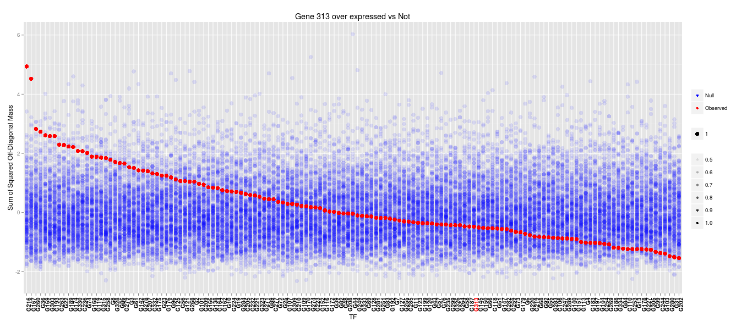
Validation Approach for Network Transition

Slide 17
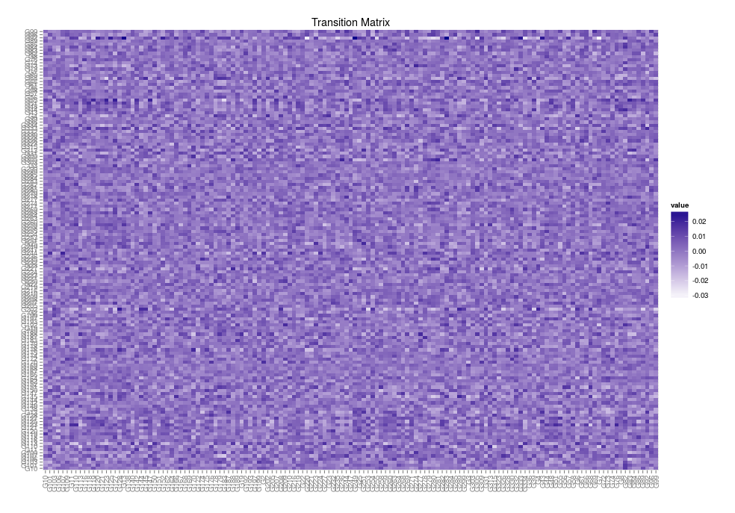
Validation Approach for Network Transition

Slide 18
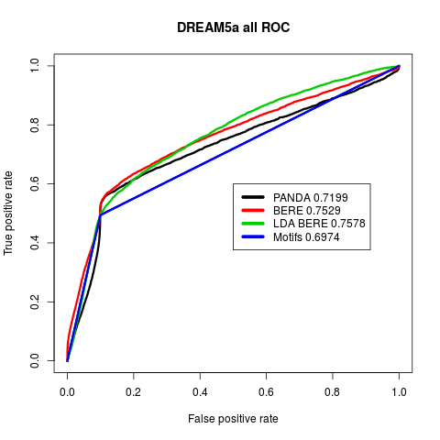
Validation for single network

Slide 19
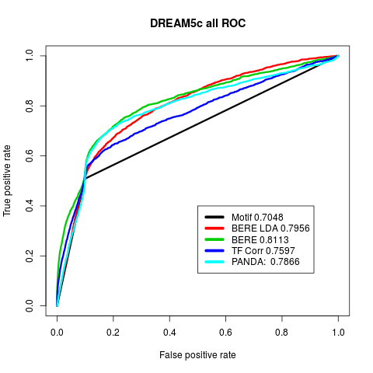
Validation for single network

Slide 20
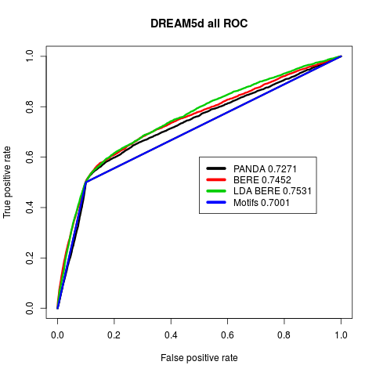
Validation for single network

Slide 21
BERE
TF A
Motif
Data
TF C targets
Targeted by TF A?
TF A targets
TF B targets
Expr
Data
Samples
Genes
Gene X
Gene for
TFA

Slide 22
BERE
Divide evidence for regulation into 2 parts:
1.) Direct evidence
Measured by squared correlation with expression level for transcription factor.
2.) Indirect evidence
Classification from a regularized logistic regression, with penalty model matrix as TF A expression levels.
Gene X
Gene for
TFA

Slide 23
BERE
Indirect and direct evidence is then combined as a weighted sum after scaling:
How much weight to give direct vs indirect evidence?
Empirically, a 50/50 split was more effective than indirect or direct by itself.
In DREAM5 data, better AUCROC were achieved by giving more weight to the direct evidence, but in microorganisms, preference was for more weight to indirect evidence
Gene X
Gene for
TFA

Slide 24
BERE
Penalized Logistic Regression Classification
Indirect
R-squared
Motif
Data
TF C targets
Direct
TF A targets
TF B targets
Expr
Data
Samples
Genes
Gene X
Gene for
TFA

