Slide 1
Meeting 5/11/15

Slide 2
Misc. stuff
Submitted poster for BCB retreat
Met with Kimbie, Vincent Carey regarding pandaR.
PandaR

Slide 3
Research progress
Rethinking AUCROC
  Edges from high degree TFs...
  Key is to focus on expression based inference.
Major suggestions from oral qual
  Homogeneity assessment
  Single-cell analysis
  Lambda estimation

Slide 4
Issues with AUC ROC
Prior probability for an edge is a function of TF-degree, not simply presence/absence of motif.
Much of AUCROC can be recovered with a simple degree function.
Very useful for network inference, not very useful for network transition analysis.

Slide 5
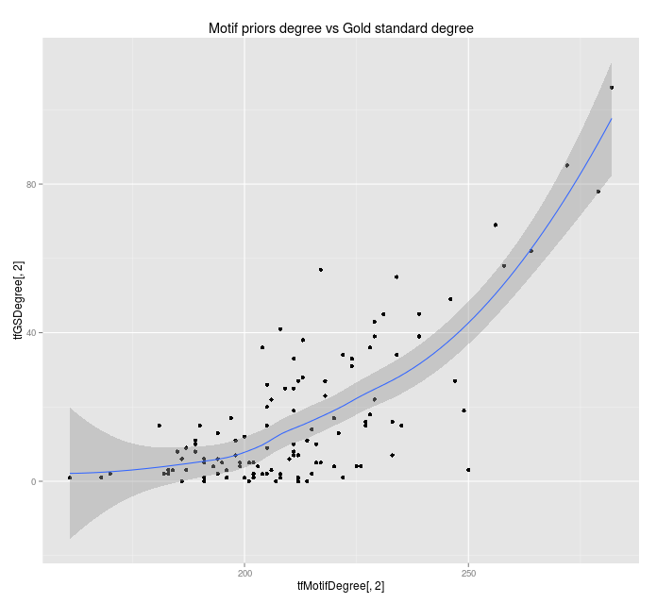
Evaluating prediction
For non-motifs, number of GS edges vs TFmotif-degree

Slide 6
Evaluating prediction
For context-specific networks, we want edge prediction to be driven by context-specific data.
Challenges:
  Evaluation of methods is based on out-of-context gold standards
  Our gene expression data is far less powerful than motif in predicting regulation.
See comparison of ROC curves.

Slide 7
Homogeneity Assessment
Goal:
  Identify whether previously obtained significant results could be attributable to a homogeneous observed dataset compared to heterogeneous null datasets.
Approach:
  Generate 1000 pairs of pairs of BERE networks from 50 samples each (500 COPD splits and 500 SMC splits)
    i.e. 1000 groups of 4 networks.
  Run TM on each pairwise combination within each set.
  Evaluate distribution of key statistics for cross phenotype vs within phenotype.

Slide 8
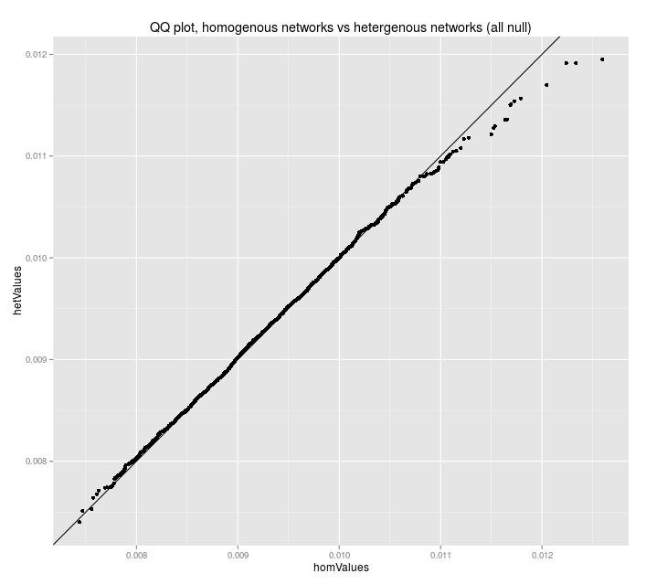
Homogeneity Assessment
Results:
  Distribution of dTFI between homogeneous vs heterogeneous populations (all null)

