Slide 1
Meeting 7/27/15

Slide 2
TM progress
Rethinking AUCROC
  Edges from high degree TFs...
  Key is to focus on expression based inference.
Homogeneity assessment
Transition simulation

Slide 3
Issues with AUC ROC
Prior probability for an edge is a function of TF-degree, not simply presence/absence of motif.
Much of AUCROC can be recovered with a simple degree function (something like out-degree of TF plus in-degree of gene).
Very useful for network inference, not very useful for network transition analysis.

Slide 4
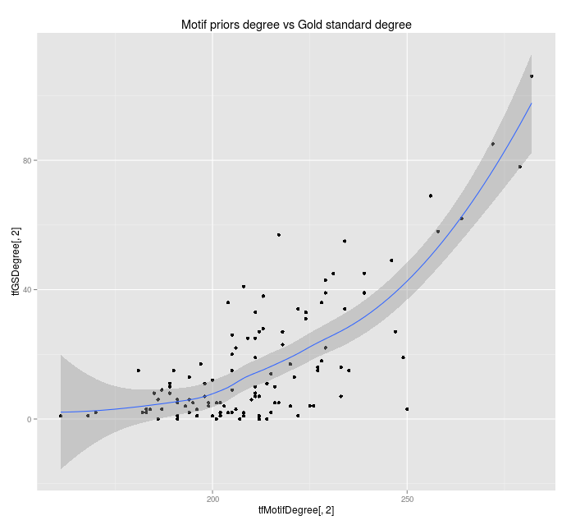
Evaluating prediction
For non-motifs, number of GS edges vs TFmotif-degree

Slide 5
Evaluating prediction
For context-specific networks, we want edge prediction to be driven by context-specific data.
Challenges:
  Evaluation of methods is based on out-of-context gold standards
  Our gene expression data is far less powerful than motif in predicting regulation.
See comparison of ROC curves.

Slide 6
Combined approach
1.) Use PANDA as motif-only to extract maximum motif-based information on regulatory network.
2.) Run BERE algorithm using expression data and PANDA results as regulatory priors.
COPD Results coming this week...

Slide 7
Homogeneity Assessment
Goal:
  Identify whether previously obtained significant results could be inflated/attributable to homogeneous case, homogeneous control. Our null distribution is estimated with heterogeneous null datasets.
Approach:
  Generate 1000 pairs of pairs of BERE networks from 50 samples each (500 COPD splits and 500 SMC splits)
    i.e. 1000 groups of 4 networks.
  Run TM on each intra-group partition network and a random selection of pairwise combination within each set.
  Evaluate distribution of key statistics for cross phenotype vs within phenotype.

Slide 8
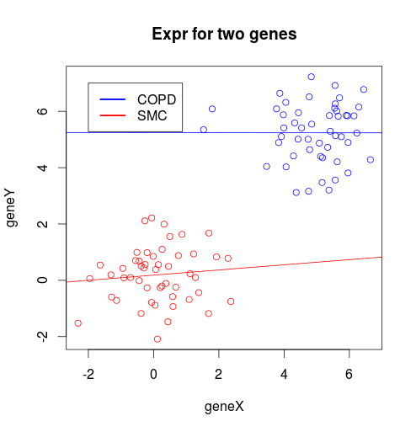
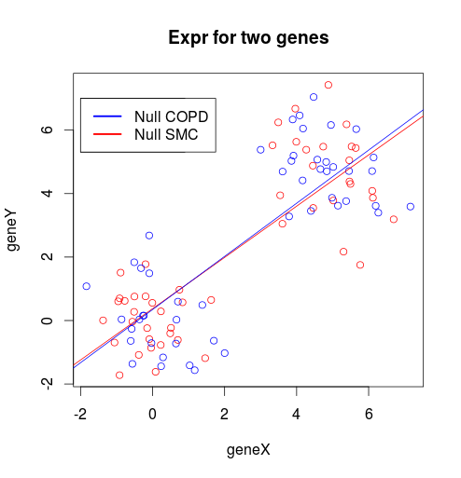
Homogeneity Assessment
Example: Two highly correlated genes
- Power to detect interaction will be greater under the null
- Edges under the null may be more stable.
- Transition may be less variable under the null
- p-values for observed transition may become smaller,
i.e. variance inflation

Slide 9
Homogeneity Assessment
Randomly select 200 samples
Calculate dTFI:
1.) Within phenotype
2.) Across phenotype
(observed)
3.) Random phenotype
Store values
COPD
(50)
TM
COPD
(50)
Homogenous samples
TM
TM
SMC
(50)
TM
SMC
(50)
Resample 500 times
Mixed
(50)
TM
Mixed
(50)
Heterogeneous samples
Mixed
(50)
Mixed
(50)
TM

Slide 10
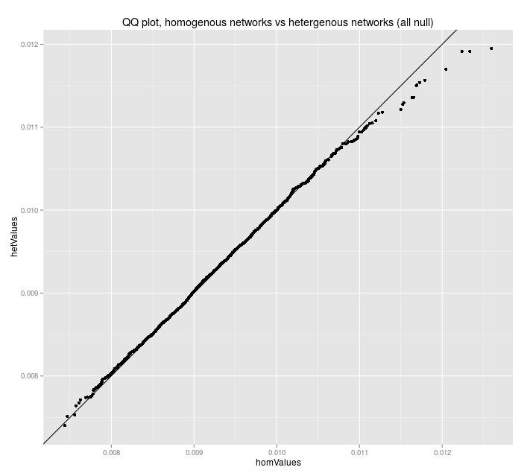
Homogeneity Assessment
Results:
  Distribution of dTFI between homogeneous vs heterogeneous populations (all null)

Slide 11
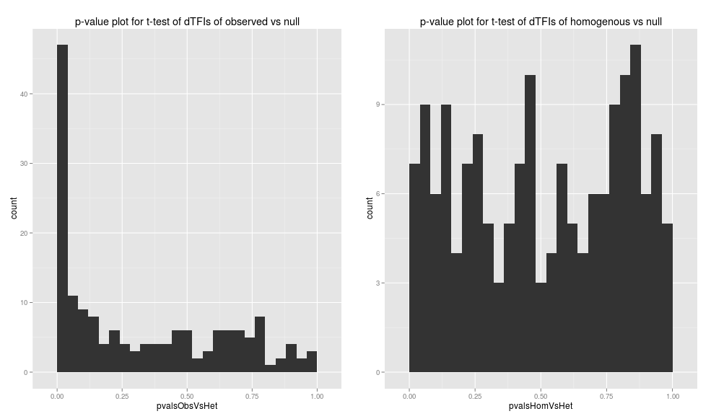
Homogeneity Assessment
Results:
  The observed phenotype (COPD vs Control) is the driver behind the distinction.

Slide 12
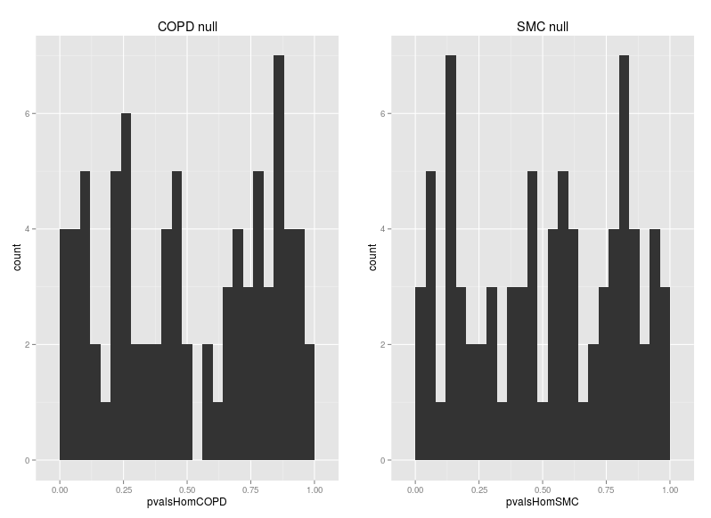
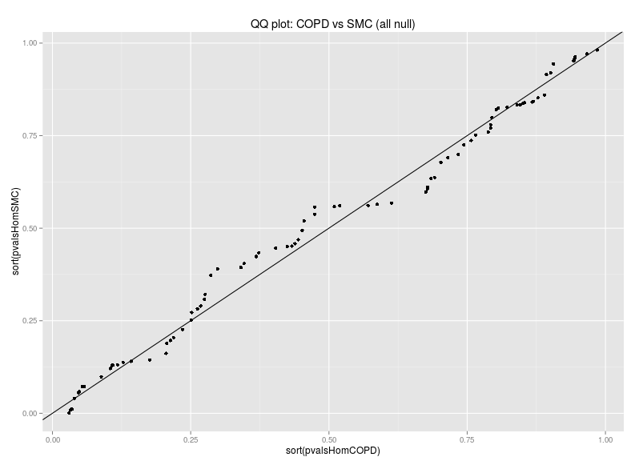
Homogeneity Assessment
Results:
  Biological variability of COPD is not demonstrated to be more responsible for variance inflation than smoker control.

Slide 13
Creating a simulated network transition
Gene expression sample ~ MVN(0,Sigma)
Sigma=Adjacency matrix ^ 2
Perturb network by randomly switching edges
Edges from TF to TF (red-red) will be most interesting and hopefully measured by TM approach

