Slide 1
Meeting 8/10/15

Slide 2
TM applied to other datasets
TM applied to
ECLIPSE (136 cases, 84 controls)
COPDGene (94 cases, 42 controls)
LGRC (164 cases, 64 controls)
Standard Case-Control
Reverse Transition
Male vs Female

Slide 3
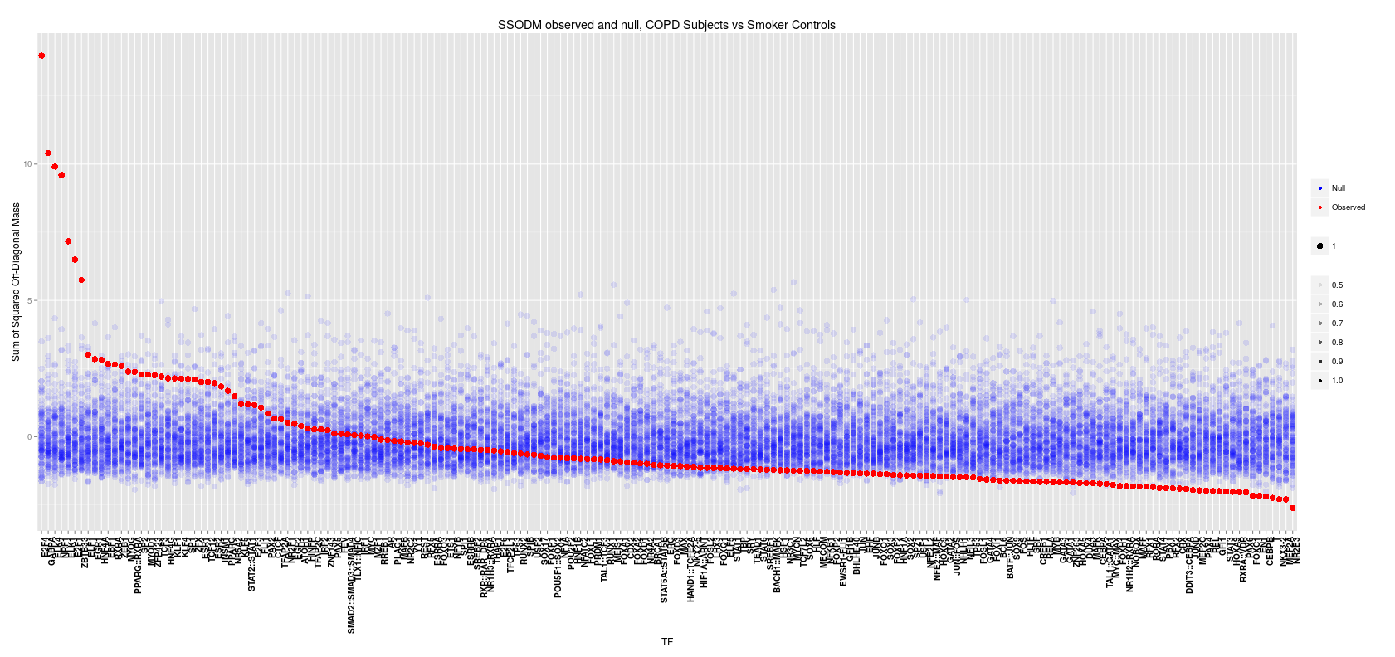
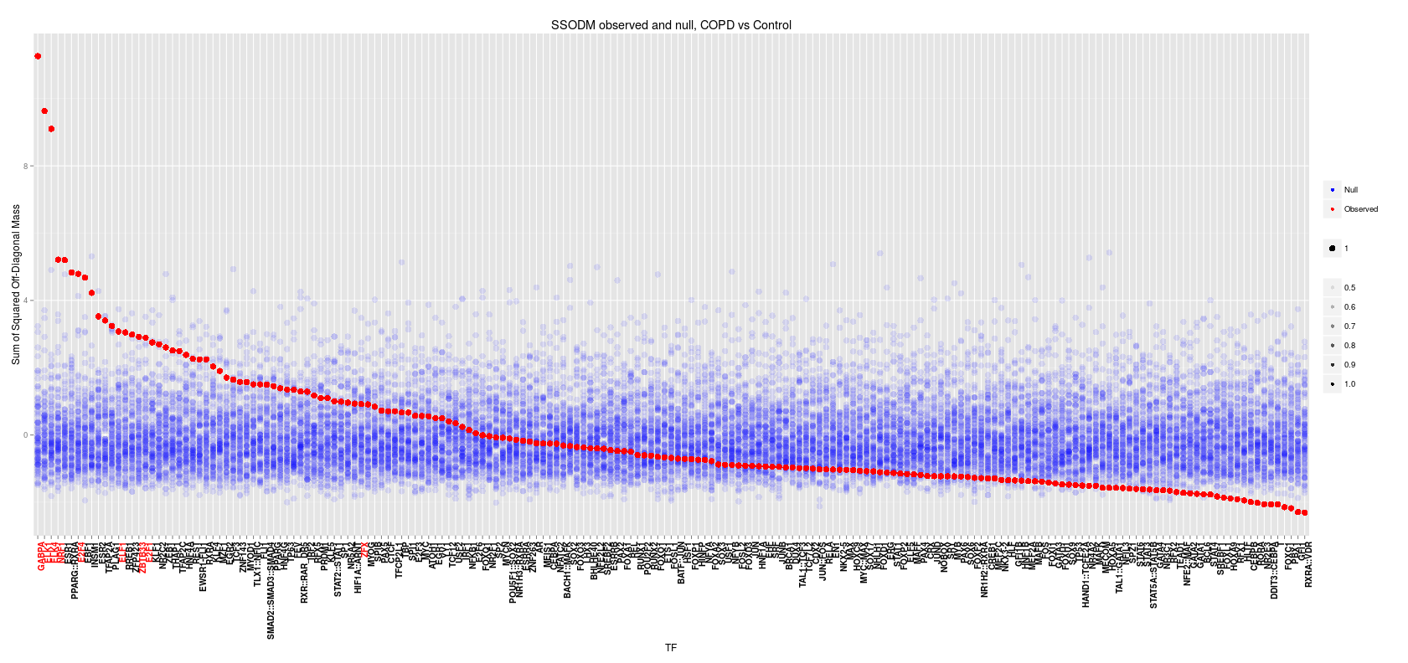
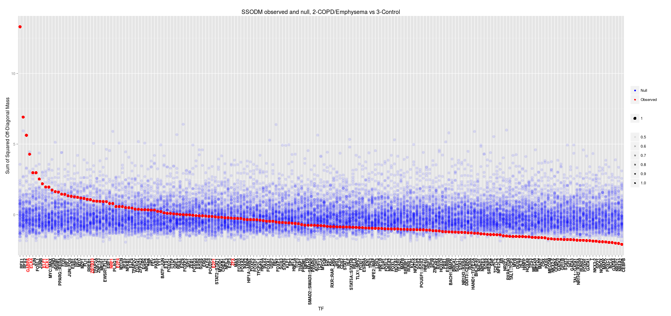
Transition matrix Case-Control
ECLIPSE
COPDGene
LGRC

Slide 4
Transition matrix Case-Control
ECLIPSE
 | t-statistic | p-values | FDR | Sig (LIMMA) | Notes
E2F4 | 12.666 | 0.0000 | 0.0000 | 0.337 | Binds EGR-1, SMAD3. Tumor suppression.
NRF1 | 10.232 | 0.0000 | 0.0000 | 0.215 | Acts on nuclear genes encoding respiratory subunits and components of the mitochondrial transcription and replication machinery.
GABPA | 9.747 | 0.0000 | 0.0000 | 0.816 | Related to NRF1, involved in activation of cytochrome oxidase expression and nuclear control of mitochondrial function
ELK1 | 8.480 | 0.0000 | 0.0000 | 0.080 | Binds to the the serum response factor
ELK4 | 8.379 | 0.0000 | 0.0000 | 0.000 | Binds promoter of the c-fos proto-oncogene
E2F1 | 6.126 | 0.0000 | 0.0000 | 0.714 | E2F family...
ZBTB33 | 5.281 | 0.0000 | 0.0000 | 0.602 | shown to interact with HDAC3, Nuclear receptor co-repressor 1
ELF1 | 3.083 | 0.0010 | 0.0242 | 0.301 | primarily expressed in lymphoid cells
ZFX | 2.998 | 0.0014 | 0.0285 | 0.987 | gene on the X chromosome

Slide 5
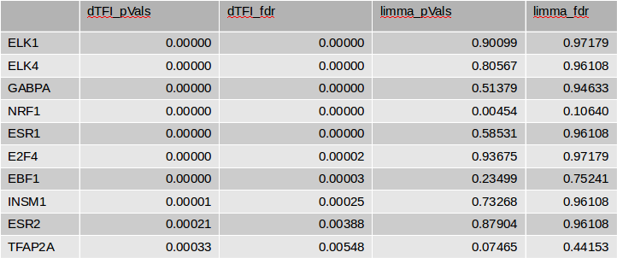
Transition matrix Case-Control
COPDGene

Slide 6
Transition matrix Case-Control
LGRC
 | dTFI_pVals | dTFI_fdr | limma_pVals | limma_fdr
RFX1 | 0.00000 | 0.00000 | 0.02022 | 0.09350
RFX2 | 0.00000 | 0.00000 | 0.00022 | 0.00354
GABPA | 0.00000 | 0.00000 | 0.44621 | 0.61937
ELK4 | 0.00001 | 0.00034 | 0.02905 | 0.11422
JUN | 0.00148 | 0.03664 | 0.22114 | 0.43064
FOSL1 | 0.00149 | 0.03664 | 0.82594 | 0.91058
JUNB | 0.00584 | 0.12338 | 0.37555 | 0.57410
ELF1 | 0.01417 | 0.26216 | 0.39745 | 0.58240
ELK1 | 0.02516 | 0.41370 | 0.90705 | 0.95761

Slide 7
Transition matrix Case-Control
Common Transcription Factors
GABPA, ELK1 and ELK4 all appear at p<.0001 and FDR<.001 in all 3 datasets.
Overlap:
6605 ELK1 targets
8652 ELK4 targets
8849 GABPA targets
ELK1 and ELK4:
5035 common targets
ELK1 and GABPA:
5145 common targets
ELK1 and GABPA:
7794 common targets

Slide 8
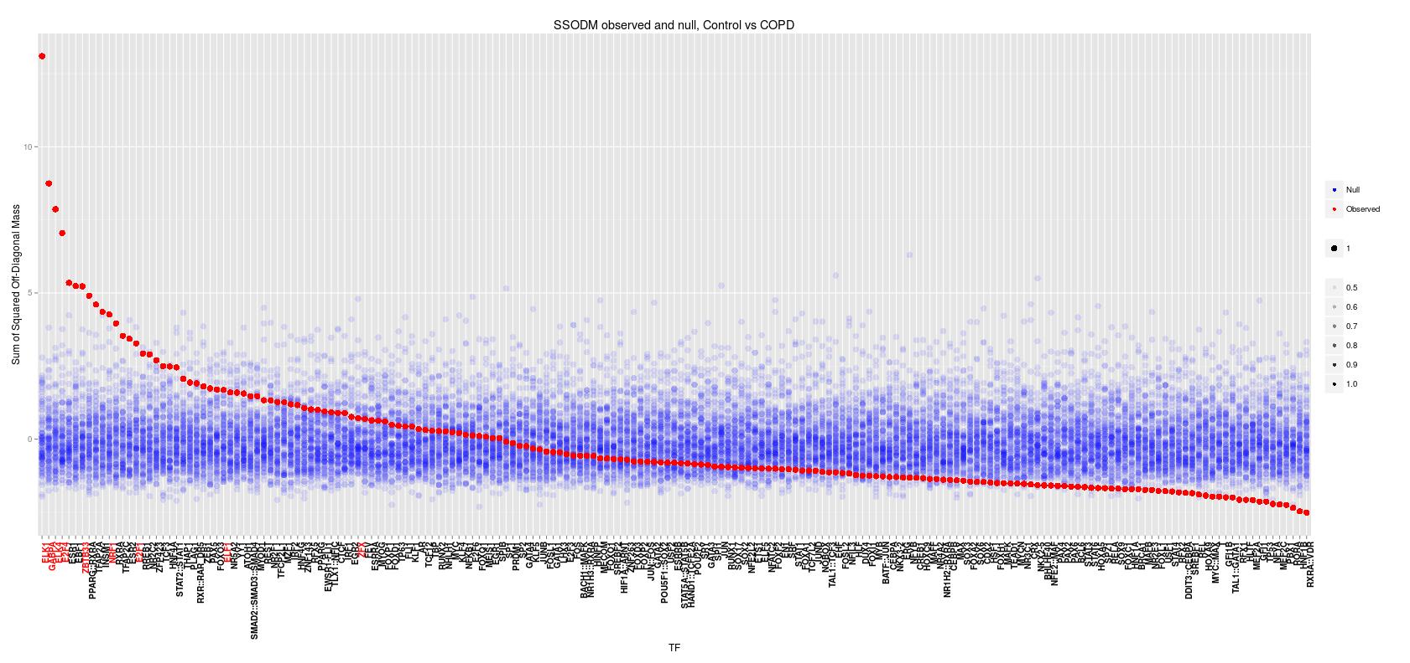
Transition matrix Reverse Case-Control
Check to see if we're getting similar results when calculating in the opposite direction
COPDGene

Slide 9
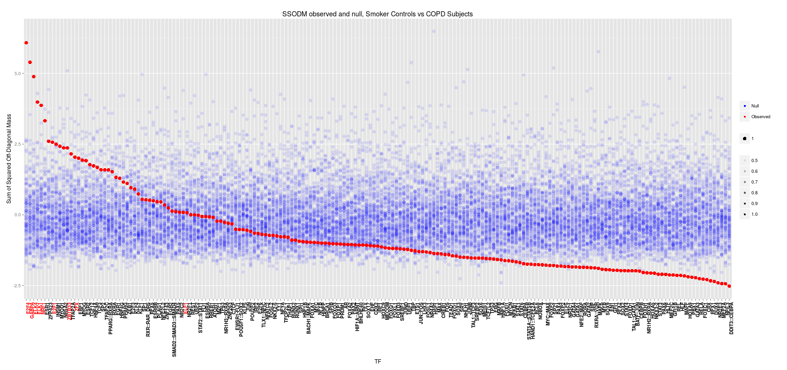
Transition matrix Reverse Case-Control
Check to see if we're getting similar results when calculating in the opposite direction
ECLIPSE

Slide 10
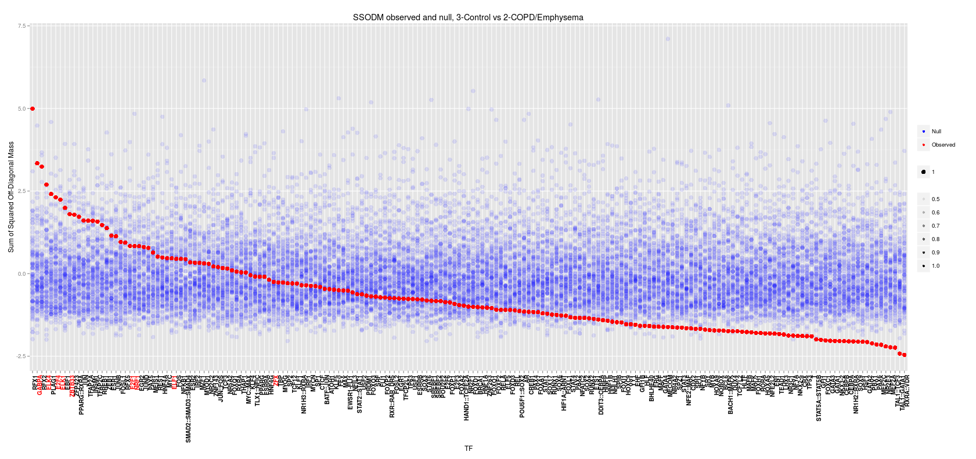
Transition matrix Reverse Case-Control
Check to see if we're getting similar results when calculating in the opposite direction
LGRC

Slide 11
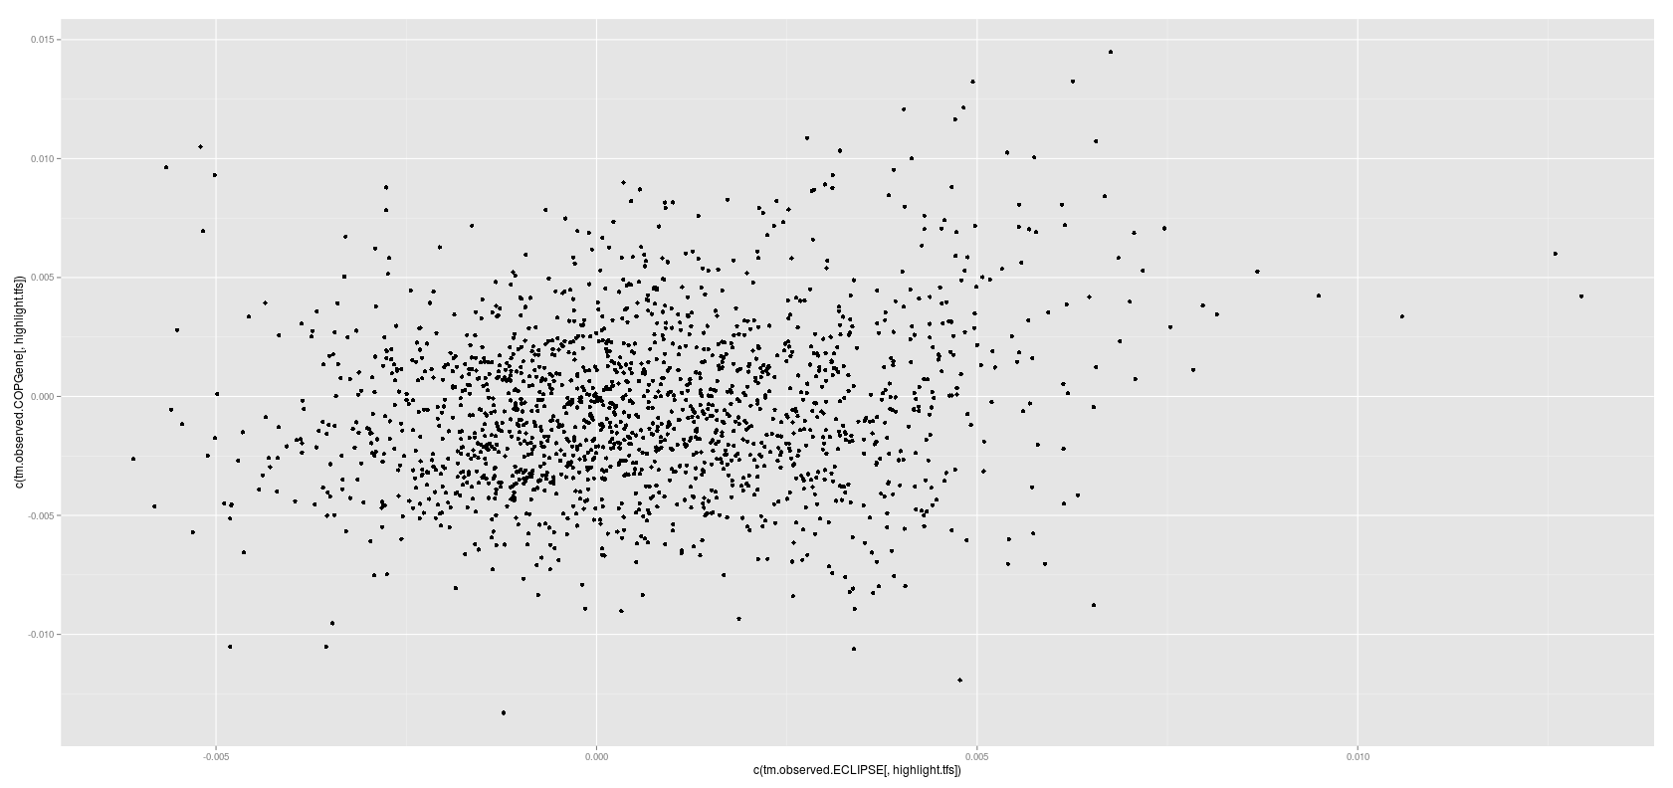
The involvement is the same, is the actual transition the same?
ECLIPSE TM results vs COPDGene TM results (p=1.1e-14)

Slide 12
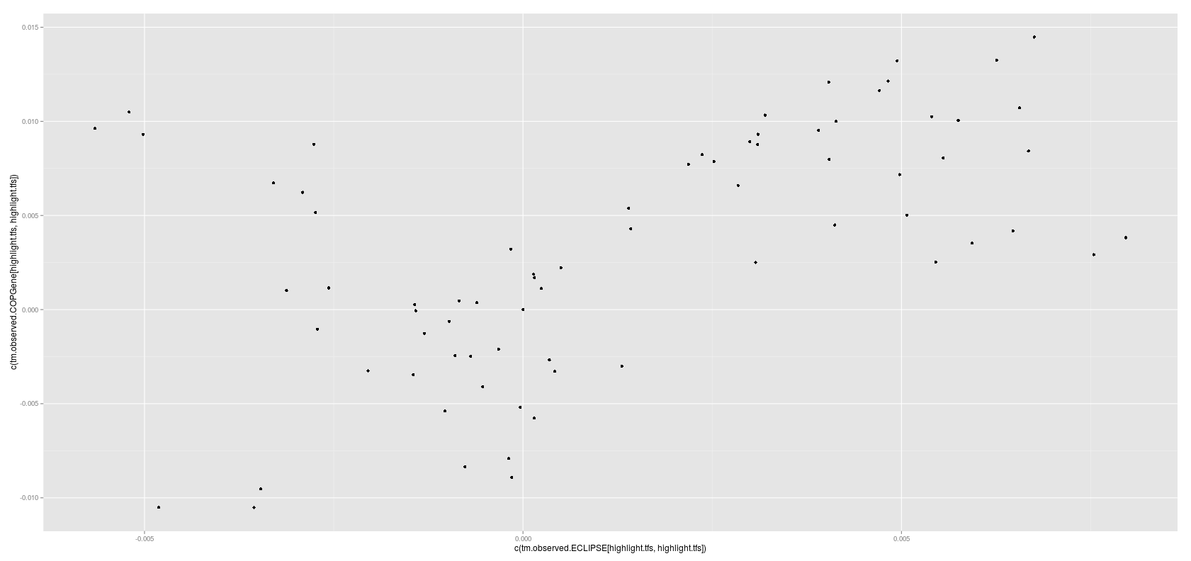
The involvement is the same, is the actual transition the same?
Filtering by our top TFs
ECLIPSE TM results vs COPDGene TM results (p=1.1e-14)

Slide 13
Criticisms
Confounding:
-This does invalidate the approach, but may indicate that the biological explanation could be explainable without COPD (still a valid approach in a different setting)
- We can address this in the COPD setting by showing that our case-control results are more significant than the confounder results

