Slide 1
Meeting 8/24/15

Slide 2
TODO
1.) List of 2-3 figures, supporting text
2.) Color code TM plot from last week
3.) Design, generate dTFI plot
4.) Run on other covariates
5.) Run on better sampling (equal M/F, packyears, age...)
6.) Identify better resampling scheme.

Slide 3
Confounding
ECLIPSE |  | Control | COPD
Sex | Male | 55 | 91
 | Female | 29 | 45
Packyears |  | NA | NA
Age |  | 61.5 | 64.9
Somewhat well matched
LGRC |  | Control | COPD
Sex | Male | 31 | 102
 | Female | 43 | 77
Packyears |  | 22 | 54
Age |  | 64.0 | 65.4
Poorly matched
COPDGene |  | Control | COPD
Sex | Male | 22 | 52
 | Female | 20 | 42
Packyears |  | NA | NA
Age |  | NA | NA
Better matched,
but few covariates

Slide 4
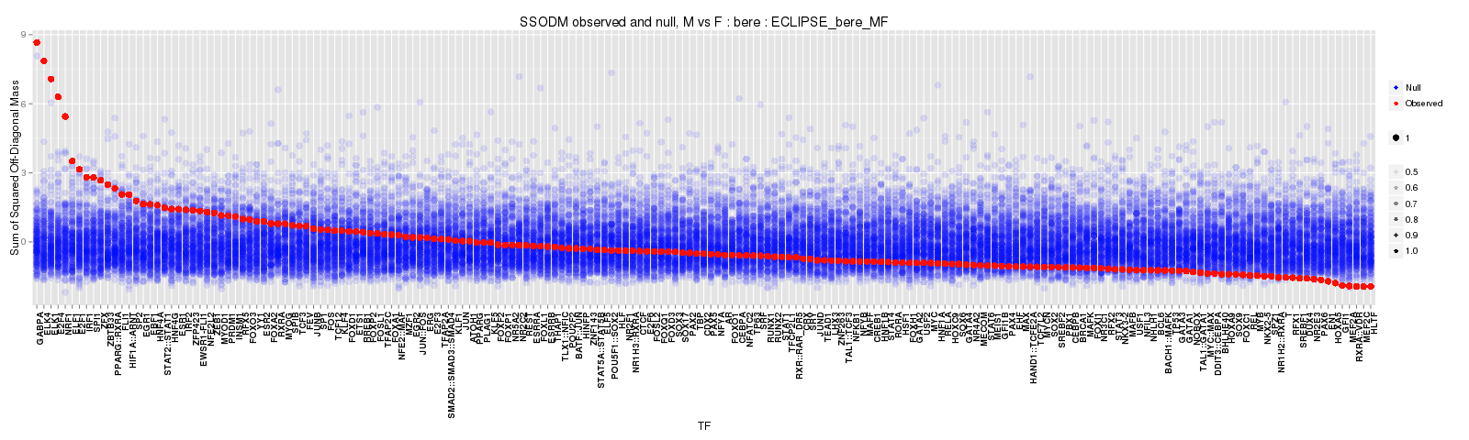
Covariate analysis
- BERE → TM analysis yields similar results in the M/F partition as in the COPD/Control partition.

Slide 5
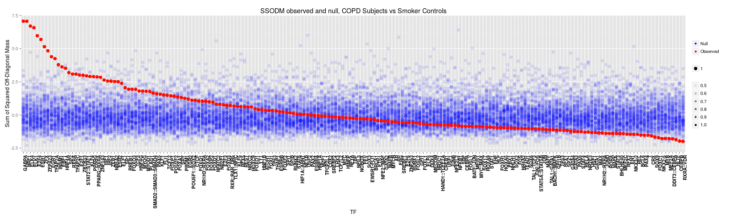
Covariate analysis
- But, within only males, we still see significant results for the COPD/Control analysis.
Similar results for females subset.

Slide 6
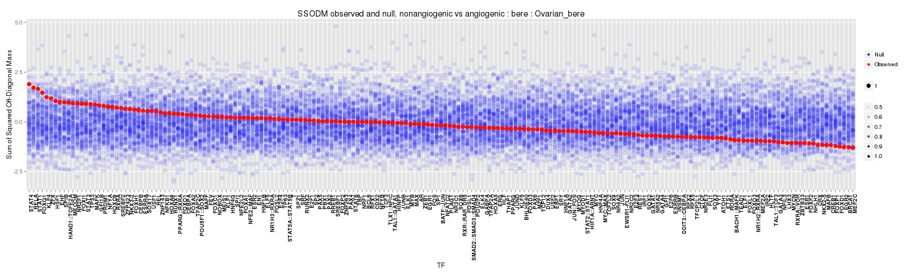
Covariate analysis
In Ovarian cancer dataset, angiogenic vs non-angiogenic, using the same motif priors...
No significant results

Slide 7
An adjustment to the resampling procedure?
It seems that clinical partitions – those such as case/control, high/low age, M/F, packyears etc... all seem to yield results for our usual suspects of TFs (GABPA, E2F4, ELK1, ELK4...)
Each of these partitions has a higher than expected (under H0) number of differentially expressed genes.
We can address this by normalizing each partition prior to running our network inference method, thus ensuring no statistically significant genes across the partitions.

Slide 8
An adjustment to the resampling procedure?
 | dTFI_pVals | dTFI_fdr | limma_pVals | limma_fdr
HOXA5 | 0.00000 | 0.00000 | 0.44733 | 0.70618
NR2F1 | 0.00003 | 0.00129 | 0.86801 | 0.95415
NR5A2 | 0.00003 | 0.00129 | 0.92448 | 0.96742
PPARG | 0.00004 | 0.00129 | 0.93202 | 0.96742
RXRA | 0.00004 | 0.00129 | 0.27162 | 0.61005
MYC | 0.00024 | 0.00649 | 0.16408 | 0.47486
SREBF2 | 0.00028 | 0.00656 | 0.38120 | 0.70525
ZNF143 | 0.00041 | 0.00840 | 0.99906 | 0.99906
TCF12 | 0.00051 | 0.00929 | 0.00221 | 0.02786
Further down the list...
ELK4 | 0.03366 | 0.11798 | 0.00010 | 0.01105
GABPA | 0.09453 | 0.20134 | 0.46504 | 0.70618
ELK1 | 0.12211 | 0.21533 | 0.09128 | 0.29932
Eclipse results

Slide 9
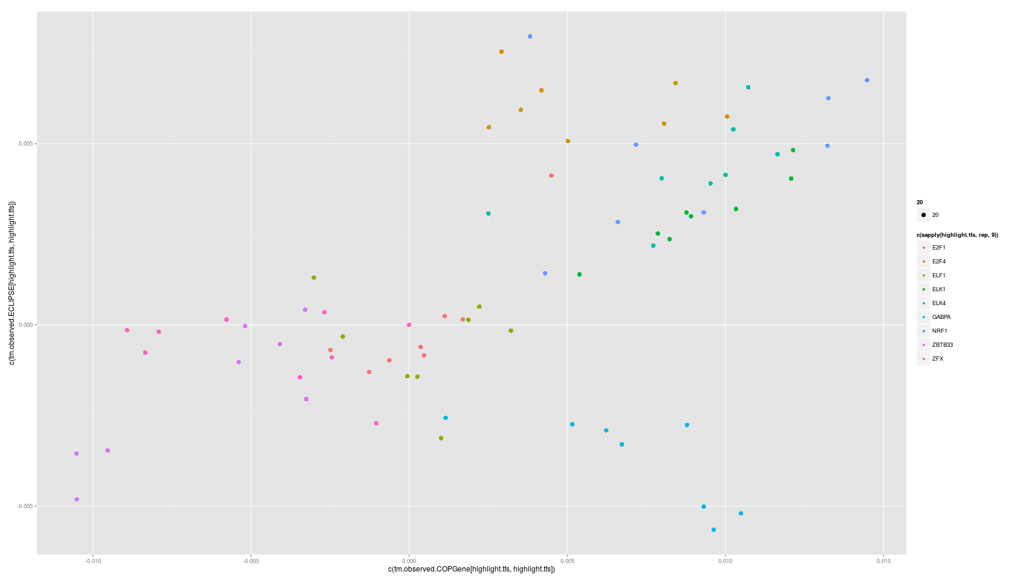
Plot of TF-TF transitions of top 10 TFs in independent datasets
ECLIPSE
COPDGene

Slide 10
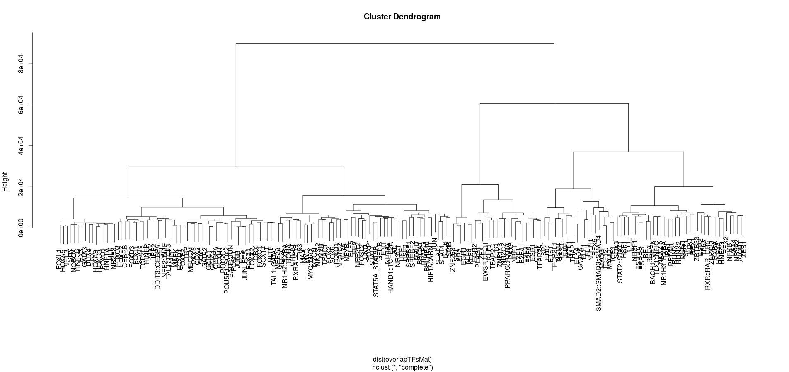
How similar are the motif targets of relevant TFs?
Top TF hits do not appear to be strange in any way – each are average in terms of their number of targets and have a reasonable overlap with other TF targets.
While motifs of ELK4 and GABPA cluster together, ELK1 does not
ELK4
GABPA
ELK1

Slide 11
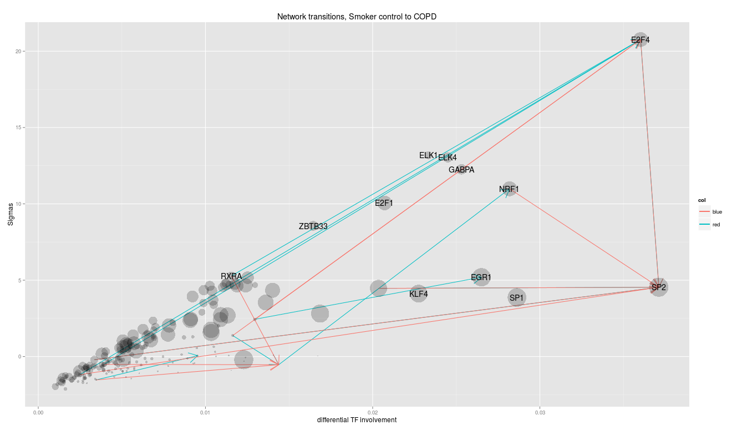
Results plot
A key feature of our transition calculation is the ability to infer biological transitions between states. These transitions are observed when the targetting pattern of a DNA binding protein is altered in a manner which is systematically related to other biological features.
In the chart above, we see the magnitude of the network transition plotted on the x-axis against the statistical significance of the change on the y-axis. Arrows indicate a acquistion(red) or loss(blue) of the features of the the targeted TF by the source TF.

