Slide 1
Meeting 9/7/15

Slide 2
Story
1.) Method works?
  Theoretical basis
  Controlled environment with assumptions satisfied
2.) Method replicates
  Check sensitivity to Network inference methods
3.) Method is useful
  Latest COPD results

Slide 3
Story- simplest case
A true network
Bipartite model

Slide 4
Story- simplest case
A true network transition
A
B
TF A is said to “acquire” the targets of TF B
In other words, we combine the information from many downstream edgeweights to infer the interaction between A and B.
We can demonstrate that the transition matrix works in this simple example by adding the diminished version of the targets of B to A.

Slide 5
Story- simplest case
Testing the transition
A
alpha
B
1.) Generate an arbitrary true network of m TFs and p genes, using any random distribution of edges. Call this AdjacencyMatrixA.
2.) Select a set of 50 transitions (From some TF_A to TF_B) among the 100 TFs to occur, each with some strength, alpha, where 0<alpha<1.
3.) Generate the transitions by adding the alpha*(targets of the TF_A) to the targets of TF_B

Slide 6
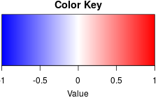
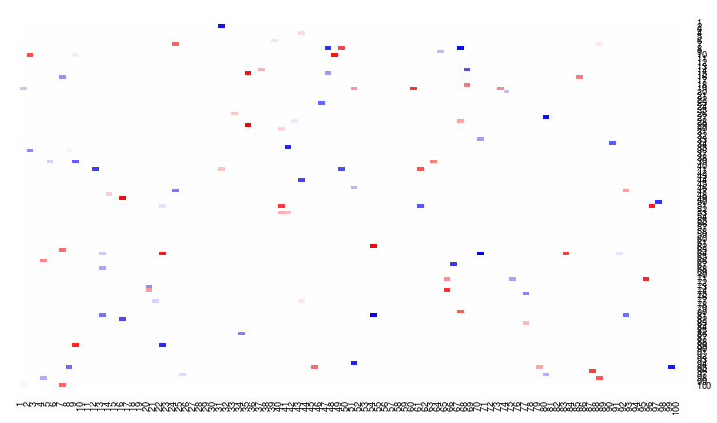
Story- simplest case
White represents 0 off-diagonal mass, and the blue-red scale exactly corresponds to the strength parameter, alpha.
Transition matrix plot for 100 TFs.
Perfect identification of every specified transition.
(Written proof of this is in progress)

Slide 7
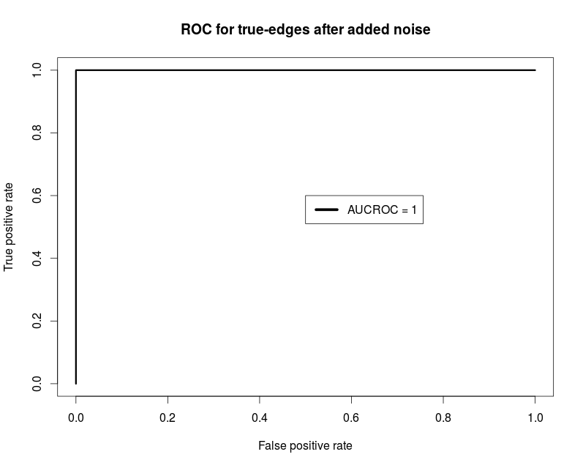
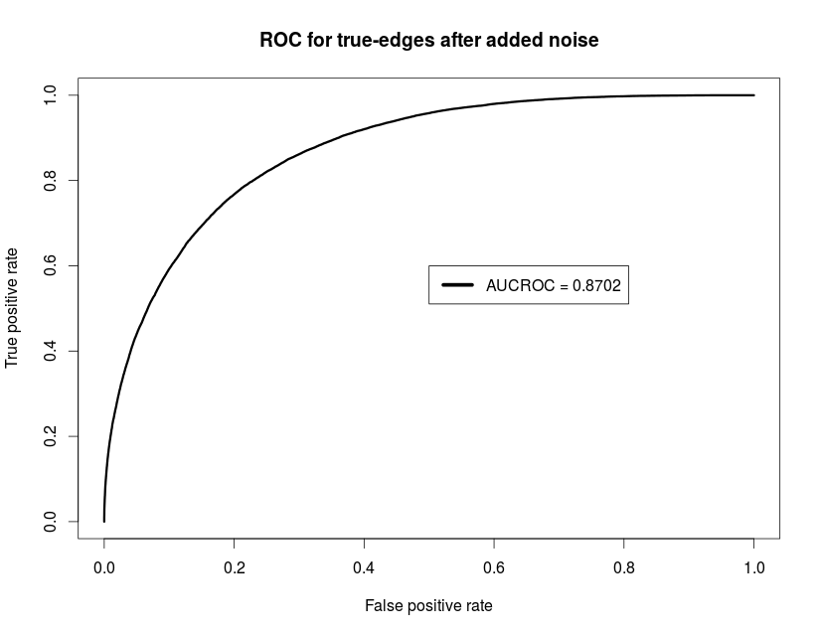
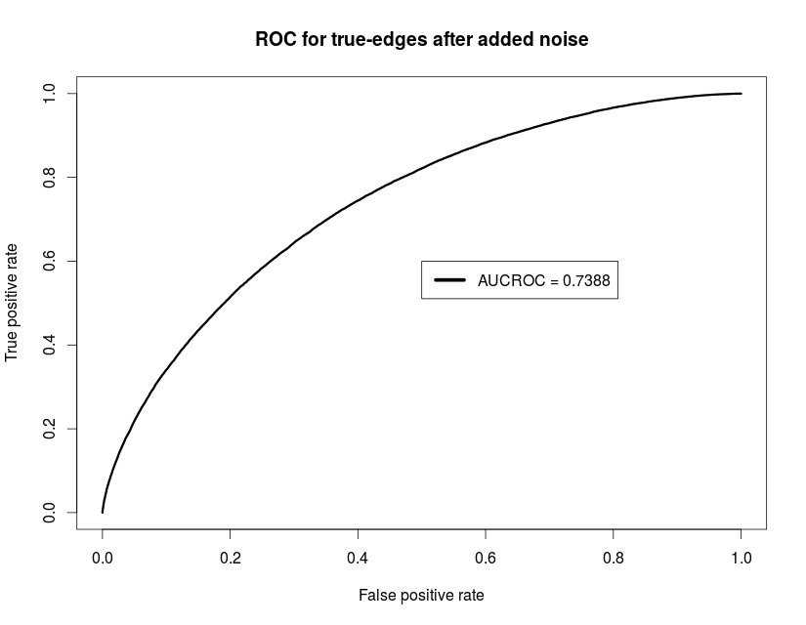
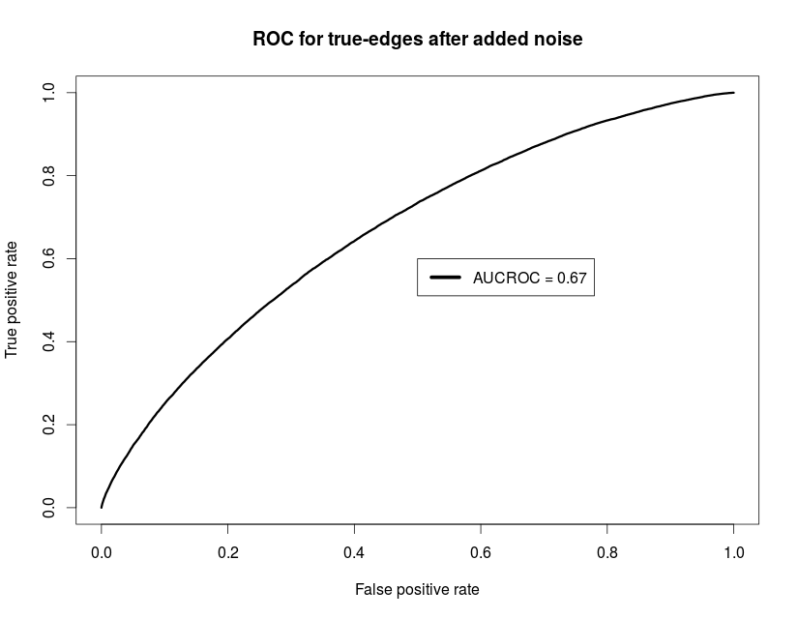
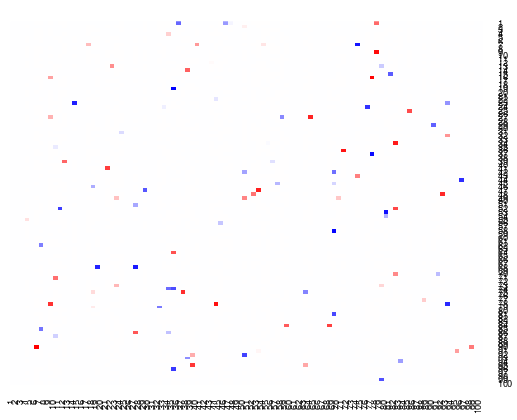
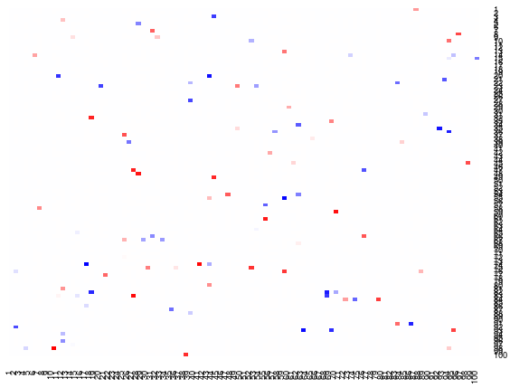
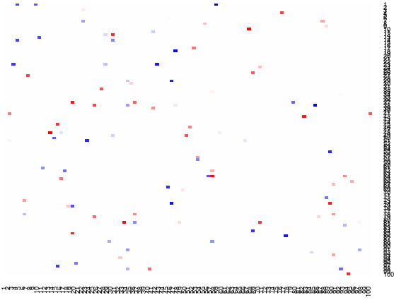
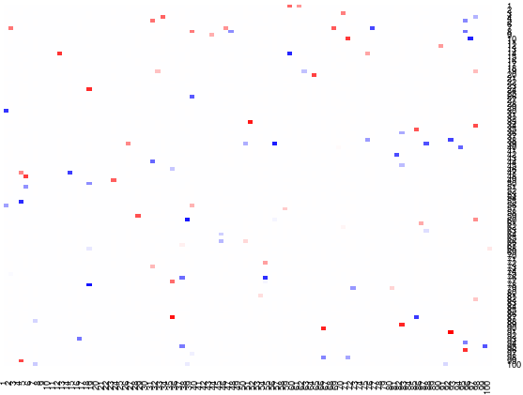
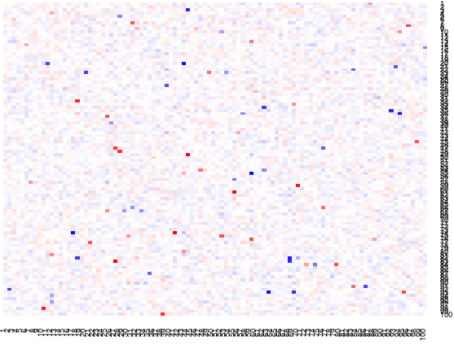
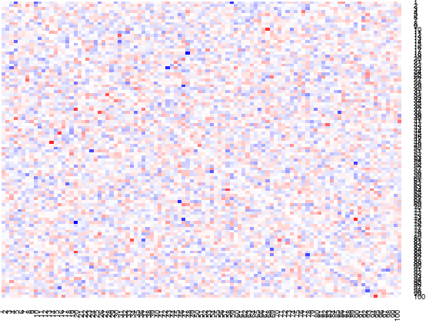
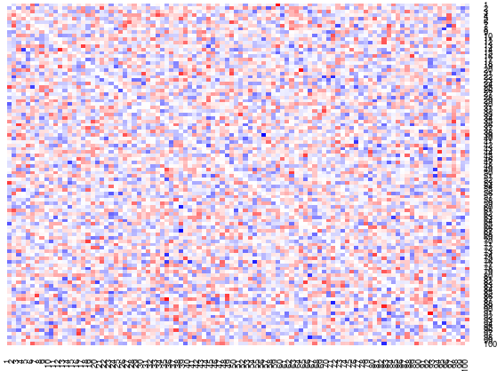
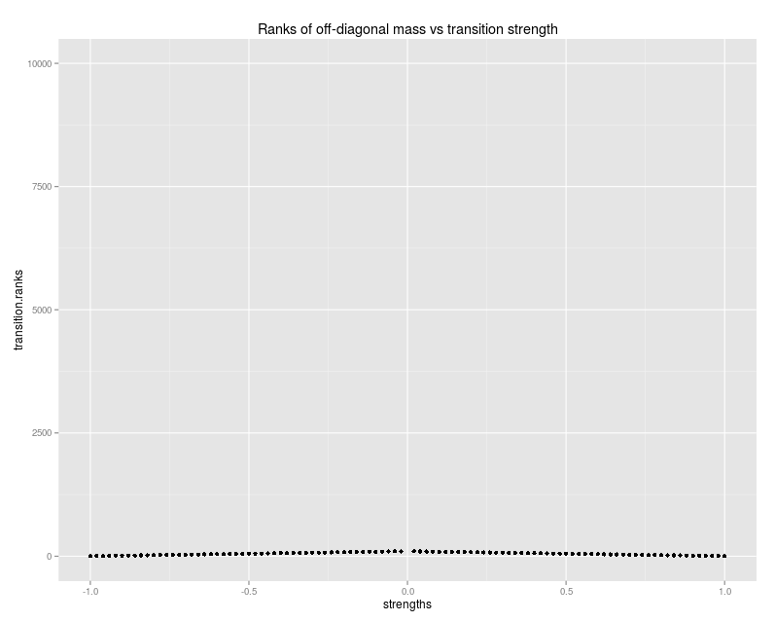
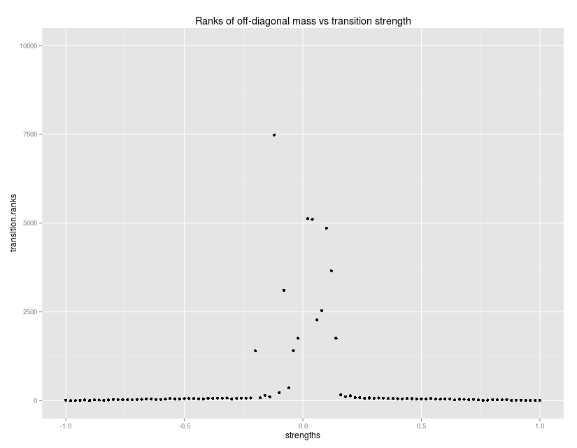
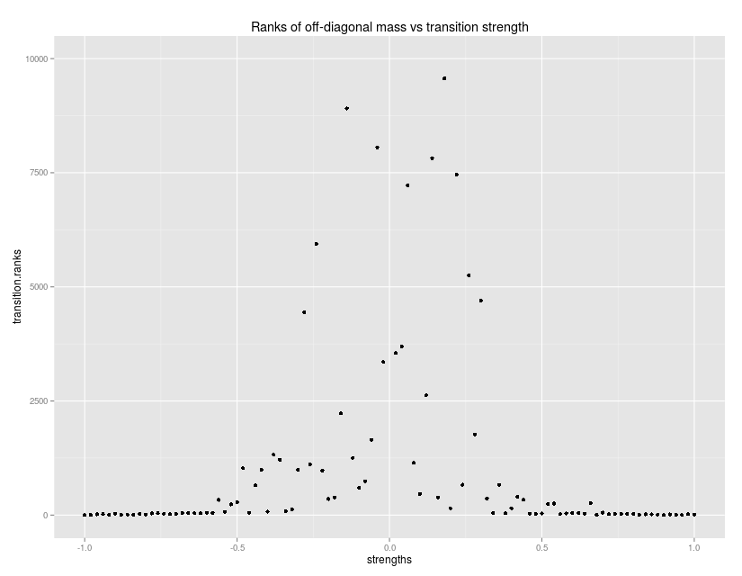
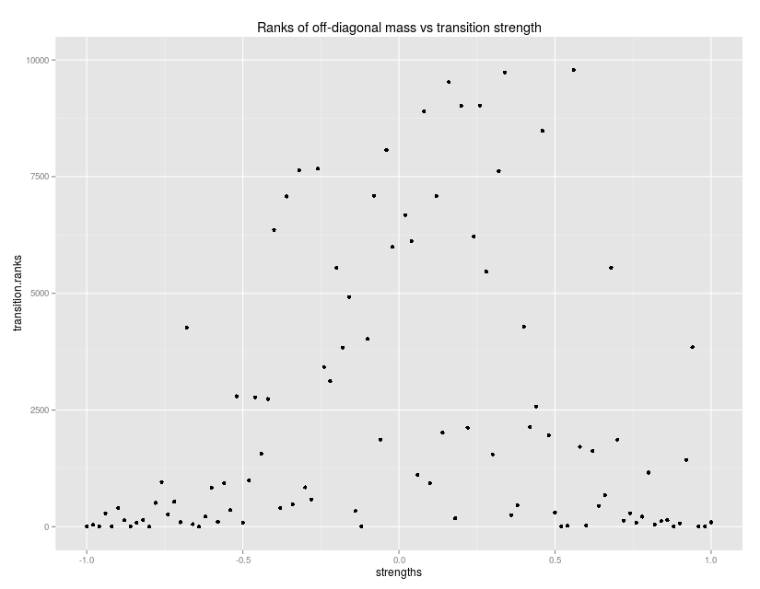
Now introduce noise (1,000 genes)
100% signal
50% signal
20% signal
10% signal
ROC
1.0
.868
.738
.67
TM w/o noise
TM with noise
Ranks vs alphas

Slide 8
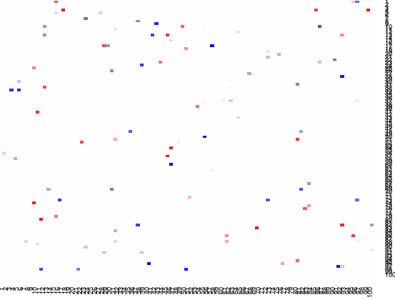
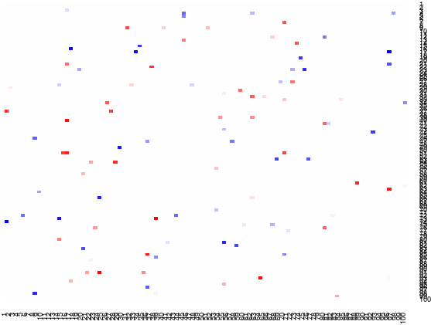
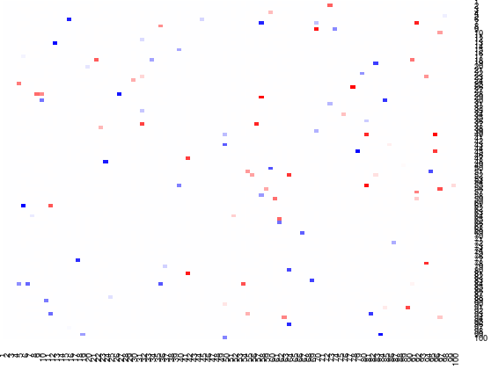
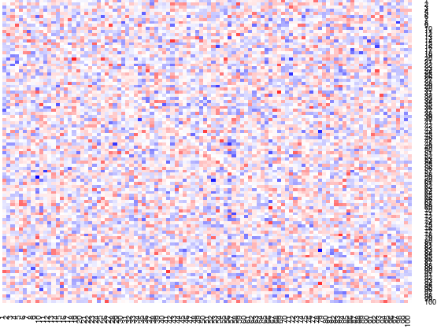
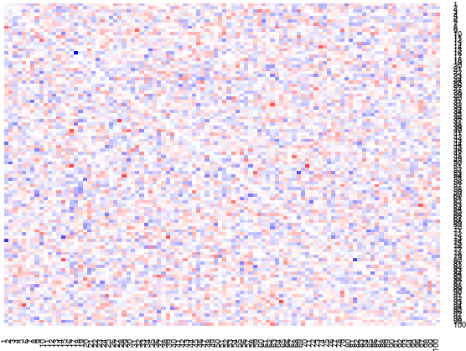
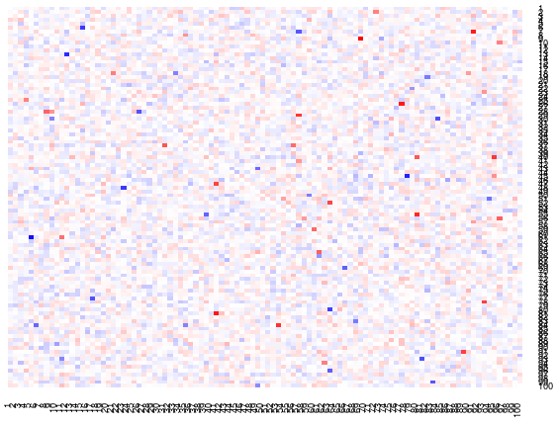
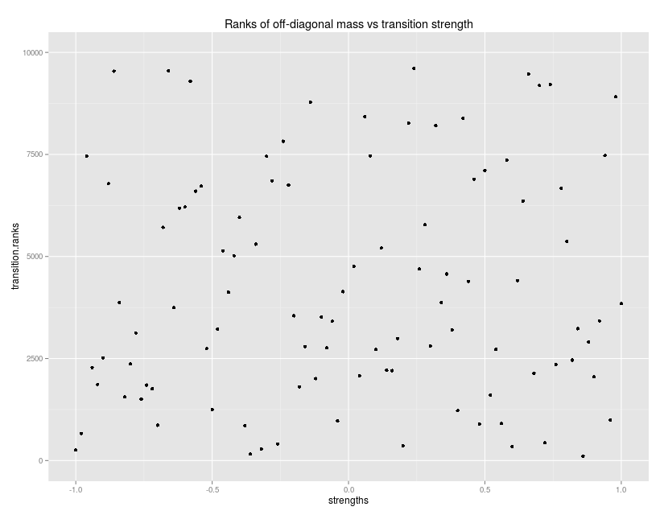
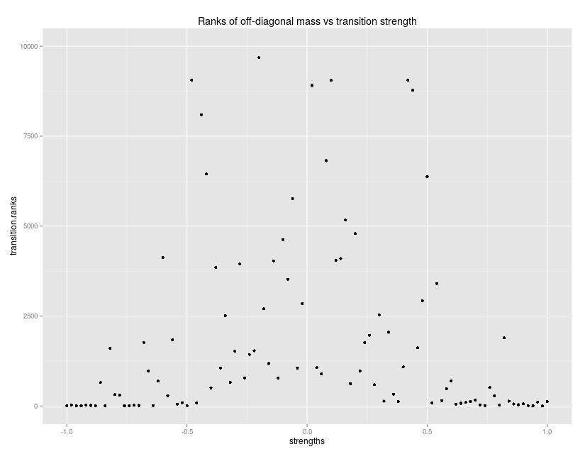

Now comparing number of genes (10% signal)
200 genes
1000 genes
2000 genes
10,000 genes
ROC
.67
.67
.67
.67
TM w/o noise
TM with noise
Ranks vs alphas

Slide 9
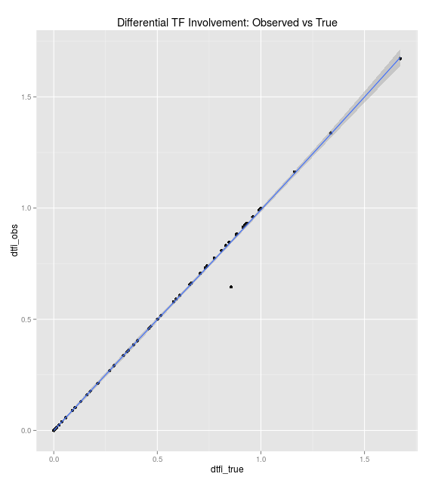
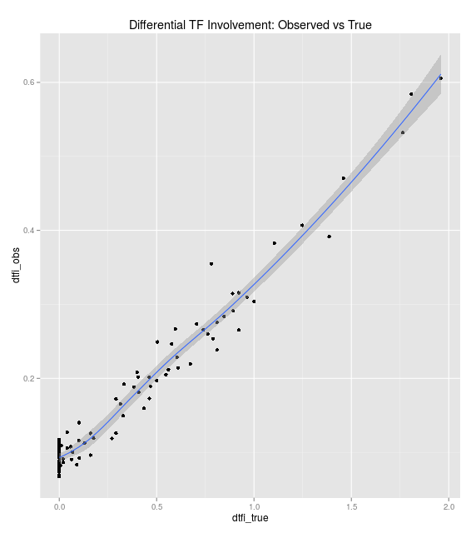
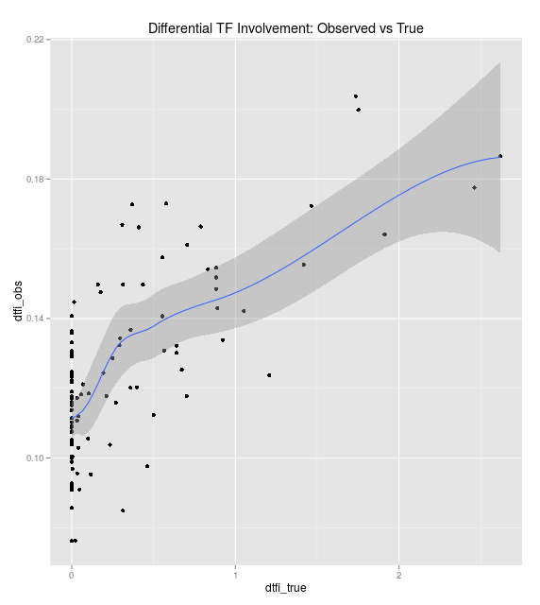
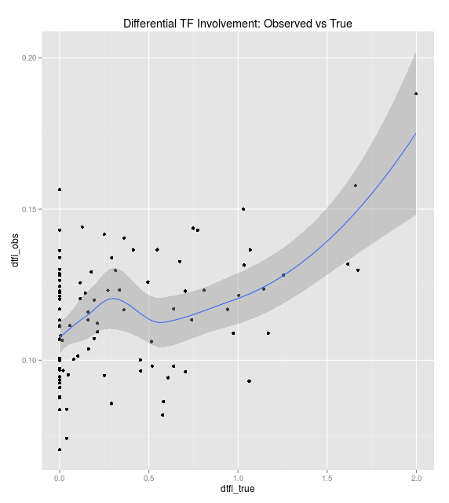
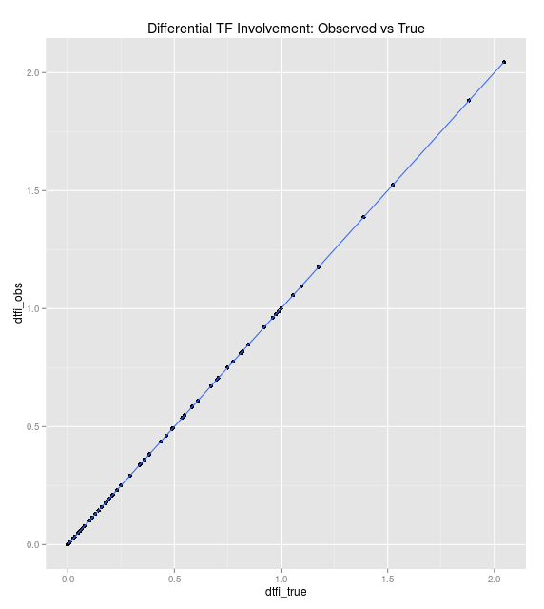
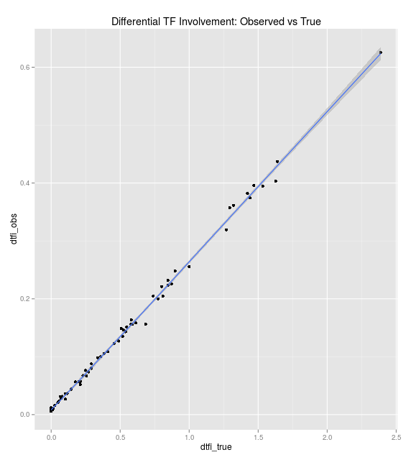
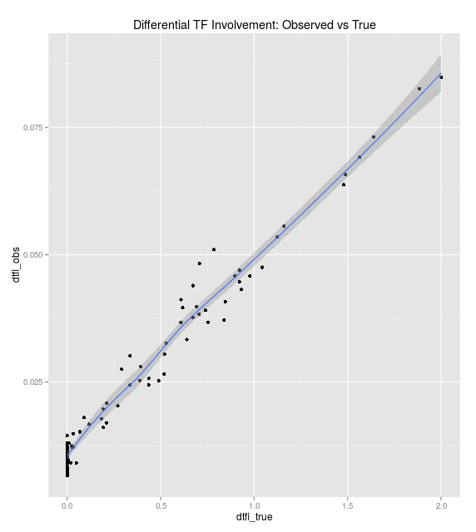
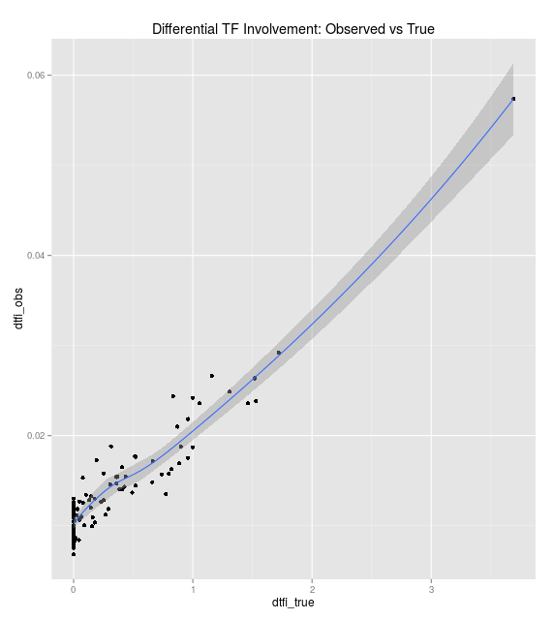
Examining dTFI
100% signal
50% signal
20% signal
10% signal
ROC
1.0
.868
.738
.67
Observed vs True dTFI
1,000 genes
10,000 genes

Slide 10
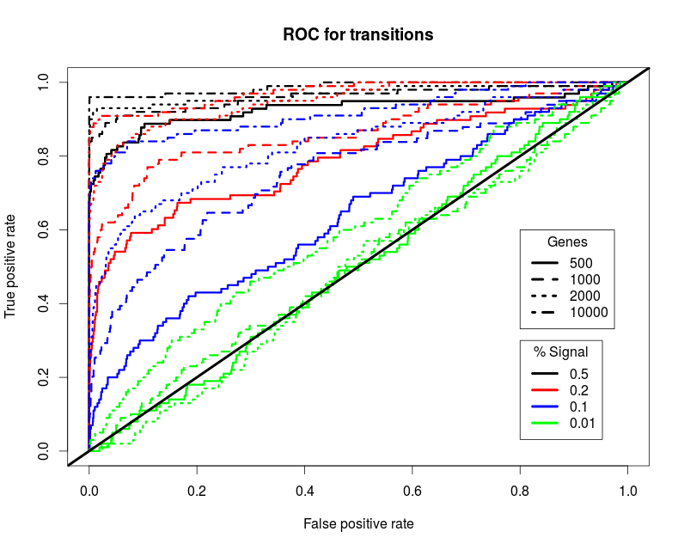
Comparing transition ROC curves for differing conditions

Slide 11
Transition on pearson inferred networks
Process:
Generate two true adjacency matrices, (A,B) characterized by a set of m network transitions. (as described above)
Generate n gene expression samples from a MVN distribution with covariance matrices=AA' and BB'
Generate gene expression for TFs via a mean expression across all genes weighted by true edgeweight.
Calculate correlation network.

Slide 12
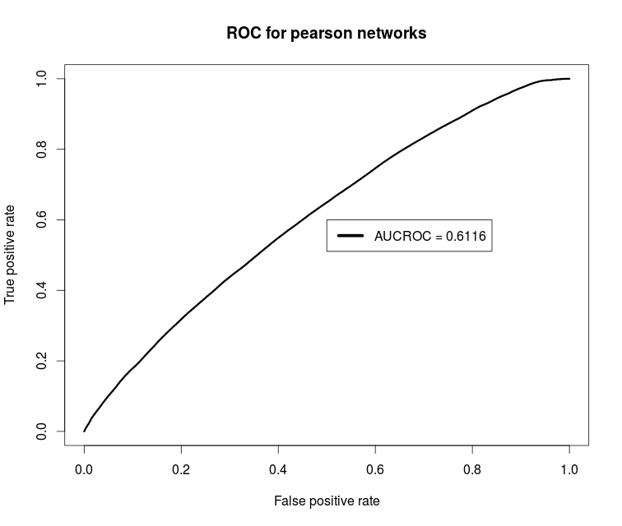
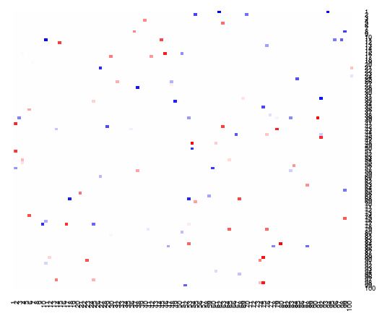
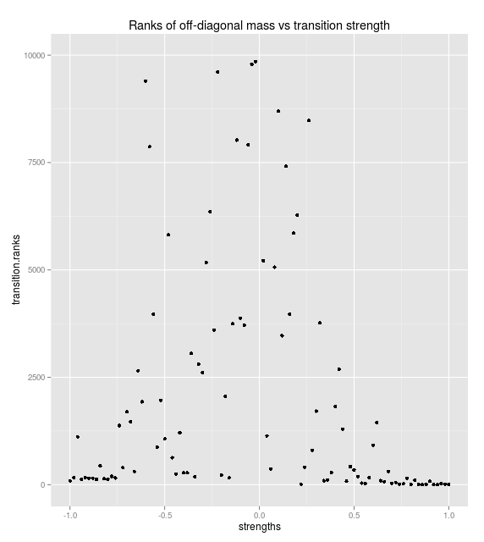
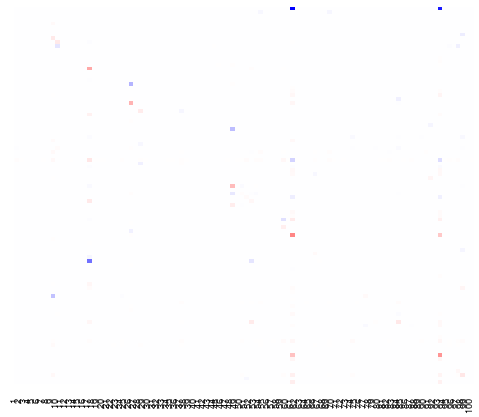
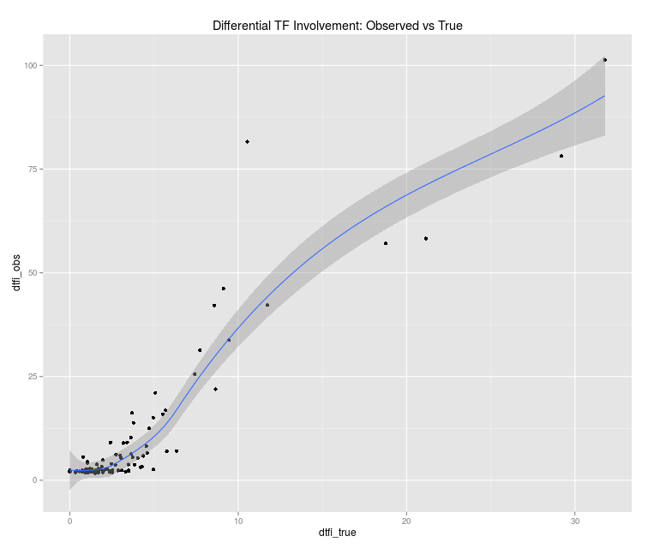
Transition on pearson inferred networks
Low quality expression data and network yields detectable transitions
Gene expression ROC curve
True transition matrix
Calculated transition matrix

Slide 13
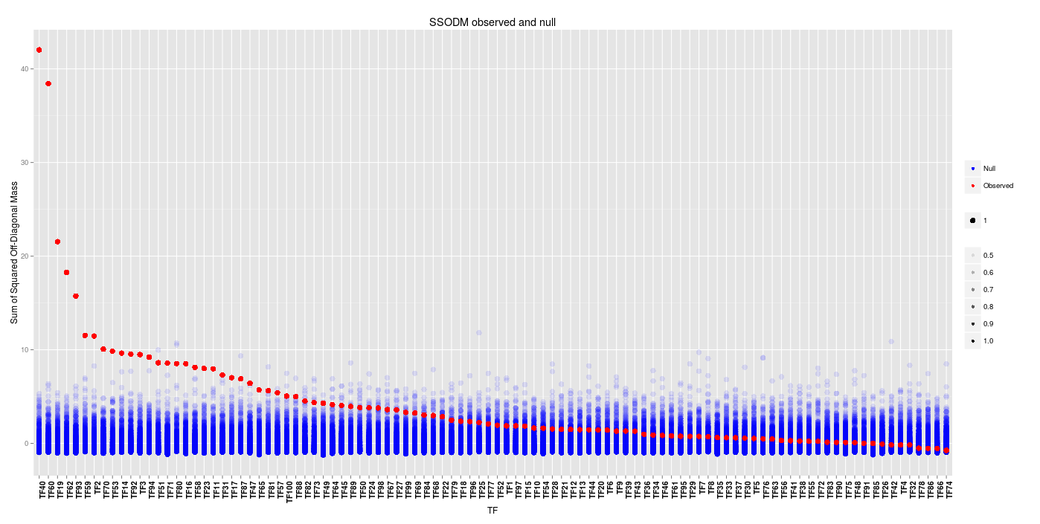
Transition on inferred networks

Slide 14
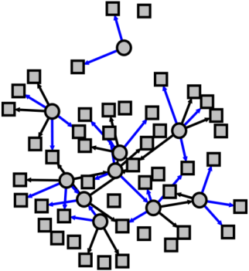
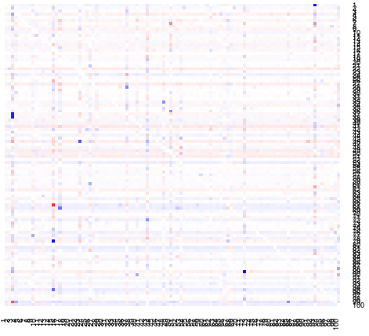
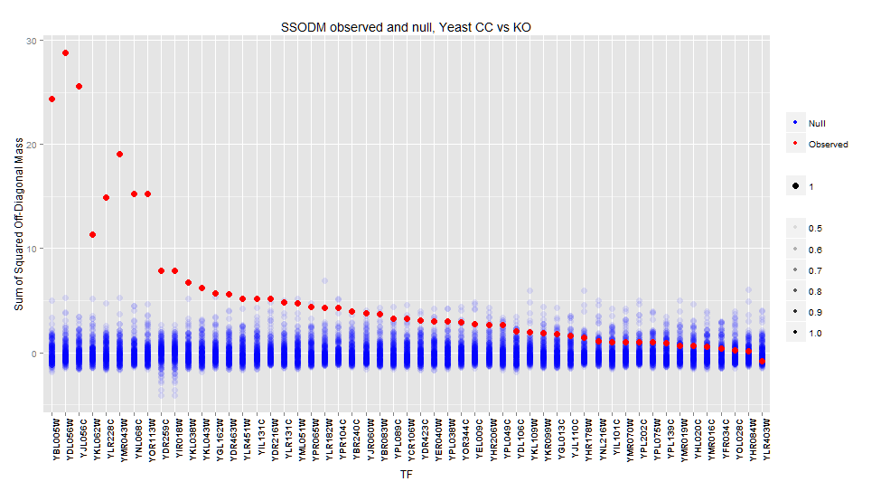
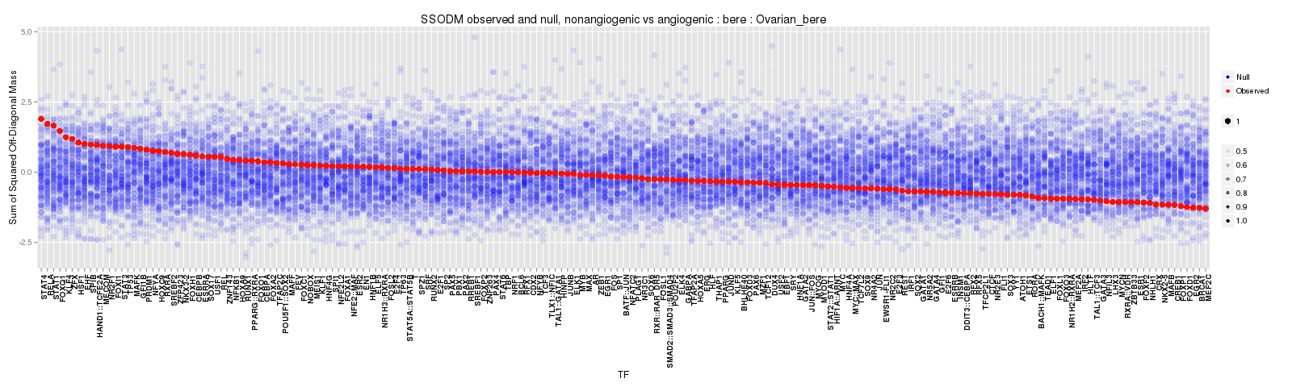
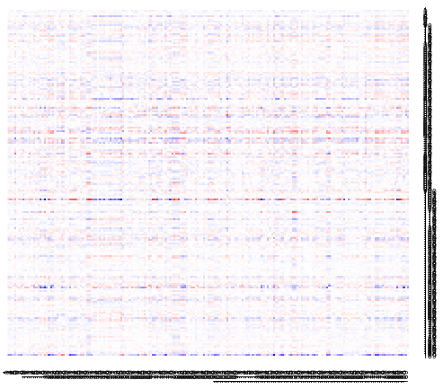
Net inf
TM
Results analysis
Designed
network
AUCROC=.59
AUCROC=.78
P<.0001
Properly identifies meaningful effects
YEAST
AUCROC=.72
(chipseq)
Unknown
Biological validation?
ECLIPSE
AUCROC=??
Unknown
Biological validation?

Slide 15
ECLIPSE latest results
 | dTFI_pVals | dTFI_fdr | limma_pVals | limma_fdr | Description
HOXA5 | 0.00000 | 0.00000 | 0.44733 | 0.70618 | Encodes a DNA-binding transcription factor which may regulate gene expression, morphogenesis, and differentiation.
NR2F1 | 0.00003 | 0.00129 | 0.86801 | 0.95415 | binds to the ovalbumin promoter
NR5A2 | 0.00003 | 0.00129 | 0.92448 | 0.96742 | plays a critical role in the regulation of development, cholesterol transport, bile acid homeostasis and steroidogenesis. maintaining pluripotence of stem cells during embryonic development
PPARG | 0.00004 | 0.00129 | 0.93202 | 0.96742 | mainly present in adipose tissue, colon and macrophages
RXRA | 0.00004 | 0.00129 | 0.27162 | 0.61005 | member of the steroid and thyroid hormone receptor superfamily
MYC | 0.00024 | 0.00649 | 0.16408 | 0.47486 | cell cycle progression, apoptosis and cellular transformation
SREBF2 | 0.00028 | 0.00656 | 0.38120 | 0.70525 | ubiquitously expressed TF that controls cholesterol homeostasis by stimulating transcription of sterol-regulated genes
ZNF143 | 0.00041 | 0.00840 | 0.99906 | 0.99906 | The transcriptional activator ZNF143 is essential for normal development in zebrafish

