Slide 1
Differential Transcription Factor analysis
PPG Meeting
5/1/15

Slide 2
Background
Transcription factors may behave in different ways in different contexts.
These changes in “involvement” may not be readily observed using standard differential gene expression analyses.
Goal
Generate context specific networks and identify structural changes between them.

Slide 3
Challenges
Ultra-high dimensionality for network inference.
Current network inference methods yield relatively poorly predictive edgeweights at the individual interaction level.
Comparison of two networks of involves the comparison of millions of noisy edges.

Slide 4
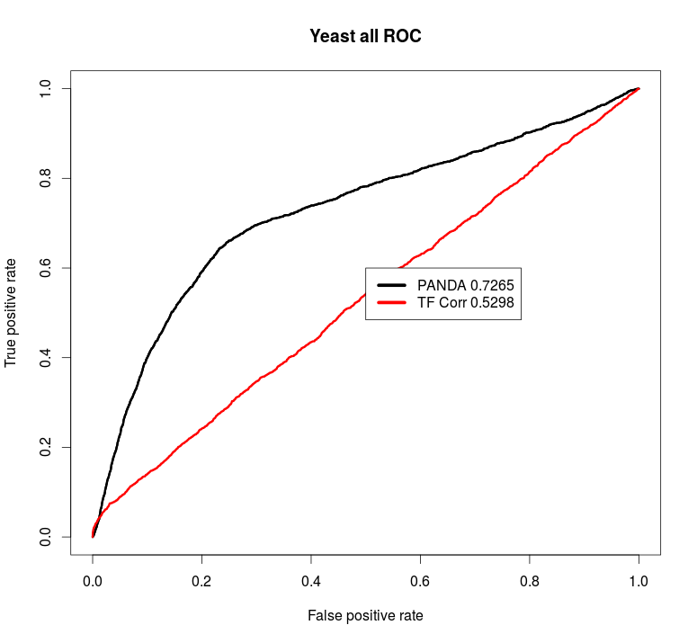
Challenges
Prediction of TF-gene regulation.
A comparison of gene expression correlation to PANDA algorithm.
Conclusion: Using gene expression patterns to discern differential transcription factor involvement may not be a sufficient approach.

Slide 5
Approach
We can view the problem as a dimension reduction problem.
Few TFs
Many Genes

Slide 6
Approach
Consider two adjacency matrices...
TFs
TFs
Genes
Genes

Slide 7
Approach
Consider two adjacency matrices...
Smoker Control
Tau
COPD
X
~

Slide 8
The Transition Matrix (Tau)
Calculated via penalized regression.
Each column in the TM can be thought of as being the best linear combination of columns in the control AM that “create” the columns in the COPD.

Slide 9
An Example
?
A
B
C
D
1
2
3
4
5
6
7
8
A
B
C
D
A
TM =
B
C
D

Slide 10
Biological Mechanism?
Suggested mechanism #1:
Differential methylation of the gene for TF C?
-CH₃
A
B
C
D
1
2
3
4
5
6
7
8

Slide 11
Biological Mechanism?
Suggested mechanism #2:
Protein complex of B-C-? with unknown 3rd protein?
?
A
B
C
D
1
2
3
4
5
6
7
8

Slide 12

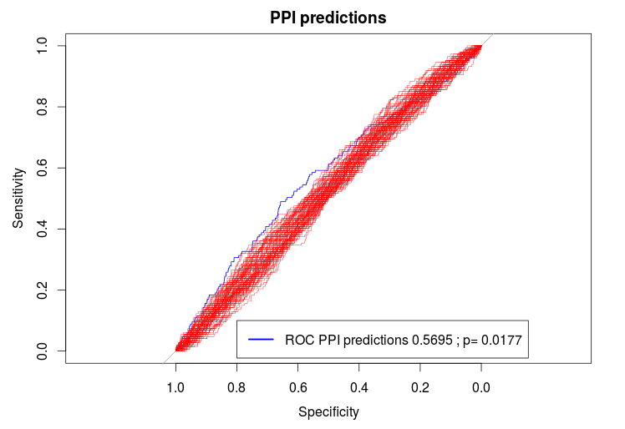

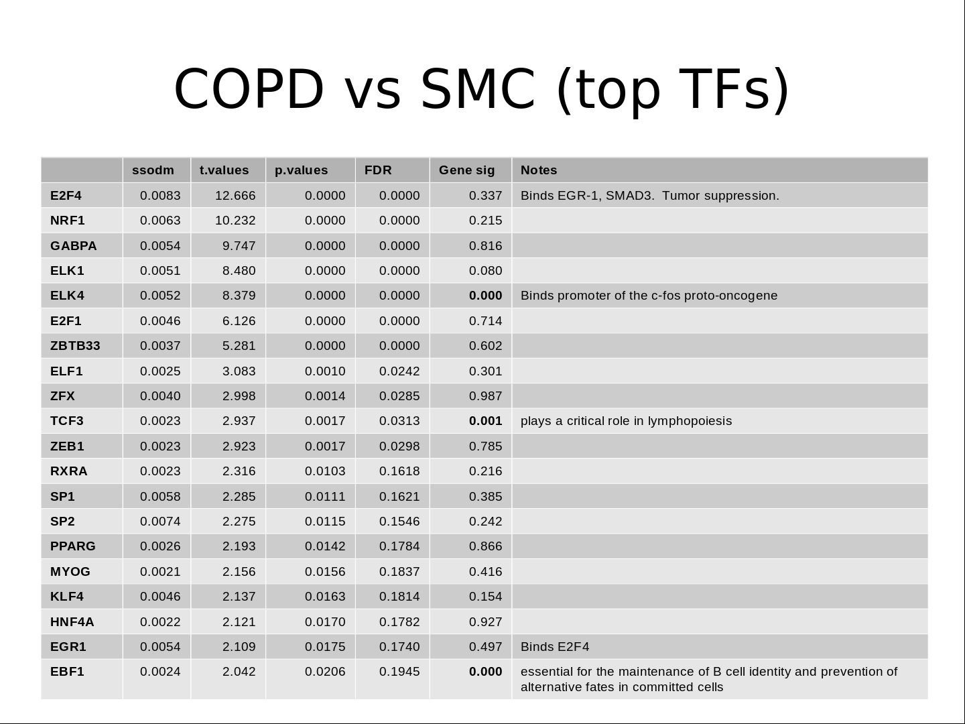
Eclipse Data Motif Data
Observed Partition
COPD vs SMC
Random Partitions
Null x 100
PANDA / BERE
}
Observed
COPD
Network
Observed
SMC
Network
Null
NetworkA
Null
NetworkB
X 1000
Transition Matrix calculation
}
X 1000
Transition Matrix analysis

Slide 13
COPD vs SMC

Slide 14
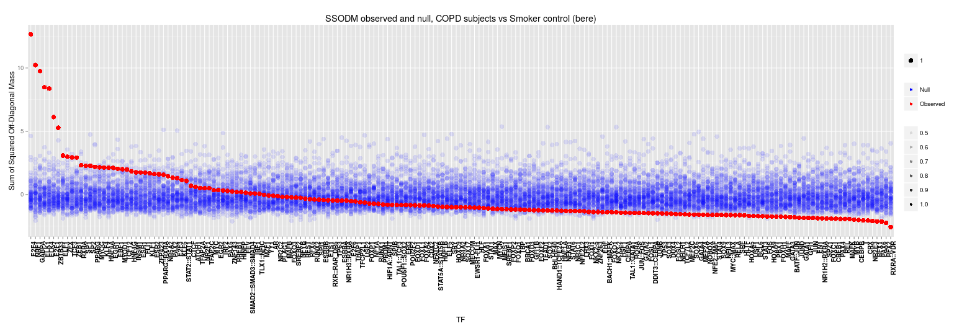
COPD vs SMC

Slide 15
COPD vs SMC (top 20 TFs)
 | ssodm | t.values | p.values | FDR | Sig (LIMMA) | Notes
E2F4 | 0.0083 | 12.666 | 0.0000 | 0.0000 | 0.337 | Binds EGR-1, SMAD3. Tumor suppression.
NRF1 | 0.0063 | 10.232 | 0.0000 | 0.0000 | 0.215 | acts on nuclear genes encoding respiratory subunits and components of the mitochondrial transcription and replication machinery.
GABPA | 0.0054 | 9.747 | 0.0000 | 0.0000 | 0.816 | Related to NRF1, involved in activation of cytochrome oxidase expression and nuclear control of mitochondrial function
ELK1 | 0.0051 | 8.480 | 0.0000 | 0.0000 | 0.080
ELK4 | 0.0052 | 8.379 | 0.0000 | 0.0000 | 0.000 | Binds promoter of the c-fos proto-oncogene
E2F1 | 0.0046 | 6.126 | 0.0000 | 0.0000 | 0.714 | E2F family...
ZBTB33 | 0.0037 | 5.281 | 0.0000 | 0.0000 | 0.602 | shown to interact with HDAC3, Nuclear receptor co-repressor 1
ELF1 | 0.0025 | 3.083 | 0.0010 | 0.0242 | 0.301 | primarily expressed in lymphoid cells
ZFX | 0.0040 | 2.998 | 0.0014 | 0.0285 | 0.987
TCF3 | 0.0023 | 2.937 | 0.0017 | 0.0313 | 0.001 | plays a critical role in lymphopoiesis
ZEB1 | 0.0023 | 2.923 | 0.0017 | 0.0298 | 0.785
RXRA | 0.0023 | 2.316 | 0.0103 | 0.1618 | 0.216
SP1 | 0.0058 | 2.285 | 0.0111 | 0.1621 | 0.385
SP2 | 0.0074 | 2.275 | 0.0115 | 0.1546 | 0.242
PPARG | 0.0026 | 2.193 | 0.0142 | 0.1784 | 0.866
MYOG | 0.0021 | 2.156 | 0.0156 | 0.1837 | 0.416
KLF4 | 0.0046 | 2.137 | 0.0163 | 0.1814 | 0.154
HNF4A | 0.0022 | 2.121 | 0.0170 | 0.1782 | 0.927
EGR1 | 0.0054 | 2.109 | 0.0175 | 0.1740 | 0.497 | Binds E2F4
EBF1 | 0.0024 | 2.042 | 0.0206 | 0.1945 | 0.000 | essential for the maintenance of B cell identity and prevention of alternative fates in committed cells

