Slide 1
Differential Transcription Factor analysis

Slide 2
Background
Transcription factors may behave in different ways in different contexts.
These changes in “involvement” may not be readily observed using standard differential gene expression analyses.
Goal
Generate context specific networks and identify structural changes between them.

Slide 3
Challenges
Ultra-high dimensionality for network inference.
Current network inference methods yield relatively poorly predictive edgeweights at the individual interaction level.
Comparison of two networks of involves the comparison of millions of noisy edges.

Slide 4

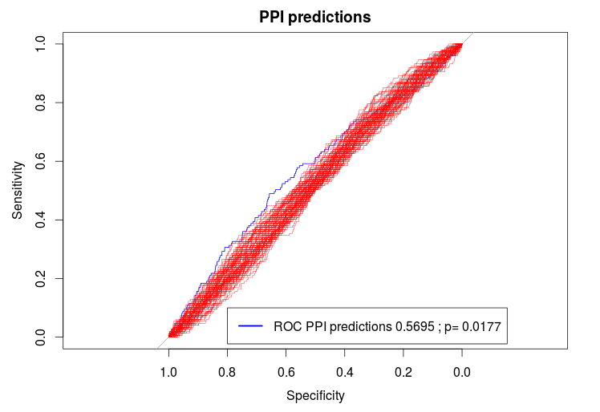

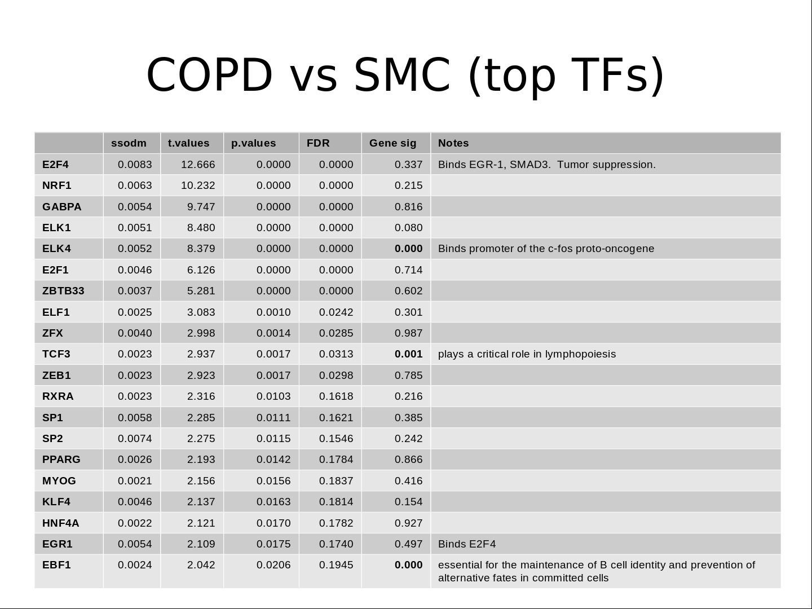
Gene expression Sequence Motifs
Observed Partition
COPD vs SMC
Random Partitions
Null x 100
BERE
}
Observed
COPD
Network
Observed
SMC
Network
Null
NetworkA
Null
NetworkB
X 1000
Transition Matrix
}
X 1000
Transition Matrix analysis

Slide 5
Gene expression Sequence Motifs
Observed Partition
COPD vs SMC
Random Partitions
Null x 100
BERE
}
Observed
COPD
Network
Observed
SMC
Network
Null
NetworkA
Null
NetworkB
X 1000
Transition Matrix
}
X 1000
Transition Matrix analysis

Slide 6
Bipartite Edge Reconstruction from Expression Data – BERE (A working title)
Approach:
1.) Model gene regulatory network as a bipartite graph between m transcription factors and n genes.
2.) Consider the direct evidence of regulation.
The squared coexpression of gene i and gene j, where gene i is a transcription factor.
3.) Consider the indirect evidence of regulation.
Use presence of sequence binding motif for TF i near gene j as a classification label and fit a penalized logistic regression model across all genes.
4.) Combine indirect and direct evidence into a score for network edgeweights.

Slide 7
BERE
TF A
Motif
Data
TF C targets
Targeted by TF A?
TF A targets
TF B targets
Expr
Data
Samples
Genes
Gene j
Gene for
TFA

Slide 8
BERE
Divide evidence for regulation into 2 parts:
1.) Direct evidence
Measured by squared correlation with expression level for transcription factor.
2.) Indirect evidence
Classification from a regularized logistic regression, with penalty model matrix as TF A expression levels.
Gene X
Gene for
TFA

Slide 9
BERE
Indirect and direct evidence is then combined as a weighted sum after scaling:
How much weight to give direct vs indirect evidence?
Empirically, a 50/50 split was more effective than indirect or direct by itself.
In DREAM5 data, better AUCROC were achieved by giving more weight to the direct evidence, but in microorganisms, preference was for more weight to indirect evidence
Gene X
Gene for
TFA

Slide 10
BERE
Penalized Logistic Regression Classification
Indirect
R-squared
Motif
Data
TF C targets
Direct
TF A targets
TF B targets
Expr
Data
Samples
Genes
Gene X
Gene for
TFA

Slide 11
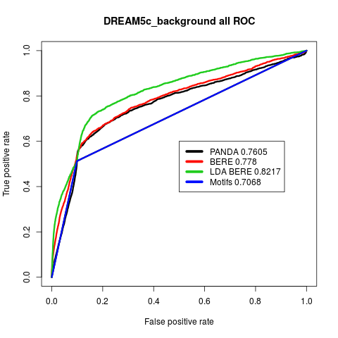
BERE

Slide 12
Gene expression Sequence Motifs
Observed Partition
COPD vs SMC
Random Partitions
Null x 100
BERE
}
Observed
COPD
Network
Observed
SMC
Network
Null
NetworkA
Null
NetworkB
X 1000
Transition Matrix
}
X 1000
Transition Matrix analysis

Slide 13
Transition Matrix Approach
We can view the problem as a dimension reduction problem.
Few TFs
Many Genes

Slide 14
Transition Matrix Approach
Consider two adjacency matrices...
TFs
TFs
Genes
Genes

Slide 15
Transition Matrix Approach
Consider two adjacency matrices...
Smoker Control
Tau
COPD
X
~

Slide 16
The Transition Matrix (Tau)
Calculated via penalized regression.
  Penalty model matrix is a diagonal matrix with value 0 for it's own TF and 1 for all others.
Each column in the TM can be thought of as being the best linear combination of columns in the control AM that “create” the columns in the COPD.

Slide 17
An Example
?
A
B
C
D
1
2
3
4
5
6
7
8
A
B
C
D
A
TM =
B
C
D

Slide 18
Biological Mechanism?
Suggested mechanism #1:
Differential methylation of the gene for TF C?
-CH₃
A
B
C
D
1
2
3
4
5
6
7
8

Slide 19
Biological Mechanism?
Suggested mechanism #2:
Protein complex of B-C-? with unknown 3rd protein?
?
A
B
C
D
1
2
3
4
5
6
7
8

Slide 20
Gene expression Sequence Motifs
Observed Partition
COPD vs SMC
Random Partitions
Null x 100
BERE
}
Observed
COPD
Network
Observed
SMC
Network
Null
NetworkA
Null
NetworkB
X 1000
Transition Matrix
}
X 1000
Transition Matrix analysis

Slide 21
COPD vs SMC

Slide 22
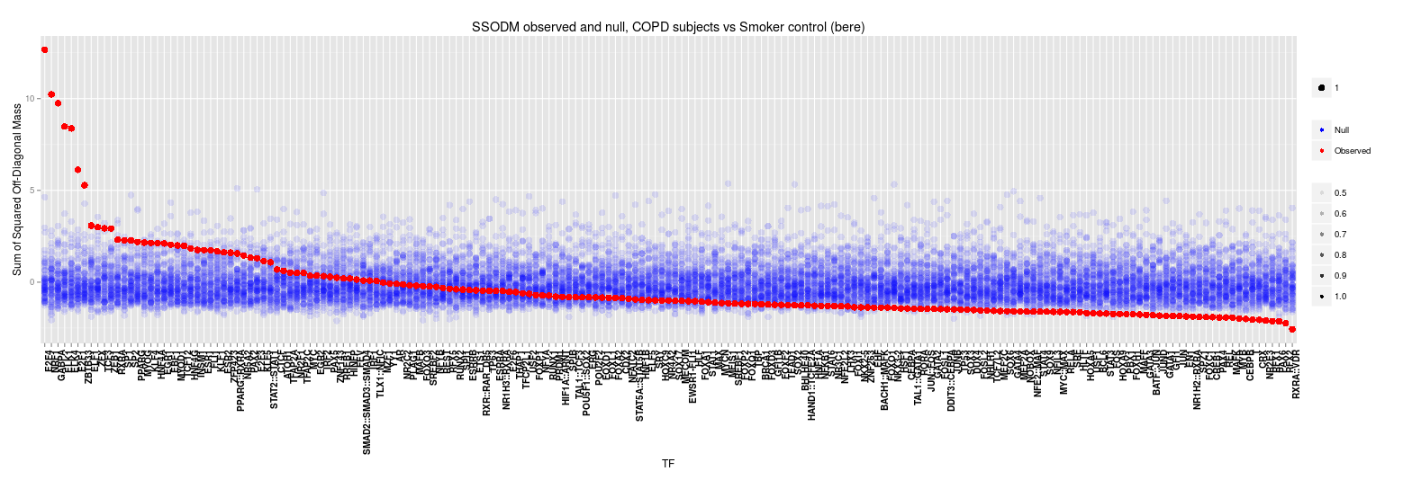
COPD vs SMC

Slide 23
COPD vs SMC (top 20 TFs)
 | ssodm | t.values | p.values | FDR | Sig (LIMMA) | Notes
E2F4 | 0.0083 | 12.666 | 0.0000 | 0.0000 | 0.337 | Binds EGR-1, SMAD3. Tumor suppression.
NRF1 | 0.0063 | 10.232 | 0.0000 | 0.0000 | 0.215 | acts on nuclear genes encoding respiratory subunits and components of the mitochondrial transcription and replication machinery.
GABPA | 0.0054 | 9.747 | 0.0000 | 0.0000 | 0.816 | Related to NRF1, involved in activation of cytochrome oxidase expression and nuclear control of mitochondrial function
ELK1 | 0.0051 | 8.480 | 0.0000 | 0.0000 | 0.080
ELK4 | 0.0052 | 8.379 | 0.0000 | 0.0000 | 0.000 | Binds promoter of the c-fos proto-oncogene
E2F1 | 0.0046 | 6.126 | 0.0000 | 0.0000 | 0.714 | E2F family...
ZBTB33 | 0.0037 | 5.281 | 0.0000 | 0.0000 | 0.602 | shown to interact with HDAC3, Nuclear receptor co-repressor 1
ELF1 | 0.0025 | 3.083 | 0.0010 | 0.0242 | 0.301 | primarily expressed in lymphoid cells
ZFX | 0.0040 | 2.998 | 0.0014 | 0.0285 | 0.987
TCF3 | 0.0023 | 2.937 | 0.0017 | 0.0313 | 0.001 | plays a critical role in lymphopoiesis
ZEB1 | 0.0023 | 2.923 | 0.0017 | 0.0298 | 0.785
RXRA | 0.0023 | 2.316 | 0.0103 | 0.1618 | 0.216
SP1 | 0.0058 | 2.285 | 0.0111 | 0.1621 | 0.385
SP2 | 0.0074 | 2.275 | 0.0115 | 0.1546 | 0.242
PPARG | 0.0026 | 2.193 | 0.0142 | 0.1784 | 0.866
MYOG | 0.0021 | 2.156 | 0.0156 | 0.1837 | 0.416
KLF4 | 0.0046 | 2.137 | 0.0163 | 0.1814 | 0.154
HNF4A | 0.0022 | 2.121 | 0.0170 | 0.1782 | 0.927
EGR1 | 0.0054 | 2.109 | 0.0175 | 0.1740 | 0.497 | Binds E2F4
EBF1 | 0.0024 | 2.042 | 0.0206 | 0.1945 | 0.000 | essential for the maintenance of B cell identity and prevention of alternative fates in committed cells

