Slide 1
Controlling Type I error in rare allele GWAS
Dan Schlauch

Slide 2
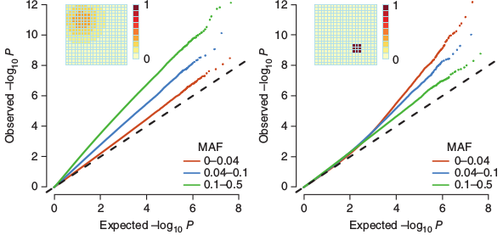
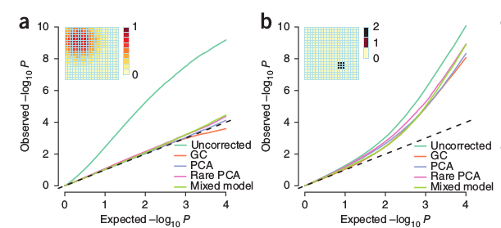
The Problem
Mathieson 2012

Slide 3
The Problem
Summary:
Associations for rare alleles (<4% MAF) are inflated for non-genetic phenotypes if phenotypic risk is sharply distributed spatially even after controlling for population stratification.
P(reject H0|H0) > alpha

Slide 4
There are at least 3 issues
1.) Common stratification correction methods use linear functions to define risk and do not distinguish a tree-like ancestry particularly well.
2.) Finite sample sizes yield overdispersion of ATT statistic.
3.) Differential genotype/phenotype variances lead to scaling of null test statistic distribution

Slide 5
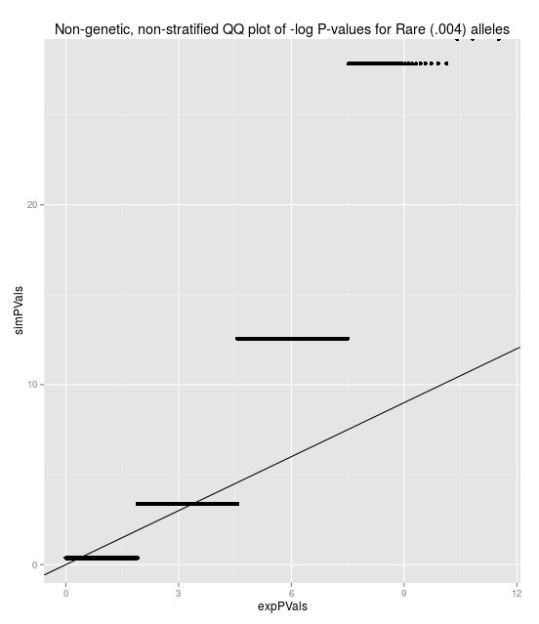
The issue is not just stratification!
Distribution of non-genetic, non-stratified armitage trend test is not chi-sq(1) for rare alleles.
E(ATT)=1
Var(ATT)!=2
For example, with no population stratification:
MAF=.004, PhenoFreq=.01
mean(ATT)=.997
Var(ATT)=3.1
This is a finite sample size issue.

Slide 6
But it's also stratification
However, correcting for stratification (even perfect correction) is insufficient to stop inflation.
Example:
After a perfect correction for stratification, for a genotype and phenotype that appear in only one subpopulation, for a non-genetic risk, ATT~n/n1*chi-sq(1)

Slide 7
Issue 1: Identifying stratification
Approach:
Find a superior method for more precise subpopulation identification - Use rare alleles only
- Use Jaccard similarity instead of Variance-Covariance matrix
(Choose top eigenvectors based on eigendecomp)
Scale by a loci-specific variance inflation factor
Apply to most recent 1000GP data (much improved quality)

Slide 8
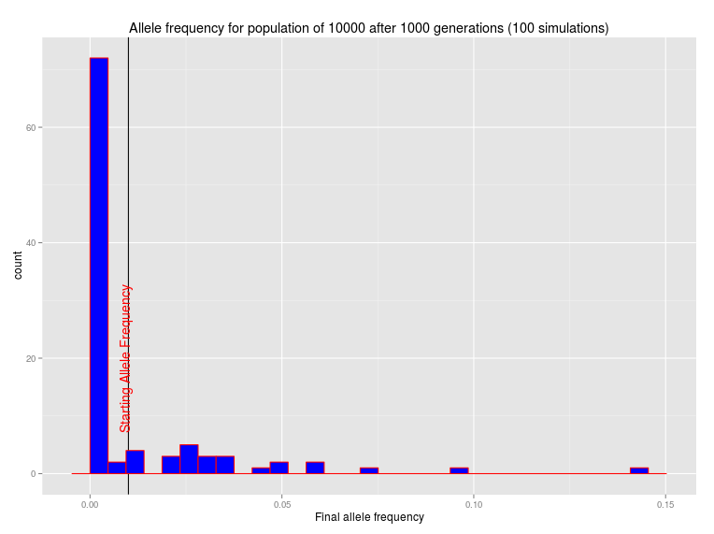
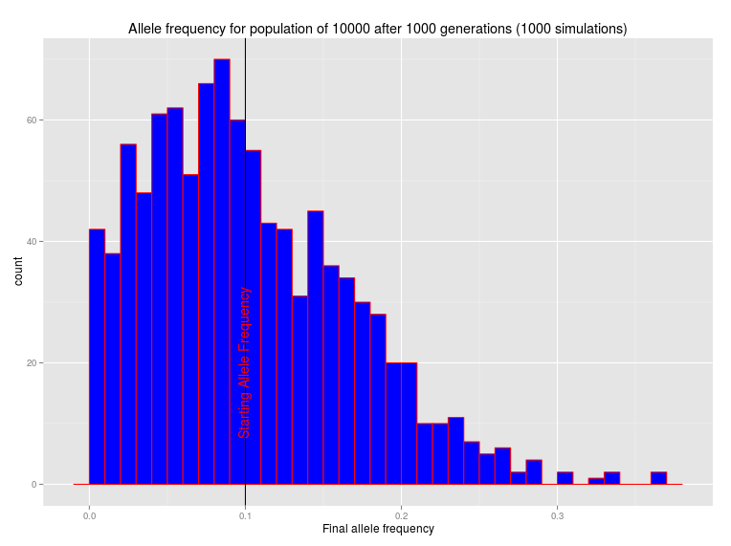

Slide 9
Using rare alleles only to inform genetic similarity

Slide 10
Inflation issues
Distribution of non-genetic, non-stratified armitage trend test is not chi-sq(1) for rare alleles.
E(ATT)=1
Var(ATT)!=2
For example, with no population stratification:
MAF=.004, PhenoFreq=.01
mean(ATT)=.997
Var(ATT)=3.1

Slide 11
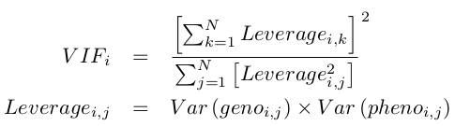
Individual SNP variance inflation
So we have a variance inflation factor of 1/n1 for that particular SNP.
Generalizing this we have
Where the leverage is the product of variance of genotype(i,j) and the variance of phenotype(i,j).
The variances are found by p(1-p) where p is the fitted value from the population correction.

Slide 12
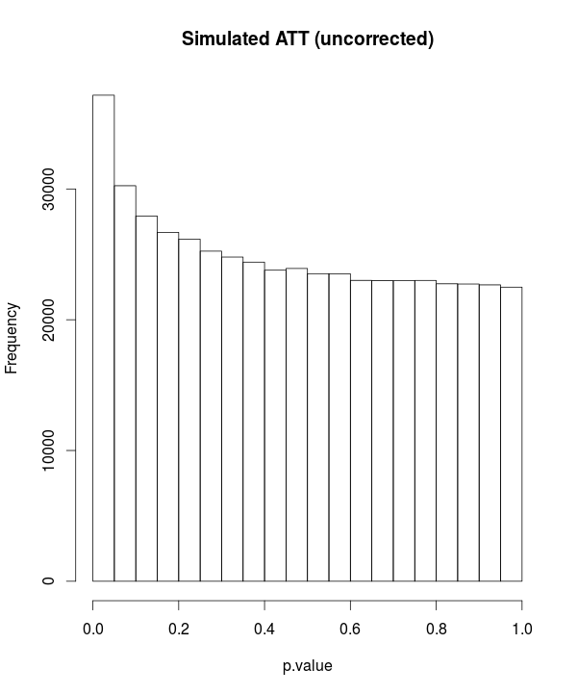
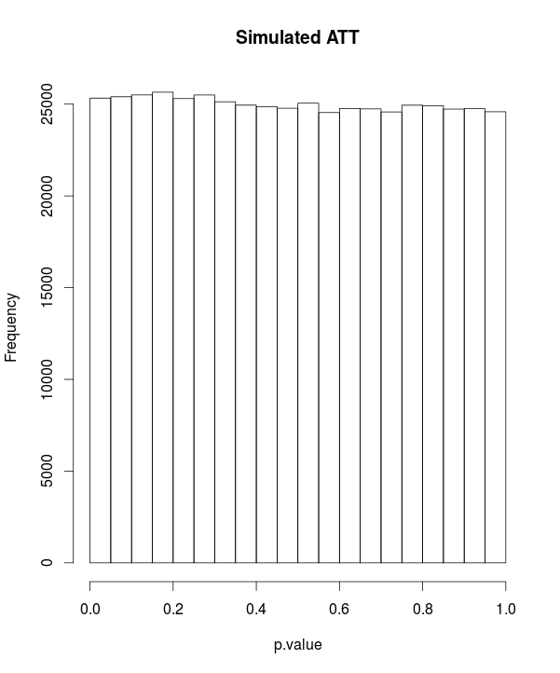
Correcting variance scaling
z <- (1:100)/200
zvar <- z*(1-z)
sumviSq <- sum(zvar)^2
sumSqvi <- sum(zvar^2)
vFactor <- 1/(sumSqvi/sumviSq)
hist(replicate(500000, {
x <- rbinom(100,1,prob=z)-z
y <- rbinom(100,1,prob=z)-z
1-pchisq(vFactor*cor(x,y)^2, 1)
vFactor*cor(x,y)^2
}))

Slide 13
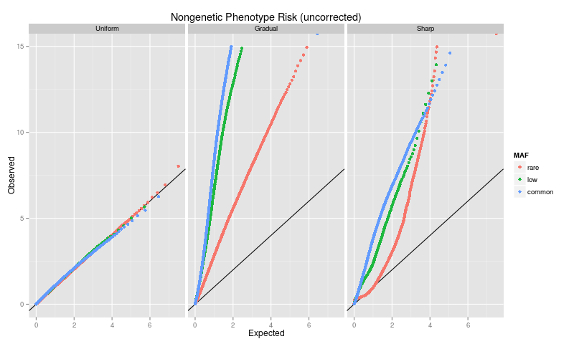
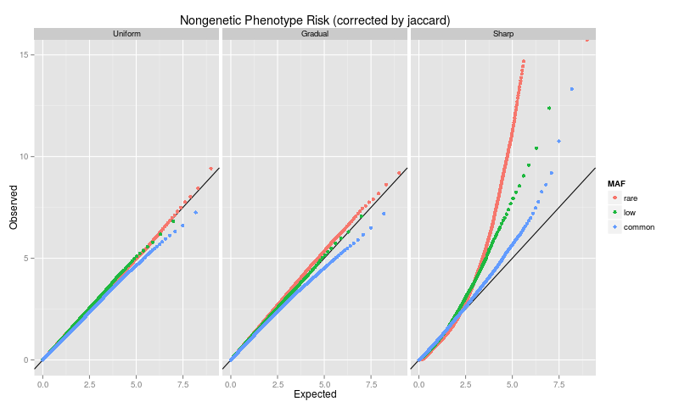
Variance inflation for associations of sharply defined, spatially separated phenotypes with rare, spatially separated alleles
1000GP

Slide 14
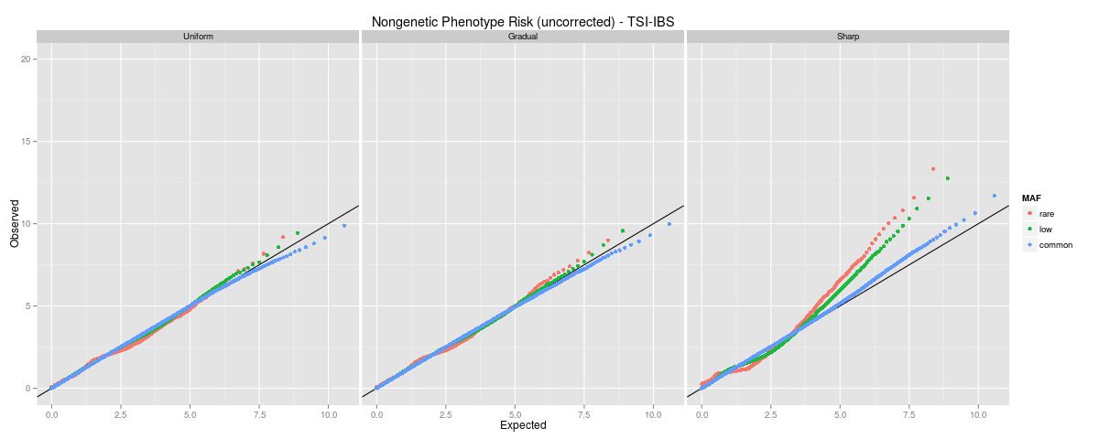
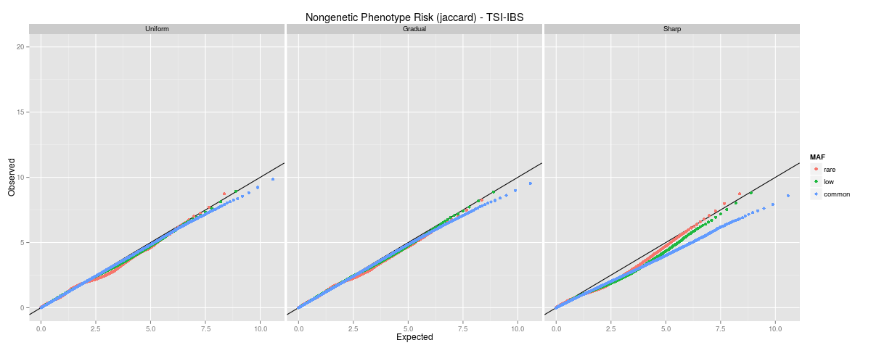
Variance inflation for associations of sharply defined, spatially separated phenotypes with rare, spatially separated alleles
1000GP

Slide 15
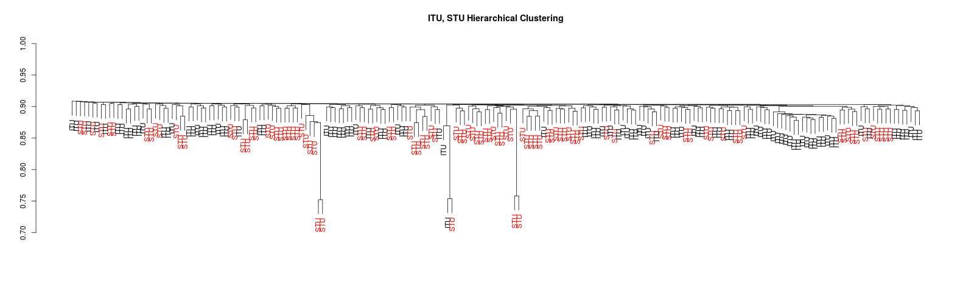
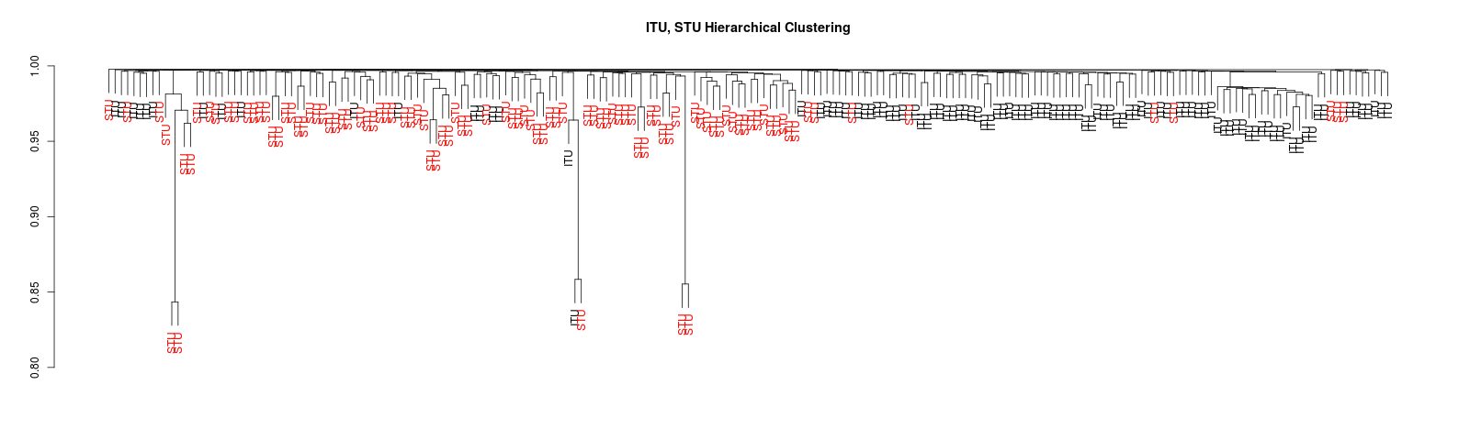
Variance inflation for associations of sharply defined, spatially separated phenotypes with rare, spatially separated alleles
Common (~10% MAF) alleles Hierachical Clusting via Jaccard similarity
Rare (<1% MAF) alleles Hierachical Clusting via Jaccard similarity

