Slide 1
Meeting 11/16/15

Slide 2
GTEx data – Transition analysis
Interesting results summary:
Highly significant results... many differentially involved TFs characterize transition from cell line to tissue.
Low concordance between tissue types... the TFs defining cell line to tissue transition for skin compared to blood have little agreement.
Magnitude of results is similar in Tissue compared to cell line in cross type transition. However, results are far more significant in cell line than tissue.

Slide 3
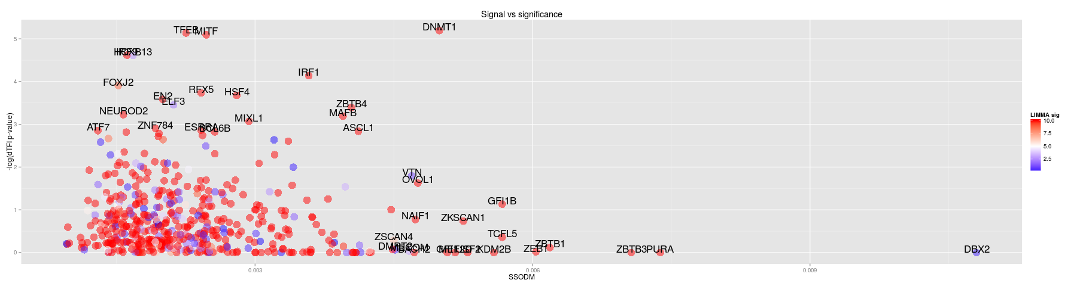
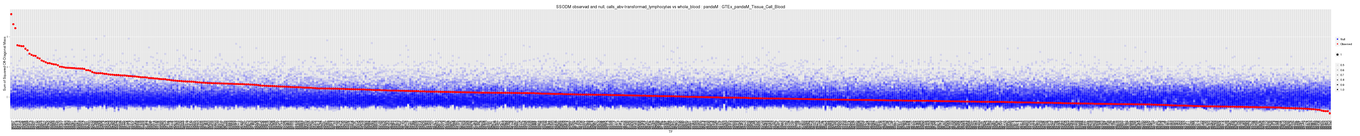
Blood: Tissue → Cell line

Slide 4
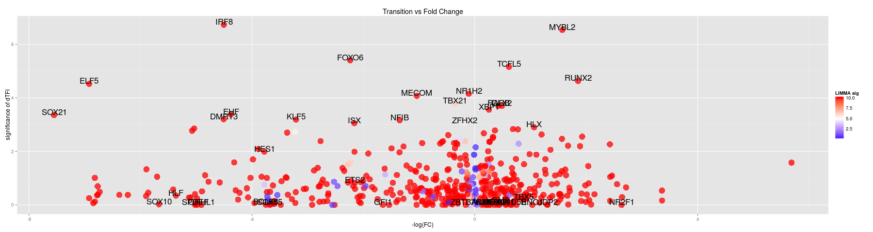
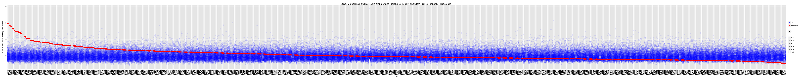
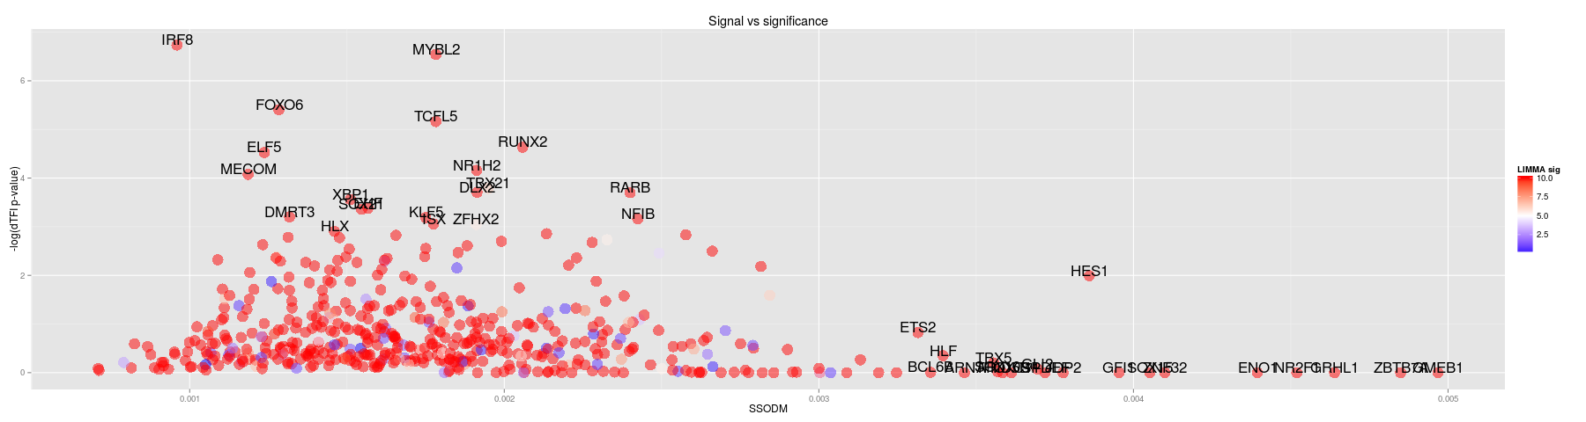
Skin: Tissue → Cell line

Slide 5
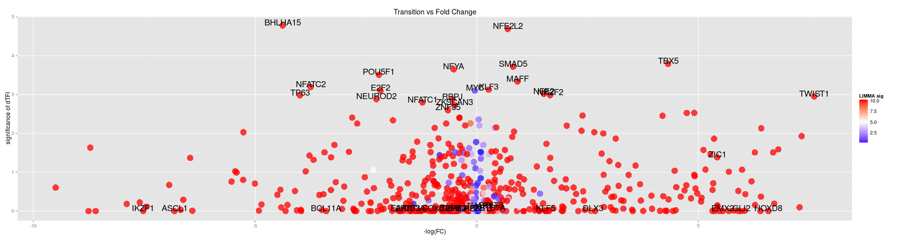
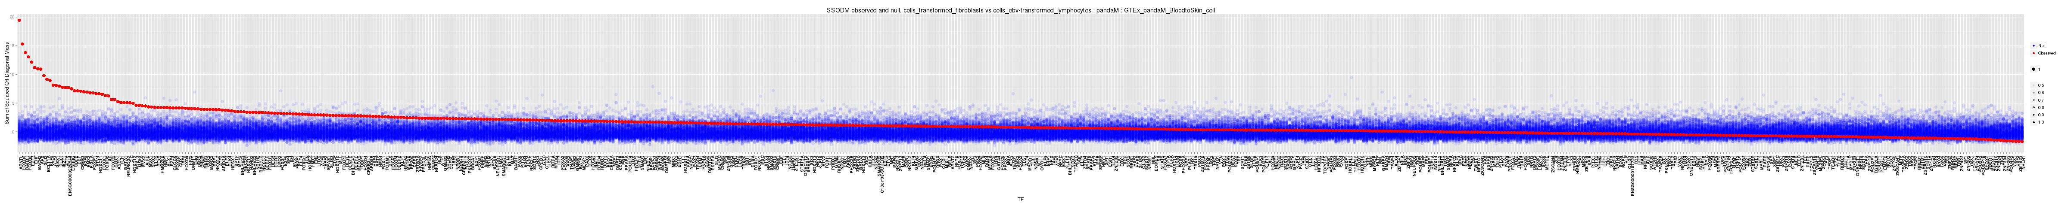
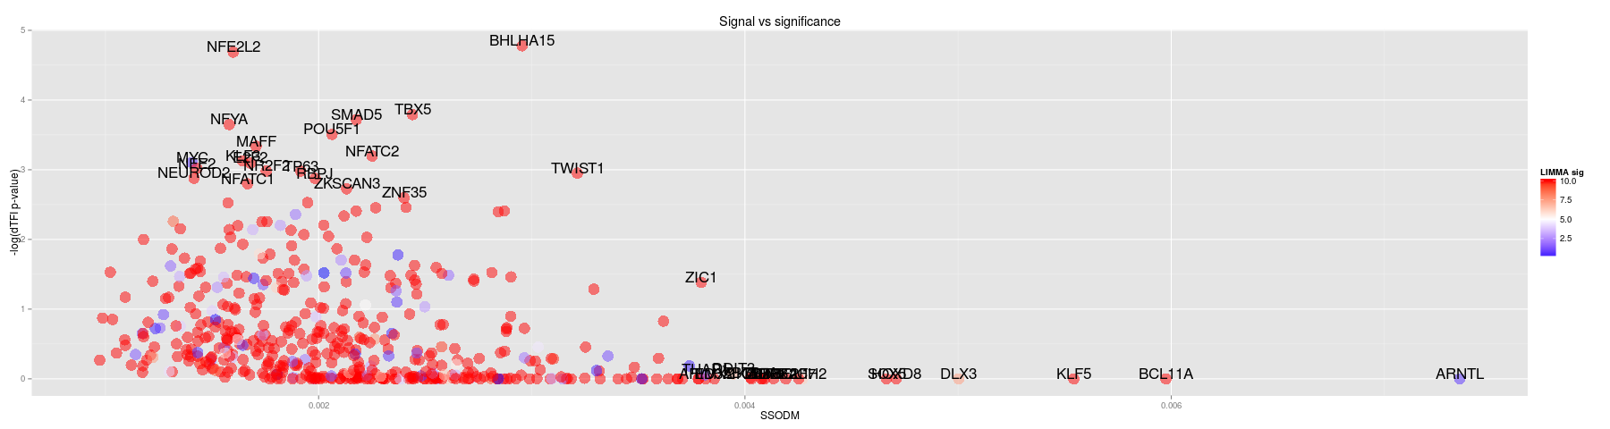
Cell line: Blood → Skin

Slide 6
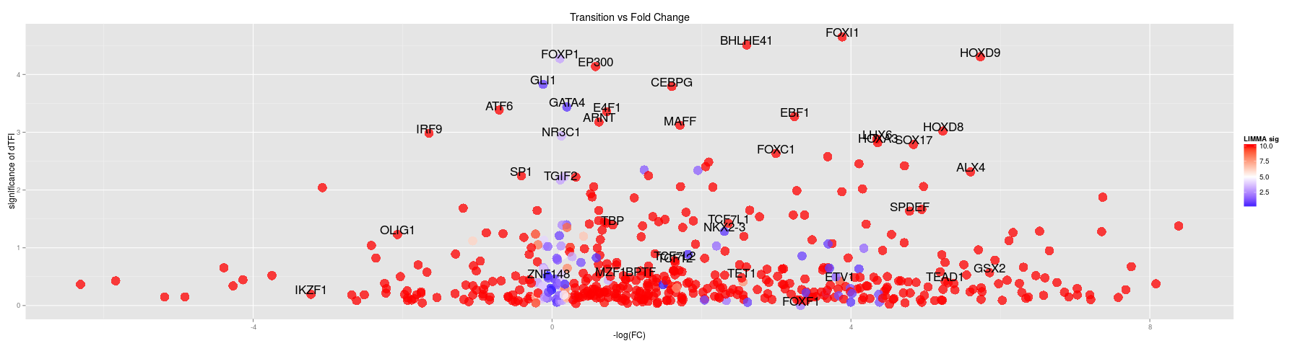
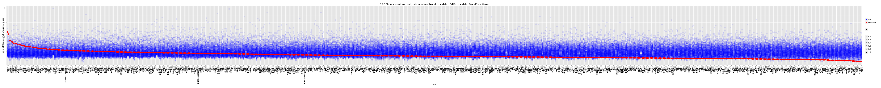
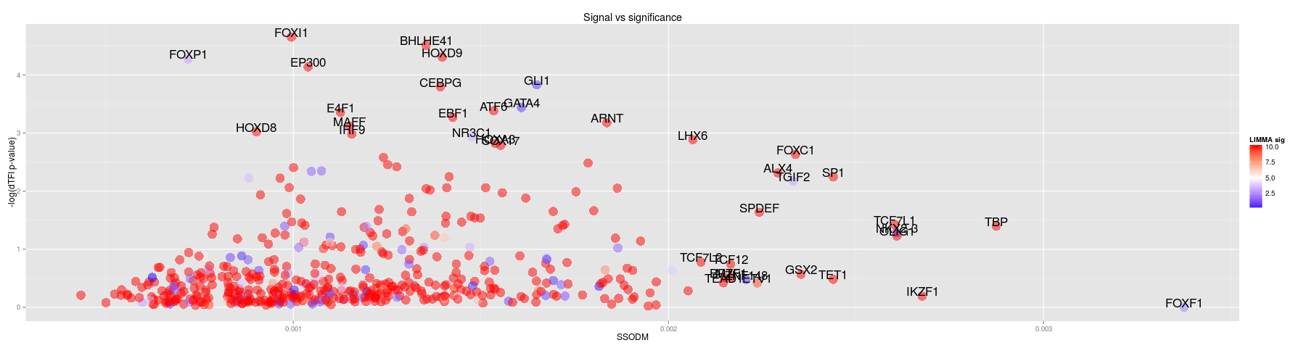
Tissue: Blood → Skin

Slide 7
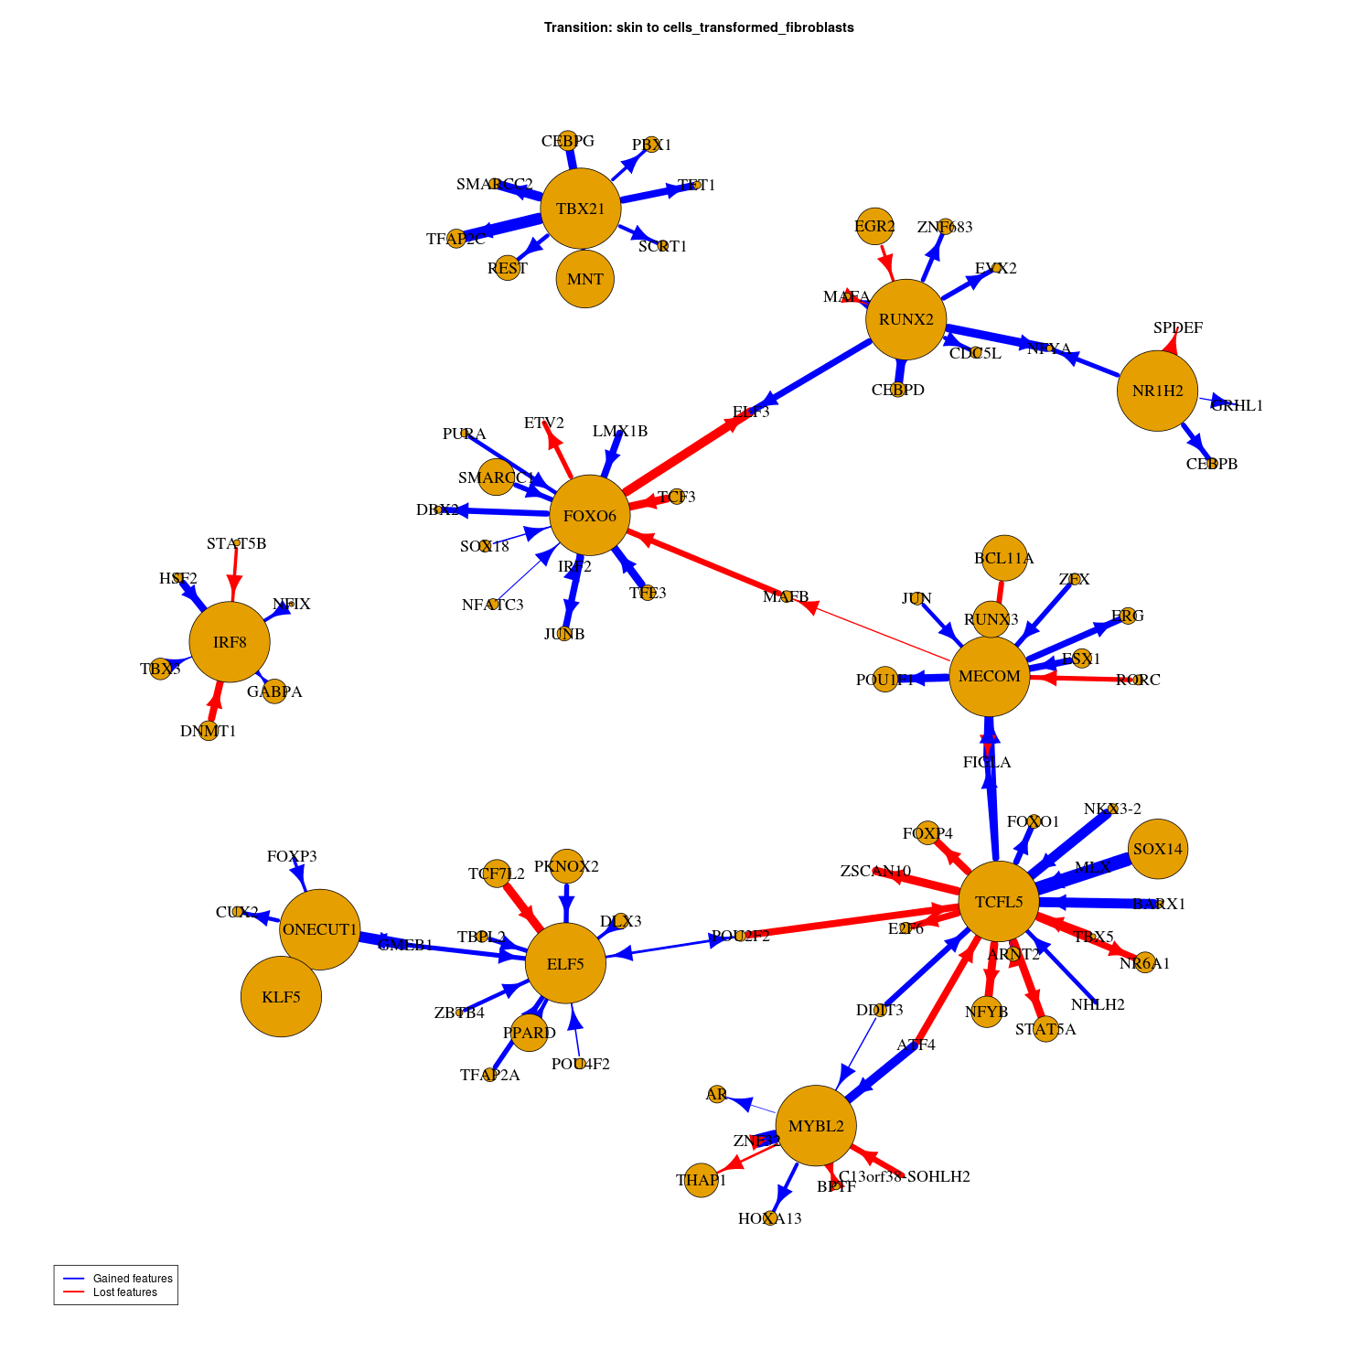
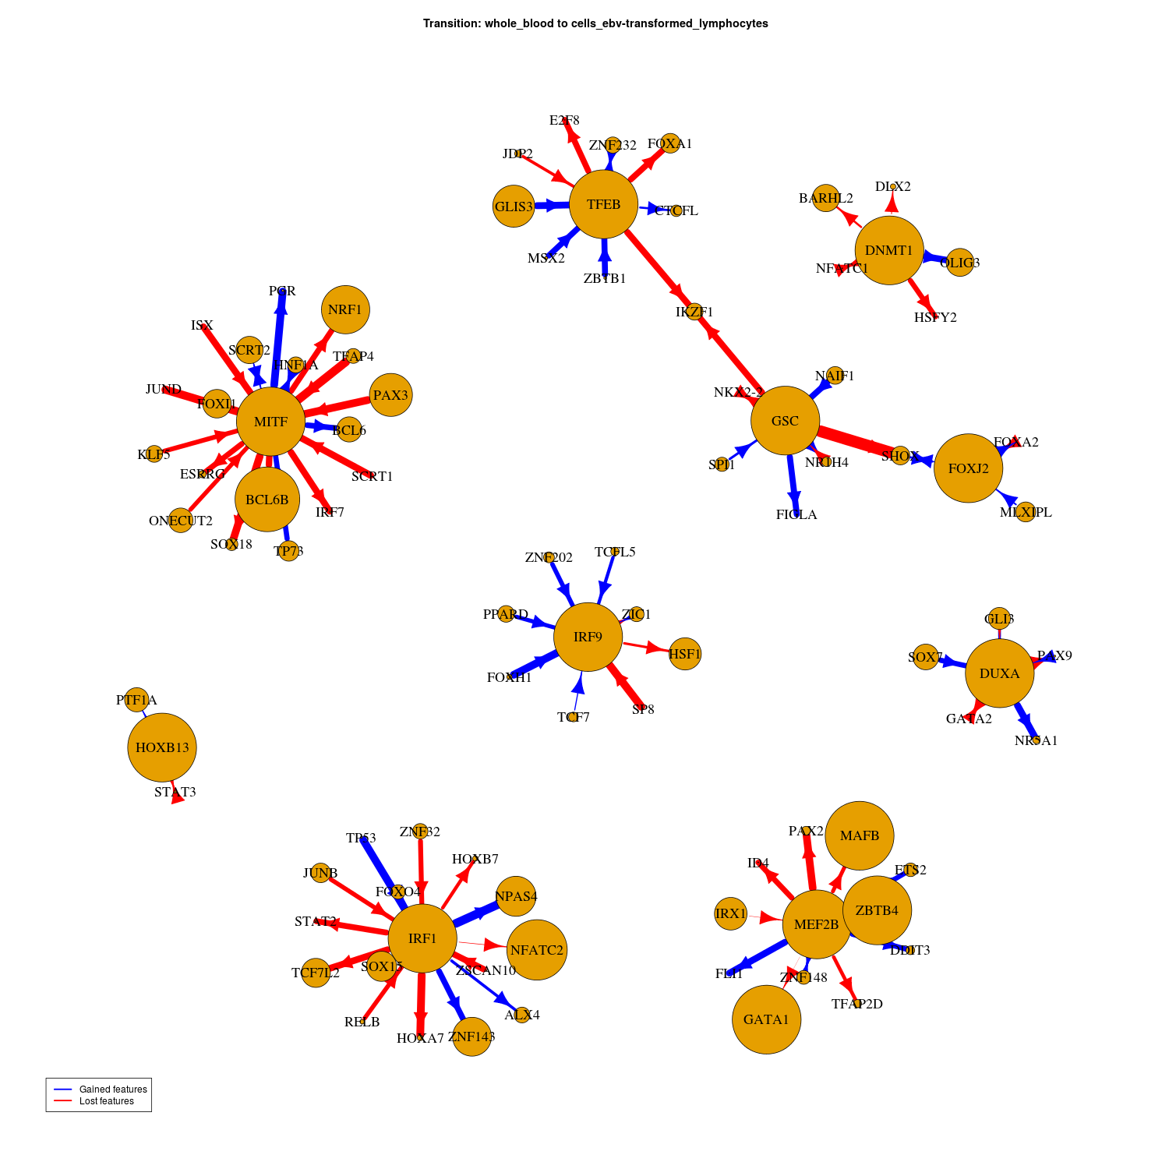
Comparing tissue to cell line in transitions of Blood/Skin
Skin: Tissue->Cell
Blood: Tissue->Cell

Slide 8
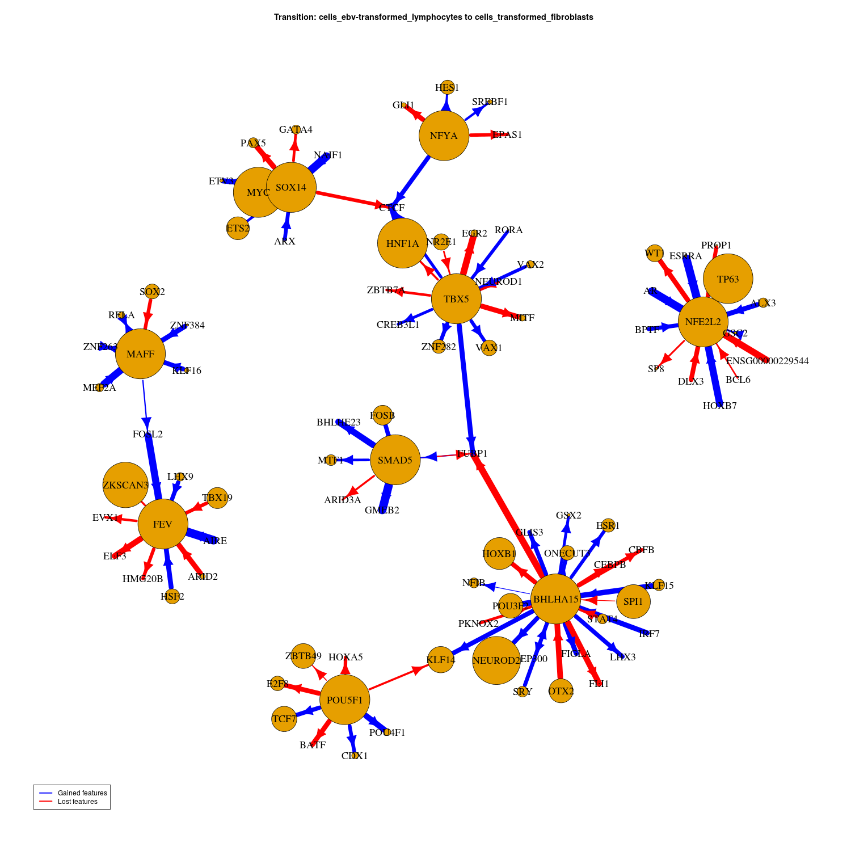
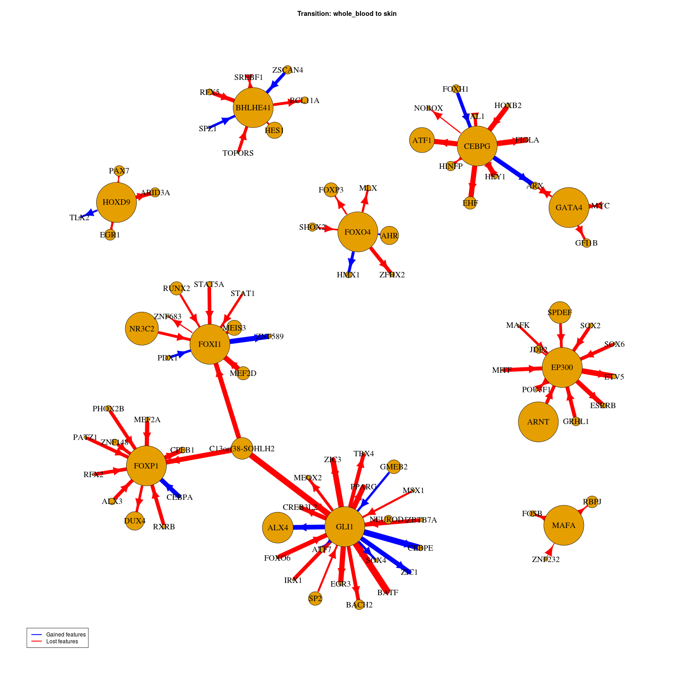
Comparing tissue to cell line in transitions of Blood/Skin
Cell: Blood->Skin
Tissue: Blood->Skin

Slide 9
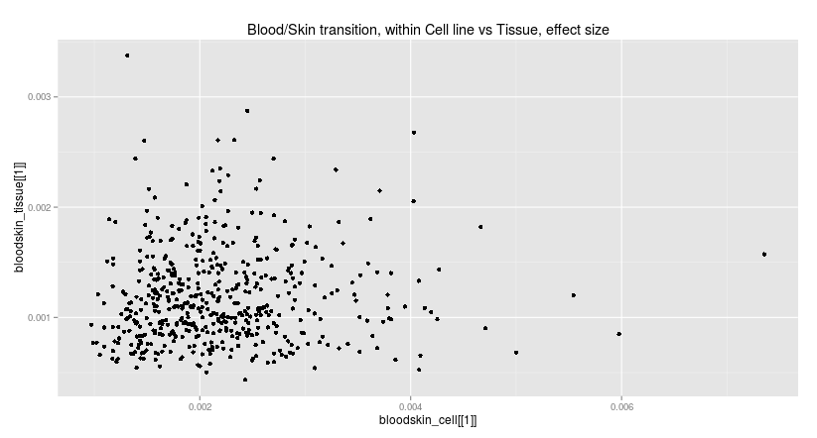
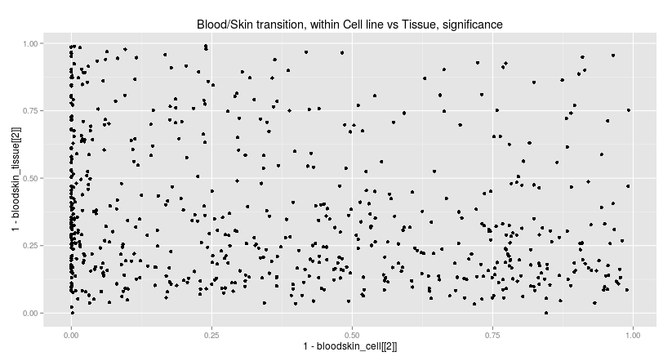
More results for cell line or tissue?

Slide 10
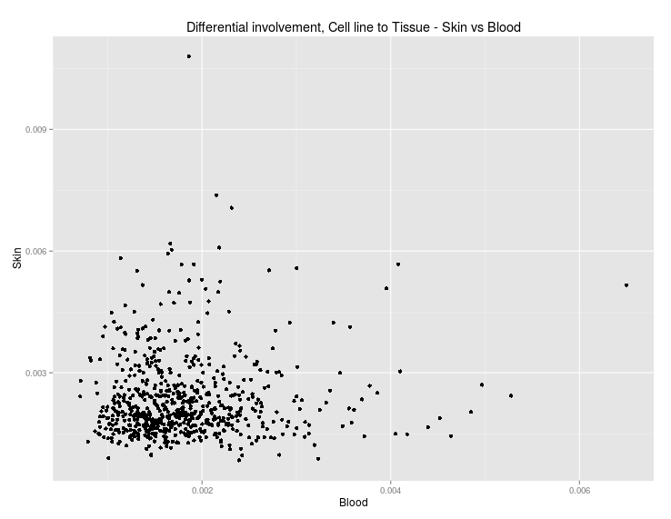

Slide 11
To do: Validation of predictions
These interactions suggest a post-translational interaction when not differentially expressed.
TFs which are differentially expressed are not particularly interesting in this analysis.
Validate with PPI or methylation data.
A PPI could be causing target acquisition, we expect edges to be a significant prediction of PPI (but effect size may be weak)
Targetting loss should be associated with methylation...

