Slide 1

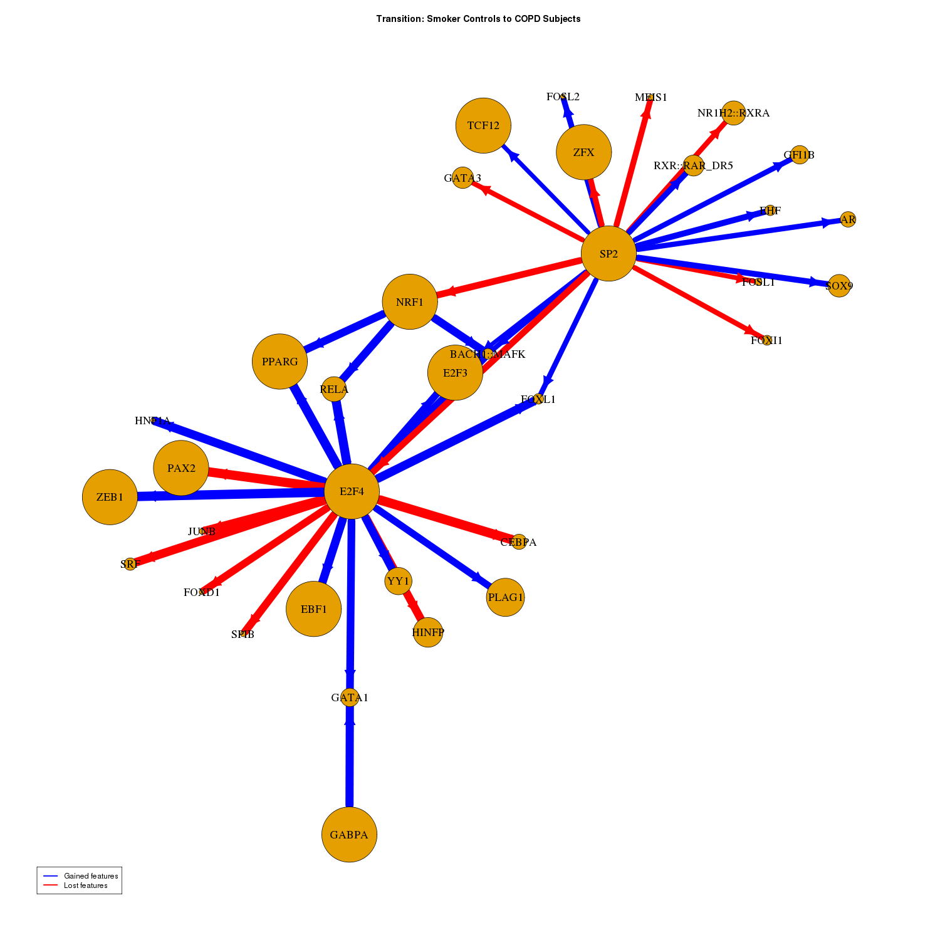

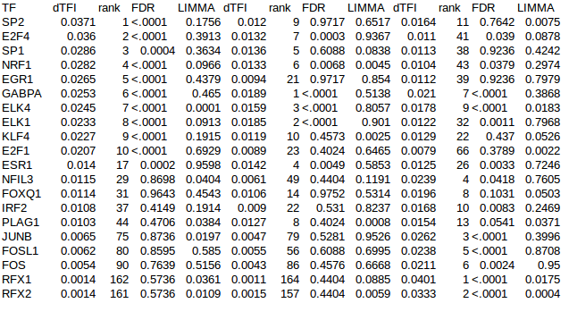
Gene expression Sequence Motifs
Observed Partition
Cases vs Controls
Random Partitions
Null x 1000
BERE
}
Observed
COPD
Network
Observed
SMC
Network
Null
NetworkA
Null
NetworkB
x N
Transition Matrix
}
x N
Transition Matrix analysis

