Slide 1
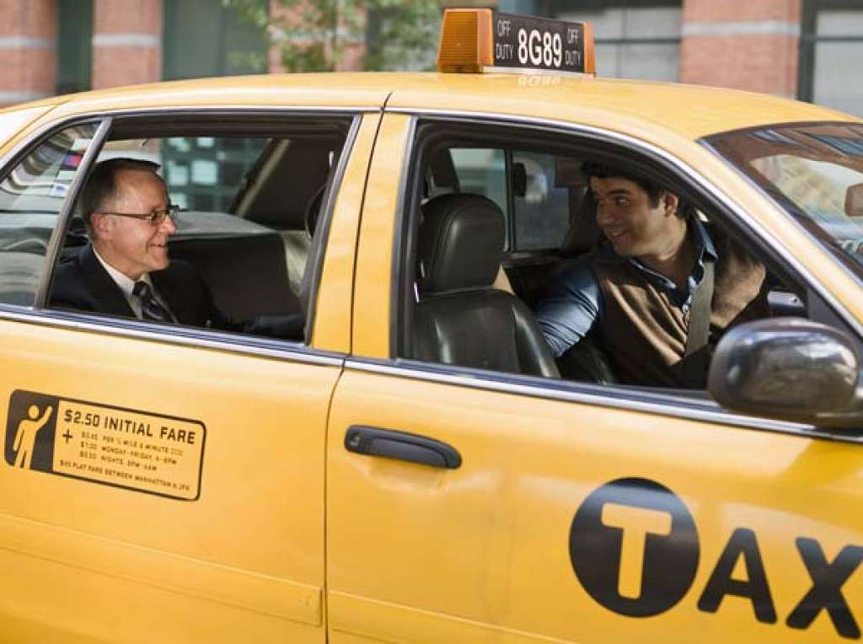
Introduction
Problem Statement:
For Yellow Cab Drivers, tips comprise most of a cab driver’s income
Drivers generally only keep a third of the base fare, so maximizing tips is top of mind
While average tip-rates are fairly consistent across time, location, & ride-variables, avoiding riders who tip 0% is a crucial concern of cab drivers.
Essential Question:
What factors increase the odds of receiving zero-tip (i.e., what should cab drivers avoid)?

Slide 2
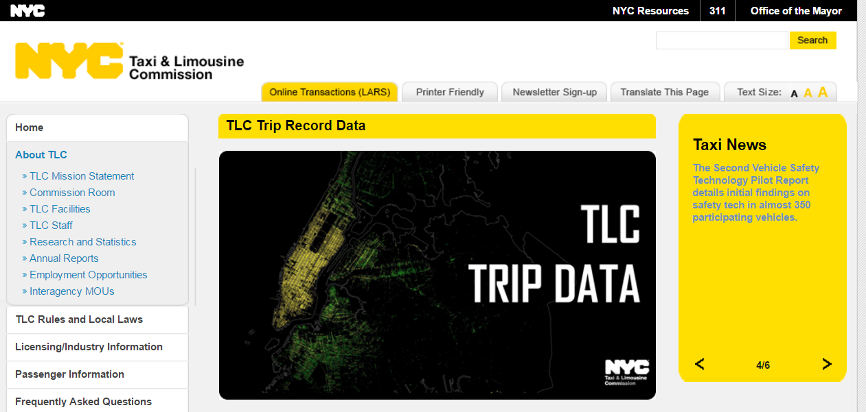
Data Source
New York City Yellow Cab Data
Publicly available
Trip-level data
Data dictionary included
~11M to 14M transactions (trips) recorded per month
Low proportion of missing values
Data Limitations:
No medallion-level data (can’t look at drivers across multiple trips; every trip is in isolation)
Tips not recorded for cash transactions (analysis limited to credit-cards only)
Potential source of bias, although existing literature did not find this to be a problem
Need to take representative, random sample from each month in order to compute with basic hardware
Nonsensical observations (e.g., fares over $600) were dropped

Slide 3
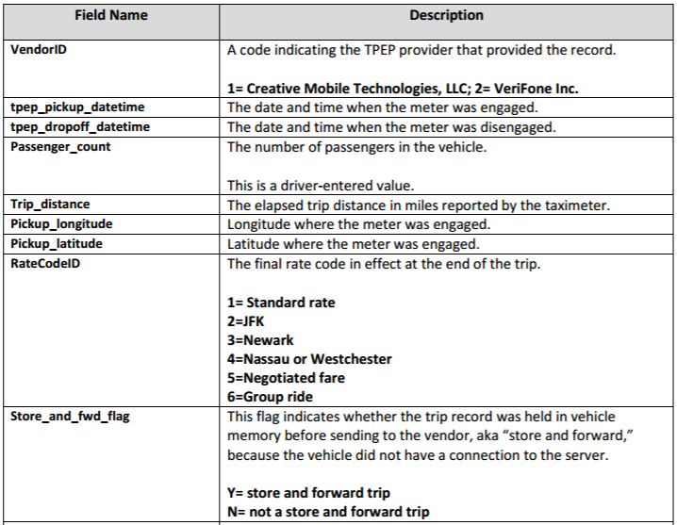
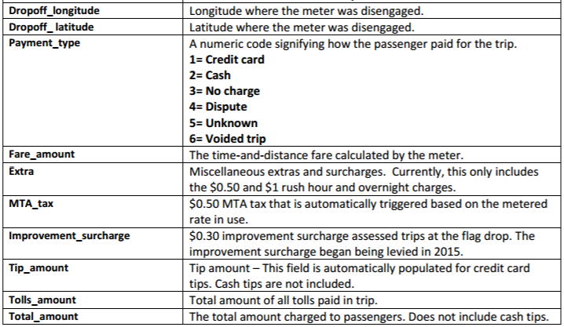
Data Dictionary

Slide 4
Prior Literature
NYC Tax Tip Predictor (Jose Mazo)
https://github.com/josemazo/nyc-taxi-tip-predictor
Essentially uses all the main predictors available, and uses a Random Forest model to predict with 70% accuracy whether a tip is Greater than 20%
Not necessarily a powerful model, as roughly 70% of tips are below 20% already.
Bloomberg 2014 – “Here’s How Much You Should Be Tipping Your Cab Driver”
http://www.bloomberg.com/news/articles/2014-07-31/heres-how-much-you-should-be-tipping-your-cab-driver
Verifies that time-related variables are relevant for tip-rates
Really just exploratory analysis rather than a model
Predicting Taxi Tip-Rates in NYC – Jain, See, Shandilya
https://cseweb.ucsd.edu/~jmcauley/cse190/reports/sp15/050.pdf
Models tip-rate as a continuous variable using linear regression, with limited success
Places lat-long information into “bins”, but the geographical data did not improve the model

Slide 5
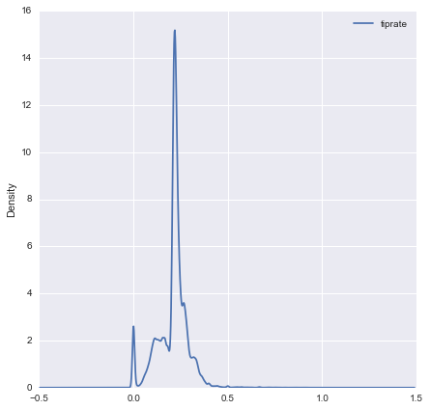
Variables
Predictors
Month
Weekday
Hour
Passenger Count
Pickup Location (Lat / Long)
Pickup Location (Lat / Long)
Passenger Count
Trip Classifier (e.g. "Newark Airport")
Trip Distance
POS Provider
Fare Amount
"Extra" Fare
Improvement Surcharge
MTA Tax
Outcome Variable
Option 1: Zero-tip
Option 2: Tip-rate (continuous)
Tip-rate Distribution, YTD
Most tips are exactly 20%
This model is focused on tips of 0%

Slide 6
Selecting a Categorical Model
Logistic Regression
Probabilistic (appropriate, as data doesn’t contain ALL explanatory variables)
Easily interpreted results (thanks to the coefficients)
Decision Tree / Random Forest
Deterministic
Depends on a small number of key variables (we need many categorical variables telling a nuanced story)
K-Nearest Neighbors
Deterministic
Risk of overfitting to “zero-tip” points.
“Nearness” of points does not imply definite zero-tip

Slide 7
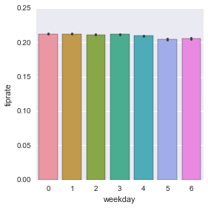
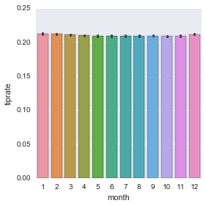
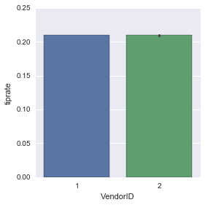
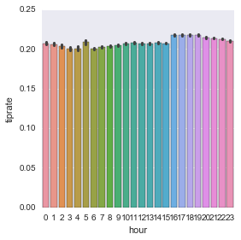
Exploratory Analysis – Tip-rate (Continuous)
In general, variation in average tiprate against important predictors is quite low
Tiprate vs. Weekday
Tiprate vs. Month
Tiprate vs. POS Provider
Tiprate vs. Hour
Variation is statistically significant but very low magnitude
No variation
No variation
Significant variation (more discussion of this later)

Slide 8
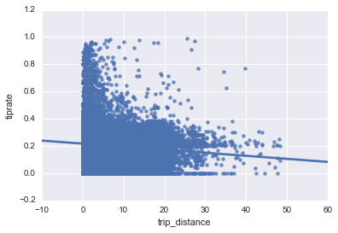
Exploratory Analysis – Tip-rate (Continuous)
Tip Rate vs. Trip Distance
Tiprate is negatively correlated with Trip Distance, likely because it increases the base on which people tip
Tiprates can be high on the low end, when people will “custom tip” fixed values (e.g, $5 tip on $5 fare)
Relationship with Fare Amount is the same

Slide 9
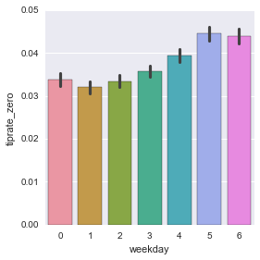
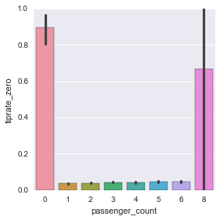
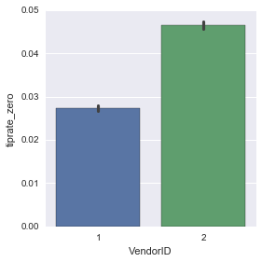
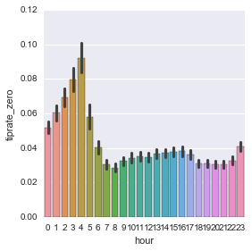
Exploratory Analysis – Zero Tip (Categorical)
Tiprate vs. Weekday
Tiprate vs. Passenger Count
Tiprate vs. POS Provider
Tiprate vs. Hour
Significant & meaningful
More likely to tip 0 on weekends
Hypothesis: alcohol-related
No meaningful variation
Low sample size or nonsense data
Significant & meaningful
Almost 2x as likely to tip 0% on VeriFone POS than Creative Mobile Tech LLC
Likely easier to click 0% tip as an option on the system
Significant & meaningful
Much more likely to tip 0 in the wee hours (9% likely at 4AM)
Hypothesis: alcohol

Slide 10
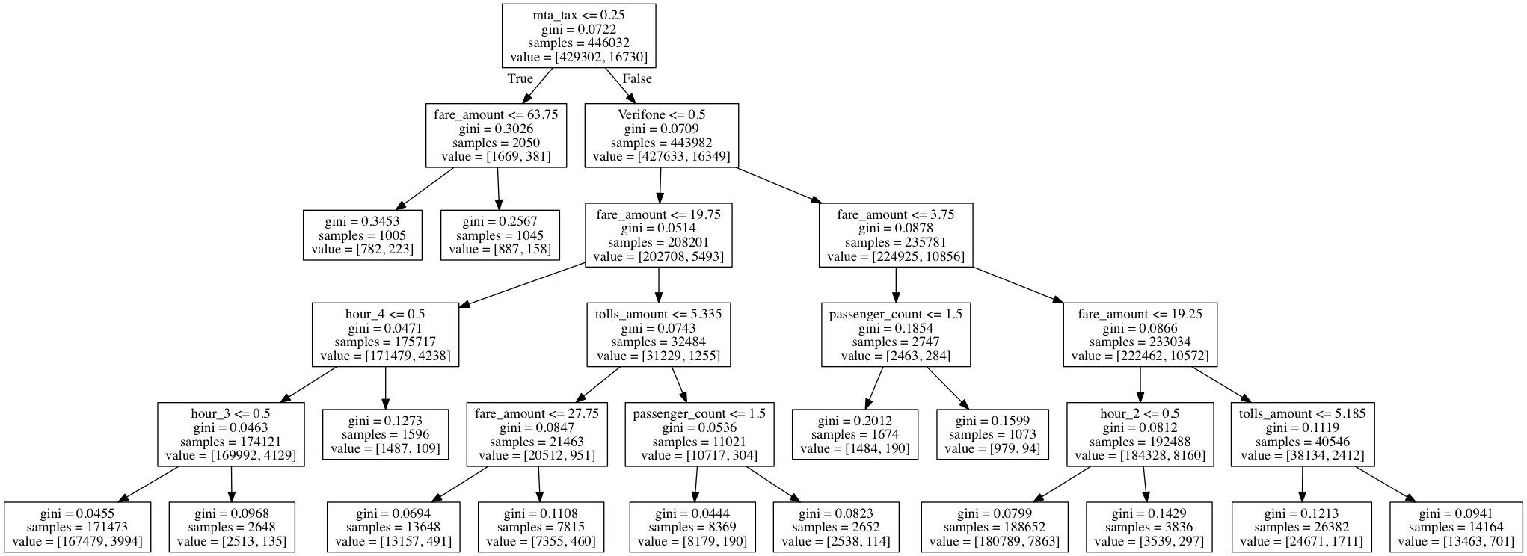
Unused Model - Sample Decision Tree
Can’t incorporate enough time-based variables
Uses cab fare, a principle predictor, unintuitively by repeating at various tree stages with various cutoffs
Doesn’t seem like more leafs (higher complexity) would offer better
Random Forest with 20 trees yielded an AUC of only .54

Slide 11
Logistic Regression Model: Detail
Logistic Regression Model (via Scikit Learn)
AUC-maximizing, for both precision and recall
Cross-Validation, 10-fold
Grid Search optimized, with regularization, class weight, and intercept
AUC Improvement
Class Weighting
Because the most important samples are ones where tip-rate = 0, the most important rows only comprise ~3% of the entire data-set.
Setting “class_weight” to “balanced” runs the model with duplicated rows of “zero-tip”, to give more weight to those rows
.58 AUC Basic Model
Regularization
Given the quantity of predictors (20) and the low frequency of zero-tip, regularization is important to avoid over fitting to outliers
Optimizing for “C” penalizes outliers and high coefficients
.62 AUC
10-Fold CV
Class Weighting
Regularization
Intercept
Intercept
Provides baseline odds for zero-tip. Appropriate because the known variables can’t capture everything about the odds – there is a starting probability based on behavioral factors

Slide 12
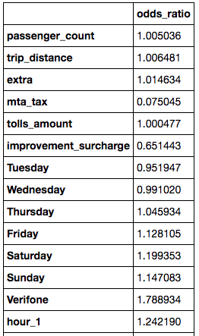
Logistic Regression Model: Results
An additional mile of travel OR an additional passenger BARELY increases the odds that someone will tip zero
No idea why additional fees would drop the odds of tipping 0 so much, but it’s not too relevant. This is exactly $.50, 99.9% of the time
In reality – not this extreme. This is for a dollar increase in Improvement Surcharge, but it’s really either 0 or $.30
The odds of zero-tip are 1.2x higher on Saturday (vs. Monday)
A Verifone POS system increases the odds by 1.8x vs. Creative Technologies LLC
Arguably the most important finding

Slide 13
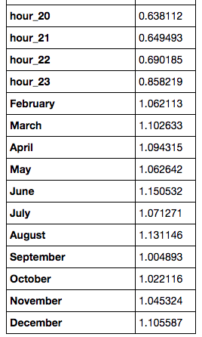
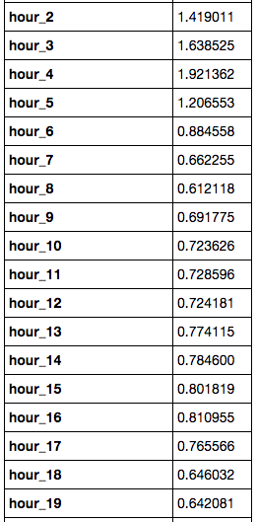
Logistic Regression Model: Results – more time-based metrics
The odds of zero-tip increase in the wee hours, up to 2x odds at 4AM (compared to midnight)
Odds of zero-tip were highest in June (1.15x odds compared to January)
In the morning and afternoon, odds of zero-tip are lowest, with a small increase around 3 and 4pm

Slide 14
Recommendation to Cab drivers
TO AVOID A ZERO DOLLAR TIP:
Avoid driving in a cab with a Verifone POS system
Avoid driving from 12AM-5AM (especially 4AM)
Avoid driving in July or August
Don’t worry about how many passengers you have
Don’t worry about how far the trip is

Slide 15
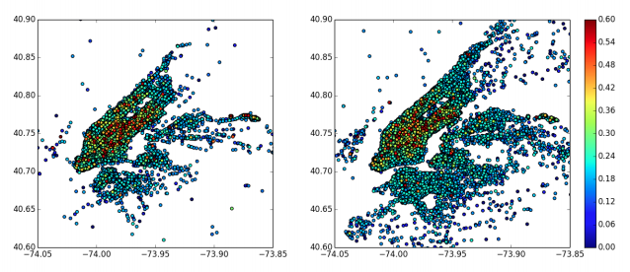
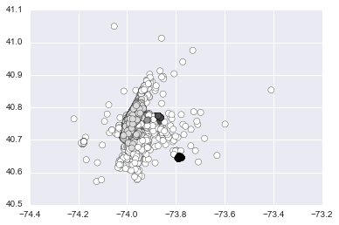
Potential Improvements – Geo Data
Tiprate by Lat/Long: Pickup & Dropoff¹
(Attempted) Clustering by DBSCAN (~.01% of original data)
While the lat-long data evidently has an impact on tip-rate, it is difficult to meaningfully aggregate into bins that are meaningful predictors of either the tip-rate, or zero tip-rate
DBSCAN could not yield meaningful clusters, because the epsilon is incredibly sensitive
Mapping lat-longs to zip codes, and zip codes to neighborhoods would likely provide a meaningful distribution
Question: Is there a way to cluster according to an outcome variable? I.e., can you cluster locations using tip-rate to inform your decisions?
Source: See, Jain, Shandilya

Slide 16
Other Improvements (besides incorporating Geo data)
In a future model, more nuanced predictors and scoring could improve the efficacy
Calculate a “speed” variable – what was the driver’s average MPH?
Need to be cognizant of bias from longer trips on highways here
Experiment with using log(distance) or log(fare_amount) as predictors
Exploratory analysis showed it may fit continuous data better – unclear whether it would improve the zero-tip model
Maximize the model on recall, not AUC
Drivers likely care more about recall than precision – there are so many trip opportunities available, that conservatively rides that might be zero-tip, is more important than precisely predicting which ones will actually be right
Question: does this involve setting a probability threshold in Grid Search? AUC doesn’t require a threshold
Normalize variables before modeling
This makes their coefficients more comparable

