Slide 1
UDACITY · SCHOOL OF ARTIFICIAL INTELLIGENCE
Agentic AI Nanodegree
From advanced prompting to multi-agent systems — what the program teaches, what you build, and what it takes.
Team briefing · September 2026

Slide 2
WHAT IT IS
The program at a glance
Intermediate
53 hours
4 courses
4.8 / 5
Skill level
Reviewed project work
4 portfolio projects
581 learner ratings
Udacity's Agentic AI Nanodegree teaches you to design, build and orchestrate teams of AI agents in Python — agents that reason, plan, use tools, and interact with databases and external APIs. Every project is reviewed by an industry professional, and the curriculum was last refreshed in July 2026.
Agentic AI Nanodegree — Udacity
2

Slide 3
CURRICULUM
From prompts to multi-agent systems
1 · Prompting for Reasoning and Planning
2 · Agentic Workflows
Chain-of-Thought, ReAct, structured prompts and feedback loops that make a model plan rather than answer.
Routing, prompt chaining and parallelization patterns; a reusable agent library for multi-step tasks.
3 · Building Agents
4 · Multi-Agent Systems
Tool use, state and memory. Agents that search, call APIs and retrieve context with RAG.
Shared state, role assignment and orchestration across a coordinated team of agents.
The program teaches agents from raw Python and first principles rather than a single vendor framework.
Agentic AI Nanodegree — Udacity
3

Slide 4
PORTFOLIO
Four projects, reviewed by industry professionals
AgentsVille Trip Planner
AI-Powered Agentic Workflow
Multi-agent travel itinerary — Chain-of-Thought, ReAct, prompt engineering.
Reusable agent library, routing and prompt chaining for project management.
UdaPlay AI Research Agent
Beaver's Choice Sales System
Stateful research agent — RAG, tool use and agent memory.
Coordinated agent sales team — shared state and orchestration.
Each submission is graded with written feedback, so the portfolio is defensible in an interview or an internal review.
Agentic AI Nanodegree — Udacity
4

Slide 5
TIME & PREREQUISITES
What it takes to finish
2–3 months
53 hours
Solid Python
Typical completion time, self-paced. Roughly 10–15 hours per week across the four courses.
Of reviewed project work — Udacity's own estimate for the program content.
Not a beginner program. Expects comfortable Python and some exposure to LLMs and prompting.
Format: short video lessons, coding labs, mentor support, and four projects reviewed by industry professionals. Reviewers consistently rate it as genuinely hands-on rather than theoretical — and explicitly not suitable for people new to Python.
Agentic AI Nanodegree — Udacity
5

Slide 6
PART 2
PROMPTING: REASONING AND PLANNING
Course 1, in code
Every prompting pattern from the lessons, shown as something you can actually build.
Agentic AI Nanodegree — Udacity
6

Slide 7

LESSON 1 · FOUNDATIONS
An agent perceives, decides, acts
Perceive — read the environment
Decide — reason about the next step
Act — call a tool, then observe the result
THE LOOP, IN ONE FUNCTION
while not done:
step = llm(history)
if step.tool == "final_answer":
done = True
else:
result = TOOLS[step.tool](**step.args)
history.append(result)
The model never runs anything. Your code does.
Agentic AI Nanodegree — Udacity
7

Slide 8
LESSON 1 · ANATOMY
The five parts of every agent
LLM
Tools
Instructions
The brain — produces text only.
Search, queries, APIs, actions.
The system prompt.
Memory
Orchestration
In code
This conversation, and past ones.
The runtime that executes.
llm + TOOLS dict + history + loop.
Agentic AI Nanodegree — Udacity
8

Slide 9
LESSON 2 · PROMPT DESIGN
What a good prompt actually looks like
PYTHON · SYSTEM PROMPT
FIVE LEVERS
SYSTEM = """
# ROLE
You are a refund agent for an online shop.
# TASK
Decide whether a refund request is valid.
# CONTEXT
Refund window: 30 days. Today: {today}
# OUTPUT FORMAT
JSON only: {"decision": ..., "reason": ...}
# EXAMPLE
in : "Broken on arrival, bought 3 days ago"
out: {"decision": "approve",
"reason": "Defective, within window."}
"""
Role — who the model is
Task — the one instruction
Context — what it cannot know
Output format — machine-readable
Examples — one shot beats a paragraph
Agentic AI Nanodegree — Udacity
9

Slide 10

LESSON 2 · PERSONAS
Swap the role, swap the voice
PYTHON · ONE QUESTION, THREE ROLES
for role in ["a scientist", "a poet",
"a 17th-century pirate"]:
ask(f"You are {role}. Describe cats"
f" in one sentence.")
Scientist — "Cats are common domestic pets, playful and independent."
Poet — "Cats are celebrated for their playful antics and self-reliant nature."
Pirate — "Cats be beloved mates, prized for their cheeky antics."
No role named? The model invents one.
Agentic AI Nanodegree — Udacity
10

Slide 11
LESSON 2 · EVALUATION
Write the test before you tune the prompt
PYTHON · GROUND TRUTH + SCORING
WHAT TO MEASURE
CASES = [
{"q": "What is 1 + 1?", "a": "2"},
]
def score(out, case):
yield case["a"] in out # correct
yield out.count(".") == 1 # 1 sentence
yield "yar" in out.lower() # in character
for c in CASES:
out = llm(SYSTEM, c["q"])
log(c, out, list(score(out, c)))
Accuracy against the ideal answer
Format — parseable every time
Persona held under off-topic input
Free text? Let a second model judge
Always read a few raw traces
Agentic AI Nanodegree — Udacity
11

Slide 12

LESSON 3 · REASONING
Chain-of-Thought: make it show its work
PYTHON · ZERO-SHOT COT
q = "A pen costs 3, a book 12. I buy"
" 2 pens and 1 book. Total?"
answer = llm(q + "\nLet's think step by step.")
MODEL OUTPUT
2 pens = 2 x 3 = 6
1 book = 12
6 + 12 = 18
Answer: 18
You get accuracy — and steps you can inspect.
Agentic AI Nanodegree — Udacity
12

Slide 13

LESSON 3 · REACT
ReAct: thought, action, observation
ONE REAL TRANSCRIPT
Thought: I need the weather in Berlin.
Action: {"tool": "get_weather",
"args": {"city": "Berlin"}}
Observation: 18 C, light rain
Thought: I can answer now.
Action: {"tool": "final_answer",
"args": {"text": "18 C, rain."}}
Observation: -
# the model emits JSON, your runtime runs it
Every turn stays in the history. Cap the loop.
Agentic AI Nanodegree — Udacity
13

Slide 14

LESSON 4 · WORKFLOWS
Prompt chaining, with a gate between links
PYTHON · THREE-STEP CHAIN
facts = llm(f"List 5 facts about {topic}")
outline = llm(f"Outline a post:\n{facts}")
# gate check before the next link
if len(outline.splitlines()) < 3:
outline = llm("Add more sections:\n"
+ outline)
post = llm(f"Write the post:\n{outline}")
You fix the order. ReAct lets the model pick it.
Agentic AI Nanodegree — Udacity
14

Slide 15
LESSON 4 · ITERATION
Feedback loops: draft, critique, revise
PYTHON · SELF-CRITIQUE LOOP
WHO CRITIQUES
draft = llm(f"Reply to this email:\n{email}")
for _ in range(3): # always cap it
critique = llm(
f"Too blunt? Say OK or fix it:\n{draft}")
if critique.startswith("OK"):
break
draft = llm(
f"Revise using:\n{critique}\n{draft}")
# nothing retrained - the fix lives in context
A unit test or validator
A second model
A plain Python function
A human, for the risky calls
Iterating is what makes it agentic
Agentic AI Nanodegree — Udacity
15

Slide 16
COURSE 1 · RECAP
Five things to take into Course 2
1
An agent is an LLM, tools, memory — and a loop that runs them.
2
The prompt is the program: role, task, context, format, examples.
3
"Let's think step by step" buys accuracy and inspectable steps.
4
ReAct: the model emits JSON actions, your runtime executes them.
5
Define a ground truth and score every run against it.
Agentic AI Nanodegree — Udacity
16

Slide 17
PART 3
AGENTIC WORKFLOWS
Course 2, in code
Five workflow patterns in base Python and one LLM API — no framework.
Agentic AI Nanodegree — Udacity
17

Slide 18
LESSON 1 · WHY AGENTS
An if-statement cannot improvise
DETERMINISTIC FUNCTION
LLM-POWERED FUNCTION
def reply(q):
if q == "hello there":
return "Hi! How can I help?"
return "I cannot respond to that."
def reply(q):
r = client.chat.completions.create(
model="gpt-4",
messages=[{"role": "user",
"content": q}])
return r.choices[0].message.content
SAME INPUT: "TELL ME A JOKE"
Deterministic — falls off the end of the if: "I cannot respond to that."
LLM — answers with something it was never programmed to say. That flexibility is what makes a workflow agentic.
Agentic AI Nanodegree — Udacity
18

Slide 19
LESSON 2 · ANATOMY
What actually defines an agent
Persona
Knowledge
Prompting strategy
Who it is — set in the system prompt.
Training, fine-tuning, tools, memory.
Zero-shot, few-shot, CoT, ReAct.
Execution & tools
Interaction
In code
Search, queries, code, other agents.
Input, output format, agent-to-agent.
SYSTEM + context + TOOLS + a schema.
Agentic AI Nanodegree — Udacity
19

Slide 20
LESSON 2 · AGENT TYPES
Four agent types, one spectrum
Direct prompting
Prompt augmentation
Dynamic context
Autonomous
→
→
→
Pass the prompt through. One-step tasks.
Add persona, examples, documents first.
Tools and memory update context mid-run.
Plans, executes, self-corrects on its own.
PROMPT AUGMENTATION IS JUST THIS
def ask(user_q):
context = retrieve(user_q) # docs, memory, tool output
return llm(SYSTEM_PERSONA + context + user_q)
Agentic AI Nanodegree — Udacity
20

Slide 21
LESSON 3 · MODELING
From fixed script to planned run
DETERMINISTIC — YOU FIX THE ORDER
AGENTIC — THE PLANNER DECIDES
def run(request):
a = step_one(request)
b = step_two(a)
return step_three(b)
# same three steps, every time
def run(request):
plan = planner(request) # list of steps
out = request
for step in plan:
out = AGENTS[step](out)
return out
THE LEAP IS GENERALISATION
Start by automating one documented process, then add a planner and a toolset so it serves many.
Agentic AI Nanodegree — Udacity
21

Slide 22
PATTERN 1 · PROMPT CHAINING
Chaining: validate before you pass it on
PYTHON · CHAIN WITH A QUALITY GATE
WHEN THE GATE FAILS
def gate(out):
json.loads(out) # programmatic
return llm(f"Accurate? OK/why:\n{out}")
data = llm(EXTRACT, doc)
for attempt in range(3):
verdict = gate(data)
if verdict.startswith("OK"):
break
data = llm(f"Fix this:\n{verdict}\n{data}")
else:
data = SAFE_DEFAULT # fallback
report = llm(WRITE, data)
Retry — for a transient blip
Re-prompt with the critique attached
Fall back to a safe output
Log every input, output and verdict
Pass only the context the step needs
Agentic AI Nanodegree — Udacity
22

Slide 23

PATTERN 2 · ROUTING
Routing: classify, then dispatch
PYTHON · CLASSIFY + DISPATCH
ROUTES = {
"billing": billing_agent,
"tech": support_agent,
"sales": sales_agent,
}
label = llm(
"Reply with one word - billing, tech"
f" or sales:\n{query}").strip()
agent = ROUTES.get(label, fallback_agent)
answer = agent(query)
Cheap model for easy routes, strong one for hard.
Agentic AI Nanodegree — Udacity
23

Slide 24
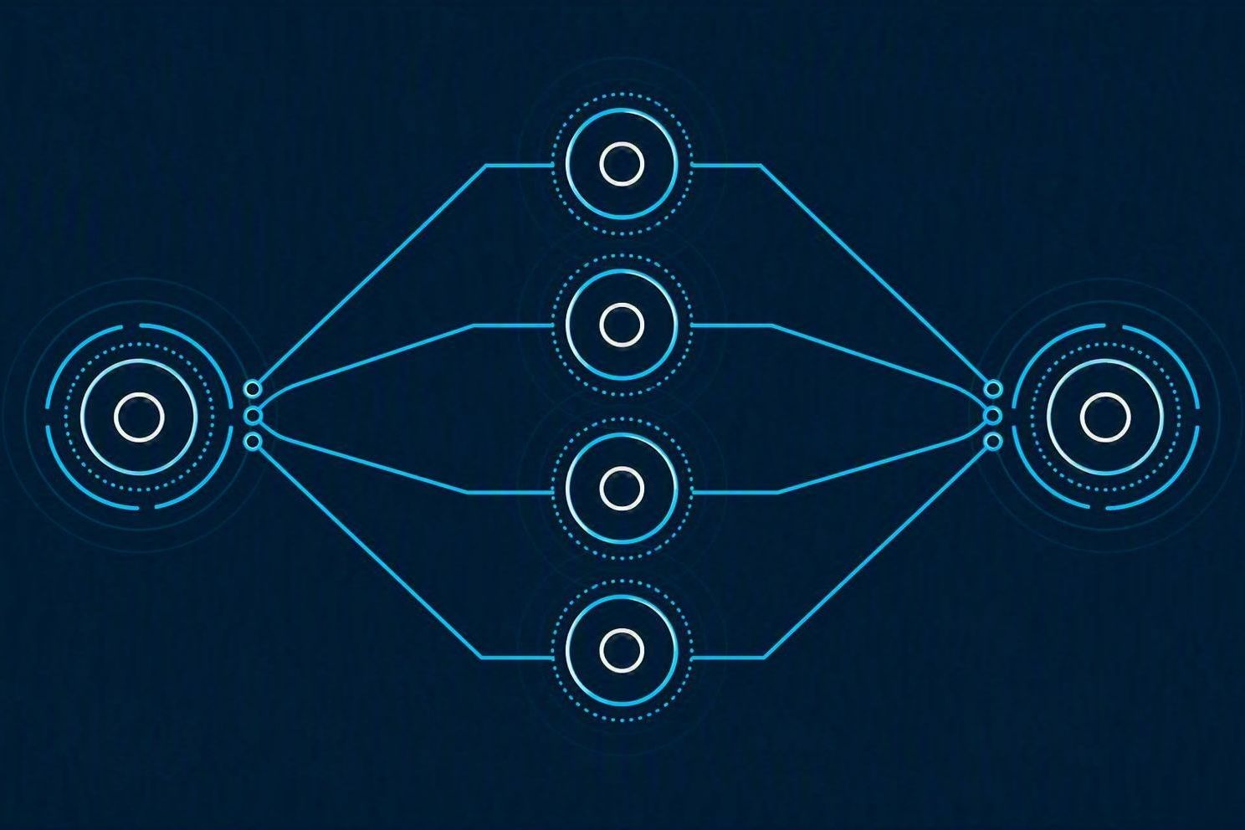
PATTERN 3 · PARALLELIZATION
Parallelization: scatter, then gather
PYTHON · SCATTER-GATHER
from concurrent.futures import ThreadPoolExecutor
chunks = split(document) # independent!
with ThreadPoolExecutor() as pool:
parts = list(pool.map(
lambda c: llm(SUMMARISE, c), chunks))
summary = llm(SYNTHESISE, "\n".join(parts))
Only parallelise genuinely independent subtasks.
Agentic AI Nanodegree — Udacity
24

Slide 25

PATTERN 4 · EVALUATOR–OPTIMIZER
Evaluator–Optimizer: generate, critique, refine
PYTHON · TWO ROLES, ONE LOOP
CRITERIA = "Factual, under 300 words, cites data."
draft = llm(OPTIMIZER, task)
for i in range(MAX_ROUNDS):
fb = llm(EVALUATOR,
f"{CRITERIA}\n{draft}")
if fb.startswith("PASS"):
break
draft = llm(OPTIMIZER,
f"{task}\n{draft}\nFix: {fb}")
Criteria, actionable feedback, a stopping condition.
Agentic AI Nanodegree — Udacity
25

Slide 26

PATTERN 5 · ORCHESTRATOR–WORKERS
Orchestrator–Workers: delegate, then synthesise
PYTHON · EV MARKET REPORT
WORKERS = {"research": web_worker,
"analysis": data_worker,
"trends": trend_worker}
# the orchestrator picks tasks at runtime
plan = json.loads(llm(ORCHESTRATOR, goal))
results = [WORKERS[t["worker"]](t["task"])
for t in plan]
report = llm(SYNTHESISE, results)
Parallel splits a known job. This one writes the plan.
Agentic AI Nanodegree — Udacity
26

Slide 27
COURSE 2 · RECAP
Five patterns, one decision
1
Chaining — ordered steps, with a validation gate between them.
2
Routing — classify first, then dispatch to the specialist.
3
Parallelization — scatter independent subtasks, gather the results.
4
Evaluator–Optimizer — critique against criteria until it passes.
5
Orchestrator–Workers — the plan itself is decided at runtime.
Use the simplest pattern that works — every layer of autonomy costs latency, tokens and predictability.
Agentic AI Nanodegree — Udacity
27

Slide 28
PART 4
BUILDING AGENTS
Course 3, in code
Giving the agent hands and a memory — tools, structured output, state, APIs, retrieval and evaluation.
Agentic AI Nanodegree — Udacity
28

Slide 29

LESSON 1 · TOOLS
Function calling: the model asks, you run it
PYTHON · ONE TOOL ROUND TRIP
TOOLS = [{"type": "function", "function": {
"name": "get_weather",
"parameters": {"type": "object",
"properties": {"city": {"type": "string"}},
"required": ["city"]}}}]
msg = client.chat(messages, tools=TOOLS)
for c in msg.tool_calls:
out = get_weather(**json.loads(
c.function.arguments))
messages.append({"role": "tool",
"tool_call_id": c.id, "content": out})
final = client.chat(messages) # now it answers
The model only names the call. Your code executes it.
Agentic AI Nanodegree — Udacity
29

Slide 30
LESSON 1 · TOOL BINDING
A decorator turns a function into a tool
PYTHON · DECLARE ONCE, BIND ONCE
WHAT MAKES A TOOL USABLE
@tool
def get_stock(ticker: str) -> float:
"""Return the latest price for a ticker."""
return api.quote(ticker)["price"]
# name, docstring and type hints become
# the JSON schema the model sees
agent = LLM(model="gpt-4o",
tools=[get_stock, search_web])
agent.invoke("Is NVDA up today?")
A verb-shaped, unambiguous name
A docstring that says when to use it
Typed arguments — the schema
Few tools beat many similar ones
Return text the model can read
Agentic AI Nanodegree — Udacity
30

Slide 31
LESSON 2 · STRUCTURED OUTPUT
Stop parsing prose — demand a schema
PYTHON · PYDANTIC AS THE CONTRACT
PICK YOUR PARSER
class CalendarEvent(BaseModel):
title: str
date: datetime.date
attendees: list[str]
event = client.parse(
messages=[{"role": "user",
"content": email_text}],
response_format=CalendarEvent)
event.date # a real date object
calendar.create(**event.model_dump())
Str — plain text, no structure
Json — dict, no guarantees
Pydantic — typed and validated
Tool output — straight into a call
Validation failure = retry signal
Agentic AI Nanodegree — Udacity
31

Slide 32
LESSON 3 · AGENT STATE
State is just a dict you pass along
PYTHON · TYPED STATE
PYTHON · WIRE THE MACHINE
class State(TypedDict):
question: str
documents: list[str]
answer: str | None
attempts: int
def retrieve(state: State) -> State:
docs = store.search(state["question"])
return {"documents": docs}
# each step returns only what it changed
m = StateMachine(State)
m.add(EntryPoint(), retrieve, generate,
reflect, Termination())
def router(state):
if state["answer"]: return "end"
if state["attempts"] < 3:
return "retrieve"
return "end"
m.add_conditional(reflect, router)
m.run({"question": q, "attempts": 0})
Agentic AI Nanodegree — Udacity
32

Slide 33
LESSON 3 · CONTROL FLOW
Why a state machine beats a while-loop
Every step is testable
Transitions are explicit
Snapshots per step
State in, state out — pure functions.
The router is the only branching point.
Replay or resume from any point.
Loops are bounded
Observable by default
Swappable steps
A counter in state caps the retries.
The trace is the state history.
Change one node, not the runtime.
Agentic AI Nanodegree — Udacity
33

Slide 34

LESSON 4 · MEMORY
Short-term memory: what fits in context
PYTHON · THREE STRATEGIES
# 1. full history - simple, gets expensive
ctx = history
# 2. sliding window - last N turns
ctx = history[-10:]
# 3. summarisation - compress the tail
if len(history) > 20:
ctx = [llm(SUMMARISE, history[:-10])]
ctx += history[-10:]
reply = llm(SYSTEM, ctx + [user_msg])
Always pin the system prompt and the last user turn.
Agentic AI Nanodegree — Udacity
34

Slide 35
LESSON 5 · EXTERNAL APIS
Calling the outside world, safely
PYTHON · A TOOL THAT CAN FAIL
AND THEN THERE'S MCP
@tool
def create_ticket(title: str) -> str:
"""Open a support ticket."""
r = requests.post(URL, json={"title": title},
headers={"Authorization": f"Bearer {KEY}"},
timeout=10)
if r.status_code == 429:
return "Rate limited - try again later."
if not r.ok:
return f"Failed ({r.status_code})."
return f"Ticket {r.json()['id']} created."
# never raise at the model - return a message
One protocol for every tool server
The USB-C port for agents
Streamable HTTP replaced SSE
Write the integration once, reuse it
Keys in env vars — never in prompts
Agentic AI Nanodegree — Udacity
35

Slide 36
LESSON 6 · DATA ACCESS
Databases: let it write SQL, not run riot
PYTHON · TEXT2SQL WITH GUARDRAILS
STRUCTURED OR SEMANTIC
BANNED = ("DROP", "DELETE", "UPDATE", "INSERT")
sql = llm(f"Schema:\n{schema}\nQuery: {q}"
"\nReturn one SELECT statement.")
if any(w in sql.upper() for w in BANNED):
return "Read-only access."
rows = db.execute(sql + " LIMIT 100")
return llm(f"Answer {q} from:\n{rows}")
SQL — exact facts, filters, totals
Vector — meaning, not keywords
Hybrid — keyword plus embedding
Give the model the schema, not the data
Connect with a read-only role
Agentic AI Nanodegree — Udacity
36

Slide 37
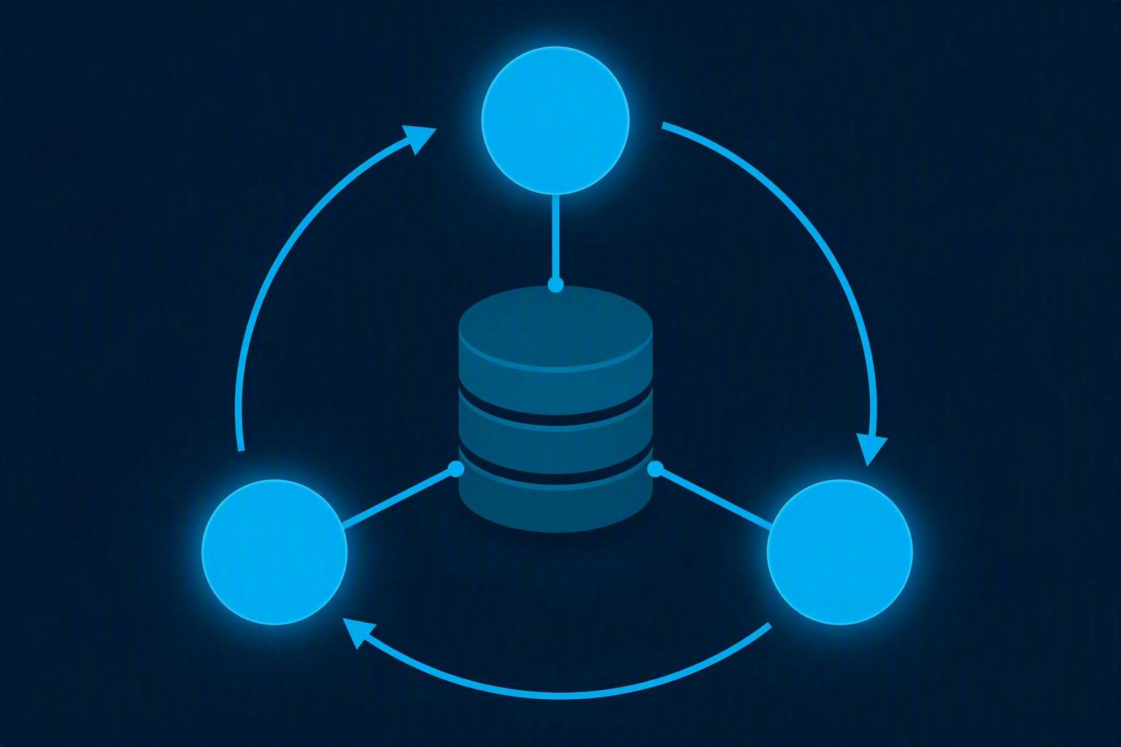
LESSON 7 · RETRIEVAL
Agentic RAG: retrieve, reflect, retry
PYTHON · RETRIEVAL THAT SELF-CORRECTS
for attempt in range(3):
docs = store.search(query)
verdict = llm("Enough to answer?"
f" OK or a better query:\n{docs}")
if verdict.startswith("OK"):
break
query = verdict # reformulate
else:
return "I don't have enough information."
answer = llm(ANSWER, docs, question)
Classic RAG retrieves once. This one judges the result.
Agentic AI Nanodegree — Udacity
37

Slide 38
LESSON 8 · PERSISTENCE
Long-term memory: three kinds, scoped
PYTHON · WRITE, THEN RECALL
SCOPE AND EXPIRY
store.save(
kind="semantic", # a fact
scope=("user", user_id),
text="Prefers window seats.",
ttl_days=365)
# episodic - what happened last time
# procedural - how to do the task
hits = store.search(user_msg,
scope=("user", user_id), k=3)
reply = llm(SYSTEM + str(hits), user_msg)
User — personal preferences
Team — shared conventions
Global — organisation-wide rules
TTLs so stale facts fall away
Recall is retrieval, not the full store
Agentic AI Nanodegree — Udacity
38

Slide 39
LESSON 9 · EVALUATION
Evaluating an agent, not just an answer
Final response
Single step
Trajectory
LLM as judge
→
→
→
Did the output match the ideal answer?
Was the right tool called with the right arguments?
Was the whole path sensible and short?
Score free text against written criteria.
PYTHON · A TRAJECTORY ASSERTION
trace = agent.run(case["input"])
assert [s.tool for s in trace] == case["expected_tools"]
assert trace.steps <= 6 and trace.cost < 0.05 # system metrics
Agentic AI Nanodegree — Udacity
39

Slide 40
COURSE 3 · RECAP
What turns a chatbot into an agent
1
Tools — the model names the call, your runtime executes it.
2
Schemas — Pydantic makes the output a contract, not prose.
3
State — a typed dict plus explicit transitions, never a loose loop.
4
Memory — a window for now, a scoped store with TTLs for later.
5
Evaluation — score the trajectory and the tool calls, not just the answer.
Every capability you add is another thing that can fail — wrap it, cap it, log it.
Agentic AI Nanodegree — Udacity
40

Slide 41
PART 5
MULTI-AGENT SYSTEMS
Course 4, in code
Multi-agent systems — an org chart for your AI team: roles, orchestration, routing, shared state and retrieval.
Agentic AI Nanodegree — Udacity
41

Slide 42
LESSON 1 · ORCHESTRATING AGENT ACTIVITIES
A restaurant, not a genius
Host
Waiter
Chef
Greets, triages, seats — the router.
Takes the order, carries it both ways.
Deep specialism, one station each.
Manager
The rule
In code
Sees the whole floor — the orchestrator.
Clear roles beat one clever generalist.
One class per role, each with its own tools.
Agentic AI Nanodegree — Udacity
42

Slide 43

LESSON 1 · ORCHESTRATING AGENT ACTIVITIES
Orchestrator: one manager, many workers
PYTHON · E-COMMERCE RETURN
def handle_return(req):
check = policy_agent.run(req)
if check.status != "eligible":
return denial_agent.run(check)
inventory_agent.run(check.sku)
refund = refund_agent.run(check.order_id)
return comms_agent.run(refund)
# hub and spoke - every hop via the centre
Best when the order of steps is known and matters.
Agentic AI Nanodegree — Udacity
43

Slide 44

LESSON 1 · ORCHESTRATING AGENT ACTIVITIES
Peer-to-peer: no boss, more flexibility
PYTHON · AGENTS HAND OFF DIRECTLY
# network fault diagnosis
anomaly = monitor_agent.detect()
layout = topology_agent.ask(anomaly.node)
logs, traffic = run_parallel(
lambda: log_agent.check(layout.devices),
lambda: traffic_agent.scan(layout.links))
return diagnose(logs, traffic)
Flexible when the sequence isn't known — and harder to debug.
Agentic AI Nanodegree — Udacity
44

Slide 45
LESSON 1 · ORCHESTRATING AGENT ACTIVITIES
An agent is a class plus a job description
PYTHON · SPECIALISE BY PROMPT
WHAT EVERY AGENT PROMPT NEEDS
class ValidationAgent(ToolCallingAgent):
def __init__(self, model):
super().__init__(
model=model, name="validator",
tools=[validate_schema],
description="""
You are a Data Validation Agent.
You check user data against schemas.
You do NOT calculate or call APIs.
You ONLY use validate_schema.""")
Who you are
What you do — one purpose
What you do not do
Which tools you may call
Ambiguity is the enemy here
Agentic AI Nanodegree — Udacity
45

Slide 46
LESSON 1 · ORCHESTRATING AGENT ACTIVITIES
A tool must never crash the agent
PYTHON · DESCRIPTION IS THE INTERFACE
RETURN, DON'T RAISE
@tool
def check_inventory(product_id: str) -> str:
"""Check stock for a product ID in the
inventory DB. Returns the count, or an
error if the ID is unknown."""
try:
return f"{db.stock(product_id)} in stock"
except Exception as e:
log.exception(e) # for you
return "Lookup failed - try later."
The docstring is what the model reads
Typed args become the schema
Wrap every network and DB call
Log the traceback for humans
Return a sentence the model can act on
Agentic AI Nanodegree — Udacity
46

Slide 47
LESSON 1 · ORCHESTRATING AGENT ACTIVITIES
Three orchestration moves — and the mix
Sequential
Parallel
Conditional
Mixed
→
→
→
Each step needs the last one's output.
Independent tasks run at the same time.
The branch depends on an agent's verdict.
Real workflows combine all three.
PYTHON · ALL THREE IN ONE WORKFLOW
notes = research_agent.run(topic) # sequential
draft = writing_agent.run(topic, notes)
seo, art = run_parallel(seo_agent, image_agent, draft) # parallel
return publish(draft) if editor.approves(draft) else revise(draft)
Agentic AI Nanodegree — Udacity
47

Slide 48
LESSON 1 · ORCHESTRATING AGENT ACTIVITIES
Let the LLM route, not your if-statements
PYTHON · SKATE PARK ORCHESTRATOR
TWO TIERS
def process(self, request):
kind = self.support_agent.diagnose(request)
self.memory.steps = [] # fresh run
return self.run(f"""
Customer said: {request}
Diagnosed as: {kind}
Booking -> check_availability, add_booking
Shop -> inventory_level, sell_item
Unclear -> answer directly.""")
Tier 1 — classify the request
Tier 2 — execute with tools
Routing rules live in the prompt
New capability = new tool line
No if/else tree to maintain
Agentic AI Nanodegree — Udacity
48

Slide 49
LESSON 2 · ROUTING AND DATA FLOW IN AGENTIC SYSTEMS
Agents post letters, not objects
PYTHON · SENDING
PYTHON · RECEIVING
class Quote(BaseModel):
order_id: str
total: float
payload = quote.model_dump_json()
send("pricing_agent", payload)
raw = receive()
quote = Quote.model_validate_json(raw)
# frameworks usually do this for you -
# you need it when debugging a bad
# payload or talking to an outside system
SAME PROCESS? PASS THE OBJECT. DIFFERENT MACHINE? SERIALISE.
JSON is the default envelope — a typed model on both ends keeps the contract honest.
Agentic AI Nanodegree — Udacity
49

Slide 50

LESSON 2 · ROUTING AND DATA FLOW IN AGENTIC SYSTEMS
Routing: the mailroom for your agents
PYTHON · THREE ROUTING STRATEGIES
# content-based - inspect the message
if msg.type == "image": return vision_pool
# round-robin - spread the load
agent = pool[next(counter) % len(pool)]
# priority - urgent jumps the queue
heapq.heappush(q, (-msg.priority, msg))
Routing picks the path. Data flow fixes the payload.
Agentic AI Nanodegree — Udacity
50

Slide 51
LESSON 3 · STATE MANAGEMENT IN MULTI-AGENT SYSTEMS
Pass the context, not the whole world
PYTHON · SHARED STATE, SCOPED HANDOFFS
EPHEMERAL VS PERSISTENT
state = {"customer_id": "ACME", "order_id": 12345,
"items": [{"sku": "PROD_A", "qty": 10}],
"needed_by": date(2025, 5, 9)}
# each worker gets only what it needs
stock = inventory_agent.run(items=state["items"])
quote = quoting_agent.run(items=state["items"],
customer=state["customer_id"],
stock=stock)
state["quote"] = quote # write it back
Ephemeral — this conversation only
Persistent — a DB, across sessions
Transform between agents: enhance, filter, reformat
Ask: where does the real truth live?
Agentic AI Nanodegree — Udacity
51

Slide 52
LESSON 3 · STATE MANAGEMENT IN MULTI-AGENT SYSTEMS
Failing gracefully, six ways
Retry
Fallback
Report
Transient blips — back off exponentially.
Plan B: a simpler tool or another agent.
Terminate cleanly, say what broke and where.
Compensate
Escalate
Then log
Charged the card but service failed? Undo it.
Too ambiguous to automate — hand to a human.
Input, output and verdict for every step.
Agentic AI Nanodegree — Udacity
52

Slide 53
LESSON 4 · MULTI-AGENT ORCHESTRATION AND STATE COORDINATION
Two orders, one sack of flour
PYTHON · CHECK AND RESERVE, ATOMICALLY
KEEPING AGENTS IN SYNC
def reserve(self, order):
with self.lock: # one at a time
need = order.qty * 2
if self.stock["flour"] < need:
return False # conflict detected
self.stock["flour"] -= need
return True
# optimistic alternative: UPDATE ... WHERE
# version = 5 -> 0 rows means someone won
Lean on the database — it has locks
Broadcast events on critical changes
Optimistic concurrency with versions
Resolve by rule, rollback, or a human
Re-verify before acting on old reads
Agentic AI Nanodegree — Udacity
53

Slide 54

LESSON 5 · MULTI-AGENT RETRIEVAL AUGMENTED GENERATION
Multi-agent RAG: a research team
PYTHON · DELEGATE, THEN SYNTHESISE
SPECIALISTS = {"papers": pubmed_agent,
"trials": trials_agent,
"news": news_agent,
"sql": database_agent}
needed = coordinator.pick(query) # not always all
context = run_parallel(
{k: SPECIALISTS[k].search(query) for k in needed})
return synthesis_agent.write(query, context)
One pipeline struggles to mix SQL rows with free text. A team doesn't.
Agentic AI Nanodegree — Udacity
54

Slide 55
COURSE 4 · RECAP
You are the architect
1
Draw the org chart first — orchestrator for order, peer-to-peer for flexibility.
2
The system prompt is the job description: role, scope, limits, tools.
3
Sequential, parallel, conditional — every workflow is a mix of the three.
4
Route on content, load or priority; reshape the payload on the way.
5
Shared state plus conflict rules is what stops a team becoming a crowd.
Specialisation is the whole trick — narrow agents, clear handoffs, one source of truth.
Agentic AI Nanodegree — Udacity
55

Slide 56
PERSONAL TAKE
What I took away from the program
1
Great course to understand the basics and look under the hood of existing frameworks
2
Actual framework courses (LangChain, LangGraph, MCP) might be closer to how things are implemented in real life
3
I liked that this skillset applies to multiple problems in diverse industries
4
Personally, I see how building agentic workflows and AI agents can become a new problem-solving paradigm
5
Prompt engineering is key to creating meaningful results
6
Good engineering practice is to evaluate the pipeline to overcome the non-deterministic nature of agentic workflows
Agentic AI Nanodegree — Udacity
56

