Slide 1
270° Tetris
Björn Merschmeier, Sven Krefeld, Dennis Schöneborn, Tim Prange

Slide 2
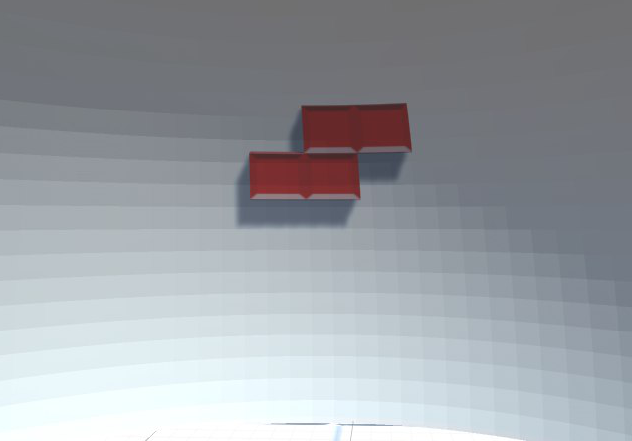
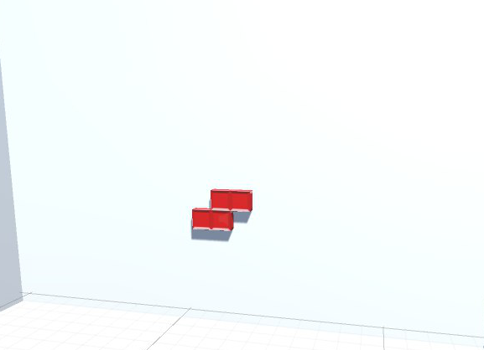
First idea
Implementation in 2D
Projection on to a 3D Sphere
Flatt view on to the Blocks
Deformation of the Blocks

Slide 3
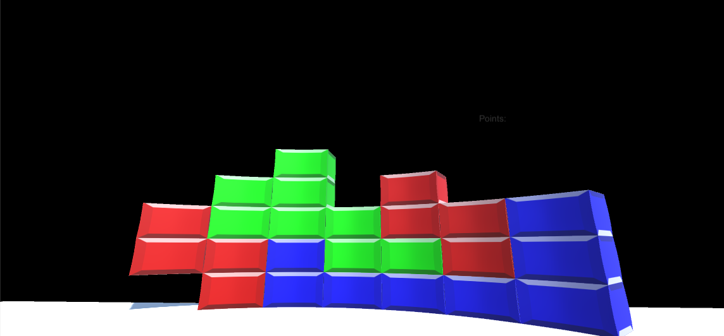
Biggest Problems
Showing blocks in a cylinder
Bending of cylinder as bending of blocks
Bending with bones in Blender
Block rotation isn‘t possible with Unity rotation anymore
Rotation around the center of the cylinder
Consider all special cases
Rotate in borders
Move blocks out of borders

Slide 4
What we finally did
Programming Tetris logic
Implemented Tetris sounds
Implemented an complex rotation algorithm
Reordering the Blocks instead of rotating the whole object
Building and bending the blocks with Blender
Implementation of a game menu
Start menu
Game over screen

Slide 5
Things for future
Game menu
Implemented
Not fully functioning
Configuration for the game and controls
Visualization of playground

