Slide 1

GPU Architecture SS2019 - Status
Dominik Schörkhuber & Thomas M. Galla

Slide 2

Status Quo
Github repository created
Execution and measurement framework created
Lemire‘s implementation added
Naive plain CUDA implementation added

Slide 3
Demo
[tom@herz GPU_Arch_SS19]$ ./streaming_min_max_comparison -s 10000000 -w 5 -i 10
Performing a comparison using the following parameters:
window_size = 5
sample_size = 10000000
number_of_iterations = 10
lemire = 18.159 seconds
cuda plain = 7.2461 seconds
thrust = 0.528345 seconds
cuda streams = 0.527815 seconds

Slide 4
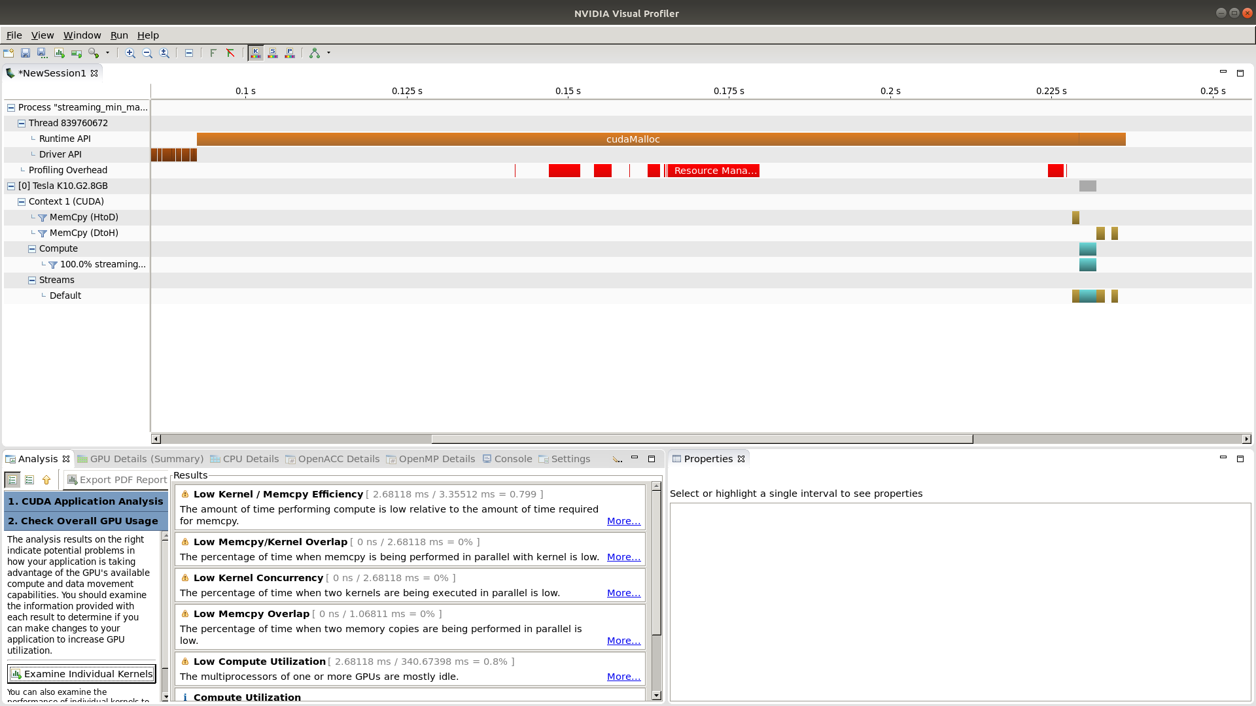
Naive CUDA Implementation Profiling

Slide 5
Next Steps (1)
Performance optimizations for plain CUDA implementation
  Use page locked memory ranges
    cudaHostRegister() and cudaHostGetDevicePointer()
  Use shared memory as program controlled per block cache
    Explicitly transfer data to and from shared memory by kernel code
  Schedule the memory transfers in a way to minimize bank conflicts

Slide 6
Next Steps (2)
Add Thrust implementation
Add CUDA streams implementation

