Slide 1

GPU Architectures SS2019
Dominik Schörkhuber & Thomas M. Galla

Slide 2

Overview
Execution and measurement framework
Dimensions of Optimization
Implementation variants
Measurement results
Summary and takeaways

Slide 3
Execution & Measurement Framework
Automated execution of all algorithm implementations
Command line configurable
  sample size, window size, iterations
Verifying correctness
  Comparison with Lemire's implmentation
Measurement of (average) runtime of each algorithm
Easy to add new algorithm implementations

Slide 4
Sample Session
$ ./streaming_min_max_comparison -s 10000000 -w 500 -i 11
Performing a comparison using the following parameters:
window_size = 500
sample_size = 10000000
number_of_iterations = 11
lemire = 2315.039919 milliseconds
cuda plain - cuda malloc = 234.845854 milliseconds
cuda plain - page locked memory = 3055.436376 milliseconds
cuda plain - page locked shared memory = 103.675406 milliseconds
thrust_naive = 221.098370 milliseconds
thrust = 235.481252 milliseconds
cuda plain - cuda tiled = 127.926657 milliseconds

Slide 5
Dimensions of Optimization
CUDA framework
  Plain CUDA
  Thrust
Memory allocation & data transfer
  Explicit memory allocation and transfer
  Page-locked host memory
  Page-locked host memory + shared memory as cache
Parallelization strategy
  One thread per sliding window/output value („linear scan“)
  Binary reduction and tiling („log linear scan“)

Slide 6
Explicit Memory Alloc. & Transfer (1)
cudaMalloc()/cudaFree()/cudaMemcpy()
Expectation
  Allocation overhead
  Memory transfer overhead
  Memory copy overhead (2x each direction!)

Slide 7
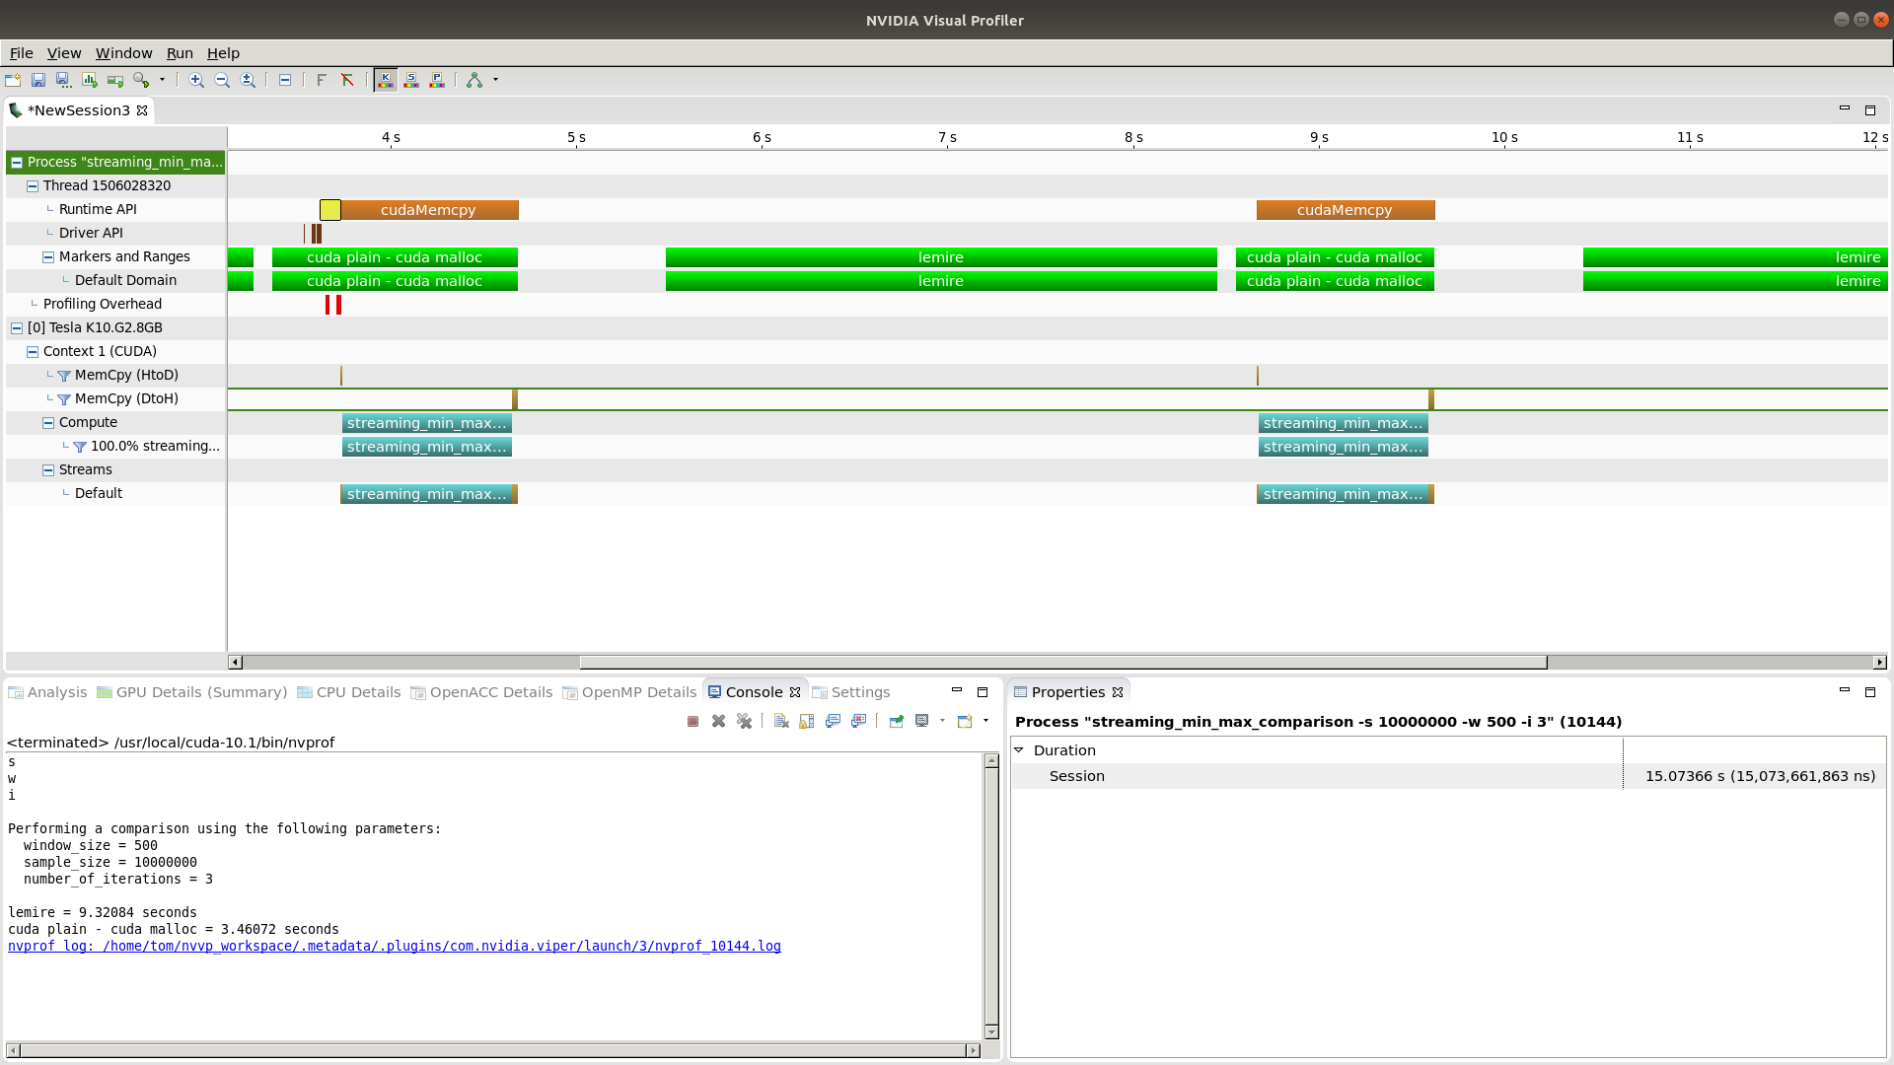
Explicit Memory Alloc. & Transfer (2)

Slide 8
Page-Locked Host Memory (1)
cudaHostRegister()/cudaHostDeregister()
Expectation
  Allocation overhead eliminated
  Memory transfer overhead still there
  Memory copy overhead partly eliminated
  (1 x each direction!)

Slide 9
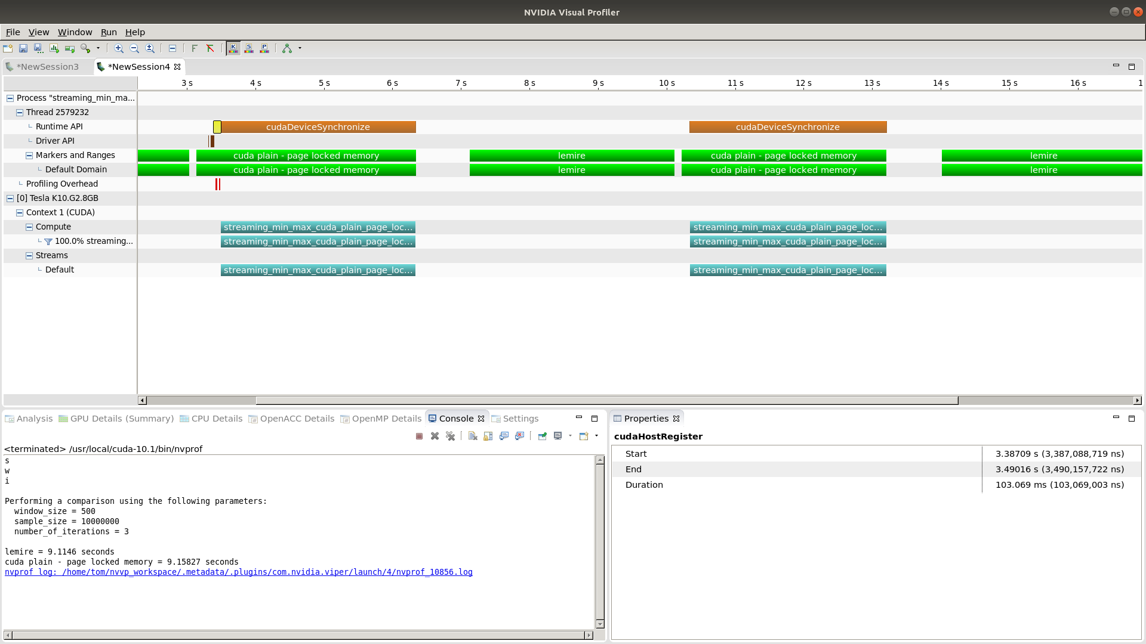
Page-Locked Host Memory (2)
Utterly useless!

Slide 10
Page-Locked Host Memory (3)
Actually a massive deterioration
Hypothesised causes
  Lack of possibility to coalesce small memory accesses into single bulk transfer
  Slow PCI bus
Interestingly depends strongly on HW platform

Slide 11
Page-Locked Host Mem. & Cache (1)
Use page-locked host memory
Use shared memory on GPU as program controlled cache
  Shared memory as fast as L1 cache
  Program controlled instead of LRU
Expectation
  Massive memory access overhead of pure page-locked memory drastically reduced

Slide 12
Page-Locked Host Mem. & Cache (2)
Split computing kernel into two parts
  Parallelized memory transfer into shared memory
    Combined effort of all threads of a thread block
  Actual compuation on shared memory

Slide 13
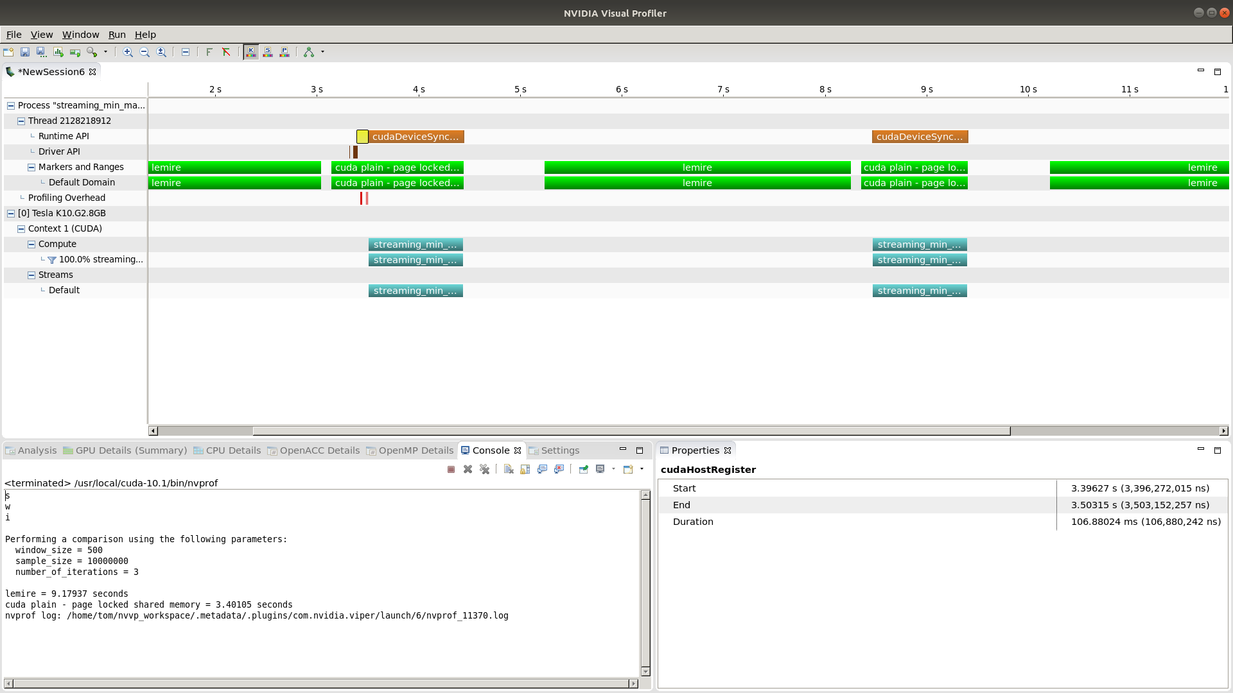
Page-Locked Host Mem. & Cache (3)

Slide 14
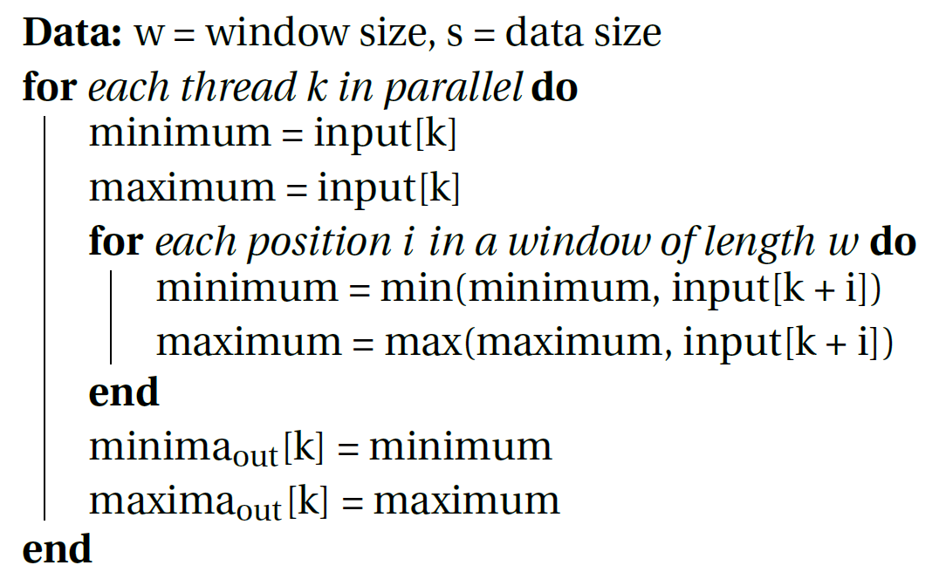
Linear Scan
One thread per output
Incremental computation

Slide 15
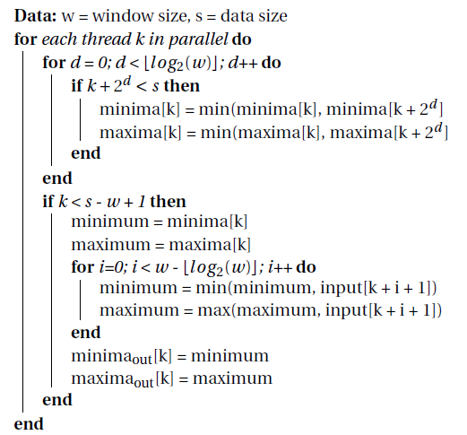
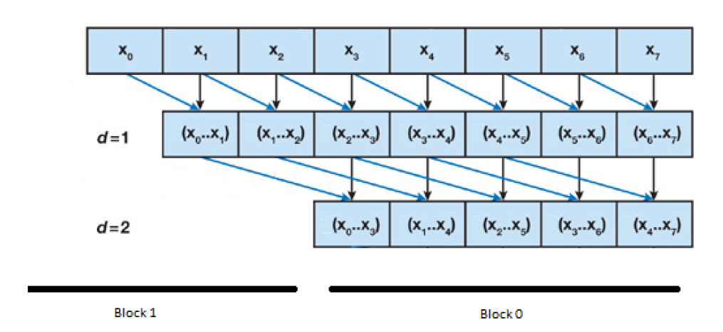
Log Linear Scan
Binary reduction
Combine results

Slide 16
Implementation of Algorithms
CUDA
  cuda_malloc: malloc – linear scan
  cuda_pagelocked: page-locked – linear scan
  cuda_pagelocked_shared: page-locked & shared memory – linear scan
  cuda_tiled: page-locked & shared memory – log linear scan & tiling
Thrust
  thrust_naive: linear scan
  thrust: log linear scan & tiling

Slide 17
Measurements
Conducted for all algorithm flavors
For various sample and window sizes
On two different HW platforms
  NVIDIA RTX2070
  NVIDIA Tesla K10.G2

Slide 18
Results – NVIDIA RTX 2070

Slide 19
Results – NVIDIA Tesla K10.G2

Slide 20
Summary & Takeaways (1)
Performance of code running on a GPU is influenced by a multitude of factors, thus
  Know your workload and your HW
  Measure carefully and optimize
    If measurement result are inconclusive, measure again …
Optimization for one HW/workload might be a deterioration on another
  Consider going for a hybrid solution
    multiple kernels
    select appropriate one during run-time (based on HW and workload)

Slide 21

Summary & Takeaways (2)
Don‘t be too clever! - a straight forward „naive“ solution might outperform a complex „smart“ solution
„Premature optimization is
the root of all evil“
[Donald Knuth]

