Slide 1












Slide 2



Notes:
Eigentlich mehr „von welchem user kommt der request“, denn darüber ob er wirklich der ist, der er angibt zu sein, sprechen wir ja gar nicht genau.
Auf Tonspur besprechen

Slide 3
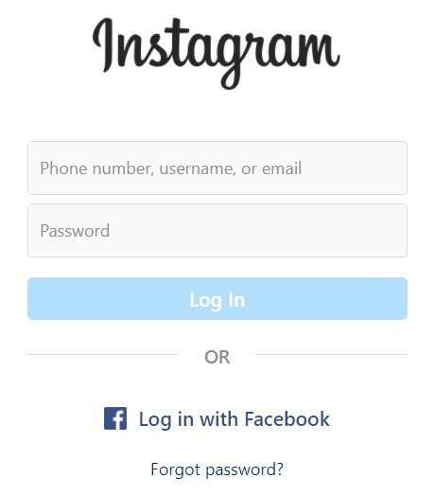



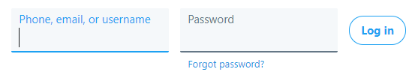
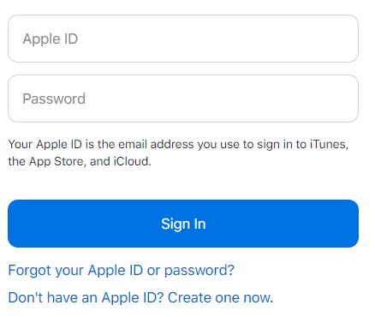
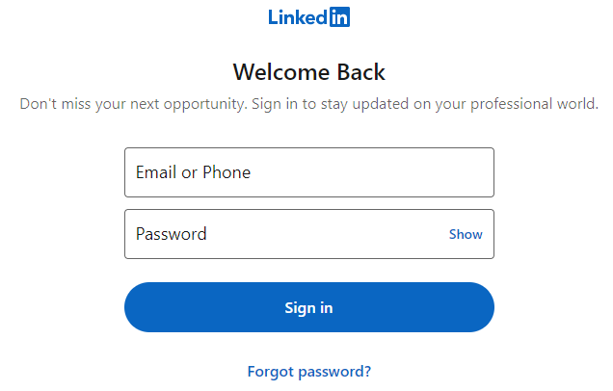
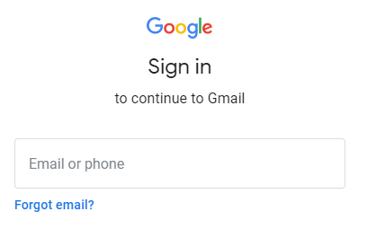
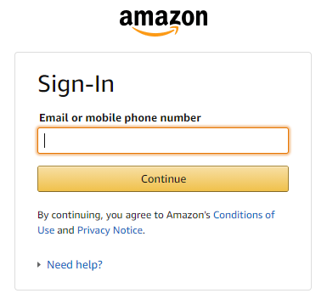
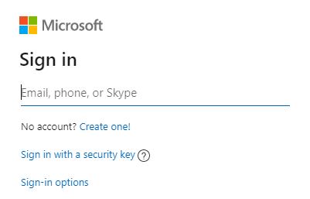

Slide 4
Plaintext Transmission (again) | SQL Injection
Goal | Read credentials in transit
How | MitM between client and server - ARP Spoofing in your network (WIFI) or the servers' network - Malicious ISP (employee) - Gateways to foreign countries - Spoofed Server (DNS Hijacking) - …
Solution | HTTPS (HTTP + SSL/TLS) HTTP/3 uses TLS 1.3 by default
OWASP Top 10 | A02:2021-Cryptographic Failures
(Primary) Violated Principle | „Earn or give, but never assume, trust. “

Slide 5
Authentication Automation Attacks | SQL Injection
Goal | Guess/Crack the user‘s credentials (e.g. username / password)
How | Brute Force Attacks Dictionary Attacks Credential Stuffing …
Solution | Generic Error Messages - Also consider this for the registration Anti-Automation Techniques - Captcha, tmp. Lockout, Tarpit, etc. Password Complexity Requirements - Current recommendation: length > complexity MFA (maybe even passwordless) Compromised Credential Checking
OWASP Top 10 | A07:2021-Identification and Authentication Failures
(Primary) Violated Principle | „Use an authentication mechanism that cannot be bypassed or tampered with.“

Slide 6

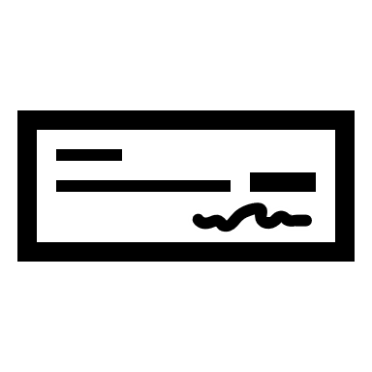

Which Auth-Factors do you know?
increase security by combining different factors 2FA / MFA
you know
you have
you are
username/password, PIN, etc.
certificate, smartcard, token, etc.
fingerprint, iris,
venes, etc.

Slide 7


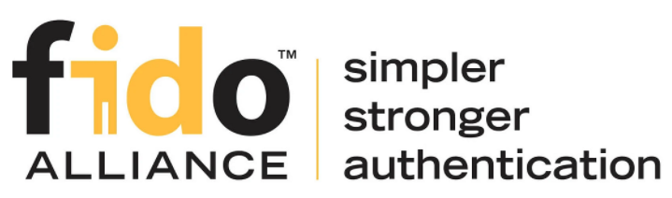
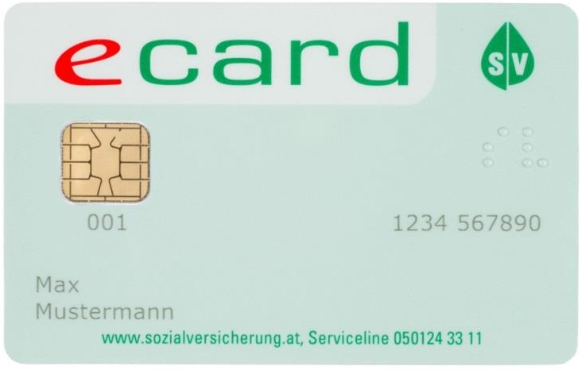

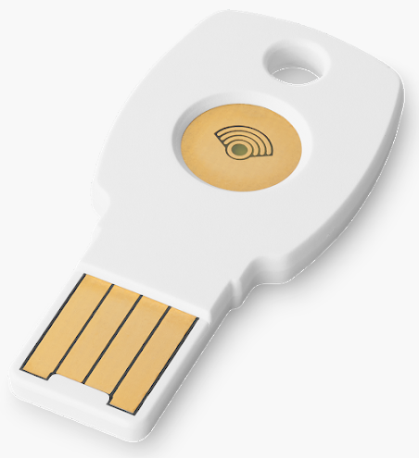
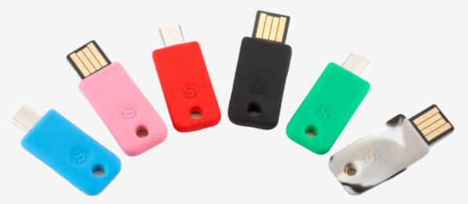
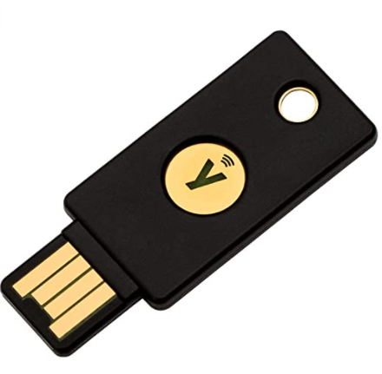

Options I personally really like…
TOTP
FIDO 2
Bürgerkarte
Time-based One-time Password
WebAuthN/CTAP U2F
Personal Smartcard in Austria
EOL
2019
=(
Notes:
TOTP und FIDO2/WebAuthN => Bsp: yubikey, solo-keys, google-titan
TLS-Clientzertifikate auch erwähnen
Hier nochmal darauf eingehen, dass eCard eine gewissen Level an Confidence mitgibt, dass es sich auch wirklich um diese Person handelt als die er sich ausgibt.
Leider mit Ende 2019 eingestellt -> man müsste sich jetzt eine separate A-Trust Karte bestellen.

Slide 8
Insecure Password Storage | SQL Injection
Goal | Steal user credentials
How | SQLi Server misconfigurations Malicious insider …
Solution | Use proper mechanisms to store credentials Special Password Hash Functions (PHF) or Password-based Key Derivation Functions (KDFs) – slow on purpose they use cryptographic hashes with large salt and high iteration count e.g. bcrypt, scrypt, PBKDF2, HKDF, Lyra2, [Argon2] etc.
OWASP Top 10 | A02:2021-Cryptographic Failures
(Primary) Violated Principle | „Use cryptography correctly. “

Slide 9
Passwords in Source Code | SQL Injection
Goal | Steal passwords of technical users
How | Error messages Logs Version control system (GIT, SVN, …)
Solution | bare minimum: put them in a config file Recommended solution heavily depends on platform, e.g. secret stores encrypted config files The „master key“ can be set e.g. via environment variable
OWASP Top 10 | A02:2021-Cryptographic Failures
(Primary) Violated Principle | „Identify sensitive data and how they should be handled.“

Slide 10
HTTP Basic Auth
Similar to form-based
Doesn‘t protect credential‘s confidentiality and integrity
Everybody can decode base64
Doesn‘t protect against server-spoofing
Needs HTTPS
User cannot manually logout
Application cannot force user to logout
Limited influence on password storage
depends on webserver
secure options available for most servers
e.g. Apache supports bcrypt
Notes:
Passworterstellung: https://en.wikipedia.org/wiki/.htpasswd
https://httpd.apache.org/docs/2.4/misc/password_encryptions.html

Slide 11
HTTP Digest Auth
Still doesn‘t really prevent MitM
Still doesn‘t really prevent server spoofing
Most security options are optional
Password is stored either in plaintext or MD5 hashed
both terrible
Just don‘t use it
If you really want to use HTTP auth:
Basic + HTTPS + Strong password storage mechanism
Notes:
Positiv: phishing nicht möglich -> Klartextpasswort wird ja nie übertragen
https://de.wikipedia.org/wiki/HTTP-Authentifizierung
https://security.stackexchange.com/questions/102833/flaw-in-http-digest-authentication
https://avdi.codes/the-trouble-with-http-digest-authentication/
https://en.wikipedia.org/wiki/Digest_access_authentication
https://httpd.apache.org/docs/2.4/mod/mod_auth_digest.html => password storage bei digest ist „less secure“ als bei basic
https://httpd.apache.org/docs/2.4/misc/password_encryptions.html

Slide 12
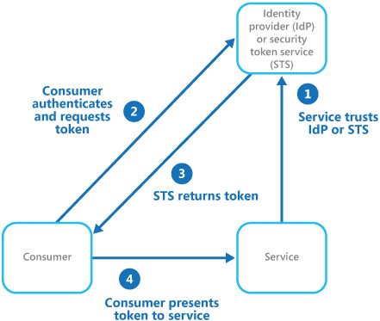
Identity Federation
or as microsoft describes it…
https://docs.microsoft.com/en-us/azure/architecture/patterns/federated-identity

Slide 13
pretty powerful to include some „environmental checks“
e.g. login attempt from foreign IP, login attempt from new/unknown device, multiple failed login attempts, etc.
notify the user if something is suspicious
a.k.a „conditional access“
Notes:
PINGO QUIZ (Authentication)

Slide 14
Client-side Manipulation (of cookies) | SQL Injection
Goal | Manipulate data security checks depend on
How | Misplaced trust User has full control over his client and can manipulate everything on it!
Solution | Encrypt and sign cookie values Remaining Problem: Application cannot close all sessions of a user (e.g in case of compromise) ASP.NET ViewState works similar (hidden form field) JWT (JSON Web Tokens) also work similar Use Server-side Session Management
OWASP Top 10 | A01:2021-Broken Access Control
(Primary) Violated Principle | „Earn or give, but never assume, trust.“

Slide 15
Session Hijacking | SQL Injection
Goal | Get victim‘s SID and hijack his session
How | Guessable SID MitM at insecure channel Firesheep (2010) SID in GET Parameter Logfiles, Browser history, Referrer header Steal SID via XSS we will cover this later
Solution | (Secure) Random generation with enough entropy bare min: >= 64 bit recommended: >= 128 bit Invalidate SIDs after a defined idle time HTTPS for whole communication not just login Secure flag Set-Cookie: SID=<ID>; Secure Send SID only in header or body Pay close attention to our XSS lecture later ;-)
OWASP Top 10 | A07:2021-Identification and Authentication Failures
Violated Principle | „Identify sensitive data and how they should be handled.“

Slide 16



what will the user‘s browser do?
HTTP/1.1 200 OK
...
<html>
<img src='https://www.jedibank.com/transfer?from=luke& to=vader&amount=3000'/>
</html>

Slide 17
he will just send the request as he is told…
5. GET /transfer?from=luke&to=vader&amount=3000 HTTP/1.1
Host: www.jedibank.com Cookie: SID=XXXX
6. HTTP/1.1 200 OK
and the sever will be happy to serve

Slide 18
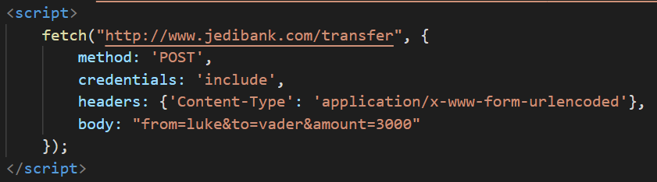
5. POST /transfer HTTP/1.1
Host: www.jedibank.com
Content-Type: application/x-www-form-urlencoded
Cookie: SID=XXXX
from=luke&to=vader&amount=3000
6. HTTP/1.1 200 OK

Slide 19


Internet
Company Network

Slide 20
Internet
Company Network
<img src='https://internalserver.intra:3000/somenastystuff'/>
especially bad if user is admin…

Slide 21
Internet
Home Network

Slide 22
Cross-Site Request Forgery (CSRF) | SQL Injection
Goal | Force user‘s browser to execute actions in the user‘s context but without the user‘s knowledge
How | Slip the user some html forms and abuse the fact that session tokens get appended automatically e.g. by phishing, forums, etc.
Solution | Synchronizer Token Pattern Server adds a random token to every form via hidden form field and checks this token in the user’s subsequent request Double Submit Pattern Server sets a random token as browser cookie. Client-side application adds it to every form/header. Server just needs to compare cookie and form-field/header. Actually works but has some pitfalls and is therefore not considered 100% secure Same-Site Flag Recommended: SameSite=Lax Complex Requests e.g. if server only accepts special content type (e.g. JSON), custom headers, etc.
OWASP Top 10 | Was kicked from Top 10 2017
(Primary) Violated Principle | „Earn or give, but never assume, trust.“

Slide 23
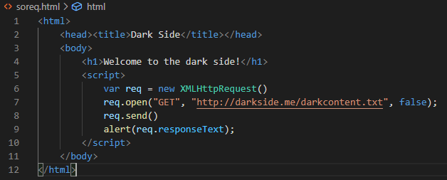




GET /soreq.html HTTP/1.1
Host: darkside.me

Slide 24
Same Origin Policy
The web‘s basic security model
Basic idea:
Code from one origin (darkside.me) is not allowed to interfere with resources of another origin (lightside.me)
Origin = Protocol + Host + Port
http://darkside.me:80
http://lightside.me:80

Slide 25
Cross Origin Resource Sharing (CORS)
Sometimes applications just really want to communicate with other origins
If the other origin is fine with it, why not…
Just define a CORS header
To allow a specific origin to read data
Access-Control-Allow-Origin: http://darkside.me
To allow any origin to read data
Access-Control-Allow-Origin: *

Slide 26
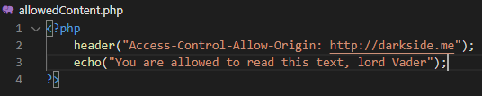
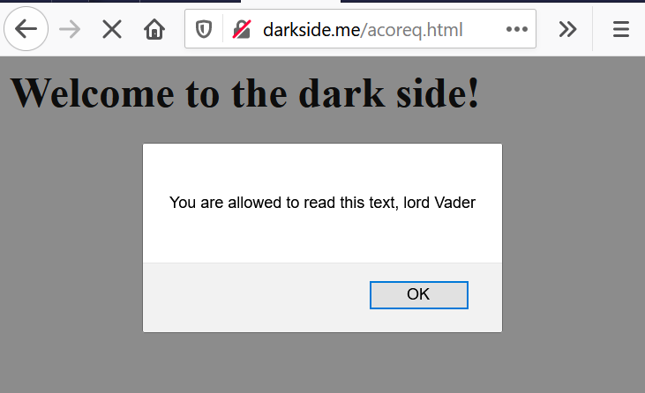
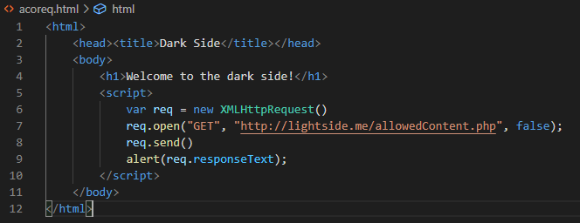



GET /allowedContent.php HTTP/1.1
Host: lightside.me
HTTP/1.1 200 OK
Access-Control-Allow-Origin: http://darkside.me
...
You are allowed to read this text, lord Vader
Notes:
https://developer.mozilla.org/de/docs/Web/HTTP/CORS:
Bei folgenden Methoden gibt’s einen „preflight“ request um vorher schon zu klären ob es erlaubt ist:
PUT
DELETE
CONNECT
OPTIONS
TRACE
PATCH

Slide 27
Key messages
Use TLS for your whole application
Store your passwords securely (bcrypt, PBKDF2,…)
Provide multi factor support and enforce it for critical areas
Secure your SID
Never trust the client or anything originating from the client

Slide 29
Forceful Browsing | SQL Injection
Goal | Directly call a URL / function which you‘re not supposed to by the ui
How | information gathering by client source code logs error messages robots.txt other users with higher privileges hacker instinct / guessing ;-)
Solution | NEVER rely on (client-side) frontend check user’s authorization to call function on server-side
OWASP Top 10 | A01:2021-Broken Access Control
(Primary) Violated Principle | „Earn or give, but never assume, trust.“ „Authorize after you authenticate“

Slide 30
Insec. Direct Object References | SQL Injection
Goal | Directly access a resource which you‘re not supposed to by the ui
How | information gathering by http parameters client source code logs error messages other users with higher privileges hacker instinct / guessing ;-)
Solution | NEVER rely on (client-side) frontend check user’s authorization to access resources on server-side use indirect object references, unguessable IDs (e.g. UUIDs) or salted hashes
OWASP Top 10 | A01:2021-Broken Access Control
(Primary) Violated Principle | „Authorize after you authenticate“
Notes:
https://www.heise.de/news/Datenleck-im-Legoland-Reisedaten-tausender-Kunden-seit-2015-betroffen-6668852.html

Slide 31
Path Traversal | SQL Injection
Goal | Directly access files (outside the webroot) which you‘re not supposed to by the application
How | whenever an application handles path’s incorrectly, try to iterate through it
Solution | Don’t use user input in filesystem APIs If you have to validate it (explicit allowlist) check the canonicalized path Run webserver under a low privileged user
OWASP Top 10 | A01:2021-Broken Access Control
(Primary) Violated Principle | “Define an approach that ensures all data are explicitly validated.”

Slide 32
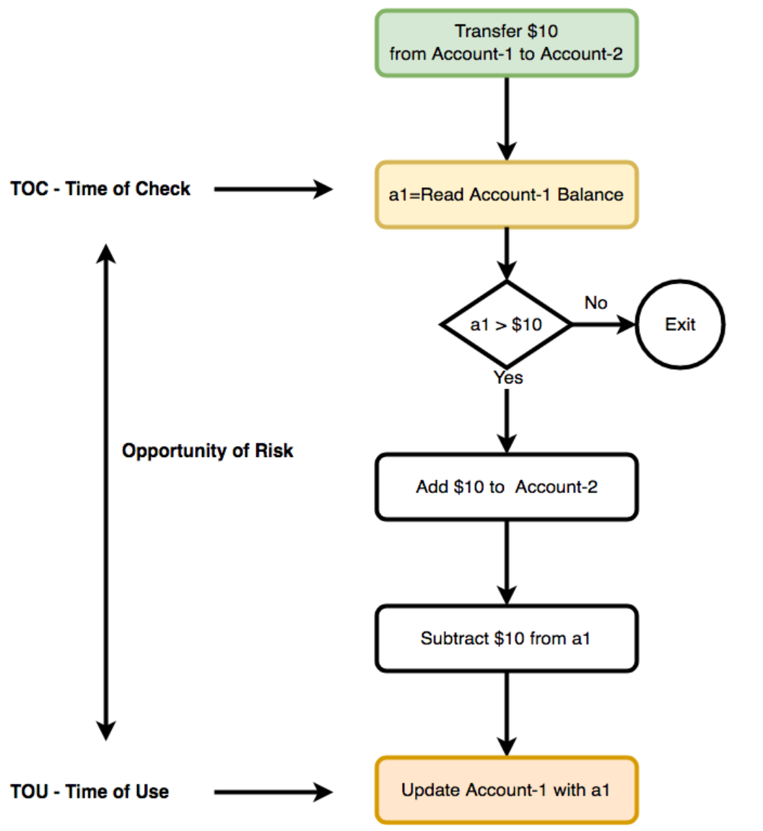
https://medium.com/@schogini/toctou-time-of-check-and-time-of-use-a-demonstration-and-mitigation-609c999042cb

Slide 33
Golden Authorization Rules
Always check everything for authorization
every request
every function call
every resource access
every everything
NEVER ever trust the client!
always check authorization on server side

