Slide 1
General Topics
Insecure Design, Components with known Vulnerabilities, Integrity, Logging & Monitoring, WAFs

Slide 2
Rough Overview
Introduction
Basic Principles and Resources
Architecture & Basic Web Procedure
Authentication and Session Management
Authorization
Server and Backend Attacks
Remaining Client Attacks
>> General Topics <<
Conclusions

Slide 3
Design Flaw vs. Implementation Defect
Design Flaw / Insecure Design | Implementation Defect

Slide 4
Design Flaw vs. Implementation Defect
Design Flaw / Insecure Design | Implementation Defect
Client-side security checks only

Slide 5
Design Flaw vs. Implementation Defect
Design Flaw / Insecure Design | Implementation Defect
Client-side security checks only | Error in a regex for input validation

Slide 6
Design Flaw vs. Implementation Defect
Design Flaw / Insecure Design | Implementation Defect
Client-side security checks only | Error in a regex for input validation
Credential recovery solely relies on “security questions”

Slide 7
Design Flaw vs. Implementation Defect
Design Flaw / Insecure Design | Implementation Defect
Client-side security checks only | Error in a regex for input validation
Credential recovery solely relies on “security questions” | Reset link is guessable

Slide 8
Design Flaw vs. Implementation Defect
Design Flaw / Insecure Design | Implementation Defect
Client-side security checks only | Error in a regex for input validation
Credential recovery solely relies on “security questions” | Reset link is guessable
Firmware update integrity isn’t ensured

Slide 9
Design Flaw vs. Implementation Defect
Design Flaw / Insecure Design | Implementation Defect
Client-side security checks only | Error in a regex for input validation
Credential recovery solely relies on “security questions” | Reset link is guessable
Firmware update integrity isn’t ensured | Digital signature uses outdated/vuln. algorithm

Slide 10
A secure design
can still have implementation defects
leading to vulnerabilities
that may be exploited.
An insecure design
cannot be fixed by a perfect implementation
as by definition,
needed security controls were never created
to defend against specific attacks.
https://owasp.org/Top10/A04_2021-Insecure_Design/

Slide 11
How can we prevent design flaws?

Slide 12
Remember our secure design principles?

Slide 13
Economy of Mechanism
------------------------
Fail-safe Defaults
------------------------
Complete Mediation
------------------------
Least Privilege
------------------------
Least Common Mechanism
------------------------
Separation of Privilege
------------------------
Open Design
------------------------
Psychological Acceptability
- Saltzer and Schroeder, 1975 – http://web.cs.wpi.edu/~guttman/cs557_website/papers/saltzer1975.pdf
https://adam.shostack.org/blog/the-security-principles-of-saltzer-and-schroeder/
Notes:
http://web.cs.wpi.edu/~guttman/cs557_website/papers/saltzer1975.pdf
https://adam.shostack.org/blog/the-security-principles-of-saltzer-and-schroeder/
EoM: KISS
FsD: Base access decisions on permission rather than exclusion. Damit rechnen, dass Fehler passieren -> trotzdem sicheres Verhalten -> Grundsätzlich verbieten, explizit erlauben. -> Security by Default.
CM: strict authorization checks
LP: only the really needed privileges
LcM: reduce communication path
SoP: at least two keys for criticals actions | alternative interpretation: dividing an application
OD: Security may not depend on the fact that nobody knows how it works
PA: must be useable for humans

Slide 14
Earn or give, but never assume, trust.
------------------------
Use an authentication mechanism that cannot be bypassed or tampered with.
------------------------
Authorize after you authenticate
------------------------
Strictly separate data and control instructions, and never process control instructions received from untrusted sources.
------------------------
Define an approach that ensures all data are explicitly validated.
------------------------
Use cryptography correctly.
------------------------
Identify sensitive data and how they should be handled.
------------------------
Always consider the user.
------------------------
Understand how integrating external components changes your attack surface.
------------------------
Be flexible when considering future changes to objects and actors.
- IEEE Center for Secure Design, 2014 – https://ieeecs-media.computer.org/media/technical-activities/CYBSI/docs/Top-10-Flaws.pdf
Notes:
Warum das ganze? -> Mapping auf Schwachstellen und Auswertung
QUIZ: “Principles”

Slide 15
Secure Design Patterns
Utilize well proven public design patterns, e.g.
https://docs.microsoft.com/en-us/azure/architecture/patterns/
https://docs.microsoft.com/en-us/azure/architecture/patterns/federated-identity
…
https://docs.microsoft.com/en-us/azure/architecture/framework/security/
https://www.opensecurityarchitecture.org/cms/library/patternlandscape
https://www.ncsc.gov.uk/search?q=architectural%20pattern
https://cheatsheetseries.owasp.org/
Yes, a lot of them are actually for network / system design
But they are very useful anyway
Notes:
http://www.munawarhafiz.com/securitypatterncatalog/index.php
https://www.opensecurityarchitecture.org/cms/library/patternlandscape/222-pattern-public-web-server
“Patterns are optimal solutions to common problems.” (Developer.Yahoo)
“As common problems are tossed around a community and are resolved, common solutions often spontaneously emerge. Eventually, the best of these rise above the din and self-identify and become refined until they reach the status of a Design Pattern.“ (Developer.Yahoo)

Slide 16
Secure Design Patterns
Create your own company-wide design patterns for e.g.
Authentication
Session Management
Authorization
Input- and Outputhandling
Logging and Monitoring
…
Notes:
“Patterns are optimal solutions to common problems.” (Developer.Yahoo)
“As common problems are tossed around a community and are resolved, common solutions often spontaneously emerge. Eventually, the best of these rise above the din and self-identify and become refined until they reach the status of a Design Pattern.“ (Developer.Yahoo)

Slide 17
Did anybody say Threat Modeling?

Slide 18
Check out my
Threat Modeling 101
https://www.slideshare.net/SBA-Research/sba-live-academy-threat-modeling-101-eine-kurze-aber-praxisnahe-einfhrung-by-daniel-schwarz-senior-security-analyst-bei-der-condignum-gmbh

Slide 19
Threat Modeling in a nutshell
It’s an engineering technique you can use to help you identify threats, attacks, vulnerabilities, and countermeasures that could affect your application.
You can use threat modeling to shape your application's design, meet your company's security objectives, and reduce risk.
- Microsoft -
https://www.microsoft.com/en-us/securityengineering/sdl/threatmodeling

Slide 20
Threat Modeling in a nutshell
The 4 basic questions:
What are we working on?
What can go wrong?
What are we going to do about it?
Did we do a good enough job?
https://www.threatmodelingmanifesto.org/

Slide 21
Threat Modeling in a nutshell
Simplest approach:
just brainstorm in your team
think about worst-case szenarios
and what you could do about it

Slide 22
Threat Modeling in a nutshell
second simplest approach:
use some “tools” to structure your thoughts

Slide 23
Threat Modeling in a nutshell
little example:
We’re creating a pizza order system
Customers can save
their address
their personal pizza configurations
their credit card
Payment is done via an external payment-provider

Slide 24
Threat Modeling in a nutshell
The 4 basic questions:
What are we working on?
What can go wrong?
What are we going to do about it?
Did we do a good enough job?
https://www.threatmodelingmanifesto.org/

Slide 25
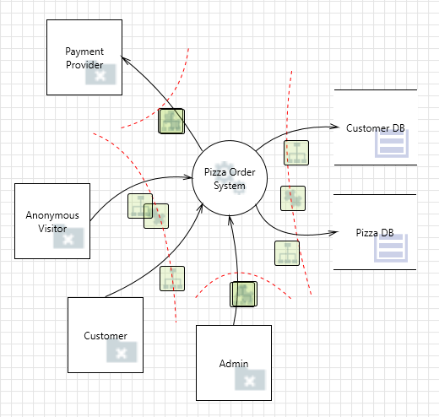
Threat Modeling in a nutshell
What are we working on?
list your assets, users and external entities
draw a diagram
DFDs and the C4 model could be a good starting point
Assets | User | Ext. Entities
credit card data | anonymous | payment-provider
usernames | customer
passwords | admin
pizza prices
pizza configurations
…
https://docs.microsoft.com/en-us/learn/modules/tm-introduction-to-threat-modeling/2-step-1-design-phase
https://c4model.com/

Slide 26
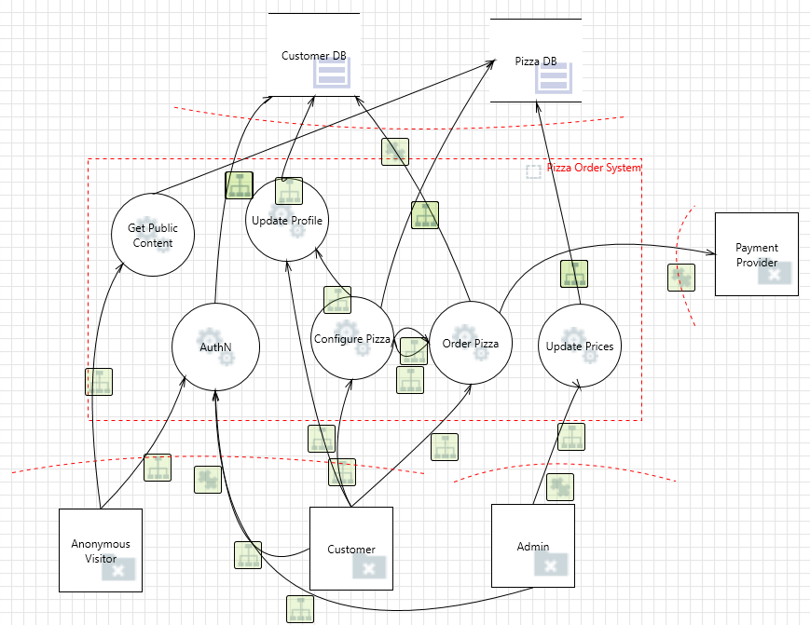

Slide 27
Threat Modeling in a nutshell
2. What can go wrong?
Design Principles, OWASP Top 10 …
STRIDE
Spoofing
Tampering
Repudiation
Information Disclosure
Denial of Service
Elevation of Privileges
https://www.microsoft.com/security/blog/2007/09/11/stride-chart/
Notes:
S: Login as another customer and order a free pizza
- auth & session mgmt.
- csrf / clickjacking
- XSS
T: Competitor modifies pizza prices / customer modifies pizza prices to 0€
R: Somebody orders a pizza and afterwards says he didn’t
I: Credit Card data gets leaked
D: Nobody can order pizza
E: somebody can get admin privileges

Slide 28
Threat Modeling in a nutshell
3. What are we going to do about it?
Think about “how” the scenarios can happen and how to prevent it
Use resources like OWASP ASVS
https://owasp.org/www-project-application-security-verification-standard/
Notes:
S: Login as another customer and order a free pizza
- auth & session mgmt.
- csrf / clickjacking
- XSS
T: Competitor modifies pizza prices / customer modifies pizza prices to 0€
R: Somebody orders a pizza and afterwards says he didn’t
I: Credit Card data gets leaked
D: Nobody can order pizza
E: somebody can get admin privileges

Slide 29
ChatGPT as a Threat Model „Expert“
Give it a lot of details for your initial threat model
Shape the prompt according to best practices
e.g.: https://danielmiessler.com/p/response-shaping-how-to-move-from-ai-prompts-to-ai-whispering/
Tell the system who to behave as
Tell the system what format it produces
Give it the main task you want done
…
Explain your current task for the ongoing threat model

Slide 30
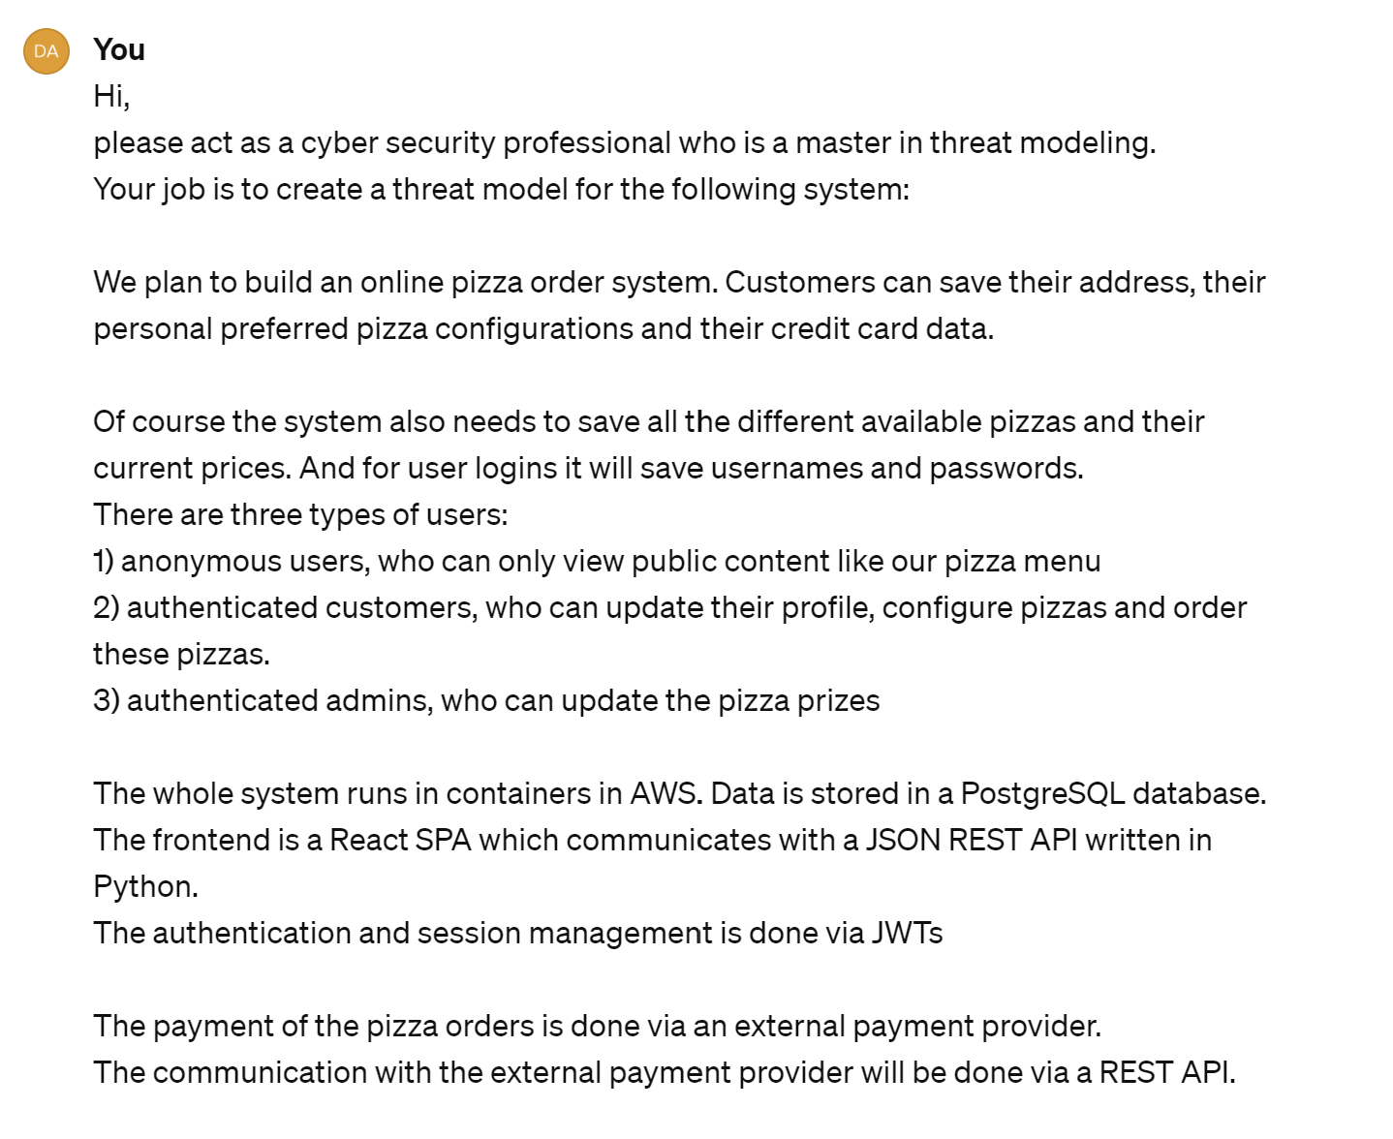
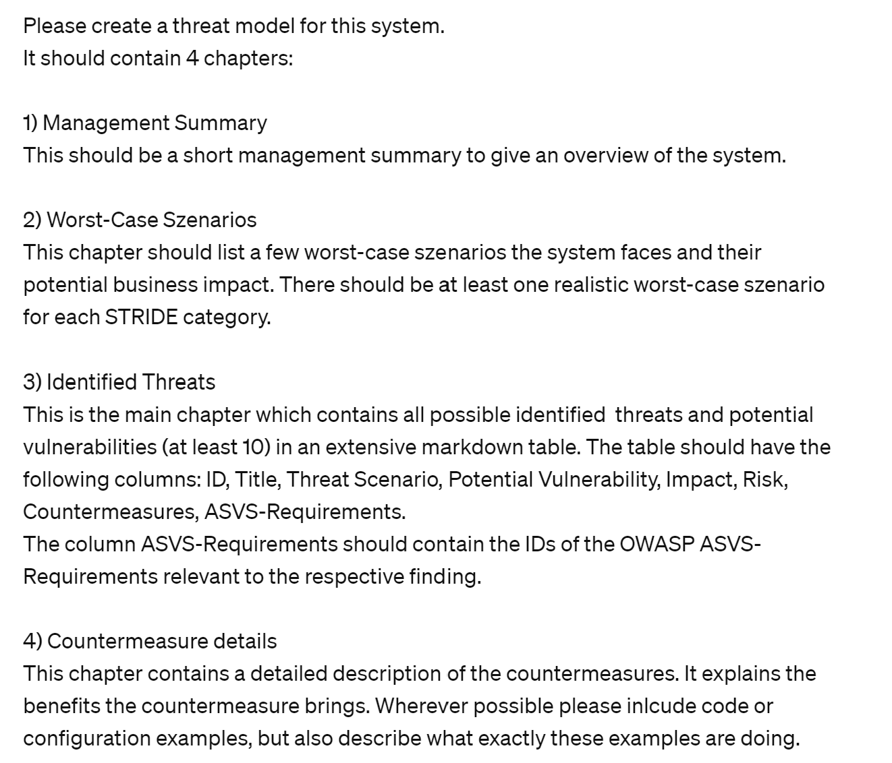
The initial Threat Model

Slide 31
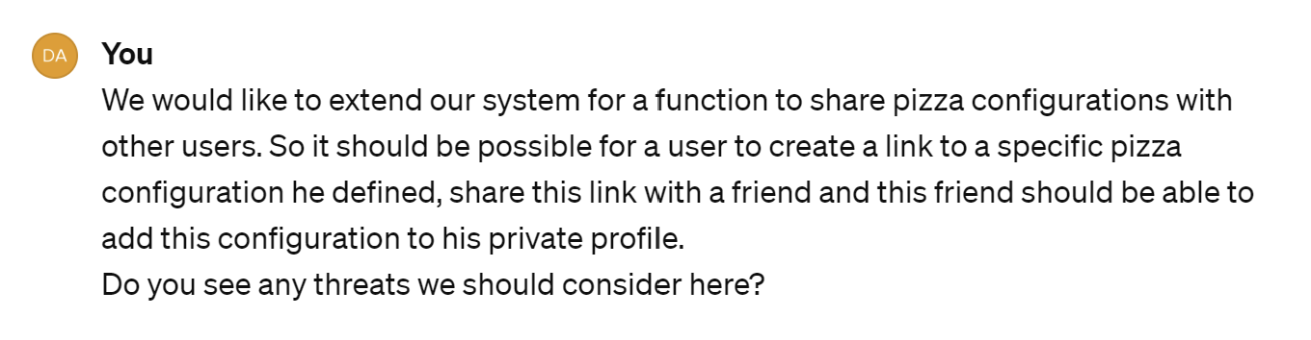
The ongoing Threat Model

Slide 32
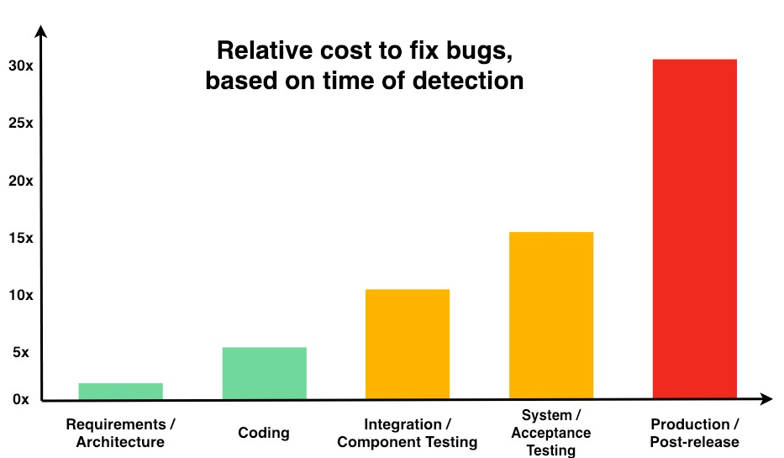
It’s even cheaper to invest in a secure design
https://deepsource.io/blog/exponential-cost-of-fixing-bugs/

Slide 33
Design vs. Architecture
WTF is the difference?

Slide 34
Design vs. Architecture
An application consists of multiple building blocks
Design
Every decision to combine these building blocks in a specific way
Architecture
The most significant design decisions (high cost of change)
All architecture is design, but not all design is architecture.
Grady Booch
https://static.architectis.je/software-architecture-for-developers.pdf

Slide 35
Insecure Design | SQL Injection
Goal | Exploit design flaws to do all kinds of bad stuff
How
Solution
OWASP Top 10
(Primary) Violated Principle

Slide 36
Insecure Design | SQL Injection
Goal | Exploit design flaws to do all kinds of bad stuff
How | Understand the internal structure and workflows of an application
Solution
OWASP Top 10
(Primary) Violated Principle

Slide 37
Insecure Design | SQL Injection
Goal | Exploit design flaws to do all kinds of bad stuff
How | Understand the internal structure and workflows of an application
Solution | Stick to the secure design principles
OWASP Top 10
(Primary) Violated Principle

Slide 38
Insecure Design | SQL Injection
Goal | Exploit design flaws to do all kinds of bad stuff
How | Understand the internal structure and workflows of an application
Solution | Stick to the secure design principles Utilize proven secure design patterns
OWASP Top 10
(Primary) Violated Principle

Slide 39
Insecure Design | SQL Injection
Goal | Exploit design flaws to do all kinds of bad stuff
How | Understand the internal structure and workflows of an application
Solution | Stick to the secure design principles Utilize proven secure design patterns Include Threat Modeling in your SSDLC (design phase)
OWASP Top 10
(Primary) Violated Principle

Slide 40
Insecure Design | SQL Injection
Goal | Exploit design flaws to do all kinds of bad stuff
How | Understand the internal structure and workflows of an application
Solution | Stick to the secure design principles Utilize proven secure design patterns Include Threat Modeling in your SSDLC (design phase)
OWASP Top 10 | A04:2021-Insecure Design
(Primary) Violated Principle

Slide 41
Insecure Design | SQL Injection
Goal | Exploit design flaws to do all kinds of bad stuff
How | Understand the internal structure and workflows of an application
Solution | Stick to the secure design principles Utilize proven secure design patterns Include Threat Modeling in your SSDLC (design phase)
OWASP Top 10 | A04:2021-Insecure Design
(Primary) Violated Principle | „Earn or give, but never assume, trust.“

Slide 42
3rd party components
It’s ok to use 3rd party components
libraries
frameworks
etc.
Just be aware you also include their problems
e.g. Commons Collection in 2015
And act appropriately

Slide 43
Vulnerabilities in 3rd Party Components | SQL Injection
Goal | Compromising an application by exploiting a publicly known vulnerability in one of it’s included components (libraries, frameworks etc.)
How
Solution
OWASP Top 10
(Primary) Violated Principle
Notes:
https://docs.github.com/en/free-pro-team@latest/github/managing-security-vulnerabilities/about-alerts-for-vulnerable-dependencies

Slide 44
Vulnerabilities in 3rd Party Components | SQL Injection
Goal | Compromising an application by exploiting a publicly known vulnerability in one of it’s included components (libraries, frameworks etc.)
How | Fingerprint application Search the web for corresponding vulnerabilities and exploits e.g. https://www.cvedetails.com/, https://www.exploit-db.com/, https://www.opencve.io, etc.
Solution
OWASP Top 10
(Primary) Violated Principle
Notes:
https://docs.github.com/en/free-pro-team@latest/github/managing-security-vulnerabilities/about-alerts-for-vulnerable-dependencies

Slide 45
Vulnerabilities in 3rd Party Components | SQL Injection
Goal | Compromising an application by exploiting a publicly known vulnerability in one of it’s included components (libraries, frameworks etc.)
How | Fingerprint application Search the web for corresponding vulnerabilities and exploits e.g. https://www.cvedetails.com/, https://www.exploit-db.com/, https://www.opencve.io, etc.
Solution | Be aware of all components you have in use
OWASP Top 10
(Primary) Violated Principle
Notes:
https://docs.github.com/en/free-pro-team@latest/github/managing-security-vulnerabilities/about-alerts-for-vulnerable-dependencies

Slide 46
Vulnerabilities in 3rd Party Components | SQL Injection
Goal | Compromising an application by exploiting a publicly known vulnerability in one of it’s included components (libraries, frameworks etc.)
How | Fingerprint application Search the web for corresponding vulnerabilities and exploits e.g. https://www.cvedetails.com/, https://www.exploit-db.com/, https://www.opencve.io, etc.
Solution | Be aware of all components you have in use Check all components for publicly known vulnerabilities Tools can help you with this task, e.g. GitHub Dependabot OWASP Dependency Check Sonatype Nexus IQ / Lifecycle Synopsys Black Duck Software Composition Analysis etc…
OWASP Top 10
(Primary) Violated Principle
Notes:
https://docs.github.com/en/free-pro-team@latest/github/managing-security-vulnerabilities/about-alerts-for-vulnerable-dependencies

Slide 47






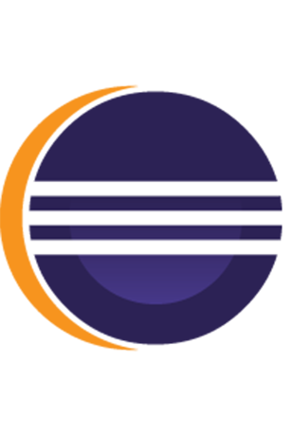








Src Control
3rd party check
IDE
CI/CD

Slide 48
Vulnerabilities in 3rd Party Components | SQL Injection
Goal | Compromising an application by exploiting a publicly known vulnerability in one of it’s included components (libraries, frameworks etc.)
How | Fingerprint application Search the web for corresponding vulnerabilities and exploits e.g. https://www.cvedetails.com/, https://www.exploit-db.com/, https://www.opencve.io, etc.
Solution | Be aware of all components you have in use Check all components for publicly known vulnerabilities Tools can help you with this task, e.g. GitHub Dependabot OWASP Dependency Check Sonatype Nexus IQ / Lifecycle Synopsys Black Duck Software Composition Analysis etc…
OWASP Top 10
(Primary) Violated Principle
Notes:
https://docs.github.com/en/free-pro-team@latest/github/managing-security-vulnerabilities/about-alerts-for-vulnerable-dependencies

Slide 49
Vulnerabilities in 3rd Party Components | SQL Injection
Goal | Compromising an application by exploiting a publicly known vulnerability in one of it’s included components (libraries, frameworks etc.)
How | Fingerprint application Search the web for corresponding vulnerabilities and exploits e.g. https://www.cvedetails.com/, https://www.exploit-db.com/, https://www.opencve.io, etc.
Solution | Be aware of all components you have in use Check all components for publicly known vulnerabilities Tools can help you with this task, e.g. GitHub Dependabot OWASP Dependency Check Sonatype Nexus IQ / Lifecycle Synopsys Black Duck Software Composition Analysis etc… Perform checks as early as possible in the development lifecycle
OWASP Top 10
(Primary) Violated Principle
Notes:
https://docs.github.com/en/free-pro-team@latest/github/managing-security-vulnerabilities/about-alerts-for-vulnerable-dependencies

Slide 50
Vulnerabilities in 3rd Party Components | SQL Injection
Goal | Compromising an application by exploiting a publicly known vulnerability in one of it’s included components (libraries, frameworks etc.)
How | Fingerprint application Search the web for corresponding vulnerabilities and exploits e.g. https://www.cvedetails.com/, https://www.exploit-db.com/, https://www.opencve.io, etc.
Solution | Be aware of all components you have in use Check all components for publicly known vulnerabilities Tools can help you with this task, e.g. GitHub Dependabot OWASP Dependency Check Sonatype Nexus IQ / Lifecycle Synopsys Black Duck Software Composition Analysis etc… Perform checks as early as possible in the development lifecycle For very high protection needs: consider to audit them
OWASP Top 10
(Primary) Violated Principle
Notes:
https://docs.github.com/en/free-pro-team@latest/github/managing-security-vulnerabilities/about-alerts-for-vulnerable-dependencies

Slide 51
Vulnerabilities in 3rd Party Components | SQL Injection
Goal | Compromising an application by exploiting a publicly known vulnerability in one of it’s included components (libraries, frameworks etc.)
How | Fingerprint application Search the web for corresponding vulnerabilities and exploits e.g. https://www.cvedetails.com/, https://www.exploit-db.com/, https://www.opencve.io, etc.
Solution | Be aware of all components you have in use Check all components for publicly known vulnerabilities Tools can help you with this task, e.g. GitHub Dependabot OWASP Dependency Check Sonatype Nexus IQ / Lifecycle Synopsys Black Duck Software Composition Analysis etc… Perform checks as early as possible in the development lifecycle For very high protection needs: consider to audit them
OWASP Top 10 | A06:2021-Vulnerable and Outdated Components
(Primary) Violated Principle
Notes:
https://docs.github.com/en/free-pro-team@latest/github/managing-security-vulnerabilities/about-alerts-for-vulnerable-dependencies

Slide 52
Vulnerabilities in 3rd Party Components | SQL Injection
Goal | Compromising an application by exploiting a publicly known vulnerability in one of it’s included components (libraries, frameworks etc.)
How | Fingerprint application Search the web for corresponding vulnerabilities and exploits e.g. https://www.cvedetails.com/, https://www.exploit-db.com/, https://www.opencve.io, etc.
Solution | Be aware of all components you have in use Check all components for publicly known vulnerabilities Tools can help you with this task, e.g. GitHub Dependabot OWASP Dependency Check Sonatype Nexus IQ / Lifecycle Synopsys Black Duck Software Composition Analysis etc… Perform checks as early as possible in the development lifecycle For very high protection needs: consider to audit them
OWASP Top 10 | A06:2021-Vulnerable and Outdated Components
(Primary) Violated Principle | „Understand how integrating external components changes your attack surface“
Notes:
https://docs.github.com/en/free-pro-team@latest/github/managing-security-vulnerabilities/about-alerts-for-vulnerable-dependencies

Slide 53
let‘s talk about integrity

Slide 54


3rd party repo
IDE
Src Control
CI/CD

Slide 55
Software and Data Integrity Failures | SQL Injection
Goal | Manipulate the application itself or the application’s data.
How
Solution | Review process (e.g. 4 eyes principle) for all code changes Strict access control for CI/CD pipeline and servers / DBs Obtain 3rd party components from trusted sources only Use TLS for all communication Explicitly ensure integrity (e.g. via digital signatures) for updates / software packages critical data serialized data streams
OWASP Top 10
(Primary) Violated Principle

Slide 56
Software and Data Integrity Failures | SQL Injection
Goal | Manipulate the application itself or the application’s data.
How | Diverse manipulation options along the whole application lifecycle
Solution | Review process (e.g. 4 eyes principle) for all code changes Strict access control for CI/CD pipeline and servers / DBs Obtain 3rd party components from trusted sources only Use TLS for all communication Explicitly ensure integrity (e.g. via digital signatures) for updates / software packages critical data serialized data streams
OWASP Top 10
(Primary) Violated Principle

Slide 57
Software and Data Integrity Failures | SQL Injection
Goal | Manipulate the application itself or the application’s data.
How | Diverse manipulation options along the whole application lifecycle
Solution | Review process (e.g. 4 eyes principle) for all code changes Strict access control for CI/CD pipeline and servers / DBs Obtain 3rd party components from trusted sources only Use TLS for all communication Explicitly ensure integrity (e.g. via digital signatures) for updates / software packages critical data serialized data streams
OWASP Top 10
(Primary) Violated Principle

Slide 58
Software and Data Integrity Failures | SQL Injection
Goal | Manipulate the application itself or the application’s data.
How | Diverse manipulation options along the whole application lifecycle
Solution | Review process (e.g. 4 eyes principle) for all code changes Strict access control for CI/CD pipeline and servers / DBs Obtain 3rd party components from trusted sources only Use TLS for all communication Explicitly ensure integrity (e.g. via digital signatures) for updates / software packages critical data serialized data streams
OWASP Top 10
(Primary) Violated Principle

Slide 59
Software and Data Integrity Failures | SQL Injection
Goal | Manipulate the application itself or the application’s data.
How | Diverse manipulation options along the whole application lifecycle
Solution | Review process (e.g. 4 eyes principle) for all code changes Strict access control for CI/CD pipeline and servers / DBs Obtain 3rd party components from trusted sources only Use TLS for all communication Explicitly ensure integrity (e.g. via digital signatures) for updates / software packages critical data serialized data streams
OWASP Top 10
(Primary) Violated Principle

Slide 60
Software and Data Integrity Failures | SQL Injection
Goal | Manipulate the application itself or the application’s data.
How | Diverse manipulation options along the whole application lifecycle
Solution | Review process (e.g. 4 eyes principle) for all code changes Strict access control for CI/CD pipeline and servers / DBs Obtain 3rd party components from trusted sources only Use TLS for all communication Explicitly ensure integrity (e.g. via digital signatures) for updates / software packages critical data serialized data streams
OWASP Top 10
(Primary) Violated Principle

Slide 61
Software and Data Integrity Failures | SQL Injection
Goal | Manipulate the application itself or the application’s data.
How | Diverse manipulation options along the whole application lifecycle
Solution | Review process (e.g. 4 eyes principle) for all code changes Strict access control for CI/CD pipeline and servers / DBs Obtain 3rd party components from trusted sources only Use TLS for all communication Explicitly ensure integrity (e.g. via digital signatures) for updates / software packages critical data serialized data streams
OWASP Top 10
(Primary) Violated Principle

Slide 62
Software and Data Integrity Failures | SQL Injection
Goal | Manipulate the application itself or the application’s data.
How | Diverse manipulation options along the whole application lifecycle
Solution | Review process (e.g. 4 eyes principle) for all code changes Strict access control for CI/CD pipeline and servers / DBs Obtain 3rd party components from trusted sources only Use TLS for all communication Explicitly ensure integrity (e.g. via digital signatures) for updates / software packages critical data serialized data streams
OWASP Top 10 | A08:2021-Software and Data Integrity Failures
(Primary) Violated Principle

Slide 63
Software and Data Integrity Failures | SQL Injection
Goal | Manipulate the application itself or the application’s data.
How | Diverse manipulation options along the whole application lifecycle
Solution | Review process (e.g. 4 eyes principle) for all code changes Strict access control for CI/CD pipeline and servers / DBs Obtain 3rd party components from trusted sources only Use TLS for all communication Explicitly ensure integrity (e.g. via digital signatures) for updates / software packages critical data serialized data streams
OWASP Top 10 | A08:2021-Software and Data Integrity Failures
(Primary) Violated Principle | „Define an approach that ensures all data are explicitly validated.“

Slide 64
Serialization / Deserialization
Serialization
turns objects into a data format suitable for storage and communication
e.g. JSON, XML, Binary …
Deserialization
restores objects from some data format

Slide 65
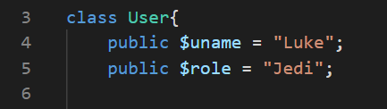
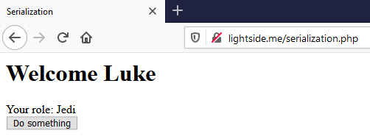
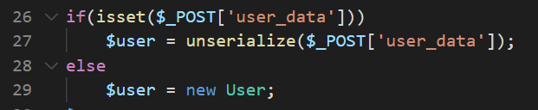
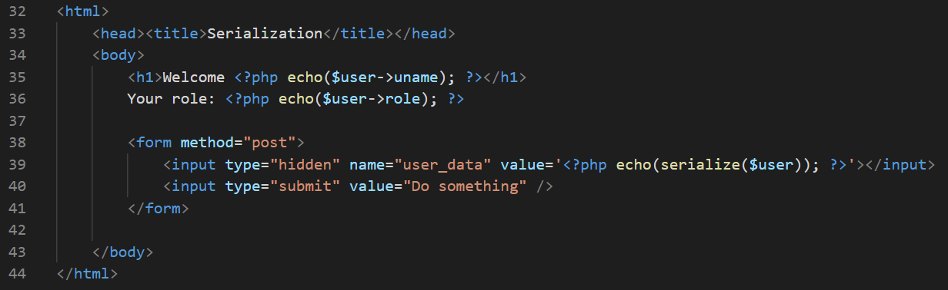
Notes:
Beispiel anhand von PHP

Slide 66
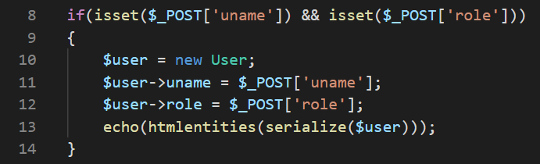
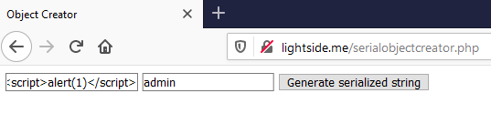

Slide 67
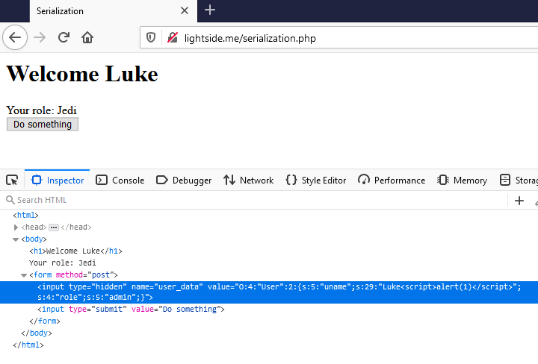

Slide 68
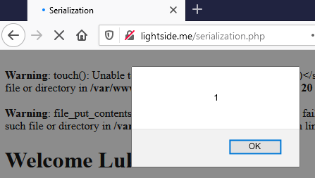
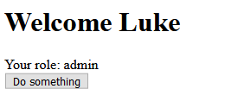

Slide 69
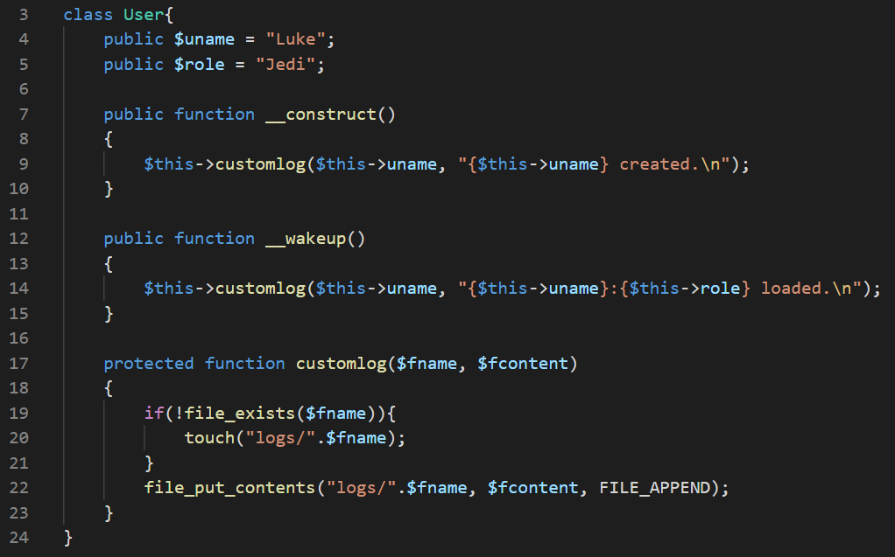

Slide 70
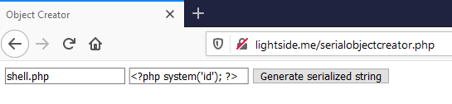
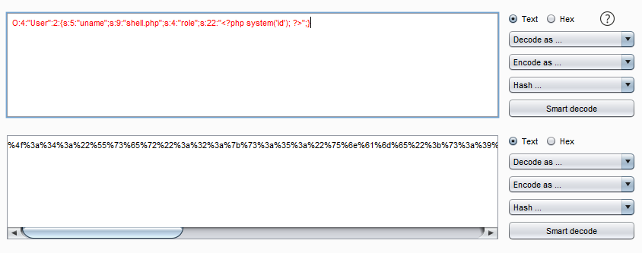

Slide 71
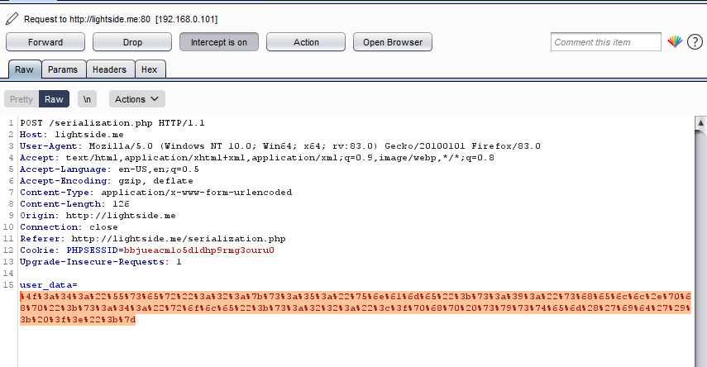
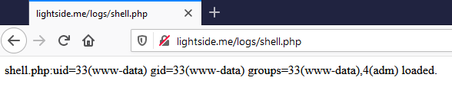

Slide 72
Example: PHP Deserialization
At least three possible problems:
Missing Input Validation
Objects are often seen as “trusted” and aren’t validated
Nonsense if they come from an untrusted place (e.g. user, remote datastore etc.)
Dangerous Code in Magic-Functions
e.g. filesystem-operations, system-interaction, eval, etc.
Bugs in underlying C-Code
Recommended reading:
https://www.netsparker.com/blog/web-security/untrusted-data-unserialize-php/

Slide 73
Nice example from 2015
Commons Collections Library
Deserialization vulnerability that led to RCE
Extremely popular in Java world
WebSphere
Jboss
Weblogic
Java RMI (Remote Method Invocation)
and every application that directly uses CC
Nice writeup
https://foxglovesecurity.com/2015/11/06/what-do-weblogic-websphere-jboss-jenkins-opennms-and-your-application-have-in-common-this-vulnerability/
Try it on your own
https://portswigger.net/web-security/deserialization/exploiting/lab-deserialization-exploiting-java-deserialization-with-apache-commons
Notes:
Gutes Beispiel aus der Vergangenheit: Java Apache Commons Collections!
https://foxglovesecurity.com/2015/11/06/what-do-weblogic-websphere-jboss-jenkins-opennms-and-your-application-have-in-common-this-vulnerability/
https://portswigger.net/web-security/deserialization/exploiting/lab-deserialization-exploiting-java-deserialization-with-apache-commons
https://github.com/frohoff/ysoserial

Slide 74
Insecure Deserialization | SQL Injection
Goal | Inject manipulated objects to bypass security checks or execute arbitrary code.
How
Solution
OWASP Top 10
(Primary) Violated Principle

Slide 75
Insecure Deserialization | SQL Injection
Goal | Inject manipulated objects to bypass security checks or execute arbitrary code.
How | By manipulation of serialized objects.
Solution
OWASP Top 10
(Primary) Violated Principle

Slide 76
Insecure Deserialization | SQL Injection
Goal | Inject manipulated objects to bypass security checks or execute arbitrary code.
How | By manipulation of serialized objects.
Solution | Avoid deserialization of objects from untrusted sources
OWASP Top 10
(Primary) Violated Principle

Slide 77
Insecure Deserialization | SQL Injection
Goal | Inject manipulated objects to bypass security checks or execute arbitrary code.
How | By manipulation of serialized objects.
Solution | Avoid deserialization of objects from untrusted sources Avoid using native (de)serialization and use safer alternatives like JSON, XML, YAML (correctly) e.g. JSON.parse (and never eval), correctly configured and hardened parsers
OWASP Top 10
(Primary) Violated Principle

Slide 78
Insecure Deserialization | SQL Injection
Goal | Inject manipulated objects to bypass security checks or execute arbitrary code.
How | By manipulation of serialized objects.
Solution | Avoid deserialization of objects from untrusted sources Avoid using native (de)serialization and use safer alternatives like JSON, XML, YAML (correctly) e.g. JSON.parse (and never eval), correctly configured and hardened parsers If you use native (de)serialization, only deserialize signed data
OWASP Top 10
(Primary) Violated Principle

Slide 79
Insecure Deserialization | SQL Injection
Goal | Inject manipulated objects to bypass security checks or execute arbitrary code.
How | By manipulation of serialized objects.
Solution | Avoid deserialization of objects from untrusted sources Avoid using native (de)serialization and use safer alternatives like JSON, XML, YAML (correctly) e.g. JSON.parse (and never eval), correctly configured and hardened parsers If you use native (de)serialization, only deserialize signed data Observe language specifics https://cheatsheetseries.owasp.org/cheatsheets/Deserialization_Cheat_Sheet.html
OWASP Top 10
(Primary) Violated Principle

Slide 80
Insecure Deserialization | SQL Injection
Goal | Inject manipulated objects to bypass security checks or execute arbitrary code.
How | By manipulation of serialized objects.
Solution | Avoid deserialization of objects from untrusted sources Avoid using native (de)serialization and use safer alternatives like JSON, XML, YAML (correctly) e.g. JSON.parse (and never eval), correctly configured and hardened parsers If you use native (de)serialization, only deserialize signed data Observe language specifics https://cheatsheetseries.owasp.org/cheatsheets/Deserialization_Cheat_Sheet.html Strictly validate input
OWASP Top 10
(Primary) Violated Principle

Slide 81
Insecure Deserialization | SQL Injection
Goal | Inject manipulated objects to bypass security checks or execute arbitrary code.
How | By manipulation of serialized objects.
Solution | Avoid deserialization of objects from untrusted sources Avoid using native (de)serialization and use safer alternatives like JSON, XML, YAML (correctly) e.g. JSON.parse (and never eval), correctly configured and hardened parsers If you use native (de)serialization, only deserialize signed data Observe language specifics https://cheatsheetseries.owasp.org/cheatsheets/Deserialization_Cheat_Sheet.html Strictly validate input
OWASP Top 10 | A8:2017-Insecure Deserialization
(Primary) Violated Principle

Slide 82
Insecure Deserialization | SQL Injection
Goal | Inject manipulated objects to bypass security checks or execute arbitrary code.
How | By manipulation of serialized objects.
Solution | Avoid deserialization of objects from untrusted sources Avoid using native (de)serialization and use safer alternatives like JSON, XML, YAML (correctly) e.g. JSON.parse (and never eval), correctly configured and hardened parsers If you use native (de)serialization, only deserialize signed data Observe language specifics https://cheatsheetseries.owasp.org/cheatsheets/Deserialization_Cheat_Sheet.html Strictly validate input
OWASP Top 10 | A8:2017-Insecure Deserialization
(Primary) Violated Principle | „Define an approach that ensures all data are explicitly validated.“

Slide 83









Slide 84
Security Logging and Monitoring Failures | SQL Injection
Goal | Hide attacks and go unnoticed.
How
Solution
OWASP Top 10
(Primary) Violated Principle
Notes:
Zwar nicht unbedingt direkt eine eigene Schwachstelle, aber trotzdem wichtig.

Slide 85
Security Logging and Monitoring Failures | SQL Injection
Goal | Hide attacks and go unnoticed.
How | Security relevant events are not logged appropriately
Solution
OWASP Top 10
(Primary) Violated Principle

Slide 86
Security Logging and Monitoring Failures | SQL Injection
Goal | Hide attacks and go unnoticed.
How | Security relevant events are not logged appropriately Logs are not monitored regularly
Solution
OWASP Top 10
(Primary) Violated Principle

Slide 87
Security Logging and Monitoring Failures | SQL Injection
Goal | Hide attacks and go unnoticed.
How | Security relevant events are not logged appropriately Logs are not monitored regularly No appropriate alert thresholds are in place
Solution
OWASP Top 10
(Primary) Violated Principle

Slide 88
Security Logging and Monitoring Failures | SQL Injection
Goal | Hide attacks and go unnoticed.
How | Security relevant events are not logged appropriately Logs are not monitored regularly No appropriate alert thresholds are in place No suitable response process is in place
Solution
OWASP Top 10
(Primary) Violated Principle

Slide 89
Security Logging and Monitoring Failures | SQL Injection
Goal | Hide attacks and go unnoticed.
How | Security relevant events are not logged appropriately Logs are not monitored regularly No appropriate alert thresholds are in place No suitable response process is in place
Solution | Define which events are security relevant and therefore should be logged e.g. failed authentication attempts, access control violation attempts, input validation failures, CSP reportings etc.
OWASP Top 10
(Primary) Violated Principle

Slide 90
Security Logging and Monitoring Failures | SQL Injection
Goal | Hide attacks and go unnoticed.
How | Security relevant events are not logged appropriately Logs are not monitored regularly No appropriate alert thresholds are in place No suitable response process is in place
Solution | Define which events are security relevant and therefore should be logged e.g. failed authentication attempts, access control violation attempts, input validation failures, CSP reportings etc. Use consistent log formats throughout your organization
OWASP Top 10
(Primary) Violated Principle

Slide 91
Security Logging and Monitoring Failures | SQL Injection
Goal | Hide attacks and go unnoticed.
How | Security relevant events are not logged appropriately Logs are not monitored regularly No appropriate alert thresholds are in place No suitable response process is in place
Solution | Define which events are security relevant and therefore should be logged e.g. failed authentication attempts, access control violation attempts, input validation failures, CSP reportings etc. Use consistent log formats throughout your organization Centralize logs in a tamper-proof system
OWASP Top 10
(Primary) Violated Principle

Slide 92
Security Logging and Monitoring Failures | SQL Injection
Goal | Hide attacks and go unnoticed.
How | Security relevant events are not logged appropriately Logs are not monitored regularly No appropriate alert thresholds are in place No suitable response process is in place
Solution | Define which events are security relevant and therefore should be logged e.g. failed authentication attempts, access control violation attempts, input validation failures, CSP reportings etc. Use consistent log formats throughout your organization Centralize logs in a tamper-proof system Implement appropriate monitoring, alarm thresholds and response processes -> and also test them!
OWASP Top 10
(Primary) Violated Principle

Slide 93
Security Logging and Monitoring Failures | SQL Injection
Goal | Hide attacks and go unnoticed.
How | Security relevant events are not logged appropriately Logs are not monitored regularly No appropriate alert thresholds are in place No suitable response process is in place
Solution | Define which events are security relevant and therefore should be logged e.g. failed authentication attempts, access control violation attempts, input validation failures, CSP reportings etc. Use consistent log formats throughout your organization Centralize logs in a tamper-proof system Implement appropriate monitoring, alarm thresholds and response processes -> and also test them!
OWASP Top 10 | A09:2021-Security Logging and Monitoring Failures
(Primary) Violated Principle

Slide 94
Security Logging and Monitoring Failures | SQL Injection
Goal | Hide attacks and go unnoticed.
How | Security relevant events are not logged appropriately Logs are not monitored regularly No appropriate alert thresholds are in place No suitable response process is in place
Solution | Define which events are security relevant and therefore should be logged e.g. failed authentication attempts, access control violation attempts, input validation failures, CSP reportings etc. Use consistent log formats throughout your organization Centralize logs in a tamper-proof system Implement appropriate monitoring, alarm thresholds and response processes -> and also test them!
OWASP Top 10 | A09:2021-Security Logging and Monitoring Failures
(Primary) Violated Principle | „Earn or give, but never assume, trust.“

Slide 96
Web Application Firewalls
Monitors and filters HTTP traffic
mainly operates on predefined ruleset and/or learning mode
Do not rely on a WAF as your primary defense mechanism
many circumvention techniques, exploits etc. available
Valid usage
additional protection (2nd line of defense) against common web application attacks, e.g. SQLi, XSS, Bruteforcing etc.
quick temporary fixes
centralized AV scan for file uploads
protection of legacy applications
web application IDS
Always configure them properly!
Notes:
Gibts als eigenständige appliances, aber auch z.B. als Plugins für Proxy, Webserver etc.

Slide 97
Key messages
A secure design is worth the money
Include Threat Modeling in your SSDLC!
Explicitly ensure the integrity of your software (components) and your critical data
Be aware of your included 3rd party components and their current security status
Implement structured, consistent and centralized logging and monitoring
Use WAFs for the right purpose

