Slide 1
Conclusions
pretty tough place this web, huh…

Slide 2
Rough Overview
Introduction
Basic Principles and Resources
Architecture & Basic Web Procedure
Authentication and Session Management
Authorization
Server and Backend Attacks
Remaining Client Attacks
General Topics
>> Conclusions <<

Slide 3












Slide 4
Security Principles | SQL Injection
Earn or give, but never assume, trust. | DNS Hijacking Plaintext Transmission Client-side Manipulation (of cookies) CSRF Forceful Browsing XML External Entitiy (XXE) Clickjacking Insufficient Logging and Monitoring
Use an authentication mechanism that cannot be bypassed or tampered with. | Authentication Automation Attacks
Authorize after you authenticate | Forceful Browsing Insec. Direct Object References TOCTOU (Race Condition)
Strictly separate data and control instructions, and never process control instructions received from untrusted sources. | SQL Injection XPath Injection OS Command Injection Cross-Site Scripting (XSS)
Define an approach that ensures all data are explicitly validated. | Path Traversal Insecure File Upload Unverified/Open Redirects/Forwards Insecure Deserialization
Use cryptography correctly. | Insecure Password Storage Passwords in Source Code
Identify sensitive data and how they should be handled. | Information Disclosure Session Hijacking Session Fixation
Always consider the user.
Understand how integrating external components changes your attack surface. | Vulnerabilities in 3rd Party Components
Be flexible when considering future changes to objects and actors.

Slide 5
OWASP Top 10 | SQL Injection
A1:2017-Injection | SQL Injection XPath Injection OS Command Injection
A2:2017-Broken Authentication | Authentication Automation Attacks Session Hijacking Session Fixation
A3:2017-Sensitive Data Exposure | Information Disclosure Plaintext Transmission Insecure Password Storage Passwords in Source Code
A4:2017-XML-External Entities (XXE) | XML External Entitiy (XXE)
A5:2017-Broken Access Control | Client-side Manipulation (of cookies) Forceful Browsing Insec. Direct Object References Path Traversal TOCTOU (Race Condition)
A6:2017-Security Misconfiguration | Information Disclosure
A7:2017-Cross-Site Scripting (XSS) | Cross-Site Scripting (XSS)
A8:2017-Insecure Deserialization | Insecure Deserialization
A9:2017-Using Components with Known Vulnerabilities | Vulnerabilities in 3rd Party Components
A10:2017-Insufficient Logging&Monitoring | Insufficient Logging and Monitoring
Not in OWASP Top 10 2017 | DNS Hijacking CSRF Insecure File Upload Unverified/Open Redirects/Forwards Clickjacking

Slide 6
Most important security techniques
Most vulnerabilities can be avoided by a combination of
strong authentication and session management
SQL Injection | Client-side Manipulation (of cookies)
XPath Injection | Forceful Browsing
OS Command Injection | Insec. Direct Object References
XML External Entitiy (XXE) | Path Traversal
Authentication Automation Attacks | TOCTOU (Race Condition)
Session Hijacking | Cross-Site Scripting (XSS)
Session Fixation | Insecure Deserialization
Information Disclosure | Vulnerabilities in 3rd Party Components
Plaintext Transmission | Insufficient Logging and Monitoring
Insecure Password Storage | DNS Hijacking
Passwords in Source Code | CSRF
Insecure File Upload | Unverified/Open Redirects/Forwards
Clickjacking

Slide 7
Most important security techniques
Most vulnerabilities can be avoided by a combination of
strong authentication and session management
SQL Injection | Client-side Manipulation (of cookies)
XPath Injection | Forceful Browsing
OS Command Injection | Insec. Direct Object References
XML External Entitiy (XXE) | Path Traversal
Authentication Automation Attacks | TOCTOU (Race Condition)
Session Hijacking | Cross-Site Scripting (XSS)
Session Fixation | Insecure Deserialization
Information Disclosure | Vulnerabilities in 3rd Party Components
Plaintext Transmission | Insufficient Logging and Monitoring
Insecure Password Storage | DNS Hijacking
Passwords in Source Code | CSRF
Insecure File Upload | Unverified/Open Redirects/Forwards
Clickjacking

Slide 8
Most important security techniques
Most vulnerabilities can be avoided by a combination of
strong authentication and session management
consistent authorization checks
SQL Injection | Client-side Manipulation (of cookies)
XPath Injection | Forceful Browsing
OS Command Injection | Insec. Direct Object References
XML External Entitiy (XXE) | Path Traversal
Authentication Automation Attacks | TOCTOU (Race Condition)
Session Hijacking | Cross-Site Scripting (XSS)
Session Fixation | Insecure Deserialization
Information Disclosure | Vulnerabilities in 3rd Party Components
Plaintext Transmission | Insufficient Logging and Monitoring
Insecure Password Storage | DNS Hijacking
Passwords in Source Code | CSRF
Insecure File Upload | Unverified/Open Redirects/Forwards
Clickjacking

Slide 9
Most important security techniques
Most vulnerabilities can be avoided by a combination of
strong authentication and session management
consistent authorization checks
strict input validation
context-sensitive output encoding/sanitization
SQL Injection | Client-side Manipulation (of cookies)
XPath Injection | Forceful Browsing
OS Command Injection | Insec. Direct Object References
XML External Entitiy (XXE) | Path Traversal
Authentication Automation Attacks | TOCTOU (Race Condition)
Session Hijacking | Cross-Site Scripting (XSS)
Session Fixation | Insecure Deserialization
Information Disclosure | Vulnerabilities in 3rd Party Components
Plaintext Transmission | Insufficient Logging and Monitoring
Insecure Password Storage | DNS Hijacking
Passwords in Source Code | CSRF
Insecure File Upload | Unverified/Open Redirects/Forwards
Clickjacking

Slide 10
Most important security techniques
Most vulnerabilities can be avoided by a combination of
strong authentication and session management
consistent authorization checks
strict input validation
context-sensitive output encoding/sanitization
constant TLS usage
SQL Injection | Client-side Manipulation (of cookies)
XPath Injection | Forceful Browsing
OS Command Injection | Insec. Direct Object References
XML External Entitiy (XXE) | Path Traversal
Authentication Automation Attacks | TOCTOU (Race Condition)
Session Hijacking | Cross-Site Scripting (XSS)
Session Fixation | Insecure Deserialization
Information Disclosure | Vulnerabilities in 3rd Party Components
Plaintext Transmission | Insufficient Logging and Monitoring
Insecure Password Storage | DNS Hijacking
Passwords in Source Code | CSRF
Insecure File Upload | Unverified/Open Redirects/Forwards
Clickjacking

Slide 12
and of course…

Slide 13
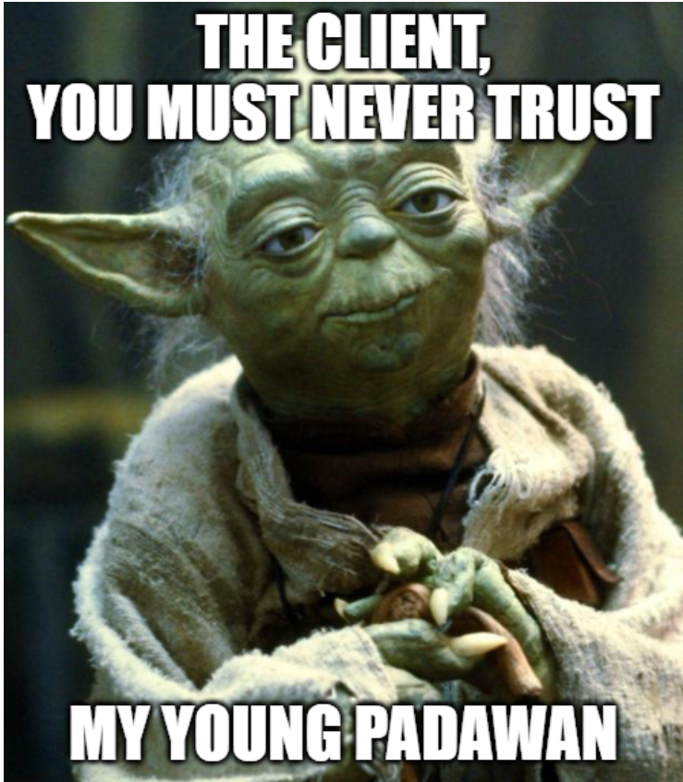
Notes:
https://imgflip.com/memegenerator/Star-Wars-Yoda

