Slide 1
Basic Principles and Resources
Saltzer & Schröder, IEEE CSD, OWASP Top 10 / STG / ASVS

Slide 2
Rough Overview
Introduction
>> Basic Principles and Resources <<
Architecture & Basic Web Procedure
Authentication and Session Management
Authorization
Server and Backend Attacks
Remaining Client Attacks
General Topics
Conclusions

Slide 3
There are a few basic principles that apply to almost all vulnerabilities

Slide 4
Economy of Mechanism
------------------------
Fail-safe Defaults
------------------------
Complete Mediation
------------------------
Least Privilege
------------------------
Least Common Mechanism
------------------------
Separation of Privilege
------------------------
Open Design
------------------------
Psychological Acceptability
- Saltzer and Schroeder, 1975 – http://web.cs.wpi.edu/~guttman/cs557_website/papers/saltzer1975.pdf
https://adam.shostack.org/blog/the-security-principles-of-saltzer-and-schroeder/
Notes:
http://web.cs.wpi.edu/~guttman/cs557_website/papers/saltzer1975.pdf
https://adam.shostack.org/blog/the-security-principles-of-saltzer-and-schroeder/
EoM: KISS
FsD: Base access decisions on permission rather than exclusion. Damit rechnen, dass Fehler passieren -> trotzdem sicheres Verhalten -> Grundsätzlich verbieten, explizit erlauben. -> Security by Default.
CM: strict authorization checks
LP: only the really needed privileges
LcM: reduce communication path
SoP: at least two keys for criticals actions | alternative interpretation: dividing an application
OD: Security may not depend on the fact that nobody knows how it works
PA: must be useable for humans

Slide 5
Earn or give, but never assume, trust.
------------------------
Use an authentication mechanism that cannot be bypassed or tampered with.
------------------------
Authorize after you authenticate
------------------------
Strictly separate data and control instructions, and never process control instructions received from untrusted sources.
------------------------
Define an approach that ensures all data are explicitly validated.
------------------------
Use cryptography correctly.
------------------------
Identify sensitive data and how they should be handled.
------------------------
Always consider the user.
------------------------
Understand how integrating external components changes your attack surface.
------------------------
Be flexible when considering future changes to objects and actors.
- IEEE Center for Secure Design, 2014 – https://ieeecs-media.computer.org/media/technical-activities/CYBSI/docs/Top-10-Flaws.pdf
Notes:
Warum das ganze? -> Mapping auf Schwachstellen und Auswertung
QUIZ: “Principles”

Slide 6
Some resources which might be useful…

Slide 7
OWASP
(Open Web Application Security Project)

Slide 8
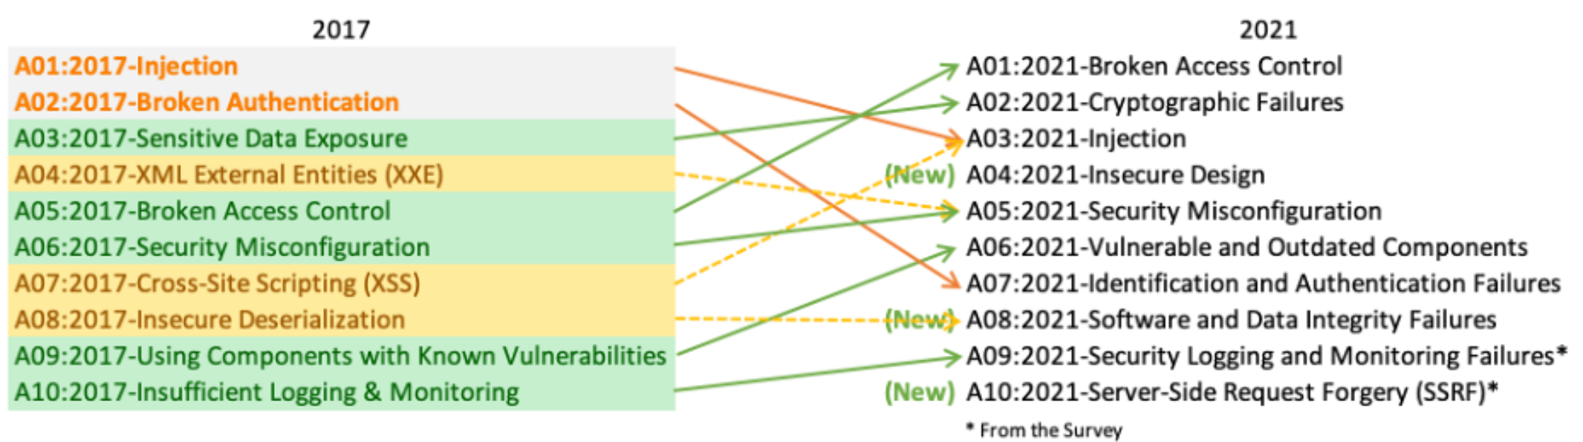
OWASP Top 10
https://owasp.org/www-project-top-ten/
https://owasp.org/Top10

Slide 9
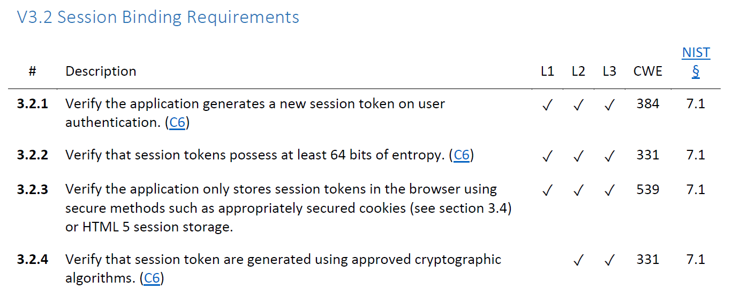
OWASP ASVS
V1: Architecture, Design and Threat Modeling Requirements
V2: Authentication Verification Requirements
V3: Session Management Verification Requirements
V4: Access Control Verification Requirements
V5: Validation, Sanitization and Encoding Verification Requirements
V6: Stored Cryptography Verification Requirements
V7: Error Handling and Logging Verification Requirements
V8: Data Protection Verification Requirements
V9: Communications Verification Requirements
V10: Malicious Code Verification Requirements
V11: Business Logic Verification Requirements
V12: File and Resources Verification Requirements
V13: API and Web Service Verification Requirements
V14: Configuration Verification Requirements
https://owasp.org/www-project-application-security-verification-standard/

Slide 10
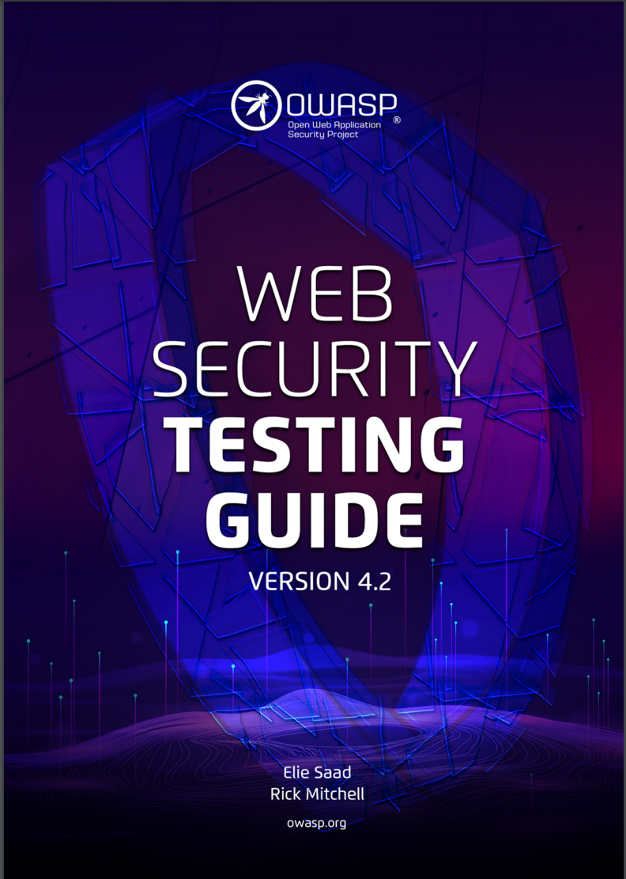
OWASP Web Security Testing Guide
https://owasp.org/www-project-web-security-testing-guide/

Slide 11
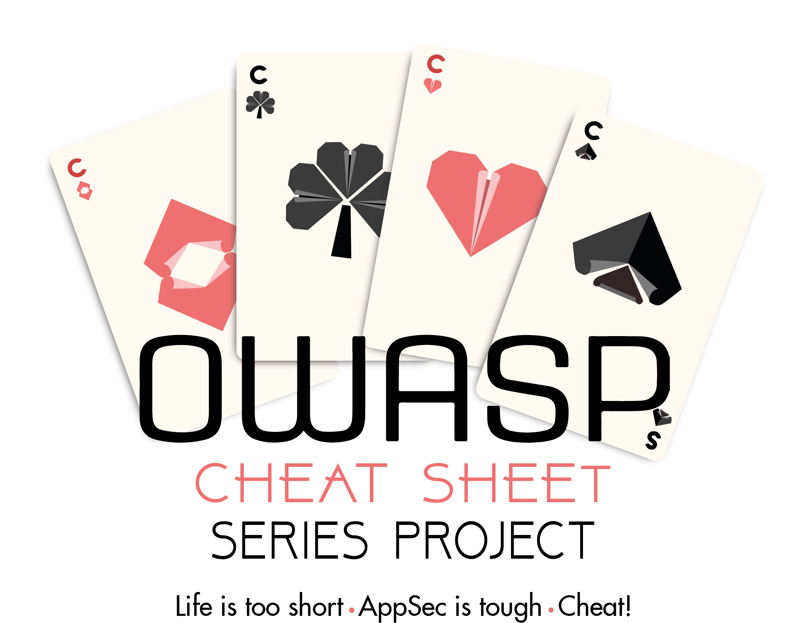
OWASP Cheat Sheet Series
https://cheatsheetseries.owasp.org/

Slide 12
Some more interesting resources
Similar courses from other universities
Feross Aboukhadijeh (Stanford)
https://web.stanford.edu/class/cs253/
Andreas Happe (FH/Technikum Wien)
https://snikt.net/WebSec.pdf
Björn Kimminich
https://github.com/bkimminich/it-security-lecture
PortSwigger Web Security Academy
https://portswigger.net/web-security
Hacker101
https://www.hacker101.com/

Slide 13
Key Messages
Sticking to a few design principles helps to avoid a lot of flaws and vulnerabilities
they also help to find flaws and vulnerabilities
A lot of great resources are available when it comes to web security
OWASP is your friend

Slide 14
Quiz Time

