Slide 1
Economy of Mechanism
------------------------
Fail-safe Defaults
------------------------
Complete Mediation
------------------------
Least Privilege
------------------------
Least Common Mechanism
------------------------
Separation of Privilege
------------------------
Open Design
------------------------
Psychological Acceptability
- Saltzer and Schroeder, 1975 – http://web.cs.wpi.edu/~guttman/cs557_website/papers/saltzer1975.pdf
https://adam.shostack.org/blog/the-security-principles-of-saltzer-and-schroeder/
Notes:
http://web.cs.wpi.edu/~guttman/cs557_website/papers/saltzer1975.pdf
https://adam.shostack.org/blog/the-security-principles-of-saltzer-and-schroeder/

Slide 2
Earn or give, but never assume, trust.
------------------------
Use an authentication mechanism that cannot be bypassed or tampered with.
------------------------
Authorize after you authenticate
------------------------
Strictly separate data and control instructions, and never process control instructions received from untrusted sources.
------------------------
Define an approach that ensures all data are explicitly validated.
------------------------
Use cryptography correctly.
------------------------
Identify sensitive data and how they should be handled.
------------------------
Always consider the user.
------------------------
Understand how integrating external components changes your attack surface.
------------------------
Be flexible when considering future changes to objects and actors.
- IEEE Center for Secure Design, 2014 – https://ieeecs-media.computer.org/media/technical-activities/CYBSI/docs/Top-10-Flaws.pdf
Notes:
Warum das ganze? -> Mapping auf Schwachstellen und Auswertung
QUIZ: “Principles”

Slide 3
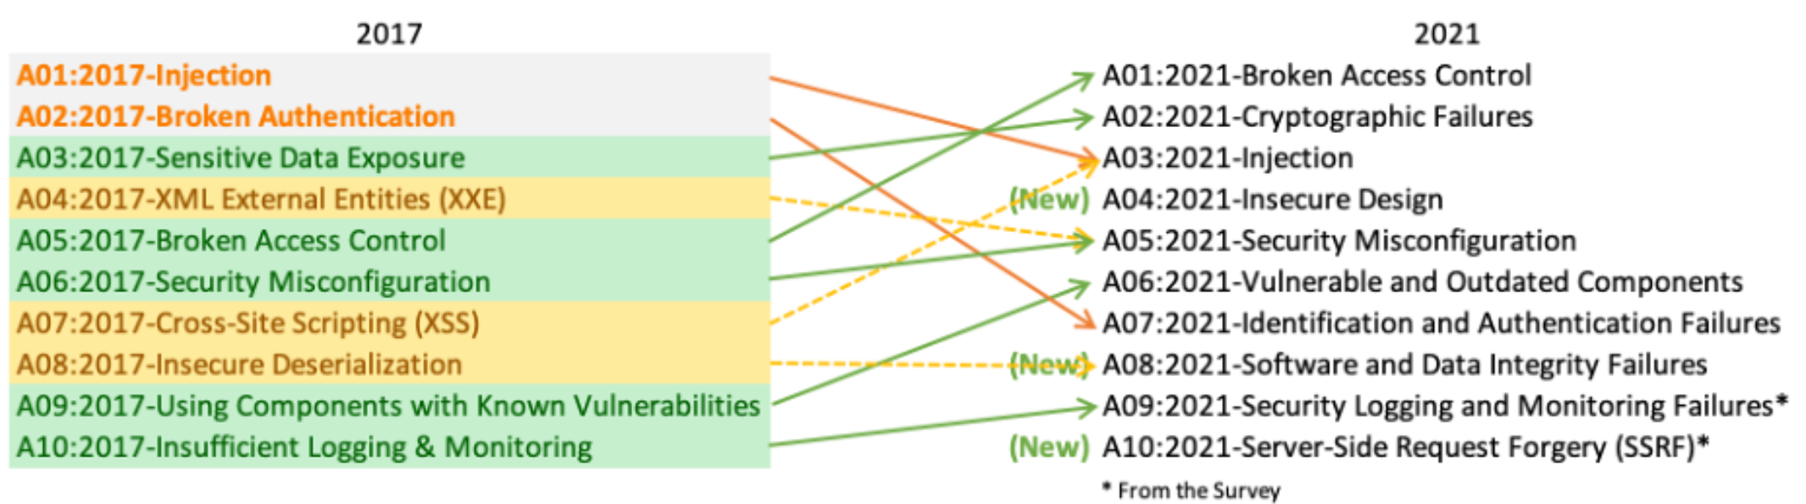
OWASP Top 10
https://owasp.org/www-project-top-ten/
https://owasp.org/Top10

Slide 4
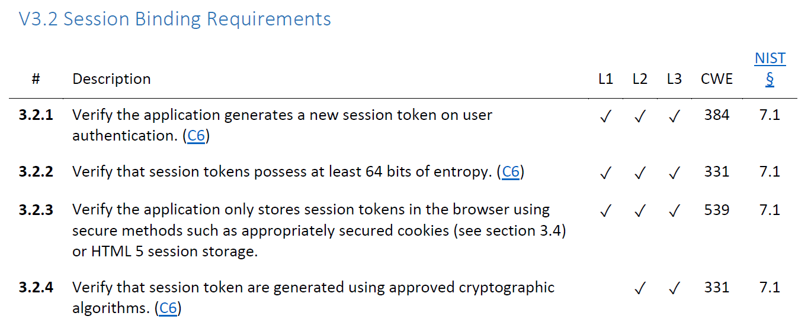
OWASP ASVS
V1: Architecture, Design and Threat Modeling Requirements
V2: Authentication Verification Requirements
V3: Session Management Verification Requirements
V4: Access Control Verification Requirements
V5: Validation, Sanitization and Encoding Verification Requirements
V6: Stored Cryptography Verification Requirements
V7: Error Handling and Logging Verification Requirements
V8: Data Protection Verification Requirements
V9: Communications Verification Requirements
V10: Malicious Code Verification Requirements
V11: Business Logic Verification Requirements
V12: File and Resources Verification Requirements
V13: API and Web Service Verification Requirements
V14: Configuration Verification Requirements
https://owasp.org/www-project-application-security-verification-standard/

Slide 5

OWASP Web Security Testing Guide
https://owasp.org/www-project-web-security-testing-guide/

Slide 6
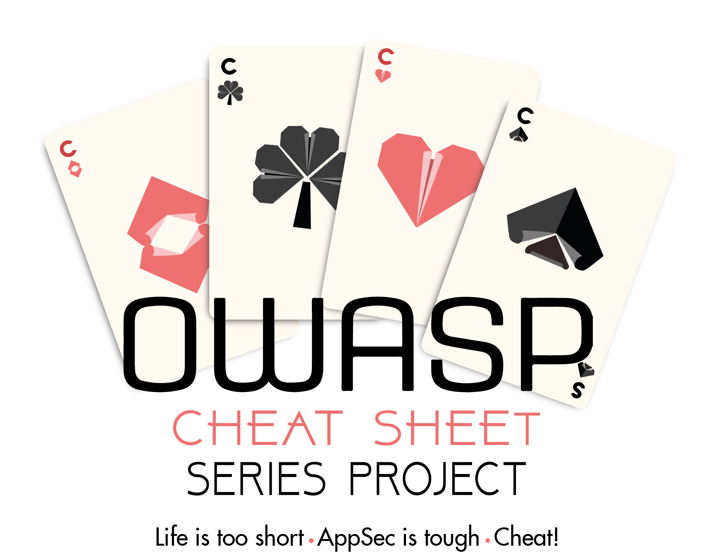
OWASP Cheat Sheet Series
https://cheatsheetseries.owasp.org/

Slide 7












Slide 8
How do you access a website?
(except for googling it...)
You enter a URL
Uniform Resource Locator
and hit enter…
http://example.com:8080/demos/demo1.html?id=123&name=Luke#ref1
Protocol
Hostname
Port
Path
Query / Parameters
Fragment

Slide 9
DNS Hijacking | SQL Injection
Goal | Redirect user to a rogue server by manipulation of DNS records
How | Malware on client DNS server attack, e.g. DNS spoofing / cache poisoning MitM between client and DNS server Subdomain takeover
Solution | Hardening DNSSEC / TSIG Be aware of your subdomains
OWASP Top 10 | -
(Primary) Violated Principle | „Earn or give, but never assume, trust.“
Notes:
Is used by
- ISPs to display advertisement or collect statistics
Some Captive Portals for logon page
http://labsdetectify.wpengine.com/2014/10/21/hostile-subdomain-takeover-using-herokugithubdesk-more/

Slide 10
HTTP Request Verbs / Methods
classic.com/customers?id=12
restapi.com/customer/12
 | Safe / Idempotent | Intended Use | Intended RESTful Use
GET | Y / Y | Read | Read Resource
HEAD | Y / Y | Read (no body) | Read Resource Metadata
POST | N / N | Send something to the server | Create Resource
PUT | N / Y | Update something | Create/Update Resource
DELETE | N / Y | Delete something | Delete Resource
PATCH | N / Y | Update a part of something | Update Resource
CONNECT | N / N | Establish a tunnel | -
OPTIONS | Y / Y | List allowed verbs/methods | -
TRACE | Y / Y | Message loop-back test | -
https://developer.mozilla.org/en-US/docs/Web/HTTP/Methods
Notes:
REST = Representational State Transfer; Architekturstil / Abstraktion / einheitliche Schnittstelle / Zustandslos / URL-Path gibt Ort und Name der Ressource an
Connect: oft in Verbindung mit Proxies und HTTPS (https://developer.mozilla.org/en-US/docs/Web/HTTP/Methods/CONNECT)
Trace: Server spiegelt Anfrage wieder zurück (https://developer.mozilla.org/en-US/docs/Web/HTTP/Methods/TRACE)
=> man sieht z.B. was Proxies am Weg mit der Anfrage machen
Safe: doesn't alter the state of the server – read-only (https://developer.mozilla.org/en-US/docs/Glossary/safe)
Idempotent: if an identical request can be made once or several times in a row with the same effect while leaving the server in the same state – no side-effects (https://developer.mozilla.org/en-US/docs/Glossary/idempotent)

Slide 11
HTTP Response Status Codes
Code | Meaning
1xx | Informational Everything fine, continue what you‘re doing
2xx | Success Yes, everything worked out
3xx | Redirection Look at some other place
4xx | Client errors Server doesn‘t understand you or you try to do something you‘re not allowed to
5xx | Server errors Something didn‘t work out
https://developer.mozilla.org/en-US/docs/Web/HTTP/Status

Slide 12
Information Disclosure | SQL Injection
Goal | Gather useful information – either for direct use or for further attacks.
How | two categories: - technical data - e.g. HTTP Header, unhandled errors, status, directory index, robots.txt - business data - authorization problems, SQLi, etc. – we will talk about that later
Solution | Webserver configuration hardening Error-Handling Secure Coding
OWASP Top 10 | A05:2021-Security Misconfiguration
(Primary) Violated Principle | „Identify sensitive data and how they should be handled.“

Slide 13
Plaintext Transmission (Info-Discl.) | SQL Injection
Goal | Read or modify data in transit
How | MitM between client and server - ARP Spoofing in your network (WIFI) or the servers' network - Malicious ISP (employee) - Gateways to foreign countries - DNS Hijacking - …
Solution | HTTPS (HTTP + SSL/TLS) HTTP/3 uses TLS 1.3 by default
OWASP Top 10 | A02:2021-Cryptographic Failures
(Primary) Violated Principle | „Earn or give, but never assume, trust. “

Slide 14
Transport Layer Security (TLS)
TLS = successor of SSL (Secure Socket Layer)
SSL 1.0 ~ 1994/1995
…
TLS 1.3 ~ 2018
Family of multiple protocols
Handshake, Change Cipher Spec., Alert, Application Data, Record
Builds an authenticated encrypted tunnel
Authenticates the accessed website (at least)
Protects the confidentiality and integrity of the data in transfer
HTTP over TLS = HTTPS (port 443 for https://)
HTTPS usage: https://transparencyreport.google.com/https/overview
PKI needed
Chain of trust ( > 1000 CAs & Intermediate CAs )
Notes:
Notiz für Zukunft: da TLS mittlerweile ein integraler Bestandteil des Webs ist könnte man es auch schon davor beim Verbindungsaufbau beschreiben.
https://transparencyreport.google.com/https/overview

Slide 15
PFS – Perfect Forward Secrecy
long-term secret is just used for authentication of session specific Diffie-Hellman Key Exchange
previous sessions cannot be decrypted, even if
one of the old session keys is compromised
the long-term secret (server’s private key) is compromised
most current TLS cipher suites implement PFS today

Slide 16
HSTS – HTTP Strict Transport Securtiy
Tells the browser to always use HTTPS for this site
e.g. for one year:
Strict-Transport-Security: max-age=31536000
Of course, first visit is still not secure
possible solution: HSTS Preload list
Strict-Transport-Security: max-age=63072000; includeSubDomains; preload
https://hstspreload.org/

Slide 17
HTML only
HTML + CSS
HTML + CSS + JS
gives you building blocks
and a basic structure
makes it „pretty“
party hard!

Slide 18
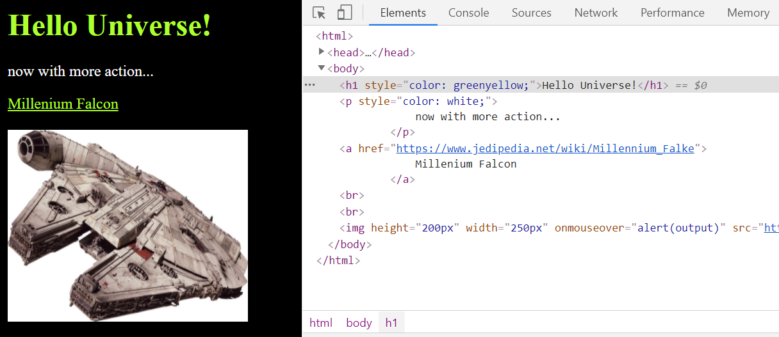
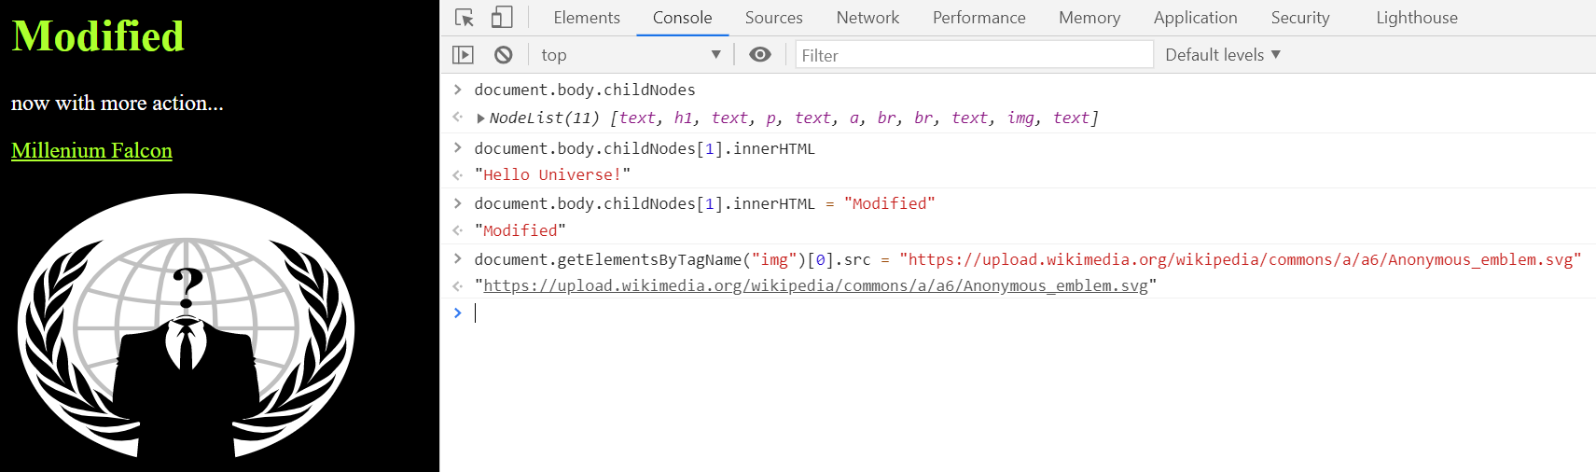

Slide 19
Key messages
HTTP is a stateless application-layer protocol based on requests and responses
It’s plaintext, so wrap it in well configured TLS
Harden your webserver properly

