Slide 1
Conclusions
pretty tough place this web, huh…

Slide 2
Rough Overview
Introduction
Basic Principles and Resources
Architecture & Basic Web Procedure
Authentication and Session Management
Authorization
Server and Backend Attacks
Remaining Client Attacks
General Topics
>> Conclusions <<

Slide 3












Slide 4
Security Principles | SQL Injection
Earn or give, but never assume, trust. | DNS Hijacking Plaintext Transmission Client-side Manipulation (of cookies) CSRF Forceful Browsing XML External Entitiy (XXE) SSRF Clickjacking Security Logging and Monitoring Failures Insecure Design
Use an authentication mechanism that cannot be bypassed or tampered with. | Authentication Automation Attacks
Authorize after you authenticate | Forceful Browsing Insec. Direct Object References TOCTOU (Race Condition)
Strictly separate data and control instructions, and never process control instructions received from untrusted sources. | SQL Injection XPath Injection OS Command Injection Cross-Site Scripting (XSS)
Define an approach that ensures all data are explicitly validated. | Path Traversal Insecure File Upload Unverified/Open Redirects/Forwards Software and Data Integrity Failures
Use cryptography correctly. | Insecure Password Storage Passwords in Source Code
Identify sensitive data and how they should be handled. | Information Disclosure Session Hijacking Session Fixation
Always consider the user.
Understand how integrating external components changes your attack surface. | Vulnerabilities in 3rd Party Components
Be flexible when considering future changes to objects and actors.

Slide 5
OWASP Top 10 2017 | SQL Injection
A1:2017-Injection | SQL Injection XPath Injection OS Command Injection
A2:2017-Broken Authentication | Authentication Automation Attacks Session Hijacking Session Fixation
A3:2017-Sensitive Data Exposure | Information Disclosure Plaintext Transmission Insecure Password Storage Passwords in Source Code
A4:2017-XML-External Entities (XXE) | XML External Entitiy (XXE)
A5:2017-Broken Access Control | Client-side Manipulation (of cookies) Forceful Browsing Insec. Direct Object References Path Traversal TOCTOU (Race Condition)
A6:2017-Security Misconfiguration | Information Disclosure
A7:2017-Cross-Site Scripting (XSS) | Cross-Site Scripting (XSS)
A8:2017-Insecure Deserialization | Software and Data Integrity Failures
A9:2017-Using Components with Known Vulnerabilities | Vulnerabilities in 3rd Party Components
A10:2017-Insufficient Logging&Monitoring | Security Logging and Monitoring Failures
Not in OWASP Top 10 2017 | DNS Hijacking CSRF Insecure File Upload Unverified/Open Redirects/Forwards Clickjacking SSRF Insecure Design

Slide 6
OWASP Top 10 2021 | SQL Injection
A01:2021-Broken Access Control | Client-side Manipulation (of cookies) Forceful Browsing Insec. Direct Object References Path Traversal TOCTOU
A02:2021-Cryptographic Failures | Plaintext Transmission Insecure Password Storage Passwords in Source Code
A03:2021-Injection | SQL Injection XPath Injection OS Command Injection Cross-Site Scripting (XSS)
A04:2021-Insecure Design | Insecure Design
A05:2021-Security Misconfiguration | Information Disclosure XML External Entity (XXE)
A06:2021-Vulnerable and Outdated Components | Vulnerabilities in 3rd Party Components
A07:2021-Identification and Authentication Failures | Authentication Automation Attacks Session Hijacking Session Fixation
A08:2021-Software and Data Integrity Failures | Software and Data Integrity Failures
A09:2021-Security Logging and Monitoring Failures | Security Logging and Monitoring Failures
A10:2021-Server-Side Request Forgery | Server-Side Request Forgery (SSRF)
Not in OWASP Top 10 2021 | DNS Hijacking CSRF Insecure File Upload Unverified/Open Redirects/Forwards Clickjacking

Slide 7
Most important security techniques
Most vulnerabilities can be avoided by a combination of
strong authentication and session management
SQL Injection | Client-side Manipulation (of cookies)
XPath Injection | Forceful Browsing
OS Command Injection | Insec. Direct Object References
XML External Entitiy (XXE) | Path Traversal
Authentication Automation Attacks | TOCTOU (Race Condition)
Session Hijacking | Cross-Site Scripting (XSS)
Session Fixation | Software and Integrity Failures
Information Disclosure | Vulnerabilities in 3rd Party Components
Plaintext Transmission | Security Logging and Monitoring Failures
Insecure Password Storage | DNS Hijacking
Passwords in Source Code | CSRF
Insecure File Upload | Unverified/Open Redirects/Forwards
Clickjacking | Server-Side Request Forgery
Insecure Design

Slide 8
Most important security techniques
Most vulnerabilities can be avoided by a combination of
strong authentication and session management
SQL Injection | Client-side Manipulation (of cookies)
XPath Injection | Forceful Browsing
OS Command Injection | Insec. Direct Object References
XML External Entitiy (XXE) | Path Traversal
Authentication Automation Attacks | TOCTOU (Race Condition)
Session Hijacking | Cross-Site Scripting (XSS)
Session Fixation | Software and Integrity Failures
Information Disclosure | Vulnerabilities in 3rd Party Components
Plaintext Transmission | Security Logging and Monitoring Failures
Insecure Password Storage | DNS Hijacking
Passwords in Source Code | CSRF
Insecure File Upload | Unverified/Open Redirects/Forwards
Clickjacking | Server-Side Request Forgery
Insecure Design

Slide 9
Most important security techniques
Most vulnerabilities can be avoided by a combination of
strong authentication and session management
consistent authorization checks
SQL Injection | Client-side Manipulation (of cookies)
XPath Injection | Forceful Browsing
OS Command Injection | Insec. Direct Object References
XML External Entitiy (XXE) | Path Traversal
Authentication Automation Attacks | TOCTOU (Race Condition)
Session Hijacking | Cross-Site Scripting (XSS)
Session Fixation | Software and Integrity Failures
Information Disclosure | Vulnerabilities in 3rd Party Components
Plaintext Transmission | Security Logging and Monitoring Failures
Insecure Password Storage | DNS Hijacking
Passwords in Source Code | CSRF
Insecure File Upload | Unverified/Open Redirects/Forwards
Clickjacking | Server-Side Request Forgery
Insecure Design

Slide 10
Most important security techniques
Most vulnerabilities can be avoided by a combination of
strong authentication and session management
consistent authorization checks
strict input validation
context-sensitive output encoding/sanitization
SQL Injection | Client-side Manipulation (of cookies)
XPath Injection | Forceful Browsing
OS Command Injection | Insec. Direct Object References
XML External Entitiy (XXE) | Path Traversal
Authentication Automation Attacks | TOCTOU (Race Condition)
Session Hijacking | Cross-Site Scripting (XSS)
Session Fixation | Software and Integrity Failures
Information Disclosure | Vulnerabilities in 3rd Party Components
Plaintext Transmission | Security Logging and Monitoring Failures
Insecure Password Storage | DNS Hijacking
Passwords in Source Code | CSRF
Insecure File Upload | Unverified/Open Redirects/Forwards
Clickjacking | Server-Side Request Forgery
Insecure Design

Slide 11
Most important security techniques
Most vulnerabilities can be avoided by a combination of
strong authentication and session management
consistent authorization checks
strict input validation
context-sensitive output encoding/sanitization
constant TLS usage
SQL Injection | Client-side Manipulation (of cookies)
XPath Injection | Forceful Browsing
OS Command Injection | Insec. Direct Object References
XML External Entitiy (XXE) | Path Traversal
Authentication Automation Attacks | TOCTOU (Race Condition)
Session Hijacking | Cross-Site Scripting (XSS)
Session Fixation | Software and Integrity Failures
Information Disclosure | Vulnerabilities in 3rd Party Components
Plaintext Transmission | Security Logging and Monitoring Failures
Insecure Password Storage | DNS Hijacking
Passwords in Source Code | CSRF
Insecure File Upload | Unverified/Open Redirects/Forwards
Clickjacking | Server-Side Request Forgery
Insecure Design

Slide 13
and of course…

Slide 14
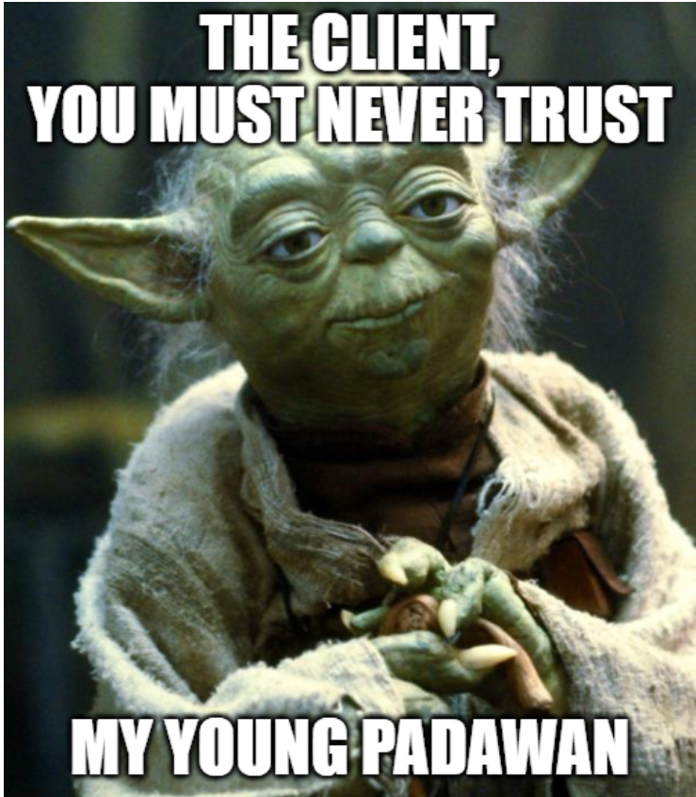
Notes:
https://imgflip.com/memegenerator/Star-Wars-Yoda

