Slide 1
Web (and) Application Security
WUAPS

Slide 2
















whoami
Daniel Schwarz
lbschwarzd@fhstp.ac.at
Education:
Prof. Exp.:
Notes:
Hobbies

Slide 3
Who are you?
Notes:
Pingo Quiz “Kennenlernen”
Name, Background (also Vorbildung) und bisherige Erfahrungen mit Web Security.

Slide 4
Hacking webapplications is illegal (https://www.oesterreich.gv.at/themen/bildung_und_neue_medien/internet_und_handy___sicher_durch_die_digitale_welt/3/Seite.1720213.html)
Notes:
PTA, Pentester….

Slide 5
But it‘s also fun!
Notes:
PTA, Pentester….

Slide 6
just become a whitehat and get legally paid for it
Notes:
PTA, Pentester….

Slide 7
and help making the internet a safer place

Slide 8
Why is web (application) security important?
Notes:
Frage ist nicht ob man angegriffen wird, sondern wann – und ob man gewappnet ist.
Jedes Unternehmen hat etwas das andere interessiert, denn sonst wären sie nicht in der Lage Geld zu verdienen.

Slide 9
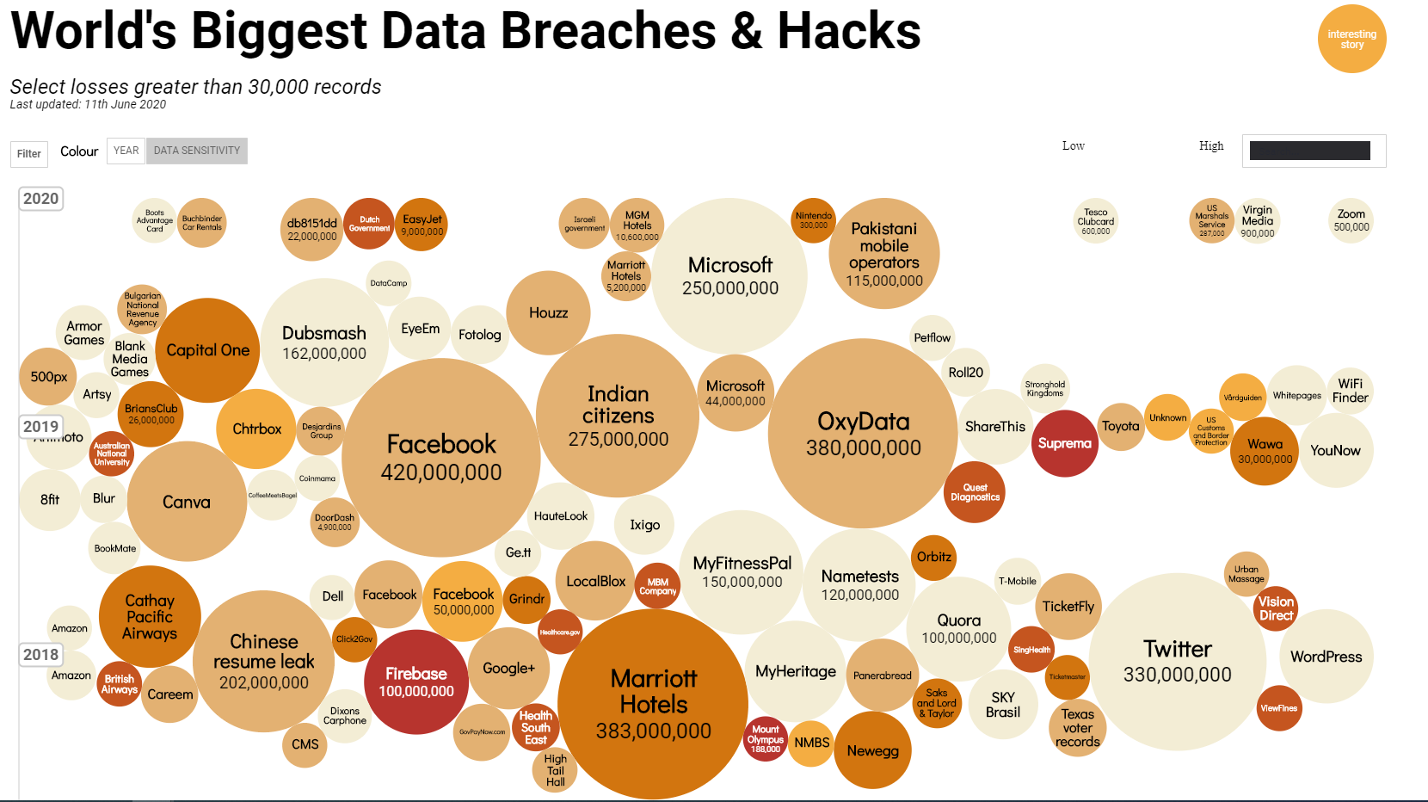
Source: https://informationisbeautiful.net/visualizations/worlds-biggest-data-breaches-hacks/
Notes:
https://informationisbeautiful.net/visualizations/worlds-biggest-data-breaches-hacks/
Nicht nur Data Breaches – Politik, Kraftwerke, Konkurrenz-Unternehmen etc.
Ransomware, Cryptomining etc.
Fancy visualisierungen von Angriffen:
- https://threatmap.checkpoint.com/
- https://cybermap.kaspersky.com/de
- https://www.digitalattackmap.com/

Slide 10
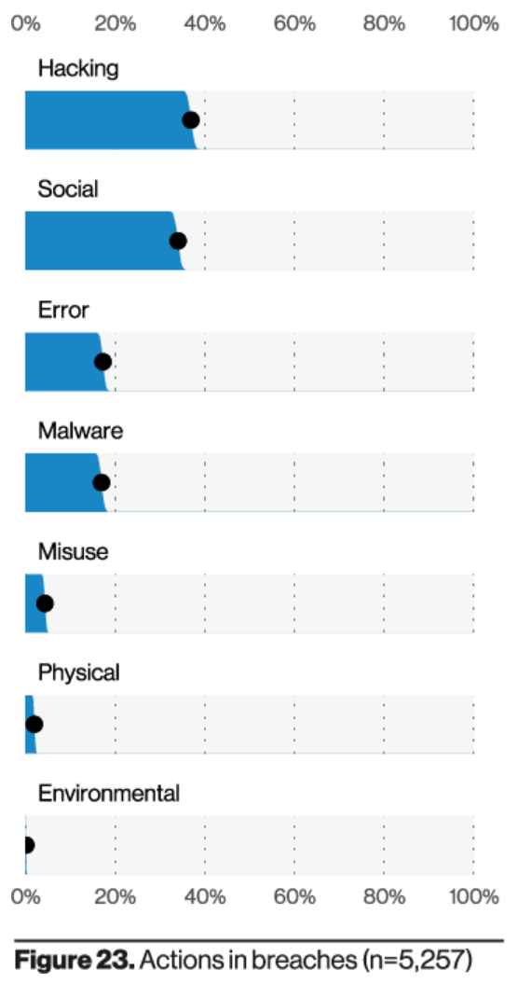
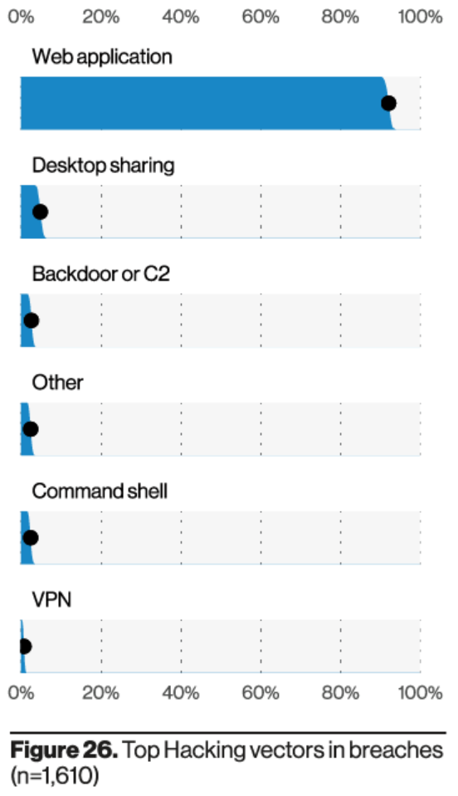
Source: Verizon 2021 Data Breach Investigation Report
Notes:
Und gerade durch Trends wie Cloud und IoT wird Web nicht weniger, sondern immer mehr.
Im Prinzip ist ja fast jede Anwendung heutzutage eine Webanwendung – und die dies bisher nicht waren (z.B. Office) werdens jetzt durch den Cloud-Trend
Mehr Statistiken:
https://www.acunetix.com/acunetix-web-application-vulnerability-report/
https://www.webarxsecurity.com/website-hacking-statistics-2018-february/

Slide 11
Why is it so hard to do it right? = secure

Slide 12
The web is a complex combination of different technologies which evolved over time

Slide 13
You have to care about:
server-side code gets untrusted input
browser
runs different applications at the same time
client-side code runs in an untrusted environment
the user
well... we all know them…

Slide 14
Rough Overview
>> Introduction <<
Basic Principles and Resources
Architecture & Basic Web Procedure
Authentication and Session Management
Authorization
Server and Backend Attacks
Remaining Client Attacks
General Topics
Conclusions

Slide 15
Overall Conditions
Grading
50% Lab
more about that in the first lab session
50% Theory
eCampus exam at the end of this course
You need to collect more than 25 of 50 points for a positive grade
Attendance
Needs to be recorded on eCampus
Breaks
Camera
Recording
Material
Released under CC Attribution-ShareAlike 4.0 International (CC BY-SA 4.0)
https://creativecommons.org/licenses/by-sa/4.0/
https://github.com/dschwarz91/websec-lecture
Notes:
Pausen: Standard 4x5min => 2x10 min auch ok?
=> wenn ihr zwischendurch wirklich Pause braucht, einfach melden.

Slide 16
After this course, you will be able to...
… explain the most common vulnerabilities in today‘s web applications
… identify vulnerabilities in web applications and give recommendations how to fix them
… use some of the most important tools to efficiently examine web applications

Slide 17
Any questions before we start?

