Slide 1
Authorization
Forceful Browsing, Path Traversal, TOCTOU

Slide 2
Rough Overview
Introduction
Basic Principles and Resources
Architecture & Basic Web Procedure
Authentication and Session Management
>> Authorization <<
Server and Backend Attacks
Remaining Client Attacks
General Topics
Conclusions

Slide 3












Slide 4



ok, we now really know who this guy is…
… and we also know how session management works
but what is he actually allowed to do?

Slide 5






what is the first thing you an attacker would do?
<button disabled>Edit Results</button>
Notes:
Show Results / Edit Results
TODO: demo-bsp vervollständigen

Slide 6
what would an attacker do now?
GET /show-results HTTP/1.1
Host: lightside.me

Slide 7
what would an attacker do now?
GET /edit-results HTTP/1.1
Host: lightside.me

Slide 8
what would an attacker do now?
POST /edit-results HTTP/1.1
Host: lightside.me

Slide 9
GET /invoice?id=1337 HTTP/1.1
Host: lightside.me
what would an attacker do?

Slide 10
GET /invoice?id=1338 HTTP/1.1
Host: lightside.me

Slide 11
Forceful Browsing | SQL Injection
Goal | Directly call a URL / function which you‘re not supposed to by the ui
How
Solution
OWASP Top 10
(Primary) Violated Principle

Slide 12
Forceful Browsing | SQL Injection
Goal | Directly call a URL / function which you‘re not supposed to by the ui
How | information gathering by client source code logs error messages robots.txt other users with higher privileges
Solution
OWASP Top 10
(Primary) Violated Principle

Slide 13
Forceful Browsing | SQL Injection
Goal | Directly call a URL / function which you‘re not supposed to by the ui
How | information gathering by client source code logs error messages robots.txt other users with higher privileges hacker instinct / guessing ;-)
Solution
OWASP Top 10
(Primary) Violated Principle

Slide 14
client-side authorization checks yay or nay?
not relevant for security
security needs server side authorization checks
as an addition good for
usability – faster feedback
alerting
if server-side checks are mirrored at the frontend, every negative authorization decision at the backend is a strong indicator for an attack

Slide 15
Forceful Browsing | SQL Injection
Goal | Directly call a URL / function which you‘re not supposed to by the ui
How | information gathering by client source code logs error messages robots.txt other users with higher privileges hacker instinct / guessing ;-)
Solution | NEVER rely on (client-side) frontend
OWASP Top 10
(Primary) Violated Principle
Notes:
Client-side authorization ist für zwei Dinge gut:
Bessere usability für user
Wenn man alle checks auch im frontend hat, dann ist ein fehlgeschlagener check im Backend ein guter Indikator für einen Angriff

Slide 16
Forceful Browsing | SQL Injection
Goal | Directly call a URL / function which you‘re not supposed to by the ui
How | information gathering by client source code logs error messages robots.txt other users with higher privileges hacker instinct / guessing ;-)
Solution | NEVER rely on (client-side) frontend check user’s authorization for function/resource on server-side
OWASP Top 10
(Primary) Violated Principle
Notes:
Client-side authorization ist für zwei Dinge gut:
Bessere usability für user
Wenn man alle checks auch im frontend hat, dann ist ein fehlgeschlagener check im Backend ein guter Indikator für einen Angriff

Slide 17

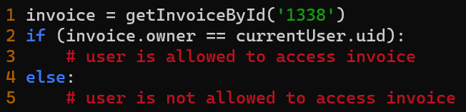
Access Control Levels
define allowed http method for every url/function
check if user is allowed to
call url/function
interact with the object/resource
https://docs.spring.io/spring-security/site/docs/3.0.x/reference/el-access.html

Slide 18
Role-based vs. Permission-based
tbd

Slide 19
Centralization for better auditability
try to centralize authorization decisions
own class / library in your own code
dedicated authorization service
e.g. https://www.openpolicyagent.org/

Slide 20
Forceful Browsing | SQL Injection
Goal | Directly call a URL / function which you‘re not supposed to by the ui
How | information gathering by client source code logs error messages robots.txt other users with higher privileges hacker instinct / guessing ;-)
Solution | NEVER rely on (client-side) frontend check user’s authorization for function/resource on server-side
OWASP Top 10
(Primary) Violated Principle
Notes:
Client-side authorization ist für zwei Dinge gut:
Bessere usability für user
Wenn man alle checks auch im frontend hat, dann ist ein fehlgeschlagener check im Backend ein guter Indikator für einen Angriff

Slide 21
Forceful Browsing | SQL Injection
Goal | Directly call a URL / function which you‘re not supposed to by the ui
How | information gathering by client source code logs error messages robots.txt other users with higher privileges hacker instinct / guessing ;-)
Solution | NEVER rely on (client-side) frontend check user’s authorization for function/resource on server-side use unguessable IDs (e.g. UUIDs) as 2nd line of defense
OWASP Top 10
(Primary) Violated Principle

Slide 22
Forceful Browsing | SQL Injection
Goal | Directly call a URL / function which you‘re not supposed to by the ui
How | information gathering by client source code logs error messages robots.txt other users with higher privileges hacker instinct / guessing ;-)
Solution | NEVER rely on (client-side) frontend check user’s authorization for function/resource on server-side use unguessable IDs (e.g. UUIDs) as 2nd line of defense
OWASP Top 10 | A01:2021-Broken Access Control
(Primary) Violated Principle

Slide 23
Forceful Browsing | SQL Injection
Goal | Directly call a URL / function which you‘re not supposed to by the ui
How | information gathering by client source code logs error messages robots.txt other users with higher privileges hacker instinct / guessing ;-)
Solution | NEVER rely on (client-side) frontend check user’s authorization for function/resource on server-side use unguessable IDs (e.g. UUIDs) as 2nd line of defense
OWASP Top 10 | A01:2021-Broken Access Control
(Primary) Violated Principle | „Earn or give, but never assume, trust.“ „Authorize after you authenticate“

Slide 24
GET /invoice?f=inv_202010_luke.pdf HTTP/1.1
Host: lightside.me
what would an attacker do?

Slide 25
GET /invoice?f=inv_202010_lea.pdf HTTP/1.1
Host: lightside.me
of course… can you think of something else?

Slide 26
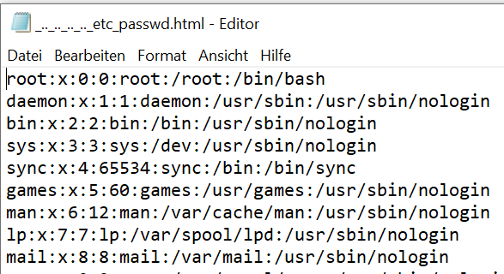
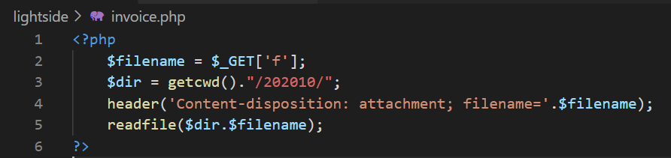
GET /invoice?f=../../../../../etc/passwd HTTP/1.1
Host: lightside.me
Notes:
TODO: um encoding-spielereien ergänzen

Slide 27
Path Traversal | SQL Injection
Goal | Directly access files (outside the webroot) which you‘re not supposed to by the application
How
Solution
OWASP Top 10
(Primary) Violated Principle

Slide 28
Path Traversal | SQL Injection
Goal | Directly access files (outside the webroot) which you‘re not supposed to by the application
How | whenever an application handles path’s incorrectly, try to iterate through it
Solution
OWASP Top 10
(Primary) Violated Principle

Slide 29
Path Traversal | SQL Injection
Goal | Directly access files (outside the webroot) which you‘re not supposed to by the application
How | whenever an application handles path’s incorrectly, try to iterate through it
Solution | Don’t use user input in filesystem APIs If you have to validate it (explicit allowlist) check the canonicalized path Run webserver under a low privileged user
OWASP Top 10
(Primary) Violated Principle

Slide 30
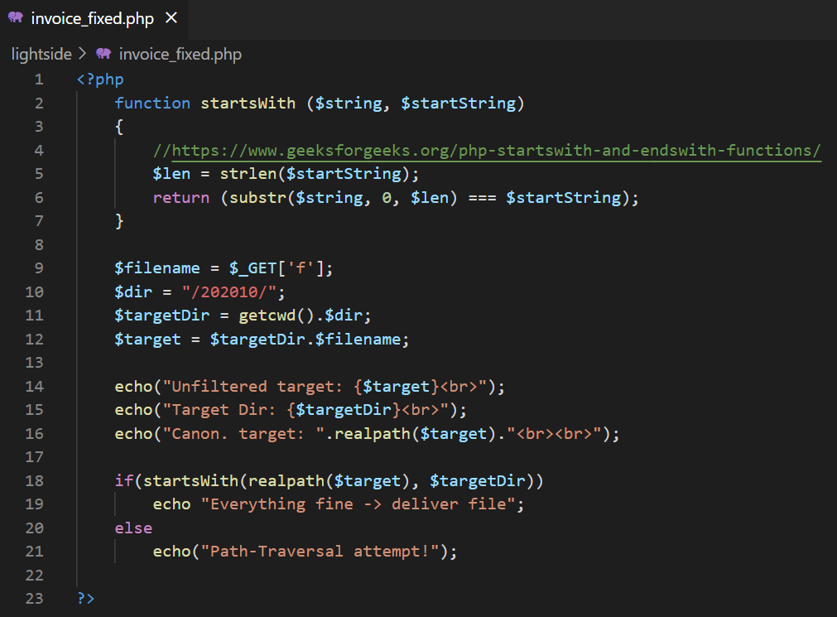
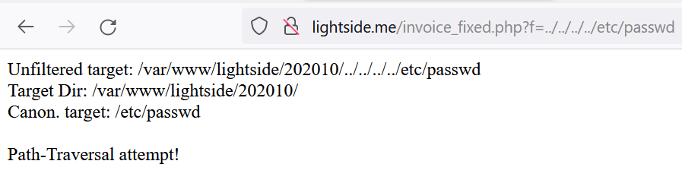

Slide 31
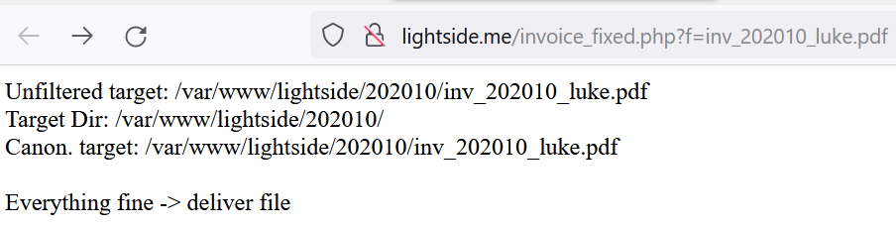

Slide 32
Path Traversal | SQL Injection
Goal | Directly access files (outside the webroot) which you‘re not supposed to by the application
How | whenever an application handles path’s incorrectly, try to iterate through it
Solution | Don’t use user input in filesystem APIs If you have to validate it (explicit allowlist) check the canonicalized path Run webserver under a low privileged user
OWASP Top 10 | A01:2021-Broken Access Control
(Primary) Violated Principle

Slide 33
Path Traversal | SQL Injection
Goal | Directly access files (outside the webroot) which you‘re not supposed to by the application
How | whenever an application handles path’s incorrectly, try to iterate through it
Solution | Don’t use user input in filesystem APIs If you have to validate it (explicit allowlist) check the canonicalized path Run webserver under a low privileged user
OWASP Top 10 | A01:2021-Broken Access Control
(Primary) Violated Principle | “Define an approach that ensures all data are explicitly validated.”

Slide 34
so one last thing about authorization…

Slide 35
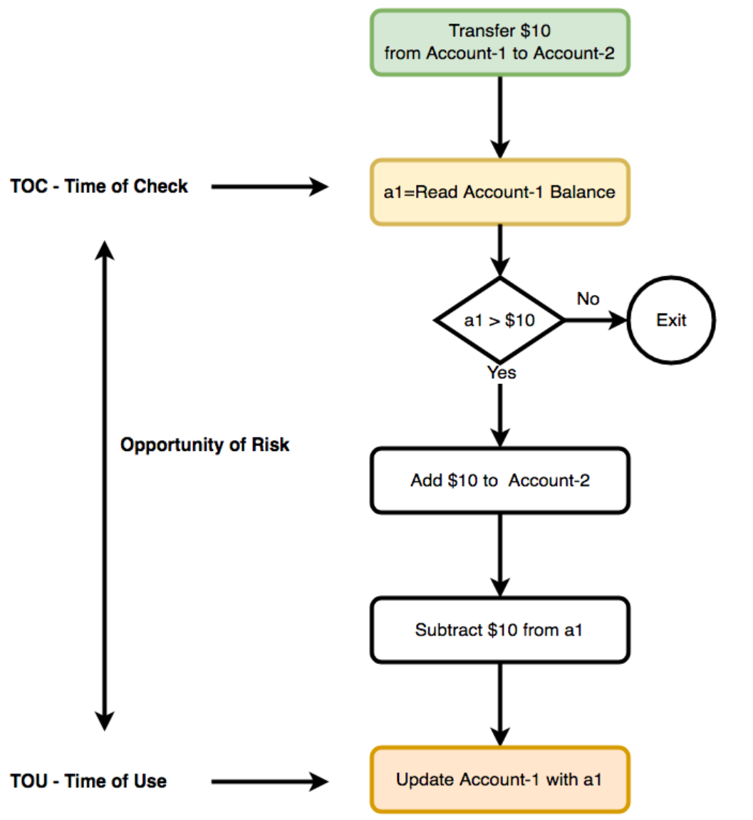
https://medium.com/@schogini/toctou-time-of-check-and-time-of-use-a-demonstration-and-mitigation-609c999042cb

Slide 36
TOCTOU (Race Condition) | SQL Injection
Goal | Execute an operation you are actually not allowed to
How
Solution
OWASP Top 10
(Primary) Violated Principle

Slide 37
TOCTOU (Race Condition) | SQL Injection
Goal | Execute an operation you are actually not allowed to
How | Take advantage of a time-window between a security check and the actual action this check should protect
Solution
OWASP Top 10
(Primary) Violated Principle

Slide 38
TOCTOU (Race Condition) | SQL Injection
Goal | Execute an operation you are actually not allowed to
How | Take advantage of a time-window between a security check and the actual action this check should protect
Solution | Apply security checks as close to the actual action as possible
OWASP Top 10
(Primary) Violated Principle

Slide 39
TOCTOU (Race Condition) | SQL Injection
Goal | Execute an operation you are actually not allowed to
How | Take advantage of a time-window between a security check and the actual action this check should protect
Solution | Apply security checks as close to the actual action as possible Use locking mechanisms, e.g. locking / semaphores database transactions etc.
OWASP Top 10
(Primary) Violated Principle

Slide 40
TOCTOU (Race Condition) | SQL Injection
Goal | Execute an operation you are actually not allowed to
How | Take advantage of a time-window between a security check and the actual action this check should protect
Solution | Apply security checks as close to the actual action as possible Use locking mechanisms, e.g. locking / semaphores database transactions etc.
OWASP Top 10 | A01:2021-Broken Access Control
(Primary) Violated Principle

Slide 41
TOCTOU (Race Condition) | SQL Injection
Goal | Execute an operation you are actually not allowed to
How | Take advantage of a time-window between a security check and the actual action this check should protect
Solution | Apply security checks as close to the actual action as possible Use locking mechanisms, e.g. locking / semaphores database transactions etc.
OWASP Top 10 | A01:2021-Broken Access Control
(Primary) Violated Principle | “Authorize after you authenticate”

Slide 42
Authorization pitfalls
Worst: no authorization
Second: client-side authorization
actually, it‘s the same as „no authorization“
Third: Inconsistent authorization, e.g.:
check GET, but not POST
check via direct web access but not via SOAP service
Notes:
Client-side authorization ist für zwei Dinge gut:
Bessere usability für user
Wenn man alle checks auch im frontend hat, dann ist ein fehlgeschlagener check im Backend ein guter Indikator für einen Angriff

Slide 43
Golden Authorization Rules
Always check everything for authorization
every request
every function call
every resource access
every everything
NEVER ever trust the client!
always check authorization on server side

Slide 44
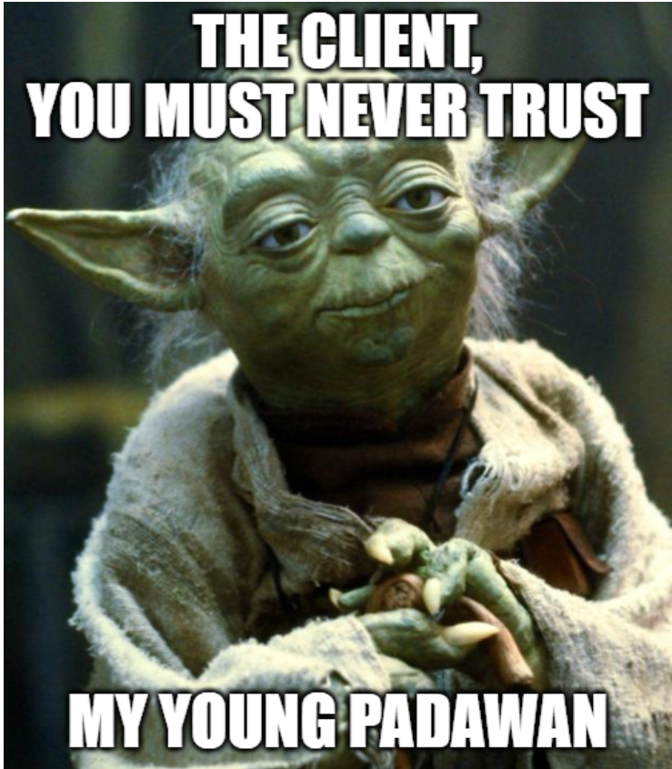
Notes:
https://imgflip.com/memegenerator/Star-Wars-Yoda

Slide 45
GET /invoice?id=1337 HTTP/1.1
Host: lightside.me
what would an attacker do?

Slide 46
GET /invoice?id=1338 HTTP/1.1
Host: lightside.me

Slide 47
Insec. Direct Object References | SQL Injection
Goal | Directly access a resource which you‘re not supposed to by the ui
How
Solution
OWASP Top 10
(Primary) Violated Principle
Notes:
https://www.heise.de/news/Datenleck-im-Legoland-Reisedaten-tausender-Kunden-seit-2015-betroffen-6668852.html

Slide 48
Insec. Direct Object References | SQL Injection
Goal | Directly access a resource which you‘re not supposed to by the ui
How | information gathering by http parameters client source code logs error messages other users with higher privileges hacker instinct / guessing ;-)
Solution
OWASP Top 10
(Primary) Violated Principle
Notes:
https://www.heise.de/news/Datenleck-im-Legoland-Reisedaten-tausender-Kunden-seit-2015-betroffen-6668852.html

Slide 49
Insec. Direct Object References | SQL Injection
Goal | Directly access a resource which you‘re not supposed to by the ui
How | information gathering by http parameters client source code logs error messages other users with higher privileges hacker instinct / guessing ;-)
Solution | NEVER rely on (client-side) frontend check user’s authorization to access resources on server-side
OWASP Top 10
(Primary) Violated Principle
Notes:
https://www.heise.de/news/Datenleck-im-Legoland-Reisedaten-tausender-Kunden-seit-2015-betroffen-6668852.html

Slide 50
Direct vs. Indirect Object Reference
ID | Object | Owner
1336 | inv_202010_luke.pdf | Luke
1337 | inv_202010_lea.pdf | Lea
1338 | inv_202011_luke.pdf | Luke
1339 | inv_202011_lea.pdf | Lea
1340 | inv_202011_vader.pdf | Vader
Session | RID | ID | Object
Luke | 1 | 1336 | inv_202010_luke.pdf
 | 2 | 1338 | inv_202011_luke.pdf
Session | RID | ID | Object
Lea | 1 | 1337 | inv_202010_lea.pdf
 | 2 | 1339 | inv_202011_lea.pdf
Session | RID | ID | Object
Vader | 1 | 1340 | inv_202011_vader.pdf
Notes:
Bei direkter eigentlich egal ob man die erratbare ID oder direkt den Objektnamen nimmt – beides das gleiche Problem. (nur FS vs. DB)
Nachteil: man braucht mappingtabelle

Slide 51
Using random values (e.g. UUID)
ID | Object | Owner
14b7bdea-e58d-46ec-bfd7-e175022f32ce | inv_202010_luke.pdf | Luke
b113479b-46ad-42e6-a3f3-0d5f80847d38 | inv_202010_lea.pdf | Lea
11dfa49e-f585-4e93-8a76-2a1843b7d118 | inv_202011_luke.pdf | Luke
7255e1bd-417a-425b-ba88-98c3fe2405b2 | inv_202011_lea.pdf | Lea
6a08f5e6-4fa8-44e6-92bb-db0d7b38a393 | inv_202011_vader.pdf | Vader
still needs a mapping table…

Slide 52
Salted Hashes
ID | Salt | Object | Owner
6cc433f2803080c9a633b2d110a745e264baca6c9e4455ea4d02f9ae41efe146 | MYSALT | inv_202010_luke.pdf | Luke
bd4fbb2af573895ab6f239b2ba9f60f651098a1f6c357a7ca7d018f1c46432f6 | MYSALT | inv_202010_lea.pdf | Lea
b0a85076b44450cab45b507c8c0ddb0b36e46402204ca593bcc9a8db8119edb6 | MYSALT | inv_202011_luke.pdf | Luke
ff33b6dfdddcd14ed700d19dcca736b3b6015f2badab5b9e740988e1ab70cc1b | MYSALT | inv_202011_lea.pdf | Lea
1bf50583d983a9981a86761daae7c1b6c136bb932f9f921bd6cf20c01e6271b1 | MYSALT | inv_202011_vader.pdf | Vader
Notes:
Salt wird benötigt, damit es für den Angreifer schwieriger wird von der ausgelieferten Ressource auf den Hash zu schließen.
Braucht keine serverseitige Speicherung – kann immer wieder berechnet werden. (Salt z.b. per Config File)

Slide 53
Insec. Direct Object References | SQL Injection
Goal | Directly access a resource which you‘re not supposed to by the ui
How | information gathering by http parameters client source code logs error messages other users with higher privileges hacker instinct / guessing ;-)
Solution | NEVER rely on (client-side) frontend check user’s authorization to access resources on server-side use indirect object references, unguessable IDs (e.g. UUIDs) or salted hashes
OWASP Top 10
(Primary) Violated Principle
Notes:
https://www.heise.de/news/Datenleck-im-Legoland-Reisedaten-tausender-Kunden-seit-2015-betroffen-6668852.html

Slide 54
Insec. Direct Object References | SQL Injection
Goal | Directly access a resource which you‘re not supposed to by the ui
How | information gathering by http parameters client source code logs error messages other users with higher privileges hacker instinct / guessing ;-)
Solution | NEVER rely on (client-side) frontend check user’s authorization to access resources on server-side use indirect object references, unguessable IDs (e.g. UUIDs) or salted hashes
OWASP Top 10 | A01:2021-Broken Access Control
(Primary) Violated Principle
Notes:
https://www.heise.de/news/Datenleck-im-Legoland-Reisedaten-tausender-Kunden-seit-2015-betroffen-6668852.html

Slide 55
Insec. Direct Object References | SQL Injection
Goal | Directly access a resource which you‘re not supposed to by the ui
How | information gathering by http parameters client source code logs error messages other users with higher privileges hacker instinct / guessing ;-)
Solution | NEVER rely on (client-side) frontend check user’s authorization to access resources on server-side use indirect object references, unguessable IDs (e.g. UUIDs) or salted hashes
OWASP Top 10 | A01:2021-Broken Access Control
(Primary) Violated Principle | „Authorize after you authenticate“
Notes:
https://www.heise.de/news/Datenleck-im-Legoland-Reisedaten-tausender-Kunden-seit-2015-betroffen-6668852.html

