Slide 1
General Topics
Insecure Deserialization, Components with known Vulnerabilities, Logging & Monitoring, WAFs

Slide 2
Rough Overview
Introduction
Basic Principles and Resources
Architecture & Basic Web Procedure
Authentication and Session Management
Authorization
Server and Backend Attacks
Remaining Client Attacks
>> General Topics <<
Conclusions

Slide 3
Serialization / Deserialization
Serialization
turns objects into a data format suitable for storage and communication
e.g. JSON, XML, Binary …
Deserialization
restores objects from some data format

Slide 4
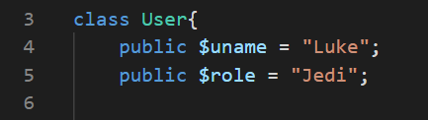
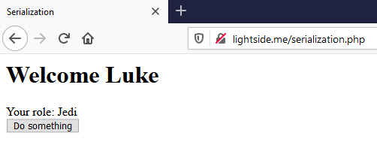
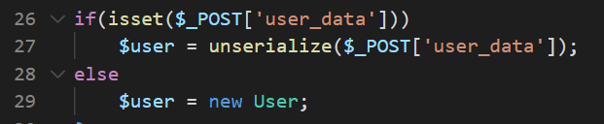
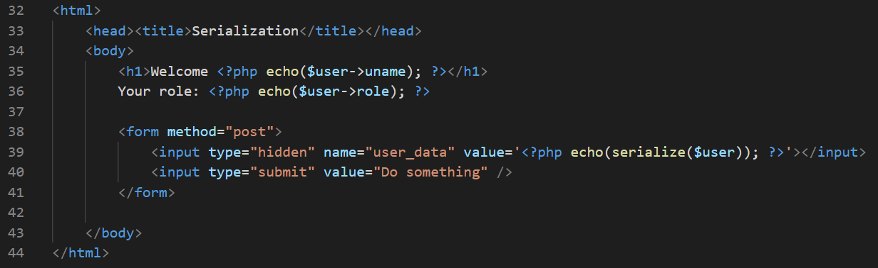
Notes:
Beispiel anhand von PHP

Slide 5
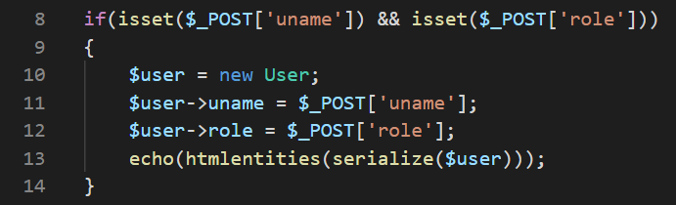
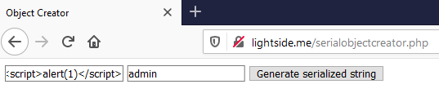

Slide 6
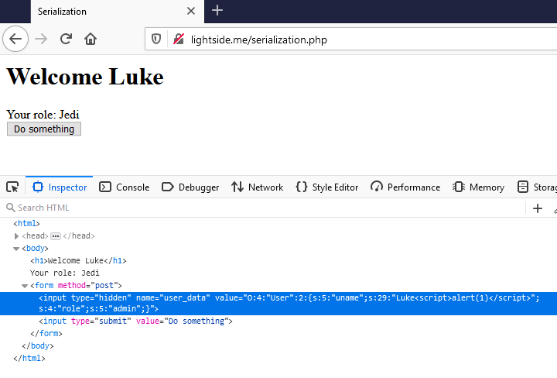

Slide 7
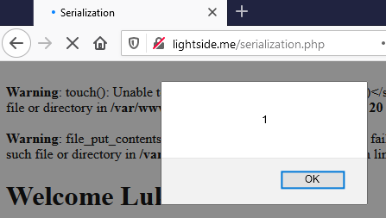
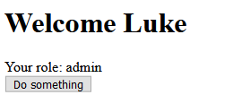

Slide 8
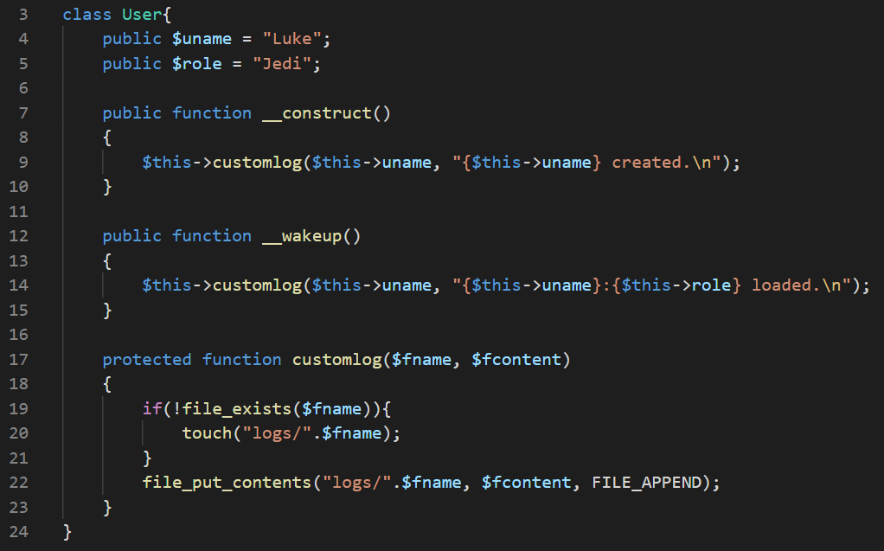

Slide 9
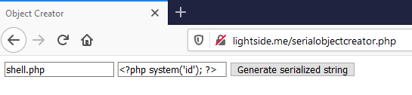
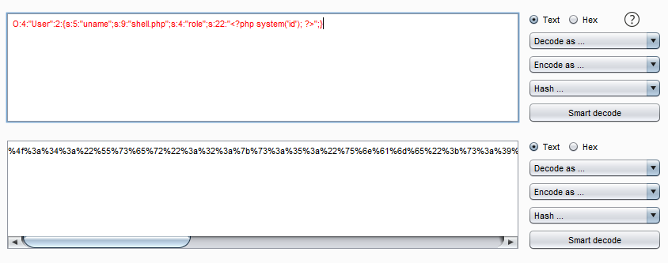

Slide 10
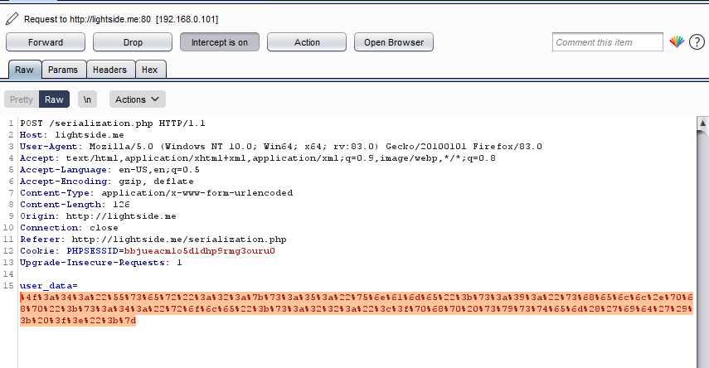
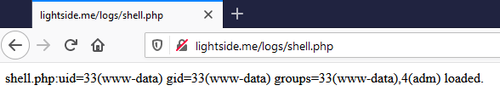

Slide 11
Example: PHP Deserialization
At least three possible problems:
Missing Input Validation
Objects are often seen as “trusted” and aren’t validated
Nonsense if they come from an untrusted place (e.g. user, remote datastore etc.)
Dangerous Code in Magic-Functions
e.g. filesystem-operations, system-interaction, eval, etc.
Bugs in underlying C-Code
Recommended reading:
https://www.netsparker.com/blog/web-security/untrusted-data-unserialize-php/

Slide 12
Nice example from 2015
Commons Collections Library
Deserialization vulnerability that led to RCE
Extremely popular in Java world
WebSphere
Jboss
Weblogic
Java RMI (Remote Method Invocation)
and every application that directly uses CC
Nice writeup
https://foxglovesecurity.com/2015/11/06/what-do-weblogic-websphere-jboss-jenkins-opennms-and-your-application-have-in-common-this-vulnerability/
Try it on your own
https://portswigger.net/web-security/deserialization/exploiting/lab-deserialization-exploiting-java-deserialization-with-apache-commons
Notes:
Gutes Beispiel aus der Vergangenheit: Java Apache Commons Collections!
https://foxglovesecurity.com/2015/11/06/what-do-weblogic-websphere-jboss-jenkins-opennms-and-your-application-have-in-common-this-vulnerability/
https://portswigger.net/web-security/deserialization/exploiting/lab-deserialization-exploiting-java-deserialization-with-apache-commons
https://github.com/frohoff/ysoserial

Slide 13
Insecure Deserialization | SQL Injection
Goal | Inject manipulated objects to bypass security checks or execute arbitrary code.
How
Solution
OWASP Top 10
(Primary) Violated Principle

Slide 14
Insecure Deserialization | SQL Injection
Goal | Inject manipulated objects to bypass security checks or execute arbitrary code.
How | By manipulation of serialized objects.
Solution
OWASP Top 10
(Primary) Violated Principle

Slide 15
Insecure Deserialization | SQL Injection
Goal | Inject manipulated objects to bypass security checks or execute arbitrary code.
How | By manipulation of serialized objects.
Solution | Avoid deserialization of objects from untrusted sources
OWASP Top 10
(Primary) Violated Principle

Slide 16
Insecure Deserialization | SQL Injection
Goal | Inject manipulated objects to bypass security checks or execute arbitrary code.
How | By manipulation of serialized objects.
Solution | Avoid deserialization of objects from untrusted sources Avoid using native (de)serialization and use safer alternatives like JSON, XML, YAML (correctly) e.g. JSON.parse (and never eval), correctly configured and hardened parsers
OWASP Top 10
(Primary) Violated Principle

Slide 17
Insecure Deserialization | SQL Injection
Goal | Inject manipulated objects to bypass security checks or execute arbitrary code.
How | By manipulation of serialized objects.
Solution | Avoid deserialization of objects from untrusted sources Avoid using native (de)serialization and use safer alternatives like JSON, XML, YAML (correctly) e.g. JSON.parse (and never eval), correctly configured and hardened parsers If you use native (de)serialization, only deserialize signed data
OWASP Top 10
(Primary) Violated Principle

Slide 18
Insecure Deserialization | SQL Injection
Goal | Inject manipulated objects to bypass security checks or execute arbitrary code.
How | By manipulation of serialized objects.
Solution | Avoid deserialization of objects from untrusted sources Avoid using native (de)serialization and use safer alternatives like JSON, XML, YAML (correctly) e.g. JSON.parse (and never eval), correctly configured and hardened parsers If you use native (de)serialization, only deserialize signed data Observe language specifics https://cheatsheetseries.owasp.org/cheatsheets/Deserialization_Cheat_Sheet.html
OWASP Top 10
(Primary) Violated Principle

Slide 19
Insecure Deserialization | SQL Injection
Goal | Inject manipulated objects to bypass security checks or execute arbitrary code.
How | By manipulation of serialized objects.
Solution | Avoid deserialization of objects from untrusted sources Avoid using native (de)serialization and use safer alternatives like JSON, XML, YAML (correctly) e.g. JSON.parse (and never eval), correctly configured and hardened parsers If you use native (de)serialization, only deserialize signed data Observe language specifics https://cheatsheetseries.owasp.org/cheatsheets/Deserialization_Cheat_Sheet.html Strictly validate input
OWASP Top 10
(Primary) Violated Principle

Slide 20
Insecure Deserialization | SQL Injection
Goal | Inject manipulated objects to bypass security checks or execute arbitrary code.
How | By manipulation of serialized objects.
Solution | Avoid deserialization of objects from untrusted sources Avoid using native (de)serialization and use safer alternatives like JSON, XML, YAML (correctly) e.g. JSON.parse (and never eval), correctly configured and hardened parsers If you use native (de)serialization, only deserialize signed data Observe language specifics https://cheatsheetseries.owasp.org/cheatsheets/Deserialization_Cheat_Sheet.html Strictly validate input
OWASP Top 10 | A8:2017-Insecure Deserialization
(Primary) Violated Principle

Slide 21
Insecure Deserialization | SQL Injection
Goal | Inject manipulated objects to bypass security checks or execute arbitrary code.
How | By manipulation of serialized objects.
Solution | Avoid deserialization of objects from untrusted sources Avoid using native (de)serialization and use safer alternatives like JSON, XML, YAML (correctly) e.g. JSON.parse (and never eval), correctly configured and hardened parsers If you use native (de)serialization, only deserialize signed data Observe language specifics https://cheatsheetseries.owasp.org/cheatsheets/Deserialization_Cheat_Sheet.html Strictly validate input
OWASP Top 10 | A8:2017-Insecure Deserialization
(Primary) Violated Principle | „Define an approach that ensures all data are explicitly validated.“

Slide 22
3rd party components
It’s ok to use 3rd party components
libraries
frameworks
etc.
Just be aware you also include their problems
Commons Collection is the best example
And act appropriately

Slide 23
Vulnerabilities in 3rd Party Components | SQL Injection
Goal | Compromising an application by exploiting a publicly known vulnerability in one of it’s included components (libraries, frameworks etc.)
How
Solution
OWASP Top 10
(Primary) Violated Principle
Notes:
https://docs.github.com/en/free-pro-team@latest/github/managing-security-vulnerabilities/about-alerts-for-vulnerable-dependencies

Slide 24
Vulnerabilities in 3rd Party Components | SQL Injection
Goal | Compromising an application by exploiting a publicly known vulnerability in one of it’s included components (libraries, frameworks etc.)
How | Fingerprint application Search the web for corresponding vulnerabilities and exploits e.g. https://www.cvedetails.com/, https://www.exploit-db.com/, etc.
Solution
OWASP Top 10
(Primary) Violated Principle
Notes:
https://docs.github.com/en/free-pro-team@latest/github/managing-security-vulnerabilities/about-alerts-for-vulnerable-dependencies

Slide 25
Vulnerabilities in 3rd Party Components | SQL Injection
Goal | Compromising an application by exploiting a publicly known vulnerability in one of it’s included components (libraries, frameworks etc.)
How | Fingerprint application Search the web for corresponding vulnerabilities and exploits e.g. https://www.cvedetails.com/, https://www.exploit-db.com/, etc.
Solution | Be aware of all components you have in use
OWASP Top 10
(Primary) Violated Principle
Notes:
https://docs.github.com/en/free-pro-team@latest/github/managing-security-vulnerabilities/about-alerts-for-vulnerable-dependencies

Slide 26
Vulnerabilities in 3rd Party Components | SQL Injection
Goal | Compromising an application by exploiting a publicly known vulnerability in one of it’s included components (libraries, frameworks etc.)
How | Fingerprint application Search the web for corresponding vulnerabilities and exploits e.g. https://www.cvedetails.com/, https://www.exploit-db.com/, etc.
Solution | Be aware of all components you have in use Check all components for publicly known vulnerabilities Tools can help you with this task, e.g. GitHub Dependabot OWASP Dependency Check Sonatype Nexus IQ / Lifecycle Synopsys Black Duck Software Composition Analysis etc…
OWASP Top 10
(Primary) Violated Principle
Notes:
https://docs.github.com/en/free-pro-team@latest/github/managing-security-vulnerabilities/about-alerts-for-vulnerable-dependencies

Slide 27















Src Control
3rd party check
IDE
CI/CD

Slide 28
Vulnerabilities in 3rd Party Components | SQL Injection
Goal | Compromising an application by exploiting a publicly known vulnerability in one of it’s included components (libraries, frameworks etc.)
How | Fingerprint application Search the web for corresponding vulnerabilities and exploits e.g. https://www.cvedetails.com/, https://www.exploit-db.com/, etc.
Solution | Be aware of all components you have in use Check all components for publicly known vulnerabilities Tools can help you with this task, e.g. GitHub Dependabot OWASP Dependency Check Sonatype Nexus IQ / Lifecycle Synopsys Black Duck Software Composition Analysis etc…
OWASP Top 10
(Primary) Violated Principle
Notes:
https://docs.github.com/en/free-pro-team@latest/github/managing-security-vulnerabilities/about-alerts-for-vulnerable-dependencies

Slide 29
Vulnerabilities in 3rd Party Components | SQL Injection
Goal | Compromising an application by exploiting a publicly known vulnerability in one of it’s included components (libraries, frameworks etc.)
How | Fingerprint application Search the web for corresponding vulnerabilities and exploits e.g. https://www.cvedetails.com/, https://www.exploit-db.com/, etc.
Solution | Be aware of all components you have in use Check all components for publicly known vulnerabilities Tools can help you with this task, e.g. GitHub Dependabot OWASP Dependency Check Sonatype Nexus IQ / Lifecycle Synopsys Black Duck Software Composition Analysis etc… Perform checks as early as possible in the development lifecycle
OWASP Top 10
(Primary) Violated Principle
Notes:
https://docs.github.com/en/free-pro-team@latest/github/managing-security-vulnerabilities/about-alerts-for-vulnerable-dependencies

Slide 30
Vulnerabilities in 3rd Party Components | SQL Injection
Goal | Compromising an application by exploiting a publicly known vulnerability in one of it’s included components (libraries, frameworks etc.)
How | Fingerprint application Search the web for corresponding vulnerabilities and exploits e.g. https://www.cvedetails.com/, https://www.exploit-db.com/, etc.
Solution | Be aware of all components you have in use Check all components for publicly known vulnerabilities Tools can help you with this task, e.g. GitHub Dependabot OWASP Dependency Check Sonatype Nexus IQ / Lifecycle Synopsys Black Duck Software Composition Analysis etc… Perform checks as early as possible in the development lifecycle For very high protection needs: consider to audit them
OWASP Top 10
(Primary) Violated Principle
Notes:
https://docs.github.com/en/free-pro-team@latest/github/managing-security-vulnerabilities/about-alerts-for-vulnerable-dependencies

Slide 31
Vulnerabilities in 3rd Party Components | SQL Injection
Goal | Compromising an application by exploiting a publicly known vulnerability in one of it’s included components (libraries, frameworks etc.)
How | Fingerprint application Search the web for corresponding vulnerabilities and exploits e.g. https://www.cvedetails.com/, https://www.exploit-db.com/, etc.
Solution | Be aware of all components you have in use Check all components for publicly known vulnerabilities Tools can help you with this task, e.g. GitHub Dependabot OWASP Dependency Check Sonatype Nexus IQ / Lifecycle Synopsys Black Duck Software Composition Analysis etc… Perform checks as early as possible in the development lifecycle For very high protection needs: consider to audit them
OWASP Top 10 | A9:2017-Using Components with Known Vulnerabilities
(Primary) Violated Principle
Notes:
https://docs.github.com/en/free-pro-team@latest/github/managing-security-vulnerabilities/about-alerts-for-vulnerable-dependencies

Slide 32
Vulnerabilities in 3rd Party Components | SQL Injection
Goal | Compromising an application by exploiting a publicly known vulnerability in one of it’s included components (libraries, frameworks etc.)
How | Fingerprint application Search the web for corresponding vulnerabilities and exploits e.g. https://www.cvedetails.com/, https://www.exploit-db.com/, etc.
Solution | Be aware of all components you have in use Check all components for publicly known vulnerabilities Tools can help you with this task, e.g. GitHub Dependabot OWASP Dependency Check Sonatype Nexus IQ / Lifecycle Synopsys Black Duck Software Composition Analysis etc… Perform checks as early as possible in the development lifecycle For very high protection needs: consider to audit them
OWASP Top 10 | A9:2017-Using Components with Known Vulnerabilities
(Primary) Violated Principle | „Understand how integrating external components changes your attack surface“
Notes:
https://docs.github.com/en/free-pro-team@latest/github/managing-security-vulnerabilities/about-alerts-for-vulnerable-dependencies

Slide 33










Slide 34
Insufficient Logging and Monitoring | SQL Injection
Goal | Hide attacks and go unnoticed.
How
Solution
OWASP Top 10
(Primary) Violated Principle
Notes:
Zwar nicht unbedingt direkt eine eigene Schwachstelle, aber trotzdem wichtig.

Slide 35
Insufficient Logging and Monitoring | SQL Injection
Goal | Hide attacks and go unnoticed.
How | Security relevant events are not logged appropriately
Solution
OWASP Top 10
(Primary) Violated Principle

Slide 36
Insufficient Logging and Monitoring | SQL Injection
Goal | Hide attacks and go unnoticed.
How | Security relevant events are not logged appropriately Logs are not monitored regularly
Solution
OWASP Top 10
(Primary) Violated Principle

Slide 37
Insufficient Logging and Monitoring | SQL Injection
Goal | Hide attacks and go unnoticed.
How | Security relevant events are not logged appropriately Logs are not monitored regularly No appropriate alert thresholds are in place
Solution
OWASP Top 10
(Primary) Violated Principle

Slide 38
Insufficient Logging and Monitoring | SQL Injection
Goal | Hide attacks and go unnoticed.
How | Security relevant events are not logged appropriately Logs are not monitored regularly No appropriate alert thresholds are in place No suitable response process is in place
Solution
OWASP Top 10
(Primary) Violated Principle

Slide 39
Insufficient Logging and Monitoring | SQL Injection
Goal | Hide attacks and go unnoticed.
How | Security relevant events are not logged appropriately Logs are not monitored regularly No appropriate alert thresholds are in place No suitable response process is in place
Solution | Define which events are security relevant and therefore should be logged e.g. failed authentication attempts, access control violation attempts, input validation failures, CSP reportings etc.
OWASP Top 10
(Primary) Violated Principle

Slide 40
Insufficient Logging and Monitoring | SQL Injection
Goal | Hide attacks and go unnoticed.
How | Security relevant events are not logged appropriately Logs are not monitored regularly No appropriate alert thresholds are in place No suitable response process is in place
Solution | Define which events are security relevant and therefore should be logged e.g. failed authentication attempts, access control violation attempts, input validation failures, CSP reportings etc. Use consistent log formats throughout your organization
OWASP Top 10
(Primary) Violated Principle

Slide 41
Insufficient Logging and Monitoring | SQL Injection
Goal | Hide attacks and go unnoticed.
How | Security relevant events are not logged appropriately Logs are not monitored regularly No appropriate alert thresholds are in place No suitable response process is in place
Solution | Define which events are security relevant and therefore should be logged e.g. failed authentication attempts, access control violation attempts, input validation failures, CSP reportings etc. Use consistent log formats throughout your organization Centralize logs in a tamper-proof system
OWASP Top 10
(Primary) Violated Principle

Slide 42
Insufficient Logging and Monitoring | SQL Injection
Goal | Hide attacks and go unnoticed.
How | Security relevant events are not logged appropriately Logs are not monitored regularly No appropriate alert thresholds are in place No suitable response process is in place
Solution | Define which events are security relevant and therefore should be logged e.g. failed authentication attempts, access control violation attempts, input validation failures, CSP reportings etc. Use consistent log formats throughout your organization Centralize logs in a tamper-proof system Implement appropriate monitoring, alarm thresholds and response processes -> and also test them!
OWASP Top 10
(Primary) Violated Principle

Slide 43
Insufficient Logging and Monitoring | SQL Injection
Goal | Hide attacks and go unnoticed.
How | Security relevant events are not logged appropriately Logs are not monitored regularly No appropriate alert thresholds are in place No suitable response process is in place
Solution | Define which events are security relevant and therefore should be logged e.g. failed authentication attempts, access control violation attempts, input validation failures, CSP reportings etc. Use consistent log formats throughout your organization Centralize logs in a tamper-proof system Implement appropriate monitoring, alarm thresholds and response processes -> and also test them!
OWASP Top 10 | A10:2017-Insufficient Logging & Monitoring
(Primary) Violated Principle

Slide 44
Insufficient Logging and Monitoring | SQL Injection
Goal | Hide attacks and go unnoticed.
How | Security relevant events are not logged appropriately Logs are not monitored regularly No appropriate alert thresholds are in place No suitable response process is in place
Solution | Define which events are security relevant and therefore should be logged e.g. failed authentication attempts, access control violation attempts, input validation failures, CSP reportings etc. Use consistent log formats throughout your organization Centralize logs in a tamper-proof system Implement appropriate monitoring, alarm thresholds and response processes -> and also test them!
OWASP Top 10 | A10:2017-Insufficient Logging & Monitoring
(Primary) Violated Principle | „Earn or give, but never assume, trust.“

Slide 46
Web Application Firewalls
Monitors and filters HTTP traffic
mainly operates on predefined ruleset and/or learning mode
Do not rely on a WAF as your primary defense mechanism
many circumvention techniques, exploits etc. available
Valid usage
additional protection (2nd line of defense) against common web application attacks, e.g. SQLi, XSS, Bruteforcing etc.
quick temporary fixes
centralized AV scan for file uploads
protection of legacy applications
web application IDS
Always configure them properly!
Notes:
Gibts als eigenständige appliances, aber auch z.B. als Plugins für Proxy, Webserver etc.

Slide 47
Key messages
Be really careful with object deserialization
Be aware of your included 3rd party components and their current security status
Implement structured, consistent and centralized logging and monitoring
Use WAFs for the right purpose

