Slide 1
Group 3: Predicting WAR
Gioia Bonanno-Garcia, Ari Crumley, Vincent West

Slide 2
Overview

Slide 3
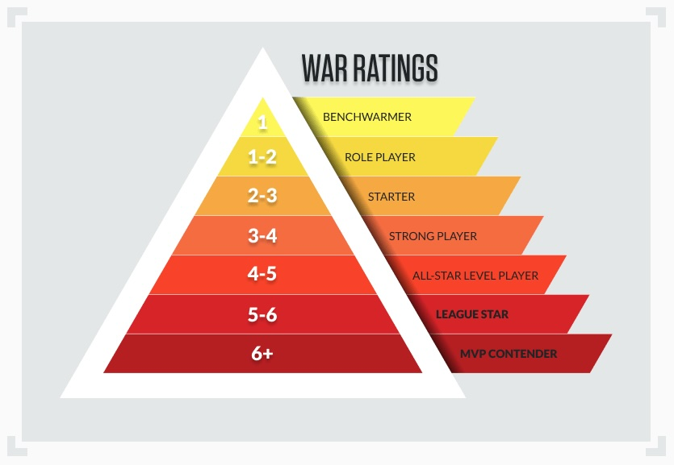
Goal: build a model to predict WAR (Wins Above Replacement)
compared to a replacement-level player
  It combines multiple aspects of performance: hitting, baserunning, defensive value, positional difficulty, and their playing time, and puts it into a single number.
  Interpreted as the number of additional wins a player adds to a team
  Since it provides a single encompassing measure of a player’s value, WAR is greatly relied on by MLB front offices

Slide 4
Motivation
Can a player’s current-season performance statistics be used to predict their next season Wins Above Replacement (WAR)?
Major League Baseball teams rely heavily on WAR to evaluate a players value, make contract decisions, and project roster needs.
It provide a competitive advantage for a team by:
  Helps identify declining players
  Allows for budgeting and contract planning
  Encourages player development and roster optimization
Our goal is, by using statistical and machine learning models, we will:
  Identify which player statistics best predict future WAR
  Compare the performance of three different statistical learning models: OLS, LASSO, and BOOSTING
  Build a model that maintains high predictive accuracy

Slide 5
Data used
Our data came from baseball-reference.com
We used standard batting data from 2020-2025 to build our models (500 obs each year)
  2020-2024 was used for training
  2025 was our test data set
Variables:
  WAR, age, games played, plate appearances, at bats, runs scored, hits, doubles, triples, home runs, RBIs, stolen bases, caught stealing, walks, strikeouts, batting average, on base percentage, slugging percentage, OPS percentage, OPS+, rOBA, Rbat+, total bases, double plays grounded into, hit by pitch, sacrifice hits, sacrifice flies, intentional walks

Slide 6
Models Used

Slide 7
OLS
  Baseline linear model
  Benchmark for comparing models
LASSO
  Feature selection through L1 regularization

Slide 8
OLS Models
OLS identifies and measures the relationship between a response variable and predictor variables.
  Finds a best-fitting line through a set of data points
Pros: Convenient, accurate regression results for linearly related data
Cons: May be too simplistic for real world examples, assumptions of Linear Regression

Slide 9
OLS Metrics Plot

Slide 10
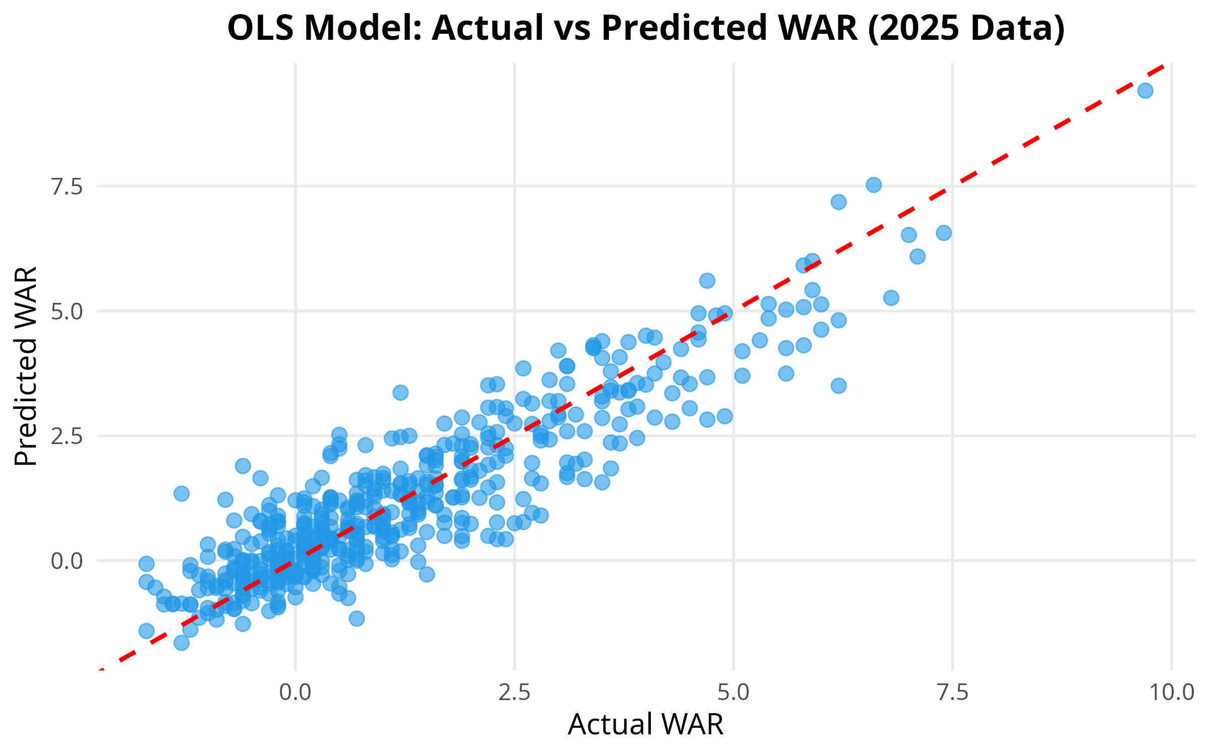
Error metrics for both final testing data set (2025) and the training data split into training and testing sets
Significant terms:
  age, games played, plate appearances, at bats, runs, hits, doubles, triples, home runs, stolen bases, caught stealing, walks, strikeouts, OPS+

Slide 11
Model Comparison: RMSE, MAE, and R²

Slide 12
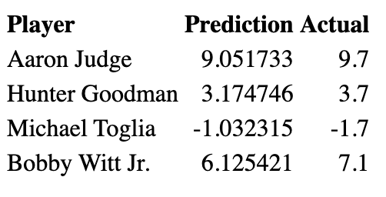
Player Examples Using OLS model

Slide 13
## Key Findings
OLS performed the best overall
  Lowest prediction error
  Highest explained variance
LASSO selected a subset of meaningful predictors, making it easier to understand which player stats drive WAR
Variables with a strong predictive value: plate apperances, home runs, hits, OPS+, walks, and strikouts
WAR prediction is challenging
  some components are hard to obtain from batting-only statistics
  player injuries, playing time, or other extrnal factors produce noise

Slide 14
Questions?

