Slide 1
Juan’s Slides on Random Foresting
Juan Gonzalez

Slide 2
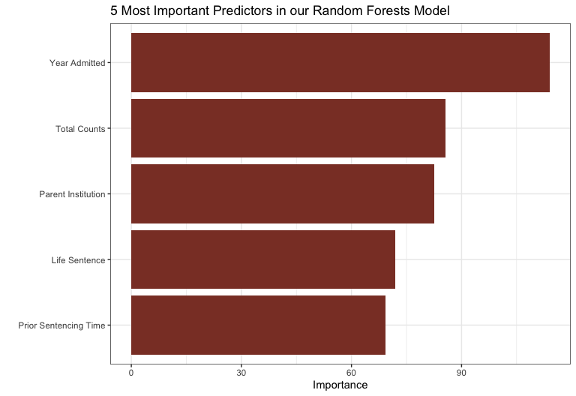
Random Forests
Chosen to deal with correlation amongst trees.
59,333 observations. 70:30 Split ~ (41,500 | 17,800)
Fit 500 trees with 4 randomly chosen predictors for each tree.

Slide 3
Random Forests - Results

