Slide 1
AaronSlides

Slide 2
K-Nearest Neighbors Background
K-Nearest Neighbors (KNN) is a classification method that loops through each point in a dataset, and identifies the k points that are closest to that point
  This k value is adjustable and helps determine the classifier itself, so tuning k is critical for optimizing performance.

Slide 3
KNN on Offense Category
Goal: Predict offense category for individuals based on all other variables.
  Offense categories (manually created): controlled substance possession without a prescription, burglary, murder, armed robbery, theft (identity or property), battery, sexual assault, forgery, kidnapping, illegal firearm/weapon/handgun use or possession, harassment, bribery, drug/meth manufacturing, vehicular hijacking/theft, DUI, child porn, obstructing justice, home invasion, and other
    Categories besides other accounted for >90% of offenses
Problem: This method can be extremely time-expensive with large training sets due to the nature of looping through each point, as I found out during data fitting
  47,000+ training observations (for an 80-20 split)
  2.75 hour runtime

Slide 4
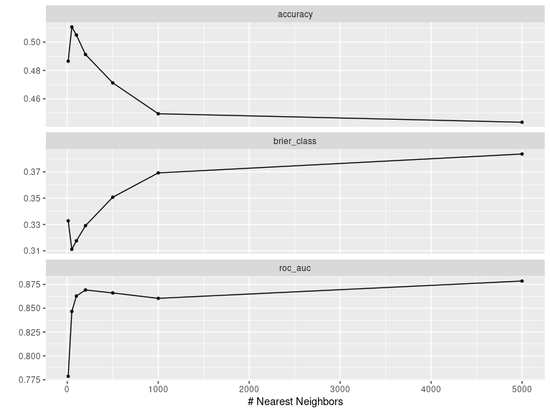
KNN Cross Validation Results
Ten-fold cross-validation performed with the following possible k-values:
  10, 50, 100, 200, 500, 1000, 5000
  Chose wide range due to large amount of data
Cross-validation used to pick the k-value returning the best accuracy, which was k=50
Accuracy decreased significantly for k > 50

Slide 5
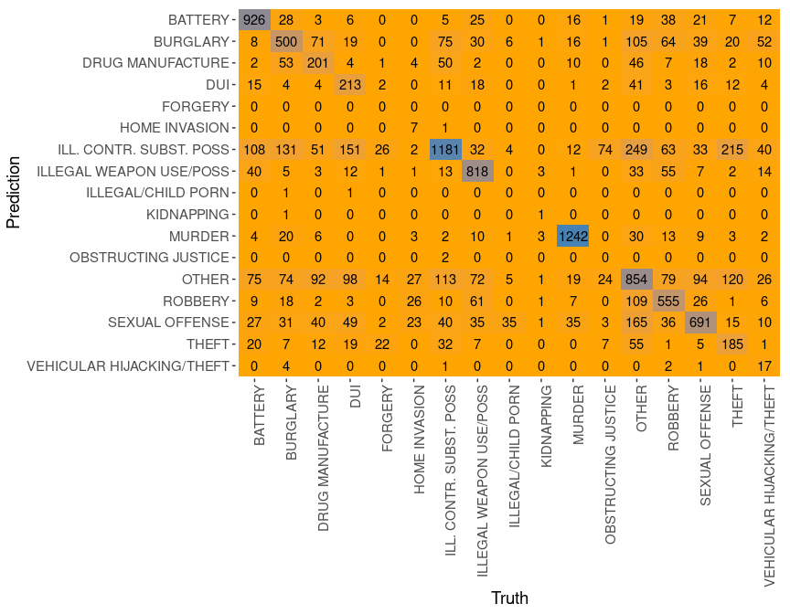
KNN Model Performance

Slide 6
[1] "KNN Test Error for predicting offense category: 0.377"
Test error rate seems high on the surface (almost 50%)
  But we have to account for the fact that 17 categories are present
    Expected error rate with 17 prediction categories, if randomly guessing: ~94.12%
    Reduction in error, from this sense, by almost half

