Slide 1
Illinois DOC Sentencing Machine Learning Analysis
Juan Gonzalez, Aaron Graff, Ilijah Pearson, Hope Winsor

Slide 2
Dataset and Preparation
Our data comes from Kaggle, it consists of 3 CSV files with data scraped off the Illinois Department Of Corrections website.
Contains information 61,052 individuals who have been incarcerated in Illinois from 1952-2018.
“Person” dataset includes simple descriptive information on the person: Name, DOB, Sentencing Date, Race, Eye Color, Hair Color, etc…
“Marks” has multiple rows per person listing any additional descriptive features like scars and tattoos.
“Sentencing” is information on the charges faced by the individual, the crime categorized by Illinois’ felony classes, and our response variable, sentencing time.

Slide 3
Research Questions
What predictors have the strongest effect on sentencing length?
How accurately can we predict sentencing length?
What predictors have the strongest effect on offence category?
How accurately can we predict offence categories?

Slide 4
K-Nearest Neighbors Background
K-Nearest Neighbors (KNN) is a classification method that loops through each point in a dataset, and identifies the k points that are closest to that point
  This k value is adjustable and helps determine the classifier itself, so tuning k is critical for optimizing performance.

Slide 5
KNN on Offense Category
Goal: Predict offense category for individuals based on all other variables.
  Offense categories (manually created): controlled substance possession without a prescription, burglary, murder, armed robbery, theft (identity or property), battery, sexual assault, forgery, kidnapping, illegal firearm/weapon/handgun use or possession, harassment, bribery, drug/meth manufacturing, vehicular hijacking/theft, DUI, child porn, obstructing justice, home invasion, and other
    Categories besides other accounted for >90% of offenses

Slide 6
Drawbacks/Issues
Problem: This method can be extremely time-expensive with large training sets due to the nature of looping through each point, as I found out during data fitting
  47,000+ training observations (for an 80-20 split)
  2.75 hour runtime
No variable selection or subset with KNN

Slide 7
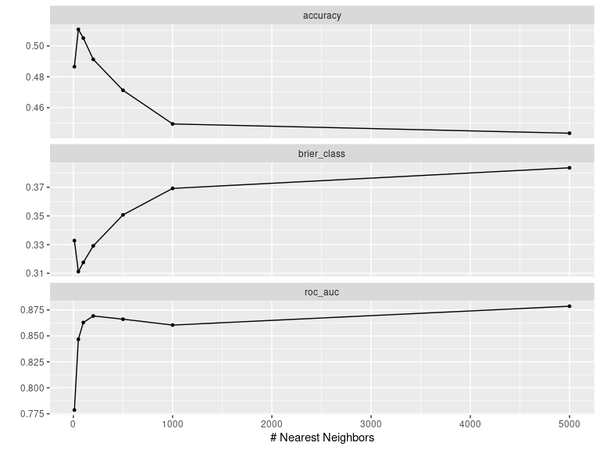
KNN Cross Validation Results
Ten-fold cross-validation performed with the following possible k-values:
  10, 50, 100, 200, 500, 1000, 5000
  Chose wide range due to large amount of data
Cross-validation used to pick the k-value returning the best accuracy, which was k=50
Accuracy decreased significantly for k > 50

Slide 8
KNN Model Performance
Truth | total | correct | prop_correct
BATTERY | 1234 | 926 | 0.750
BURGLARY | 877 | 500 | 0.570
DRUG MANUFACTURE | 485 | 201 | 0.414
DUI | 575 | 213 | 0.370
FORGERY | 68 | 0 | 0.000
HOME INVASION | 93 | 7 | 0.075
ILL. CONTR. SUBST. POSS | 1536 | 1181 | 0.769
ILLEGAL WEAPON USE/POSS | 1110 | 818 | 0.737
ILLEGAL/CHILD PORN | 51 | 0 | 0.000

Slide 9
Truth | total | correct | prop_correct
KIDNAPPING | 11 | 1 | 0.091
MURDER | 1359 | 1242 | 0.914
OBSTRUCTING JUSTICE | 112 | 0 | 0.000
OTHER | 1706 | 854 | 0.501
ROBBERY | 916 | 555 | 0.606
SEXUAL OFFENSE | 960 | 691 | 0.720
THEFT | 582 | 185 | 0.318
VEHICULAR HIJACKING/THEFT | 194 | 17 | 0.088

Slide 10
KNN Model Analysis
Test error rate seems high on the surface (almost 40%)
  But we have to account for the fact that 17 categories are present
    Expected guessing error w/ 17 prediction categories: ~94.12%
Predictive accuracy was significantly better in categories with more observations (e.g., battery, illegal weapon use/possession, murder) than categories with few observations (e.g., vehicular hijacking/theft, forgery).
  Only exceptions: drug manufacturing, theft (< 45% accuracy).
Interpretation: more variability in predictor means for lower level offenses

Slide 11
LASSO
LASSO model = RSS + $λ\sum_{j=1}^{p}{β_{j}^{2}}$
where $λ$ is the tuning parameter, to improve interpretability, use penalty to perform feature selection
cross validation selected $λ=0.01$
term | estimate
height | 0
hair_Salt.and.Pepper | 0
sex_Male | 0
race_Bi.Racial | 0
race_White | 0

Slide 12
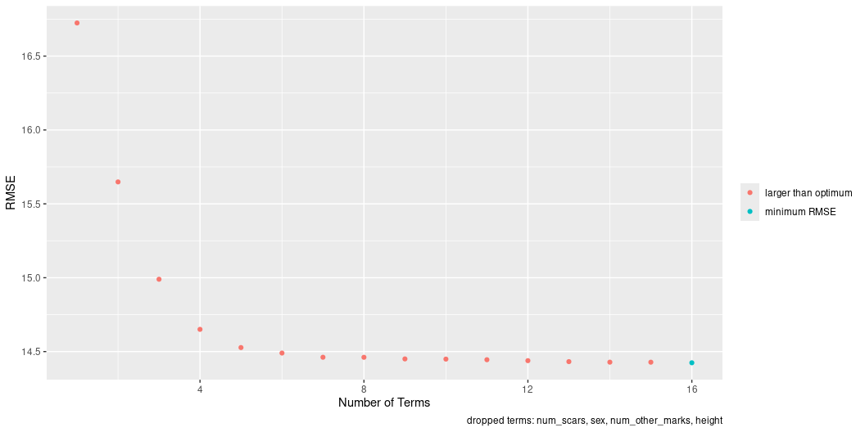
Forward and Backward Subset
step | variable | step (cont) | variable (cont)
1 | year_adm | 9 | armed
2 | class | 10 | attempted
3 | parent_institution | 11 | race
4 | total_counts | 12 | weight
5 | offense_category | 13 | month_adm
6 | aggravated | 14 | time_sentenced_prior
7 | appx_age | 15 | hair
8 | eyes | 16 | num_tattoos

Slide 13
Generalized Additive Model (GAM)
Extension of linear regression that allows each predictor to have a continuous nonlinear effect on the response
80:20 split
Used 10 fold CV to tune the degrees of freedom
On the test set the GAM achieved:
RMSE = 12.20631
Meaning that our prediction error is $12.20631$ years.
R^2=0.7139504
Meaning that our model explains 71% of the variability in sentencing length on new data.

Slide 14
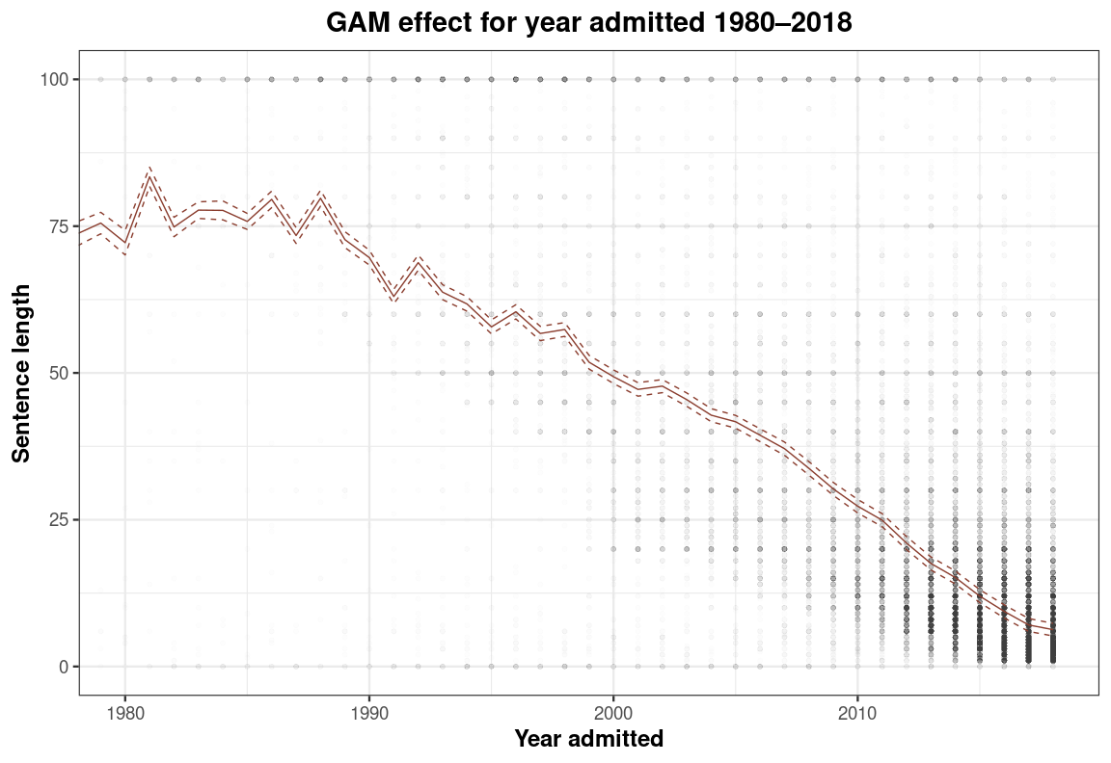
GAM

Slide 15
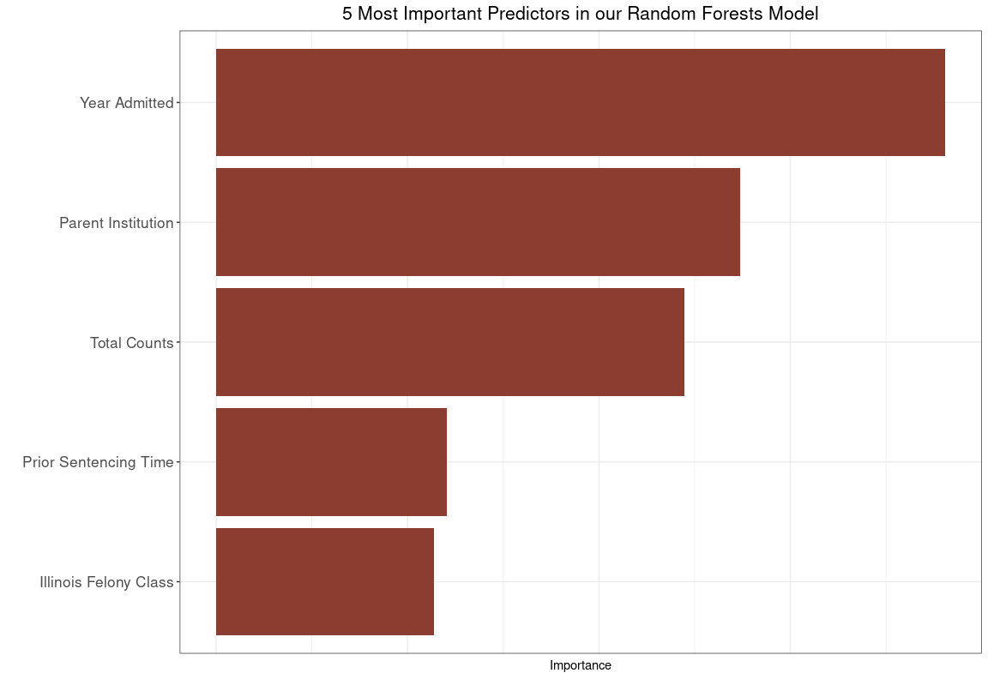
Random Forest
Chosen to deal with correlation amongst trees.
58,836 observations. 70:30 Split $∼$ (41,200 | 17,600)
Fit 500 trees with 4 randomly chosen predictors for each tree.
Out-of-Bag error is calculated by checking the performance of each tree on a subset of unseen data during the training process.

Slide 16
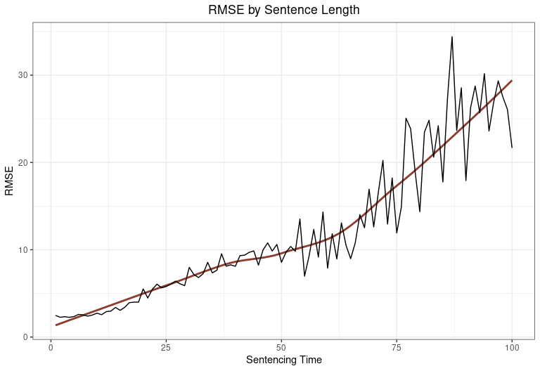
Predictive Performance - Random Forests
12.11 OOB RMSE / 12. 18 Test RMSE. Similar RMSEs is good (generalizes well).
As sentencing length goes up, our models prediction becomes more variable. However, the models’ errors scale proportionally to sentencing length. Meaning we don’t typically get crazy predictions for lower sentencing lengths.

Slide 17
Conclusion

Slide 18
References
-https://www.kaggle.com/datasets/davidjfisher/illinois-doc-labeled-faces-dataset -https://www.idoc.state.il.us

Slide 19
Questions?

Slide 20
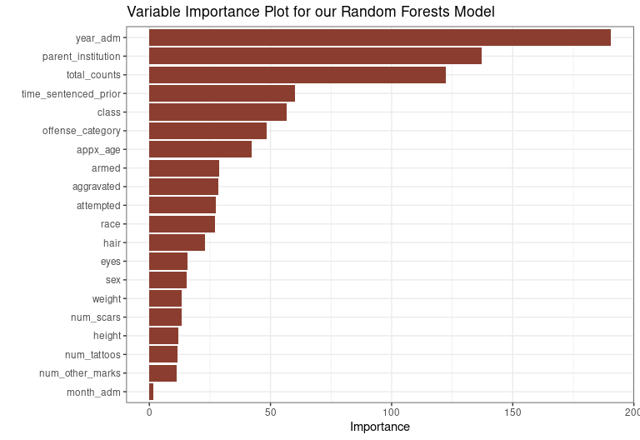
Bonus Slides - Complete Variable Importance for RF

