Slide 1
Drivers of Si Export in Small Watersheds

Slide 2
Introduction
Chemical weathering of silicate rocks is a major control on the earth-climate system
Modern chemical weathering rates are poorly understood
Acid availability, wetness, and plant growth can all affect rates
Climate change
Acid Rain
Clean Air Act Amendments of 1990 (CAA)
Silicon (Si) is a product of weathering processes

Slide 3
Question
What are the primary drivers in trends of Si export from small watersheds before and after the CAA?
How did they change?

Slide 4

Macrosheds Dataset
macrosheds.org

Slide 5
*** ## Data Used
Used MS data to calculate Si loads and water yield from 3 watersheds
California
Colorado
Vermont
Used DAYNET for grided precipitation
Used MODIS satellite for gross primary productivity

Slide 6
Methods
Aggregated data monthly
Split data
Pre-CAA (1988 and 1989)
Pre-CAA (2011 and 2012)
Ran suite of models
MLR
Ridge GLM
Random Forest
Compared results

Slide 7
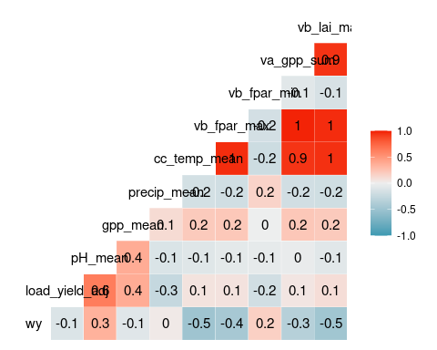
Variable Selection

Slide 8
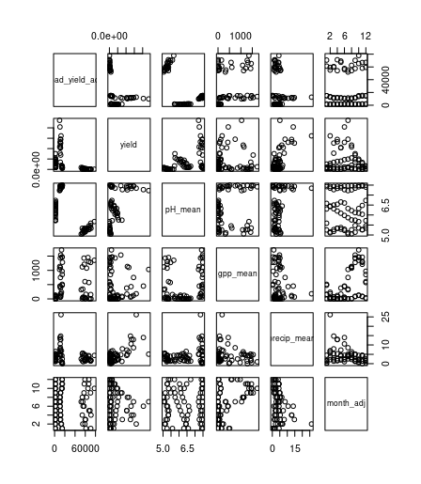
Correlation pre CAA
Correlations Pre CAA

Slide 9
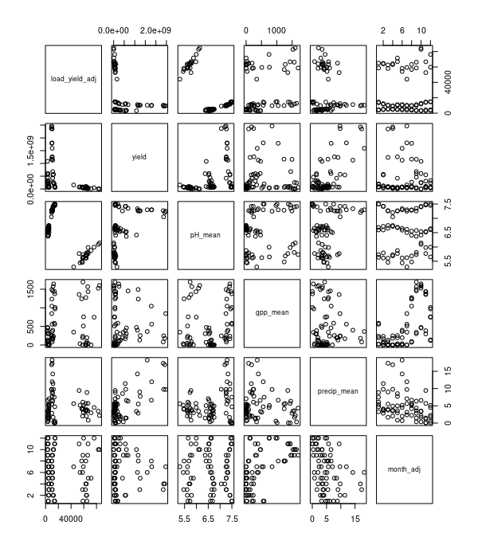
correlation post CAA
Correlations Post CAA

Slide 10
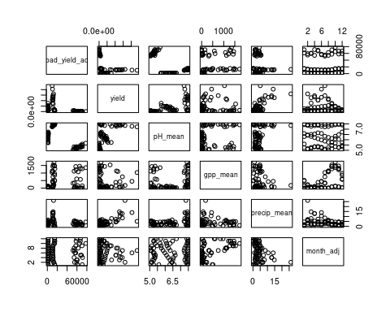
Random forest varaible selection

Slide 11
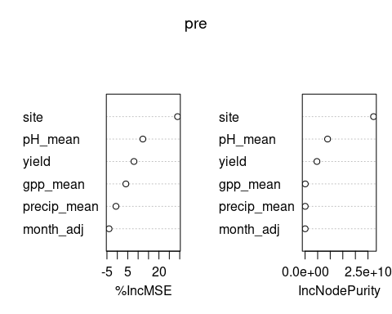

Slide 12
MLR
Run the mlr one the dataset with all three site prior to the Caa to find signifiacnt variable(s) that were not site locations
I then did a mlr for each site location

Slide 13
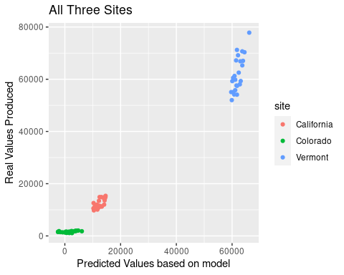
All three site Graph

Slide 14
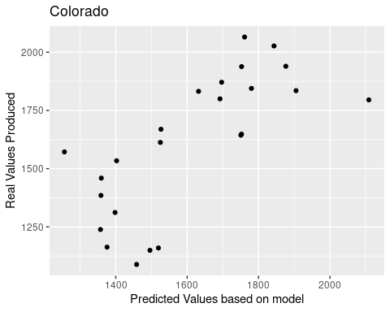
Colorado

Slide 15
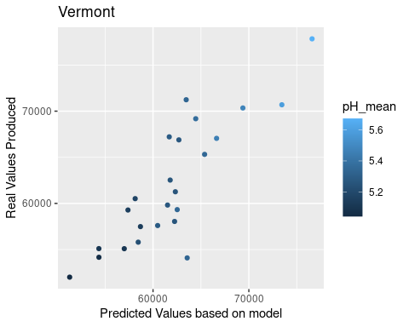
Vermont

Slide 16
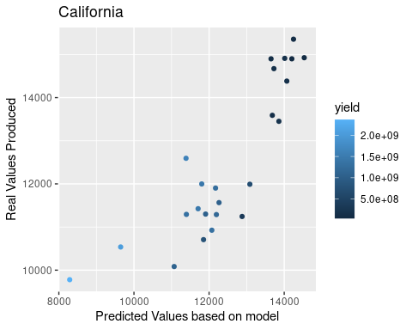
California

Slide 17
MLR Conclusions
The only significant variable in the combined site data set was pH_mean
Each of the sites had differnt Significant variables
Colorado did not have any significant predictors
Vermont had ph_mean
California had total yield

Slide 18
Ridge Regression
Normalized data
Added dummy variables for site effects
Tuned lambda
Used tuned lambda to estimate coefficients

Slide 19
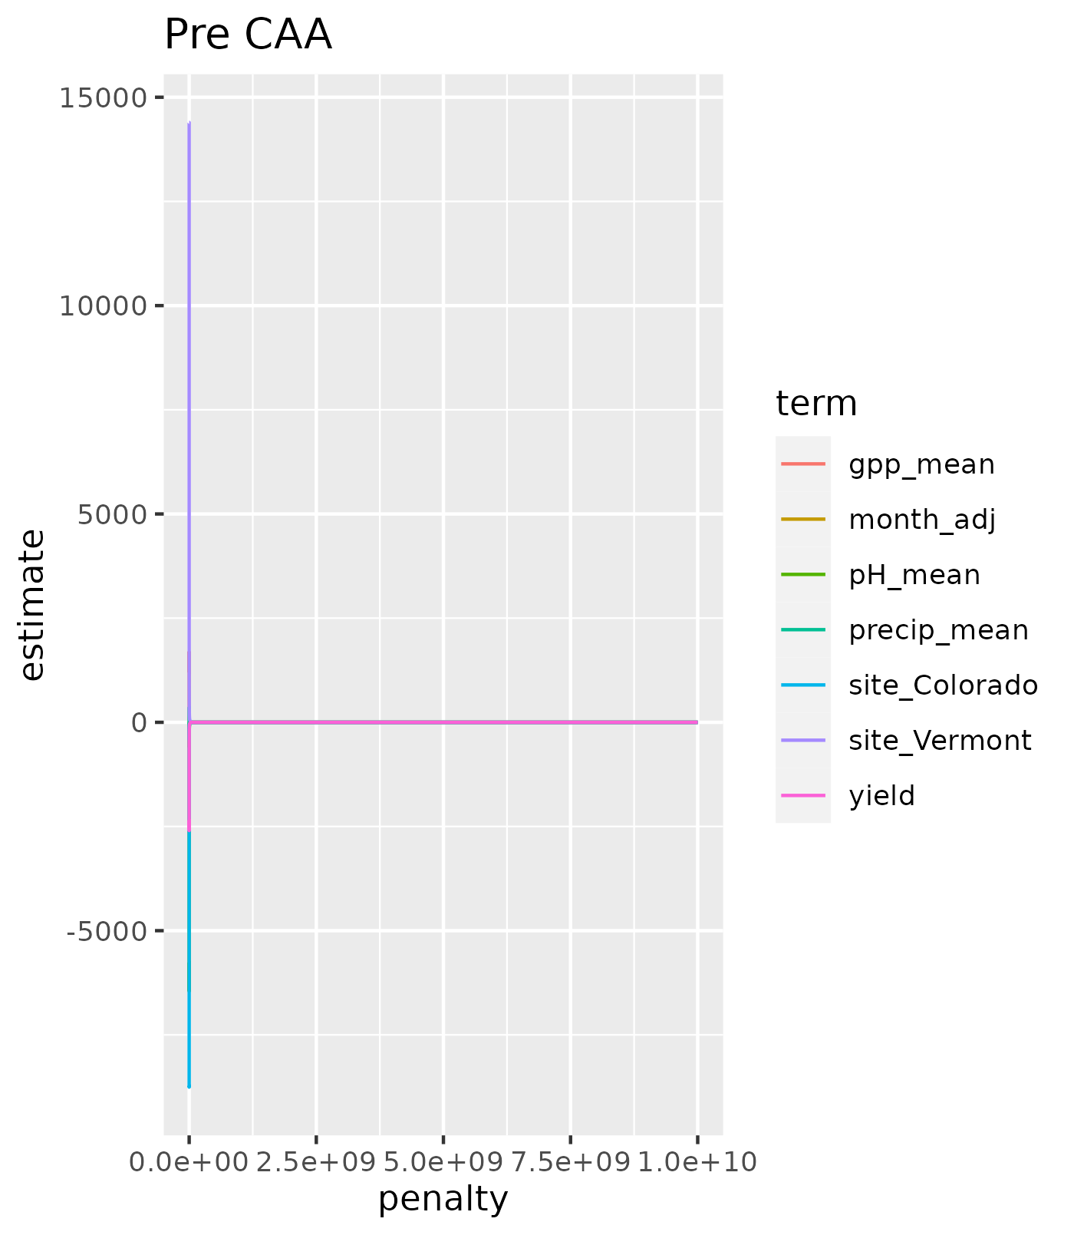

Slide 20
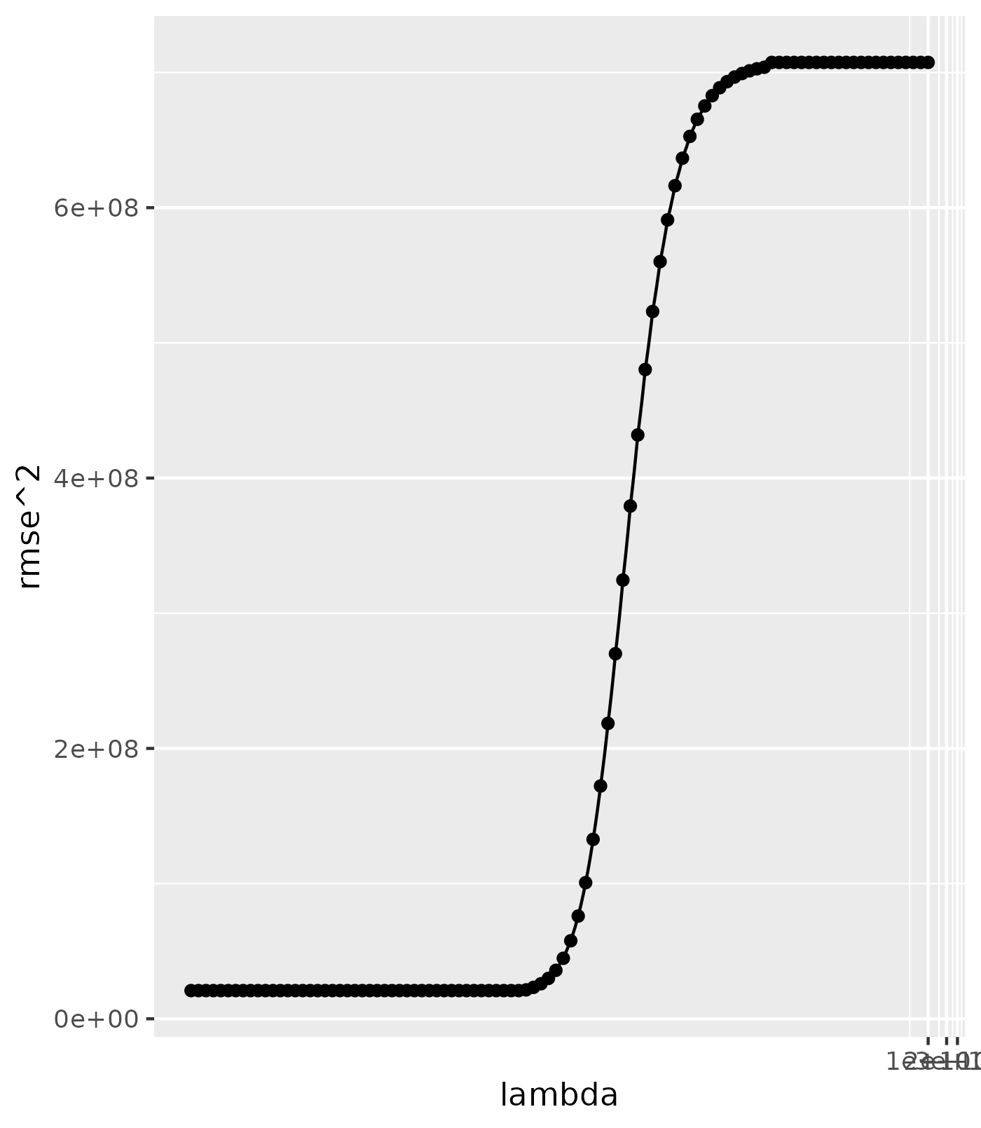
***
Pre CAA: RMSE response to different values for lambda.

Slide 21
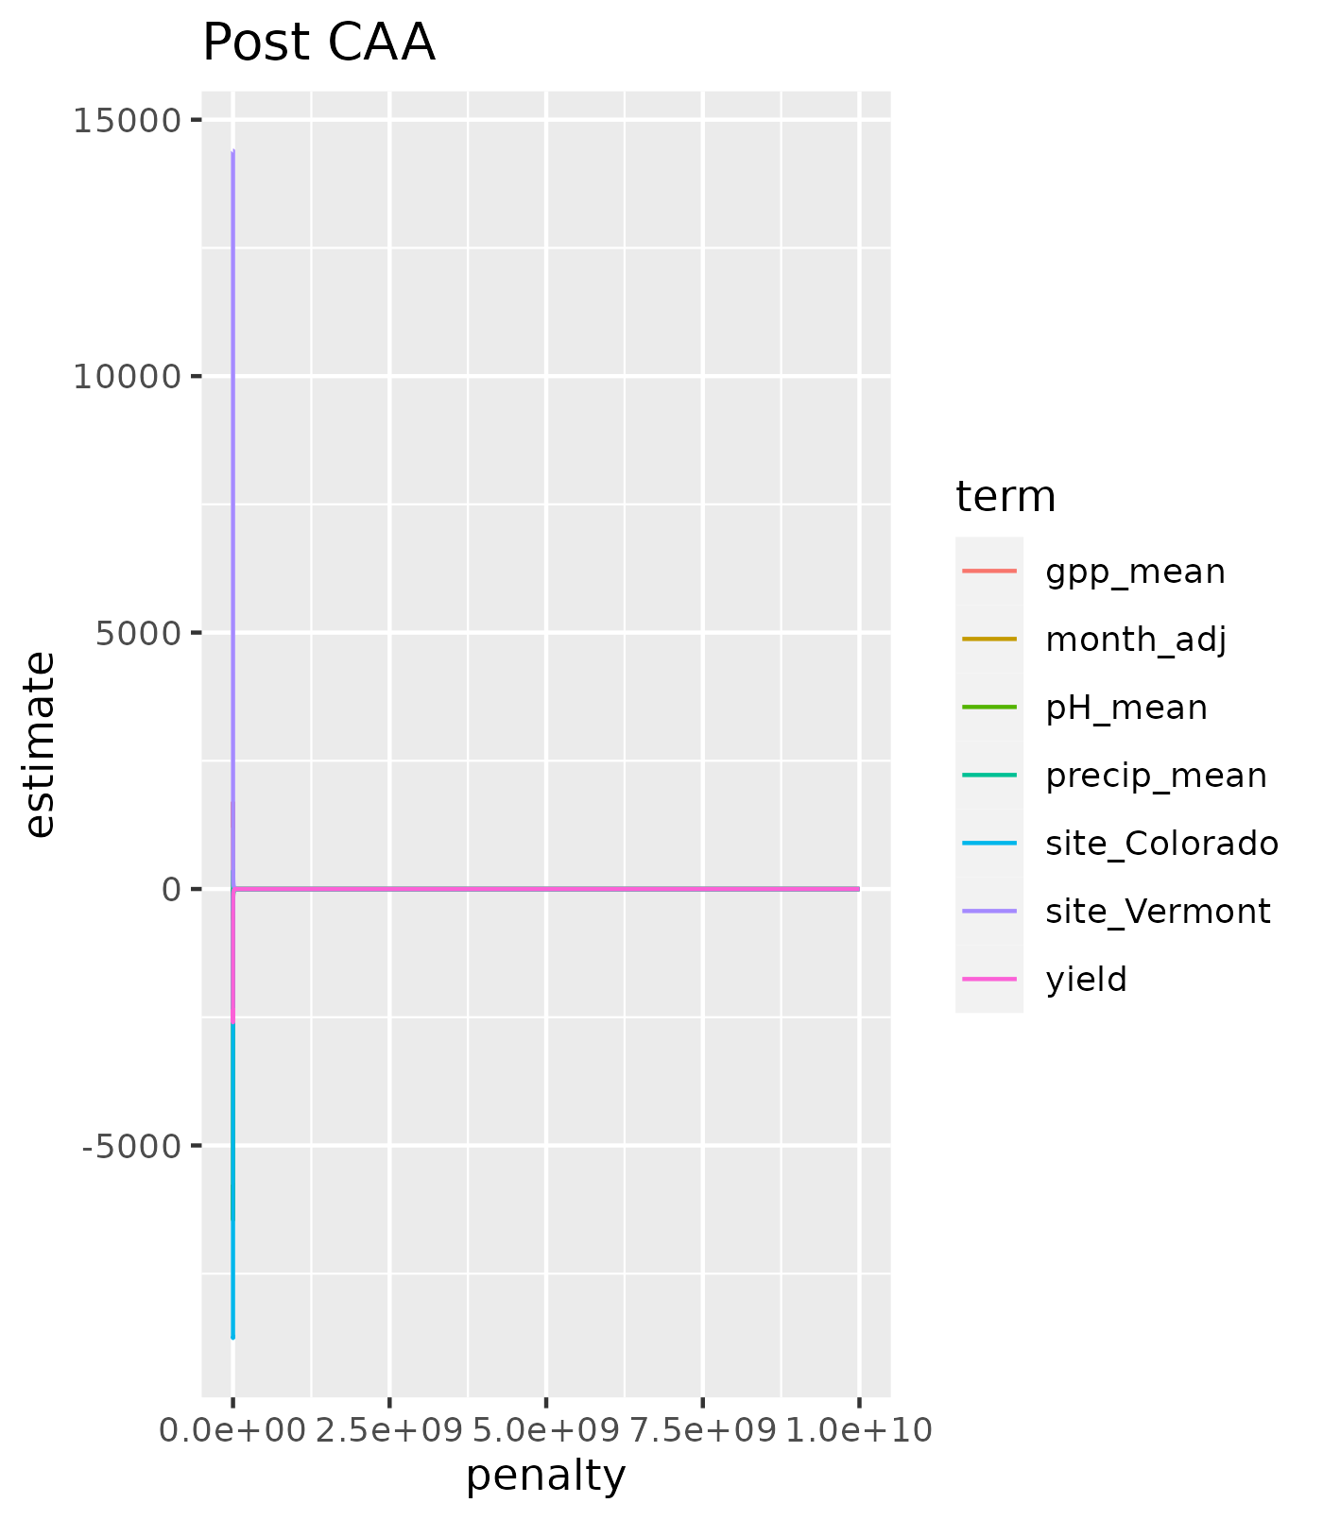

Slide 22
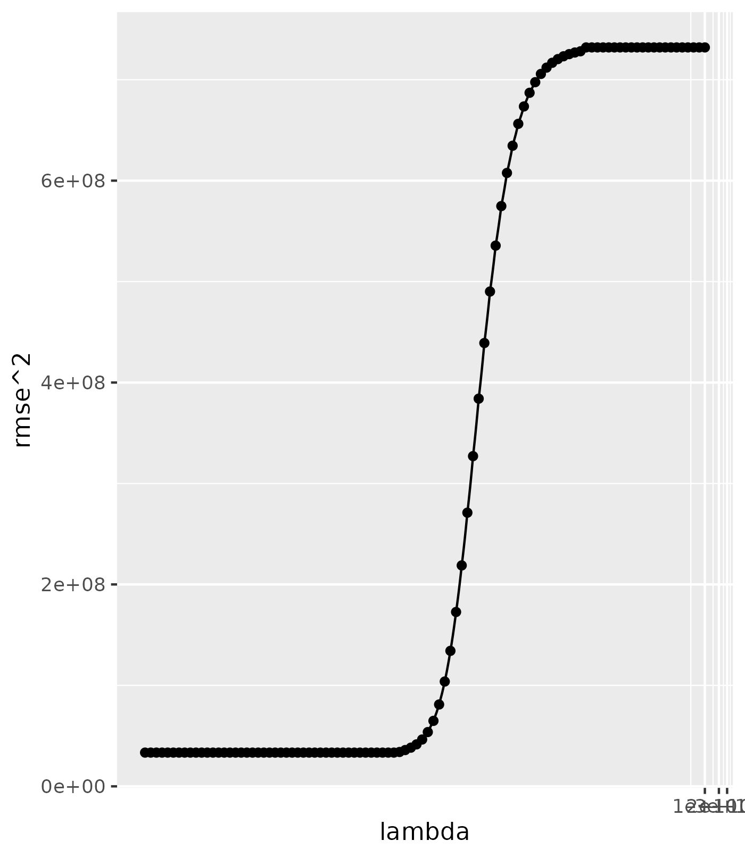
Post CAA: RMSE response to different values for lambda.

Slide 23
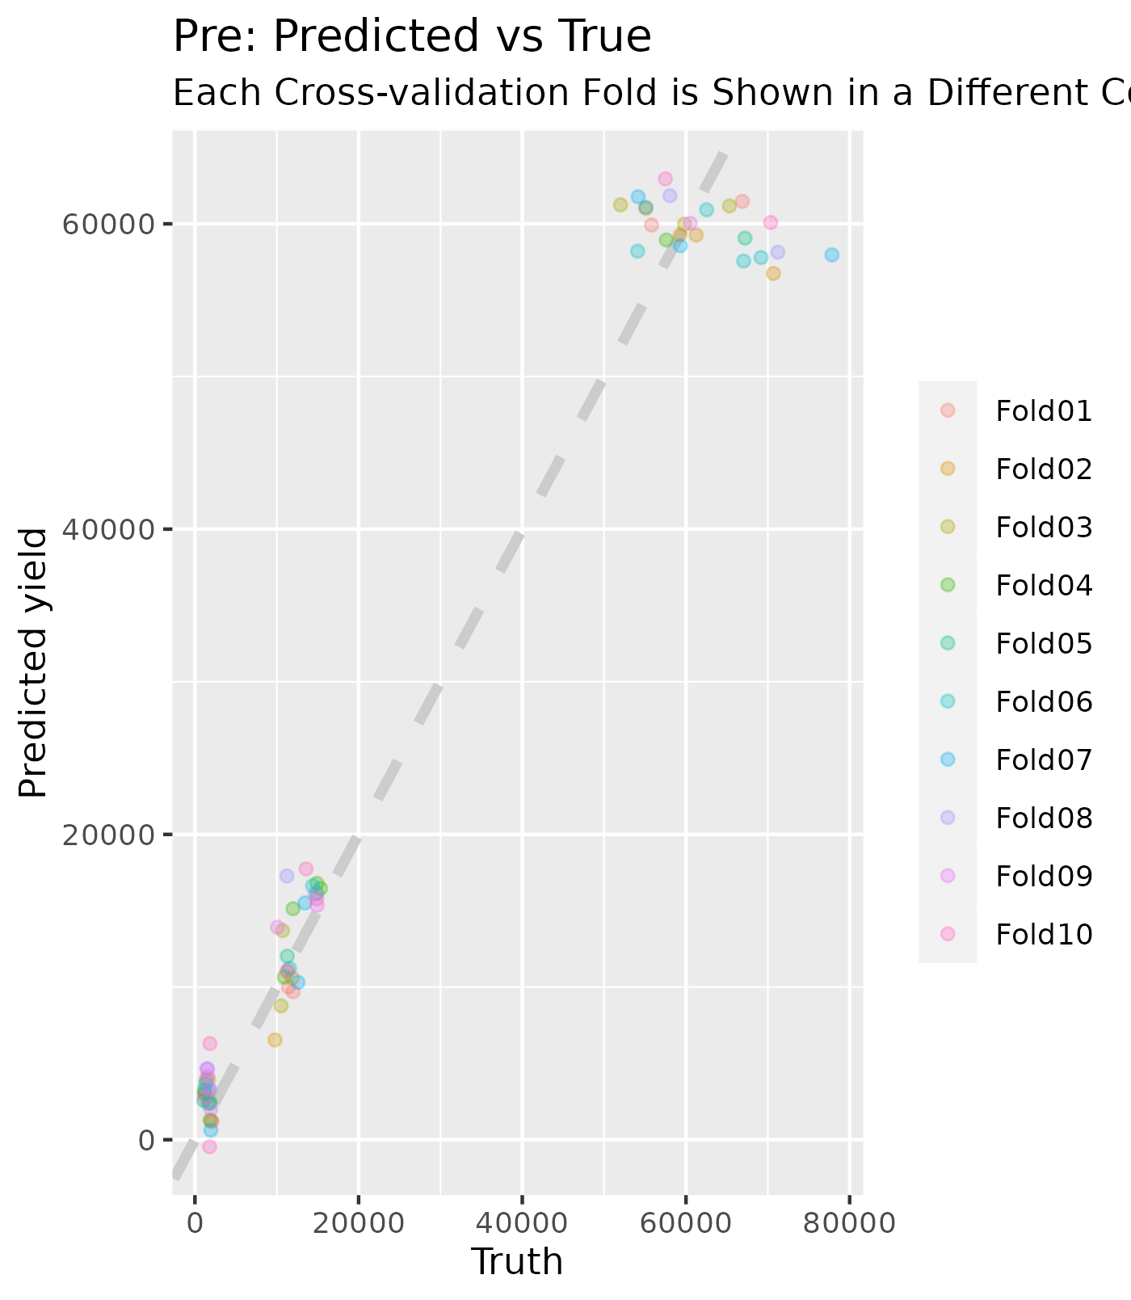

Slide 24


Slide 25
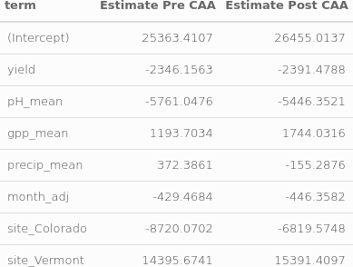

Slide 26
Conclusions From Ridge Regression
The models described the data well (although maybe over-fitted)
Both Pre and Post had R-squared values of ~0.97
Change in Precipitation term sign indicates change in role of rain

Slide 27
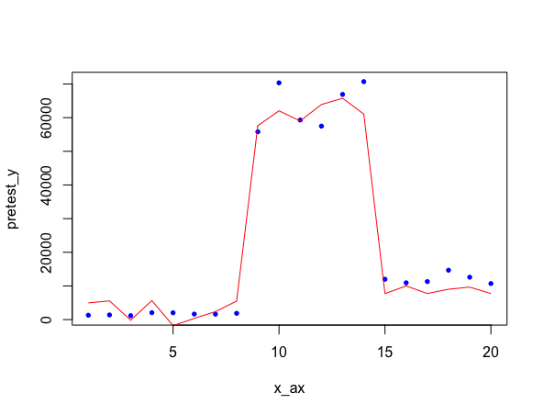
Random forest
Bagging - Pre_caa: RMSE: 72933232 - Post_caa: RMSE: 7196922
Gradient boosting - Pre_caa: RMSE: 6476.693, R squared: 0.975 - post_caa: RMSE: 6667.378, R squared: 0.929

Slide 28
Conclusions
All models showed evidence of the CAA changing the role of precipitation in weathering
Random forest with bagging and boosting gave the most robust model
We should probably keep regulating air quality in the US

