Slide 1
Predicting Problematic Internet Use
Kwan Eum, Eddie Haggerty, Nathan Seto

Slide 2
Premise: Kaggle Competition
Child Mind Institute: Problematic Internet Use
Main goal of competition is to predict Severity Impairment Index (SII) score
Also wanted to try to predict Sleep Disturbance score (SDS) out of curiosity

Slide 3
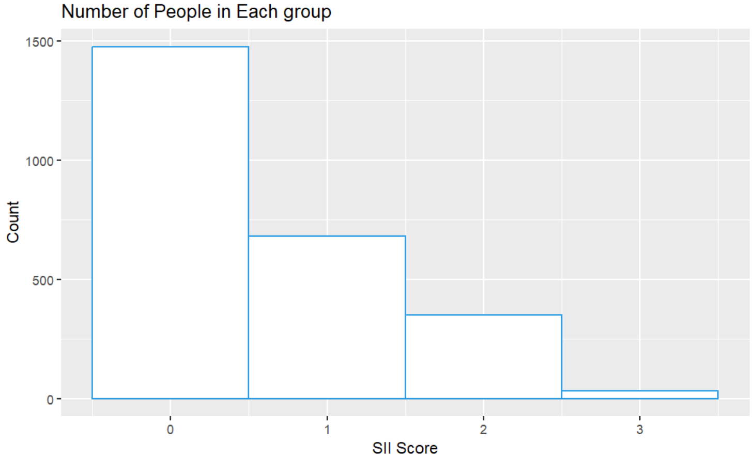
Exploratory Data Analysis
“SII” stands for “Severity Impairment Index”

Slide 4
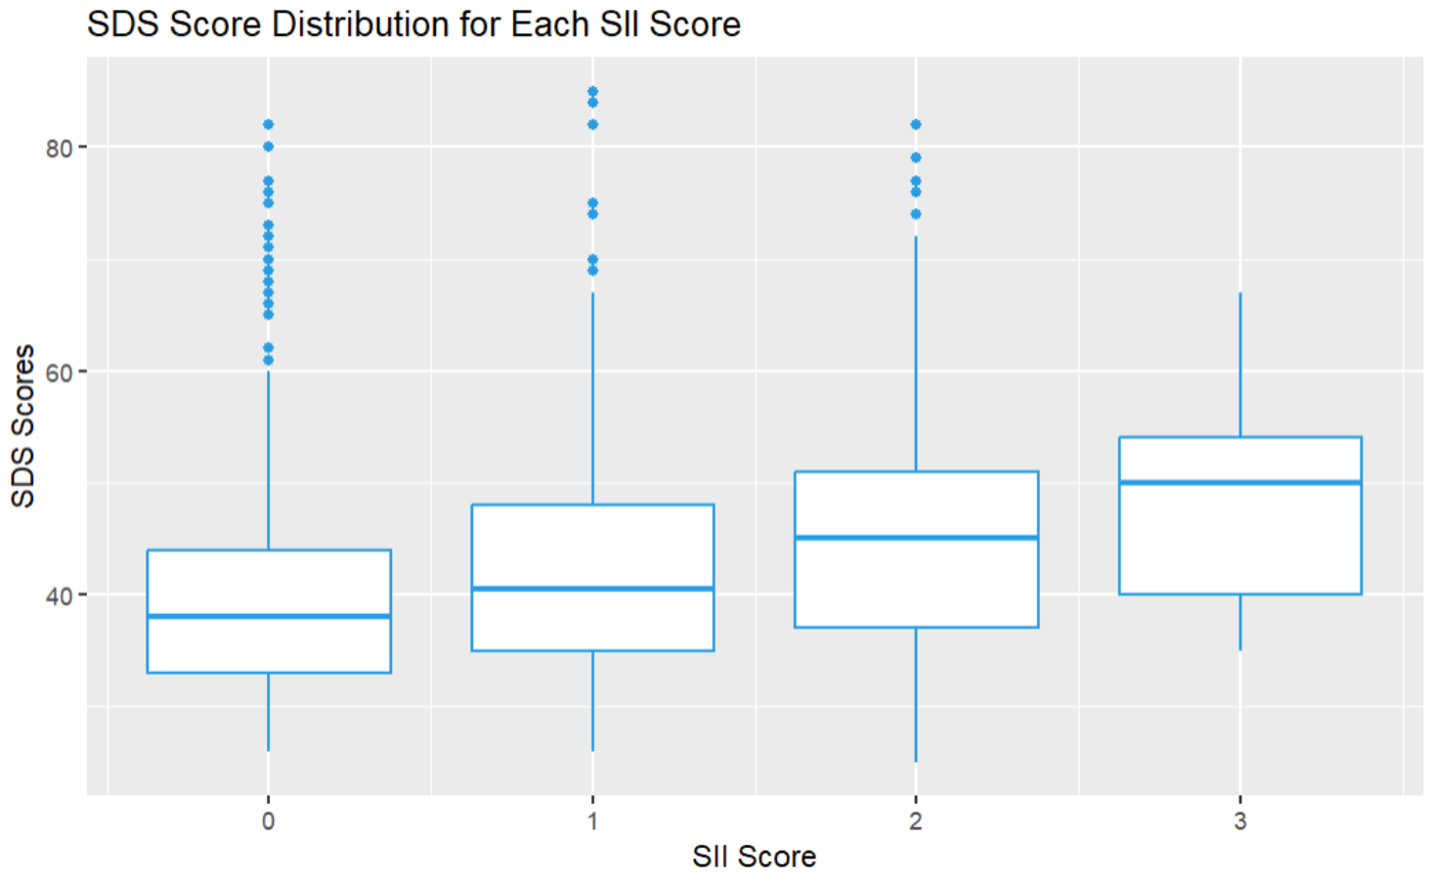
Exploratory Data Analysis
“SDS” stands for “Sleep Disturbance Scale”

Slide 5
Linear Regression

Slide 6
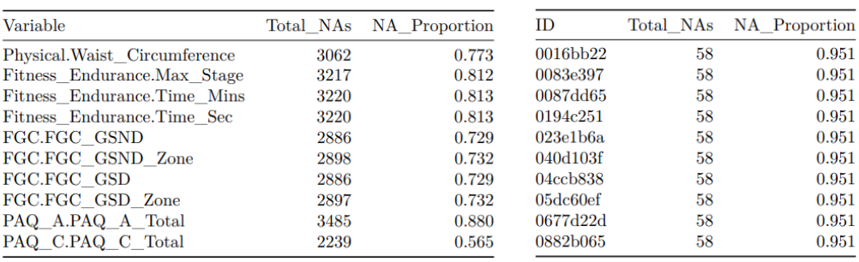
Dealing with NAs
Removed variables with proportion of NAs over 0.5
10 Variables removed this way
Then removed all observations with proportion of NAs over 0.5
1097 observations removed this way

Slide 7
Dealing with NAs
Used imputation for rest of NAs; mice and tidyr packages were good for this
There were still some NAs in the data after imputing
All remaining NAs were in same columns/rows
Chose to get rid of observations rather than removing more variables
Final dataset had 61 variables
Training set had 1584 observations
Test set had 360 observations

Slide 8
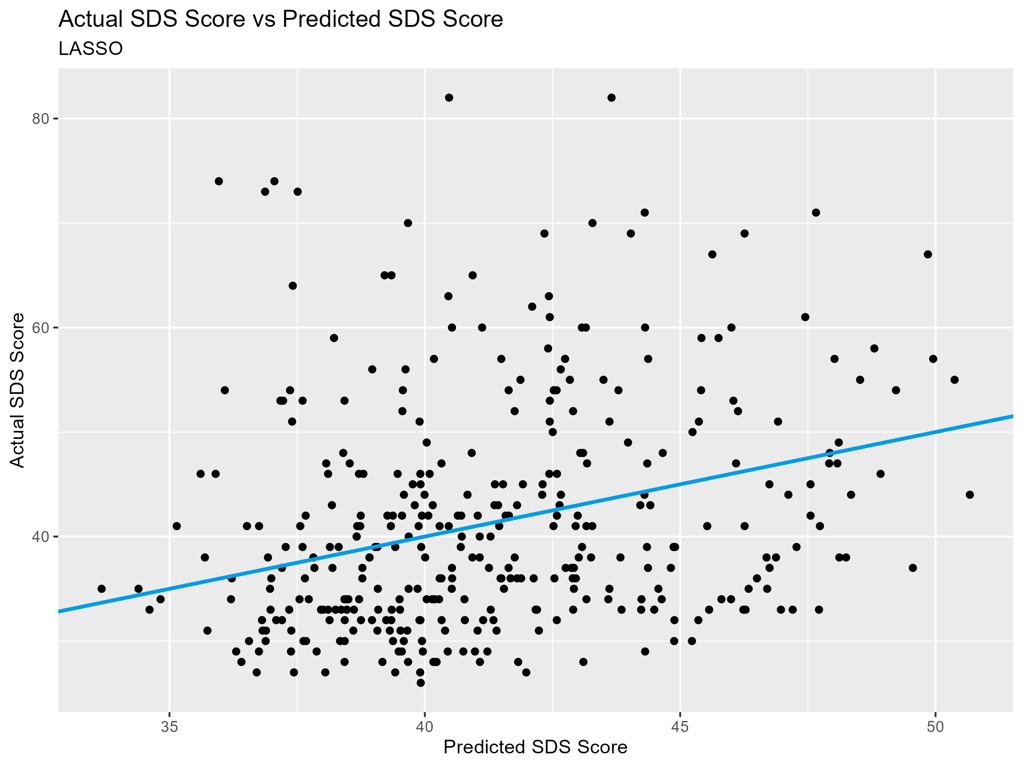
Lasso
Trying to predict SDS Score
28 predictors were used, including sii
Only 2 of the 17 Bioelectric Impedance Analysis variables were used
BMI and Activity Level
Test RMSE for the best Lasso model was 10.73954

Slide 9
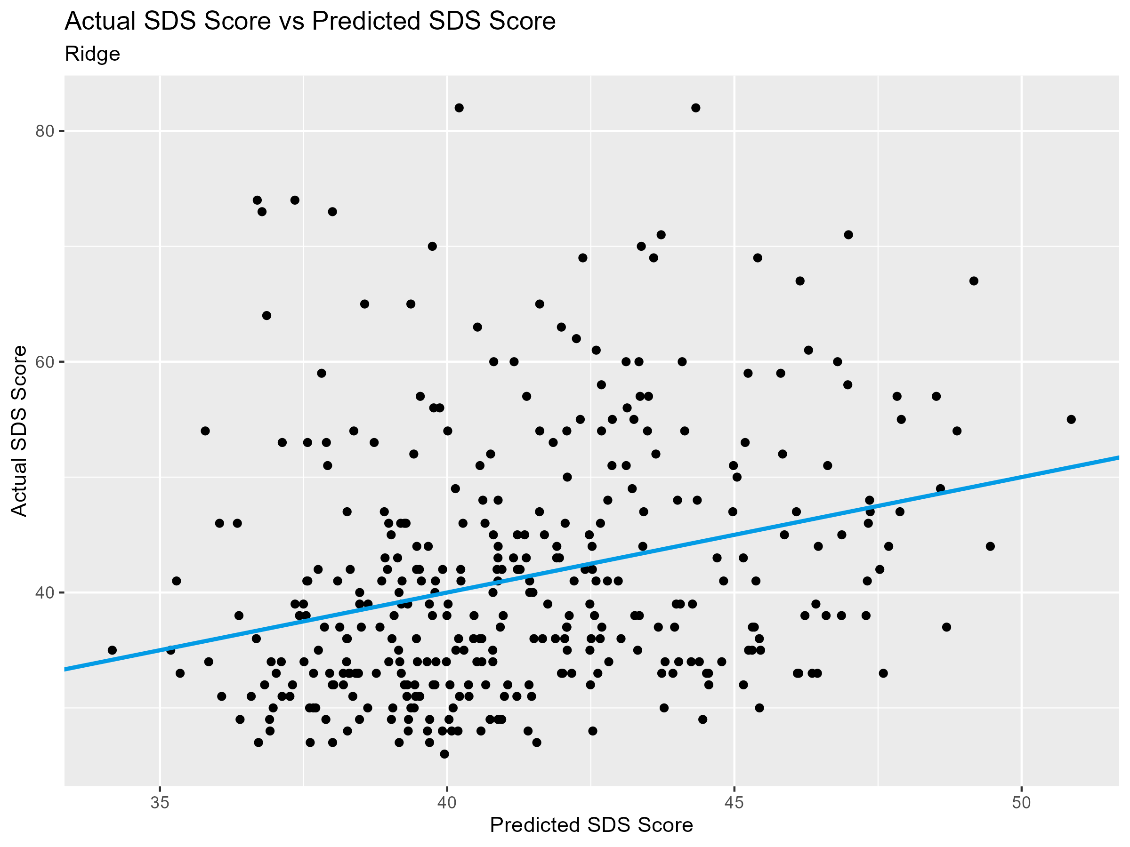
Ridge
Same 28 predictors were used in both Ridge and Lasso
Different coefficient estimates
Test RMSE for best Ridge model was 10.6742

Slide 10
Random Forest

Slide 11
Random Forest
Removed predictors and observations with more than 40% missing data; 36 variables, 1,225 observations excluded
Applied Random Forest to identify key variables associated with SII and SDS
Excluded the Parent-Child Internet Addiction Test (PCIAT) total score because it is a linear combination of other PCIAT variables.
PCIAT variables are categorical, ranging from 0 (strongly disagree) to 5 (strongly agree).

Slide 12
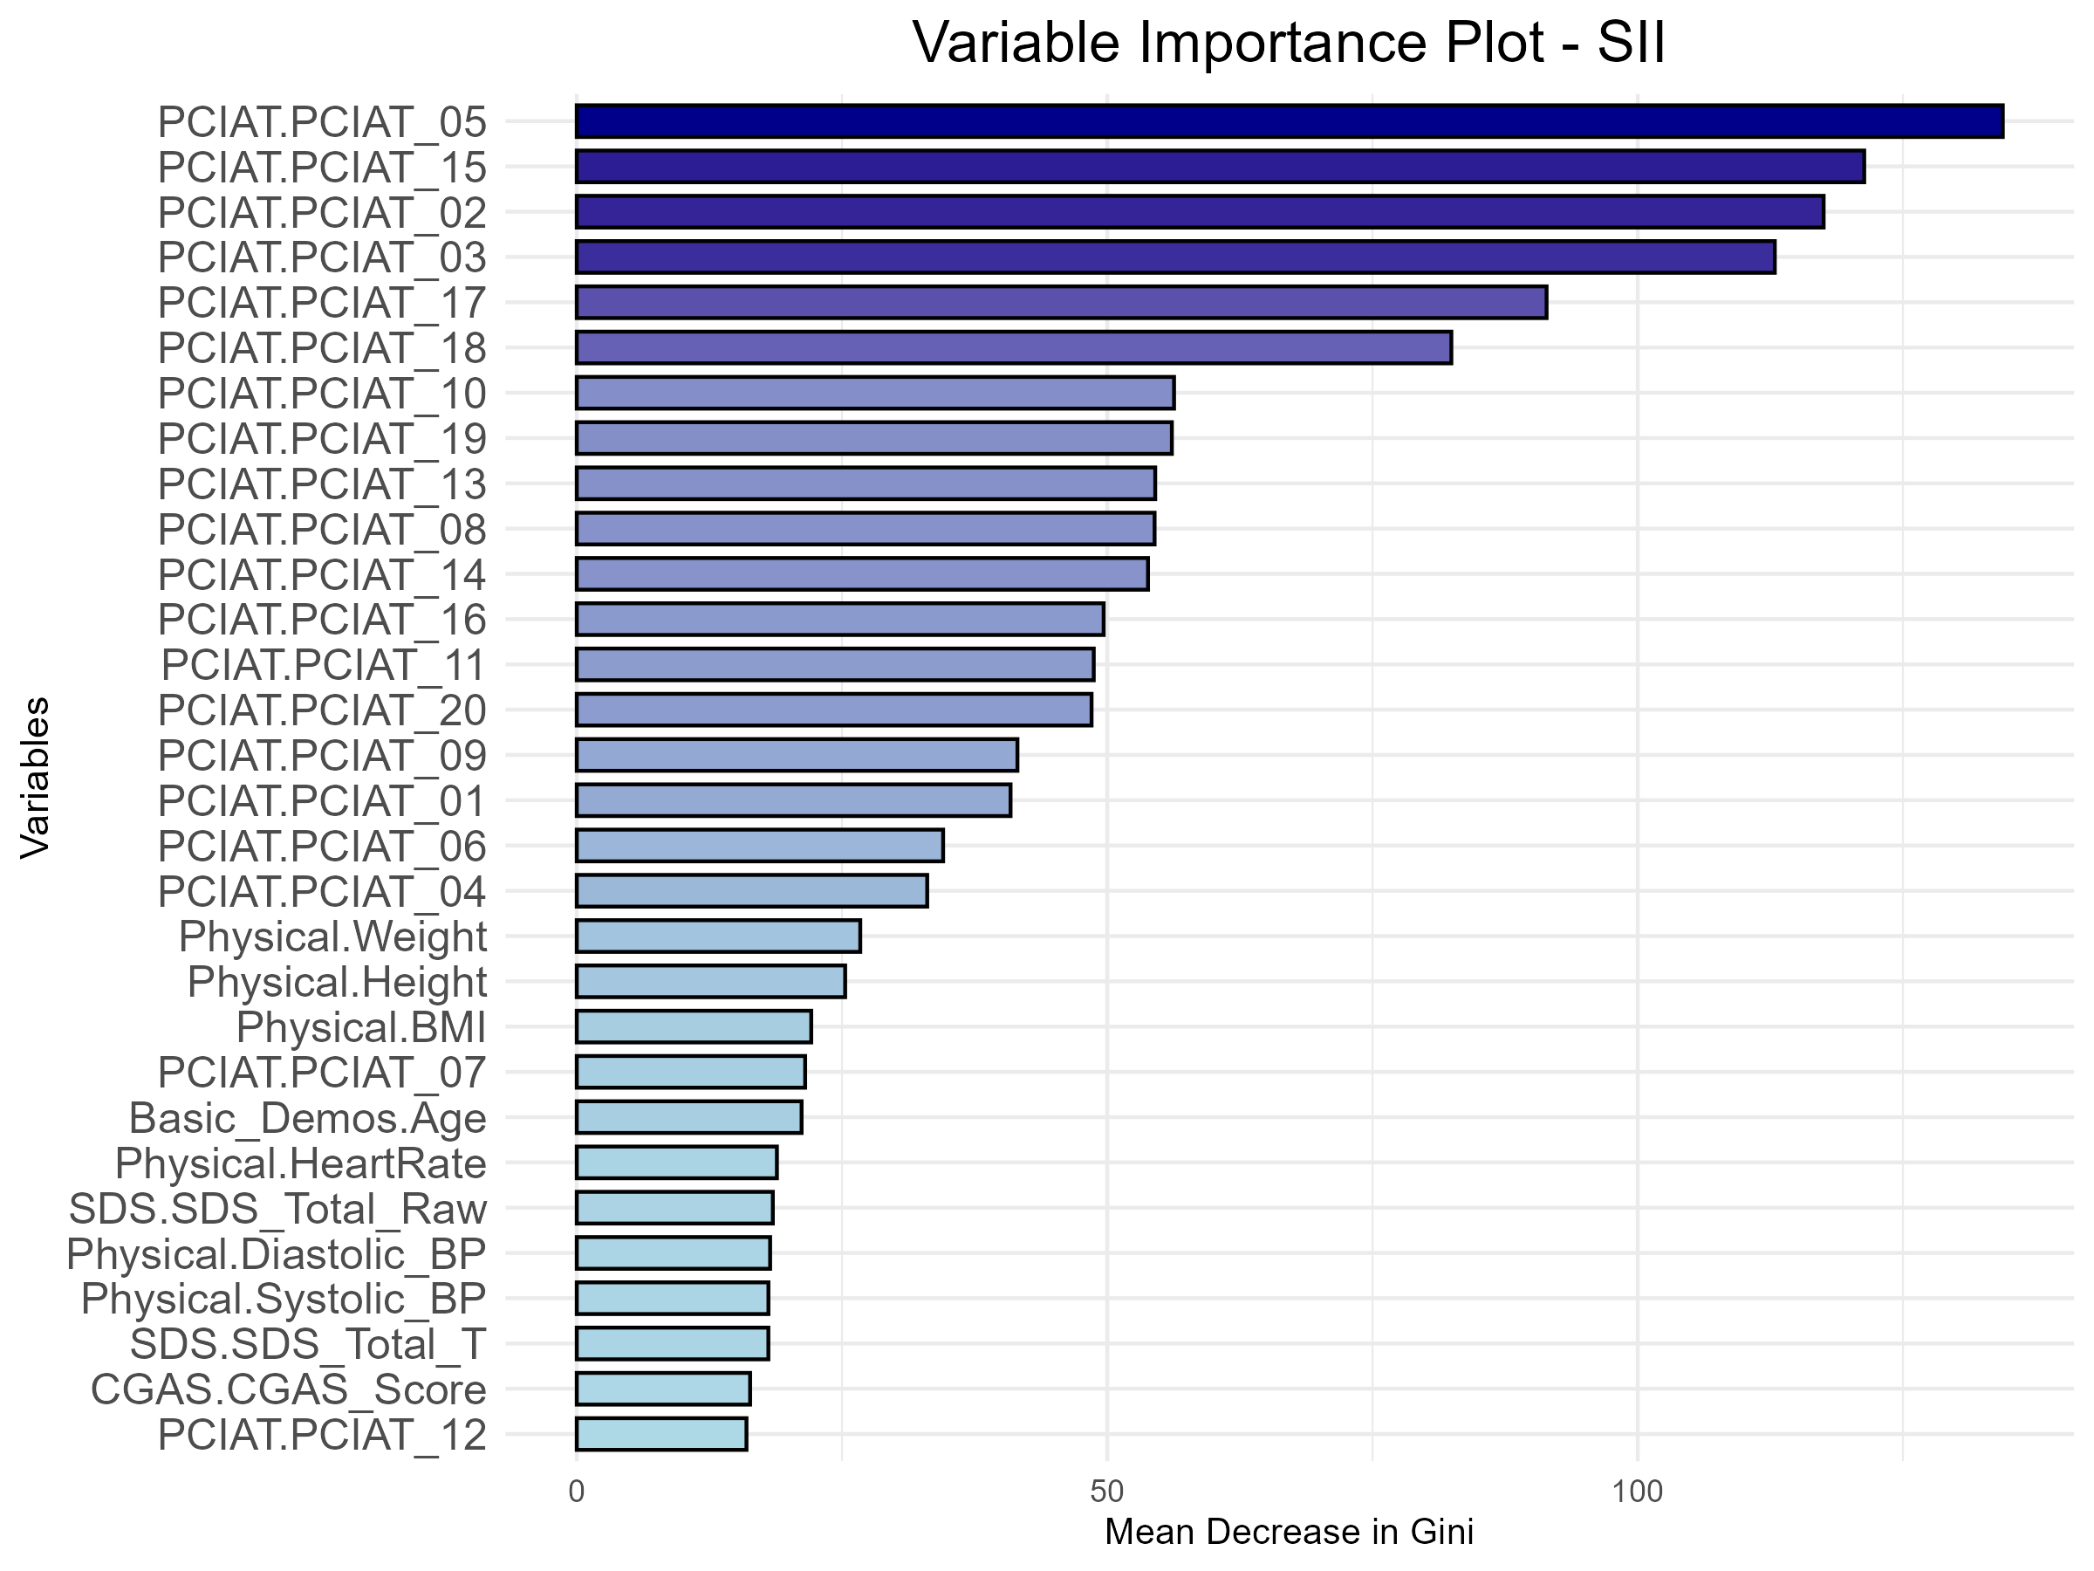
Random Forest
The plot highlights the most important variables related to the SII.
PCIAT variables are the most strongly associated with SII.
Physical measures (Weight, Height, BMI) are the next most important contributors

Slide 13
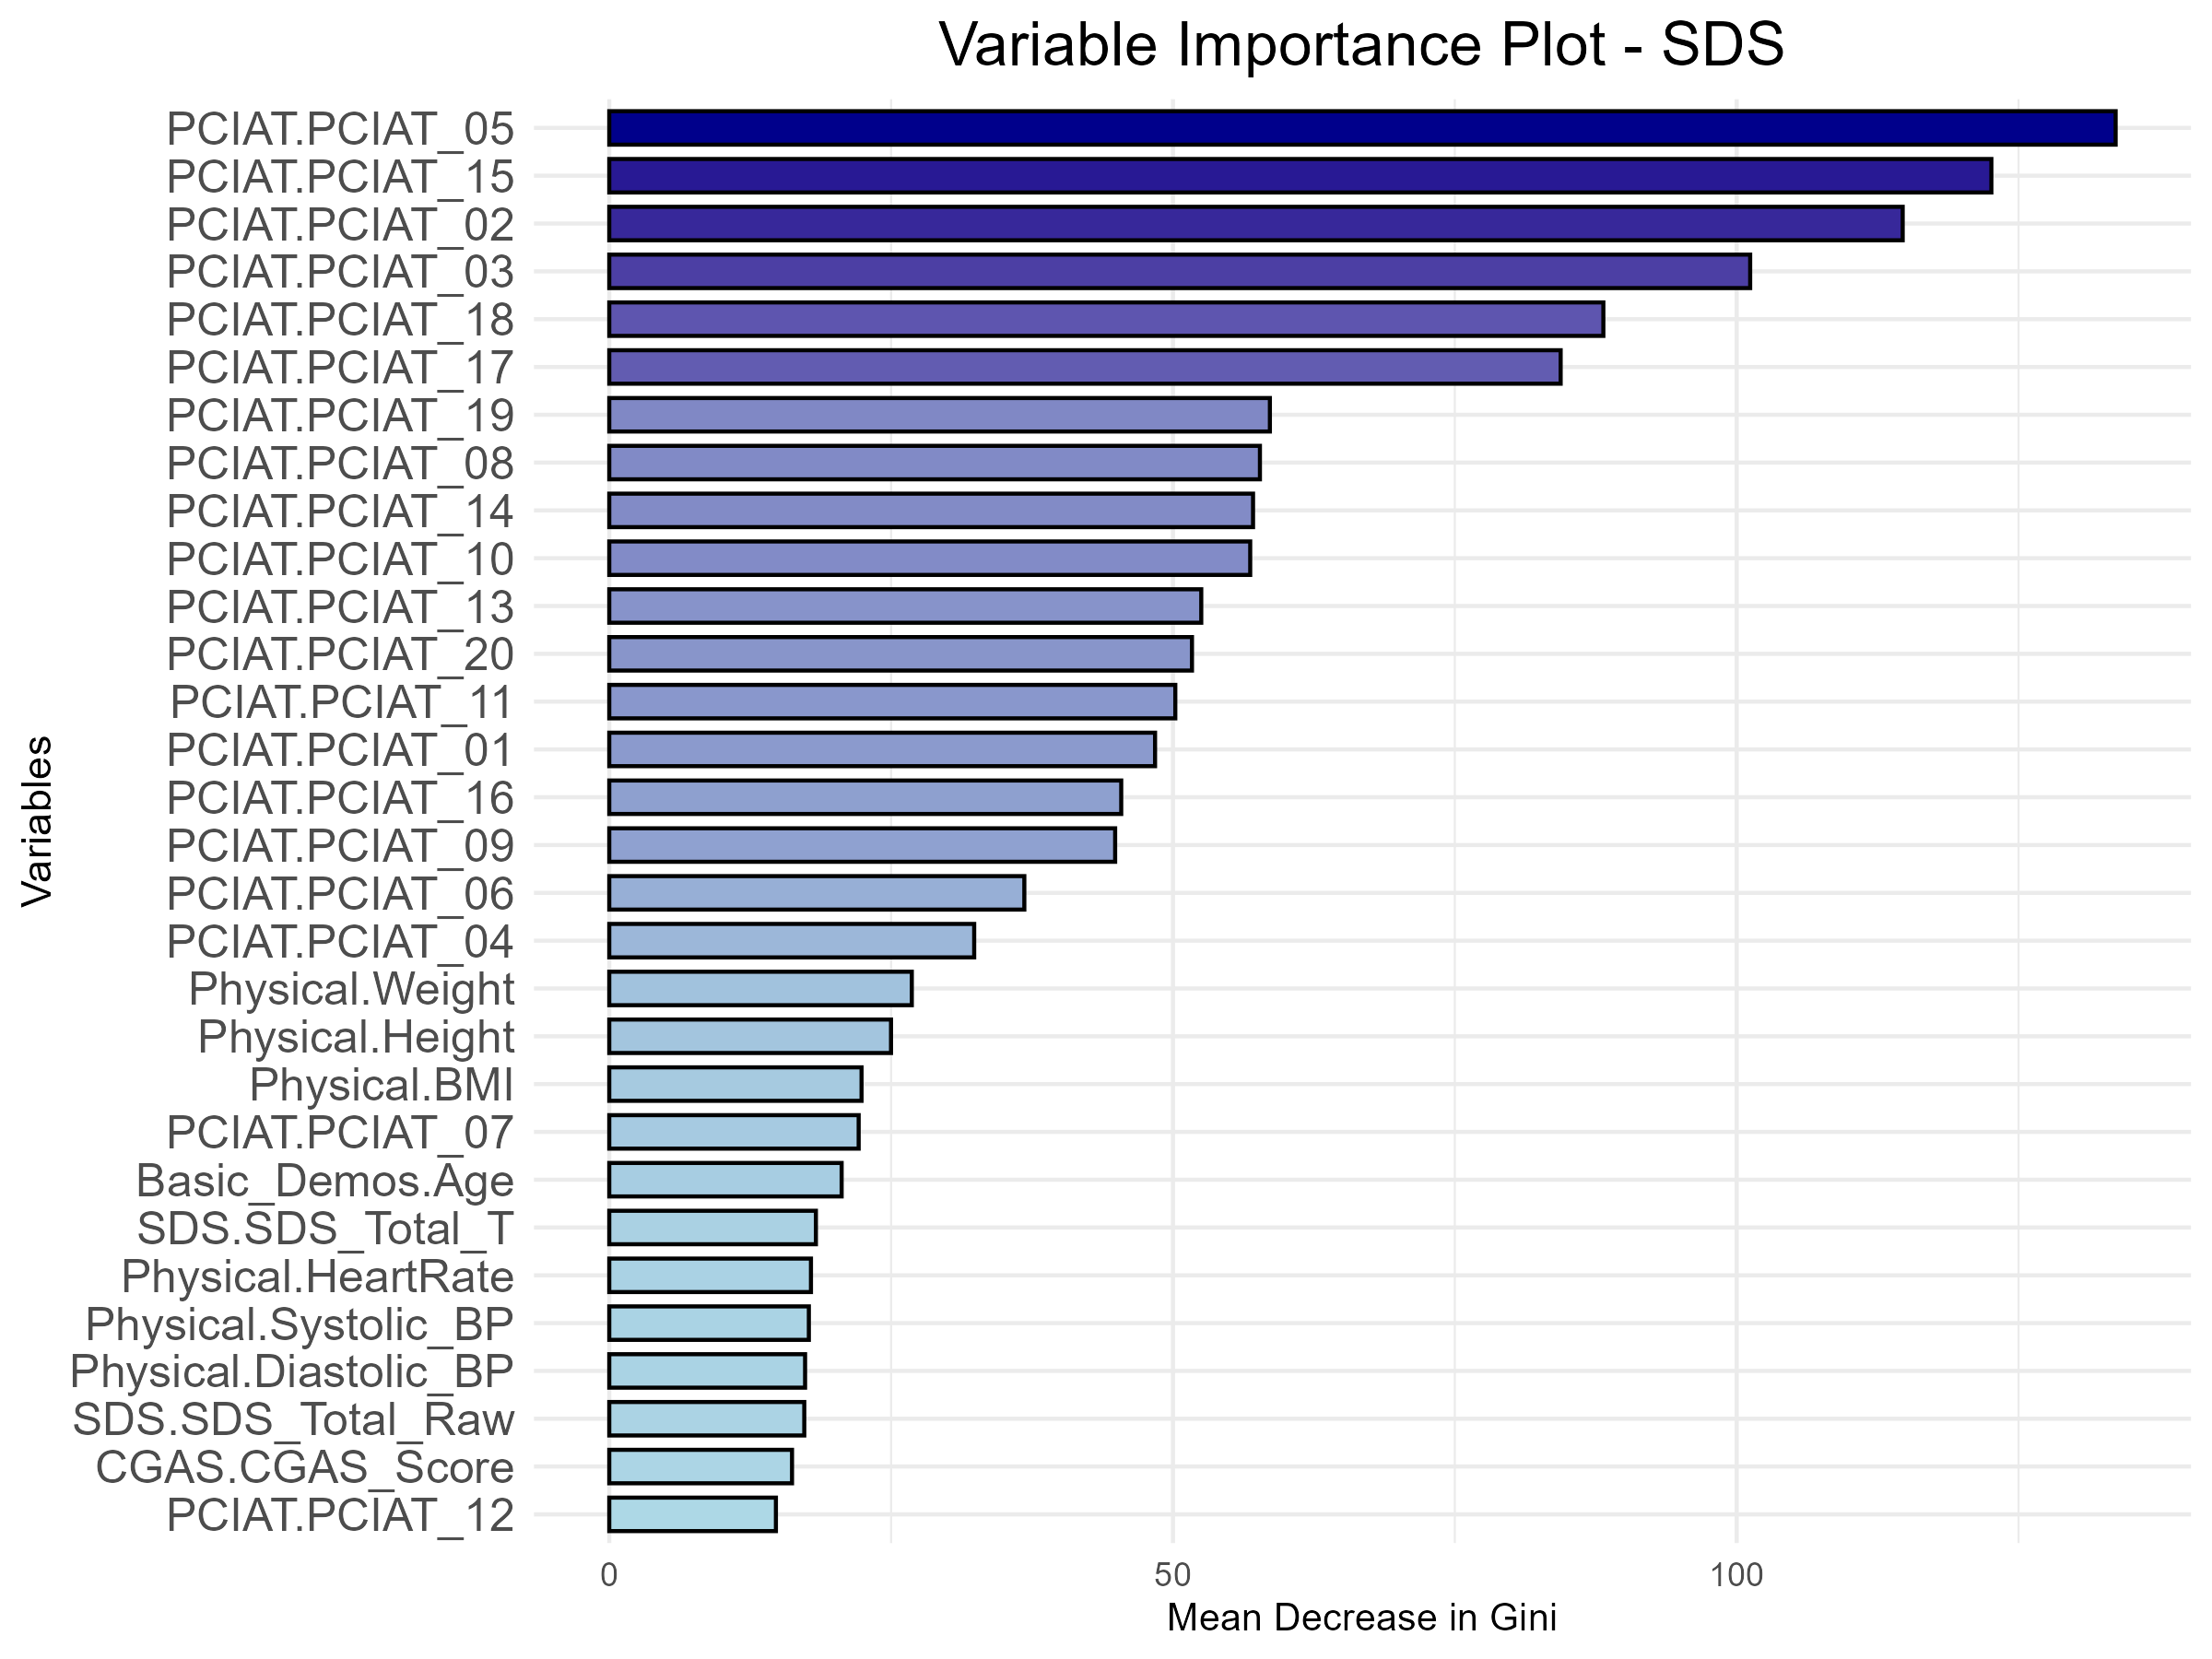
Random Forest
This plot reflecting their importance in predicting the Sleep Disturbance Scale (SDS).
PCIAT variables again show the strongest association with SDS.
Physical measures are the second most important contributors, consistent with the SII results.

Slide 14
Linear Discriminant Analysis

Slide 15
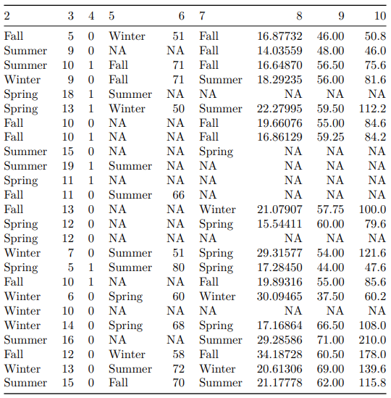
Dealing with NAs
Options:
Imputation
Median for numerical variables
“Missing” for categorical variables
Remove rows where response = NA
Followed with imputation
Removing Variables

Slide 16
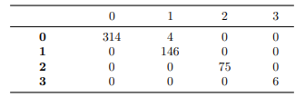
Linear Discriminant Analysis
Test Data Confusion Matrix: 99.27% accuracy

Slide 17
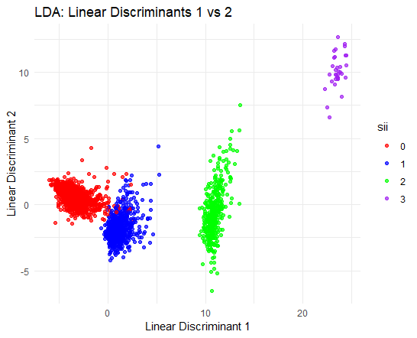
Linear Discriminant Analysis
Points of same class grouped together
Observable approximate decision boundaries

