Slide 1
Decision Trees
Let’s play a Game!

Slide 2
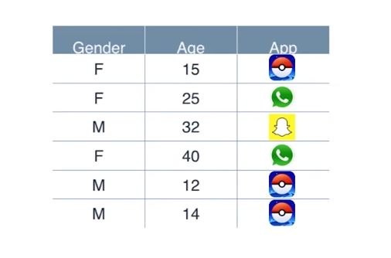
Decision Trees
Quiz 1

Slide 3
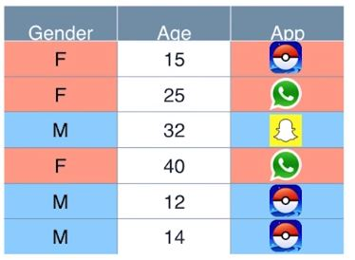
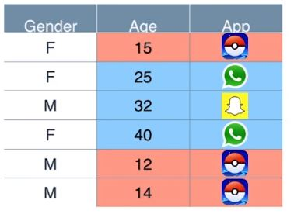
Answer
age

Slide 4
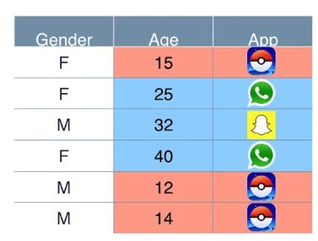
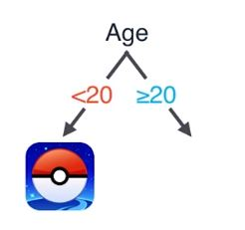

Slide 5
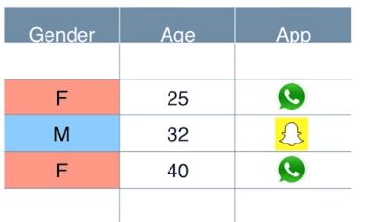
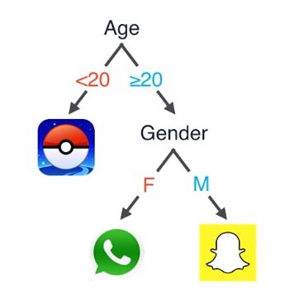

Slide 6
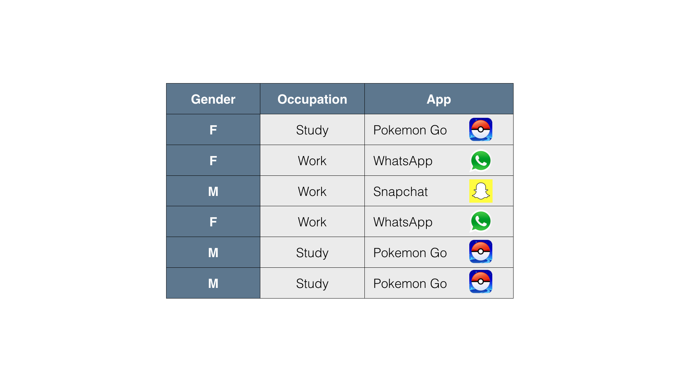
For a woman who works at an office, which app do we recommend?
Whatsapp

Slide 7
For a man who works at a factory, which app do we recommend?
Snapchat

Slide 8
For a girl who goes to high school, which app do we recommend?
Pokemon Go

Slide 9
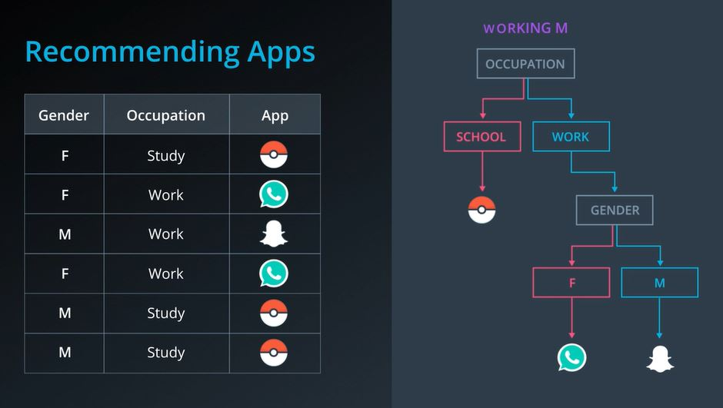
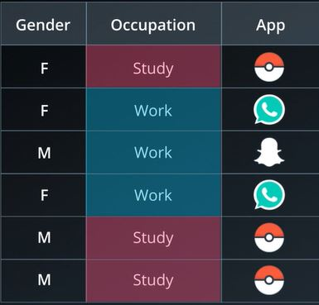
Between Gender and Occupation, which one seems more decisive for predicting what app will the users download?
Occupation

Slide 10
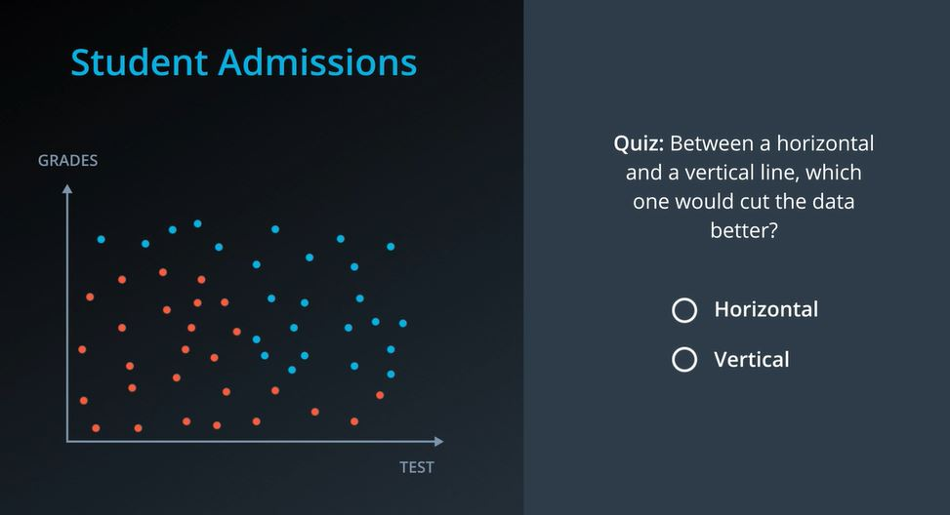
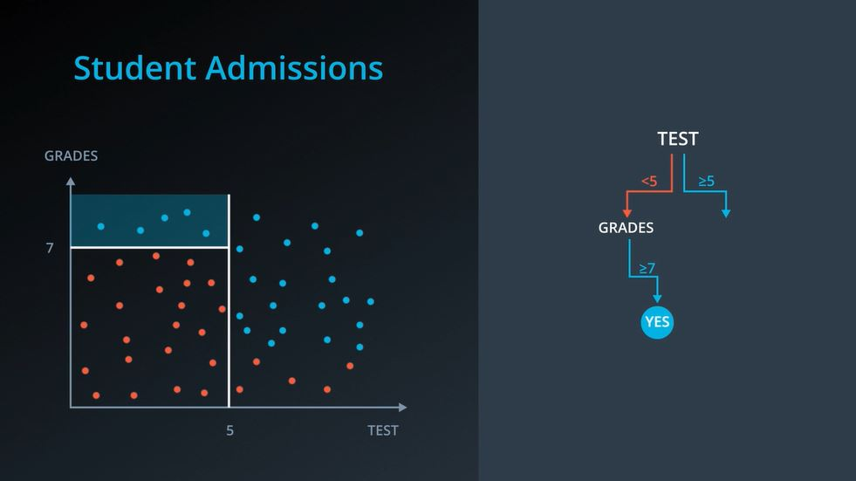
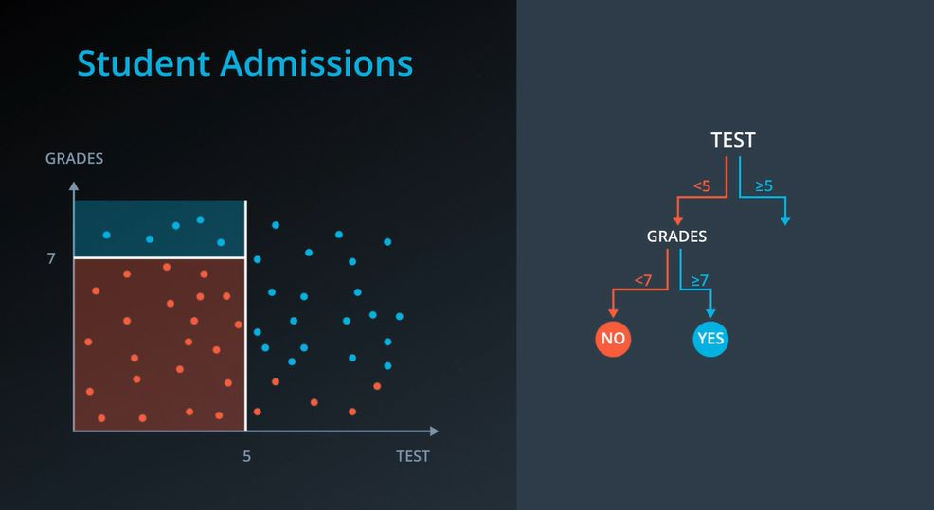
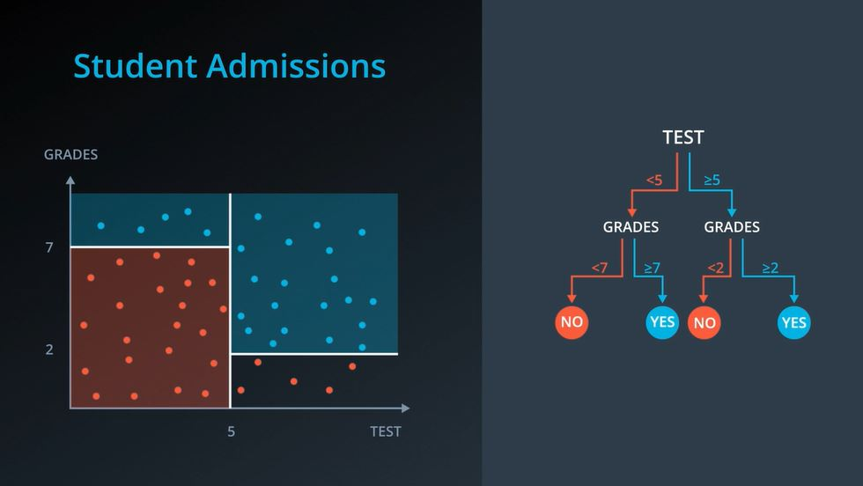
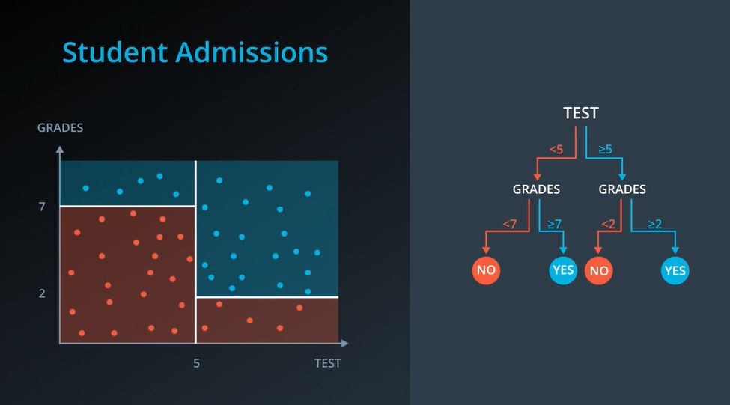
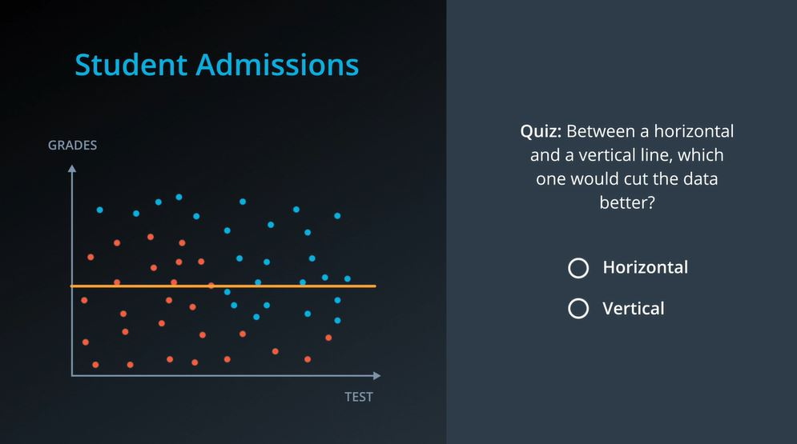
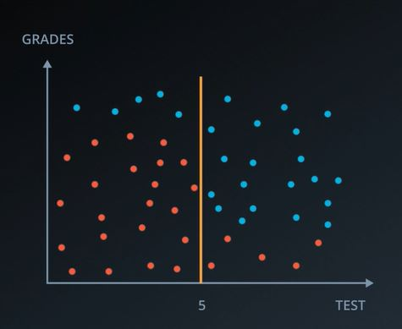

Slide 11
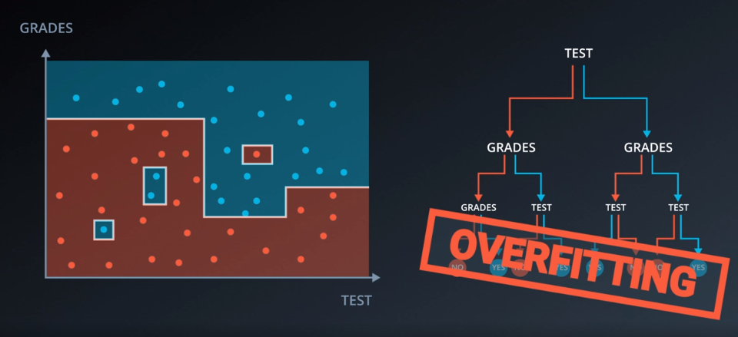
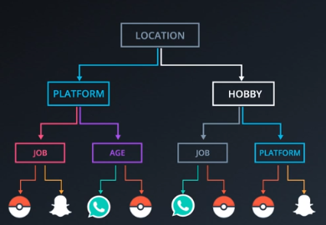
Gender | Age | Location | Platform | Job | Hobby | App
F | 30 | US | IOS | School | Games | Whatsapp
F | 11 | France | Android | Work | Tennis | Pokemon Go
M | 16 | Chile | IOS | Temp | Tennis | Snapchat
F | 15 | China | IOS | Retired | Chess | Whatsapp
M | 25 | Us | Android | School | Games | Snapchat
M | 32 | Us | IOS | School | Tennis | Whatsapp
F | 40 | Egypt | Android | Work | Chess | Snapchat
M | 12 | France | Android | Temp | Tennis | Whatsapp
M | 14 | Australia | Android | School | chess | Pokemon Go

Slide 12
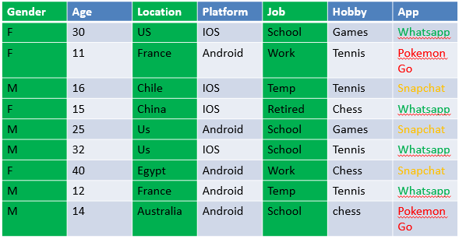
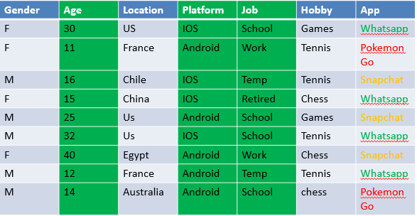
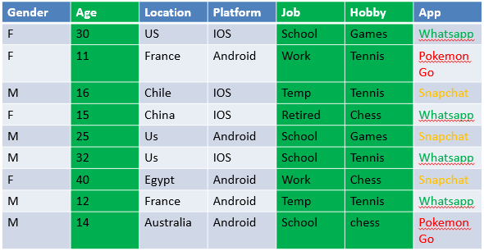
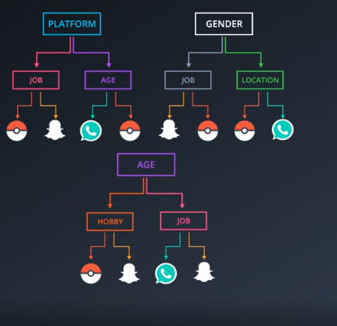

Random Forests

Slide 13
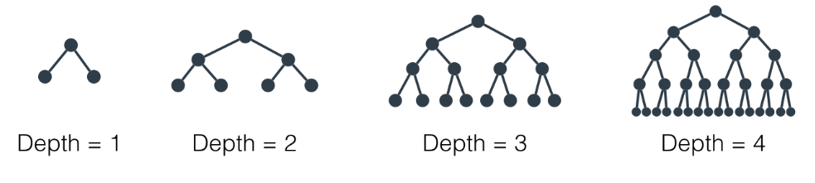
Hyperparameters for Decision Trees

Slide 14
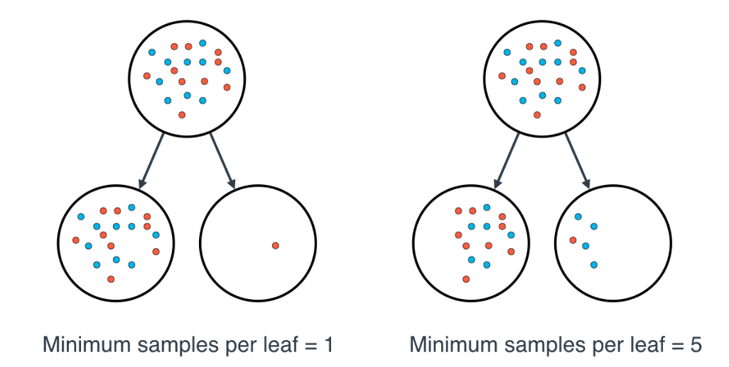
Minimum number of samples per leaf
This number can be specified as an integer, or as a float.

Slide 15
Minimum number of samples per split
This is the same as the minimum number of samples per leaf, but applied on any split of a node.

Slide 16
Decision Trees in Sk-Learn

Slide 17
Resources
Applications of Random Forest Algorithm pdf
entropy in decision trees

