Slide 1

Revision Deep Learning

Slide 2
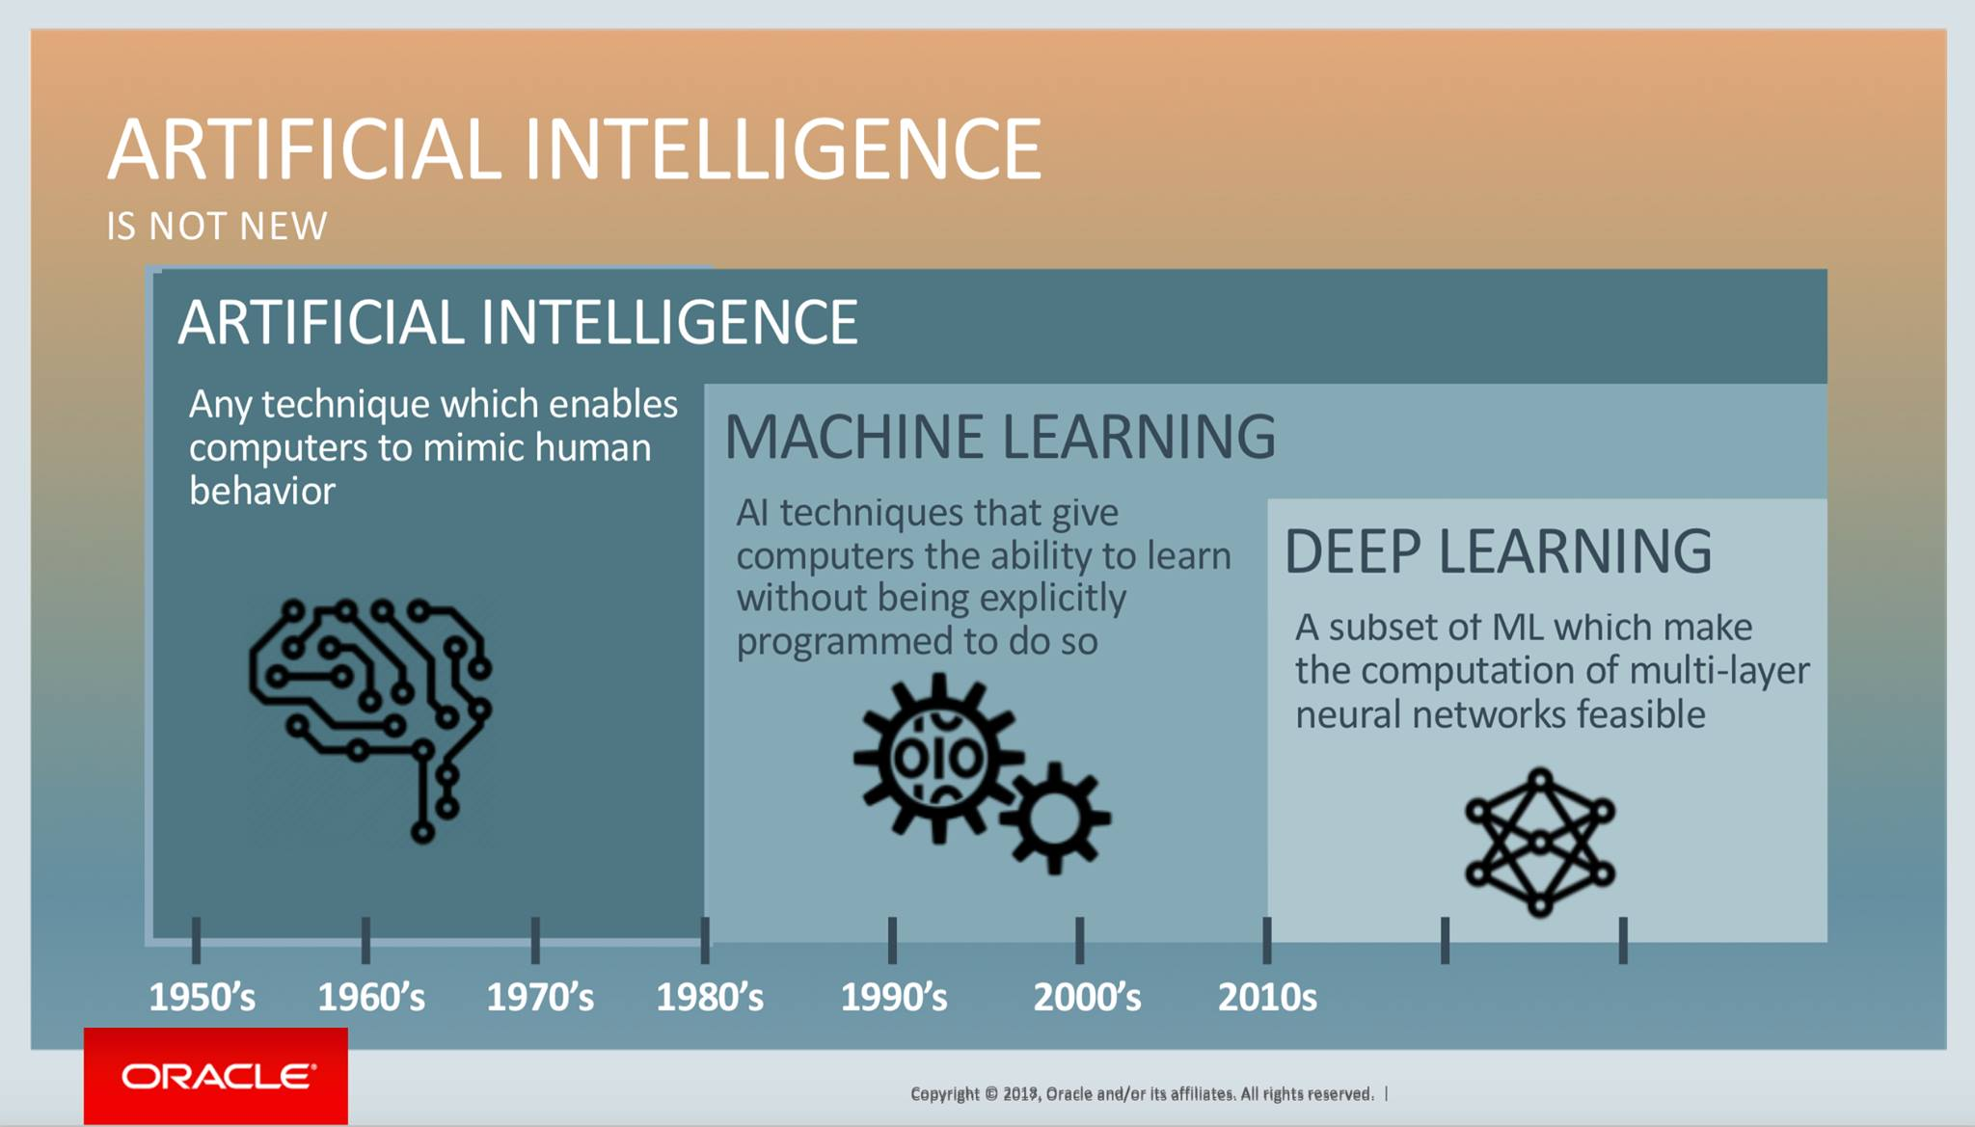
Differentiate between
AI, Machine Learning and Deep Learning

Slide 3
Artificial Intelligence is a technique which enables machines to mimic human behavior.
Machine Learning is a subset of AI technique which uses statistical methods to enable machines to improve with experience.
Deep learning is a subset of ML which make the computation of multi-layer neural network feasible. It uses Neural networks to simulate human-like decision making.

Slide 4
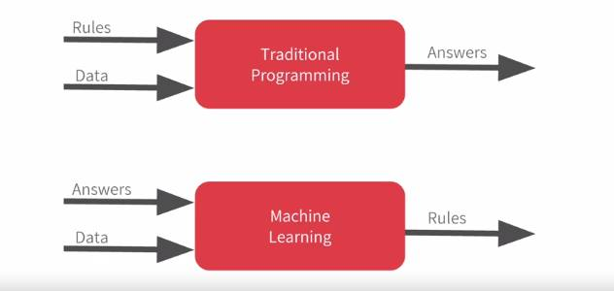

Slide 5
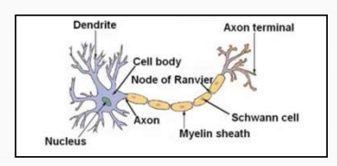
Discovering deep learning
nervous cells
1 - Dendrite is the input.
2 - The axon is where the calculations are done and transfer data.
3 - At the end, he will get his results

Slide 6
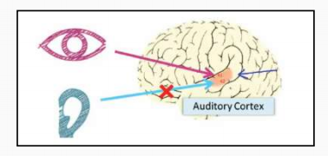
How does it Work?

Slide 7
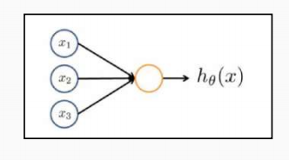
From the previous example we were inspired by the idea of using the neural network for deep learning

Slide 8
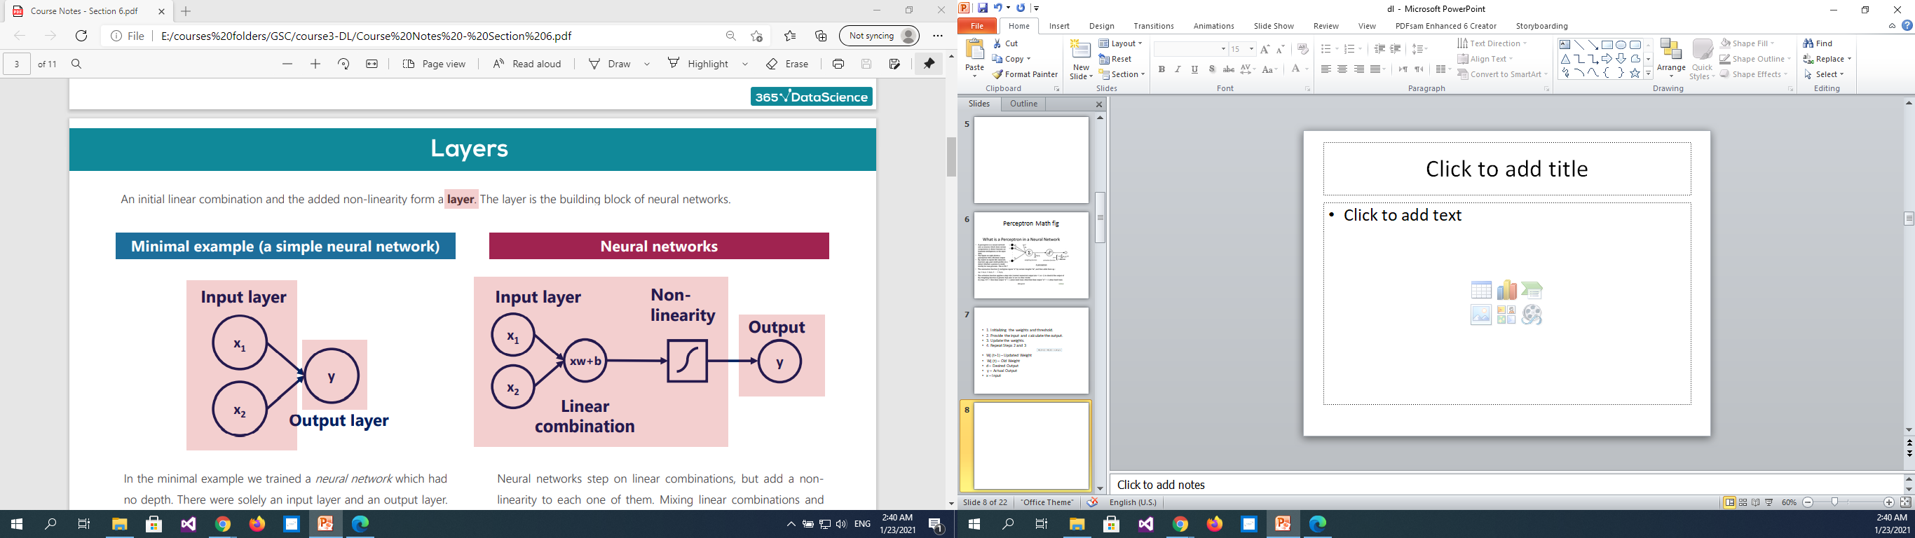
What is Perceptron ? And How does it Work?

Slide 9
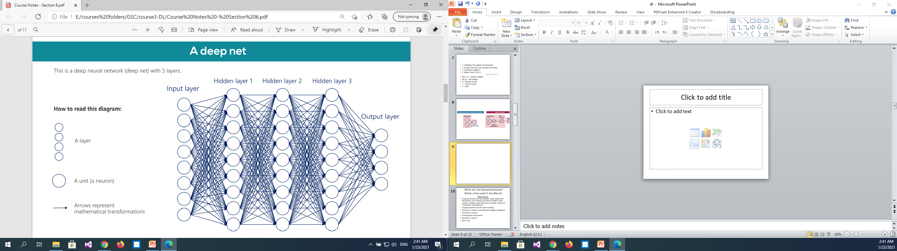

Slide 10
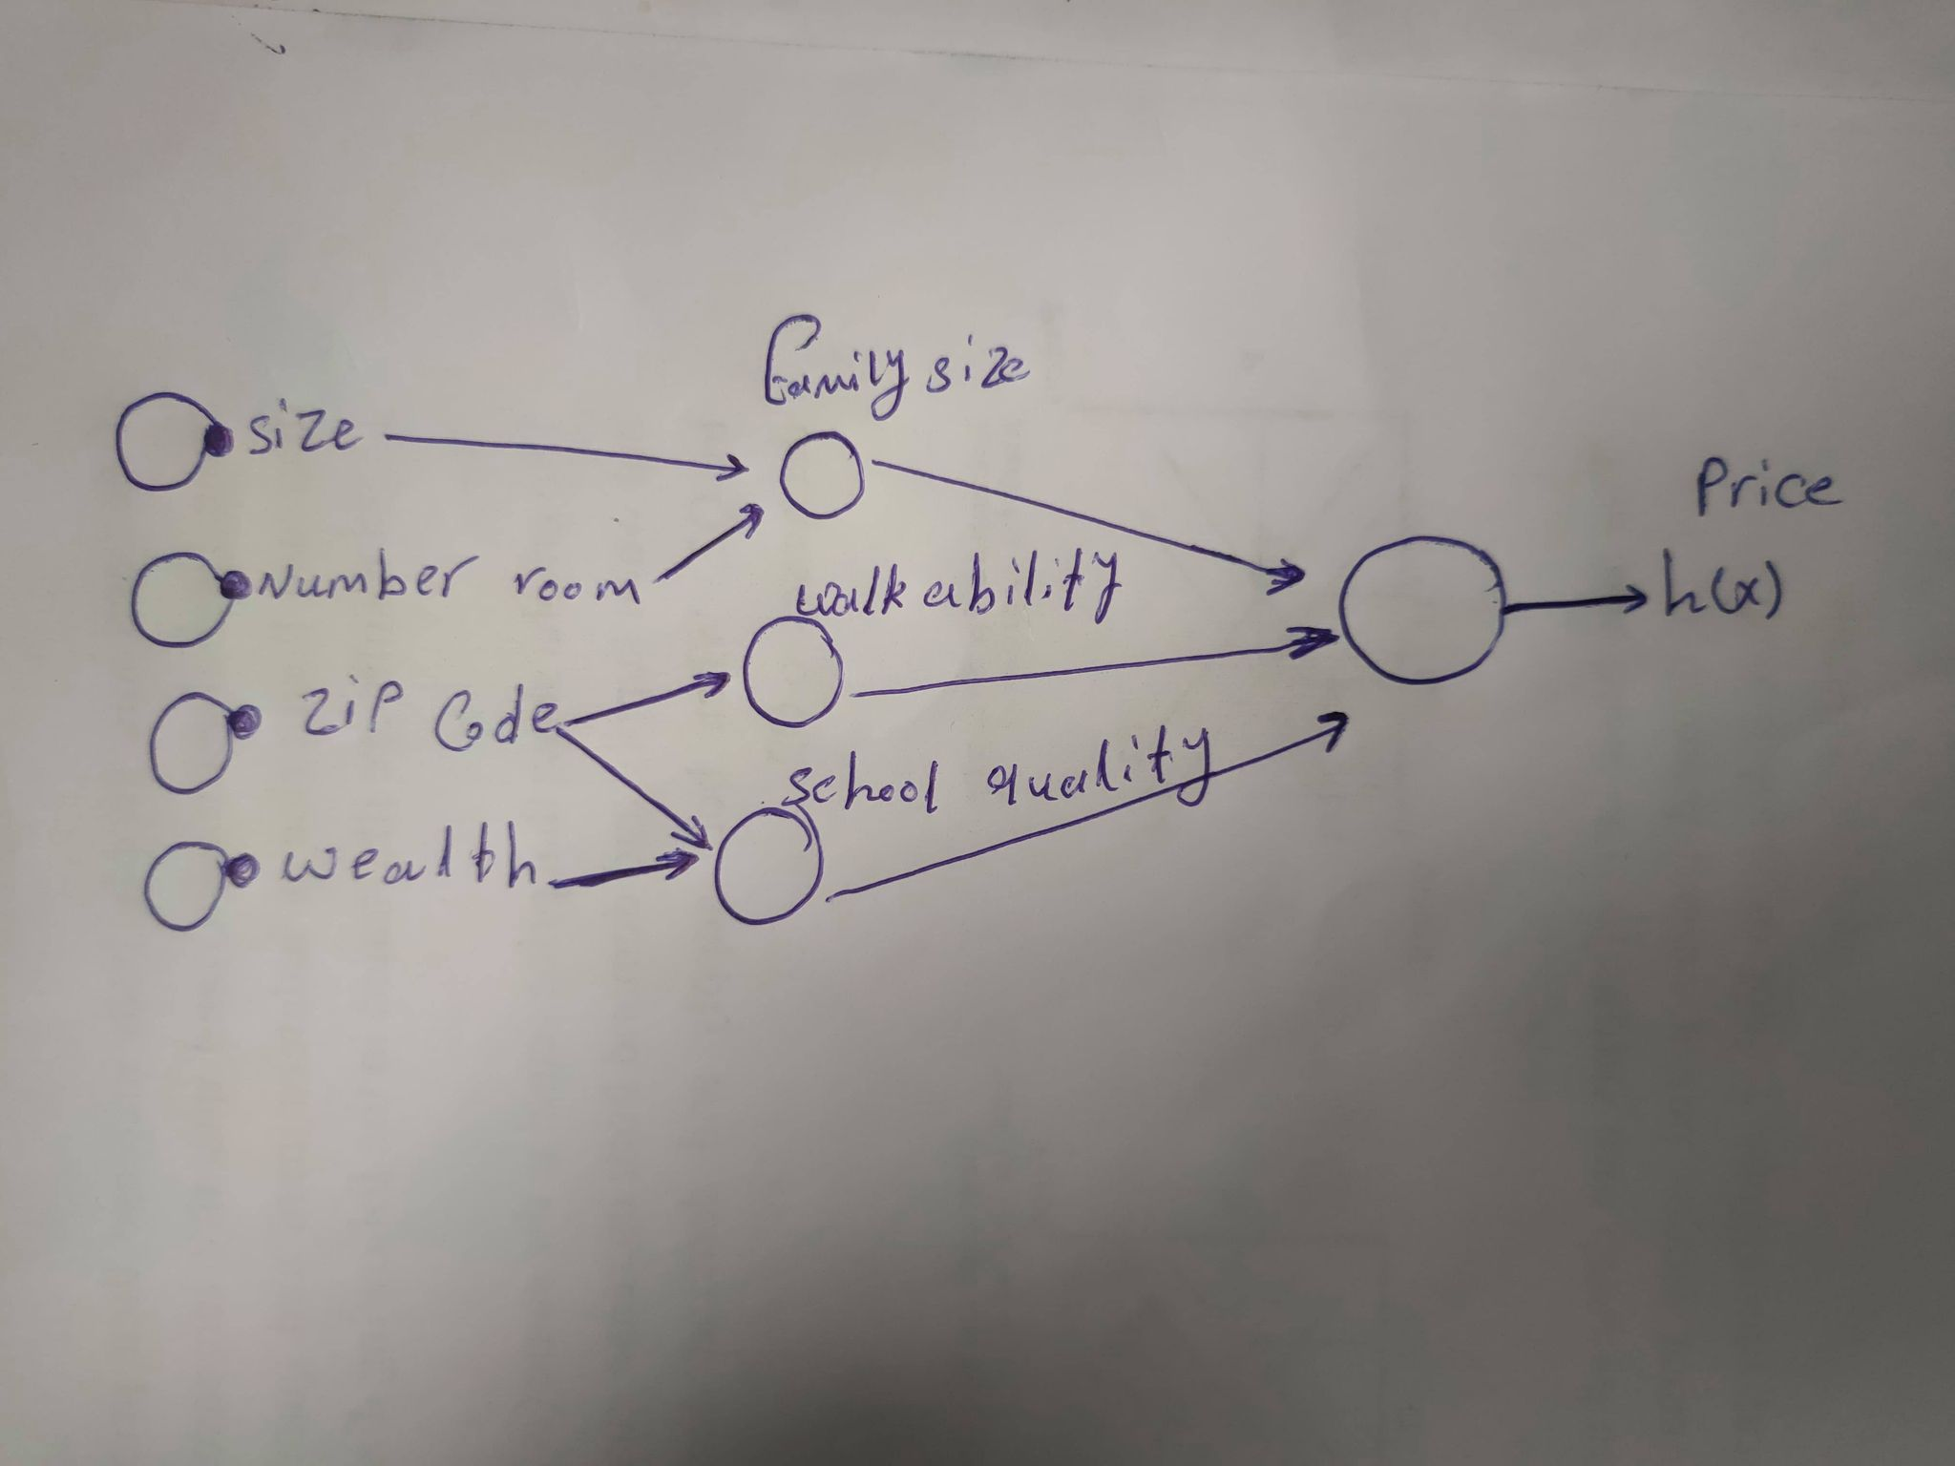
Predict a house price

Slide 11
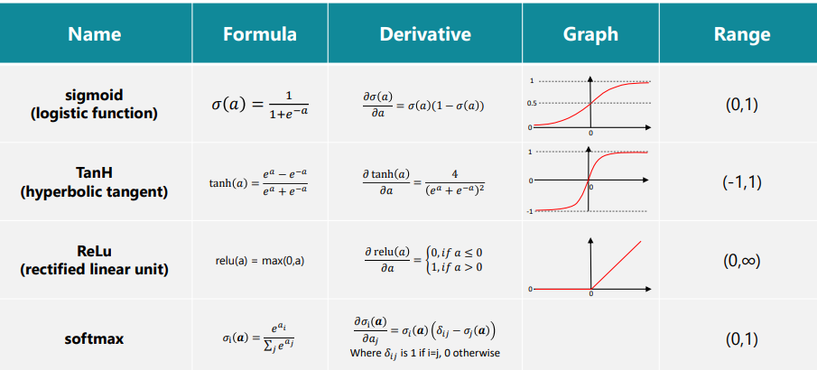
What are the activation functions

Slide 12
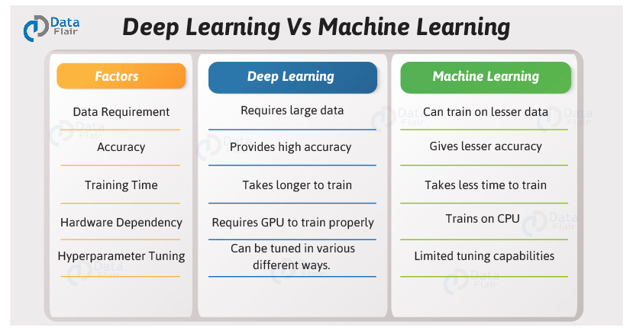
Do you think Deep Learning is Better than Machine Learning? If so, why?

Slide 13
