Slide 1

Image Processing

Slide 2
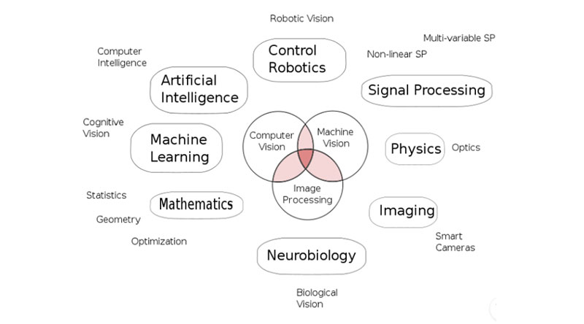
Computer Vision is a field of Artificial Intelligence and Computer Science that aims at giving computers a visual understanding of the world, and is the heart of Hayo’s powerful algorithms. It is one of the main components of machine understanding :

Slide 3
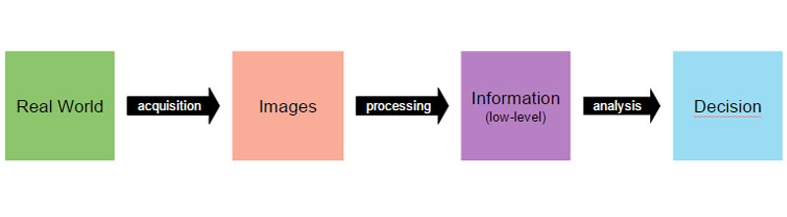
The goal of Computer Vision is to emulate human vision using digital images through three main processing components, executed one after the other: 1. Image acquisition 2. Image processing 3. Image analysis and understanding
As our human visual understanding of world is reflected in our ability to make decisions through what we see, providing such a visual understanding to computers would allow them the same power :

Slide 4
Image acquisition
Image acquisition is the process of translating the analog world around us into binary data composed of zeros and ones, interpreted as digital images.
Different tools have been created to build such datasets: 1. Webcams & embedded cameras 2. Digital compact cameras & DSLR 3. Consumer 3D cameras & laser range finders

Slide 5
Image processing
The second component of Computer Vision is the low-level processing of images. Algorithms are applied to the binary data acquired in the first step to infer low-level information on parts of the image. This type of information is characterized by image edges, point features or segments, for example. They are all the basic geometric elements that build objects in images.
This second step usually involves advanced applied mathematics algorithms and techniques.
Low-level image processing algorithms include: 1. Edge detection 2. Segmentation 3. Classification 4. Feature detection and matching

Slide 6
Image analysis and understanding
The last step of the Computer Vision pipeline if the actual analysis of the data, which will allow the decision making. High-level algorithms are applied, using both the image data and the low-level information computed in previous steps.
Examples of high-level image analysis are: 1. 3D scene mapping 2. Object recognition 3. Object tracking

Slide 7
Lets start with Image

Slide 8
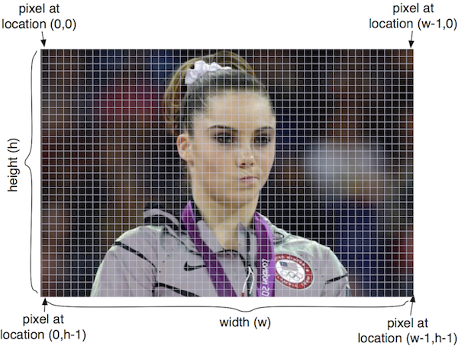
Image
An image is a two-dimensional matrix of pixel values
The origin is in the upper left corner, see below:

Slide 9
What is a pixel?
All images consist of pixels which are the raw building blocks of images.
A 640 x 480 image has 640 columns (the width) and 480 rows (the height). There are
640 * 480 = 307200
pixels in an image with those dimensions.

Slide 10
Pixel values stored in an image can be:
RGB — a “three-tuple” consisting of the red, green and blue values, all non-negative integers
L — a single “gray-scale” integer value representing the brightness of each pixel

Slide 11
Some basic colors:
Color | (red,green,blue) value
Black | (0,0,0)
Red | (255,0,0)
Green | (0,255,0)
Blue | (0,0,255)
White | (255,255,255)
Light Gray | (122,122,122)

Slide 12
Some important image modules Image
module contains main functions to manipulate images: open, save, resize, crop, paste, create new images, change pixels, etc.
Image Draw module contains functions to touch up images by adding text to it, draw ellipses, rectangles, etc.
Image Font contains functions to create images of text for a specific font.
We will only use the Image module in this lecture.

Slide 13
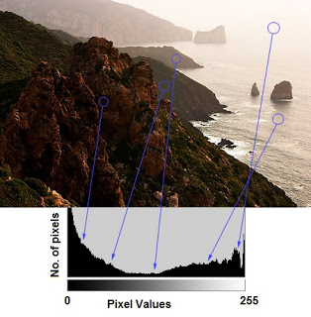
histogram
what is histogram ?
You can consider histogram as a graph or plot, which gives you an overall idea about the intensity distribution of an image. It is a plot with pixel values (ranging from 0 to 255, not always) in X-axis and corresponding number of pixels in the image on Y-axis.
It is just another way of understanding the image. By looking at the histogram of an image, you get intuition about contrast, brightness, intensity distribution etc of that image.

Slide 14
Histogram Calculation in OpenCV
cv.calcHist(images, channels, mask, histSize, ranges[, hist[, accumulate]])
images : it is the source image of type uint8 or float32. it should be given in square brackets, ie, "[img]".
channels : it is also given in square brackets. It is the index of channel for which we calculate histogram. For example, if input is grayscale image, its value is [0]. For color image, you can pass [0], [1] or [2] to calculate histogram of blue, green or red channel respectively.
mask : mask image. To find histogram of full image, it is given as "None". But if you want to find histogram of particular region of image, you have to create a mask image for that and give it as mask. (I will show an example later.)
histSize : this represents our BIN count. Need to be given in square brackets. For full scale, we pass [256].
ranges : this is our RANGE. Normally, it is [0,256].
Notes:
https://docs.opencv.org/master/d1/db7/tutorial_py_histogram_begins.html

Slide 15
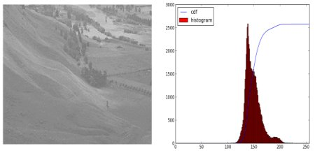
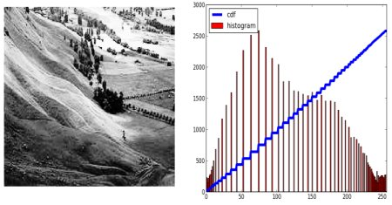
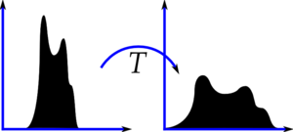
Histogram Equalization
Theory
Consider an image whose pixel values are confined to some specific range of values only. For eg, brighter image will have all pixels confined to high values. But a good image will have pixels from all regions of the image. So you need to stretch this histogram to either ends (as given in below image, from wikipedia) and that is what Histogram Equalization does (in simple words). This normally improves the contrast of the image.

Slide 16
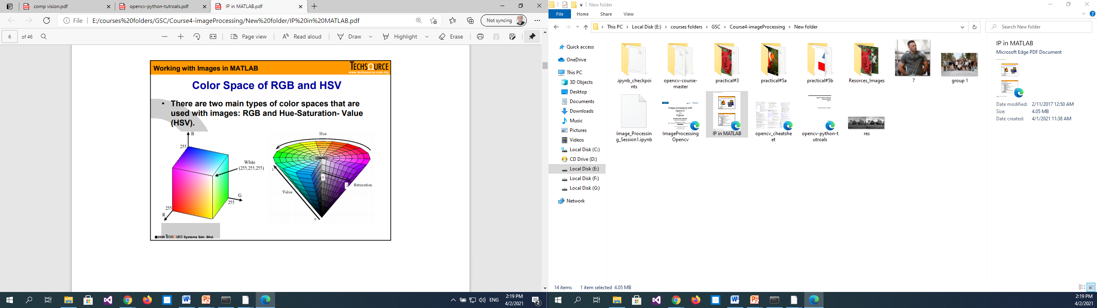

Slide 17
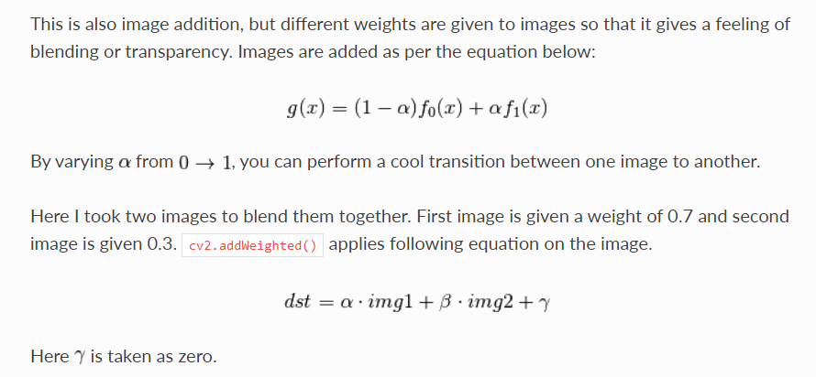
Image Blending
Notes:
https://opencv-python-tutroals.readthedocs.io/en/latest/py_tutorials/py_core/py_image_arithmetics/py_image_arithmetics.html#image-arithmetics

Slide 18
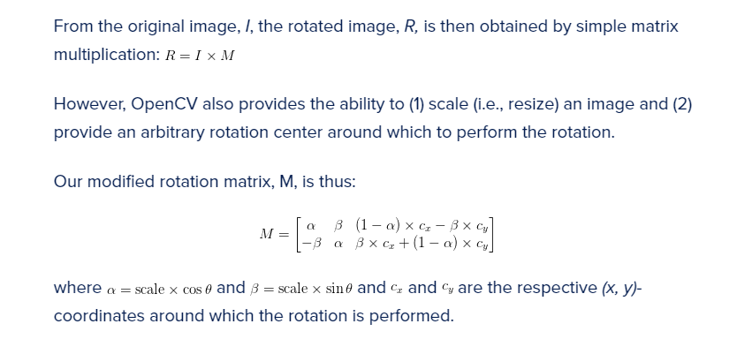
Rotate Image

Slide 19
THANKS
Any questions?

