Slide 1

Course 2 SVM

Slide 2
AGENDA SVM
01
02
03
04
INTRODUCTION
THEORY
--
Visual Approach
Theoretical Approach
IMPLEMENTATION
PARCTICE
Direct Coding
Exercies

Slide 3
01
INTRODUCTION
Support Vector Machine

Slide 4
—(Boser et al., 1992, Guyon et al., 1993, Vapnik et al., 1997)
“Support-Vector Machines
(SVMs, also support-vector networks)
are supervised learning models with associated learning algorithms that analyze data for regression analysis and classification and . Developed at AT&T Bell Laboratories by Vapnik with colleagues.”

Slide 5
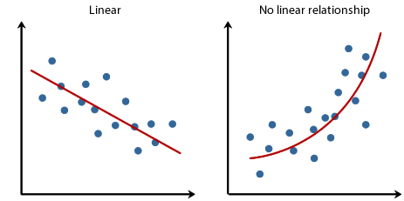
REGRESSION

Slide 6
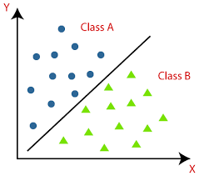
CLASSIFICATION

Slide 7
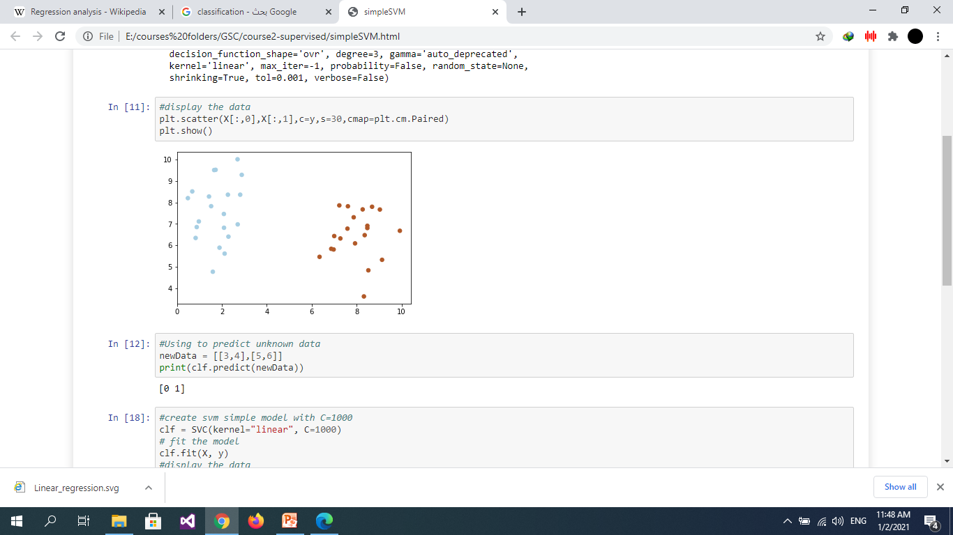

Slide 8
02
THEORY
Support-Vector Machines

Slide 9
THEORY
Visual Approach
Theoretical Approach

Slide 10
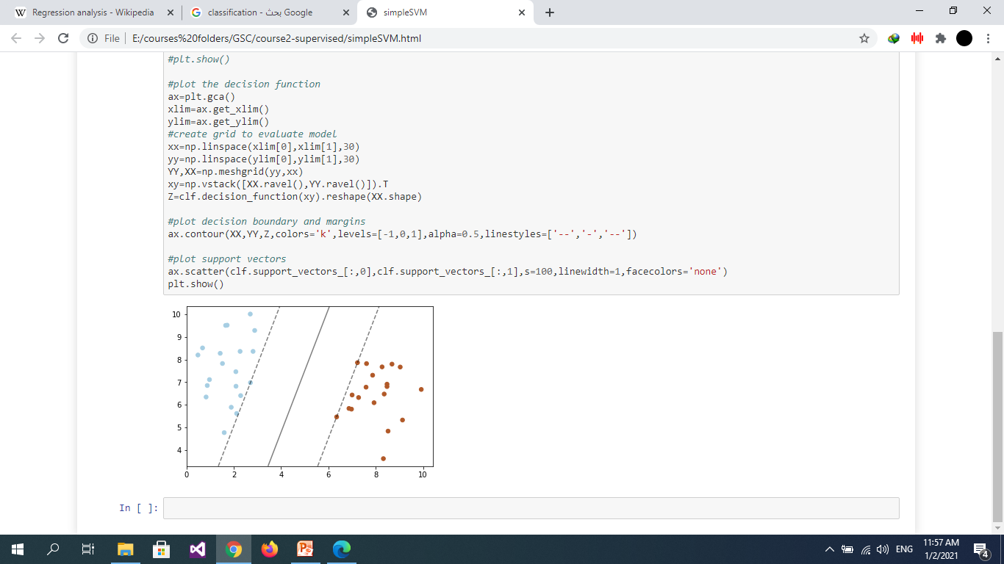
Visual Approach

Slide 11
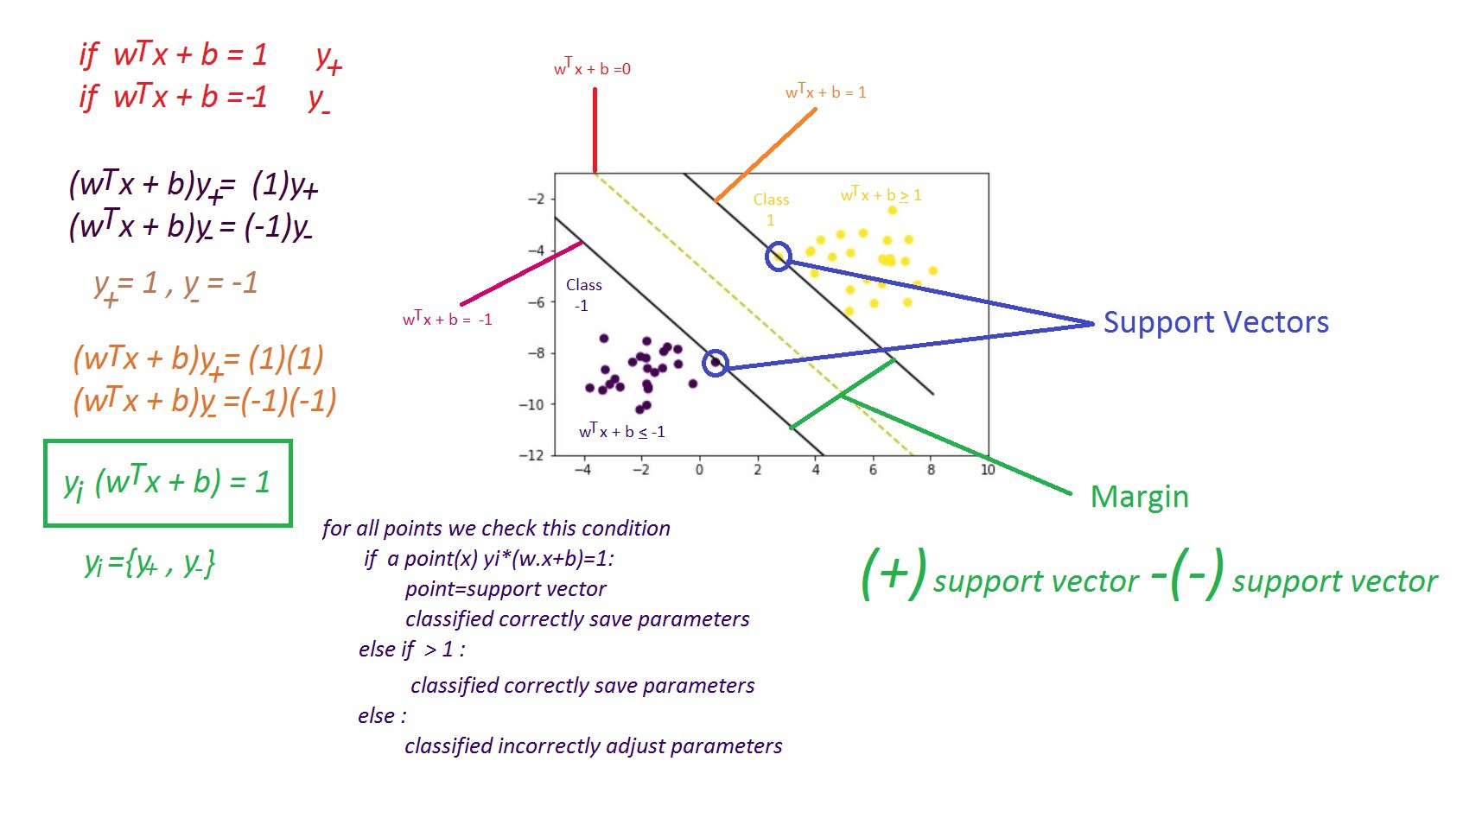
Theoretical Approach

Slide 12
Linear separable Vs Nonlinear separable

Slide 13
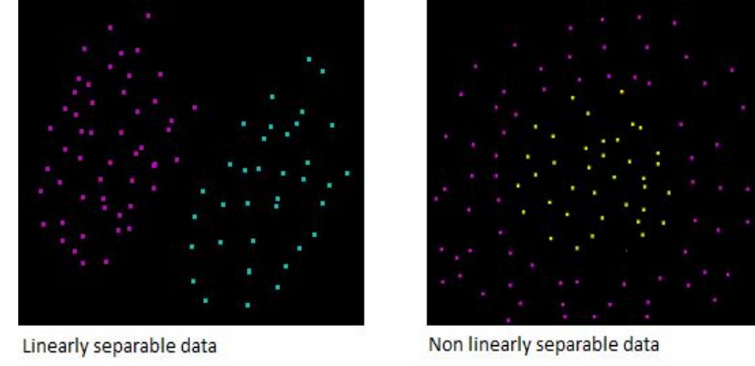

Slide 14
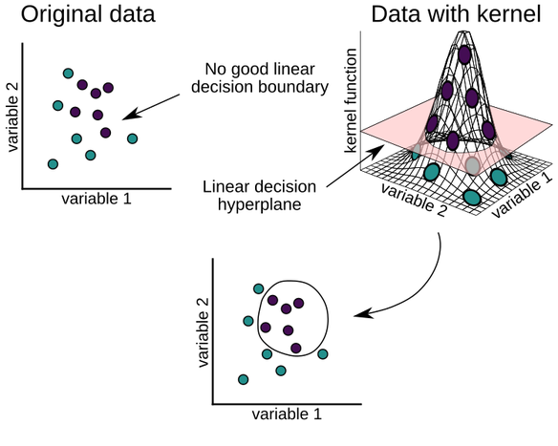

Slide 15
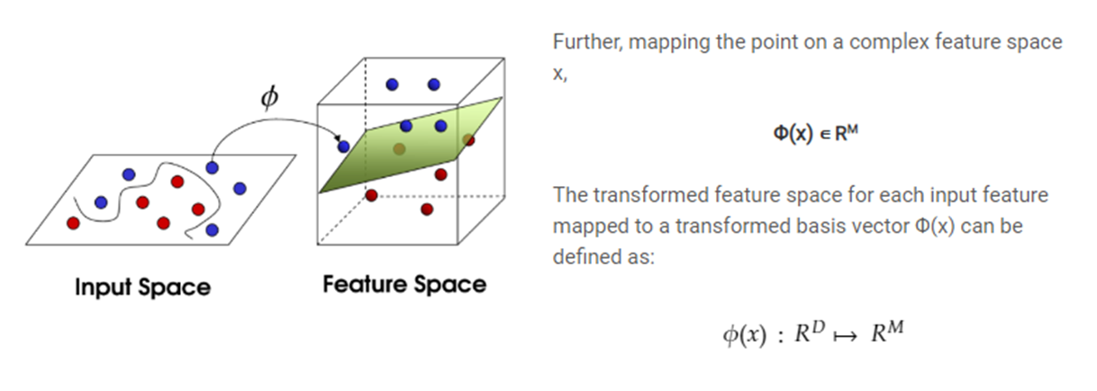
Notes:
https://www.google.com/search?q=support+vector+machine&rlz=1C1GCEJ_enEG926EG927&sxsrf=ALeKk01jgOcUH6He0oAzQo3bPqgBekfAug:1609585909343&source=lnms&tbm=isch&sa=X&ved=2ahUKEwjuhvLijv3tAhWmUxUIHfgJAkcQ_AUoAXoECBEQAw&biw=1366&bih=657

Slide 16
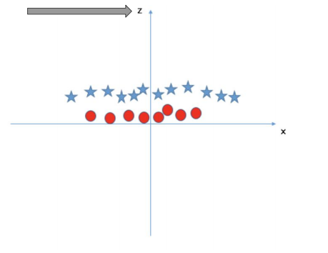
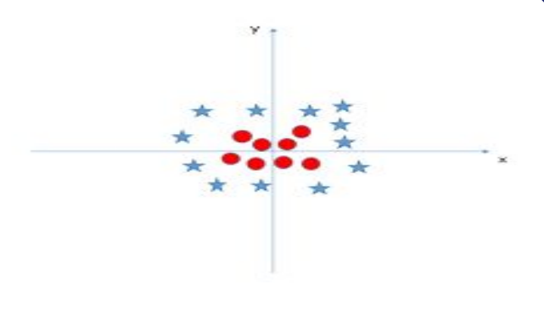

Slide 17
Margin is need to maximize

Slide 18
1
2
3

Slide 19
Outliers some time need to ignor

Slide 20
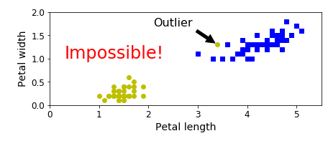

Slide 21
Tuning Parameters

Slide 22
Kernel
Gamma
Regularization
Margin

Slide 23
03
IMPLEMENTATION

Slide 24
IMPLEMENTATION
Tools
Numpy
Matplotlib
Sklearn.SVM
Direct Coding
Case Study

Slide 25
Simple SVM -python-

Slide 26
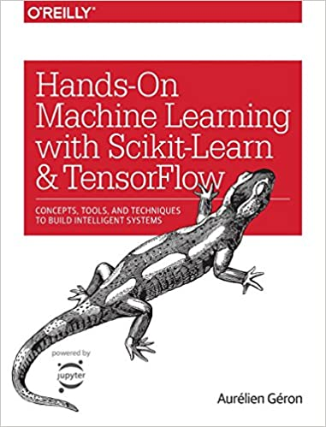
SVM Case Study -iris dataset- -Hands-On Machine Learning with Scikit-Learn and TensorFlow (Book) -Github Codes

Slide 27
Pros :
● It works really well with clear margin of separation
● It is effective in high dimensional spaces.
● It is effective in cases where number of dimensions is greater than the number of samples.
● It uses a subset of training points in the decision function (called support vectors), so it is also memory efficient.

Slide 28
Cons :
● It doesn’t perform well, when we have large data set because the required training time is higher
● It also doesn’t perform very well, when the data set has more noise i.e. target classes are overlapping
● SVM doesn’t directly provide probability estimates, these are calculated using an expensive five-fold cross-validation. It is related SVC method of Python scikit-learn library.

Slide 29
Applications :
1. Face detection
2. Text and hypertext categorization
3. Classification of images
4. Bioinformatics
5. Handwriting recognition
6. Protein fold and remote homology detection
7. Generalized predictive control(GPC)

Slide 30
04
PARCTICE

Slide 31
PARCTICE
Your Turn Now

Slide 32
THANKS
Any questions?

