Slide 1
Tableau Workshop

Slide 2
What is Tableau?
Business Intelligence Tool
Helps understand and analyze data
Data Visualization

Slide 3
Why tableau?
Support Mac/Window System
Customize Graphs
Easy to Learn/Get Started With
Great Analysis Tool

Slide 4
Why Tableau Continue
① Capable of handling large datasets.
② Highly customizable visual functions.
③ Able to provide visual chart recommendations.
④ Powerful geographic mapping visual engine.
⑤ Easily share results through the internet.

Slide 5
COMPARISON to POWER BI & EXCEL
 | TABLEAU | POWER BI | EXCEL
System Support | MacOS & Windows | Windows | MacOS & Windows
Design | Highly customize Graphs | Beautiful Graphs | Traditional
Learning Threshold | Easy to Learn w/ results | Similar to Excel | Standard
Data Connectiion | Connect to most databases | Connect to most databases | Usually can’t connec to databases
Data Handling | Handle Larger Datasets | Handle Large Datasets | Small Datasets
Price | Free/Business Version | Free/Business Version | Paid version -> Group Pucrchase

Slide 6
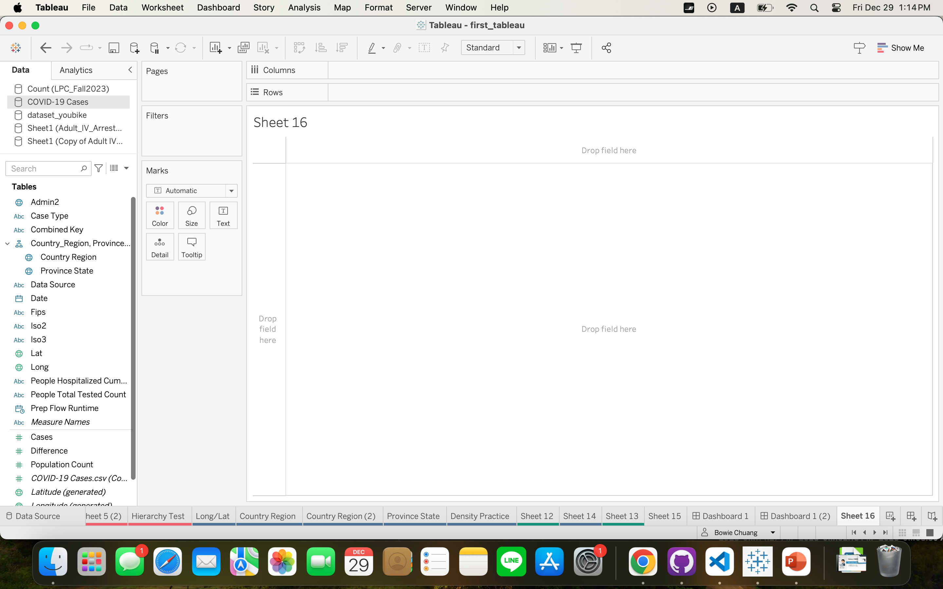

Slide 7
Download Tableau Desktop
https://www.tableau.com/blog/tableau-students-free-access-tableau-desktop
Save your PRODUCT KEY!!!!!

Slide 8
Create Graphs!
Adult_IV_Arrest_Info_Clean_Latlong.xlsx
COVID-19 Cases.csv

