Slide 1
Population Growth with Limited Resources
Scott Salmon, Jacob Beaudoin

Slide 2
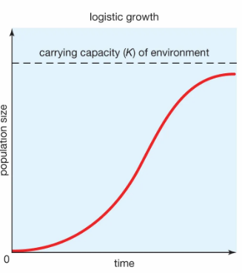

Population Dynamics
Study of change in population over time.
Interaction of populations with their environment.
By limiting the resources available, we can model realistic population growth
Sources of variation include seasons, natural disasters, disease.
[1] https://www.worldatlas.com/r/w960-q80/upload/9f/4d/df/shutterstock-231214222.jpg [2] https://www.britannica.com/science/population-ecology/Logistic-population-growth.jpg
Notes:
Population dynamics is a field that looks at how and why populations of organisms grow, shrink, or stabilize over time. It's especially interested in how environmental factors like resources, space, and predation affect population sizes.
Our problem is important because it can be used to model population growth in any realistic setting (limited resources), such as human population growth on earth, or animal population on an island.
Understanding population dynamics with limited resources is crucial in areas like ecology and human sustainability. This model helps us make informed decisions about conservation and planning, ensuring long-term balance within ecosystems and human societies.

Slide 3
Models for Population Growth
Exponential Growth Model
Unlimited resources
Population grows unchecked
Unrealistic
Logistic Growth Model
Limited resources
Growth levels off at carrying capacity, K.
Realistic
Notes:
In ideal conditions with unlimited resources, populations grow exponentially, which isn’t realistic over the long term. The logistic growth model introduces a more realistic scenario, where resource limitations slow down growth, leading to a maximum sustainable population, or carrying capacity, represented by K.

Slide 4
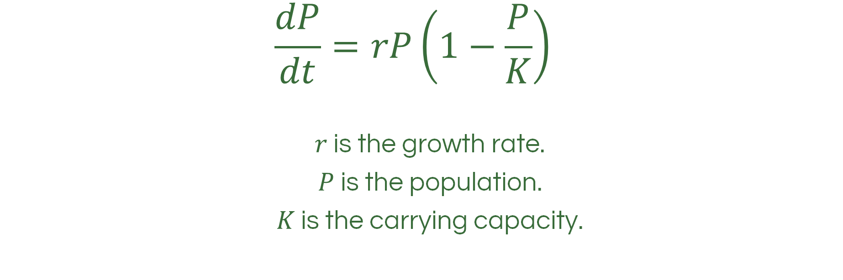
The Logistic Equation
$$\frac{dP}{dt}=rP\left(1−\frac{P}{K}\right)$$
$r$ is the growth rate.
$P$ is the population.
$K$ is the carrying capacity.
[3] https://math.libretexts.org/Bookshelves/Calculus/Calculus_(OpenStax)/08%3A_Introduction_to_Differential_Equations/8.04%3A_The_Logistic_Equation
Notes:
The logistic equation models population growth by balancing two factors: an initial exponential growth phase and a limit imposed by available resources. Here, r is the growth rate, P is the current population size, and K is the carrying capacity.

Slide 5
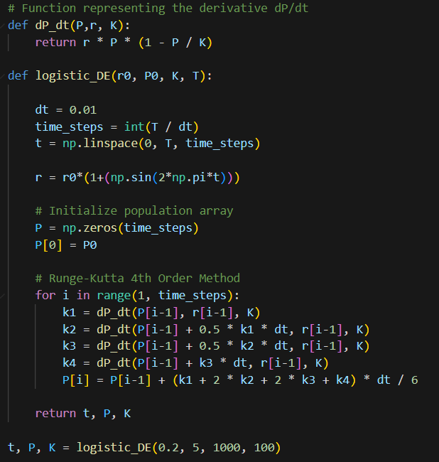
Logistic Growth Equation with Runge- Kutta-4 Algorithm

Slide 6
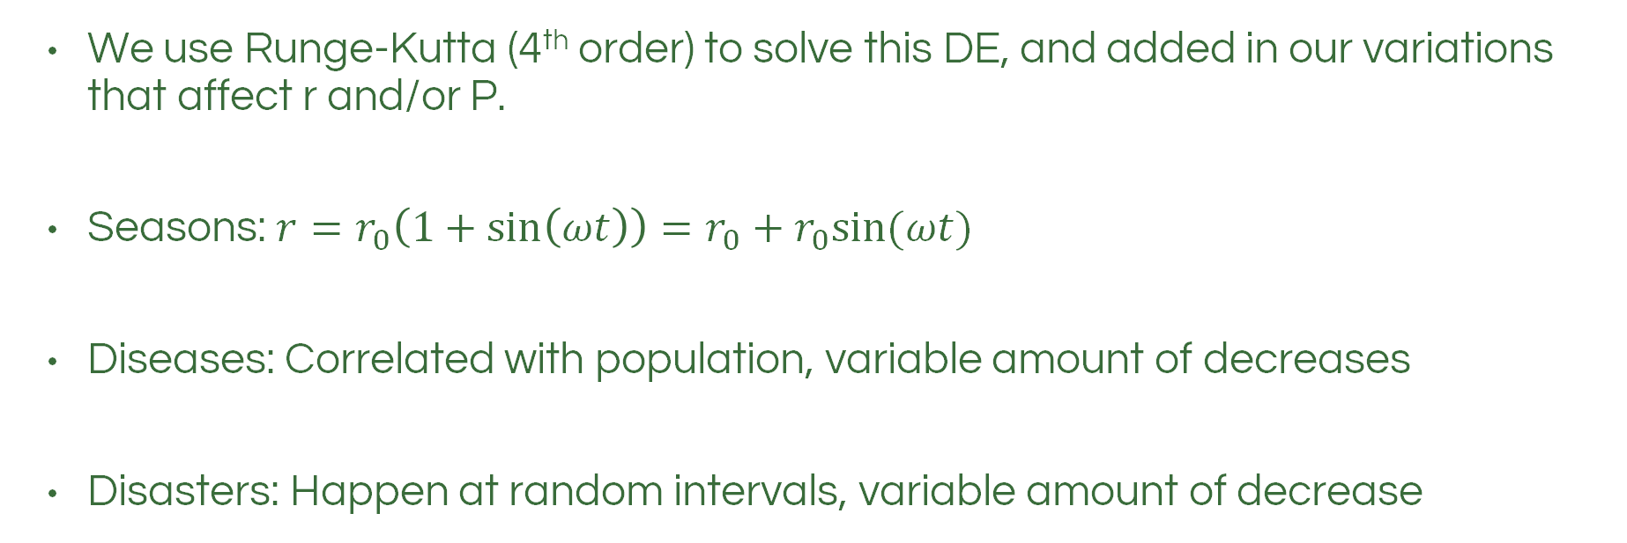
Methods
We use Runge-Kutta (4th order) to solve this DE, and added in our variations that affect r and/or P.
Seasons: $r=r_{0}\left(1+\sin\left(ωt\right)\right)=r_{0}+r_{0}sin⁡(ωt)$
Diseases: Correlated with population, variable amount of decreases
Disasters: Happen at random intervals, variable amount of decrease
Notes:
Seasons: if $ω=\text{2}π$, then the period of the sin function is 1 year.
Disease: has a chance of occurring every “x” amount of years, population instantly declines between 1-7%, and growth rate is reduced by a randomized amount for a “y” years
Disaster: has a chance of occurring every once every so many years, population instantly declines between

Slide 7
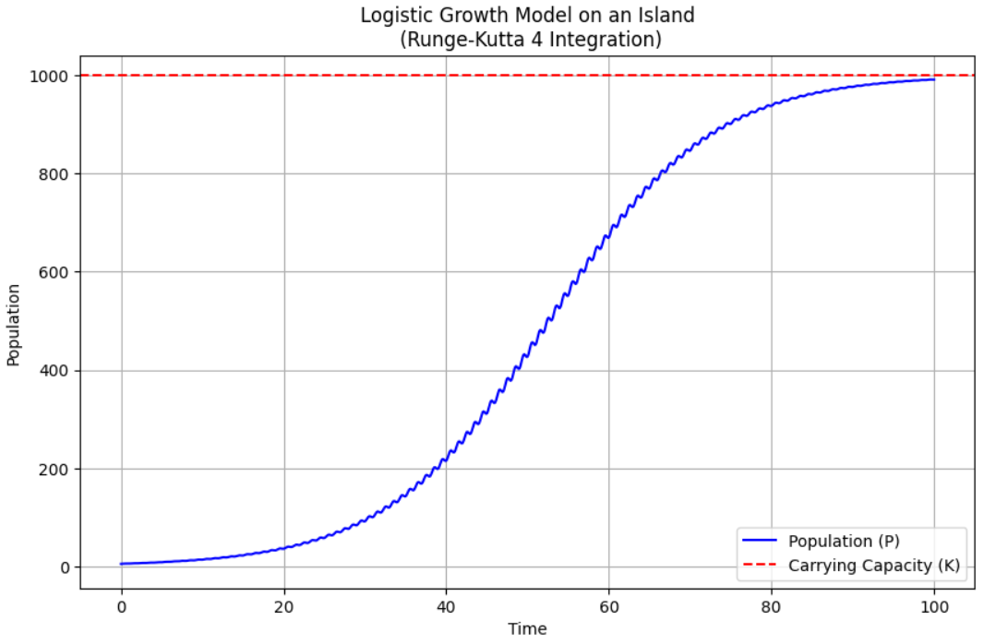
Limited “Island” Experiment

Slide 8
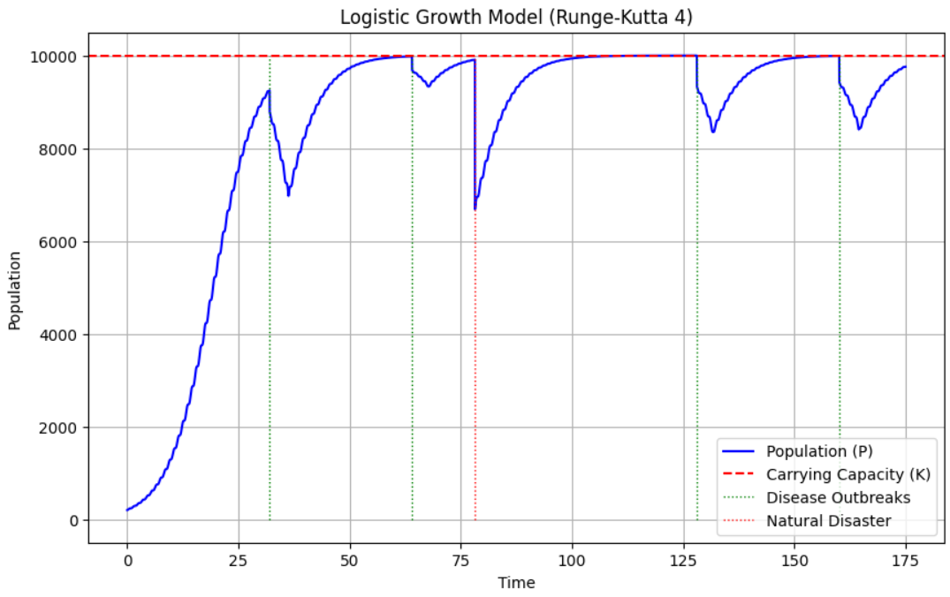
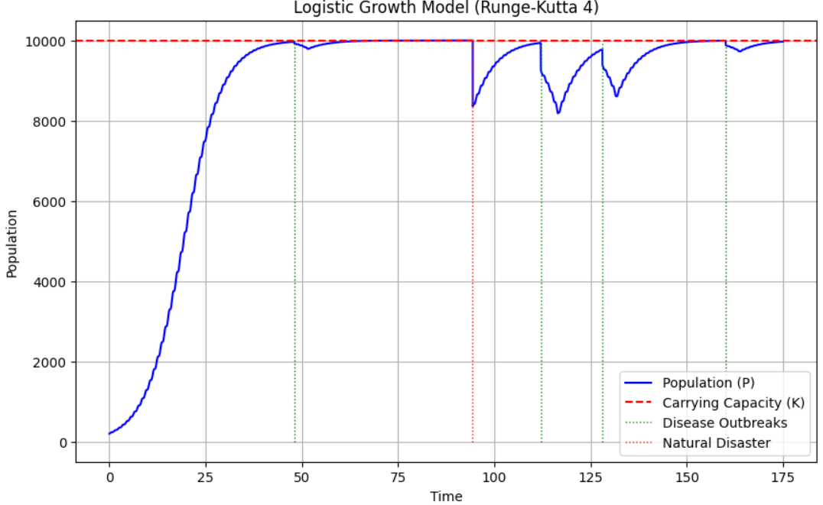
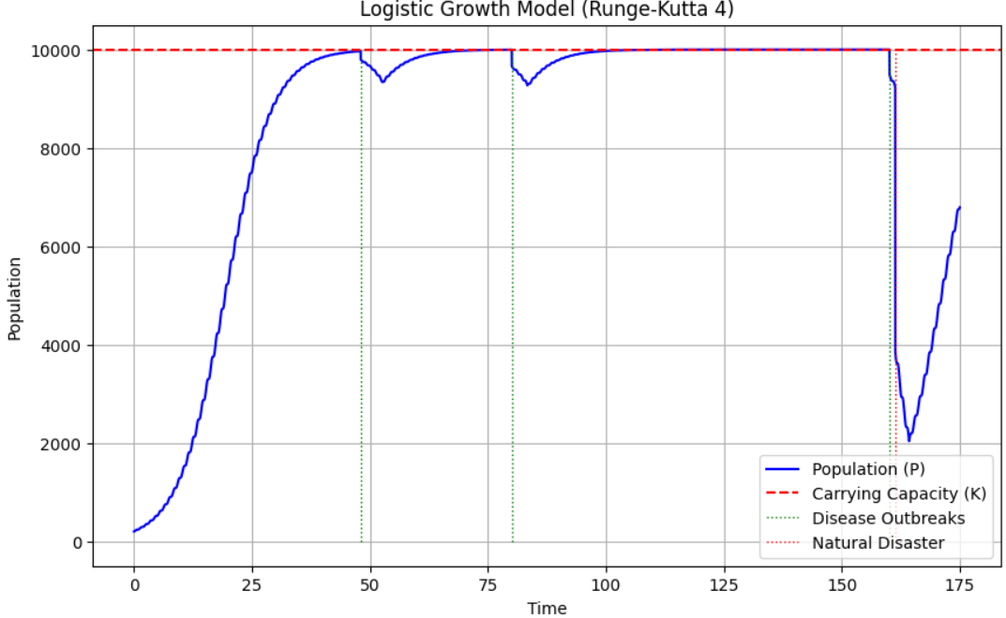
Adding in Disease and Disaster Dynamics

Slide 9
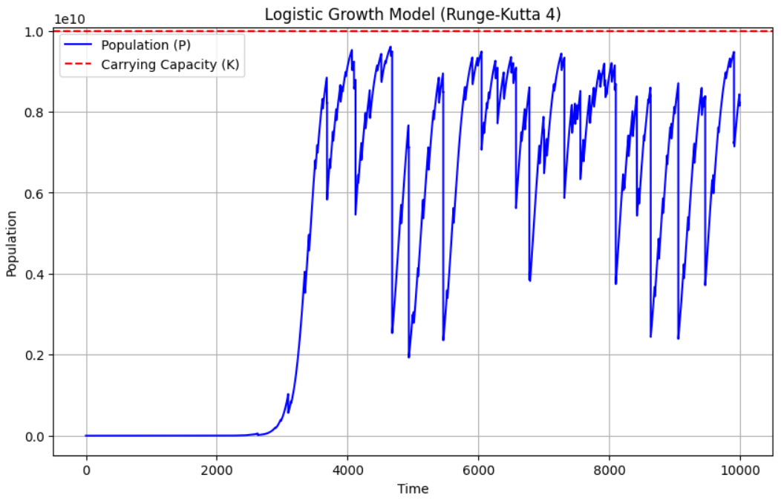
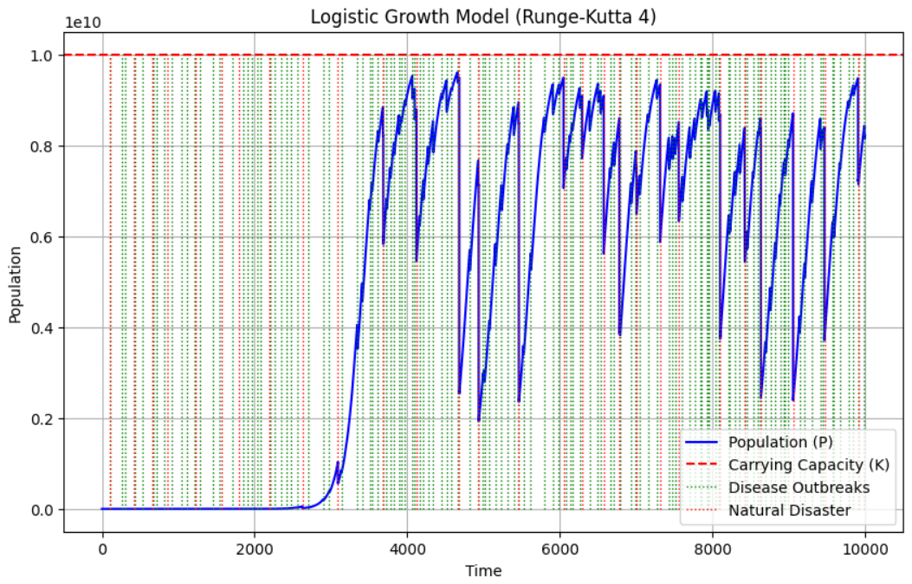
Increasing Carrying Capacity to 10 billion

Slide 10
References
[1] World Atlas. (Unknown). https://www.worldatlas.com/r/w960-q80/upload/9f/4d/df/shutterstock-231214222.jpg
[2] Population Ecology. (2024, September 13). https://www.britannica.com/science/population-ecology/Calculating-population-growth
[3] The Logistic Equation. (2024, August 17). https://math.libretexts.org/@go/page/2559
[4] One Planet, How Many People? A Review of Earth’s Carrying Capacity. (2012, June). https://na.unep.net/geas/archive/pdfs/GEAS_Jun_12_Carrying_Capacity.pdf

