Slide 1
Concurrency
Chapter 5
Fall 2018
© 2018 by Greg Ozbirn, UTD, for use with Stalling's 9th Ed. OS book
<number>
Notes:
<number>

Slide 2
Concurrency
Concurrency refers to concurrent activities.
Concurrent means happening at the same time.
We saw in the earlier chapters that we want to run more than one process or thread at the same time.
This concurrency presents a set of problems we must deal with.
<number>

Slide 3
Process Management
Concurrency arises in each of these kinds of systems:
Multiprogramming: multiple processes on a uniprocessor system (also called multitasking).
Multiprocessing: multiple processes on a multiprocessor system.
Distributed processing: multiple processes on multiple distributed systems.
<number>

Slide 4
Concurrency
Concurrency occurs in the following contexts:
Multiple applications: running at once
Structured applications: applications made of multiple pieces running at once
OS Structure: OS made of multiple pieces running at once.
<number>

Slide 5
Principles of Concurrency
Some of the problems in running more than one process at a time (interleaved uniprocessor or multiprocessor):
Sharing of resources among processes, for example, a variable. If two or more processes use a variable, then the order of execution may be critical.
Allocation of resources. (Deadlocks).
Debugging: since bug may be due to particular order of process execution and therefore hard to reproduce.
The relative order of execution of concurrent processes is unpredictable, because so many things can affect how processes run (interrupts, activities of other processes, scheduler, etc.)
<number>

Slide 6
Uniprocessor Concurrency Problem
char chin; // shared variable
void echo()
{
chin = getchar();
char chout = chin;
putchar(chout);
}
On a single-processor machine, if p1 calls echo and is interrupted after getchar, and p2 runs and calls echo, then when p1 resumes the chin will have p2’s value rather than p1’s.
Thus both processes print p2’s value.
<number>

Slide 7
Multiprocessor Concurrency Problem
Process P1 Process P2
. .
chin = getchar(); .
. chin = getchar();
chout = chin; chout = chin;
putchar(chout); .
. putchar(chout);
. .
On a multiprocessor machine, if p1 and p2 both call echo at the same time, and the instructions are executed as shown above, we have the same problem as before, with p2’s value printing twice.
<number>

Slide 8
Conclusion
We can see from both examples that there is a need to enforce mutual exclusion of access to shared variables.
This is true for uniprocessor systems due to interrupts, and in multiprocessor systems due to simultaneous execution.
Such a situation where the outcome of two processes accessing the same variable depends on their relative order of execution is sometimes called a race condition.
<number>

Slide 9
Race Condition
A race condition occurs when multiple processes or threads read and write data items so that the final results depends on the order of execution of instructions.
Suppose p1 and p2 both share variable a. If p1 will update it to 1, and p2 will update it to 2, then it becomes a race to update the variable. In this case, the loser is actually the winner, since their value will persist.
Suppose p3 and p4 share variables b=1 and c=2. If p3 will execute b=b+c and p4 will execute c=b+c, then again it is a race. If p3 executes first, b becomes 3 and when p4 executes, c becomes 5. But if p4 executes first, c becomes 3 and b becomes 4.
<number>

Slide 10
OS Concerns
What problems does concurrency pose to the OS?
Keep track of various active processes (use PCBs and other structures).
Allocate resources (CPU, Memory, Files, I/O devices) to each process.
Protect data and resources of each process from interference from other processes.
Process results must be independent of the speed at which execution occurs relative to other processes (the topic of this chapter).
<number>

Slide 11
Process Interaction
To better understand how processes interact with each other, we consider three cases:
Processes unaware of each other
Independent processes (competition)
Processes indirectly aware of each other
Shared resource (cooperation)
Process directly aware of each other
Communicate with each other (cooperation)
<number>

Slide 12
Competition
Competition poses three problems:
Mutual Exclusion
Critical resource: only one process at a time can use it. Example is a printer.
Critical sections: portion of program using a critical resource. Only one program at a time is allowed in its critical section.
Deadlock:
example: two processes want two resources but each owns only one.
Starvation
A process competing for a resource never receives it due to scheduling of other processes.
<number>

Slide 13
Cooperation by Sharing
Again we have the same problems of mutual exclusion, deadlock, and starvation.
A new problem is data coherence, which means the problem of keeping data in a consistent state. This is shown on the next slide:
<number>

Slide 14
Data Coherence
P1:
a = a + 1
b = b + 1
P2:
a = a * 2
b = b * 2
If a=b=2, then a=6, b=6
But if interleaved:
a = a + 1
a = a * 2
b = b * 2
b = b + 1
Then a = 6 and b = 5
If we wish to execute P1 and P2 and ensure a and b are always equal, we see a problem if their instructions are interleaved.
Can be solved by critical section.
<number>

Slide 15
Cooperation by Communication
Here there is no mutual exclusion issue since the processes are not sharing a resource but rather sending messages to each other, but there could still be deadlock or starvation.
A pair of processes may be deadlocked waiting for the other to send a message.
Three processes may be sending messages to each other, but one could be starved while the other two communicate.
<number>

Slide 16
Mutual Exclusion Support Requirements
What are some requirements for mutual exclusion support?
Enforcement. Only one process at a time in its critical section.
Non-interference. A process that halts in its non-critical section does not affect other processes.
No deadlock or starvation of processes needing to enter critical section.
When critical section is open, any process wanting entry should be permitted entry without delay.
No assumptions about process speeds or number of CPUs.
Finite time inside critical section.
<number>

Slide 17
Achieving Mutual Exclusion
There are three general approaches:
Software: let the applications enforce it themselves through coding.
Hardware: disable interrupts or have special machine instructions to support mutual exclusion.
Operating System or Language: let the OS or programming language offer support for this capability.
<number>

Slide 18
Software Solutions
A Dutch mathematician named Dekker produced an algorithm for mutual exclusion in software.
The next set of slides will develop this algorithm in four stages to demonstrate the problems that are possible.
Note that these four attempts are in Appendix A of the textbook.
<number>

Slide 19
Software Approaches to Mutual Exclusion
First Attempt:
Variable “turn” used to indicate which process may enter its critical section.
Other processes “busy wait” until it is their turn.
Called a “coroutine” (pass control back and forth)
Problems:
Processes must alternate critical section usage, slowing down other processes to the slowest one.
A process that fails hangs the system.
<number>

Slide 20
First Attempt
// process 0
// busy wait
while (turn != 0) // not my turn
// do nothing
//… code of critical section
turn = 1; // your turn
// process 1
// busy wait
while (turn != 1)
// do nothing
//… code of critical section
turn = 0;
<number>

Slide 21
Software Approaches to Mutual Exclusion
Second Attempt:
Uses a variable for each process.
Solves problem of taking turns.
Problems:
Process failing inside its critical section hangs system.
Doesn’t enforce mutual exclusion since each could see the other’s flag set to false and proceed.
<number>

Slide 22
Second Attempt
// process 0
// busy wait
while (flag[1]) // p1 in crit.sec.
// do nothing
flag[0] = true; // I’m in
//… code of critical section
flag[0] = false; // I’m out
// process 1
// busy wait
while (flag[0])
// do nothing
flag[1] = true;
//… code of critical section
flag[1] = false;
<number>

Slide 23
Software Approaches to Mutual Exclusion
Third Attempt:
Same as second attempt but set flag before while loop.
Problems:
Process failing inside its critical section hangs system.
Deadlocks if both set flag to true before while loop.
<number>

Slide 24
Third Attempt
// process 0
flag[0] = true; // I want in
while (flag[1]) // p1 in crit.sec.
// do nothing
//… code of critical section
flag[0] = false; // I’m out
// process 1
flag[1] = true;
while (flag[0])
// do nothing
//… code of critical section
flag[1] = false;
<number>

Slide 25
Software Approaches to Mutual Exclusion
Fourth Attempt:
Same as third attempt but after setting flag, check other process flag and reset own flag before entering critical section if other’s is set.
Problems:
Process failing inside its critical section hangs system.
Situation is possible for indefinite delay (livelock). This happens if both processes repeatedly defer to each other (mutual courtesy).
<number>

Slide 26
Fourth Attempt
// process 0
flag[0] = true; // I want in
while (flag[1]) // p1 is in
{
flag[0] = false; // defer to p1
// delay
flag[0] = true; // try again
}
//… code of critical section
flag[0] = false; // I’m out
// process 1
flag[1] = true;
while (flag[0])
{
flag[1] = false;
// delay
flag[1] = true;
}
//… code of critical section
flag[1] = false;
<number>

Slide 27
Dekker’s Algorithm
Correct Solution:
Uses a turn flag to decide in matters of deference so that the problems in the fourth attempt are solved.
<number>

Slide 28
Dekker’s Algorithm
// process 0
flag[0] = true;
while (flag[1])
{
if (turn == 1)
{
flag[0] = false;
while (turn ==1)
// busy wait
flag[0] = true;
}
}
//… code of critical section
turn = 1;
flag[0] = false;
// process 1
flag[1] = true;
while (flag[0])
{
if (turn == 0)
{
flag[1] = false;
while (turn ==0)
// busy wait
flag[1] = true;
}
}
//… code of critical section
turn = 0;
flag[1] = false;
<number>

Slide 29
Dekker’s Algorithm
flag[0] = true;
while (flag[1])
{
if (turn == 1)
{
flag[0] = false;
while (turn ==1)
// busy wait
flag[0] = true;
}
}
//… code of critical section
turn = 1;
flag[0] = false;
set my flag
while p1’s flag is set
if p1’s turn
reset my flag (defer to p1)
busy wait while p1’s turn
set my flag (try again)
now it is p1’s turn
reset my flag
<number>

Slide 30
Peterson’s Algorithm Similar but more elegant solution than Dekker’s.
I want to enter
P0:
P1:
Defer to p0
flag[0] = true;
turn = 1;
while (flag[1] && turn == 1)
/* do nothing */
/* critical section */
flag[0] = false;
/* remainder */
flag[1] = true;
turn = 0;
while (flag[0] && turn == 0)
/* do nothing */
/* critical section */
flag[1] = false;
/* remainder */
While p0 wants
to enter and p0’s turn, I’ll wait.
I’m done
<number>

Slide 31
Hardware Approaches to Mutual Exclusion
Two ways hardware can support mutual exclusion:
1) Interrupt disabling
2) Special machine instructions
<number>

Slide 32
Mutual Exclusion Hardware Support
Interrupt Disabling
In a uniprocessor system, processes cannot have overlapped execution, but only interleaved execution.
Interleaving occurs when a process is interrupted.
Disabling interrupts lets a process complete its critical section without worrying about being interrupted and switched to another process.
Problems:
Degrades multitasking performance.
Doesn’t work on multiprocessor system where multiple processes execute at once regardless of interrupts.
<number>

Slide 33
Special Machine Instructions
Access to a memory location by a process excludes simultaneous access by other processes.
A special machine instruction could be designed that carries out two operations against a memory location atomically (without interruption).
For example, reading and writing or testing and setting a single memory location.
These instructions can be used to design software algorithms to enforce mutual exclusion by relying on their atomic behavior.
<number>

Slide 34
Compare and Swap Instruction
// critical section based on
// compare_and_swap instruction
Shared variable x=0
while (true)
{
while (compare_and_swap(x, 0, 1) == 1)
// do nothing
// critical section code here
x = 0;
// remaining code…
}
// instruction logic
int compare_and_swap(int *word, int testval, int newval)
{
int oldval;
oldval = *word;
if (oldval == testval)
*word = newval;
return oldval;
}
<number>

Slide 35
Exchange Instruction
// critical section based on
// exchange instruction
Shared variable x=0
Local variable i
i = 1;
do exchange(i, x)
while (i != 0);
// critical section code here
x = 0;
// remainding code…
// this procedure is implemented
// as a single machine instruction:
void exchange(int &reg, int &mem)
{
int temp;
temp = mem;
mem = reg;
reg = temp;
}
<number>

Slide 36
Special Machine Instructions
Advantages to special machine instructions are:
Works on uniprocessor or shared-memory multiprocessor
Simple and easy to verify
Permits multiple critical sections, each with its own variable
Drawbacks to special machine instructions are:
Busy-waiting consumes processor time
Starvation possible since the process that runs next is arbitrary.
Deadlock is possible if p1 enters the critical section and is interrupted by a higher priority process p2. p2 cannot enter due to p1, and p1 will not be scheduled due to p2.
<number>

Slide 37
OS or Language Approaches to Mutual Exclusion
Semaphores:
Semaphores are an OS or language mechanism to support concurrency.
Proposed by Dijkstra in 1965.
A semaphore is a variable with an integer value
may be initialized to a nonnegative number
wait(s) operation decrements the value
signal(s) operation increments value
Queue is used to hold processes waiting on the semaphore.
Semaphore operations are made atomic by the provider.
<number>

Slide 38
Types of Semaphores
Strong semaphore: queue uses FIFO order. No starvation.
Weak semaphore: no queue ordering. Could have starvation.
Binary semaphore: only two values, 0 and 1, but equally powerful as the general semaphore. Like a flag.
Counting semaphore: a general semaphore with n values.
<number>

Slide 39
Mutex
A concept related to a binary semaphore is a mutual exclusion lock, or mutex.
A process that acquires or locks the mutex prevents others from so doing so, until the process releases or unlocks the mutex.
Usually a mutex requires the process that locks it to be the one that unlocks it.
This differs from a binary semaphore, where one can wait for another to signal it.
<number>

Slide 40
Semaphore Behavior
In general, there is no way to know before a process calls wait whether it will block or not.
When a process calls signal to awaken a waiting process, both processes will continue running concurrently, so on a uniprocessor system, there is no way to know which one will actually proceed next.
When you signal a semaphore, you don’t necessarily know whether another process is waiting, so the number of processes awakened at that time may be zero.
<number>

Slide 41
struct binary_semaphore
{
enum (zero, one) value;
queueType queue;
};
void waitB(binary_semaphore s)
{
if (s.value == one)
s.value = zero;
else
{
place this process in s.queue;
block this process;
}
}
void signalB(binary_semaphore s)
{
if (s.queue.is_empty())
s.value = one;
else
{
remove a process P from s.queue;
place process P on the ready list;
}
}
struct semaphore
{
int count;
queueType queue;
};
void wait(semaphore s)
{
s.count--;
if (s.count < 0)
{
place this process in s.queue;
block this process;
}
}
void signal(semaphore s)
{
s.count++;
if (s.count <= 0)
{
remove a process P from s.queue;
place process P on the ready list;
}
}
<number>

Slide 42
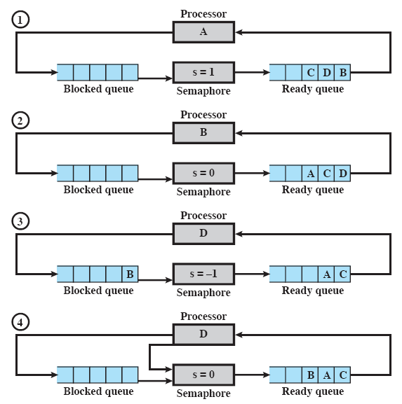
D is producer, A,B,C are consumers
<number>

Slide 43
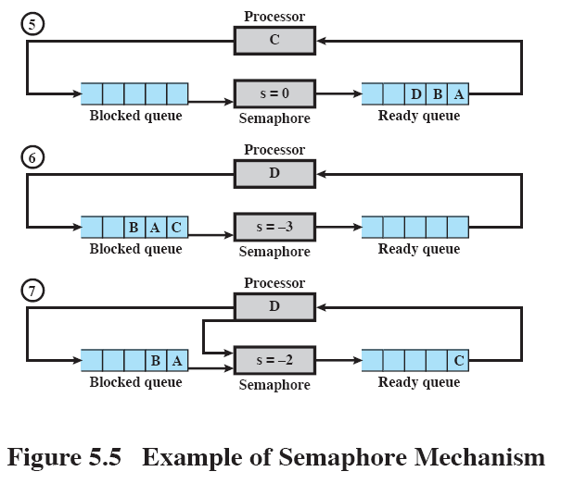
<number>

Slide 44
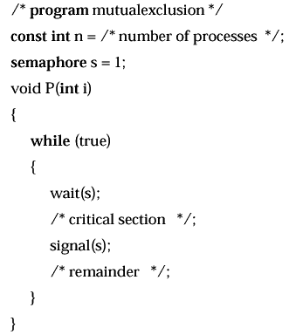
<number>

Slide 45
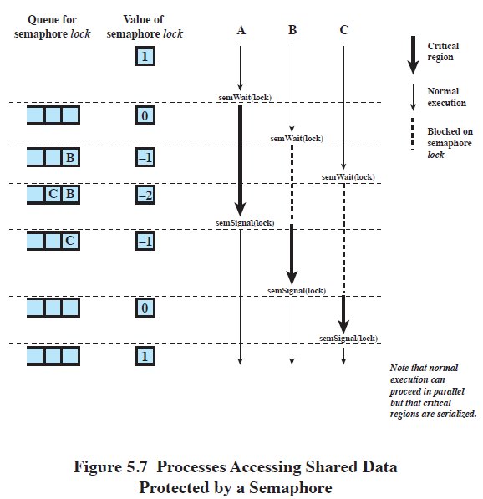
<number>

Slide 46
Semaphores
To allow more than one process into a critical sections, initialize the semaphore s to that number.
Values of a semaphore s:
s > 0: s processes may wait(s) without delay
s = 0: no processes waiting
s < 0: s processes are suspended waiting on s.
<number>

Slide 47
Producer / Consumer Problem
Suppose there are one or more producers generating some type of data and putting it in a buffer, and there is one consumer taking items out of the buffer.
The system is to be constrained to prevent overlapping buffer operations.
<number>

Slide 48
/* program producerconsumer */
int n;
binary_semaphore s=1;
binary_semaphore delay = 0;
void producer()
{
while (true)
{
produce();
waitB(s);
append();
n++;
if (n==1)
signalB(delay);
signalB(s);
}
}
void consumer()
{
waitB(delay);
while (true)
{
waitB(s);
take();
n--;
signalB(s);
consume();
if (n==0)
waitB(delay);
}
}
Wait before buffer append
Append to buffer (produce)
Increment n (buffer count)
If buffer was empty
signal consumer
Allow others to use buffer
Wait for producer to tell
us something is in buffer
Wait for buffer operation
Remove, decrement, signal
Process item
<number>
Buffer is empty, wait

Slide 49
Problem
There is a problem with the code on the previous slide.
The producer may increment n before the consumer tests for n==0.
This leads the consumer to not wait on the delay semaphore as it normally would.
If the consumer runs again immediately, it will attempt to take one from the buffer that isn’t there.
<number>

Slide 50
Solution
A solution is to save n’s value inside the consumer’s critical section, then test the saved value outside:
void consumer() // before
{
waitB(delay);
while (true)
{
waitB(s);
take();
n--;
signalB(s);
consume();
if (n==0)
waitB(delay);
}
}
void consumer() // after
{
int m;
waitB(delay);
while (true)
{
waitB(s);
take();
n--;
m = n;
signalB(s);
consume();
if (m==0)
waitB(delay);
}
}
Save n’s
value
inside
critical
section.
Test
outside.
<number>

Slide 51
Counting Semaphores
/* program producerconsumer */
semaphore n=0;
semaphore s=1;
void producer()
{
while (true)
{
produce();
wait(s);
append();
signal(s);
signal(n);
}
}
void consumer()
{
while (true)
{
wait(n);
wait(s);
take();
signal(s);
consume();
}
}
Can replace the binary semaphores
with counting semaphores.
This lets the variable n be a semaphore
itself rather than an integer variable.
If wait on s first then n, it deadlocks. Why?
Because if n is 0, then consumer waits
for producer inside the critical section, but
producer can’t get into the critical section
to produce.
<number>

Slide 52
Finite Buffer Solution
A finite buffer solution can be constructed by adding a semaphore to keep track of the buffer size.
A semaphore “e” is used to keep from inserting into a full buffer.
<number>

Slide 53
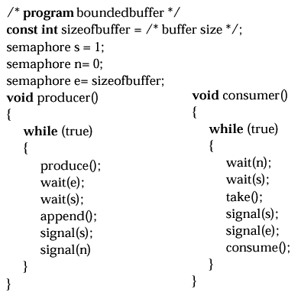
wait(e) can
only be called
sizeofbuffer
times before
having to wait
(means buffer
is full).
signal(e) each
time an item
is taken from
the buffer.
p.228
<number>

Slide 54
Barbershop Example
We can simulate a barbershop using semaphores.
The barbershop has three chairs, three barbers, a waiting room for up to 20 customers, and 4 of these waiting customers may sit on the couch.
Note that the Barbershop example is in Appendix A of the textbook.
<number>

Slide 55
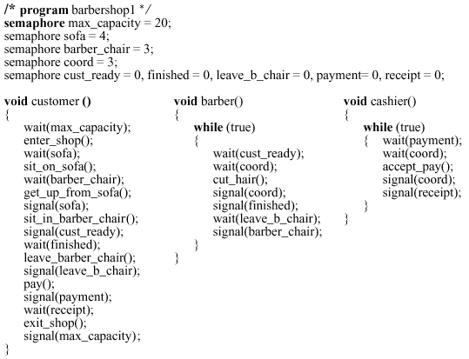
<number>

Slide 56
Problem
There is a problem with this barbershop.
In a real barbershop, if three customers in a row are seated for a haircut, the haircuts will not necessarily be completed in that order (one customer may not have much hair to cut).
However, our code will cause the first customer seated to leave and pay as soon as any haircut is finished.
A solution uses a separate semaphore for each customer.
<number>

Slide 57
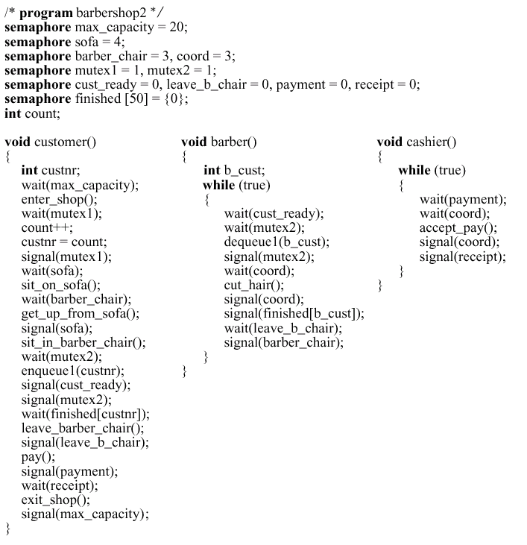
<number>

Slide 58
Readers/Writers Problem
Classic concurrency problem:
Any number of readers may simultaneously read the file.
Only one writer at a time may write to the file.
If a writer is writing to the file, no reader may read it.
This is a special case of the more general mutual exclusion problem.
It differs from the producer/consumer problem where both producer and consumer write to the buffer.
<number>

Slide 59
int readcount;
semaphore x=1, wsem=1;
void reader( )
{
while (true)
{
wait(x);
readcount++;
if (readcount == 1)
wait(wsem);
signal(x);
READUNIT( );
wait(x);
readcount--;
if (readcount == 0)
signal(wsem);
signal(x);
}
}
void writer( )
{
while (true)
{
wait(wsem);
WRITEUNIT( );
signal(wsem);
}
}
critical
section
protects
writing
critical
section
protects
count
Readers/Writers code.
Writers protected from
each other and from
readers.
Readers may all read
unless there is a writer.
critical
section
protects
reading
critical
section
protects
count
First reader waits on wsem, other readers need not. So as long as
a reader is reading, other readers may also read. Could starve writer.
<number>

Slide 60
Monitors
Semaphores are a primitive yet powerful and flexible tool for enforcing mutual exclusion, but because the wait and signal calls may be scattered throughout the code, it is sometimes not easy to see their overall effect.
A monitor is a programming language construct found in Java, Concurrent Pascal, and Modula-3.
Equivalent capability of semaphore but easier to control.
A monitor is a software module with these chief characteristics:
Local data variables are accessible only by the monitor
Process enters monitor by invoking one of its procedures
Only one process may be executing in the monitor at a time, others are suspended waiting for the monitor to become available
<number>

Slide 61
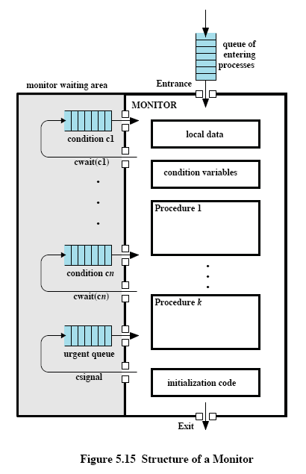
Only one process may enter the monitor at a time.
A process may choose to wait on a condition.
When the condition is signaled, the waiting process may reenter the monitor.
<number>

Slide 62
Condition Variables
A monitor uses condition variables for synchronization.
cwait(c) – suspend execution of the calling process on condition c. The monitor is now available for others.
csignal(c) – resume execution of some process blocked after a cwait on c. If there are many, choose one, if there are none, do nothing.
Notice the signal is different from a semaphore signal. In this case, the signal is lost if no one is waiting.
<number>

Slide 63
void producer()
{
char x;
while (true)
{
produce(x);
append(x);
}
}
void consumer()
{
char x;
while (true)
{
take(x);
consume();
}
}
monitor boundedbuffer;
char buffer[N];
int nextin=0, nextout=0, count=0;
cond notfull, notempty;
void append(char x)
{
if (count == N)
cwait(notfull);
buffer[nextin] = x;
nextin=(nextin+1)%N;
count++;
/* one more item in buffer */
csignal(notempty);
}
void take(char x)
{
if (count == 0)
cwait(notempty);
x = buffer[nextout];
nextout=(nextout + 1)%N;
count--;
csignal(notfull);
}
<number>

Slide 64
Message Passing
Processes that interact may have two requirements:
Synchronization (for mutual exclusion)
Communication (to exchange information)
Message passing can satisfy both of these requirements and works well in a distributed environment.
Basic message passing commands:
send (destination, message)
receive (source, message)
<number>

Slide 65
Message Passing
Sender and receiver may or may not be blocking (waiting to send or receive message)
Three combinations are typical:
Blocking send, blocking receive
Both sender and receiver are blocked until message is delivered
Called a rendezvous
Nonblocking send, blocking receive
Sender continues processing such as sending messages as quickly as possible
Receiver is blocked until the requested message arrives
Nonblocking send, nonblocking receive
Neither party is required to wait
<number>

Slide 66
Message Addressing
Who is the message sent to?
Direct Addressing: specify destination process.
Indirect Addressing: send to mailbox and let receiving process(es) pickup whenever they are ready. (flexibility)
<number>

Slide 67
Creates Critical Section by Message Passing
const int n=numProcesses;
void P(int i)
{
message msg;
while (true)
{
receive(box, msg);
/* critical section */
send(box, msg);
/* remainder */
}
}
void main()
{
create_mailbox(box);
send(box, null);
create(P(1), P(2), … , P(n));
}
<number>

Slide 68
Consumer/Producer Problem by Message Passing
const int capacity=bufsize;
int i;
void main()
{
create_mailbox(mayproduce);
create_mailbox(mayconsume);
for (int i=1; i<=capacity; i++)
send(mayproduce, null);
create(producer, consumer);
}
void producer()
{
message pmsg;
while (true)
{
receive(mayproduce, pmsg);
pmsg=produce();
send(mayconsume, pmsg);
}
}
void consumer()
{
message cmsg;
while (true)
{
receive(mayconsume, cmsg);
consume(cmsg);
send(mayproduce, null);
}
}
<number>

Slide 69
Chapter 6
Concurrency:
Deadlock and Starvation
Fall 2018
© 2018 by Greg Ozbirn, UTD, for use with Stalling's 9th Ed. OS book
<number>

Slide 70
Deadlock
Deadlock is the permanent blocking of a set of processes that either compete for resources or communicate with each other.
Deadlocks involve conflicting needs for resources by two or more processes
There is no efficient solution.
<number>

Slide 71
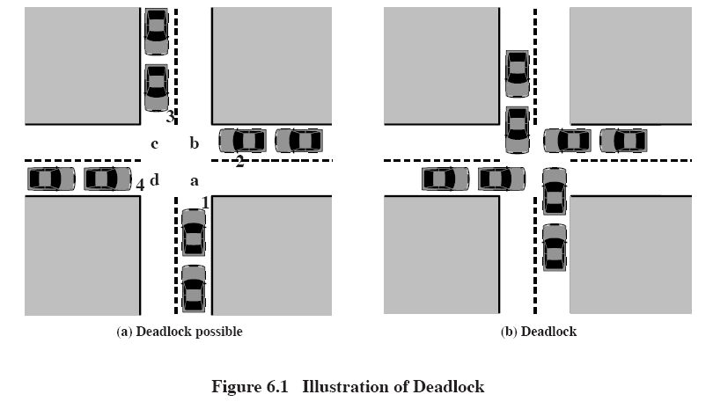
<number>

Slide 72
Deadlock Example
Process P
Get A
Get B
Release A
Release B
Process Q
Get B
Get A
Release B
Release A
<number>

Slide 73
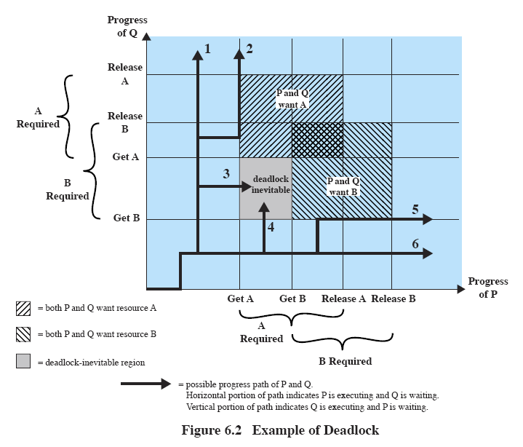
<number>

Slide 74
No Deadlock Example
Process P
Get A
Release A
Get B
Release B
Process Q
Get B
Get A
Release B
Release A
<number>

Slide 75
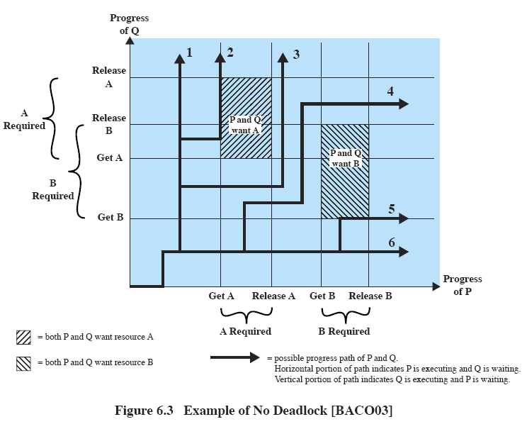
<number>

Slide 76
Reusable Resources
Two categories of resources:
Reusable
used by one process at a time and is not consumed.
For example, the processor
Consumable
Can be created and destroyed.
For example, a message.
<number>

Slide 77
Deadlock of Reusable Resource
If only 200 Kbytes available, neither one can complete
Process P1
…
Request 80 Kbytes;
…
Request 60 Kbytes;
Process P2
…
Request 70 Kbytes;
…
Request 80 Kbytes;
<number>

Slide 78
Deadlock of Consumable Resource
P1
P2
Receive (P2);
Send (P2, M1);
Receive (P1);
Send (P1, M2);
Deadlock occurs if receive calls are blocking calls,
meaning it waits until it is finished.
<number>

Slide 79
Resource Allocation Graphs
A resource allocation graph is a directed graph that depicts a state of the system of resources and processes.
Each resource and process is represented by a node.
Dots within a resource node represent instances of that resource.
An edge from a process to a resource represents a resource request.
An edge from a dot within a resource node to a process indicates a resource has been assigned to the process.
<number>

Slide 80
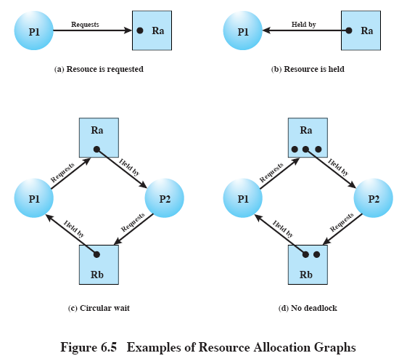
<number>

Slide 81
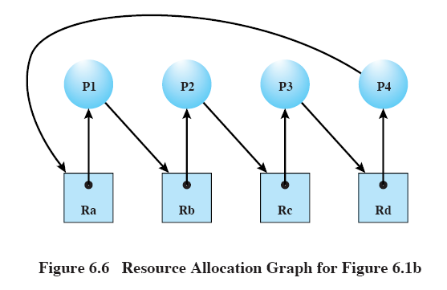
<number>

Slide 82
Required Conditions for Deadlock
Mutual exclusion:
only one process may use resource at a time
Hold and wait:
a process may hold allocated resources while awaiting assignment of other resources.
No preemption:
no resource can be forcibly removed from a process holding it.
Circular wait:
a closed chain of processes exists, such that each process holds at least one resource needed by the next process in the chain.
<number>

Slide 83
Deadlock Conditions
The first three conditions are enough to allow deadlock to occur.
The fourth condition depends on the existence of the first three conditions.
The fourth condition is required for deadlock to actually occur. If it occurs, then a deadlock has occurred.
<number>

Slide 84
Dealing with Deadlocks
There are three general approaches to dealing with deadlocks:
Prevention – prevent conditions necessary for deadlock.
Avoidance – allows first three conditions, avoids fourth condition dynamically.
Detection – detects if deadlock occurs, then deals with it.
Note that there is no single effective strategy that can deal with all types of deadlock.
<number>

Slide 85
Deadlock Prevention
Strategy is to prevent deadlock from occurring by denying the conditions:
Two approaches:
Indirect: prevent one of the three preconditions.
Direct: prevent the fourth condition (circular wait).
<number>

Slide 86
Prevention: Mutual Exclusion
Mutual Exclusion:
Hard to prevent since some resources require it.
For example, files should only be written by one writer at a time.
<number>

Slide 87
Prevention: Hold and Wait
Hold and wait:
can be prevented by making process request all of its resources at one time and blocking it until all of the resources can be granted simultaneously.
Drawbacks:
a process may have to wait a long time before all of its resources are free.
A process may acquire and keep resources a long time during which they are denied to other processes.
A process may not know in advance what resources it will need.
<number>

Slide 88
Prevention: No Preemption
Two possibilities:
If a process holding resources cannot acquire a resource it needs, it must release the ones it has and request all of them again.
If a process needs a resource held by another process, preempt the process and make it release its resources. This approach requires resources whose state can be easily saved and restored, such as the processor.
<number>

Slide 89
Prevention: Circular Wait
Require an ordering of resource requests.
Ordering prevents a circle by having all requests be forward in order, so that a process can’t acquire a resource then request one prior to it which another process may be holding.
As with preventing hold-and-wait, it may not be efficient to do this.
<number>

Slide 90
Deadlock Avoidance
Similar to deadlock prevention.
Allows the three preconditions but tries to prevent deadlock dynamically as resource requests are made.
Allows more concurrency than prevention.
Requires knowledge of future resource requests.
<number>

Slide 91
Deadlock Avoidance
Two approaches:
Process initiation denial: constrains whether a new process is allowed to run.
Resource allocation denial: lets a process run but constrains whether its resource requests are granted.
<number>

Slide 92
Process Initiation Denial
Each process declares its maximum need for each resource.
A process is only allowed to start if the maximum claim of all current processes plus the maximum claim of the new process can be met.
This strategy doesn’t work well because it assumes the worst case, that all processes will make their maximum resource requests at the same time, which is unlikely.
So it may keep processes from starting that actually would have run successfully.
<number>

Slide 93
Resource Allocation Denial
An algorithm for resource allocation denial is the “Banker’s Algorithm”, a term used by Dijkstra to compare processes and resources to bank reserves and loans.
This algorithm defines the state of the system as either safe or unsafe.
A safe state is one in which a sequence of allocations exists not leading to deadlock.
An unsafe state is one in which there is no such sequence.
The algorithm works by determining if the system would be in a safe state if the resource is granted. If so, grant the resource, if not, block the process until it is safe.
<number>

Slide 94
Banker’s Algorithm
The banker’s algorithm makes use of matrices and vectors:
Claim matrix: requirement of each process for each resource.
Allocation matrix: current allocation to each process of each resource.
Resource vector: total amount of each resource in the system.
Available vector: total amount of each resource not allocated to any process.
<number>

Slide 95
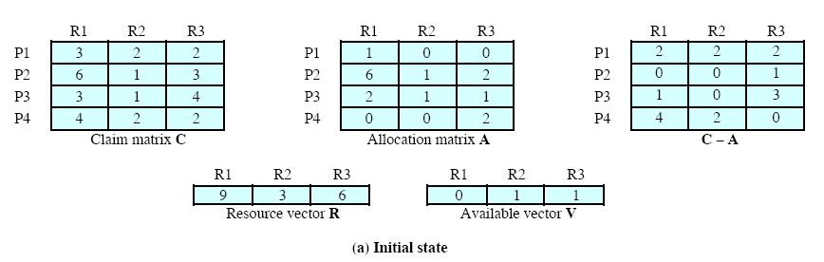
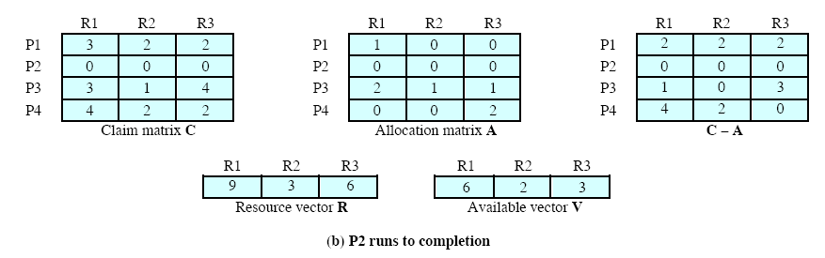
Choose P2 which can
acquire enough resources
to finish.
P2’s resources now
available.
<number>

Slide 96
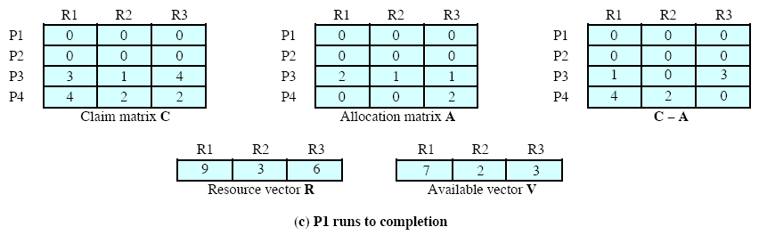
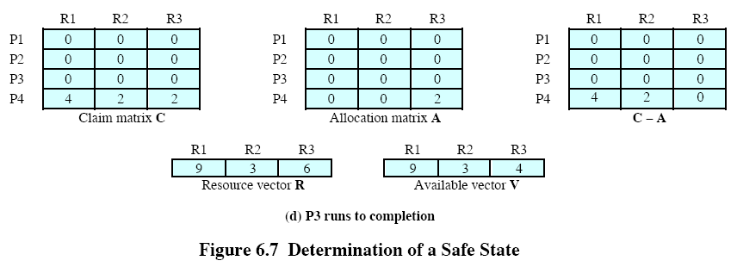
P1’s resources now
available.
Choose P1 which can
acquire enough resources
to finish.
P3’s resources now
available.
Now P4 can finish.
Choose P3 which can
acquire enough resources
to finish.
<number>

Slide 97
Banker’s Algorithm
Safe State
The previous slides represent a system that is in a “safe” state.
This means that there is a sequence of resource allocation that does not result in deadlock.
<number>

Slide 98
Banker’s Algorithm
Unsafe State
An “unsafe” state is one that is not safe.
That is, there is no sequence of resource allocation that will avoid deadlock.
The next slides illustrate an example.
<number>

Slide 99
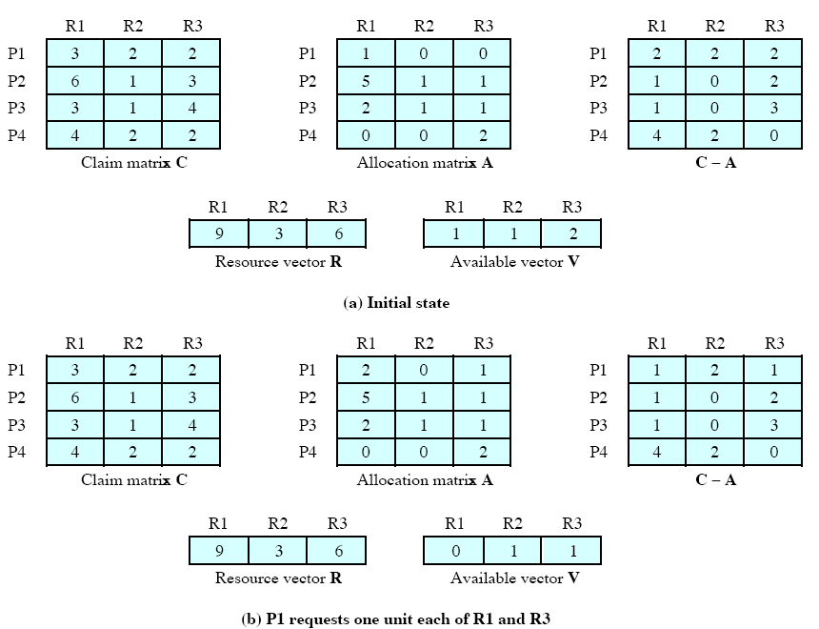
<number>
This is unsafe, because each process needs more of resource R1 and none are available.

Slide 100
Deadlock Avoidance
Advantages
Less restrictive than deadlock prevention.
Not necessary to preempt and rollback processes as in deadlock detection.
Disadvantages
Maximum resource needs must be known in advance
Process ordering needs to be independent (not constrained by any process synchronization).
Must be a fixed number of resources.
Processes can’t exit while holding resources.
<number>

Slide 101
Deadlock Detection
Deadlock prevention and avoidance strategies are conservative. They limit access to resources and impose restrictions on processes to solve the problem of deadlocks.
At the opposite extreme is deadlock detection. It doesn’t limit resource requests, which may lead to deadlock, but detects deadlocks and takes action if it occurs.
<number>

Slide 102
Deadlock Detection
Periodically, the system performs an algorithm to detect deadlock.
This can be done at each resource request, or less frequently due to the overhead involved.
The algorithm uses an allocation matrix and available vector as in the banker’s algorithm.
A request matrix states the amount of resources being requested by each process.
The algorithm is on the next slide…
<number>

Slide 103
Deadlock Detection Algorithm
Mark each process that has a row in the allocation matrix of all zeroes (holds no resources).
For each remaining process see if its resource requests can be met by the current available resources.
Mark all such rows and temporarily add their current allocation to the available list.
If there are unmarked processes at the end of these steps, then these unmarked processes are deadlocked.
<number>

Slide 104
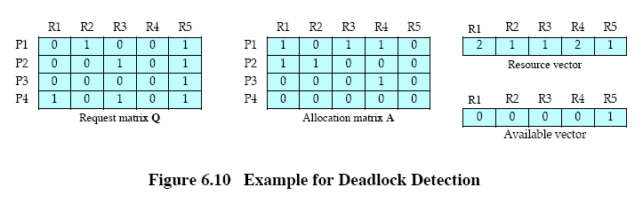
P1 and P2 Deadlocked, because:
Mark P4 since no resources.
Mark P3 since its requests can be met by available resources.
Add P3’s allocation temporarily to the available vector, giving us
0 0 0 1 1.
No other process requests can be met by this vector.
So, P1 and P2 remain unmarked, they are deadlocked.
<number>

Slide 105
Deadlock Detection
Recovery
Abort all deadlocked processes.
This is one of the most common solutions.
Back up each deadlocked process to some previous checkpoint and restart all processes.
Could result in same deadlock again.
Continue aborting deadlocked processes one by one until deadlock is resolved.
Abortion order should be intelligent.
Successively preempt resources until deadlock is resolved.
Preemption choices should be intelligent. Requires rollback of process being preempted.
<number>

Slide 106
Recovery
Possible intelligent process choice criteria:
Least CPU time so far.
Least output so far.
Most estimated remaining runtime.
Least total resources allocated so far.
Lowest priority.
<number>

Slide 107
Table 6.1 Summary of deadlock approaches
Approach
Resource Allocation Policy
Different Schemes
Major Advantages
Major Disadvantages
Works well for processes that perform a single burst of activity.
No preemption necessary
Convenient when applied to resources whose state can be saved and restored easily
Feasible to enforce via compile-time checks
Needs no run-time computation since problem is solved in system design
No preemption necessary
Never delays process initiation
Facilitates online handling
Inefficient
Delays process initiation
Future resource requirements must be known by processes
Preempts more often than necessary
Disallows incremental resource requests
Future resource requirements must be known by OS
Processes can be blocked for long periods
Inherent preemption losses
Requesting all resources at once
Conservative; undercommit resources
Prevention
Preemption
Resource ordering
Avoidance
Midway between that of detection and prevention
Manipulate to find at least one safe path
Very liberal; requested resources are granted where possible
Detection
Invoke periodically to test for deadlock
<number>

Slide 108
Combined Approaches
Another possibility is to use different approaches in different situations.
For example, resources could be grouped into classes, with a linear ordering of requests required among classes.
Within the class, the algorithm most appropriate for that class could be used.
<number>

Slide 109
Dining Philosophers Problem
The Dining Philosophers problem is a classic concurrency problem.
The problem involves five philosophers sitting down to eat spaghetti.
The philosophers require two forks each to eat.
A deadlock occurs if they all pickup their first fork before anyone can get a second fork.
<number>

Slide 110
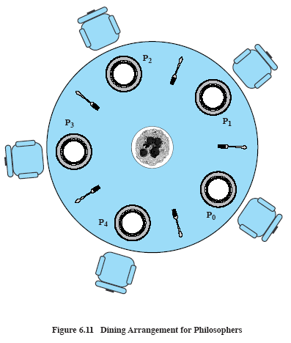
Dining Philosophers Problem
p.284
<number>

Slide 111
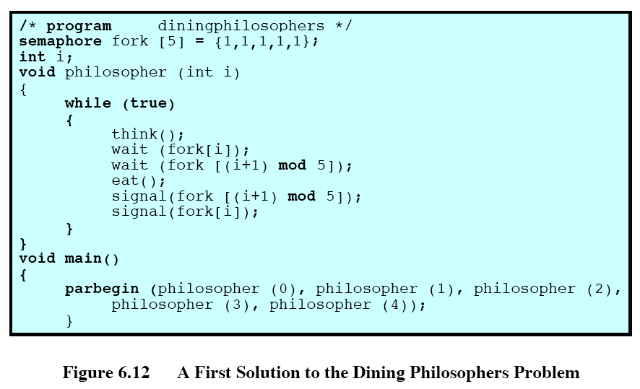
Deadlock if
all processes
complete first
wait before
any completes
second wait.
<number>

Slide 112
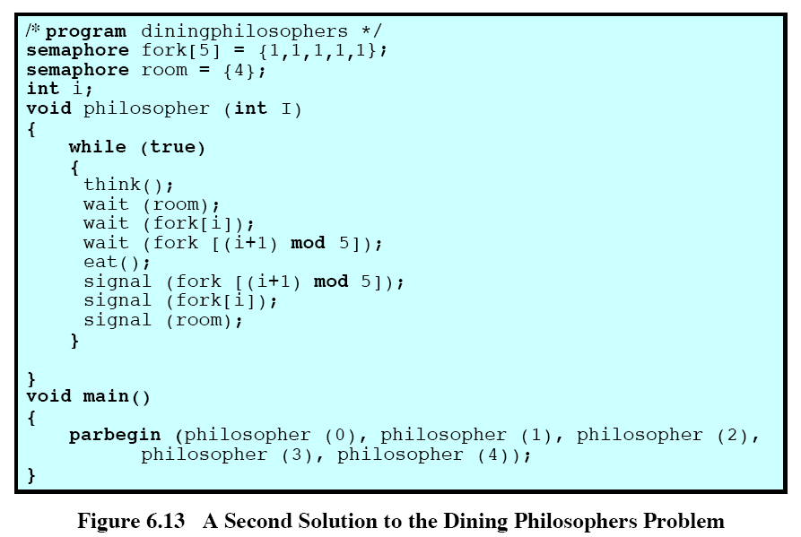
Now only
4 can enter at
a time, so one
fork is free so
that one
philosopher
can have two
forks.
<number>

Slide 113
Chapter 7
Memory Management
Fall 2018
© 2018 by Greg Ozbirn, UTD, for use with Stalling's 9th Ed. OS book
<number>

Slide 114
Memory Management Requirements
Relocation
Protection
Sharing
Logical Organization
Physical Organization
<number>

Slide 115
Memory mgmt reqs
Relocation
In a multiprogramming system with many programs running at once, a program may be loaded into any free area of memory.
Furthermore, a program may be swapped out to disk, then later swapped back into memory again.
It would be difficult to load it back into the same memory locations that it was loaded to before.
Therefore, since we don’t know in advance where the program will load, and since we may swap the program in and out of memory to different areas, we need the ability to relocate the program to any area of memory.
<number>

Slide 116
Memory mgmt reqs
Protection
Processes should be protected from each other.
This means the memory references each process makes must be checked to ensure they are allowed.
But memory references can be computed dynamically by a program (such as array positions) and therefore can’t be known in advance.
Therefore, memory references must be checked at run time by the hardware rather than by OS.
If you consider that each program instruction must be checked, it would be almost impossible for the OS to do this for the program.
<number>

Slide 117
Memory mgmt reqs
Sharing
Two or more processes may be running the same program, so we may want to let them share the program code.
Two or more processes may be working on the same data, so we may want to let them share some memory for data.
Thus the protection mechanism must also allow flexibility for sharing memory.
<number>

Slide 118
Memory mgmt reqs
Logical Organization
Logically, memory is organized as a linear address space, consisting of a sequence of bytes or words.
Programs, however, typically consist of a number of pieces, called modules, which may have different attributes, such as read only.
If the memory management system effectively deals with modules, a number of advantages can be realized:
Modules can be written and compiled independently
Modules can be given different degrees of protection (read only, execute only, etc.)
Modules may be shared among processes.
One approach we will see later that helps support the use of modules is memory segmentation.
<number>

Slide 119
Memory mgmt reqs
Physical Organization
Physically, memory is organized as main memory and secondary storage (disk).
It is difficult for the programmer to manage moving the program between these two environments as it runs.
Therefore, it is best to let the memory management system manage the moving of processes between these two types of memory.
<number>

Slide 120
Memory partitioning
Memory Partitioning
An easy way to deal with memory is to partition it into regions with fixed boundaries.
Each region can be equally sized, or each region can have different sizes.
Partitioning is an old technique that isn’t used today but is important to our understanding of modern memory management techniques.
<number>

Slide 121
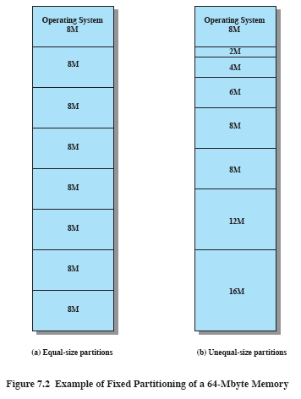
<number>

Slide 122
Memory partitioning
Partitioning: Equal Sized Partitions
Two problems:
A program may be too large for a partition. In this case the programmer must use “overlays”, wherein the program loads pieces of itself into memory to execute, overlaying other pieces.
Memory utilization is poor, since a small program occupies a large partition (called “internal fragmentation”).
<number>

Slide 123
Memory partitioning
Partitioning: Unequal Sized Partitions
Both of the problems of equal-sized partitions can be lessened by using unequal-sized partitions.
Small programs can be loaded into small partitions improving memory utilization, and large programs can be loaded into large partitions helping to avoid the need for overlays.
<number>

Slide 124
Memory partitioning
Placement Algorithm
Placement of programs in an equal-size partitioned memory is trivial since all partitions are the same.
For unequal-sized partitions, we could assign the process to the smallest partition that holds it.
This reduces internal fragmentation, but requires queues for each partition.
A disadvantage of this approach is that a large partition could be empty while a small program waits for a small partition.
A better approach is to use a single queue for all partitions and assign a process to the smallest open partition that holds it.
<number>

Slide 125
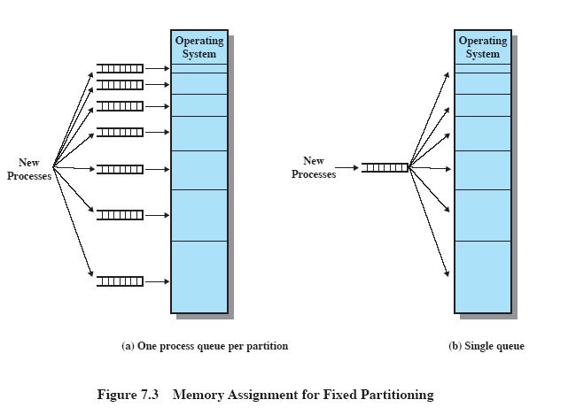
<number>

Slide 126
Memory partitioning
Advantages and Disadvantages of Fixed Partitions
Fixed partition systems are simple and require minimal OS support and overhead.
However:
The number of partitions limits the number of active (not suspended) processes.
Utilization is not as good as it could be since it is likely that part of a partition is unused.
<number>

Slide 127
Memory partitioning
Dynamic Partitioning
With dynamic partitioning, a process is given a partition exactly as big is it requires.
The partition size is not set at system initialization as in fixed partitioning, but is set dynamically as each program is loaded.
The problem with this is “external fragmentation” as shown on the next slide.
<number>

Slide 128
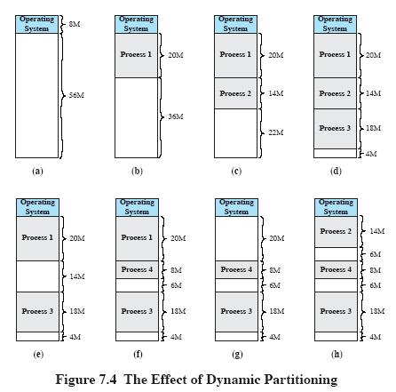
<number>

Slide 129
Memory partitioning
Compaction
One way to deal with external fragmentation is a technique called “compaction”.
Compaction shifts the processes around in memory so that there are no holes between them.
The drawback to compaction is that it is very time consuming.
<number>

Slide 130
Memory partitioning
Placement Algorithms for Dynamic Partitioning
Three placement algorithms:
Best-fit
Choose partition closest in size to the process.
First-fit
Choose first available partition from the beginning of memory that is large enough to hold the process.
Next-fit
Choose next available partition beginning at the previously chosen partition of memory that is large enough to hold the process.
<number>

Slide 131
Memory partitioning
Placement Algorithms
First-fit is usually simplest, fastest, and best.
Next-fit tends to fragment the end block of memory more than first-fit.
Best-fit is usually worst. Causes smallest fragments which are unusable by other processes.
<number>

Slide 132
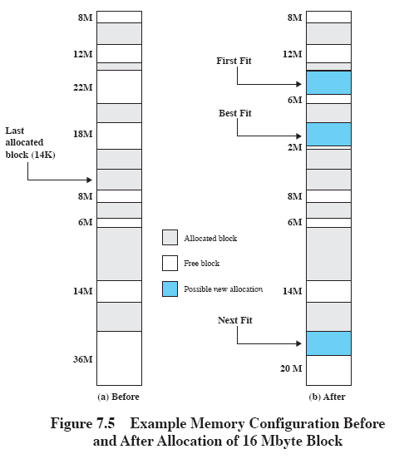
<number>

Slide 133
Memory partitioning
Buddy System
Both fixed and dynamic partitioning schemes have drawbacks.
Another approach is called the buddy system.
The buddy system divides memory blocks in half until a block size that satisfies the request is found.
When a block has been divided and is later free again, it can be combined to form the original size block again.
<number>

Slide 134
Memory partitioning
Buddy System
Consider memory being of size 2^{U}.
Then for the first request, we consider does the block fit between 2^{U-1} and 2^{U}.
If so, allocate 2^{U}.
If not, consider if the request fits between 2^{U-2} and 2^{U-1}.
If so, allocate 2^{U-1}.
If not, repeat the division until such a block is found.
<number>

Slide 135
Memory partitioning
Buddy System
The buddy system maintains a set of lists containing blocks of size 2^{i}.
If a request is made, a 2^{i+1} block in the i+1 list may be split into two blocks of size 2^{i} in the i list.
Whenever a split pair of blocks on the i list are unallocated, they are combined and placed back on the i+1 list.
<number>

Slide 136
Algorithm
// get hole of size 2^{i}
void get_hole(int i)
{
if (i == (U + 1)) < failure >;
if (< i_list empty >) {
get_hole(i+1);
< split hole into buddies >;
< put buddies on i_list >;
}
< take first hole on i_list >;
}
<number>

Slide 137
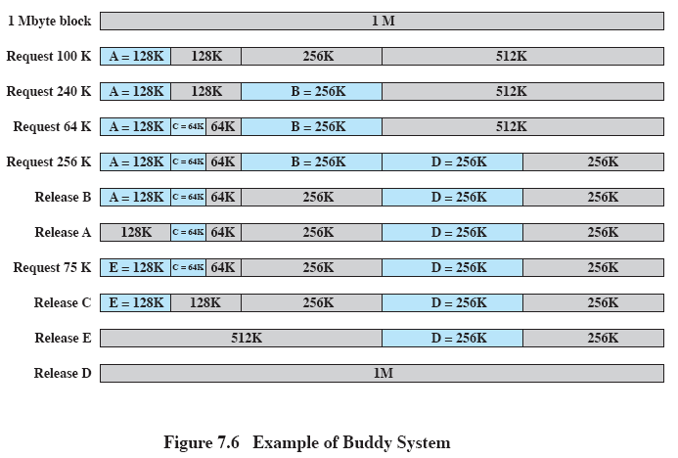
<number>
Note: split blocks are recombined when free.

Slide 138
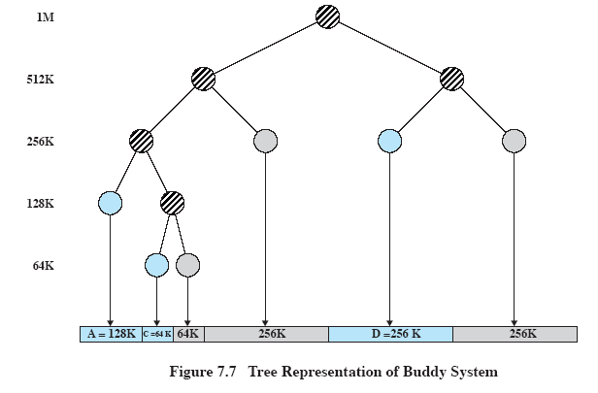
p.315
After the release B request
<number>

Slide 139
Memory partitioning
Relocation
In a fixed equal-sized partition system, a process may be loaded into any open partition. When swapped out and back in, it may be loaded into a different partition.
In a fixed unequal-sized partition system, if a single queue is used, a swapped process may load into a different partition than where it was originally loaded.
In dynamic partitioning, compaction may move processes around in memory.
So…an absolute physical addressing scheme will not work in these situations.
<number>

Slide 140
Memory partitioning
Relocation
Types of addresses:
Physical address
This is the actual memory address.
Also called the absolute address.
Logical address
Address from program’s viewpoint independent of current loaded position.
Relative address: A logical address relative to a known point (beginning of program, for example).
<number>

Slide 141
Memory partitioning
Address Translation
If relative addressing is used relative to the beginning of the program, then these addresses need to be translated to physical addresses depending on where it is loaded.
This can be done at runtime with special hardware.
For example, a “base register” may contain the physical address of the program origin. This is then added to each relative address to get the physical address. A “bounds register” ensures the new address is inside this process’s memory space.
<number>

Slide 142
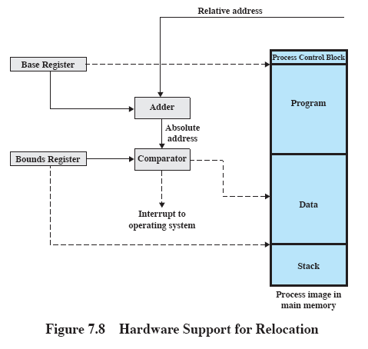
<number>

Slide 143
Paging
Paging is a more modern memory management approach.
In paging, the memory is partitioned into small equal-size chunks.
Likewise a program is divided into the same equal-size chunks.
The chunks of a program are called pages and chunks of memory are called frames.
<number>

Slide 144
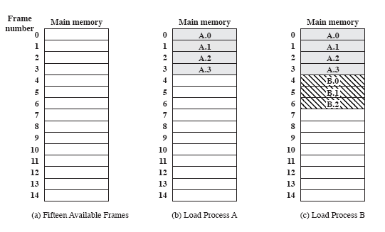
p.318
<number>

Slide 145
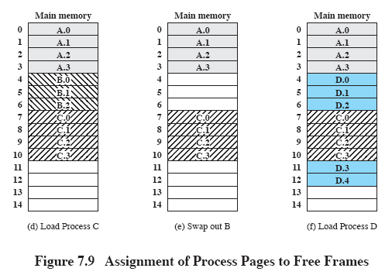
p.318
<number>

Slide 146
Paging
The OS maintains a page table for each process.
Each entry of a page table consist of the frame number where the corresponding page is physically located in memory.
The page table is indexed by the page number to obtain the frame number.
A free frame list, available for pages, is also maintained.
<number>

Slide 147
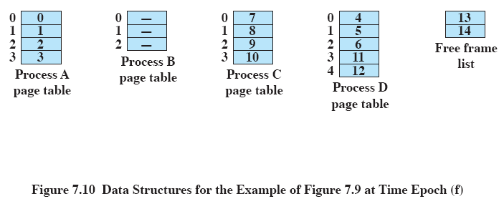
Page tables for each process in (f) of previous slide.
<number>

Slide 148
Paging
In a paging system, within each program, each logical address consists of a page number and an offset within the page.
A CPU register holds the starting physical address of the page table of the process which is running.
Presented with a logical address (page number, offset) the CPU accesses the page table to obtain the physical address (frame number, offset).
<number>

Slide 149
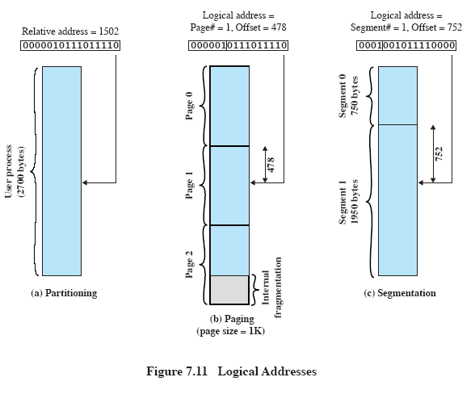
<number>

Slide 150
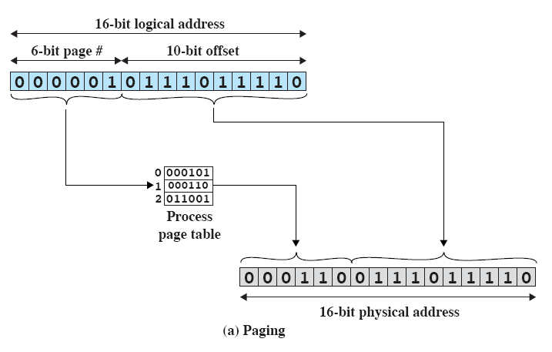
<number>

Slide 151
Segmentation
Similar to paging but uses a segment number and offset.
Segments are not equally-sized.
Similar to dynamic partitioning except a program can span multiple segments that need not be contiguous.
Suffers external fragmentation.
Segments usually are visible to the programmer for partitioning the program into segments and assigning properties to the segment (e.g. read-only).
Segment table gives starting address of segment.
Chapter 8 has more information on segmentation.
<number>

Slide 152
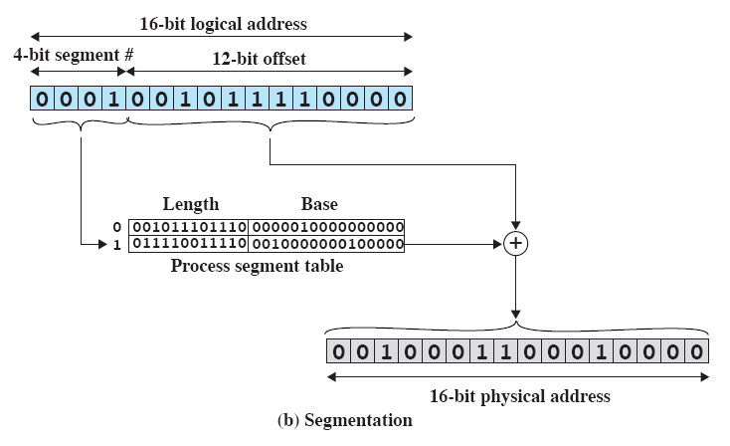
<number>

Slide 153
Chapter 8
Virtual Memory
Fall 2018
© 2018 by Greg Ozbirn, UTD, for use with Stalling's 9th Ed. OS book
<number>

Slide 154
Paging and segmentation
Paging and Segmentation
Compared to partitioning schemes, paging and segmentation lay the foundation for a fundamental breakthrough.
Two characteristics leading to this breakthrough:
All memory references are logical addresses that are translated at run time into physical addresses.
A process may be broken up into many pieces, and these pieces need not be contiguous.
Given the two previous characteristics, it is not necessary that all pages or segments of a program be in main memory at the same time, it is only necessary to have the pieces in memory that are currently needed. This is a fundamental breakthrough in memory management.
<number>

Slide 155
Paging and segmentation
Resident Set
The portion of a process in main memory at a given time is called the “resident set”.
If a program tries to access memory outside its resident set, a fault occurs interrupting the process, and the OS blocks the process and loads the requested piece of the program.
Once the piece is loaded, the process can be put back into a ready state to resume execution.
<number>

Slide 156
Paging and segmentation
Resident Set
The portion of a process in main memory at a given time is called the “resident set”.
If a program tries to access memory outside its resident set, a fault occurs interrupting the process, and the OS blocks the process and loads the requested piece of the program.
Once the piece is loaded, the process can be put back into a ready state to resume execution.
<number>

Slide 157
Paging and segmentation
Implications
Implications of loading only part of a program into memory:
More processes may be loaded at the same time.
A process can actually be larger than all of main memory and still be run. This lifts a major barrier for the programmer.
<number>

Slide 158
Paging and segmentation
Virtual Memory
Real memory is main memory. This is the physical memory on the machine. It is limited to whatever memory is available on that machine.
Virtual memory is the program’s logical view of memory. It can be very large, much larger than main memory.
Virtual memory systems typically make use of the disk drive to augment main memory. The virtual memory manager moves blocks from disk to main memory and back as needed.
This gives the appearance to the program that the main memory is actually much larger than it really is.
<number>

Slide 159
Paging and segmentation
Locality
It is likely that only a portion of the program and a portion of its data is needed in memory at any given time.
Therefore it is somewhat wasteful to load an entire program and all of its data (a large array for example) into memory when it may not be needed for some time.
Also, by loading only a portion of the program, when the process is swapped out, there is less of it in memory to swap.
<number>

Slide 160
Paging and segmentation
Principle of Locality
Just as in caching, the “principle of locality” is of great benefit in paging systems.
It says that program and data references tend to cluster.
Hence, if a cluster of needed pages is in memory, then the program can run for a while without needing more pages loaded.
<number>

Slide 161
Paging and segmentation
Thrashing
Unless the OS is intelligent in the management of this scheme, it may consume more CPU time managing the processes than running them. This is called “thrashing”.
When thrashing, the OS is spending too much of its time loading and unloading parts of processes rather than running them.
This can lead to a serious loss in performance.
<number>

Slide 162
Paging
Paging
In a paging system, each process has a page table.
Each entry in the page table can have a flag to keep track of whether the page is loaded, and if so, what frame the page is loaded into.
Another flag may be used to indicate whether a page has been modified since it was loaded.
Other flags may also be used for protection and sharing purposes.
<number>

Slide 163
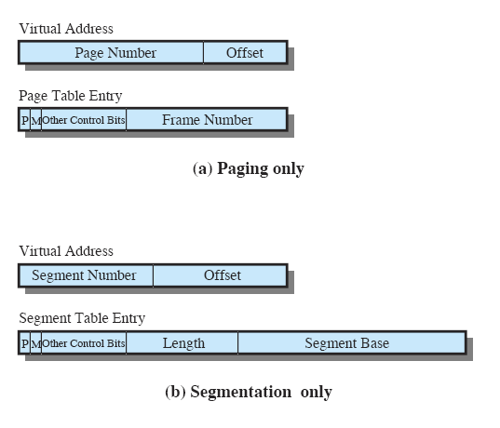
Paging
P = Present bit
M = Modified bit
<number>

Slide 164
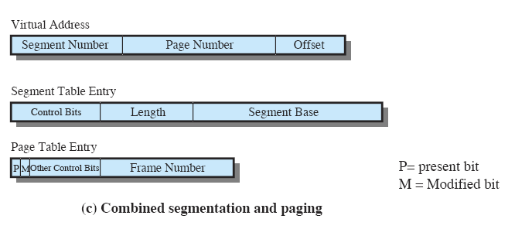
<number>

Slide 165
Paging
Address Translation
The slide on the next page illustrates how a virtual address is translated to a real address in a paging system.
The page number acts as an index into the page table, where it finds the frame number.
The offset is then added to the frame number to create the real address.
<number>

Slide 166
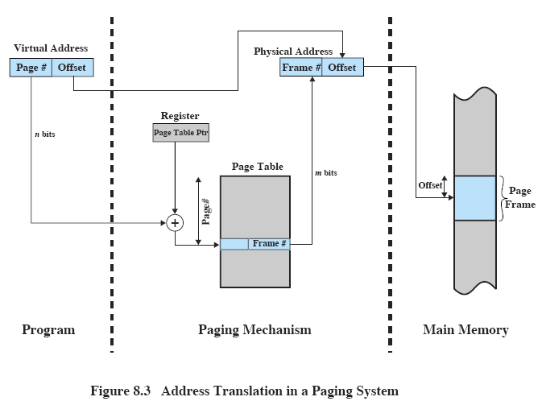
<number>

Slide 167
Paging
Page Table
Because a page table itself may be large, it also may be stored in virtual memory and have pieces loaded in and out as needed.
Some schemes make use of a two-level page table, where the first level is a directory of the second level.
The first level remains in main memory.
The second level can have pieces loaded in and out as needed.
This can result in significant space savings as only parts of the very large second level need be loaded at a time.
<number>

Slide 168
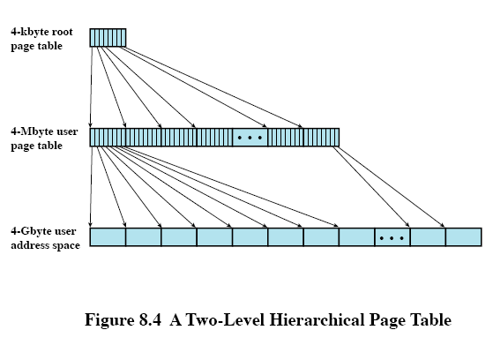
Example
2¹⁰ 4-byte entries, indexed by first 10 bits of address
Each portion of table pointed to has
2¹⁰ entries, so it is indexed by next 10 bits
The remaining 12-bits act as an offset into the 4K page
<number>

Slide 169
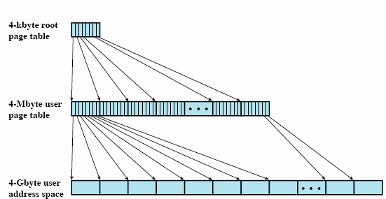
Address
10
10
12
index
index
offset
<number>

Slide 170
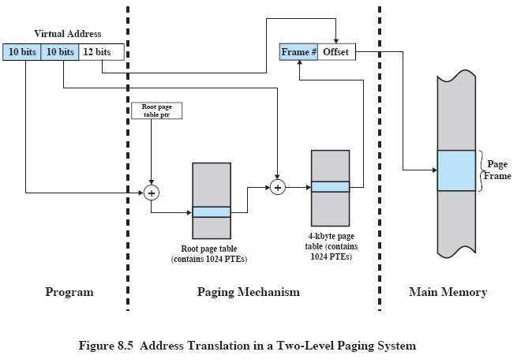
<number>

Slide 171
Paging
Inverted Page Table
Another approach to dealing with large page tables is to use an inverted page table.
This is especially needed on 64-bit machines, where the number of virtual pages can be very large.
This approach uses one page table entry per memory frame rather than one per virtual page. (Hence, it is inverted).
This reduces the size of the page table, since the table size does not depend on the number of pages in the program, but rather on the number of frames in main memory.
Such an approach is sometimes called a frame table rather than a page table.
Typically, only one frame table would be needed to support all processes, rather than each process having its own.
<number>

Slide 172
Inverted Page Table
There is a drawback to this approach, however.
Since the page number of the address can no longer be used as an index into the page table, finding an entry in the table becomes a problem.
One solution is to use a hash function to map the virtual page number to a hash table. The hash table entry has a pointer to the frame table entry.
<number>

Slide 173
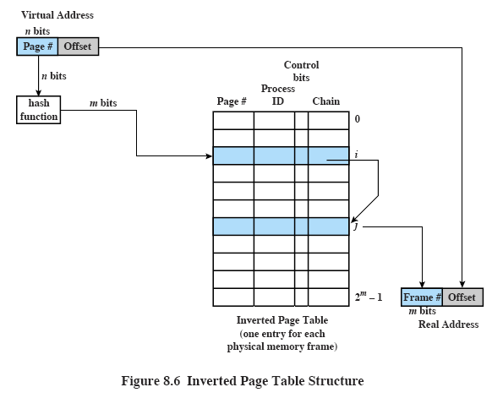
<number>

Slide 174
Paging
Translation Lookaside Buffer
In principle, each virtual address requires two physical memory accesses, one for the page table to get the frame number, and one to access that frame.
This would double the number of accesses made.
To overcome this problem, most virtual memory schemes use a special high-speed cache for page tables called a “Translation Lookaside Buffer”, or “TLB”.
<number>

Slide 175
Paging
Translation Lookaside Buffer
The TLB does for the page table what a memory cache does for main memory.
It contains the page table entries that have been most recently used.
Note that it does not cache the pages themselves, but only the page table entries.
<number>

Slide 176
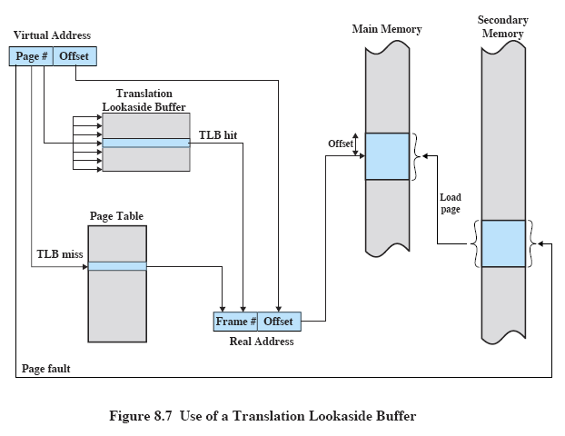
<number>

Slide 177
Paging
Translation Lookaside Buffer
Because the TLB only has a subset of page table entries, the page number cannot be used as an index into the TLB as it can for a page table.
The processor is equipped with hardware that allows it to interrogate simultaneously a number of TLB entries to find a match.
This technique is called “associative mapping”.
With this technique, the TLB entries can be examined all at once to see if there is a match.
<number>

Slide 178
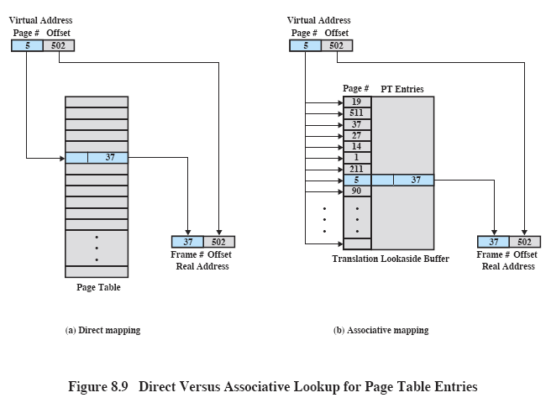
<number>

Slide 179
Cache
After accessing the TLB, the virtual memory manager must interact with the system cache.
The cache blocks are identified by a “tag”.
The tag is usually just the leftmost bits of the address.
If the address is in the cache (called a hit), it is returned to the CPU.
If not (called a miss), it is retrieved from main memory.
<number>

Slide 180
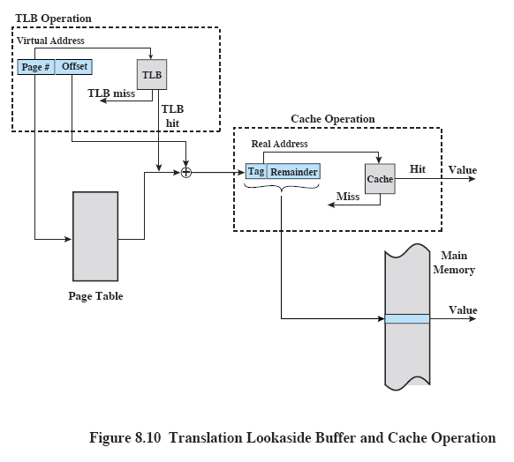
<number>

Slide 181
Paging
Page Size
How big should pages be?
Considerations:
A small page size reduces internal fragmentation which is good for memory utilization.
However, a small page size also leads to a larger number of pages per process, increasing the page table size.
A large page size may be more efficient for data transfers to and from the disk, since the disk is designed to efficiently transfer large blocks of data.
There is also a relationship between page size and page fault rates. As the page size grows, locality is weakened and more faults will occur (until the page size begins to approach the size of the entire process).
Page sizes typically range from 512 bytes to 16 megabytes.
<number>

Slide 182
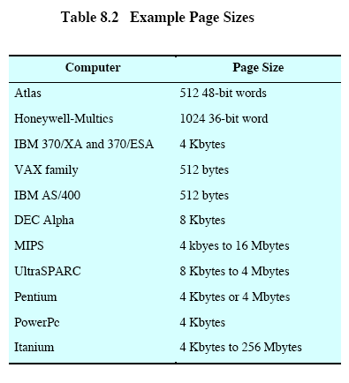
<number>

Slide 183
Paging
Frame Allocation
The page fault rate is also determined by the number of frames allocated to a process.
If the whole process is in memory, then page faults are zero.
If only one page is in memory, then each new page request results in a page fault.
<number>

Slide 184
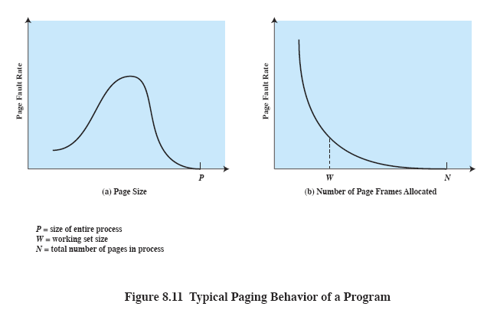
<number>

Slide 185
Segmentation
Segmentation
Segmentation is similar to paging but without a fixed size.
Addresses consist of a segment number and offset.
Program segments are determined by the programmer (unlike pages which are determined by the OS).
Benefits include:
Ease of handling growing data structures (simply increase segment size)
Modularity by assigning each module to a segment
Sharing and protection can be set per segment
<number>

Slide 186
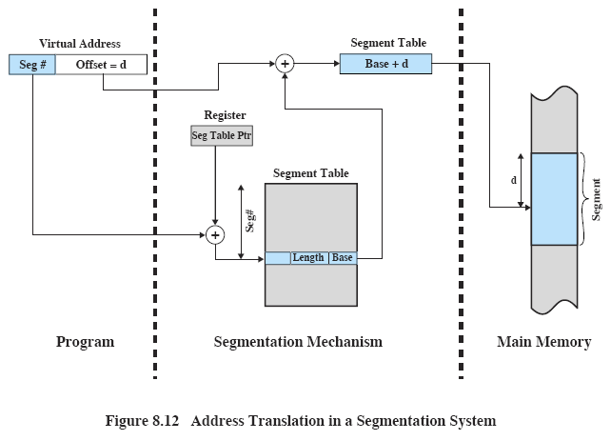
<number>

Slide 187
Segmentation
Combined Segmentation and Paging
Segmentation can be combined with paging.
The logical address is segment plus offset, but the offset is viewed as a page number and offset.
The segment number is used as an index into the segment table.
There it finds the address of a page table for the segment.
Now the page is used to index the page table to get the frame number.
Now physical memory can be accessed as frame and offset.
This offers advantages of both schemes.
<number>

Slide 188
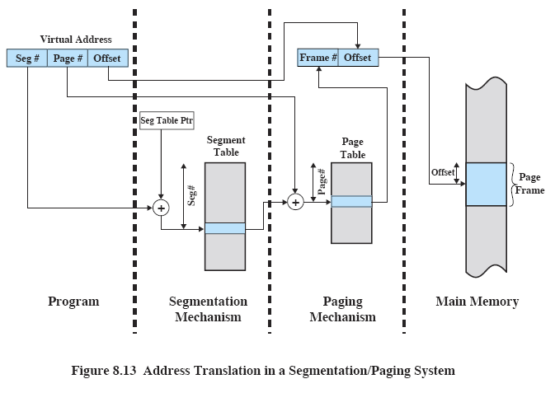
Page table ptr
for this segment
<number>

Slide 189
Operating System Software
In regards to the memory management software in the OS, there are three basic areas of choice:
Whether to use virtual memory
Whether to use paging, segmentation, or both.
What algorithms to use for various aspects of the memory management.
<number>

Slide 190
Operating System Software
Today, most operating systems use virtual memory with paging or a combined approach (segmentation with paging).
Pure segmentation systems are rarely seen today.
Most of the issues of paging or segmentation with paging depend on the paging algorithms and policies in use.
The performance of any particular set of policies depends on the memory size, the relative speed of main and secondary memory, the size and number of processes, and the execution behavior of individual programs.
<number>

Slide 191
OS Policies
Fetch Policy
The fetch policy determines when a page should be loaded into memory.
Two approaches:
Demand paging:
Only bring in a page when it is referenced. Results in high page faults at first, but low once most needed pages are loaded (due to locality).
Prepaging:
Bring in more pages than the actual page that was referenced (due to locality).
This makes efficient use of the disk drive since if the disk is already reading a page, it can continue to read pages in the same disk access.
<number>
Notes:
<number>

Slide 192
OS Policies
Placement Policy
Where should a page be placed?
If there are free frames, then it doesn’t matter since all frames are the same.
<number>

Slide 193
OS Policies
Replacement Policy
Try to replace the page that is least likely to be referenced in the near future.
Due to locality, recent references often imply near-future references.
Simplicity is desirable to keep the overhead of the replacement decision low.
<number>

Slide 194
Replacement Policy
Frame Locking
Complicating the replacement policy is the fact that some frames may be locked to keep the OS from swapping them.
Parts of the OS often reside in locked frames, as may OS control structures, I/O buffers and other time-critical areas of a program.
Replacement algorithms should not attempt to replace a locked frame.
<number>

Slide 195
Replacement Policy
Replacement Algorithms
Optimal
Least Recently Used (LRU)
First-in-first-out (FIFO)
Clock
<number>

Slide 196
Replacement Policy
Optimal
Select page to replace whose time to the next reference is the longest.
Can’t be implemented (requires exact knowledge of future events).
Serves as a standard for measuring other algorithms.
<number>

Slide 197
Replacement Policy
Least Recently Used (LRU)
Replaces the page that has not been referenced for the longest time.
Performs almost as well as the optimal policy due to locality principle.
Hard to implement due to need to time-stamp each page on every memory reference.
<number>

Slide 198
Replacement Policy
First-in-first-out
Replace page that has been in memory the longest since that page may now have fallen out of use.
May or may not hold true.
Easy to implement (can move pointer through ordered list of pages, as a circular buffer).
<number>

Slide 199
Replacement Policy
Clock Policy
Attempts to implement LRU policy with low overhead.
Use a bit for each frame called a “use bit”.
Set to 1 on first load of page and each time page is referenced.
Goes through pages in a circular buffer looking for pages set to 0 to replace.
As it searches, each page with a 1 is set back to 0. If all are 1, then all are set to 0.
Can be improved by using more than 1 bit.
<number>

Slide 200
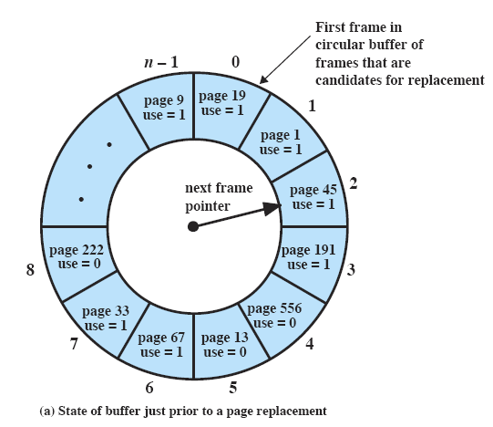
<number>

Slide 201

<number>

Slide 202

* = use bit set to 1
<number>

Slide 203

<number>

Slide 204
Replacement Policy
Page Buffering
LRU and clock are superior to FIFO, but they both have more complexity and overhead.
FIFO can be improved through a technique called page buffering.
A replaced page is not lost but rather reassigned to one of two lists: the free page list or the modified page list.
The page is not physically removed from memory.
If the process references this page again, it can be added back quickly.
In effect, the free and modified page lists act as a cache of pages.
This can reduce the impact of a poor replacement choice.
<number>

Slide 205
Resident Set
Resident Set Size
How many pages of a process should be loaded?
Three considerations:
The fewer the pages, the more processes can be loaded.
Too few pages results in high page faults.
Too many pages reduces the number of processes and doesn’t reduce page faults noticeably.
<number>

Slide 206
Resident Set
Resident Set Size
Two approaches:
Fixed-allocation: process is given a fixed set of pages within which to operate.
Variable-allocation: process is given a variable number of pages as it runs. Can be allocated according to page fault rates. (Better, but higher overhead).
<number>

Slide 207
Resident Set
Replacement Scope
Local replacement
Choose among a process’s own resident pages to replace.
Global replacement
Choose among any process’s resident pages to replace.
<number>

Slide 208
Resident Set
Replacement Scope
Fixed Allocation, Local Scope
Variable Allocation, Global Scope
Variable Allocation, Local Scope
Note that a Fixed Allocation with Global Scope would not make sense, because it must always replace its own page to keep its fixed allocation size from changing.
<number>

Slide 209
Resident Set
Working Set Strategy of Frame Allocation
In a variable allocation local scope strategy, we may want to tune the number of frames allocated as the process runs.
Over a period of time, the pages a process uses stabilizes due to the locality principle, called the working set of pages.
An OS might attempt to keep the resident set to match the working set.
The working set strategy does this by keeping the set of pages that have been referenced in the previous units of time.
Comparable results can be achieved by monitoring the page fault rate of a process.
<number>

Slide 210
Sequence of
page references
Window size,
2 3 4 5
24
15
18
23
24
17
18
24
18
17
17
15
24
17
24
18
24
24 15
15 18
18 23
23 24
24 17
17 18
18 24
.
18 17
17
17 15
15 24
24 17
.
24 18
24
24 15
24 15 18
15 18 23
18 23 24
23 24 17
24 17 18
.
18 24
24 18 17
18 17
17 15
17 15 24
.
24 17
17 24 18
24
24 15
24 15 18
24 15 18 23
.
18 23 24 17
.
24 17 18
.
.
.
18 17 15
17 15 24
.
.
17 24 18
24
24 15
24 15 18
24 15 18 23
.
15 18 23 24 17
18 23 24 17
.
24 17 18
.
.
24 18 17 15
.
17 15 24
.
15 17 24 18
<number>

Slide 211
Resident Set
Cleaning Policy
When should a modified page be written back to secondary storage?
Two approaches:
Demand Cleaning: only write page out when it is chosen for replacement. Delays the writing until necessary, but slows the processing of a page fault since the page must first be written before a new one is loaded.
Precleaning: write page out before it is chosen for replacement so that pages may be written out in batches for efficient use of the disk drive. May result in unnecessary writes since the page may be modified again.
<number>

Slide 212
Cleaning Policy
Page buffering can help with the cleaning policy by keeping two lists, one for modified pages and one for unmodified pages.
When a modified page is chosen for replacement, it is added to the list of modified pages.
The modified page list can be periodically written out in batches and added to the unmodified list.
This is a good compromise between demand cleaning and precleaning, since only pages chosen for replacement are cleaned, but the cleaning takes place at a later time in groups as with precleaning.
<number>

Slide 213
Load Control
Load Control
How many processes should run at a time?
Too few and CPU may not be utilized enough.
Too many and thrashing may occur due to too few pages per process in memory.
<number>

Slide 214

<number>

Slide 215
End of Slides
based on Stalling's official slides
<number>

