Slide 1
Jumper Virtual Lab
Installation and first steps

Slide 2

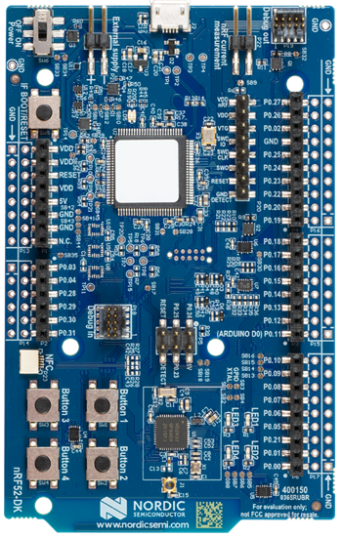
What is Jumper Virtual Lab?
Jumper Virtual Lab is a simulation enviroment for MicroController Units (MCUs).
It currently support two different MCU platforms:
NUCLEO-F411RE
Nordic nRF52 DK
Target platform for this lab!

Slide 3



Installation
What will you need:
To create a new enviroment with conda simply run in a terminal instance the following commands:
Python 2.7.13: (unfortunately the simulator only support the old python version).
$ conda create --name jumper-vlab python=2.7.13
$ conda activate jumper-vlab
Conda: We suggest to create a virtual enviroment with such intepreter using conda. Conda installers and documentation can be found at conda_doc.
Jumper vlab
Within the conda already created enviroment simply run:
$ pip install jumper matplotlib --upgrade
Solve Macos backend: https://stackoverflow.com/questions/34977388/matplotlib-runtimeerror-python-is-not-installed-as-a-framework

Slide 4


What you need to run simulations
An hex or bin file containing the binaries associated to the code that we want to simulate.
A scenario.json file containing data generators that emulates the external environment.
A python script used to guide the simulation.
A board.json file containing informations about the board used and eventual external pheriperals or sensors. The file also states the connections between the different elements.

Slide 5
Hex file generation
The code is based upon the Mbed OS by ARM.
A basic example of source code can be found at https://os.mbed.com/users/matteorisso/code/time_wave/
This is not the same code used to generate the 2 Lab workloads, it’s just an example…
IMPORTANT: the Jumper simulator does not allow to monitor if the CPU is active or inactive:
Inactive = waiting due to a sleep() system call, waiting for an interrupt, etc.
So, the example code toggles a GPIO pin (LED) before/after each inactive period, to “notify” the simulator of the state change.

Slide 6
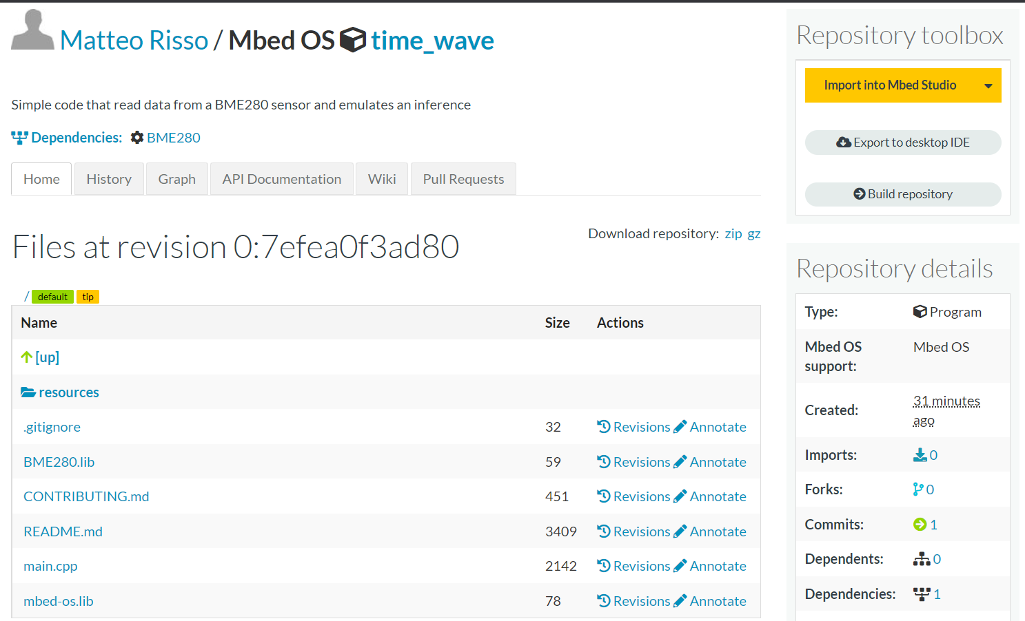
Hex file generation
The code is based upon the Mbed OS by ARM
A basic example of source code can be found at https://os.mbed.com/users/matteorisso/code/time_wave/
Click on the black triangle on the right.
Source code

Slide 7
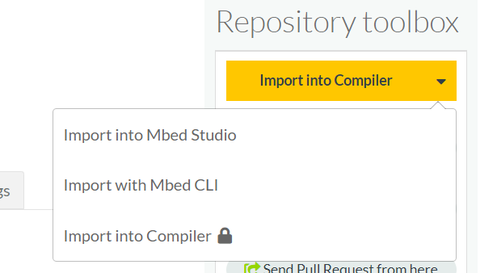
Hex file generation (cont’d)
The code is based upon the Mbed OS by ARM
A basic example of source code can be found at https://os.mbed.com/users/matteorisso/code/time_wave/
Source code
Click on Import into Compiler.
NB: you have to create an account

Slide 8
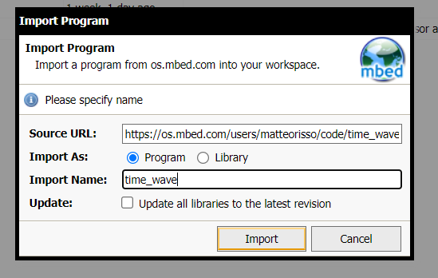
Hex file generation (cont’d)
The code is based upon the Mbed OS by ARM
A basic example of source code can be found at https://os.mbed.com/users/matteorisso/code/time_wave/
Give a sensible name to the program.
Click Import

Slide 9
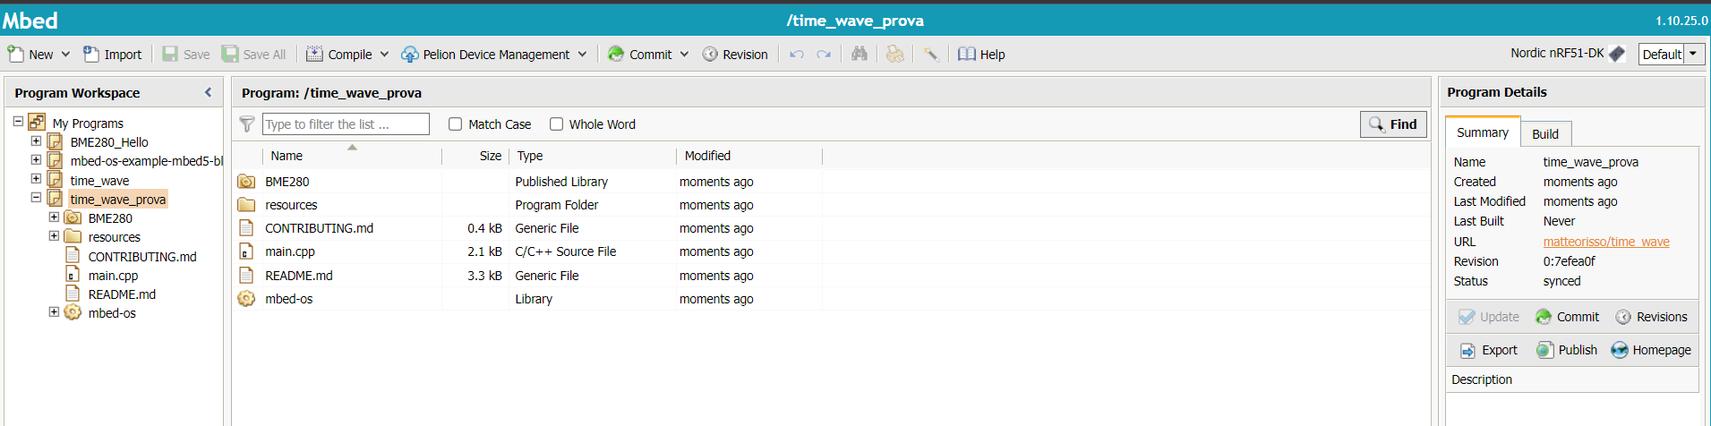
Hex file generation (cont’d)
The code is based upon the Mbed OS by ARM
A basic example of source code can be found at https://os.mbed.com/users/matteorisso/code/time_wave/
Target platform.
Always check that is Nordic nRF51-DK
From this panel you can edit and navigate files
Run Compile to generate the Hex file.

Slide 10

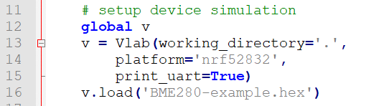

Simulation Python Script
Simulation library
Create simulation object
Load Hex file
On every GPIO event a callback function is called and a timestamp saved.
This is used to keep track of the activity waveform in the time_stamp list.

Slide 11
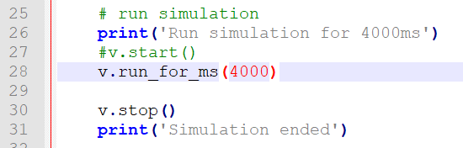
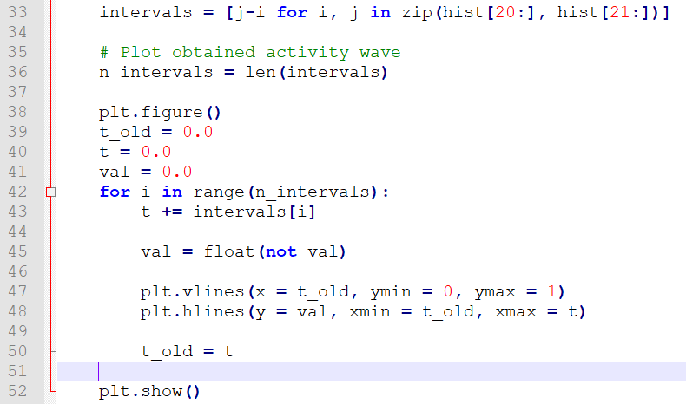
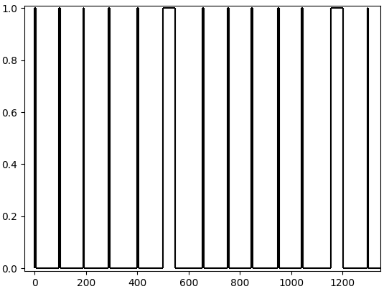
Simulation Python Script (cont’d)
Run simulation for 4000ms
Stop simulation.
Plot activity wave.

Slide 12
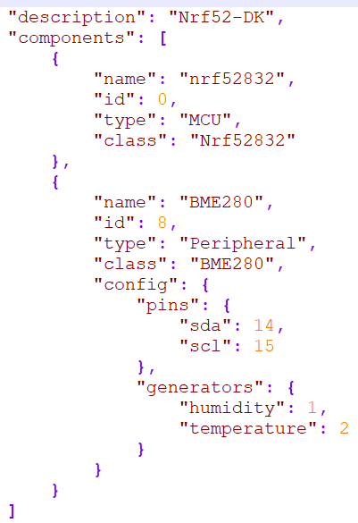
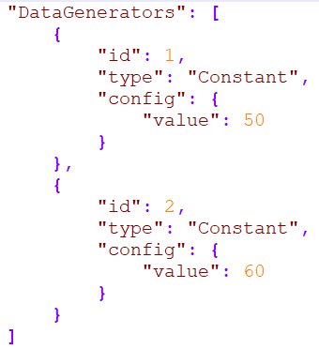
board.json and scenario.json files
board.json
Board.
scenario.json
Temperature and humidity sensor.
Board to sensor connection with I2C.
Humidity and temperature syntethic data generators

