Slide 1

Introduction of MySQL :
MySQL is an open-source Relational Database Management System (RDBMS) used to store, organize, and manage structured data in the form of tables. It uses Structured Query Language (SQL) to perform operations such as inserting, updating, deleting, and retrieving data efficiently. MySQL is widely used in web applications, business software, and backend systems because it can handle large amounts of data securely and quickly.
In the field of data analysis, MySQL plays an important role as a data storage system. Analysts use SQL queries to filter data, perform calculations, group records, and join multiple tables to extract meaningful information. This prepared data is then imported into tools like Python, Excel, Power BI, or other BI platforms for deeper analysis and visualization. By using MySQL, organizations can manage their data properly and make accurate, data-driven decisions.

Slide 2

Problem 1 — Salary Expense Report
“The total salary expense for each department, including base salary, bonus, overtime, and commission.”
Problem 2 — High Performers List
“I want a list of employees whose performance score is greater than 8.”
Problem 3 — Longest Working Employees
“Show me the top 5 employees who have been working in the company for the longest time.”
Problem 4 — City-wise Employee Distribution
“How many employees are working in each city.”

Slide 3
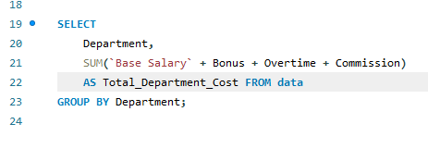
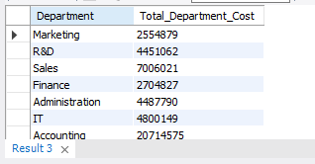
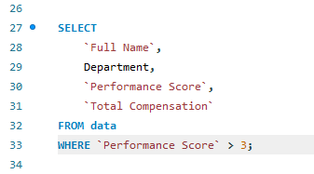
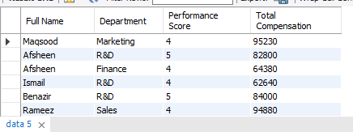

Slide 4
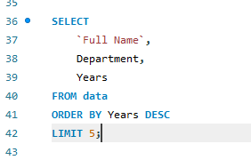
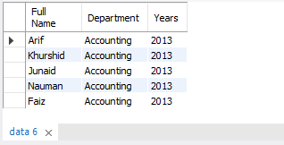
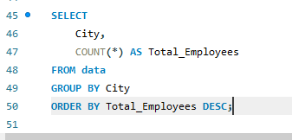
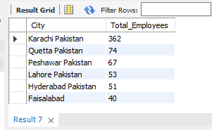

Slide 5
Problem 2 – Filter by Department
Retrieve all employees working in the HR department.
Problem 3 – Sort by Salary
List employees in descending order of their Salary.
Problem 4 – Department IT
Select all Employes Where Department is IT
Problem 1 — Name Start from “A”
Employs name start from “A”

Slide 6
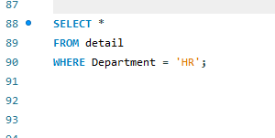
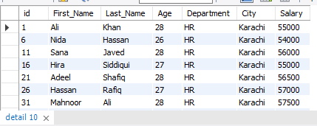
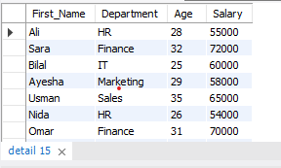
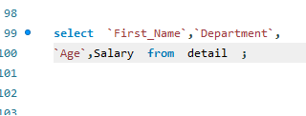

Slide 7
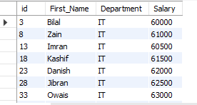
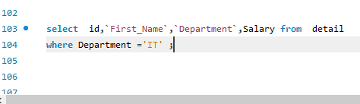
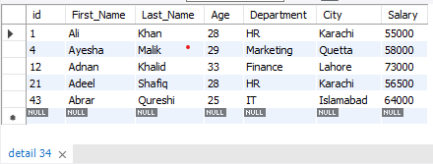
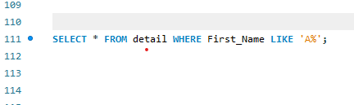

Slide 8

Python for Data Analysis
Python is a versatile, high-level programming language that is widely appreciated for its simplicity, readability, and flexibility. Its ease of use makes it suitable for both beginners and experienced developers, and it is employed across multiple domains, including web development, software engineering, automation, artificial intelligence, machine learning, and data analysis.
In the field of data analysis, Python is particularly powerful due to its rich ecosystem of libraries:
Pandas: Provides efficient tools for data manipulation, cleaning, and transformation.
NumPy: Supports fast numerical computations and advanced mathematical operations.
Matplotlib & Seaborn: Enable clear and customizable data visualizations.
These libraries allow analysts to handle large datasets, perform complex calculations, and generate meaningful insights. Python empowers organizations to make data-driven decisions by simplifying the process of analyzing and visualizing data, ultimately supporting smarter business strategies.

Slide 9
Problem1 – Total Sales by Payment Method
Calculate the total sales for each payment method and display the results.
Problem 1 – Top 5 Categories by Total Sales
List the top 5 product categories with the highest total sales.
Problem 2 – Top 5 Customers by Total Sales
List the top 5 customers who have generated the highest total sales.
Problem 3 – Top 5 Customer Locations by Total Sales
List the top 5 customer locations with the highest total sales.

Slide 10

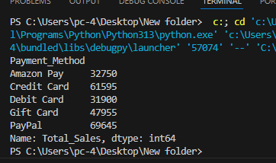
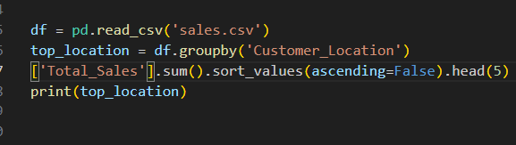
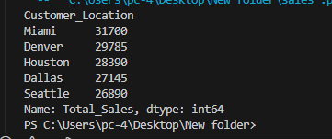

Slide 11
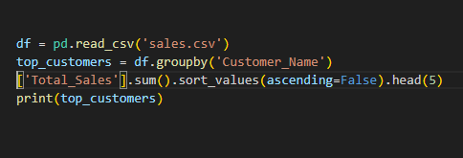
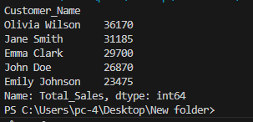
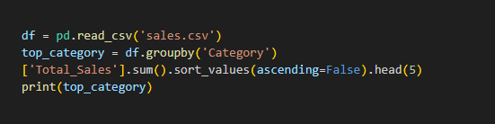
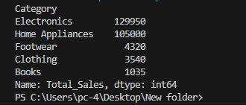

Slide 12
Problem1 : Top Performing Students
Identify the top 10 students based on their overall average score
Problem 2: Gender Performance Comparison
Compare subject performance between male and female students.
Problem 3: Impact of Weekly Study Hours on Scores
Analyze how study time affects performance.
.
Problem 6: Subject-wise Highest Score
Find the student who scored the highest in each subject

Slide 13
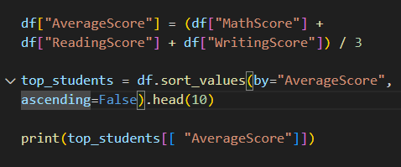
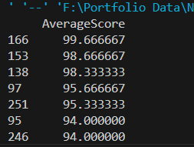
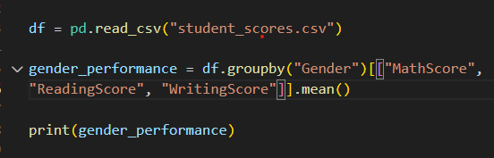
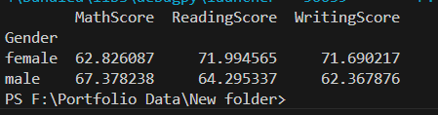

Slide 14

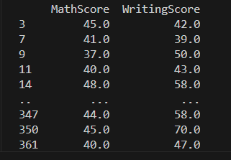

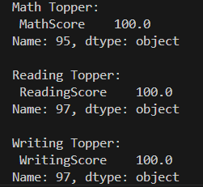

Slide 15

Power BI Introduction
Power BI is a business intelligence and data visualization tool developed by Microsoft that helps organizations analyse data and share insights through interactive reports and dashboards. It connects to multiple data sources such as Excel, databases, cloud services, and online platforms, allowing users to collect, transform, and model data in one place. Power BI uses features like Power Query for data cleaning and DAX (Data Analysis Expressions) for calculations and data modelling.
In the field of data analysis, Power BI is used to convert raw data into meaningful visual insights through charts, graphs, maps, and KPI’s. Analysts use it to track performance, identify trends, and support decision-making processes. Its real-time data updates and user-friendly interface make it suitable for both technical and non-technical users. By using Power BI, organizations can make faster, smarter, and data-driven business decisions.

Slide 16
Workforce Analytics & Performance Overview
Overall, the dashboard analysis highlights that the organization’s workforce and compensation structure are heavily concentrated in Customer Support and the Karachi region, reflecting a service-oriented and centralized operational model. While the Accounting department demonstrates the highest performance levels, variations in performance scores and leave patterns across departments indicate opportunities for targeted training, workload optimization, and improved performance management frameworks. The compensation structure is largely fixed-salary driven, suggesting financial stability for employees; however, the relatively lower proportion of performance-based incentives such as bonuses and overtime may limit motivation and productivity gains. Furthermore, the concentration of HR expenditure in a single city points to potential benefits of regional expansion and more balanced resource allocation. Overall, these insights provide a strong foundation for strategic decision-making aimed at enhancing operational efficiency, employee engagement, and sustainable organizational growth.

Slide 17
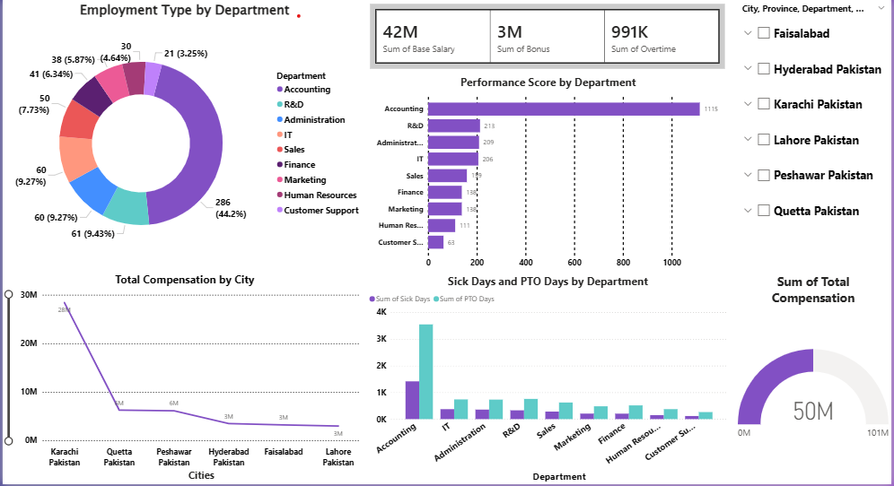

Slide 18
Coffee Sales Performance Dashboard
Overall, the Coffee Sales dashboard provides a comprehensive view of business performance across revenue, product mix, store contribution, and sales volume. The analysis clearly indicates that Coffee remains the primary revenue and volume driver, with Tea and Bakery serving as key supporting categories. Store-level performance differences highlight the impact of location and customer footfall on sales outcomes, suggesting the need for targeted, store-specific strategies to uplift underperforming outlets. The consistency in average pricing, combined with strong transaction volumes, reflects stable demand and effective pricing policies. These insights support data-driven decision-making in areas such as product portfolio optimization, inventory management, store performance improvement, and strategic sales growth planning.

Slide 19
