Slide 1
Project Title:
“LADS” (License Authorization and Driver’s Safety)
Team Name:
Y-Axis

Slide 2
Theme : Prevent Accidents due to unauthorized drivers and drowsy driving
Due to unauthorized drivers
46% of road accidents are due to unauthorized drivers i.e, teenagers
Due to drowsy driving
According to “The National Highway Traffic Safety Administration ”.
72,000 crashes
44,030 injuries Avg- 6,142 Fatal Crashes
831 deaths

Slide 3
Did you know that most of the accidents occur because of unlicensed drivers. And has a small factor that consists dizziness, so to tackle this problem we have created a solution.
Technologies Used: Python, Computer Vision, Deep learning with pre-trained models using Reinforcement learning, D-lib (face recognition)

Slide 4


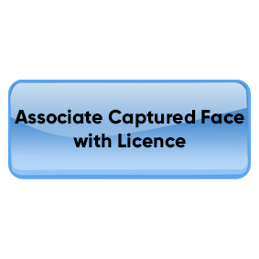

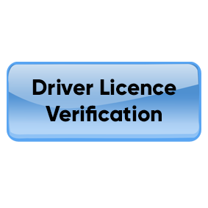
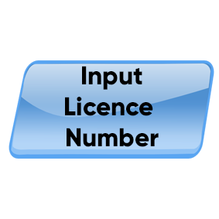

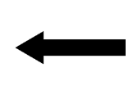





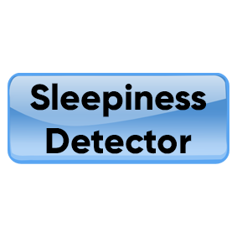

Solution
Not Verified
False
True
True

Slide 5
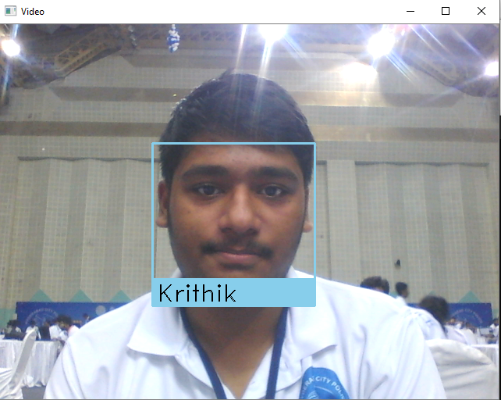
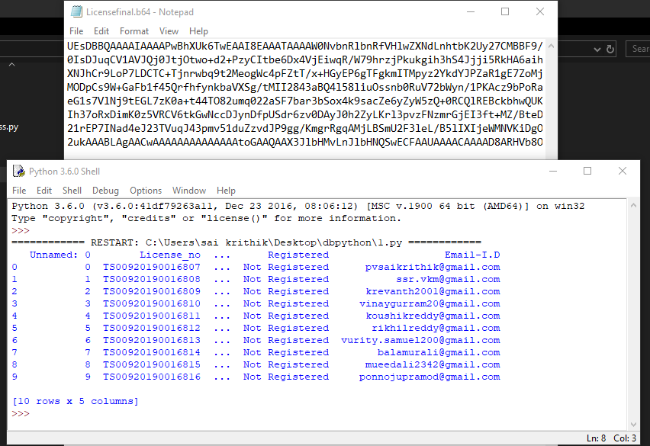

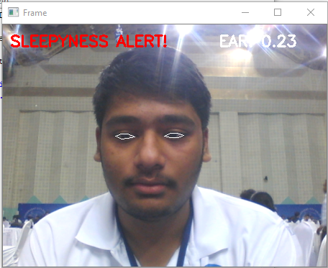
Product Screenshots

Slide 6
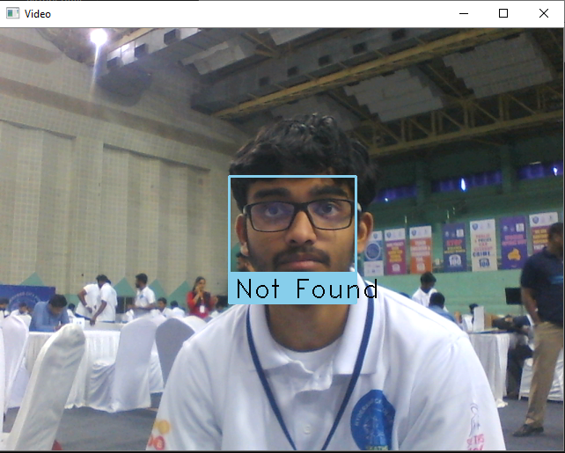
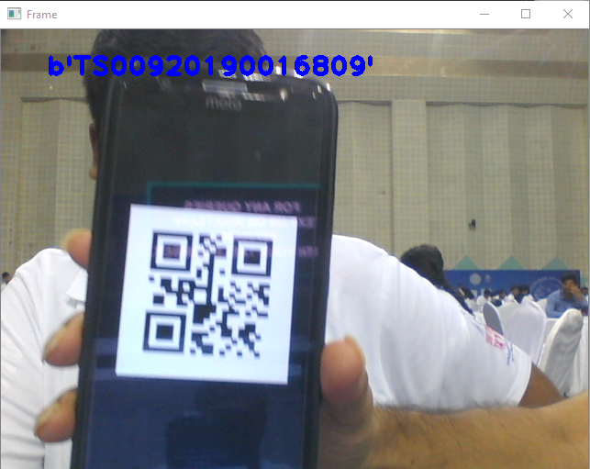
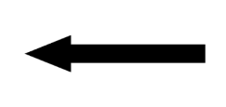
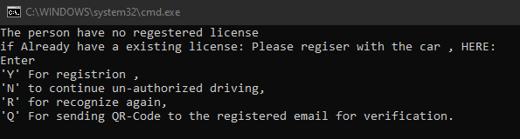
Product Screenshots

Slide 7
Existing solutions:
Driver distraction and drowsiness detection system – Dcube
Major Differences between the models:
Faster Image Processing with accuracy of 0.96 Frames Per Second
Extra features like:
Licence Authorization with Data Encryption
https://www.geeksforgeeks.org/project-idea-driver-distraction-and-drowsiness-detection-system-dcube/

Slide 8
DECK:
Price | Description
Rs.5,500 /- | For personal use Uses local Database One-Time purchase
Rs.4,500/- | For organizations Uses local Database No Cloud Database provided No maintenance services provided One-Time purchase
Rs.4,500/- + Rs.500/- (Monthly Subscription) | For organizations Provides dedicated Cloud Servers Maintenance services and updates are provided.

