Slide 1
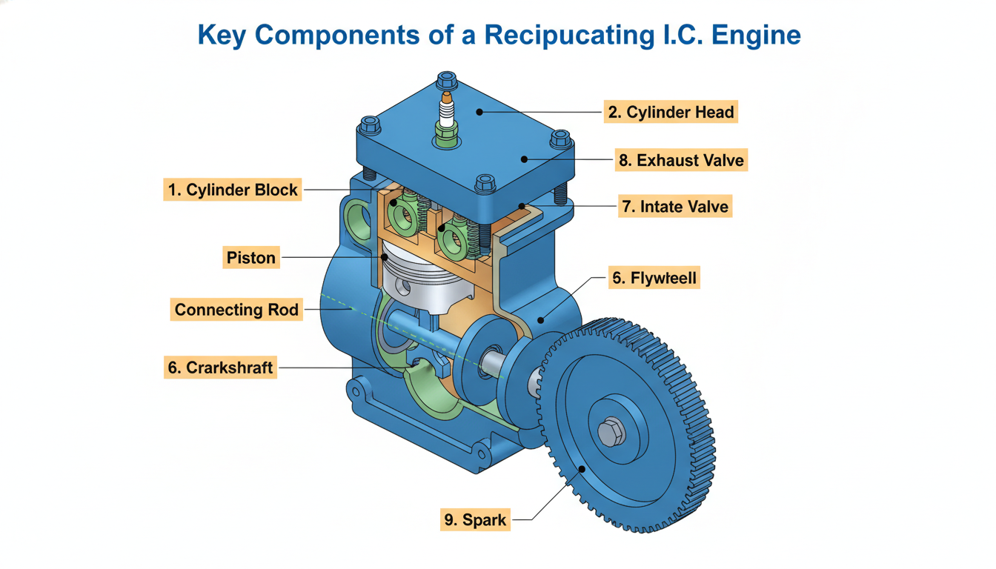
Key Components of a Reciprocating I.C. Engine
1 / 26

Slide 2
4-Stroke Petrol Engine: Suction Stroke
📊 During the suction stroke, the inlet valve opens, the piston moves downwards, and a vacuum is created, drawing the air-fuel mixture into the cylinder.
2 / 26

Slide 3
4-Stroke Petrol Engine: Compression Stroke
3 / 26

Slide 4
4-Stroke Petrol Engine: Power (Expansion) Stroke
4 / 26

Slide 5
Complete P-V Diagram for a 4-Stroke Petrol Engine (Otto Cycle)
5 / 26

Slide 6
📝 Example: Calculating Compression Ratio for a Bajaj Pulsar Engine
Problem: Given: Cylinder bore = 63.5 mm, Stroke length = 62.2 mm, Clearance volume = 10.5 cm³. Find: Compression Ratio.
Step 1: Convert units: Bore = 6.35 cm, Stroke = 6.22 cm.
Step 2: Swept volume (Vs) = (π/4) × Bore² × Stroke = (π/4) × (6.35)² × 6.22 = 196.7 cm³.
Step 3: Total volume (Vt) = Vs + Vc = 196.7 cm³ + 10.5 cm³ = 207.2 cm³.
Step 4: Compression Ratio (CR) = Vt / Vc = 207.2 cm³ / 10.5 cm³ = 19.73.
✓ The compression ratio for the engine is approximately 19.73:1.
6 / 26

Slide 7
✏️ Practice Question
1
Which of the following sequences correctly represents the four strokes of a 4-stroke engine?
A. Intake, Exhaust, Compression, Power
B. Intake, Compression, Power, Exhaust
C. Compression, Intake, Power, Exhaust
D. Power, Intake, Compression, Exhaust
Answer: B. The correct sequence is Intake (suction), Compression, Power (expansion), and Exhaust.
7 / 26

Slide 8
Working Principle: The Four Strokes of a Diesel Engine
Intake Stroke: Piston moves down, air is drawn into the cylinder through the intake valve.
Compression Stroke: Piston moves up, compressing the air, raising its temperature significantly.
Power Stroke: Fuel is injected and ignites due to high air temperature, forcing the piston down.
Exhaust Stroke: Piston moves up, expelling combustion gases through the exhaust valve.
Diesel engines use compression ignition, where fuel ignites from high air temperature, not a spark plug.
💡 Real world: Mahindra Bolero engines use this principle for robust power delivery.
8 / 26

Slide 9
4-Stroke Diesel Engine: Suction Stroke
9 / 26

Slide 10
4-Stroke Diesel Engine: Compression Stroke
📊 During the compression stroke, both intake and exhaust valves are closed, and the piston moves upward, compressing the air inside the cylinder and increasing its temperature.
10 / 26

Slide 11
4-Stroke Diesel Engine: Power (Expansion) Stroke
11 / 26

Slide 12
4-Stroke Diesel Engine: Exhaust Stroke
12 / 26

Slide 13
Working Principle: The Two Strokes of a Petrol Engine
Upward Stroke (Compression & Exhaust): Piston moves up, compressing the fresh charge and expelling exhaust.
Downward Stroke (Power & Intake): Piston moves down, generating power and drawing fresh charge into the crankcase.
Both intake and exhaust ports are briefly open simultaneously during scavenging.
A mixture of petrol and air is pre-mixed and drawn into the crankcase.
Spark plug ignites the compressed charge, initiating the power stroke.
💡 Real world: Small scooters like TVS XL100 often use 2-stroke engines for simplicity.
13 / 26

Slide 14
2-Stroke Petrol Engine: Upward Stroke (Compression & Suction)
14 / 26

Slide 15
Working Principle: The Two Strokes of a Diesel Engine
Upward Stroke (Compression): Piston moves up, compressing the air in the cylinder.
Downward Stroke (Power & Scavenging): Piston moves down, fuel is injected and ignites, exhaust ports open.
Air is forced into the cylinder by a blower during the scavenging phase to clear exhaust gases.
Fuel injection occurs near the end of the compression stroke, igniting due to high air temperature.
No separate intake valve; air enters through ports uncovered by the piston.
💡 Real world: Large marine engines and some heavy-duty trucks utilize 2-stroke diesel designs.
15 / 26

Slide 16
2-Stroke Diesel Engine: Upward Stroke (Compression)
16 / 26

Slide 17
2-Stroke Diesel Engine: Downward Stroke (Power & Scavenging)
17 / 26

Slide 18
Comparison: 2-Stroke vs. 4-Stroke Engines
2-Stroke: Completes power cycle in one crankshaft revolution (two strokes).
4-Stroke: Completes power cycle in two crankshaft revolutions (four strokes).
2-Stroke: Higher power-to-weight ratio, simpler construction, fewer moving parts.
4-Stroke: Better fuel economy, lower emissions, longer engine life.
2-Stroke: Lubrication by mixing oil with fuel, leading to higher oil consumption.
4-Stroke: Separate lubrication system (sump), reducing oil consumption and emissions.
💡 Real world: 2-stroke engines are common in scooters like TVS XL100.
18 / 26

Slide 19
Comparison: Petrol (Spark Ignition) vs. Diesel (Compression Ignition) Engines
Petrol Engine: Uses a spark plug to ignite the air-fuel mixture.
Diesel Engine: Ignites fuel by compressing air to a high temperature.
Petrol Engine: Operates on Otto cycle, typically uses lower compression ratios.
Diesel Engine: Operates on Diesel cycle, uses higher compression ratios.
Petrol Engine: Uses carburettor or fuel injection for air-fuel mixing.
Diesel Engine: Fuel is injected directly into the cylinder at high pressure.
💡 Real world: Most cars in India, like Maruti Swift, use petrol engines.
19 / 26

Slide 20
Efficiency of I.C. Engines: Key Performance Metrics
Thermal Efficiency: Ratio of useful work output to total heat input from fuel.
Mechanical Efficiency: Ratio of brake power to indicated power.
Volumetric Efficiency: Ratio of actual air drawn in to the swept volume.
Brake Power (BP): Actual power available at the crankshaft for useful work.
Indicated Power (IP): Power developed inside the engine cylinder.
Specific Fuel Consumption (SFC): Fuel consumed per unit of power output.
💡 Rule: Higher efficiency means more work from less fuel.
20 / 26

Slide 21
Thermal Efficiency: Definition and Calculation
Thermal efficiency (η_th): Measures how effectively an engine converts fuel energy into mechanical work.
It is the ratio of the net work output to the total heat supplied by the fuel.
Formula: η_th = (Work Output / Heat Input) × 100%.
Work Output: Can be brake power or indicated power, depending on the context.
Heat Input: Calculated as mass of fuel consumed multiplied by its calorific value.
Higher thermal efficiency implies better fuel utilization and lower operating costs.
η_th = (Work Output / Heat Input) × 100%.
💡 Rule: Carnot cycle sets the theoretical maximum thermal efficiency.
21 / 26

Slide 22
📝 Example: Calculating Thermal Efficiency of a Mahindra Bolero Engine
Problem: Given: Brake power = 30 kW, Fuel consumption = 10 kg/hr, Calorific value = 42 MJ/kg. Find: Thermal efficiency.
Step 1: Convert fuel consumption to kg/s: ṁ_f = 10 kg/hr / 3600 s/hr = 0.002778 kg/s.
Step 2: Calculate heat input rate: Q_in = ṁ_f × CV = 0.002778 kg/s × 42 × 10^6 J/kg = 116676 J/s.
Step 3: Convert brake power to Watts: BP = 30 kW = 30000 W.
Step 4: Calculate thermal efficiency: η_th = (BP / Q_in) × 100% = (30000 / 116676) × 100% = 25.71%.
✓ The thermal efficiency of the engine is 25.71%.
22 / 26

Slide 23
✏️ Practice Question
2
An auto-rickshaw engine consumes 0.5 kg of fuel (calorific value 44 MJ/kg) per hour. It produces 5 kW of brake power. What is its brake thermal efficiency?
A. 8.18%
B. 10.23%
C. 12.50%
D. 15.00%
Answer: A. Fuel power = 0.5 kg/hr (1/3600 hr/s) 44 MJ/kg = 6.11 kW. Efficiency = (5 kW / 6.11 kW) * 100% = 8.18%.
23 / 26

Slide 24
Volumetric Efficiency: Definition and Importance
Volumetric efficiency: Ratio of actual air drawn into cylinder to theoretical volume.
Theoretical volume: Calculated based on engine's swept volume and number of strokes.
Factors affecting it: Intake manifold design, valve timing, exhaust back pressure.
Higher volumetric efficiency: More air enters, leading to better combustion and power.
Importance: Crucial for engine performance, especially in naturally aspirated engines.
💡 Real world: Turbochargers and superchargers are used in cars like Mahindra XUV700 to increase volumetric efficiency.
💡 Rule: Higher volumetric efficiency means more air, leading to more power output.
24 / 26

Slide 25
Mechanical Efficiency: Definition and Factors Affecting It
Mechanical efficiency: Ratio of brake power (output) to indicated power (input).
Indicated power: Power developed inside the cylinder by combustion of fuel.
Brake power: Actual power delivered at the crankshaft, available for useful work.
Frictional losses: Power lost due to friction between moving parts (piston, bearings).
Factors affecting it: Engine design, lubrication quality, operating temperature, engine speed.
Importance: Indicates how effectively an engine converts internal combustion power into usable power.
💡 Real world: Good quality engine oils like Castrol GTX reduce friction, improving mechanical efficiency and fuel economy.
💡 Rule: Mechanical efficiency accounts for all power losses within the engine itself.
25 / 26

Slide 26
Key Takeaways
I.C. Engines: Convert chemical energy of fuel into mechanical work.
2-Stroke Engines: Power stroke every revolution, simpler design, higher power-to-weight ratio.
4-Stroke Engines: Four strokes per cycle (intake, compression, power, exhaust), better fuel efficiency.
Petrol Engines: Use spark ignition, lower compression ratio, suitable for lighter vehicles.
Diesel Engines: Use compression ignition, higher compression ratio, better fuel economy.
Engine Efficiency: Thermal, volumetric, and mechanical efficiencies are key performance metrics.
Fuel Properties: Calorific value and ignition quality impact engine performance and emissions.
End of Basics of I.C. Engines
26 / 26

