Slide 1
AU-EXPORTS Stress Deck — Sample text मापदंड 🔬 with symbols: ∴ A ⊂ B, P ⇒ Q, da…
Mechanics of Vibrations
Damped Oscillations
1 / 7

Slide 2
Overview — Damped Oscillations
•
Unicode check: Sample text मापदंड 🔬 with symbols: ∴ A ⊂ B, P ⇒ Q, damping ζ and ξ, em—dash, café
•
2 / 7

Slide 3
Governing Equation
•
•
•
Plain unicode bullet: Sample text मापदंड 🔬 with symbols: ∴ A ⊂ B, P ⇒ Q, damping ζ and ξ, em—dash, café
3 / 7

Slide 4
RC Circuit (SVG)
📊 Simple RC low-pass diagram
4 / 7

Slide 5
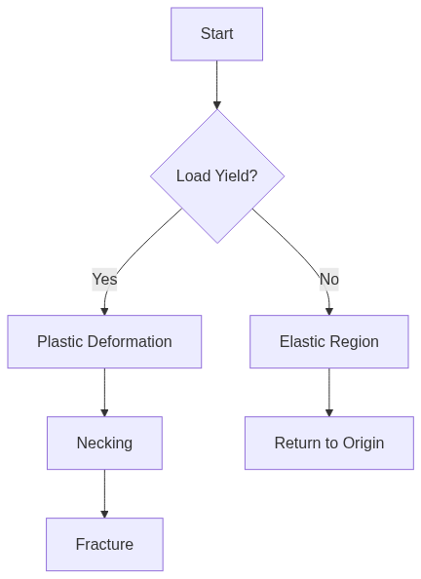
Fracture Decision Flow (Mermaid)
📊 Load vs deflection decision flow
5 / 7

Slide 6

📝 Worked Example
Step 2: Solve for constants
6 / 7

Slide 7

Key Takeaways
Unicode: Sample text मापदंड 🔬 with symbols: ∴ A ⊂ B, P ⇒ Q, damping ζ and ξ, em—dash, café
End of Damped Oscillations
7 / 7

