Slide 1


Enterprise Data Warehouse with
Google Cloud Platform
BigQuery
Prepared by: Darshana Dahanayake
Index : FGS/MDA/2021/030

Slide 2
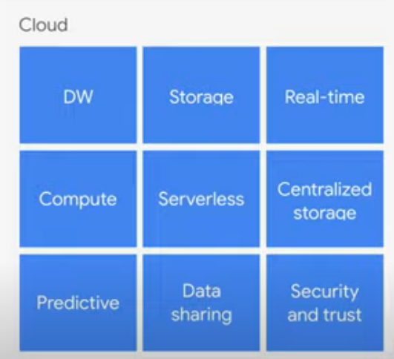
What is Google Big Query?
“BigQuery is fully-managed and cloud-based interactive Data Analytics as a Service (DAaaS) for massive datasets.”
Service for interactive analysis for massive datasets (peta-byte)
Query billions of rows: second to write, second to return
Uses a SQL style query syntax
It’s a service, accessed by a RESTful API
Reliable and secured
Data is fully encrypted. Goolge managed keys or customer keys
Secured through Access Control List
Replicated across multiple sites
Scalable
Store hundreds of peta-bytes, exabytes
Pay as you go
Fast
Run ad hoc queries on multi-petabyte datasets in seconds
Real time and Streaming data

Slide 3
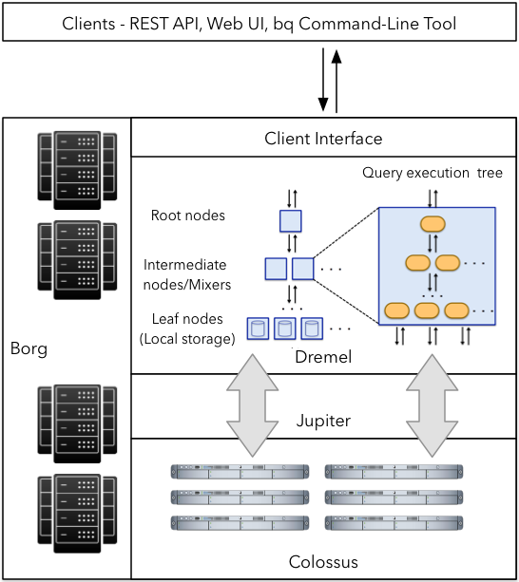
Big Query Architecture
Tree Architecture
Root server:
Receive query + table meta data
Rewrites the queries
Send queries to the next level
Return final query results
Intermediate servers:
Similar steps
Parallel partial aggregation
Leaf servers:
Actual scan(parts) of the table
Send data to intermediate servers

Slide 4
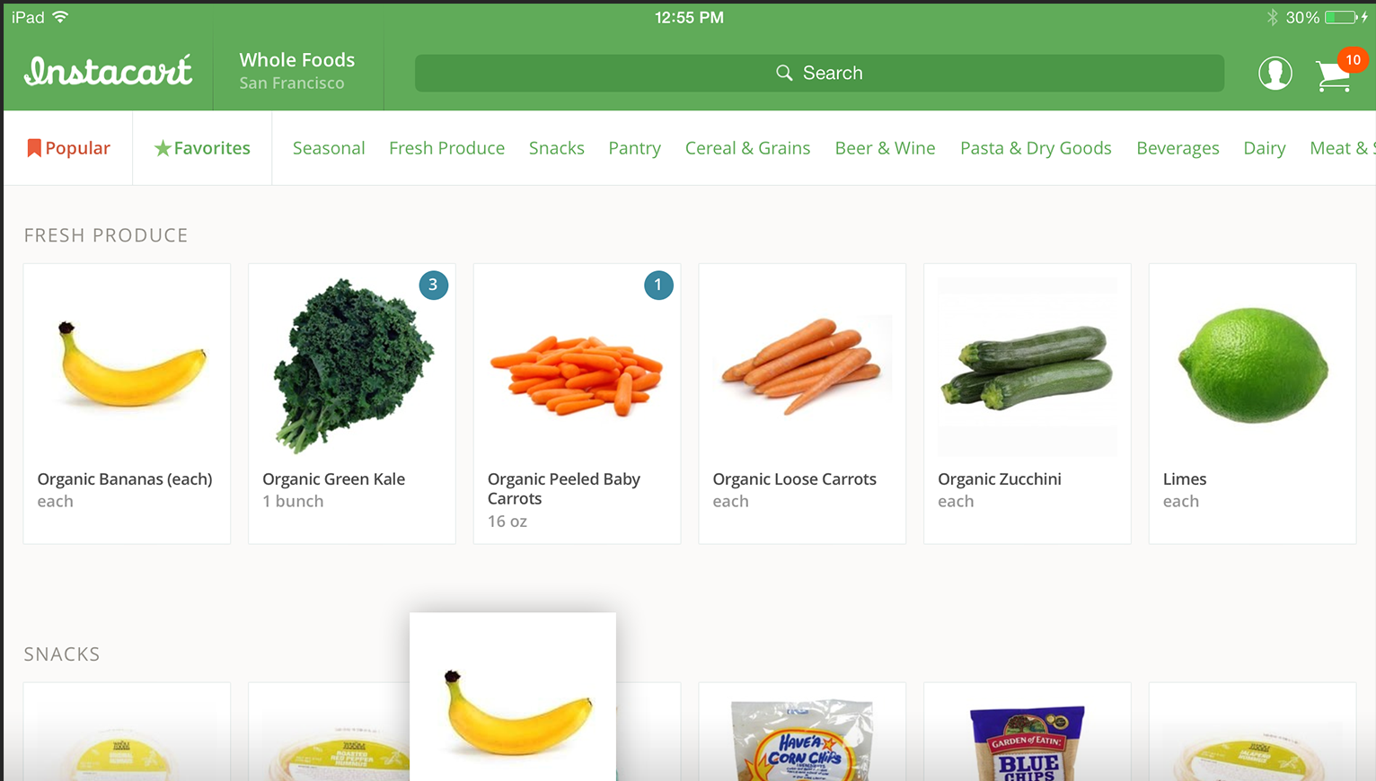
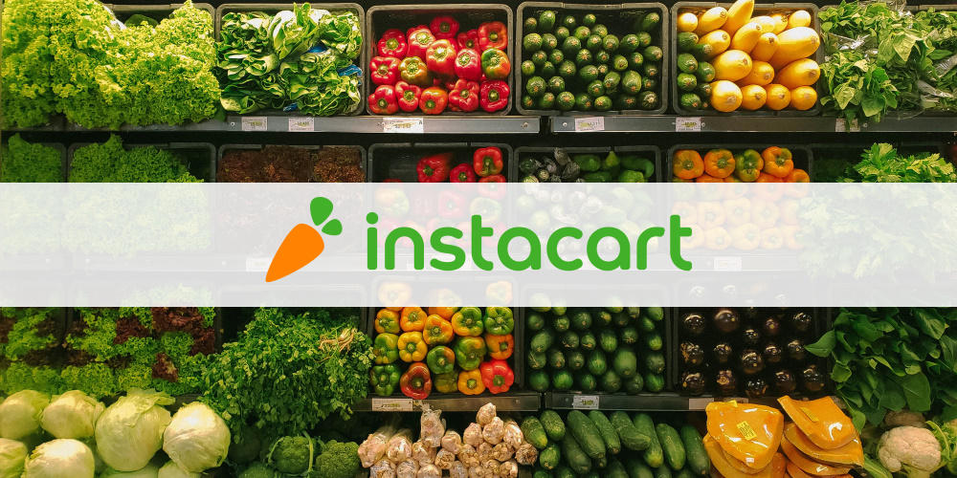
MDA MDAN 54053 - Use Case
Instacart market basket analysis public dataset from Kaggle
The dataset is anonymized and contains a sample of over 3 million grocery orders from more than 200,000 Instacart users. For each user, Instacart provide between 4 and 100 of their orders, with the sequence of products purchased in each order. We also provide the week and hour of day the order was placed, and a relative measure of time between orders.
Sources:
https://www.kaggle.com/c/instacart-market-basket-analysis/data
https://www.instacart.com/

Slide 5
Data Warehouse Design
Topology - Star schema
Dim_departments
Dim_aisle
aisle_SK
aisle_id
aisle
department_SK
department_id
Department
Dim_products
product_SK
product_id
product_name
aisle_id
department_id
Dim_date
Fact_sales
DateNum
Date
YearMonthNum
Calendar_Quarter
MonthNum
MonthName
MonthShortName
WeekNum
DayNumOfYear
DayNumOfMonth
DayNumOfWeek
DayName
DayShortName
Quarter
YearQuarterNum
DayNumOfQuarter
order_SK
product_SK
department_SK
aisle_SK
order_id
user_id
product_name
department
Aisle
order_hour_of_day
Date
Dim_orders
order_SK
order_id
user_id
eval_set
order_number
order_dow
order_hour_of_day
days_since_prior_order
product_id
purchase_date

Slide 6
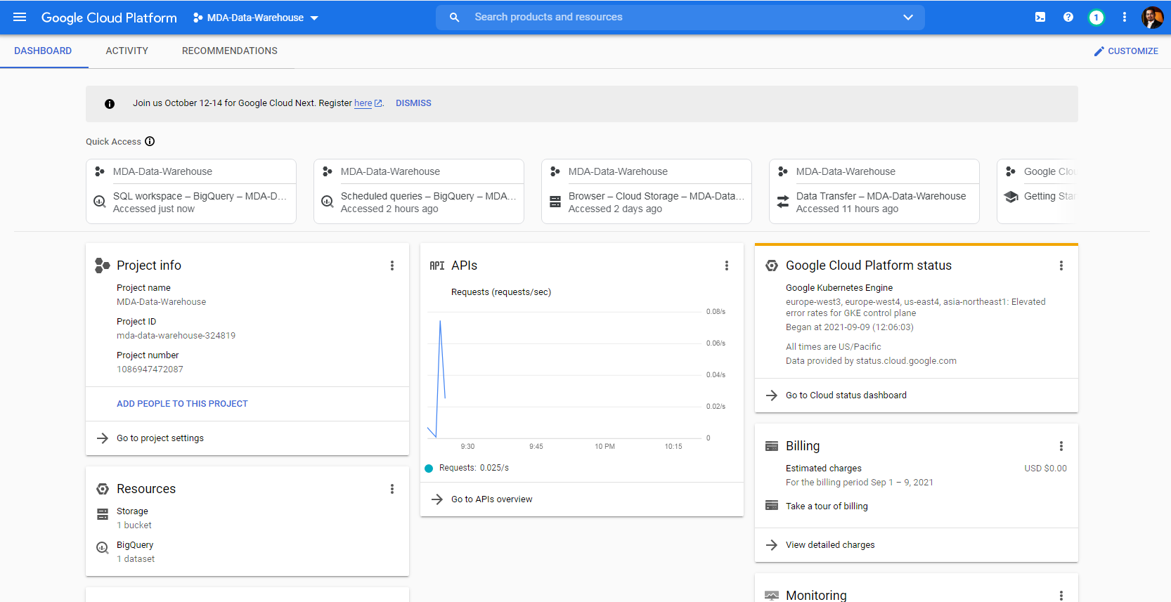
Demo

Slide 7
Pros and Cons
Pros
Cons
Multiple supported format and options for Table creation
Cloud storage / buckets
Partitioning and clustering
Easy data ingesting and ETL options
API integration
Automated load jobs/ Batch jobs
Any Table modification can accommodate while running the queries
No cost for caching queries
Inbuilt Google Data Studio for data visualization
No Primary Key, Foreign Key constrains
Configuration
Limited data types
Only few datatypes and no auto incremental
Strict data governance

Slide 8
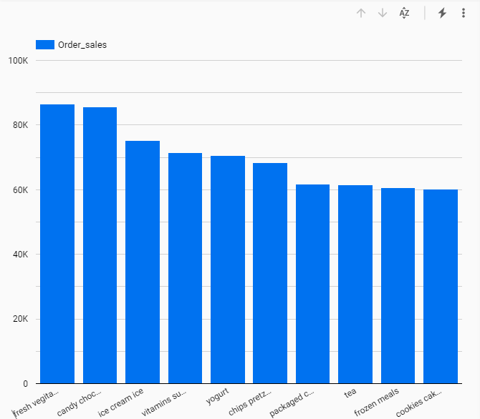
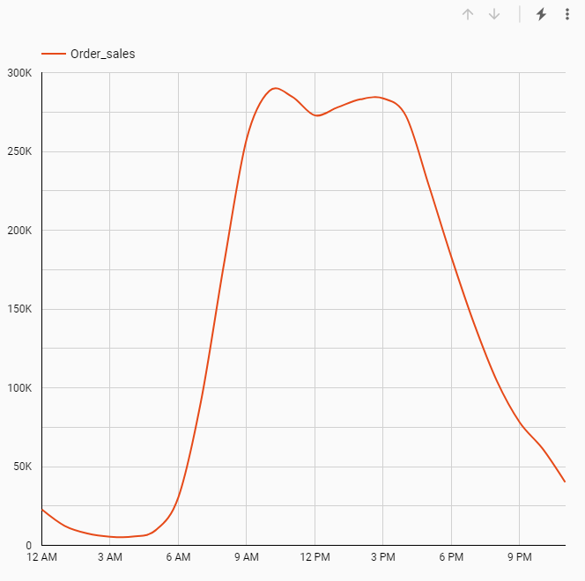
Data Visualization with Google Data Studio
Sales Vs aisle – most number of sales happen on which aisle. Poor sales aisles can be move to aisles where high sales were reported.
Order Sales during the hours of the day: Sales pickup from 9.00 am till 4.00 pm daily. More resource could be allocated during that period.

Slide 9

Thank You

