Slide 1




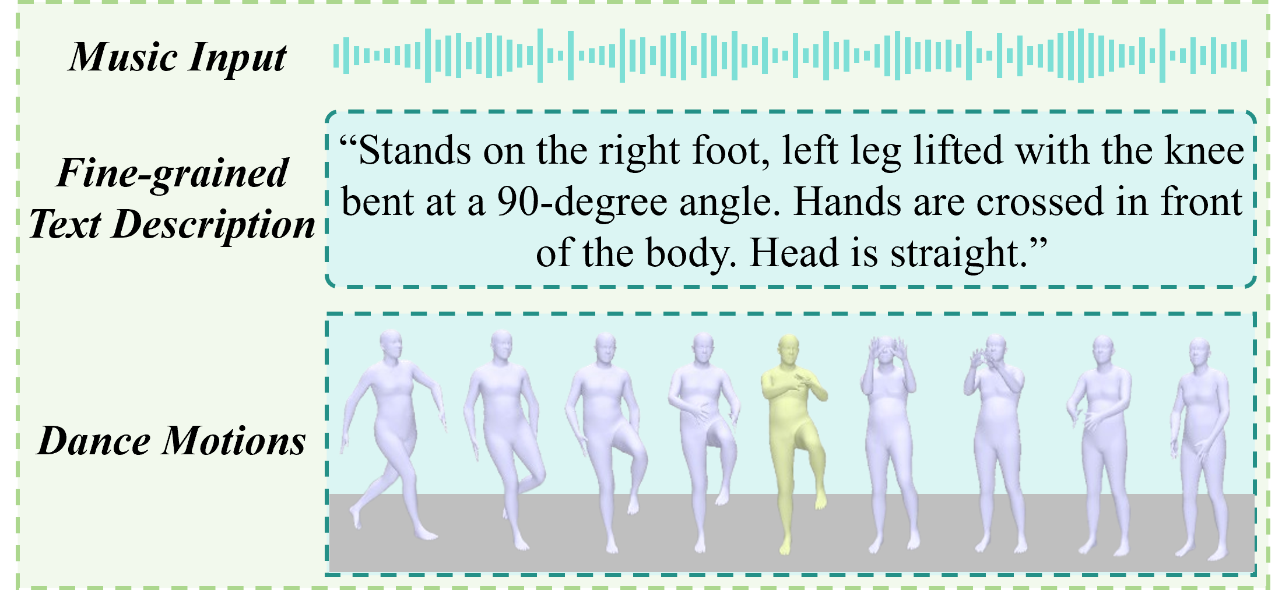
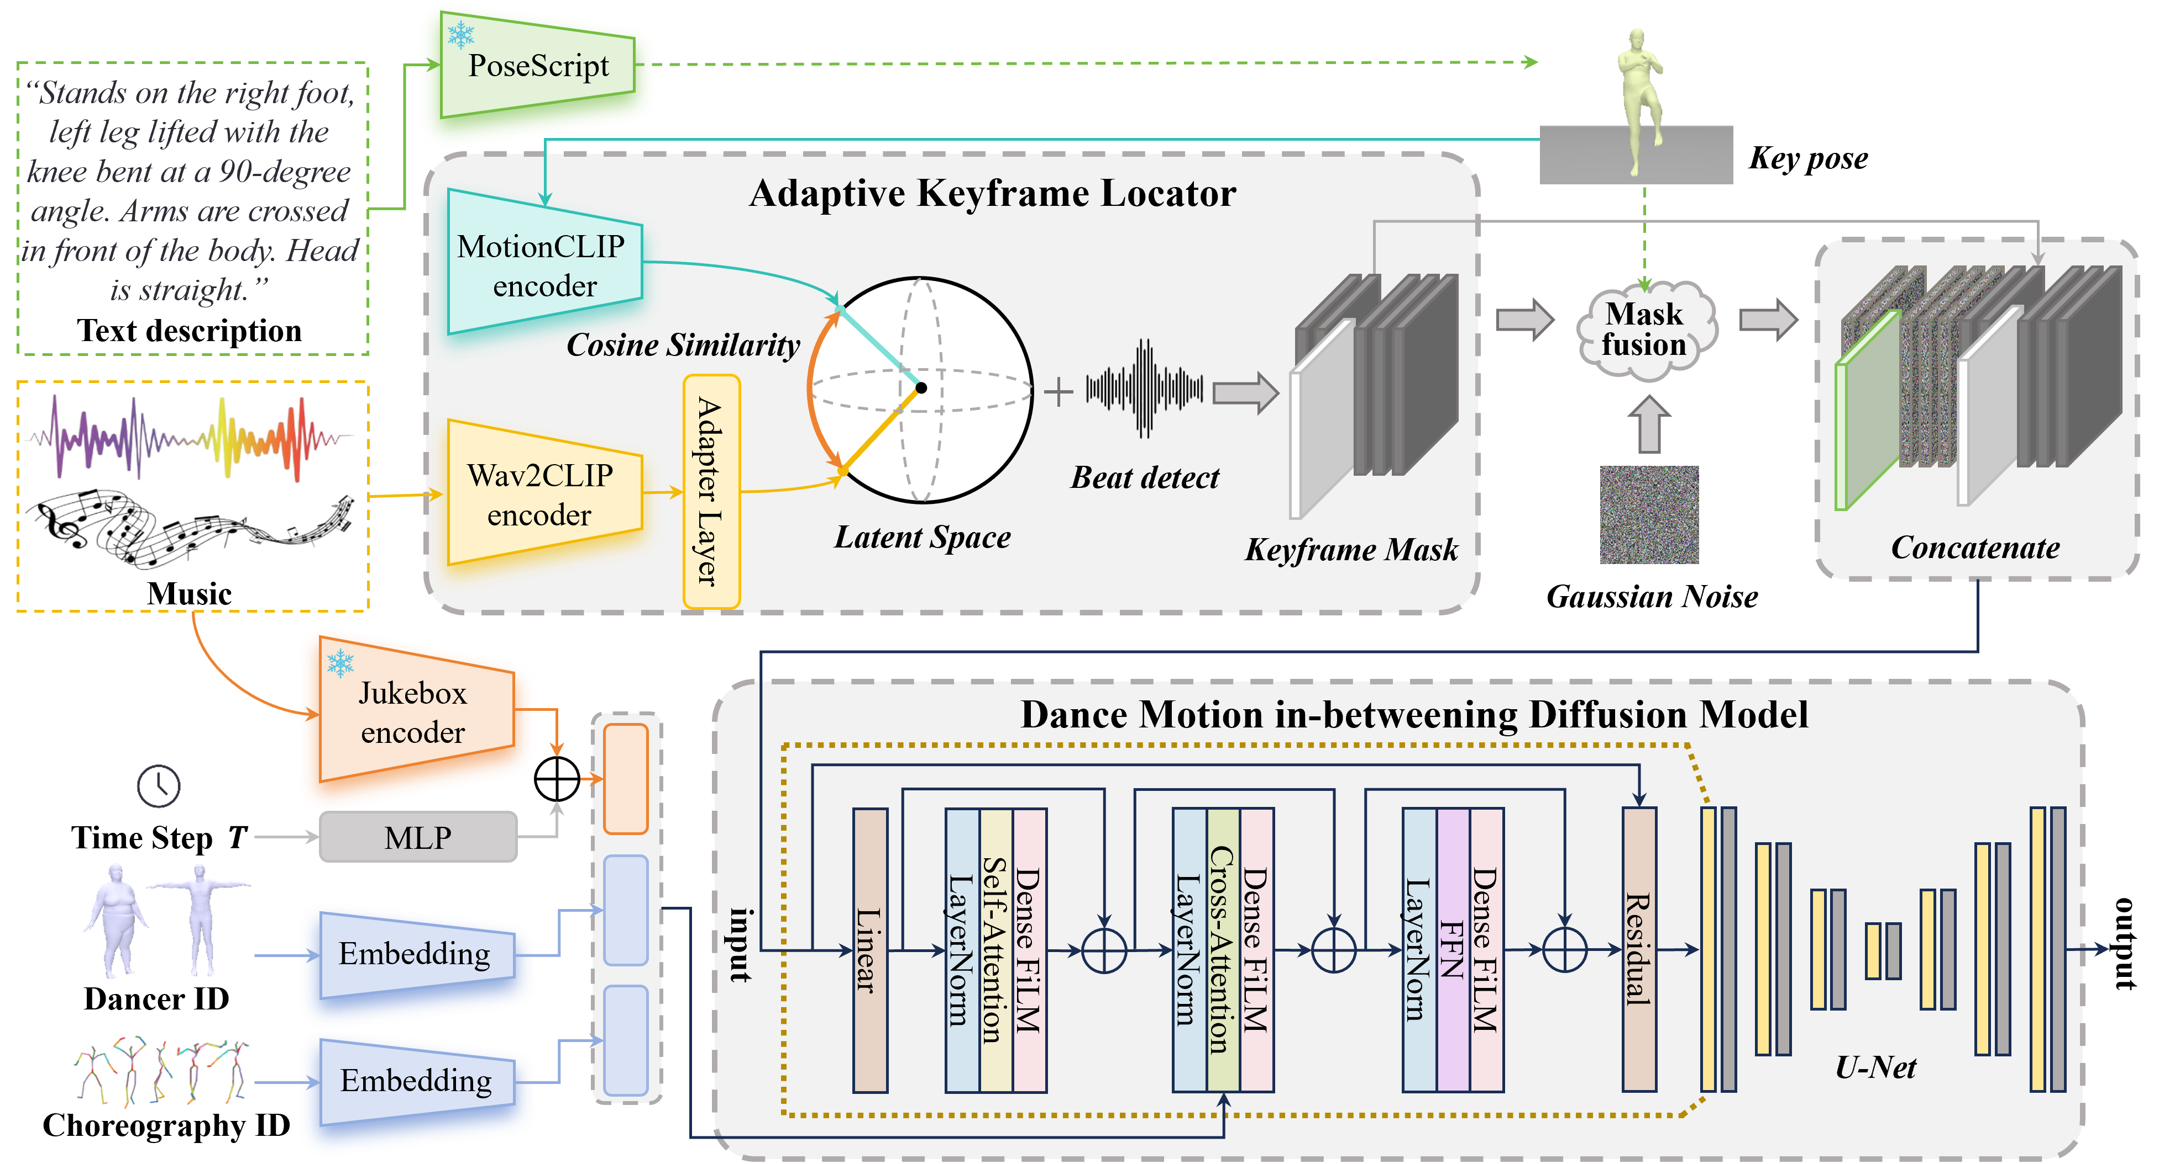

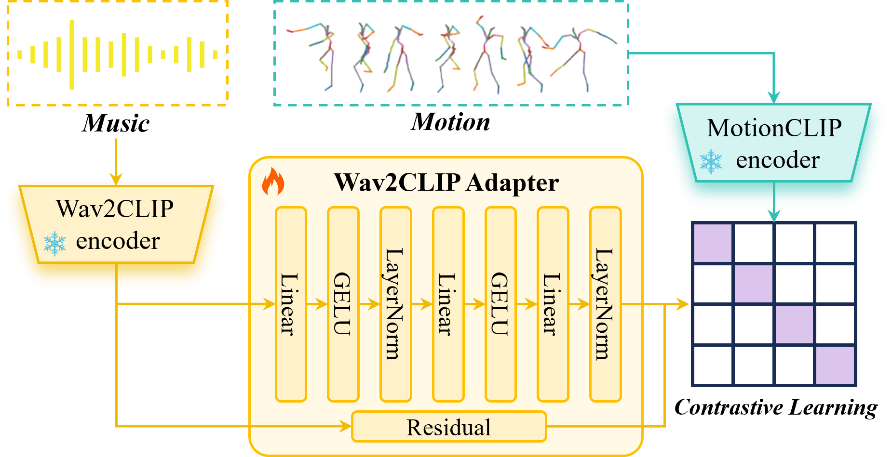
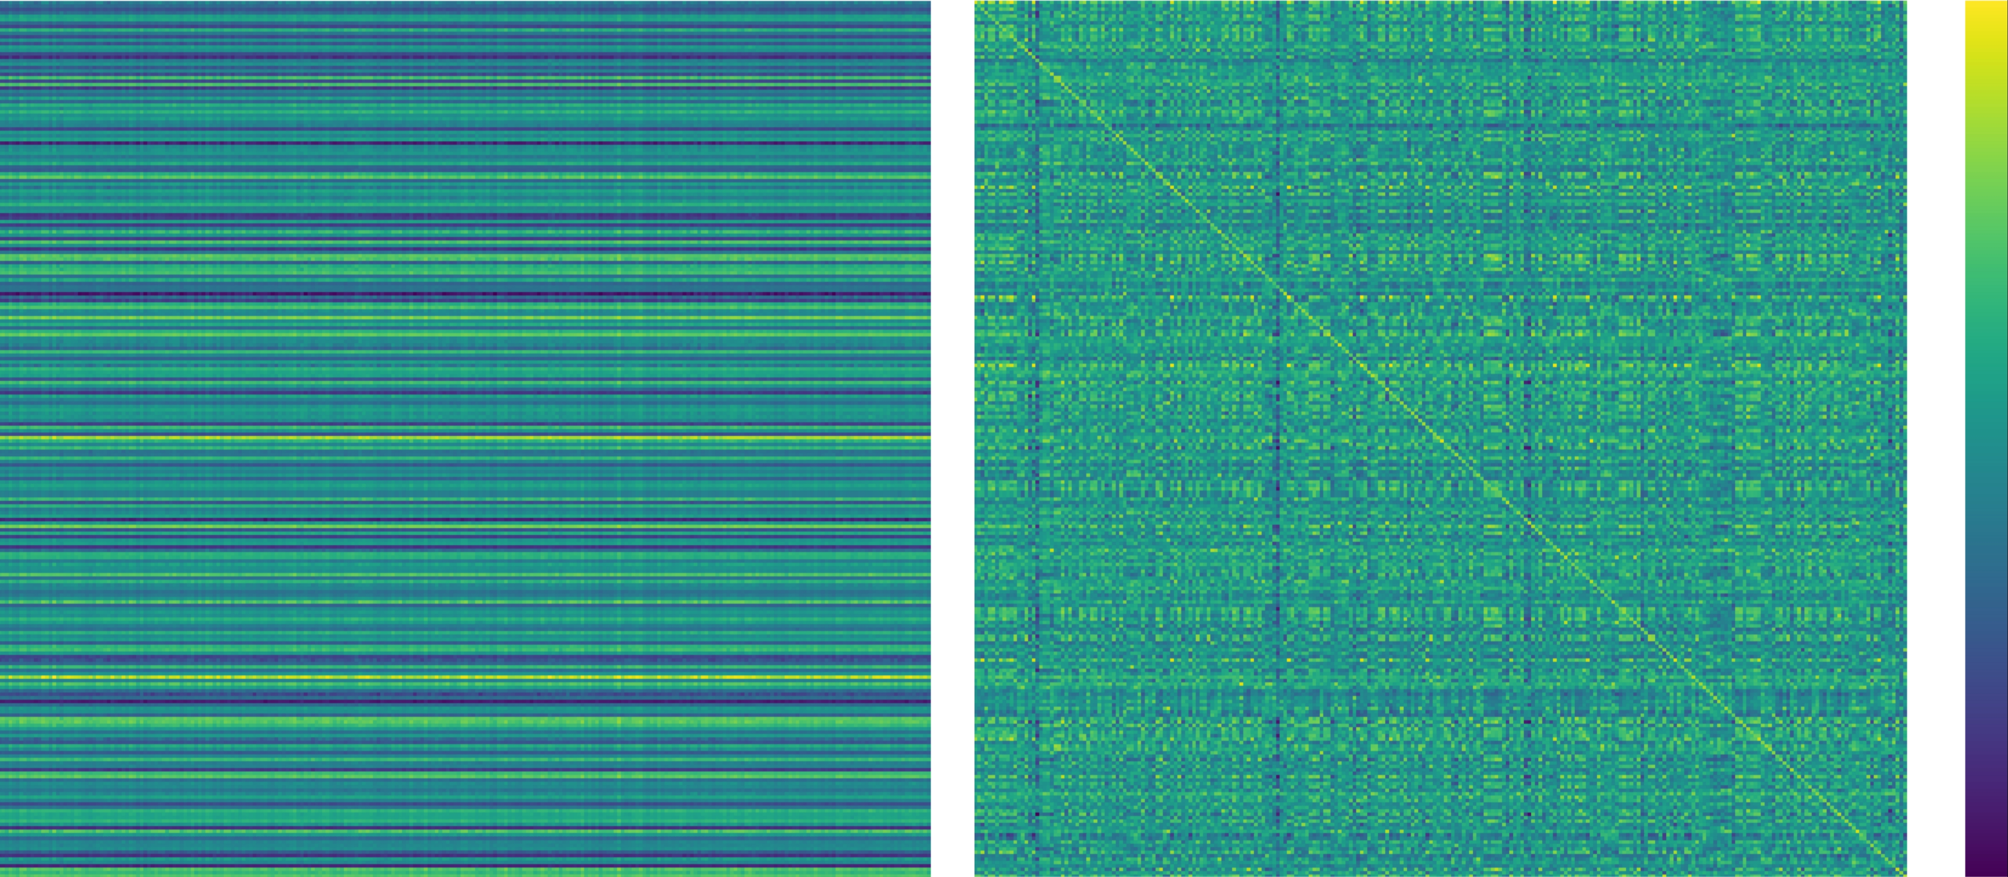
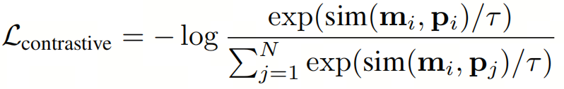
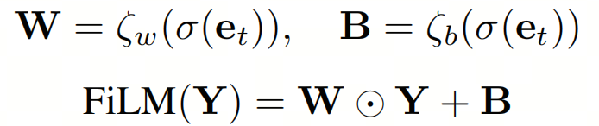
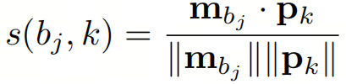
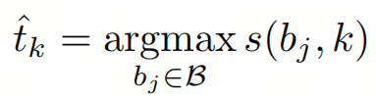
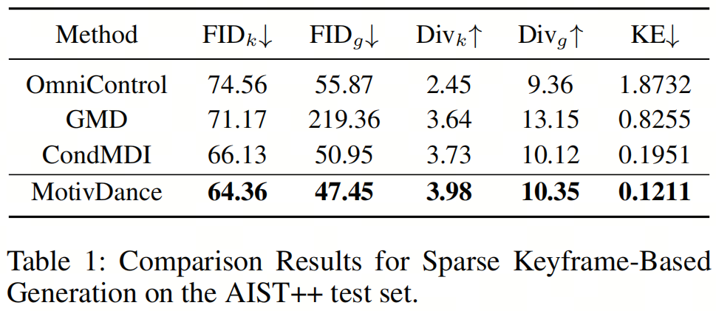
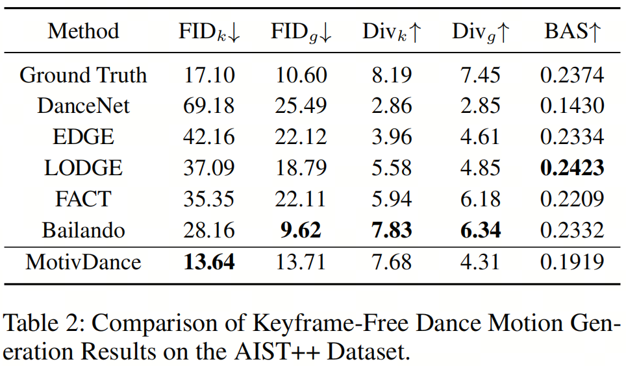
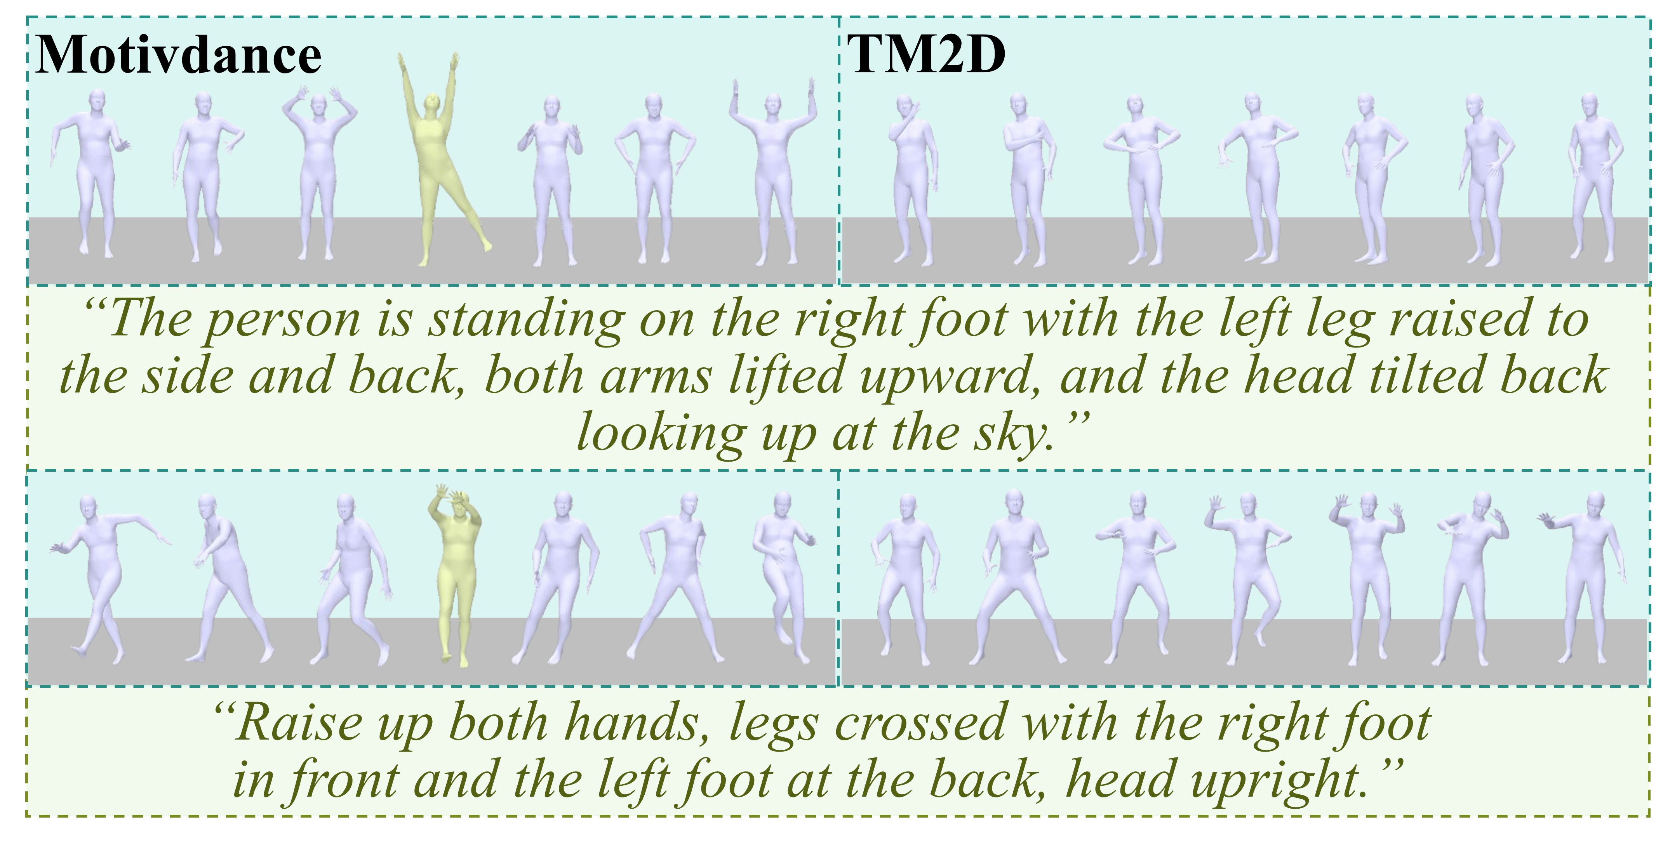
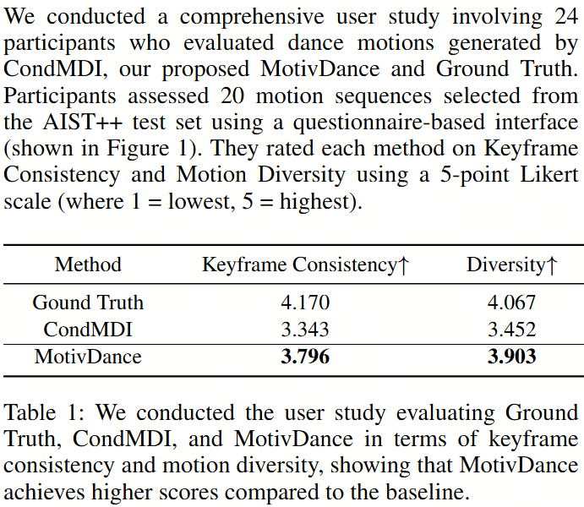
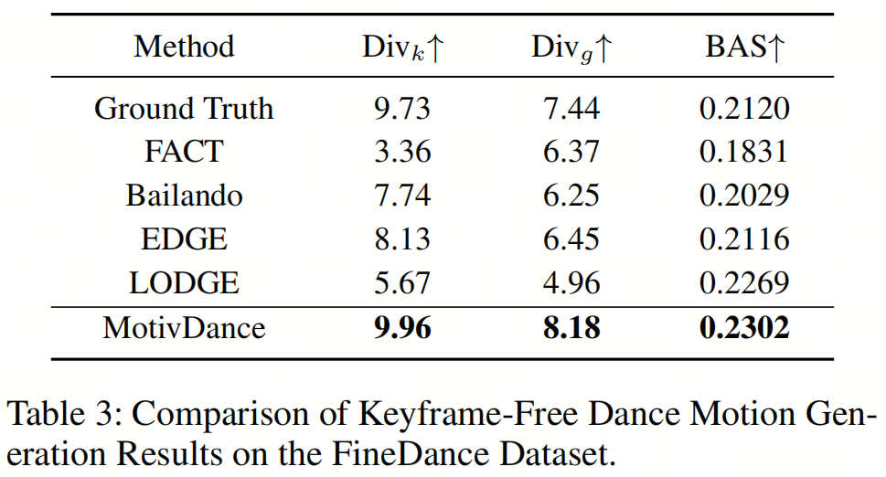
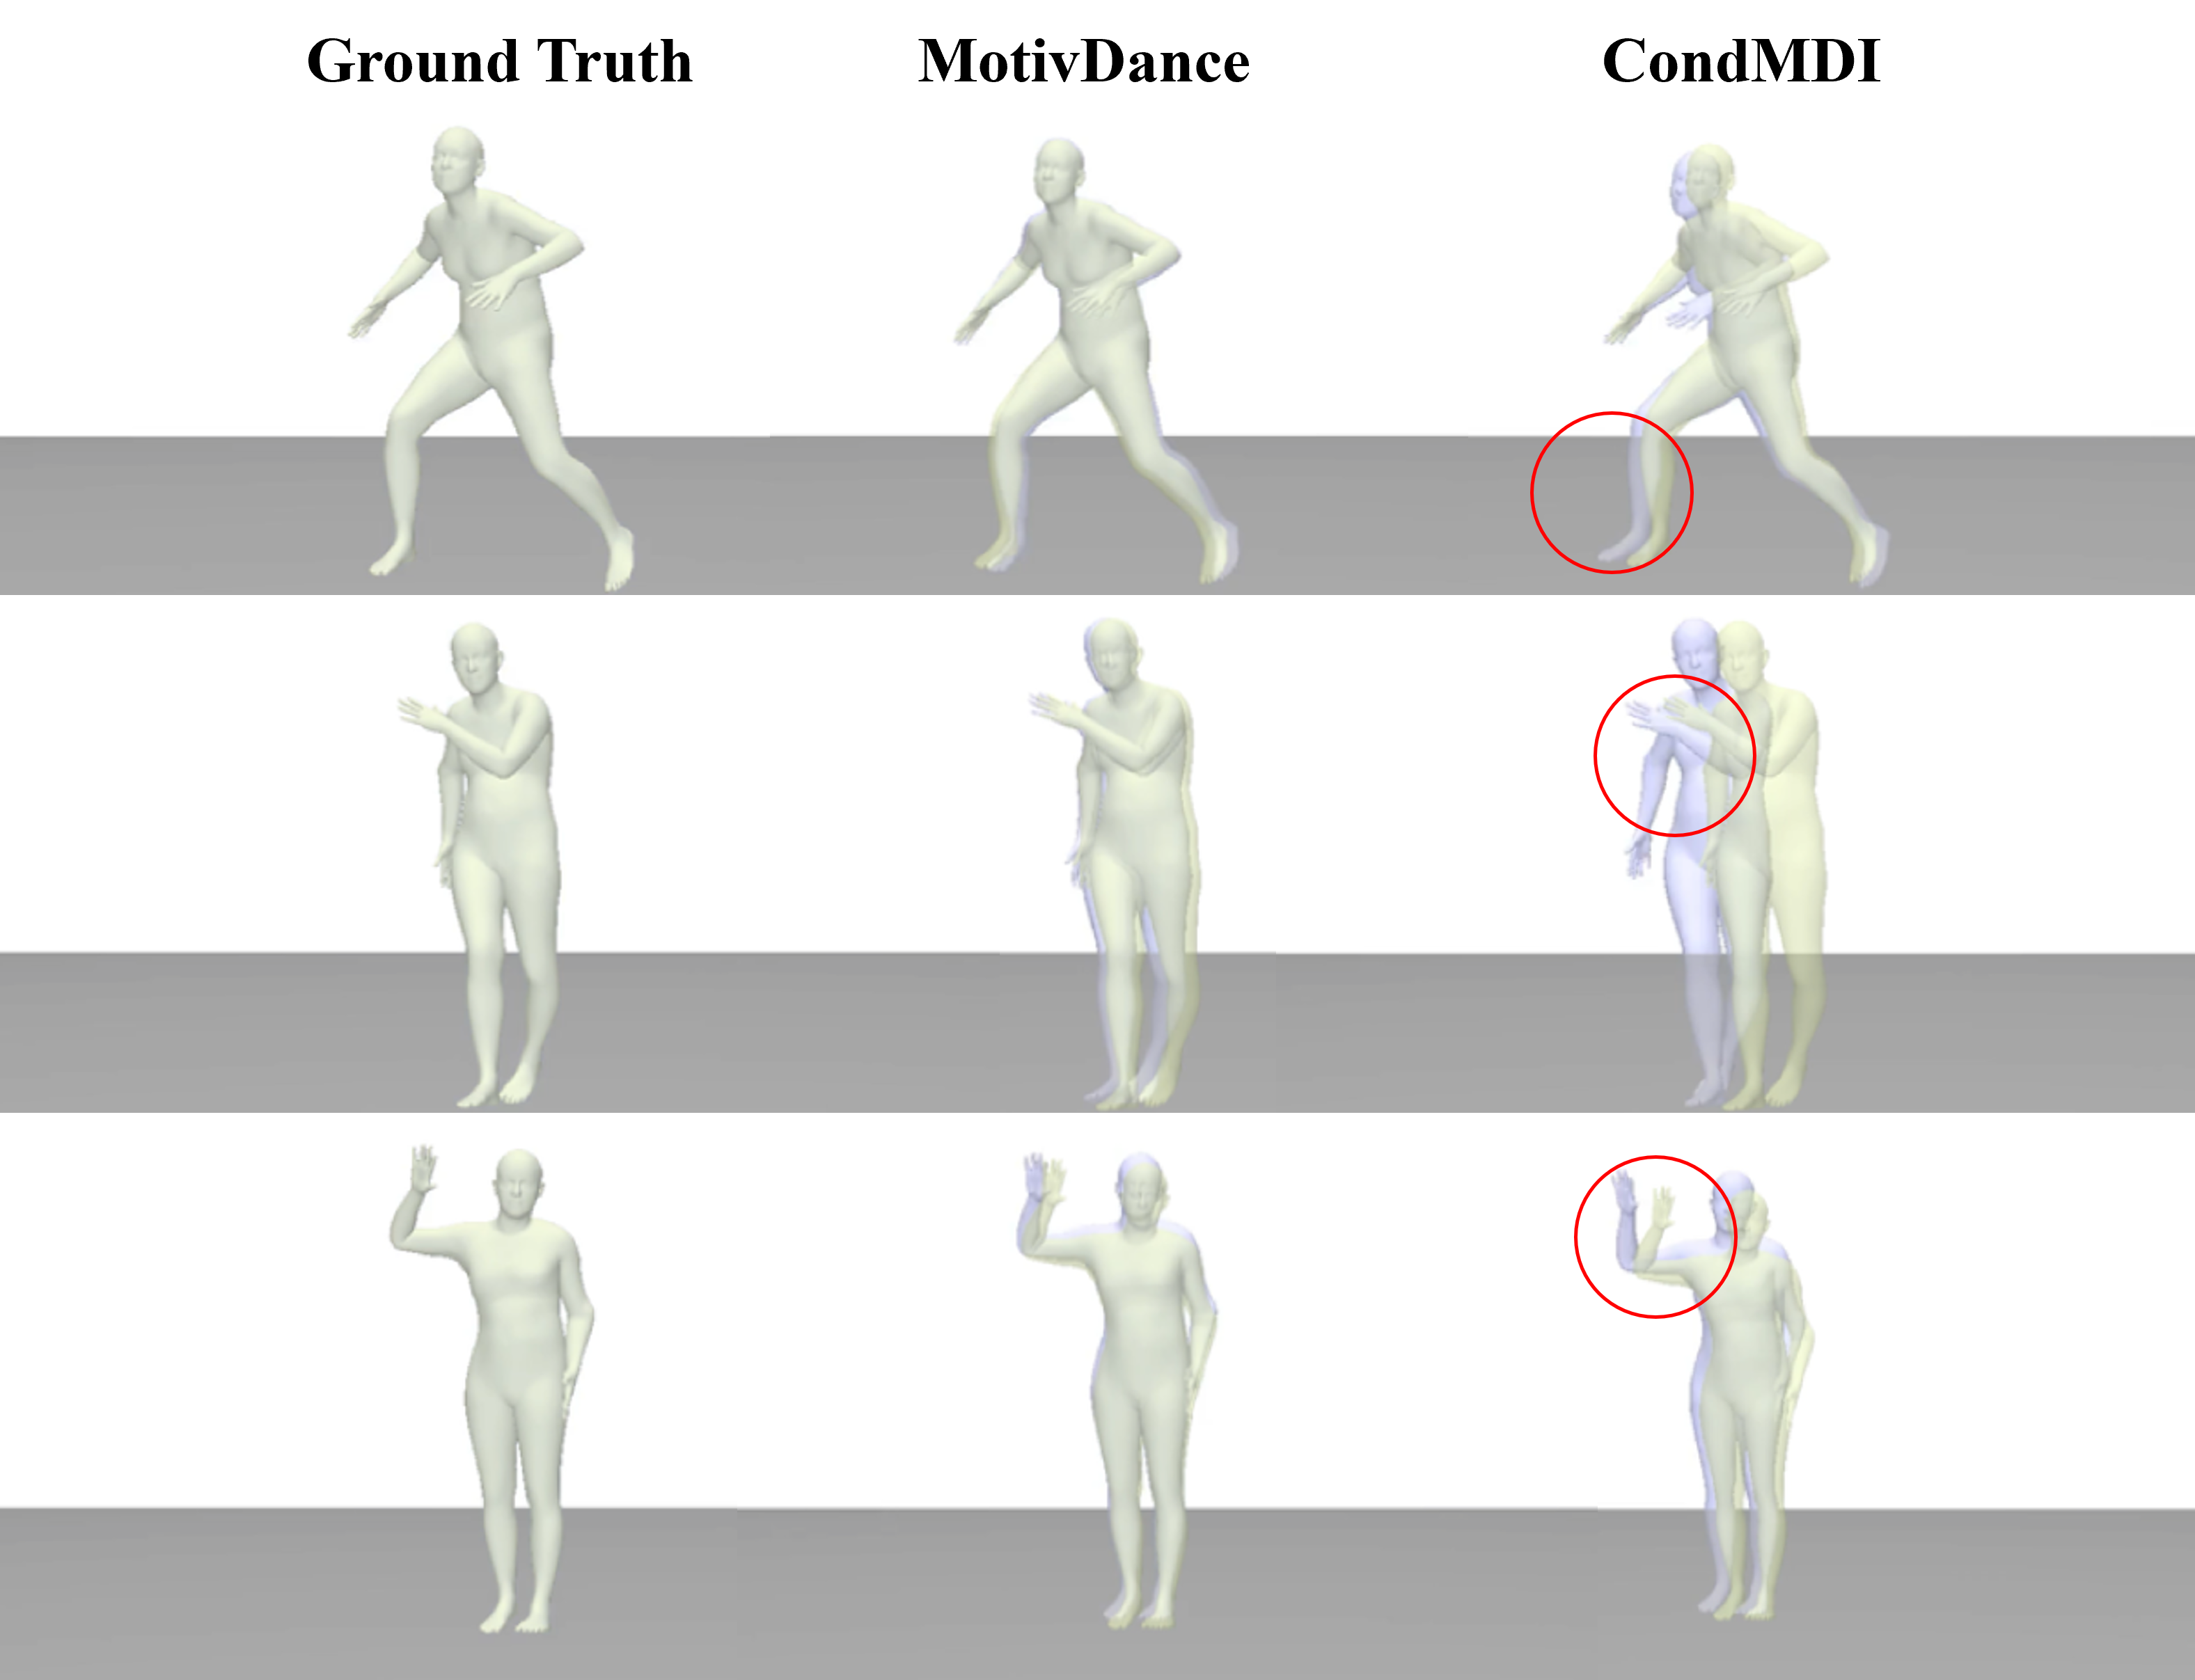
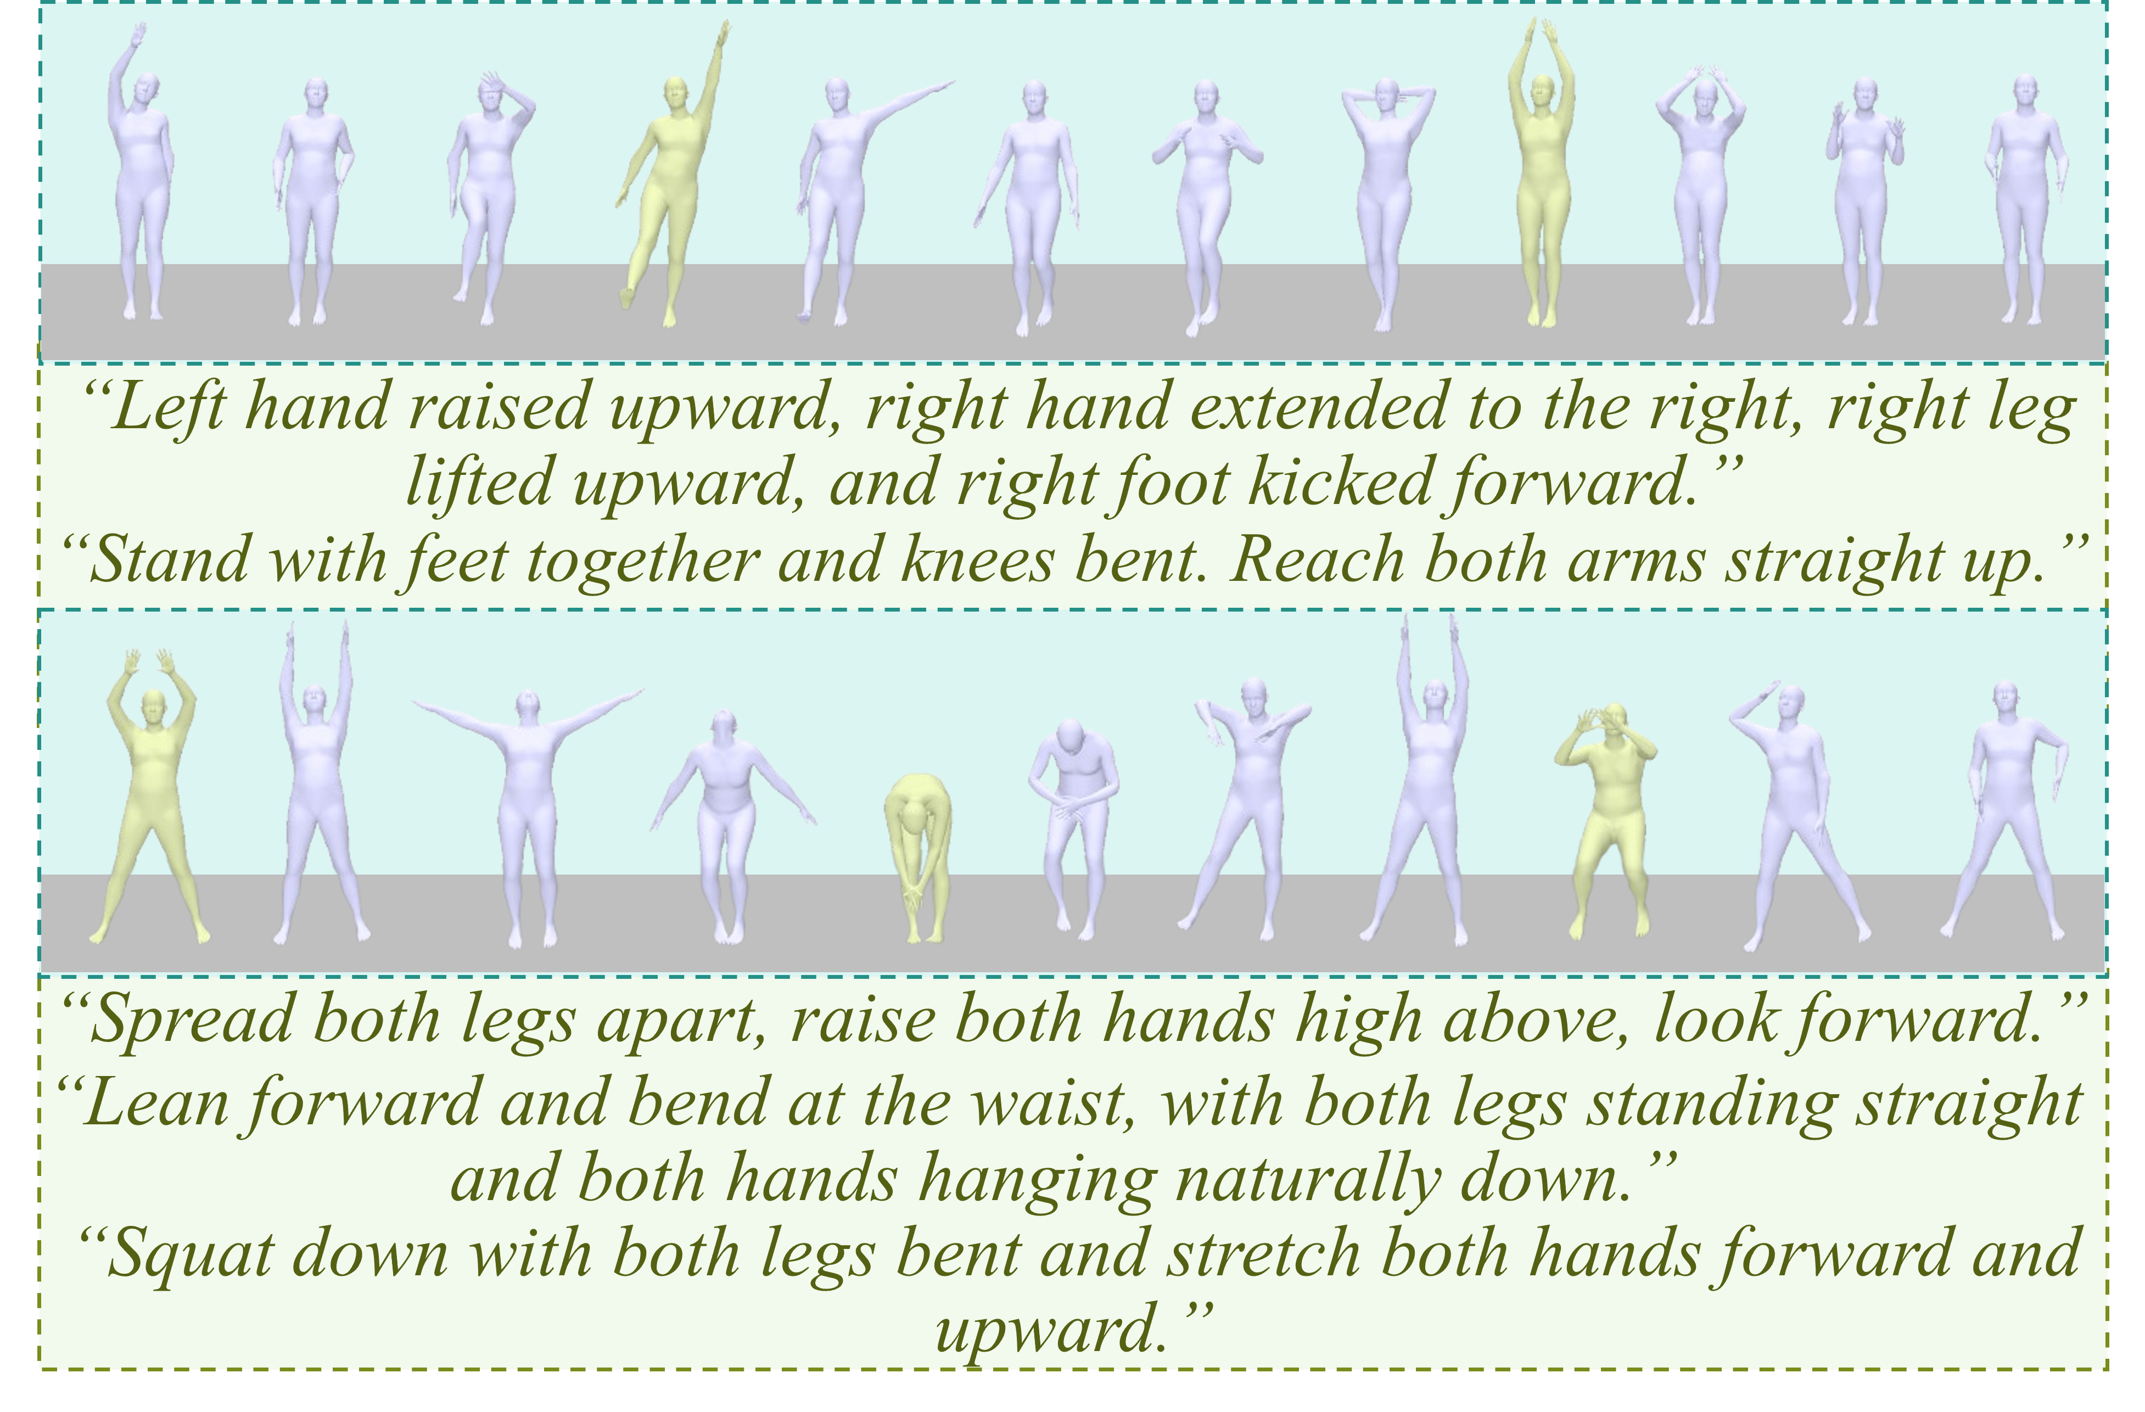
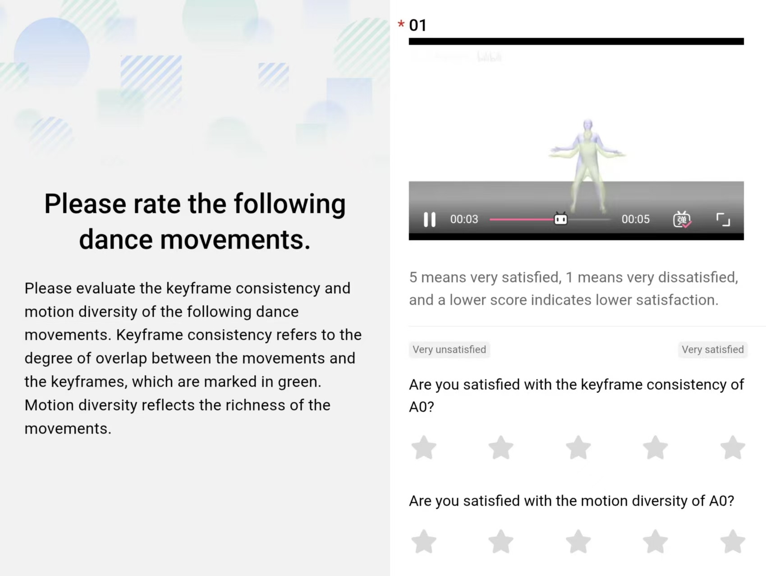
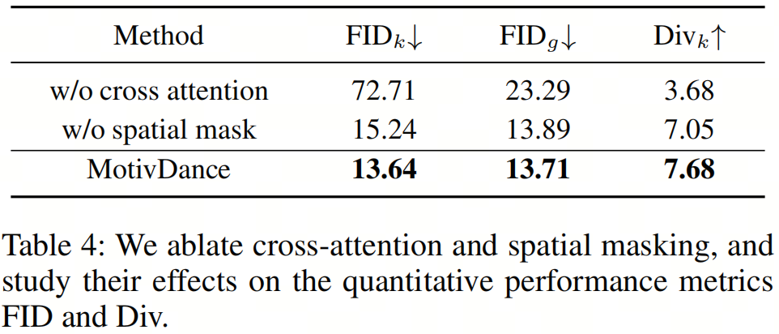
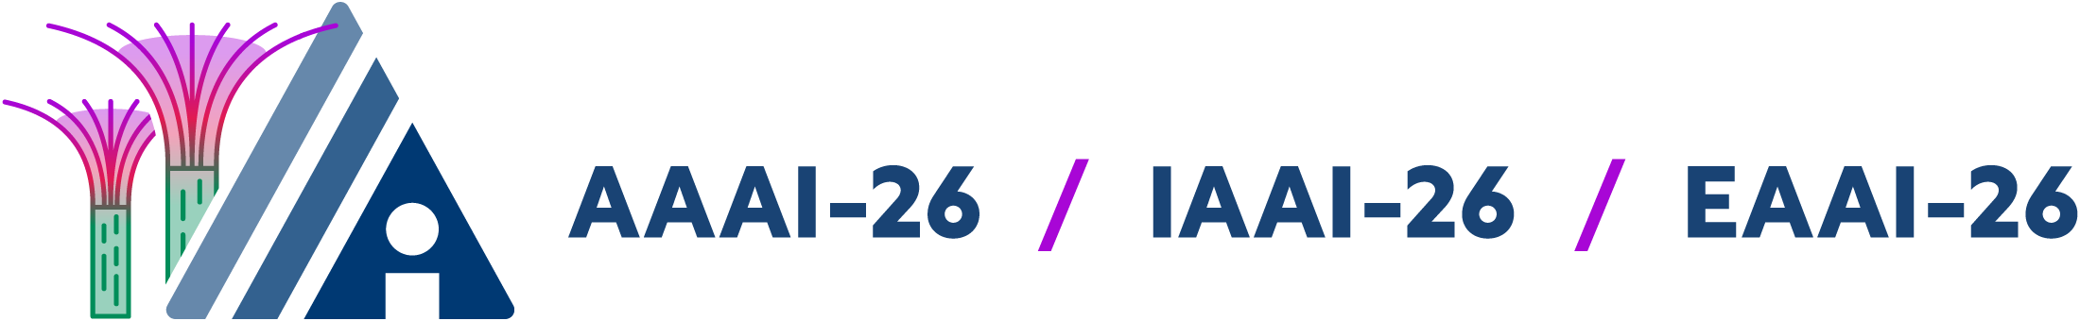
MotivDance: Fine-Grained Text-Guided Motivation Choreography with Music Synchronization
Chenguang Li^{1,2,3}, Yhu-Hui Wen^{2,3*}, Liping Jing^{1,2,3}
https://dsdf783.github.io/MotivDance/
¹State Key Laboratory of Advanced Rail Autonomous Operation, Beijing, China
²School of Computer Science and Technology, Beijing Jiaotong University, Beijing, China
³Beijing Key Laboratory of Traffic Data Mining and Embodied Intelligence, Beijing, China
Introduction
Realistic choreography demands simultaneous attention to rhythm and motivation. Prevailing automated dance generation methods mainly depend on musical input, overlooking the motivations that drive meaningful dance creation. Inspired by the motivation choreography, we aim to articulate dance motivations through textual guidance. However, the absence of high-quality datasets concurrently containing music, textual descriptions, and motion data presents a challenge in achieving accurate fine-grained textual control. To address this limitation, we present MotivDance, a novel framework integrating fine-grained textual guidance with music to synthesize semantically coherent dance sequences.
Main Contributions:
Introduce motivation choreography into the AI dance generation.
We introduce the motivation choreography into the AI dance generation, proposing a novel framework that integrates fine-grained, text-guided key poses (i.e., motivations) generation with a motion in-betweening diffusion model to synthesize structurally coherent and semantically meaningful dance sequences.
Design an Adaptive Keyframe Locator.
We design an Adaptive Keyframe Locator that integrates key poses with music by incorporating an adapter module to align the semantic latent spaces of music and motion. This locator dynamically identifies the optimal key pose positions by computing semantic similarity between motion and music features, along with beat perception.
Propose a dance motion in-betweening diffusion framework.
We propose a dance motion in-betweening diffusion framework employing a Transformer-based U-Net architecture decoder.
Adaptive Keyframe Locator
Dance Motion In-Between Diffusion Model
In motivation choreography, dance exhibits isomorphism with the semantic structure of the music. This relationship necessitates temporal coupling between dance motivations and the musical structure, requiring semantically and beat-aware key pose placement. The proposed module comprises:
(1) a Wav2CLIP Adapter transforming music features;
(2) Semantic Contrastive Alignment bridging the latent spaces of MotionCLIP and adapted music embeddings;
(3) Semantically Beat-Aware Keyframe Insertion, positioning key poses at the highest semantic-similarity music beat frame.
Semantic Contrastive Alignment:
Beat-Constrained Semantic Optimization:
The beat-first constraint ensures robust rhythmic synchronization, while the subsequent semantic optimization selects the most contextually appropriate beat position for each key pose, achieving precise alignment of choreographic motivations with musico-structural events.
Building upon the key poses, we propose a motion in-betweening diffusion model to interpolate the motion between provided keyframes while adhering to the music. The details are as follows:
Key Pose Fusion Mechanism..
We use temporal and spatial masks M to randomly sample a subset across the feature dimension, which defined as binary-valued tensors, where values are set to 1 at observed keyframe timesteps and joint positions, and 0 elsewhere.
Transformer Based Conditional Diffusion Model.
The core of the diffusion model is a denoising decoder based on the U-Net architecture, following the design of CondMDI. However, the Adaptive Group Normalization (AdaGN) for feature fusion in CondMDI is insufficient for capturing the complex relationship between musical features and dance motions. Consequently, we adopt the transformer based paradigm, and incorporate residual layers into our U-Net architecture. Furthermore, the model is enhanced with attention mechanisms and dense Feature-wise Linear Modulation (FiLM) layers to enable context-aware conditioning.
In this refined architecture, each FiLM layer processes both the output from the preceding layers Y and the timestep embedding
Through the hierarchical integration of these design elements, the framework achieves superior adaptation to input motion feature distributions and contextual nuances.
Quantitative Comparison on Benchmark.
Qualitative Comparison on Benchmark.
User Study.
Figure 6: Qualitative comparison. Our MotivDance generates dance motions faithfully reflecting body-part-aware fine-grained text control, whereas TM2D struggles to fully comply. Left: Our results. Right: TM2D results.
Figure Appendix 2: We present qualitative results of motion in-betweening with ground truth and the baseline.
Figure 5: Qualitative results demonstrate that our MotivDance achieves body-part-aware, fine-grained text-guided dance motion generation.
Figure Appendix 1: User study interface. We employ a 1-5 rating scale to evaluate keyframe consistency and motion diversity, where 1 indicates “very unsatisfied” and 5 indicates “very satisfied”.
Cronus is named after Κρόνος, the Greek Titan God of time, symbolizing temporal modeling and memory.

