Slide 1
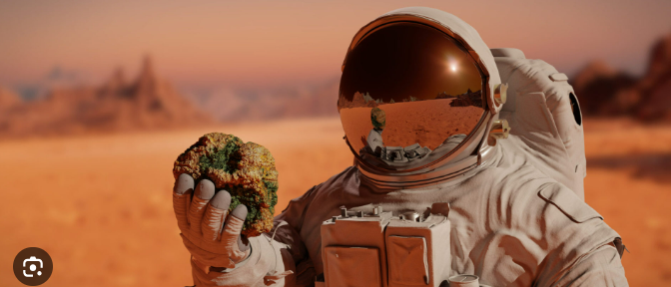
VOIP and Video Communication System
MARS
Multi-user Anytime Rendezvous Space
By TEAM 3, MARS

Slide 2
목차
xxxxx
Notes:
UX자료 진행현황 확인 필요

Slide 3
Overview
MARS is secure VOIP and video conference system.
GOAL of MARS system
GOAL of MARS team
High quality voice and video communication
Secure and reliable communication
Minimum network bandwidth
Easily adding/replacing codecs and/or encryption algorithms
Derive appropriate requirements
Decide the architectural solutions effectively
Apply the architecture to the product well
Demonstrate the product
Conference information
Conference information
Conference information
Conference information
Backend Server
Video or Voice Stream
Windows Application
Windows Application
1) ?
1 / 4
Notes:
UX자료 진행현황 확인 필요

Slide 4
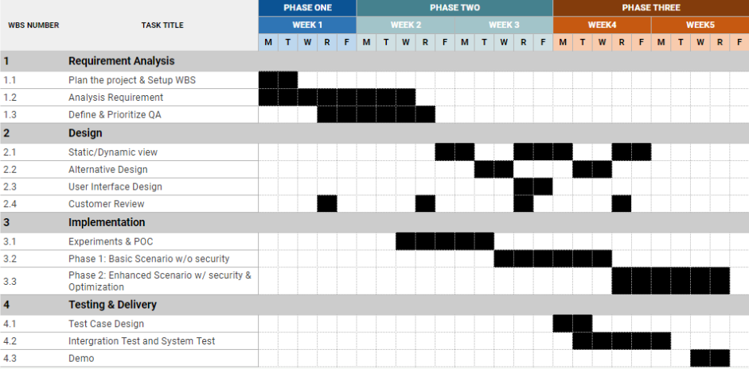
Plan & Milestone
Milestone 1
Milestone 2
Milestone 3
1) ?
1 / 4
Notes:
UX자료 진행현황 확인 필요

Slide 5
Quality Attribute
ID | QA | Description | Difficulty | Priority
QA-01 | Availability | MARS shall continue the conference, even if packets are dropped due to poor network conditions in a conference with at least four participants. | H | 1
QA-02 | Performance | MARS shall play audio/video continuously even if network jitter happens in a conference with at least four participants. | H | 1
QA-03 | Availability | MARS shall have capability to detect call drop if there is no response from the peer.. | H | 1
2 / 4
Notes:
UX자료 진행현황 확인 필요

Slide 6
Design Constraints
ID | Functional Requirement | Description
DC-01 | Platform | The User Application has to run on Windows platforms.
DC-02 | Test Router | Test router has two Wi-Fi access points (AP’s).
DC-03 | Wifi Network | System shall utilize LG’s Wi-Fi network for normal application development
DC-04 | System Environment | This project should be implemented in Microsoft Windows 10 or 11.
DC-05 | Required Software | This project should be implemented by Microsoft Visual Studio Community 2022 (64-bit) Version 17.5.5 or later.
DC-06 | Library restrictions | Should not use any Session Initiation Protocols (SIP) or any VoIP libraries in source code
2 / 4
Notes:
UX자료 진행현황 확인 필요

Slide 7
Risk Assignment
# | Risk Description | Mitigation Plan | Priority
1 | No experience on Windows application development may lead to higher development effort | Use MFC rather than Win32 as it is easier to learn MFC faster Allocate more resources (2 people) for the UI development Research on Window application development which may lead to 1W delay on UI development | H
2 | No experience on encrypting stream data (No one has experience in data encryption) | Begin without encryption Allocate more resources (2 people) for network development We may give up the use of UDP to transfer stream data, but use TCP over SSL. | H
3 | How are network jitter and packet drop different? How do they affect and look at the application level when they exist separately or in combination? | Experiment EXP-01, EXP-03 are being conducted to address this risk | M
2 / 4
Notes:
UX자료 진행현황 확인 필요

Slide 8
Risk Assignment
# | Risk Description | Mitigation Plan | Priority
4 | It is required to research how we implement AEC / VAD on the client application | Begin with no AEC / VAD Allocate more resources (2 people) for multimedia development Review the AEC / VAD in the sample program (Dan's) in depth and ensure that it is sufficient to satisfy our goal. | M
2 / 4
Notes:
UX자료 진행현황 확인 필요

Slide 10
Architectural Approach
2 / 4
Notes:
UX자료 진행현황 확인 필요

