Slide 1
Development of website for a Training Organization
Module Project
Module: Front End Web Development
Course: NICF - Front End Web Development
Start Date :
End Date :
Submission Date : 4/6/2019
Learner Name : Daniel Seah
Enrollment ID :
Presentation Date : 4/6/2019

Slide 2
Contents
Document History
Version Number | Effective Date of release | Summary of Included Changes | Author
1 | 4th March 2016 | First Edition | Satya CVS
2 | 7th April 2016 | Changed for Module 2 | Shrinivas K R
3 | 2nd April 2018 | Changed for RQF | Shrinivas K R

Slide 3
Contents
Contents
1. Project Definition
2. Development Tools
3. Information Architecture
4. Storyboard
5. Menus
6. Business Process
7. Lead Generation Form Design
8. HTML Catalog
9. HTML Pages
10. CSS Classes
11. Lead Generation Form
12. Pages with Styles
13. Pages in various Browsers
14. Project Deliverables
15. Project Environment
16. Website Review & Improvements
17. Project Milestones & Tasks
18. Milestone Feedback & Action Taken
19. Project Results
20. Proposed Improvements

Slide 4
1. Project Definition
Project Objective
Create a main container page
Create sub-pages to replace container contents
Create a Single Page Application
Proposed Solution
Use HTML for main pages
Use CSS to style webpages
Use Javascript & jQuery to enable interactivity
Use Javascript & jQuery to enable Single Page Application
Use JSON files to access data and populate content

Slide 5
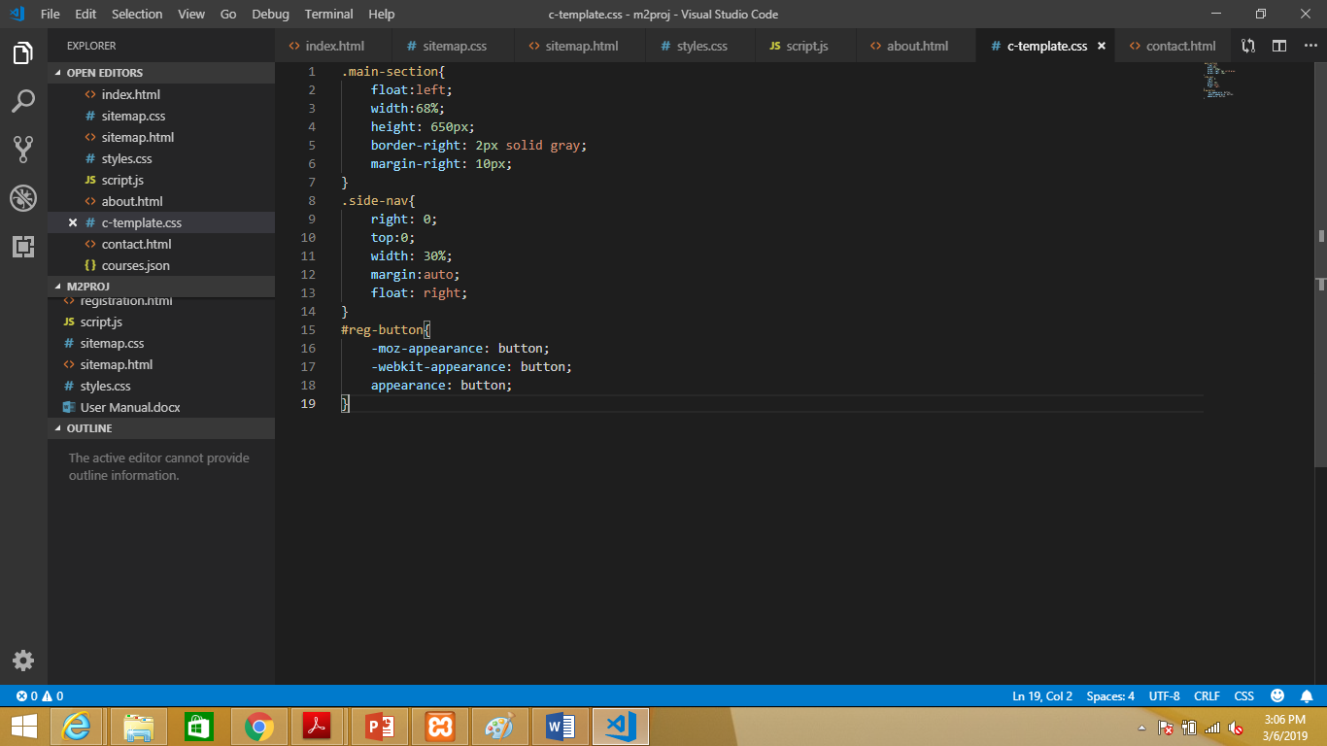
2. Development Tools

Slide 6
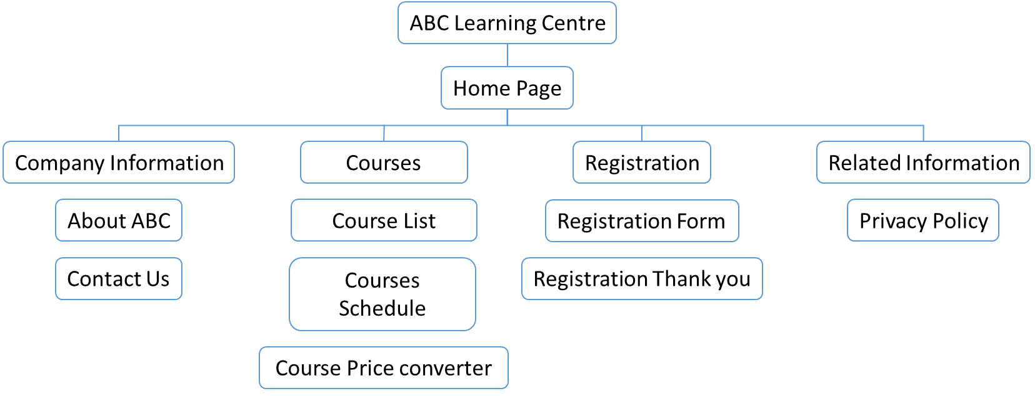
3. Information Architecture
Information Architecture

Slide 7
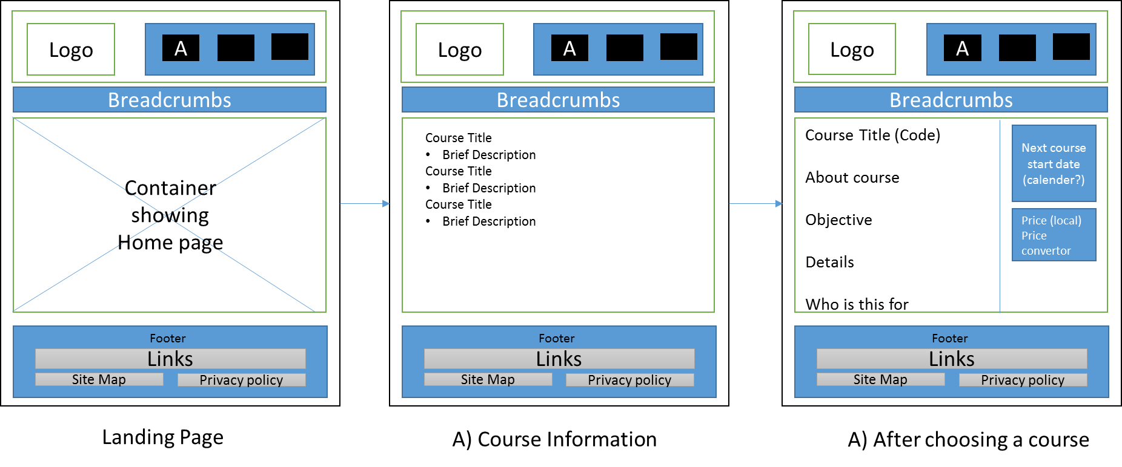
4. Storyboard (Part 1/3)
Storyboard

Slide 8
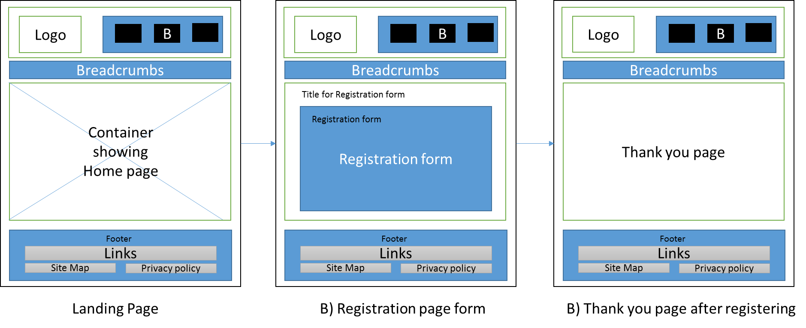
4. Storyboard (Part 2/3)
Storyboard

Slide 9
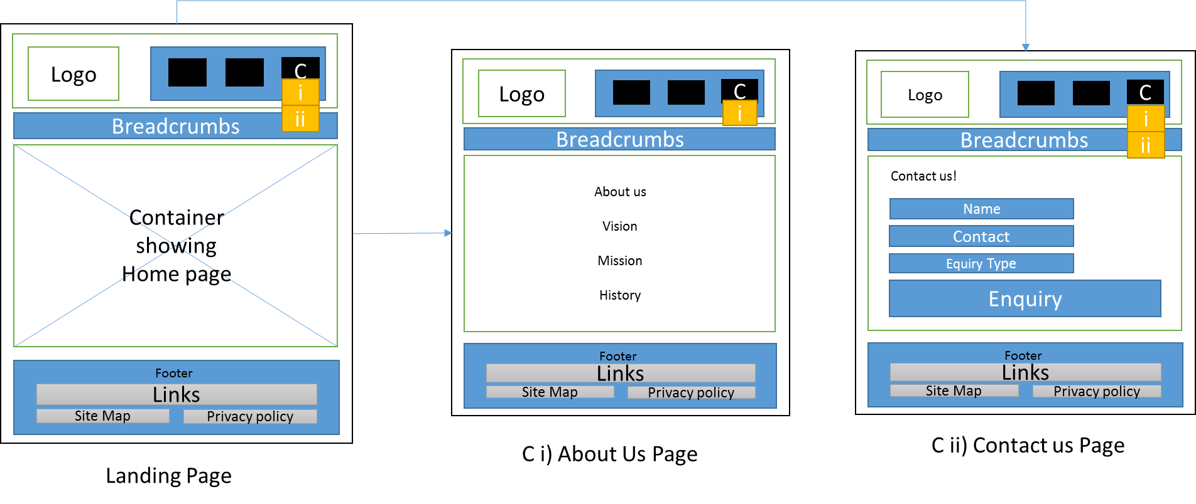
4. Storyboard (Part 3/3)
Storyboard

Slide 10
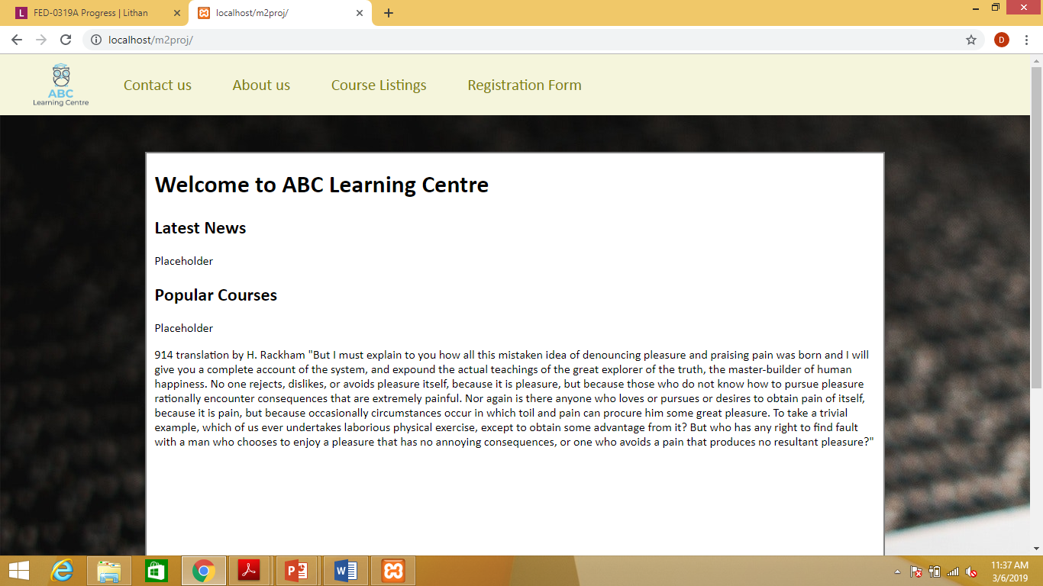
5. Menus
Menus

Slide 11
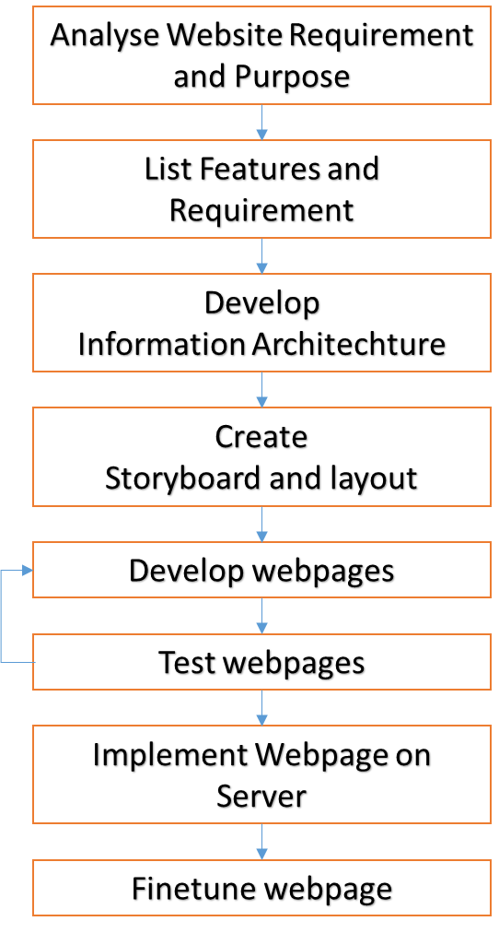
6. Business Process

Slide 12
8. HTML Catalog
List of HTMLs to be developed
Landing Container page
Register Interest
Registration Form
Registration Thank you page
Company Info
About us
Contact us
Course
Course Listing
Course Details including schedule, pricing
Privacy policy
Sitemap page

Slide 13
10. CSS Classes
CSS Classes
S. No. | Selector | Style to be Created
1 | Body | Background image
2 | #logo | Height (100px), width(100px) Margin(0 5px 0 30px)
3 | Nav | Background color (beige) Height (5rem) Margin(0 0 20px 0)
4 | #top-nav | List-styles (None) Padding (0.92em), Text aligned (centre), Font-size (1.3em), Float left
5 | A | Colour (olive) text decoration (none)
6 | A:hover | Colour(chartreuse)
7 | #bot-nav | Background color (Beige) Bottom (0) Height (125px)

Slide 14
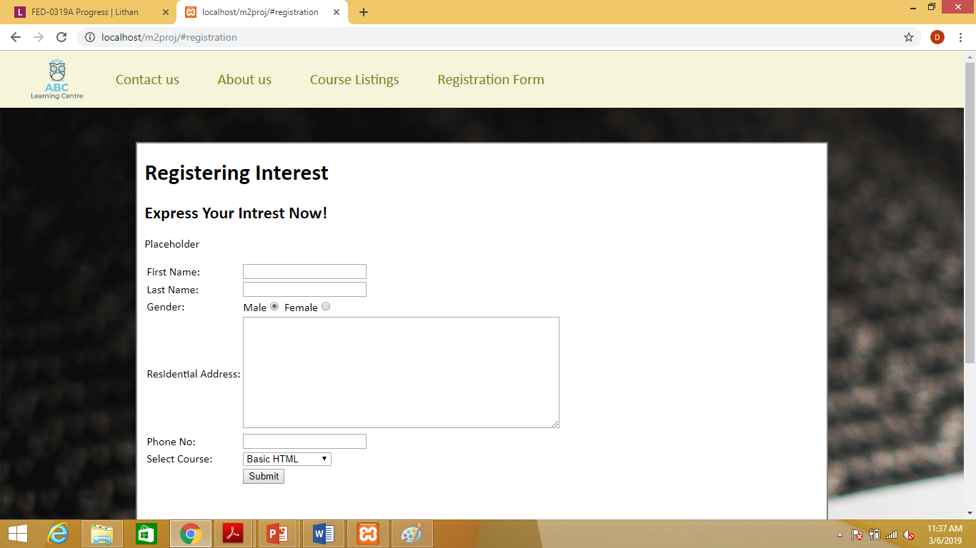
11. Lead Generation Form
Lead Generation Form

Slide 15
12. Pages with Styles
Pages with Styles

Slide 16
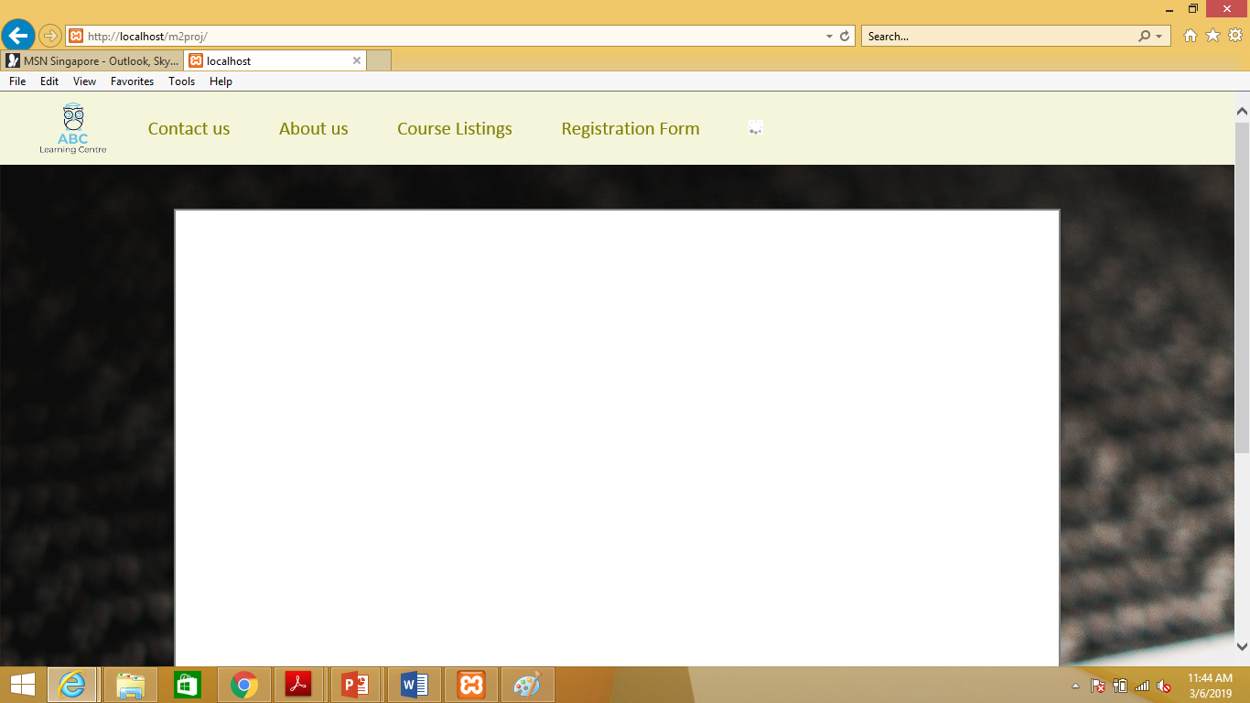
13. Pages in Various Browsers
Screen Capture of Pages in Various Browsers (Chrome, Edge, Safari)
Internet Explorer

Slide 17
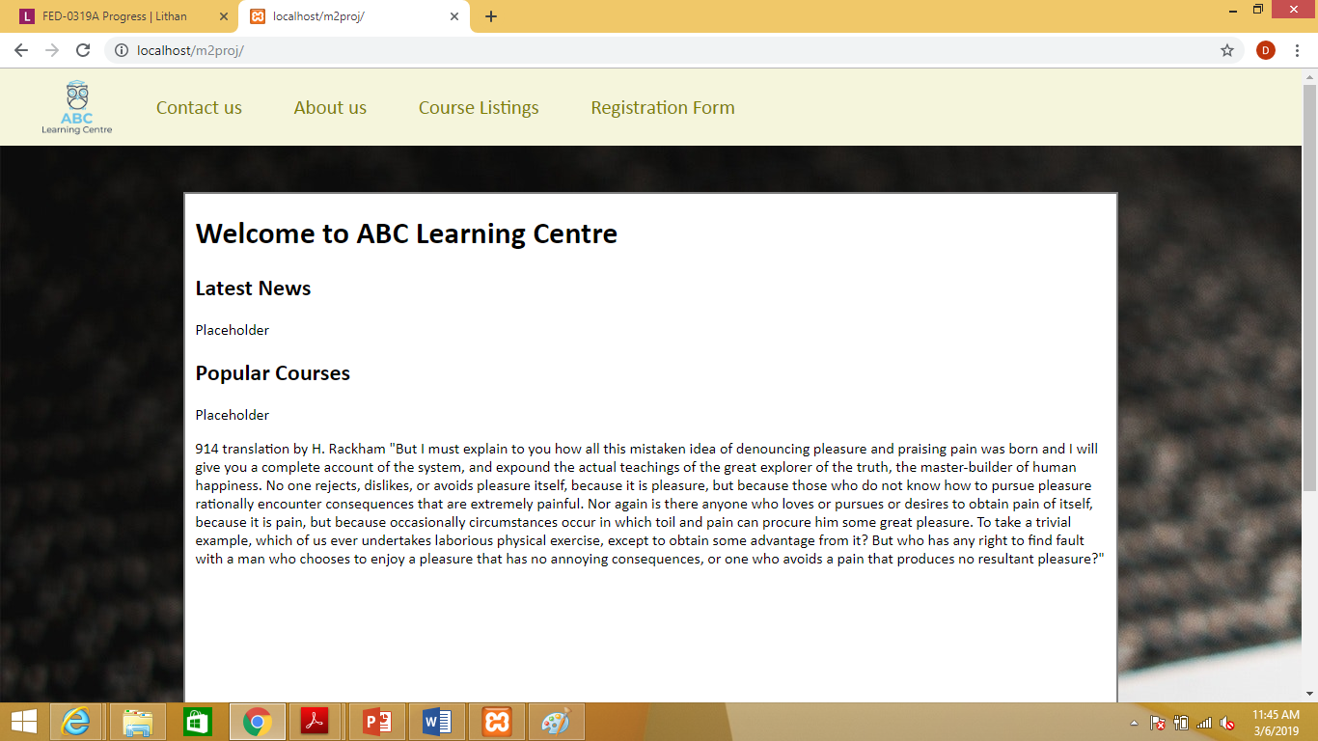
13. Pages in Various Browsers
Screen Capture of Pages in Various Browsers (Chrome, Edge, Safari)
Chrome

Slide 18
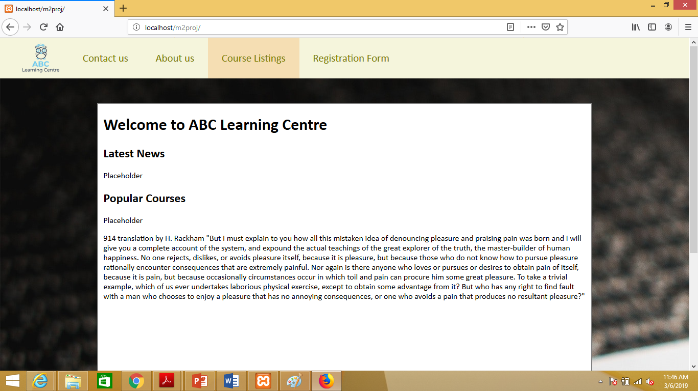
13. Pages in Various Browsers
Screen Capture of Pages in Various Browsers (Chrome, Edge, Safari)
FireFox

Slide 19
14. Project Deliverables
Project Deliverables
Create a main Container page
Style container page
Use Javascript & jQuery for interactivity
Use jQuery for Ajax implementation
Update container to show other HTML page
List of Evidences
Main container page: index.html
Style file provided: styles.css, c-template.css, sitemap.css
Javascript file: script.js

Slide 20
15. Project Environment
Technical Environment and Tools Used
Visual Studio Code
Jquery v3.4.1
List of references
https://developer.mozilla.org/en-US/
https://api.jquery.com/
https://developer.mozilla.org/en-US/docs/Web/CSS

Slide 21
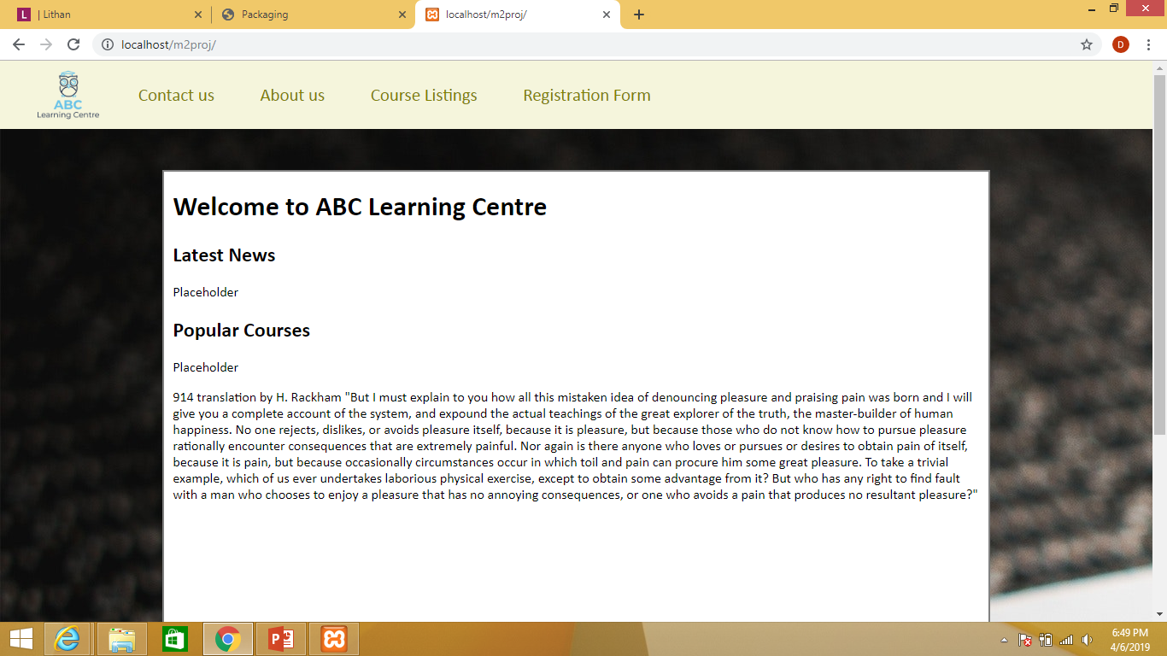
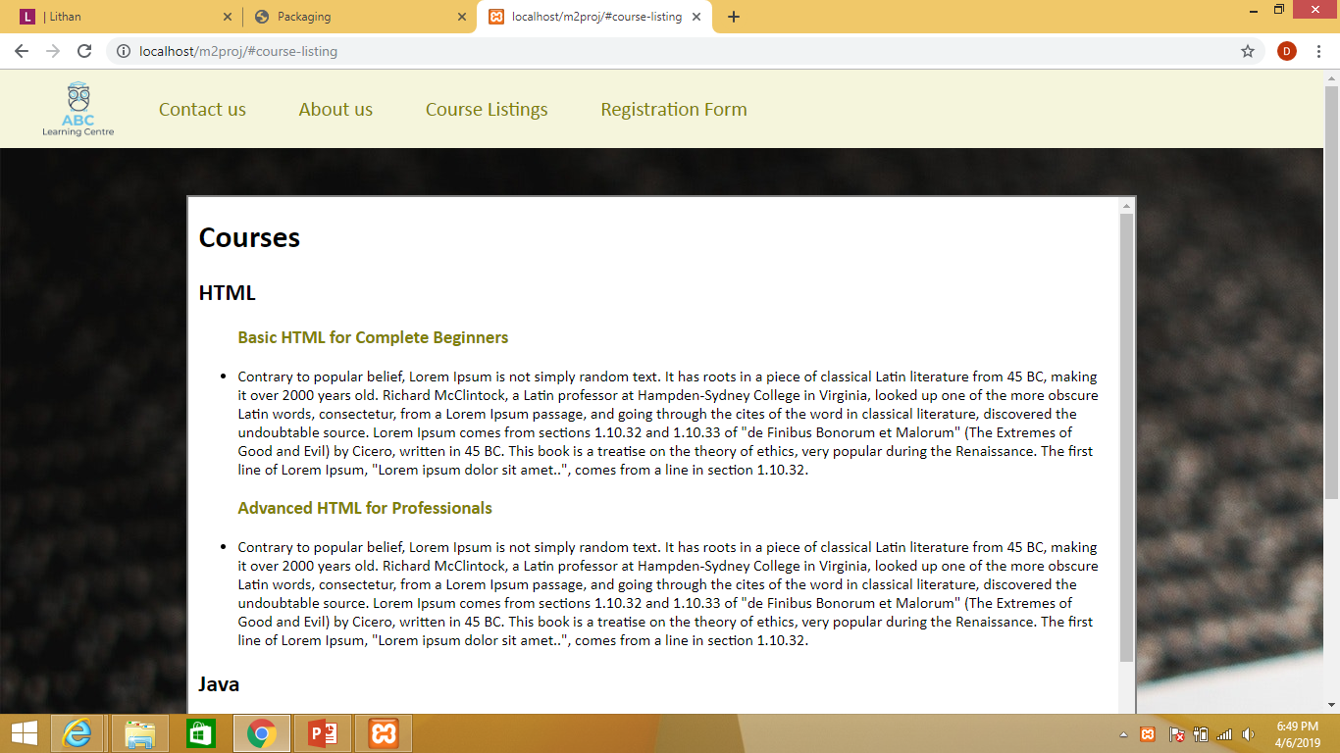
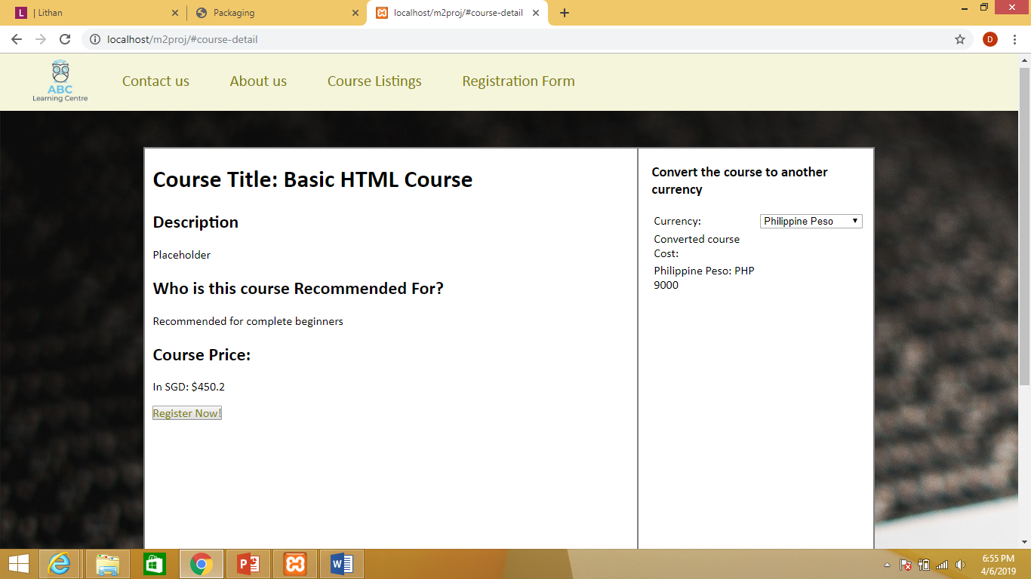
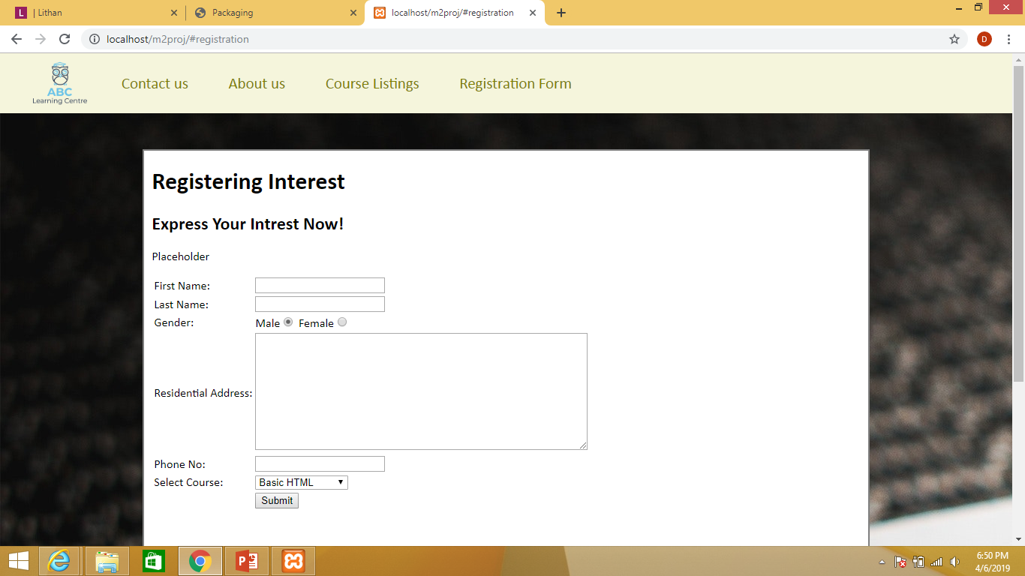
19. Project Results (1/2)
Screen Shots of Evidences

Slide 22
19. Project Results (2/2)
Link for the Project Walkthrough
http://projects.lithan.net/Singapore/SG0319A10L/Singapore/SG0319A10L/m2proj/
http://projects.lithan.net/Singapore/SG0319A10L/Singapore/SG0319A10L/m2proj/#course-listing
http://projects.lithan.net/Singapore/SG0319A10L/Singapore/SG0319A10L/m2proj/#HTML
http://projects.lithan.net/Singapore/SG0319A10L/Singapore/SG0319A10L/m2proj/#registration

Slide 23
20. Proposed Improvements
List of Improvements
Edit styling such as colour choices to improve presentation
Decrease Coding overhead
Make codes more efficient
Use JSON to load all course details rather than hardcoding

